Slide 2
Solving Data Security with Hybrid Cloud Architectures
SESSION CODE: ARC202
Rocky Heckman
Architect Advisor
Microsoft

Slide 3
Data Security with Hybrid Cloud Architectures
Agenda
What’s the problem
  Why do we have to deal with data sovereignty.
How do we address it
  How can it be fixed without in-country data centers.
Challenges
  What are the issues with this solution and how to address them

Slide 4
The Problem

Slide 5
What is the problem?
Data Centre Locations
Corporate policy or regulatory compliance
  Privacy Act
  Freedom of Information Act
  Patriot Act
Data custodianship
  Why do I care about it?
F.U.D.

Slide 6
Regulatory Bodies The Chess Match
AGIMO – Position Paper
Defence / DSD – Recommendations Paper
AG – Policy Paper
None of them actually say, “Don’t do it.”
They all recommend a risk based approach

Slide 7
Risks according to Gartner…
Privileged User Access
Data location (Data Sovereignty)
Data Segregation
Recovery
Investigative support
Long-term viability
Get as much information as you can about the people who manage your data.
Regulatory Compliance
Customers are ultimately responsible for the security and integrity of their own data.
Ask providers if they will commit to storing and processing data in specific jurisdictions
Data in the cloud is typically in a shared environment alongside data from other customers.
What are the data recovery capabilities?
What kind of support does your cloud provider offer to help you investigate a problem?
Make sure they are not going to go bust overnight, or won’t keep services in perpetual beta so they can turn them off

Slide 8
There is no ‘One Size Fits All’
Some cloud providers would like you to believe that:
  You don’t need a private cloud, everything should be in the public cloud.
  There is no such thing as public cloud, everything should be in a private cloud
  You will take what we give you and be happy with it, after all we were born in the internet and we know best
This is because they can’t address genuine needs of enterprise and government computing

Slide 9
How do we address it?

Slide 10
Start with a data classification scheme
If you don’t know what data is classified in your system, the rest is pointless
You have to be able to clearly define what you want to send off-site and what needs to be kept in-house
Rule of thumb – anything below highly protected can probably be put in a cloud provider’s data center

Slide 11


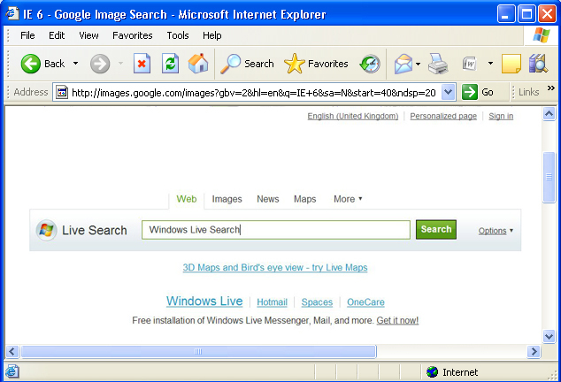
Application Topologies
From
Windows Azure
From Outside
Microsoft Datacenter
From Windows Azure & Outside
Microsoft Datacenter
Microsoft Datacenter
Microsoft Datacenter
Microsoft Datacenter
SQL Azure
SQL Azure
Windows Azure
Windows Azure
SQL Azure
SQL Azure
Data Sync
SQL Server
App Code / Tools
Application / Browser
App Code / Tools
Code Near
Code Far
Hybrid

Slide 12
A Closer Look At Hybrid Apps
A combination of on-premises and cloud based components
Cloud based apps can access local systems and services, and vice versa
Provides the most flexibility in relation to cloud advantages and data security
Microsoft Datacenter
SQL Azure
Windows Azure
SQL Azure
Data Sync
SQL Server
App Code / Tools
Hybrid

Slide 13
Common Deployments
UI based in the cloud including static content (CDN)
Good for applications with low back-end support
Web Services at the BL still hosted on-premises
Keeps the bad guys (end user clients) off your network
Microsoft Datacenter
Windows Azure UI
Client
Business Layer
SQL Server
On Premises
Hybrid – UI as Boundary

Slide 14
Common Deployments
UI & BL based in the cloud
Good for applications that do form filing, or CPU bound
Web Services at the BL hosted in cloud
Keeps the bad guys (end users and service calls) off your network
Microsoft Datacenter
UI
Windows Azure
Web Roles
Client
Business Layer
Windows Azure
Worker Roles
SQL Server
On Premises
Hybrid – UI BL cloud Based

Slide 15
Common Deployments
UI & BL & Unclass. Data based in the cloud
Good for applications that do form filing, CPU bound, client data lookup
Web Services at the BL hosted in cloud
Keeps the bad guys (end users and service calls) off your network
Microsoft Datacenter
UI
Windows Azure
Web Roles
Business Layer
Windows Azure
Worker Roles
Client
SQL Server
SQL Azure
Data Sync
SQL Server
On Premises
Hybrid – UI BL cloud Based

Slide 16
How does this help security?
Provides excellent DDoS protection
Keeps the bad guys off your network infrastructure
Allows you to keep classified data in your own data centre while providing all of the cloud advantages
Limits inbound connections to a single well validated source

Slide 17
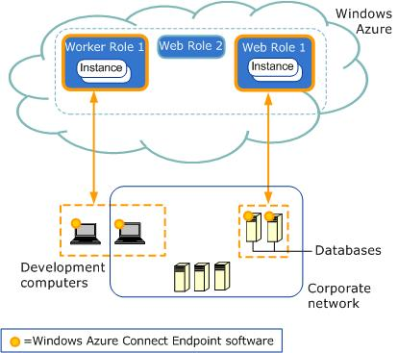
Securing the Communications
Windows Azure Connect
Secure network connectivity between on-premises and cloud
  Supports standard IP protocols
Enables hybrid apps access to on-premises servers
Allows remote administration of Azure apps
Simple setup and management
  Integrated with WA Service Model
  Web, Worker and VM Roles supported

Slide 18
The Challenges

Slide 19


Challenge: Latency
Minimising latency for users accessing cloud solutions
Windows Azure
AppFabric Cache
Web Role
On-Premise Systems
Blob
Content Delivery
Network

Slide 20






Windows Azure Content Delivery Network (CDN)
North America Region
Europe Region
Asia Pacific Region
Dublin, IE
London, GB
Stockholm, SE
Amsterdam, NL
Chicago, IL
Seattle, WA
Newark, NJ
Seoul, KR
Bay Area, CA
Los Angeles, CA
Ashburn, VA
Paris, FR
Zurich, CH
Miami, FL
Vienna, AT
Tokyo, JP
San Antonio, TX
Hong Kong, HK
Singapore, SG
Taipei, TWN
São Paulo, BR
Sydney, AU
  Over 2 terabits per second of capacity is available at 99.95% availability from our 22 global locations. CDN service scales automatically without user intervention

Slide 21


Challenge: System Dependencies
Legacy systems, e.g. mainframes
Other internal systems and services
Data or systems that must stay on-premise for compliance reasons
Web Role
Service Bus
Worker Role
Windows Azure
Connect
VM Role

Slide 22




Challenge: Authentication and Authorisation
Manage and authenticate users in the cloud
Integrate with your existing Active Directory
Federate with partner or cloud identity stores, e.g. Facebook or Windows Live ID
Trust
ADFS
Active Directory
ASP.NET Membership
Database
Web Role
Trust
Access Control
Service

Slide 23

Challenge: Large Databases
Storing >50GB of data in the cloud
Blob
Multiple SQL Azure databases
Sharded SQL Azure databases
Azure Storage

Slide 24







Challenge: Management and Operations
Microsoft looks after the hardware and OS… but you still need to look after your application!
How do you monitor performance and troubleshoot errors?
Visual Studio
Remote Desktop
System Center
Operations Manager
Trace Listeners,
Instrumentation
Blob
Web Role
DiagnosticMonitor
TraceListener
Azure Storage
3rd Party Tools

Slide 25

Technical Considerations
Which applications are easiest to migrate?
Favour applications that:
  Have web or web services interfaces
  Are architected for scale-out
  Can run on Windows Server 2008+
  Are predominantly custom code
  Use SQL Server
  Do not depend on durable state
Avoid applications that:
  Use thick-client interfaces
  Require complex network topologies or scale-up
  Cannot run on Windows Server 2008+
  Leverage Microsoft or 3rd party COTS products
  Require Oracle/DB2/MySQL or advanced SQL Server features
  Require durable state outside of databases

Slide 26
Data Security – better?
Confidentiality
  It is as good as what you do now. It is application and procedure dependant
Integrity
  It is as good as you have not. Data integrity is guaranteed by cloud providers. It is in their best interest to make sure that this is rock solid
Availability
  Probably better than what you have now. You won’t beat the DDoS protection. Much better for making sure citizens can access their data or FOI requests.

Slide 27
Enrol in Microsoft Virtual Academy Today
Why Enroll, other than it being free?
The MVA helps improve your IT skill set and advance your career with a free, easy to access training portal that allows you to learn at your own pace, focusing on Microsoft technologies.
What Do I get for enrolment?
Free training to make you become the Cloud-Hero in my Organization
Help mastering your Training Path and get the recognition
Connect with other IT Pros and discuss The Cloud
Where do I Enrol?
www.microsoftvirtualacademy.com
Then tell us what you think. TellTheDean@microsoft.com

Slide 28

© 2010 Microsoft Corporation. All rights reserved. Microsoft, Windows, Windows Vista and other product names are or may be registered trademarks and/or trademarks in the U.S. and/or other countries.
The information herein is for informational purposes only and represents the current view of Microsoft Corporation as of the date of this presentation. Because Microsoft must respond to changing market conditions, it should not be interpreted to be a commitment on the part of Microsoft, and Microsoft cannot guarantee the accuracy of any information provided after the date of this presentation. MICROSOFT MAKES NO WARRANTIES, EXPRESS, IMPLIED OR STATUTORY, AS TO THE INFORMATION IN THIS PRESENTATION.

Slide 29




Resources
www.msteched.com/Australia
  Sessions On-Demand & Community
www.microsoft.com/australia/learning
Microsoft Certification & Training Resources
http:// technet.microsoft.com/en-au
  Resources for IT Professionals
http://msdn.microsoft.com/en-au
  Resources for Developers

