Slide 2
Migrating XP to Windows 7 using ConfigMgr 2007
SESSION CODE: CLI308
Johan Arwidmark
Chief Technical Architect
Knowledge Factory
Mikael Nystrom
Senior Executive Consultant
TrueSec

Slide 3
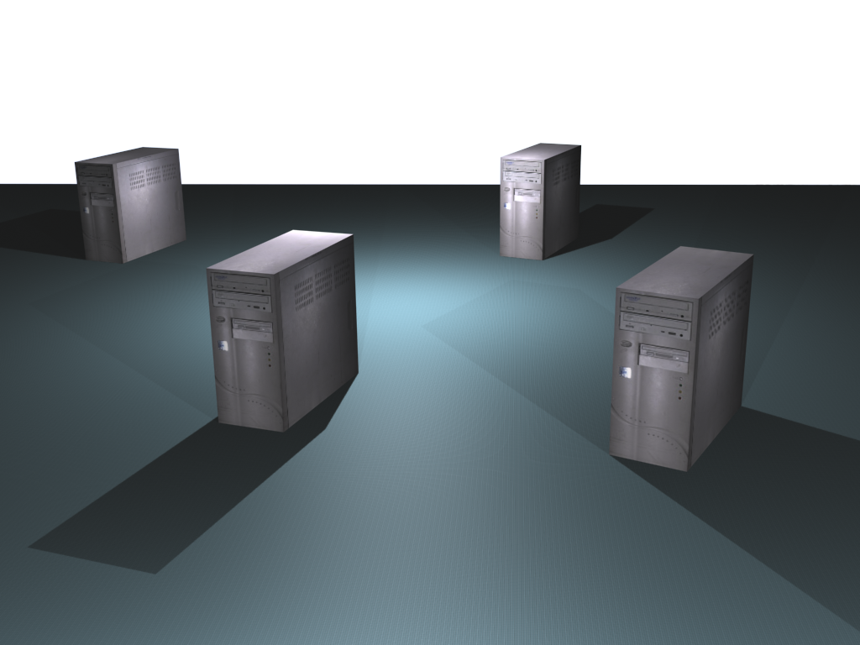
Demo Environment – ConfigMgr 2007
DC01
DC and DNS
DC02
DC and DNS
MDT01
MDT 2010
WDS, WSUS and DHCP
SQL 2008 R2 Express
CM01
MDT 2010
SQL 2008 R2
WDS, WSUS and DHCP
ConfigMgr 2007 SP2 R3

Slide 4
Windows 7 Deployment
Larger images
Branch Office scenarios
Windows Recovery
Offline Servicing
Bitlocker

Slide 5
Why create a reference image?
Save time during deployment
ConfigMgr OS Image Package requirement

Slide 6
Creating a reference image for ConfigMgr 2007 using MDT 2010 Lite Touch
demo

Slide 7
ConfigMgr 2007 OSD Scenarios
New Machine (Bare Metal)
Wipe-And-Load (Refresh)
Side-By-Side (Replace)
Offline Media

Slide 8
Implementing ConfigMgr 2007 OSD – Integrating with Zero Touch from MDT 2010
demo

Slide 9
Migrating XP to Windows 7
Can you afford not to Migrate?
Hidden (huge) cost for the Organization
What data does exist locally?
User State Migration Tool (USMT) can help
Captures and migrates user settings and data
USMT is well suited for bulk/mass migrations.

Slide 10
Computer Refresh
demo

Slide 11
Scenarios – Side-By-Side (Replace)
Similar to Wipe-and-Load
User state is saved on the Server (SMP)
Image is installed
Other SCCM packages follows rapidly
User state is restored

Slide 12
Replace Computer
demo

Slide 13
Customizing Data Being Migrated
XML-files control the behavior of the USMT tool
Migration .xml files
Custom .xml file
Config.xml

Slide 14
Basic Custom XML-file
<migration urlid="http://www.microsoft.com/migration/1.0/migxmlext/filemig"> <component type="Application" context="System"> <displayName>File Migration Test</displayName> <role role="Data"> <rules context="System"> <include> <objectSet> <pattern type="File">C:\Demo1\* [filename.txt]</pattern> <pattern type="File">C:\Demo2\* [*]</pattern> </objectSet> </include> </rules> </role> </component> </migration>

Slide 15
Support for Additional Data and Settings – Integrating with ZTI
demo

Slide 16
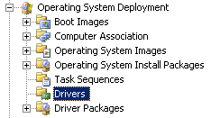
Driver Catalog
Catalog of Managed device drivers
Drivers node
Import drivers into this node and assign to Driver Packages
Driver Packages node
ConfigMgr packages that are copied to DPs

Slide 17
Driver Catalog
Auto Apply Drivers
PnP scan and inserts matching drivers
Apply Driver Package
Inserts all drivers in the package

Slide 18
Drivers
demo

Slide 19
Enrol in Microsoft Virtual Academy Today
Why Enroll, other than it being free?
The MVA helps improve your IT skill set and advance your career with a free, easy to access training portal that allows you to learn at your own pace, focusing on Microsoft technologies.
What Do I get for enrolment?
Free training to make you become the Cloud-Hero in my Organization
Help mastering your Training Path and get the recognition
Connect with other IT Pros and discuss The Cloud
Where do I Enrol?
www.microsoftvirtualacademy.com
Then tell us what you think. TellTheDean@microsoft.com

Slide 20
© 2010 Microsoft Corporation. All rights reserved. Microsoft, Windows, Windows Vista and other product names are or may be registered trademarks and/or trademarks in the U.S. and/or other countries.
The information herein is for informational purposes only and represents the current view of Microsoft Corporation as of the date of this presentation. Because Microsoft must respond to changing market conditions, it should not be interpreted to be a commitment on the part of Microsoft, and Microsoft cannot guarantee the accuracy of any information provided after the date of this presentation. MICROSOFT MAKES NO WARRANTIES, EXPRESS, IMPLIED OR STATUTORY, AS TO THE INFORMATION IN THIS PRESENTATION.

