Slide 2
Troubleshooting Application Compatibility Issues with Internet Explorer 9
SESSION CODE: CLI31
Chris Jackson
Principal Consultant, “The App Compat Guy”
Microsoft Corporation
http://www.appcompatguy.com appcompatguy@microsoft.com @appcompatguy

Slide 3
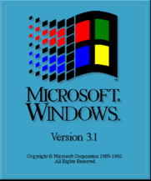
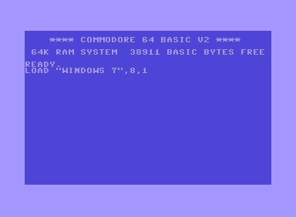


How Long is 9 Years?

Slide 4


Slide 5
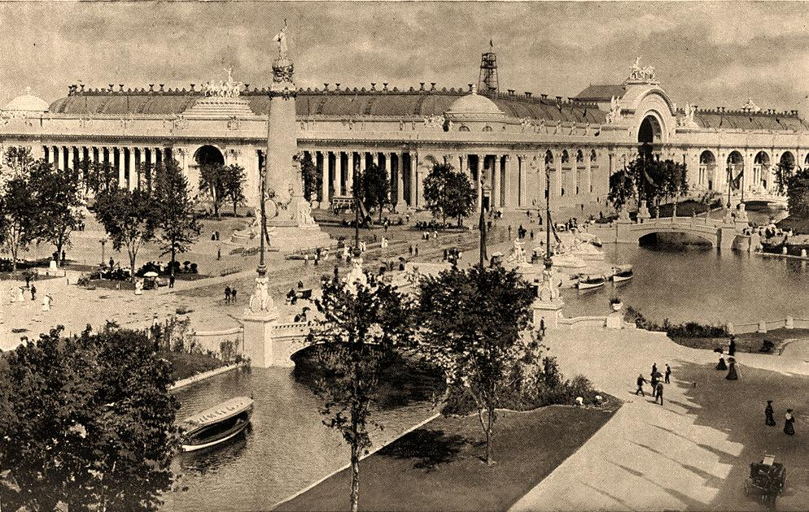
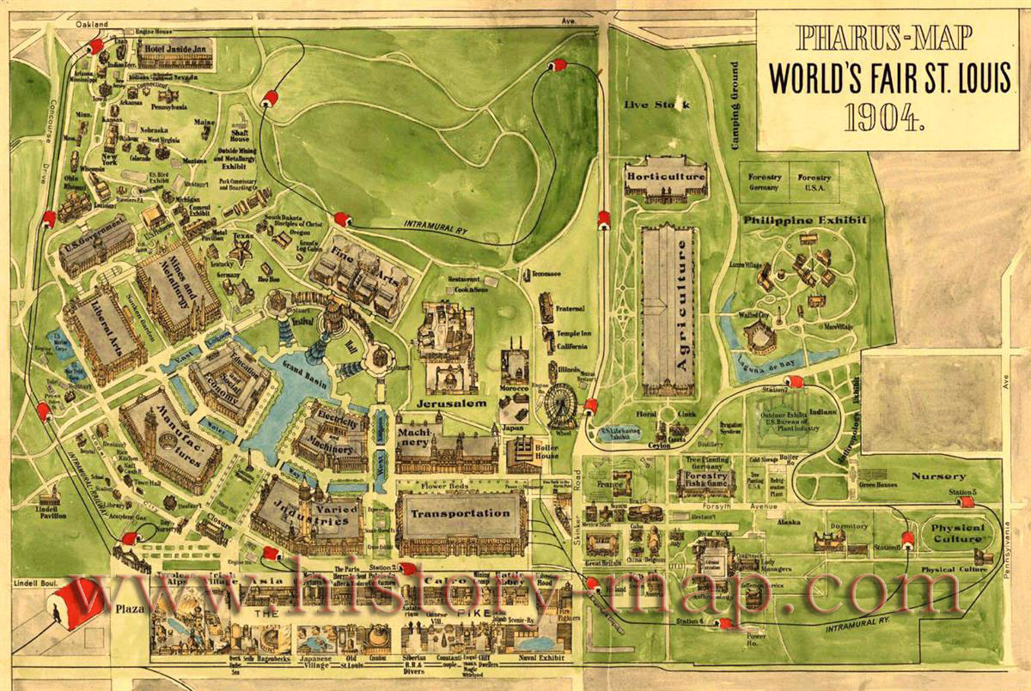

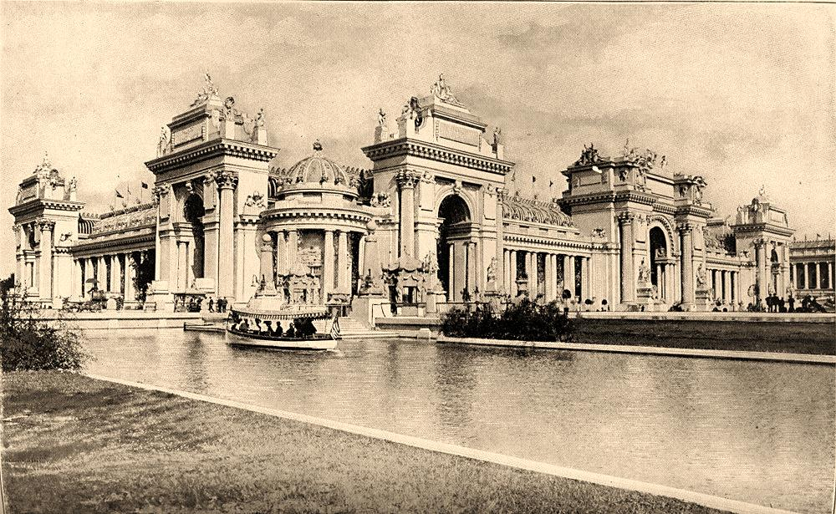

Slide 6
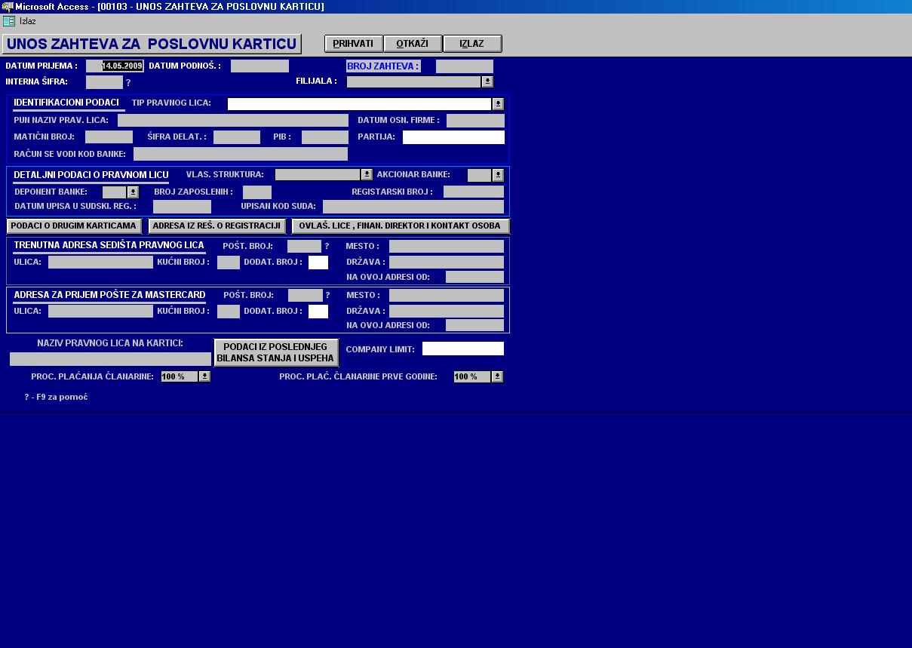

Slide 7

“While it’s true that Windows ___ sports some impressive technical features, I believe that Windows owes most of its success to the third-party companies that have devoted their time and money into producing Windows applications. After all, people don’t buy operating environments; they buy applications that help them do their work more efficiently.”

Slide 8
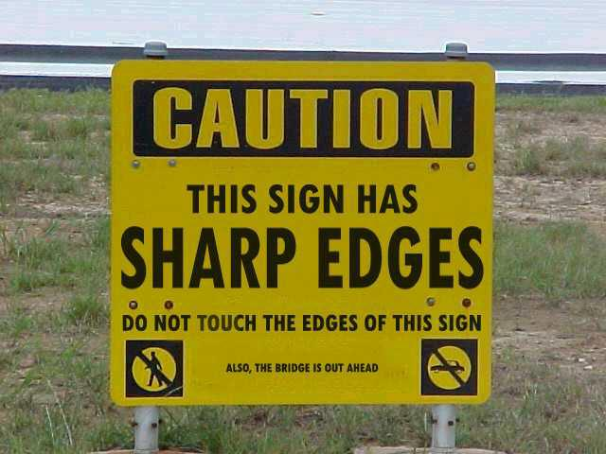

Slide 9
Chris Jackson’s Formula
$${cost}_{failure}×{probability}_{failure}>{cost}_{testing}$$

Slide 10
FAQs

Slide 11
What Breaks on 64-bit?
16-bit Binaries
32-bit drivers
Managed code / interop
Path differences

Slide 12
What About VB6?
Supported / Needs Install

Slide 13
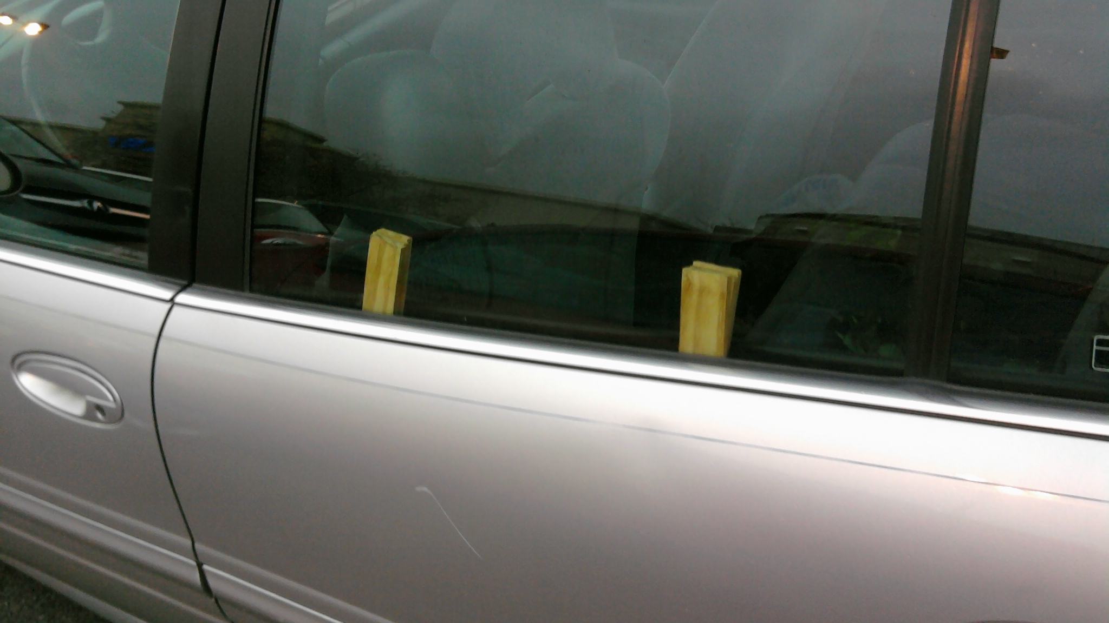
How to Shim Windows

Slide 14
Shims
How do shims work?
What can shims do?
What can shims fix?
Can I use shims with App-V?

Slide 15
How Shims Work
Application
Windows
Shimmed
Function
Export
Function
Import Function
Shim DLL

Slide 16
Case Studies
demo

Slide 17
The Debugging Process
Verify the bug is fixed
Duplicate the bug
Start heavy debugging
Describe the bug
Learn and share
Assume the bug is in your app
Utilize tools
Think creatively
Divide and conquer

Slide 18
The Debugging Process: Simplified
Hypothesis
Tool

Slide 19
The Failing Manifest
Microsoft SQL Server Integration Services
  Trying to do the right thing for UAC, but app fails to launch

Slide 20
The Unread Manifest
Microsoft Lync
  Manifested for UIAccess
  Can’t drive elevated windows

Slide 21
The Ugly Colors
Customer ISV Application
  “They look peach colored”
  Opened full TS, also “peach colored”
  Monitor
  Cable

Slide 22
The Treacherous CorrectFilePaths
SQLNav5
  Not redirecting
Customer application
  A better way to investigate

Slide 23
The Unreadable Colors
Customer application
  Dialog boxes no longer readable
  Seeing black text on a black background

Slide 24
The Managed Shim Demo
ExpenseIt Demo Application
  Unable to version lie

Slide 25
Aggressive Security Config
SQL Server 2008
  Application won’t install
  SQL_Engine_Core failing custom action
  System.Diagnostics.ProcessManager.
  OpenProcess
  Customer removed SeDebugPrivilege

Slide 26
The Nostalgic Java App
Customer ISV application
  Did not run in most configurations
    “Enable next-generation Java plug-in”
  Where it ran, it complained about versions
    iexplore.exe verlie (1st run)
    iexplore.exe exclude * include java.dll (2nd run)

Slide 27
Noisy Runtime Registration
Customer in-house application
  Dialog box says it’s not registered
  VirtualizeHKCRLite to fix it, still alerts
  Subsequent runs fine
  Dialog box always appears – not a MessageBox

Slide 28

Question & Answer Session

Slide 29

Enrol in Microsoft Virtual Academy Today
Why Enroll, other than it being free?
The MVA helps improve your IT skill set and advance your career with a free, easy to access training portal that allows you to learn at your own pace, focusing on Microsoft technologies.
What Do I get for enrolment?
Free training to make you become the Cloud-Hero in my Organization
Help mastering your Training Path and get the recognition
Connect with other IT Pros and discuss The Cloud
Where do I Enrol?
www.microsoftvirtualacademy.com
Then tell us what you think. TellTheDean@microsoft.com

Slide 30

© 2010 Microsoft Corporation. All rights reserved. Microsoft, Windows, Windows Vista and other product names are or may be registered trademarks and/or trademarks
in the U.S. and/or other countries.
The information herein is for informational purposes only and represents the current view of Microsoft Corporation as of the date of this presentation. Because Microsoft must respond to changing market conditions, it should not be interpreted to be a commitment on the part of Microsoft, and Microsoft cannot guarantee the accuracy of any information provided after the date of this presentation. MICROSOFT MAKES NO WARRANTIES, EXPRESS, IMPLIED OR STATUTORY, AS TO THE INFORMATION IN THIS PRESENTATION.

Slide 31




Resources
www.msteched.com/Australia
  Sessions On-Demand & Community
www.microsoft.com/australia/learning
Microsoft Certification & Training Resources
http:// technet.microsoft.com/en-au
  Resources for IT Professionals
http://msdn.microsoft.com/en-au
  Resources for Developers

