Slide 2
Connecting Cloud and On-Premises Applications
SESSION CODE: COS-MID305
Chris Padgett
Development Consultant
Kloud Solutions

Slide 3
Mainframe 1960s

Slide 4
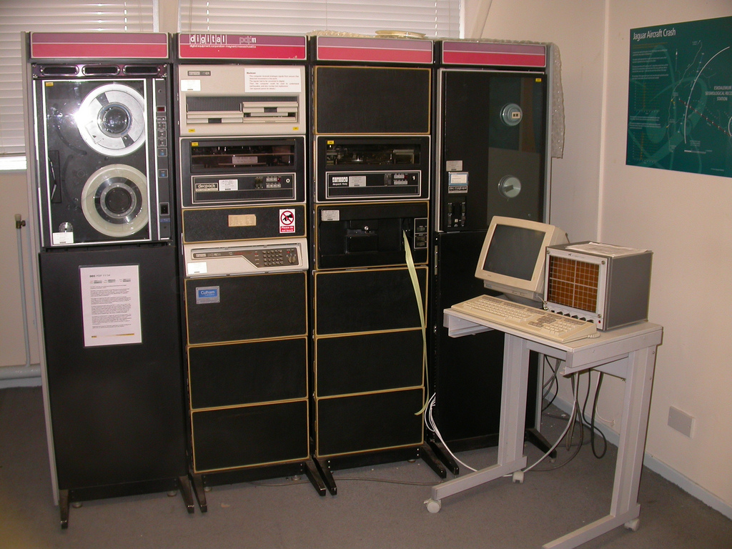
Mini 1970s
http://www.flickr.com/photos/snglinks/4990273435/sizes/l/in/photostream/

Slide 5
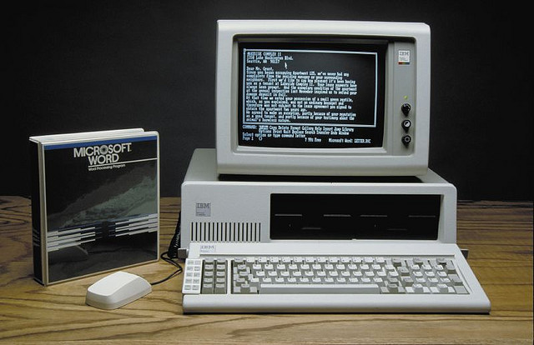
Personal
1980s
http://www.flickr.com/photos/hexholden/251138522/

Slide 6
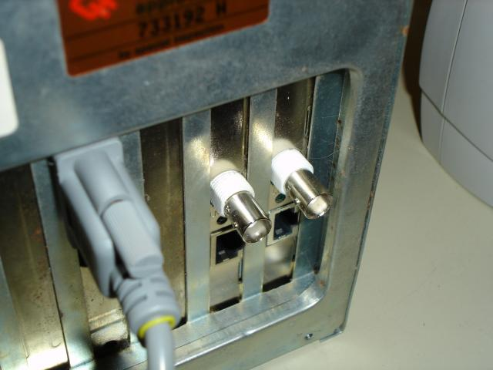
Client/server
1990s

Slide 7
Web
2000s

Slide 8
Dan Merriman, “Tying it all together”, 1996
More and more systems are designed to connect together, both within the system under construction and to systems that are already deployed

Slide 9
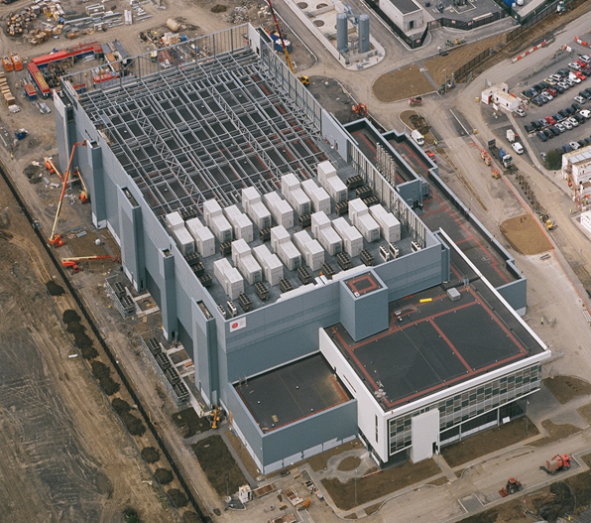
Cloud
Today

Slide 11
Agenda
Azure integration technologies overview
Windows Azure Connect overview, scenarios, and walkthroughs
Windows Azure Connect benefits, limitations, and futures

Slide 12
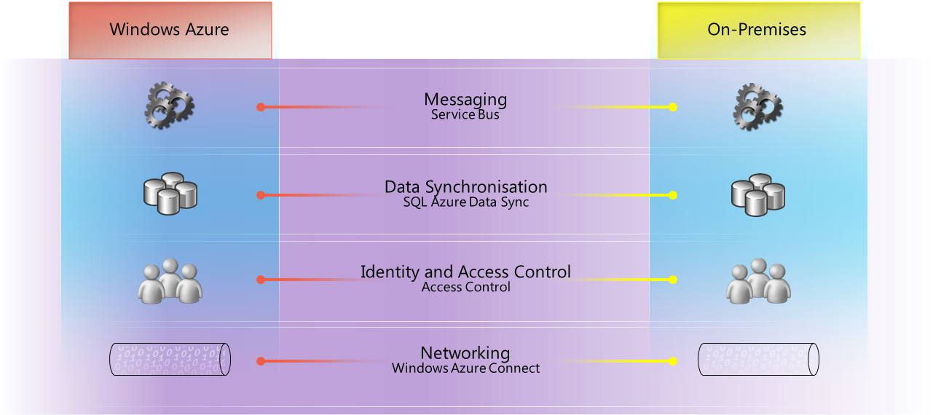
Azure Integration Technologies Overview

Slide 13
Windows Azure Network Overview
A range of networking functionality
The first feature that was shipped was Windows Azure Connect (formerly Project Sydney)
Announced at PDC10
The second feature that was shipped was Windows Azure Traffic Manager
Announced at MIX11

Slide 14
Windows Azure Connect Overview
Allows you to connect computers in your local network with roles in Windows Azure
Communications are established using relays
During CTP, relays are located in US, Europe, and Asia regions outside Microsoft data centres¹
Communications are protected using IPsec
¹ Network traffic between Windows Azure roles and Windows Azure Connect relays is charged as bandwidth usage

Slide 15
DEMO
Azure integration technologies

Slide 16
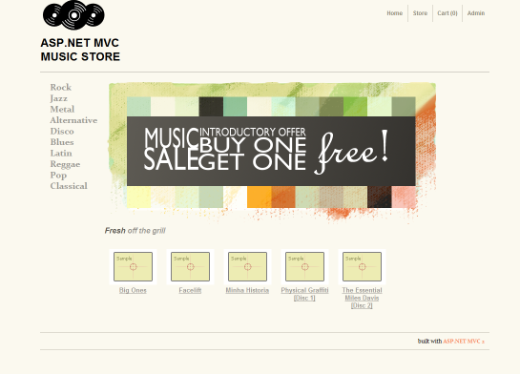
The Music Store Scenario

Slide 17
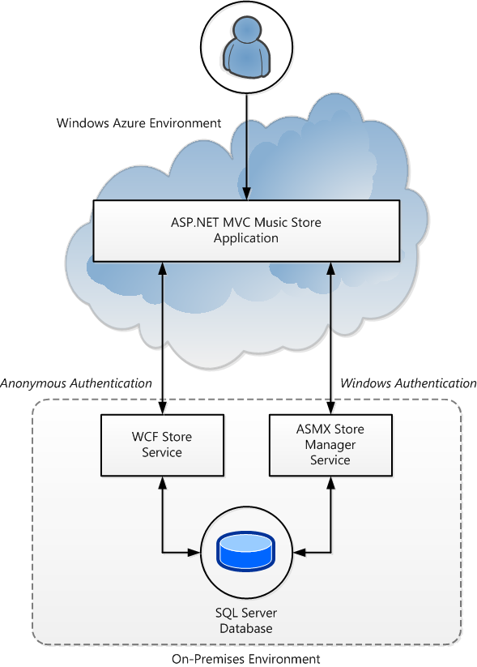
The Music Store Scenario

Slide 18
Windows Azure Connect Scenarios
Deploy a distributed application that uses roles in Windows Azure and servers in your local network
Join roles in Windows Azure to your local domain
Manage roles in Windows Azure

Slide 19
Deploying a distributed application
Windows Azure Connect: Scenario 1 of 3

Slide 20
Deploying a Distributed Application Overview
Roles can be Web, Worker, or VM roles
Servers might be Web, print, line-of-business, file, e-mail, database, or collaboration servers
Useful for extending legacy systems

Slide 21
Deploying a Distributed Application Walkthrough (1 of 5)
Sign yourself up for the Windows Azure Connect CTP

Slide 22
Deploying a Distributed Application Walkthrough (2 of 5)
Get the activation token for your Windows Azure subscription

Slide 23
Deploying a Distributed Application Walkthrough (3 of 5)
Enable roles in Windows Azure by adding the activation token to the ServiceConfiguration.cscfg file
Roles are provisioned with the Windows Azure Connect plug-in

Slide 24
Deploying a Distributed Application Walkthrough (4 of 5)
Enable computers in your local network by installing the local endpoint software to each of them
Computers are known as local endpoints
Local endpoint software can be installed using WAP Management Portal, SCCM, or the command line (updates via WU)
Local endpoint software is activated using the activation token (optionally, secured using an X.509 certificate)

Slide 25
Deploying a Distributed Application Walkthrough (5 of 5)
Create endpoint groups that “link” local endpoints with roles (and/or other groups of local endpoints)
One Windows Azure role cannot be linked with another Windows Azure role
A Windows Azure role can be linked with one or more groups of local endpoints
A local endpoint can only be added to one group of local endpoints

Slide 26
DEMO
Deploying a distributed application

Slide 27
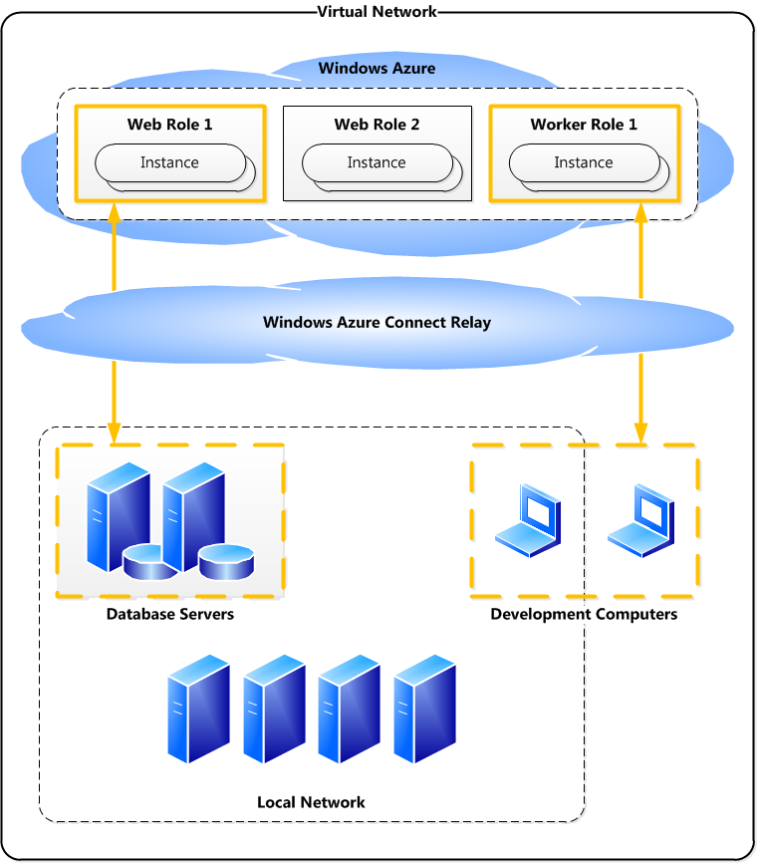
Deploying a Distributed Application Endpoint groups: single connection

Slide 28
Deploying a Distributed Application Endpoint groups: multiple connections

Slide 29
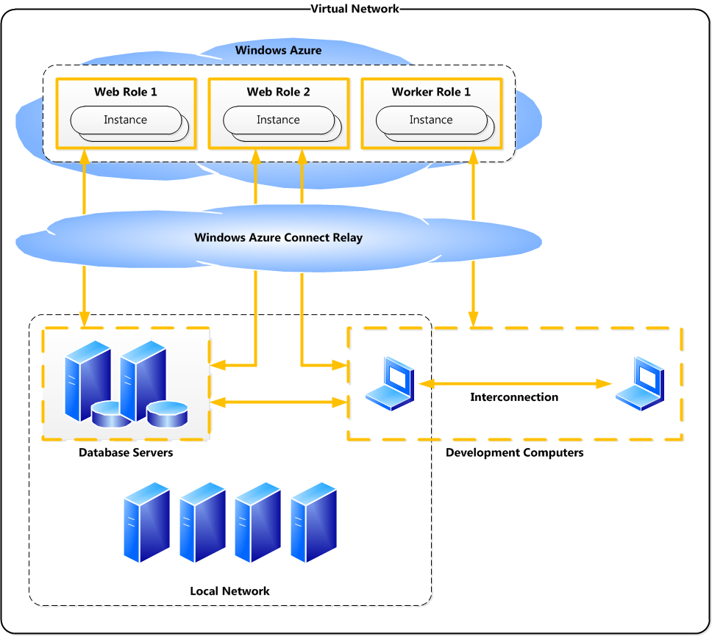
Deploying a Distributed Application Endpoint groups: interconnections

Slide 30
If you require earth-moving equipment to relocate it, it must be a
mainframe.

Slide 31
Joining roles to your local domain
Windows Azure Connect: Scenario 2 of 3

Slide 32
Joining Roles to Your Local Domain Overview
Authentication
Access Windows Azure roles using domain accounts
Run Windows Azure roles using domain accounts
Secure Web roles using Integrated Windows Authentication
Domain name resolution
Other domain-wide maintenance tasks

Slide 33
Joining Roles to Your Local Domain Walkthrough (1 of 3)
Add the following Windows Azure Connect plug-in settings to the ServiceConfiguration.cscfg file:
ActivationToken = "..."
EnableDomainJoin = "true"
DomainFQDN
DomainControllerFQDN
DomainAccountName
DomainPassword
DNSServers
DomainOU (optional)
Administrators (optional)
DomainSiteName (optional)
WaitForConnectivity (optional)

Slide 34
Joining Roles to Your Local Domain Walkthrough (2 of 3)
Enable the domain controller computer in your local network by installing the local endpoint software to it
It must also run the DNS server role

Slide 35
Joining Roles to Your Local Domain Walkthrough (3 of 3)
Create an endpoint group that links the domain controller local endpoint with roles

Slide 36
DEMO
Joining roles to your local domain

Slide 37
If it is sooo large that a dropped pen will orbit it, it must be a
mainframe.

Slide 38
Managing roles
Windows Azure Connect: Scenario 3 of 3

Slide 39
Managing Roles Overview
Group Policy
SCCM, Tivoli, or other management tool
Windows PowerShell

Slide 40
Managing Roles (using Windows PowerShell) Walkthrough
Set the osFamily attribute of the ServiceConfiguration element to 2 (compatible with Windows Server 2008 R2)
Create a user account for remote access
Add an inbound rule for TCP port 5985 (Windows Remote Management)
Enable PowerShell Remoting
Start a PowerShell session from a remote computer

Slide 41
DEMO
Managing roles

Slide 42
If the system operators considered the installation of COBOL to be an upgrade, it must be a
mainframe.

Slide 43
Windows Azure Connect Firewall settings
During the local endpoint software installation:
Rules for ICMPv6 Router Solicitation and Router Advertisement are added
Required to maintain an IPv6 link
After this installation:
Add an outbound rule for TCP port 443 (HTTPS)
Required to connect a local endpoint with Windows Azure Connect relays
Add rules for programs or ports required by applications or tools
E.g. TCP port 1433 (SQL Server)

Slide 44
Windows Azure Connect Prerequisites
Windows Azure SDK 1.4
Windows 7, Windows Vista SP1, Windows Server 2008 R2, or Windows Server 2008 operating system
IPv6-enabled network

Slide 45
Windows Azure Connect Benefits
Building new applications for or moving existing applications to Windows Azure that must integrate with existing IT resources
Securing distributed applications using Integrated Windows Authentication
Security, legal, and/or compliance requirements

Slide 46
Windows Azure Connect Limitations
Distributed applications are subject to latency between Windows Azure and your local network
Consider caching data
Consider chunkier interfaces
Consider co-locating data (syncing using SQL Azure Data Sync)
Local endpoint software can only be installed once per server
Virtual IP addresses aren’t supported
Consider software router

Slide 47
Windows Azure Connect Futures
Allow you to connect using VPN devices
Relays to be located with Microsoft data centres
UDP-based relays for higher performance
IPv4 address ranges/subnets can be assigned to Windows Azure roles
Network policies can be managed using REST API

Slide 48
Summary
Windows Azure Virtual Network adds a range of networking functionality to the Windows Azure Platform
Windows Azure Connect allows you to securely connect computers in your local network with roles in Windows Azure
Windows Azure Connect should be considered when building new applications for or moving applications to Windows Azure that must integrate with existing IT resources

Slide 49
Enrol in Microsoft Virtual Academy Today
Why Enroll, other than it being free?
The MVA helps improve your IT skill set and advance your career with a free, easy to access training portal that allows you to learn at your own pace, focusing on Microsoft technologies.
What Do I get for enrolment?
Free training to make you become the Cloud-Hero in my Organization
Help mastering your Training Path and get the recognition
Connect with other IT Pros and discuss The Cloud
Where do I Enrol?
www.microsoftvirtualacademy.com
Then tell us what you think. TellTheDean@microsoft.com

Slide 50
Resources
Windows Azure Virtual Network Homepage
http://www.microsoft.com/windowsazure/virtualnetwork/
Windows Azure Connect Team Blog
http://blogs.msdn.com/b/windows_azure_connect_team_blog/
Windows Azure Platform Training Kit – August 2011 Update
http://www.microsoft.com/download/en/details.aspx?displaylang=en&id=8396

Slide 51
© 2010 Microsoft Corporation. All rights reserved. Microsoft, Windows, Windows Vista and other product names are or may be registered trademarks and/or trademarks in the U.S. and/or other countries.
The information herein is for informational purposes only and represents the current view of Microsoft Corporation as of the date of this presentation. Because Microsoft must respond to changing market conditions, it should not be interpreted to be a commitment on the part of Microsoft, and Microsoft cannot guarantee the accuracy of any information provided after the date of this presentation. MICROSOFT MAKES NO WARRANTIES, EXPRESS, IMPLIED OR STATUTORY, AS TO THE INFORMATION IN THIS PRESENTATION.

