Slide 2
Migrating your applications to Azure
SESSION CODE: #COS204
@MaheshKrishnan
Principal Consultant
Readify
@JohnAzariah
Senior Architect
MYOB

Slide 3
Agenda
What are we gonna cover?
Getting started with Azure
Moving your DB to SQL Azure
Moving your Web App to Windows Azure
Some extras
  Using blobs
  Hooking up Google, Windows Live ID

Slide 4
The Basics
Getting started + some concepts

Slide 5


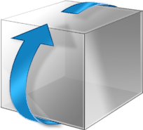




Azure in a slide
Web Role
Worker Role
SQL Azure
Azure Storage
Notes:
All roles and storage is highly available and built with redundancy

Slide 6
There is more to Azure
Access Control
AppFabric Caching
Service Bus
Virtual Network
CDNs
…

Slide 7
The Existing APP
Demo Time
Notes:
0:08

Slide 8
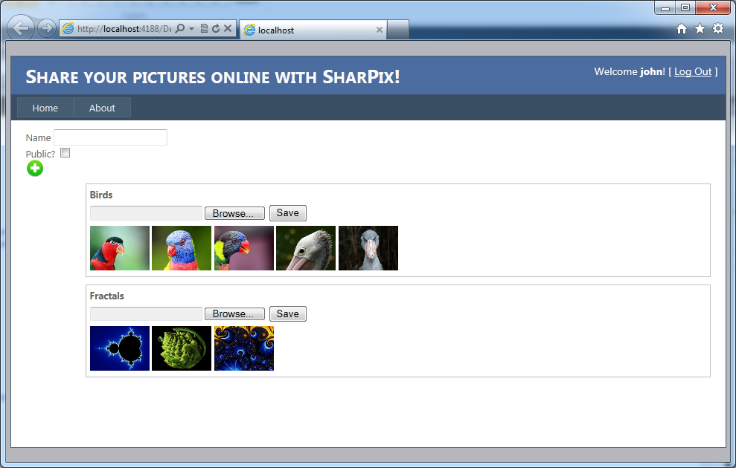
A contrived application…

Slide 9
Anatomy of the application : Before

Slide 10
Anatomy of the application : After

Slide 11
RUNNING EXISTING APP
Demo:

Slide 12
MOVE STORAGE TO AZURE
Walkthrough

Slide 13
Create Azure Subscriptions
Create one Hosted Service
Create one Storage Account
Create one SQL Azure Instance
Notes:
Get yourself an Azure subscription first…

Slide 14
Migrate the Database
Run Migration Wizard
Notes:
Available in Codeplex
Diff between Azure and SQ Server: Not all TSQL supported. No Agents, Create Database syntax difference, NO CLR types, No transactions across dbs, etc, etc
Eventually MS will narrow down the difference between the two

Slide 15
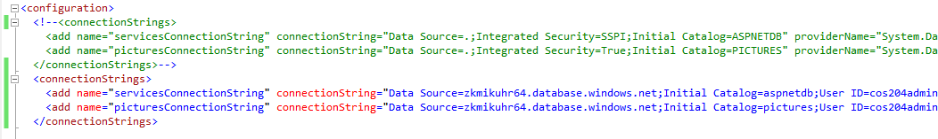
Connect to the Cloud Database
Change the connection string in Web.Config
Notes:
Connection string change
Database retry logic should be included in code

Slide 16
Anatomy of the application : After


Slide 17
LOCAL APP
REMOTE DATA
Demo:

Slide 18
Moving Files to Blobs
Use Blob storage to store cached files
Notes:
Also add the reference to the blob storage in the config file

Slide 19
Session State in the cloud
Use App Fabric Cache to store session

Slide 20
Anatomy of the application : After



Slide 21
LOCAL APP
REMOTE EVERYTHING ELSE
Demo:

Slide 22
MOVE Web App TO Windows AZURE
Walkthrough

Slide 23





All work done in local PC
Local Machine
Windows Azure Simulation Environment
Compute Emulator
Storage Emulator

Slide 24
Move the Application to Azure
Azure Project in Visual Studio
Running in Compute Emulator
Deploy to the cloud
Notes:
WebRole class with Diagnostics
Configuration changes moved away from web.config
Remember copy to local for assemblies

Slide 25
Anatomy of the application : After




Slide 26
App in Compute Emulator
Demo

Slide 27
Authentication using GooGle, WINDOWS LIVE ID
Walkthrough

Slide 28
Outsourcing your authentication
Set up Identity Providers, Relying party and settings via Management portal
Hook up app to use ACS

Slide 29
Anatomy of the application : After





Slide 30
App in Compute Emulator with Live ID/GooGLE
Demo

Slide 31
Summary
What we covered
Brief intro to Azure
Migrating to SQL Azure database
Using the WebRole
Hooking up Google/Live ID

Slide 32
Interested in more?
Slides, steps and code available in blog:
  http://scrumofone.blogspot.com
  http://blogesh.wordpress.com
Follow us on twitter
  @JohnAzariah
  @MaheshKrishnan

Slide 33

Enrol in Microsoft Virtual Academy Today
Why Enroll, other than it being free?
The MVA helps improve your IT skill set and advance your career with a free, easy to access training portal that allows you to learn at your own pace, focusing on Microsoft technologies.
What Do I get for enrolment?
Free training to make you become the Cloud-Hero in my Organization
Help mastering your Training Path and get the recognition
Connect with other IT Pros and discuss The Cloud
Where do I Enrol?
www.microsoftvirtualacademy.com
Then tell us what you think. TellTheDean@microsoft.com

Slide 34




Resources
www.msteched.com/Australia
  Sessions On-Demand & Community
www.microsoft.com/australia/learning
Microsoft Certification & Training Resources
http:// technet.microsoft.com/en-au
  Resources for IT Professionals
http://msdn.microsoft.com/en-au
  Resources for Developers

Slide 35

© 2010 Microsoft Corporation. All rights reserved. Microsoft, Windows, Windows Vista and other product names are or may be registered trademarks and/or trademarks in the U.S. and/or other countries.
The information herein is for informational purposes only and represents the current view of Microsoft Corporation as of the date of this presentation. Because Microsoft must respond to changing market conditions, it should not be interpreted to be a commitment on the part of Microsoft, and Microsoft cannot guarantee the accuracy of any information provided after the date of this presentation. MICROSOFT MAKES NO WARRANTIES, EXPRESS, IMPLIED OR STATUTORY, AS TO THE INFORMATION IN THIS PRESENTATION.

