Slide 2
Killer Real-World PowerPivot Examples
SESSION CODE: DAT303
Grant Paisley
SQL Server MVP
Angry Koala
grant@angrykoala.com.au

Slide 3

FAST
video

Slide 4

WHY
Fast
+ Flexible
= Freedom

Slide 5
PowerPivot
Navigation
Visualization
Right Metrics

Slide 6
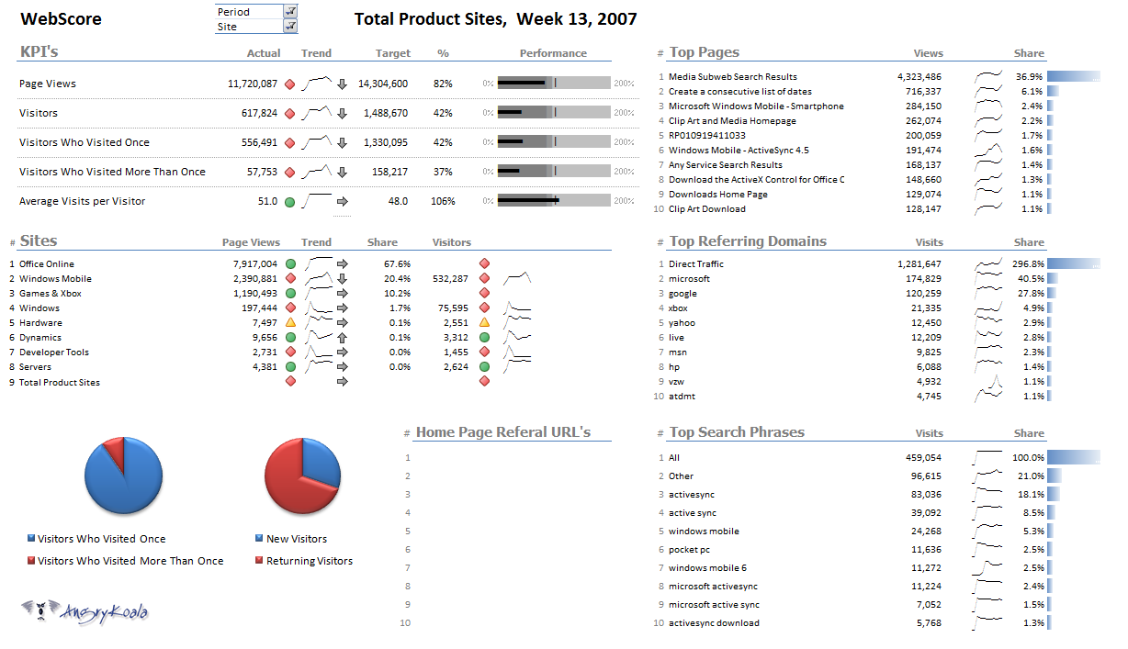

Slide 7
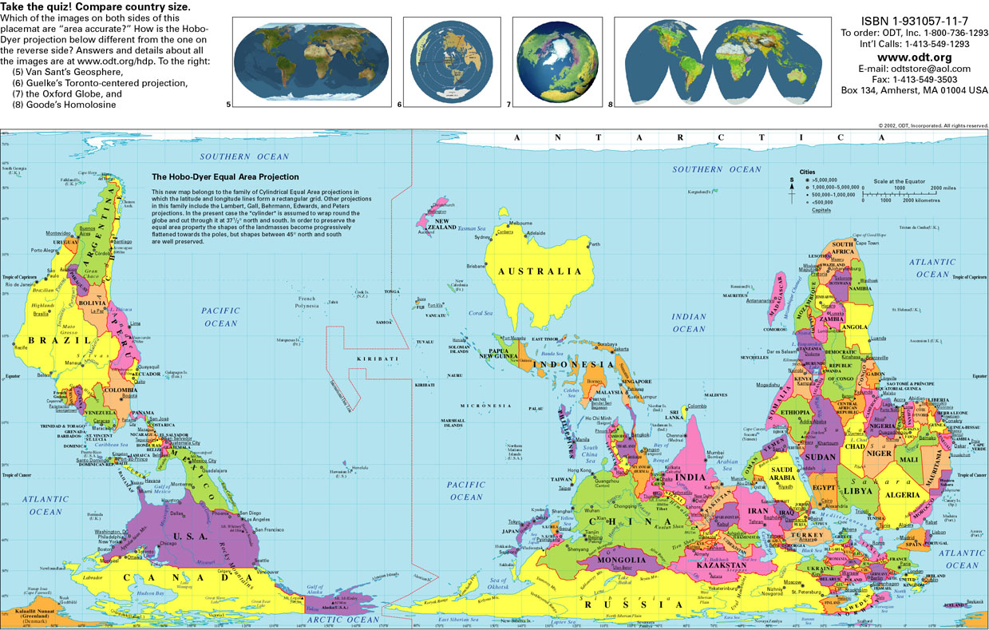

Slide 8
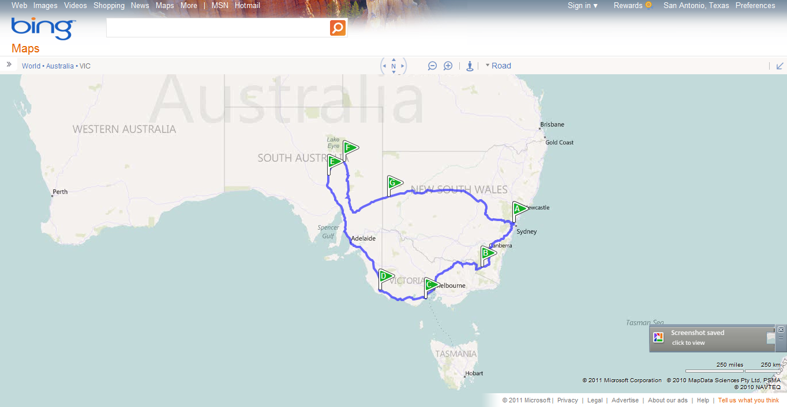

Slide 9


Slide 10


Slide 11



Slide 12



Slide 13


Slide 14


Slide 15


Slide 16


Slide 17


Slide 18


Slide 19


Slide 20


Slide 21


Slide 22


Slide 23


Slide 24


Slide 25


Slide 26

Slicer

Slide 27


Slide 28
3 Navigation
demo

Slide 29


Slide 30


Slide 31

Twelve

Slide 32


Slide 33
4 Top Twelve
demo

Slide 34
Navigation
Slicer gallery
Link pivot tables
Top 12

Slide 35


Slide 36

Big can be good

Slide 37

Too big

Slide 38

Sparklines

Slide 39


Slide 40
Sparklines
demo

Slide 41
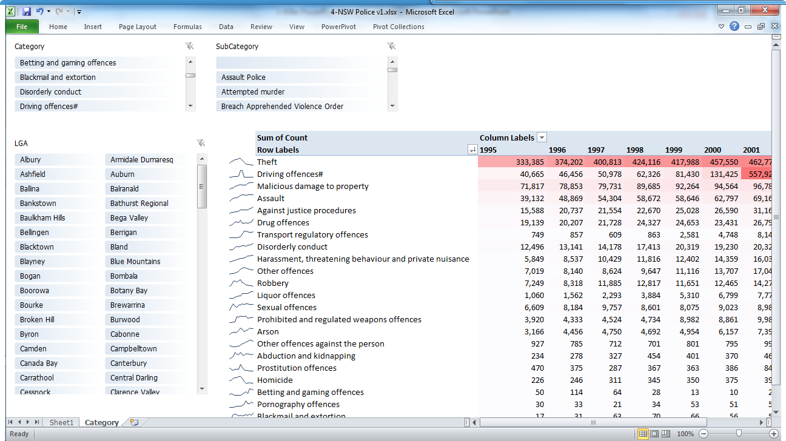

Slide 42
VISUALIZATION
Sparklines
Top 12
Conditional Formatting

Slide 43
5 ATM Transactions
demo

Slide 44
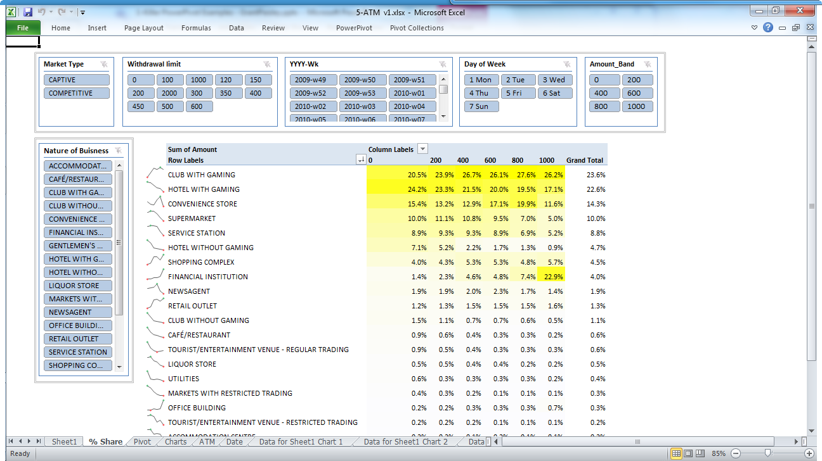

Slide 45
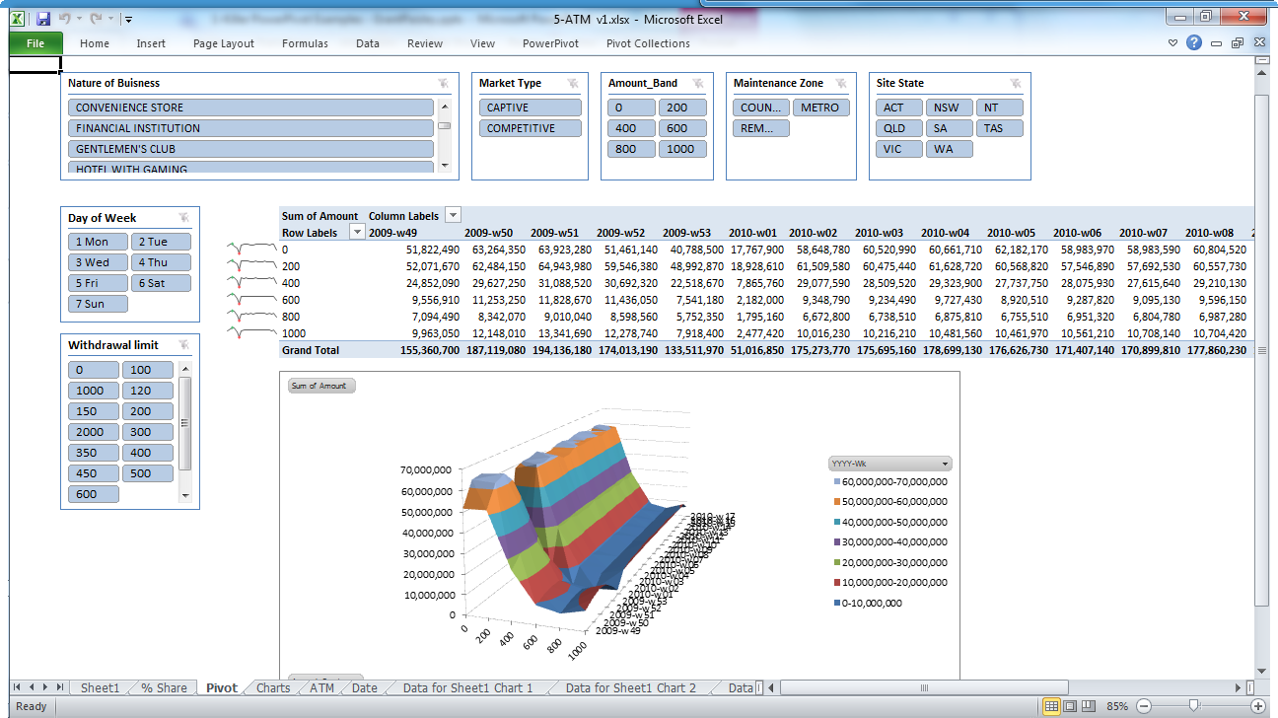

Slide 46
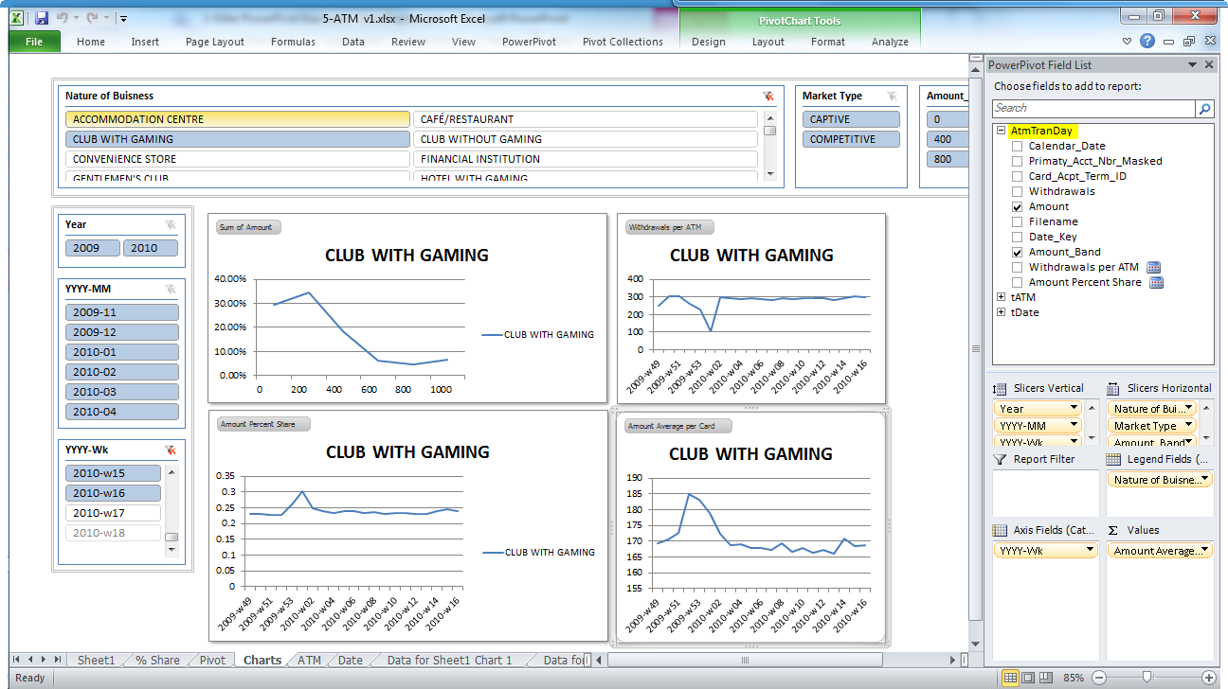

Slide 47
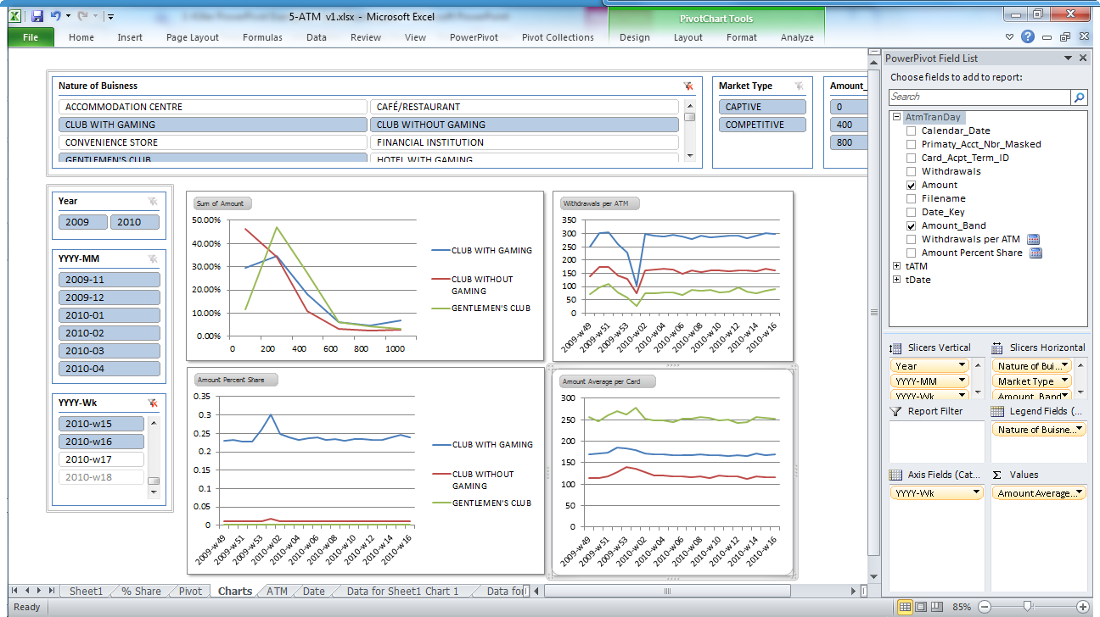

Slide 48
ATM
Sparklines
Banding
Conditional Formatting
+ Multiple Charts

Slide 49
6 Aged Payments?
demo

Slide 50
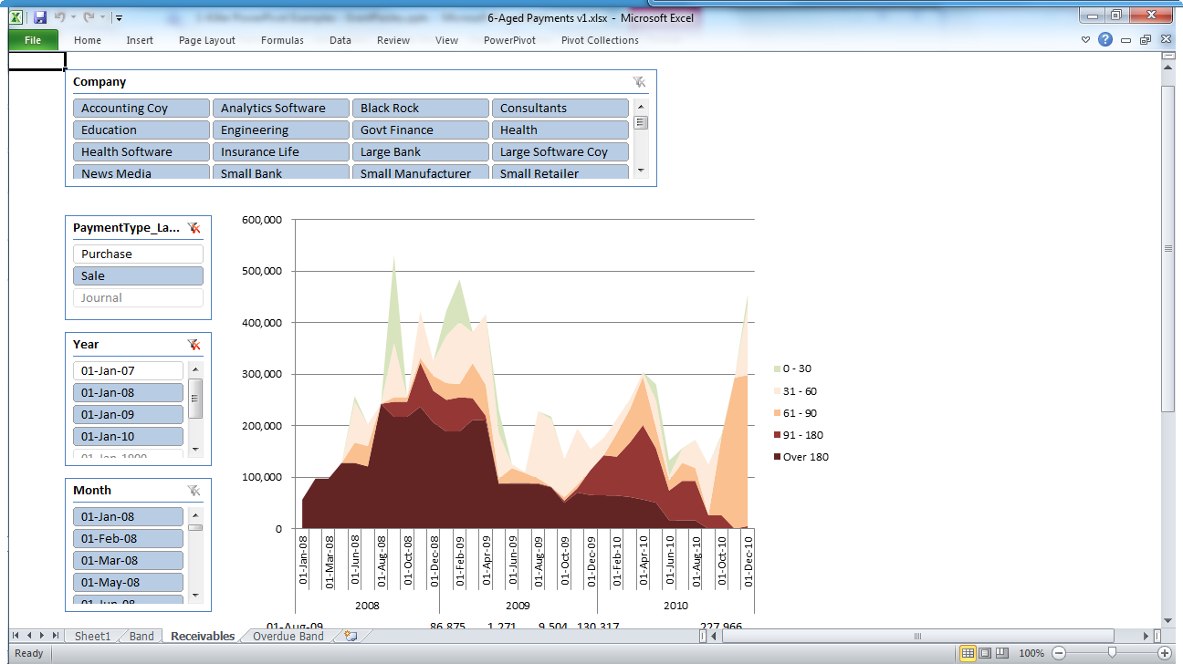

Slide 51
Aged Payments
Point in time reporting
Banding

Slide 52


Slide 53


Slide 54


Slide 55


Slide 56


Slide 57
7 Right Metrics
demo

Slide 58
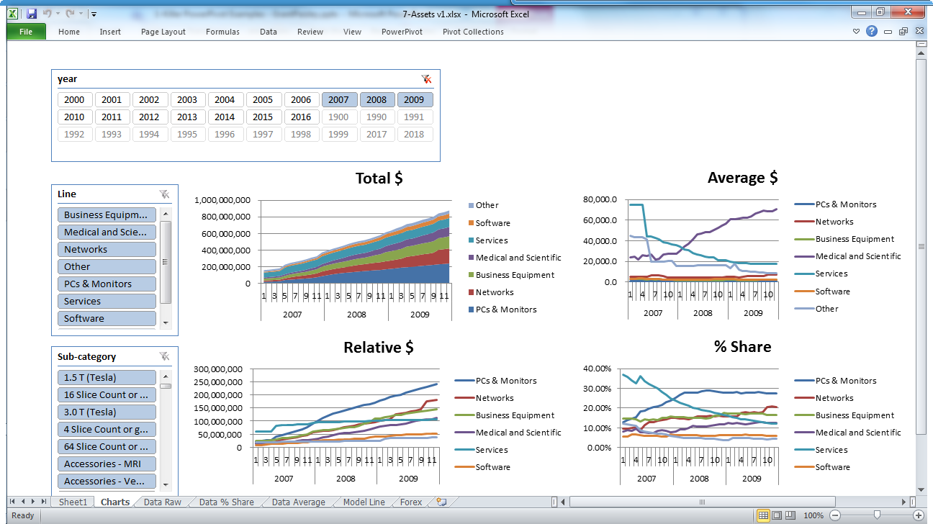

Slide 59
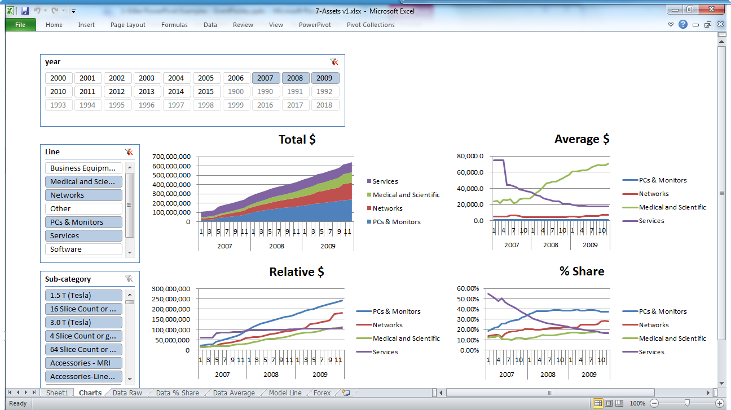

Slide 60
Asset Rental
Point in time reporting
Banding
Currency Conversion
Right metrics

Slide 61
Retailer
demo

Slide 62
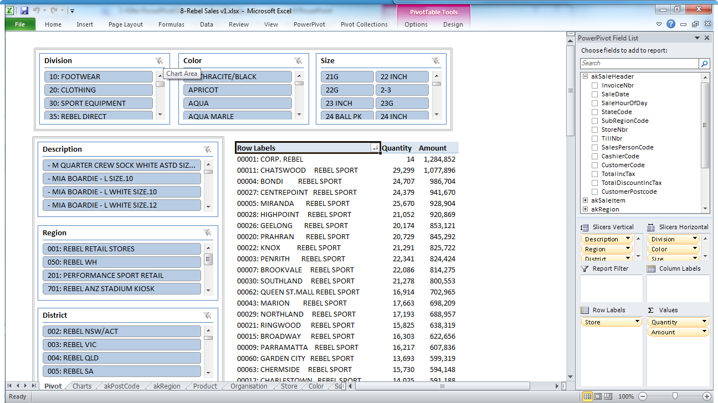

Slide 63
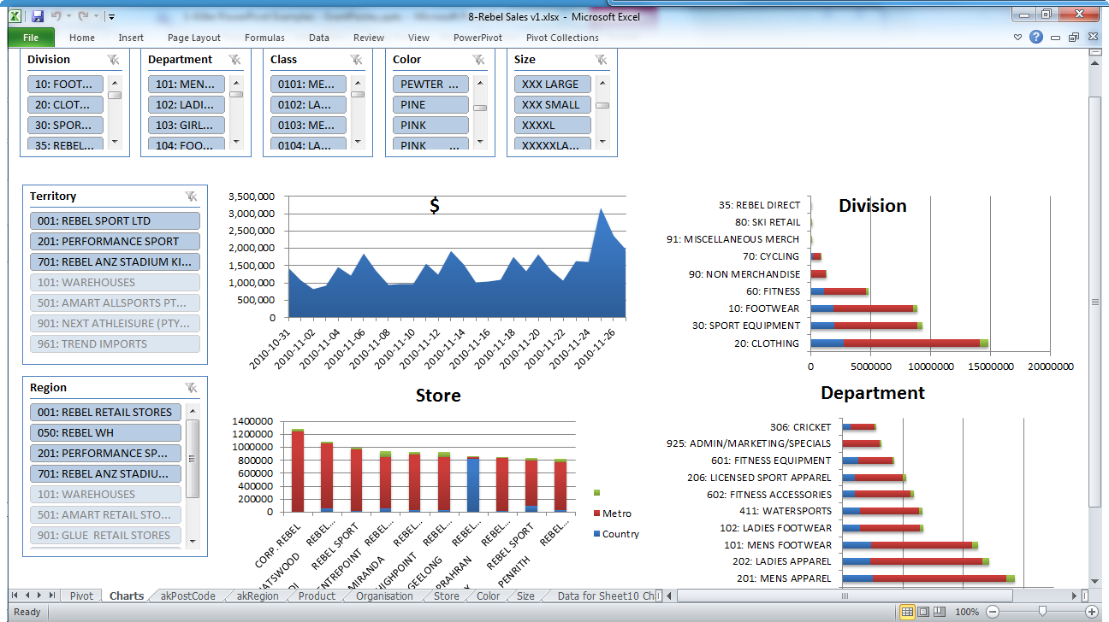

Slide 64
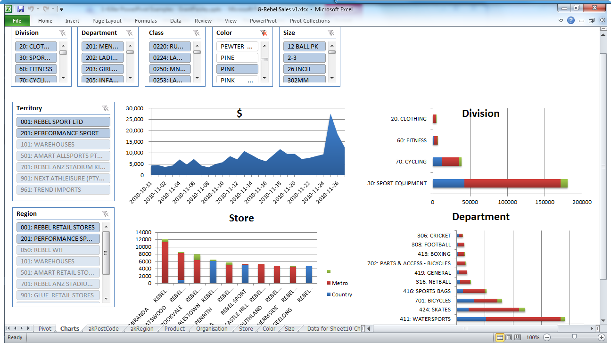

Slide 65
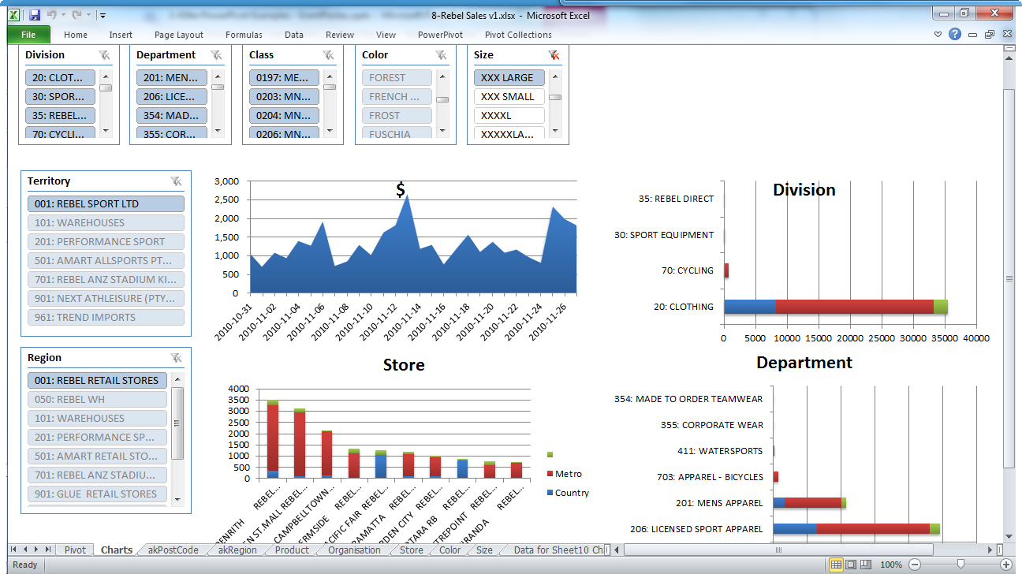

Slide 66
Retailer
Added own data
Top 12

Slide 67



Slide 68
Looking Good
demo

Slide 69
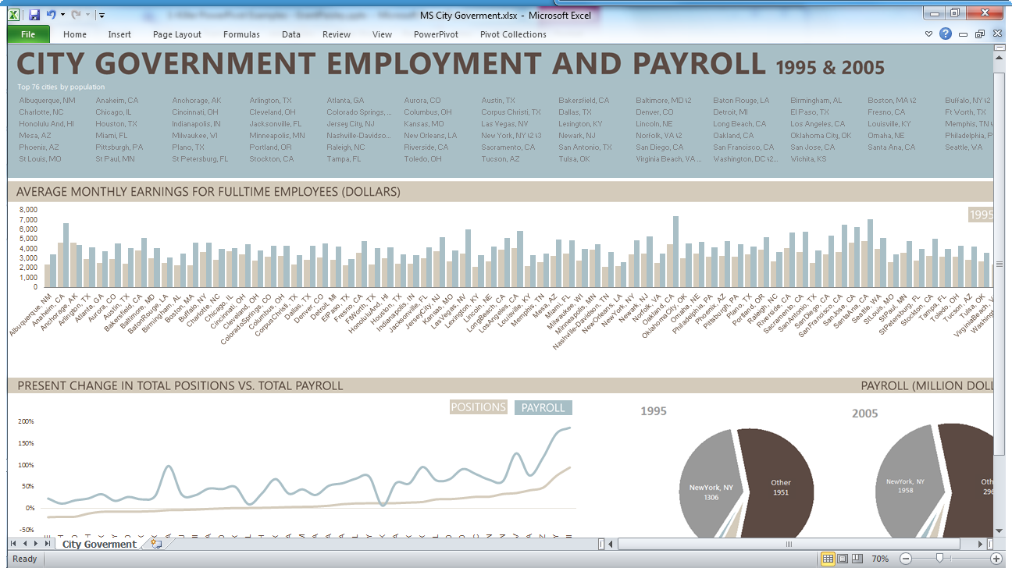

Slide 70
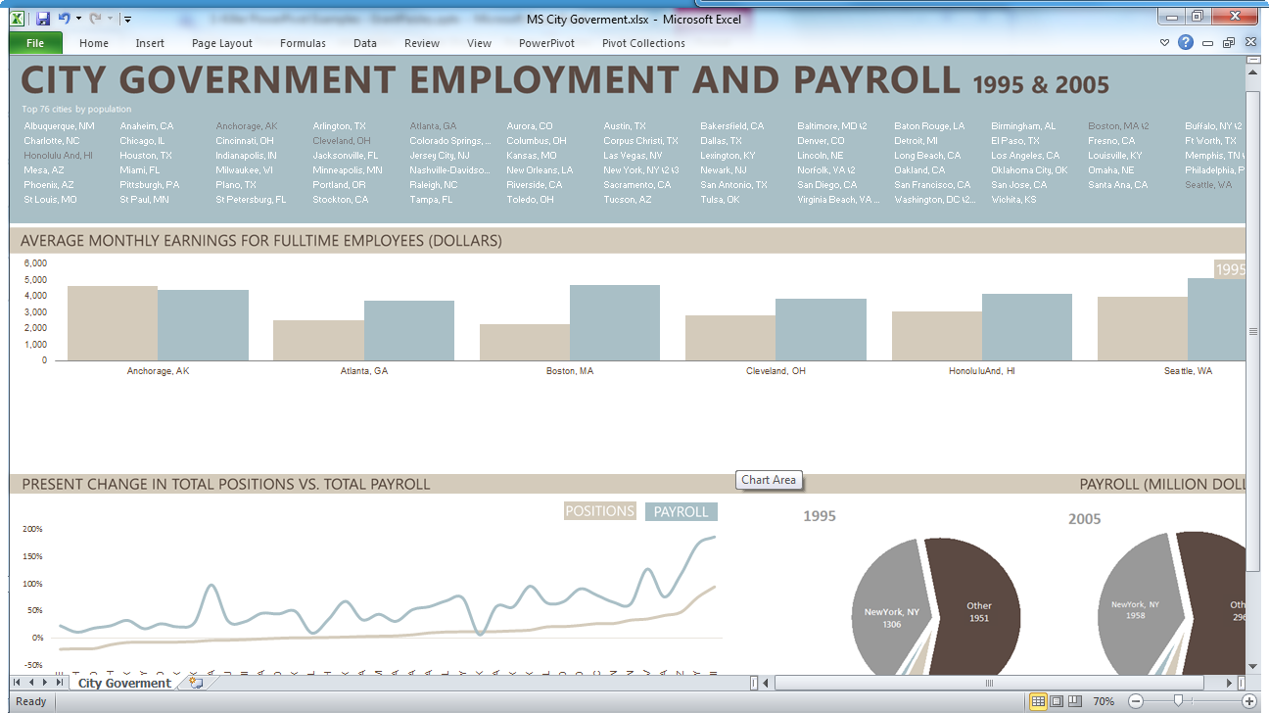

Slide 71
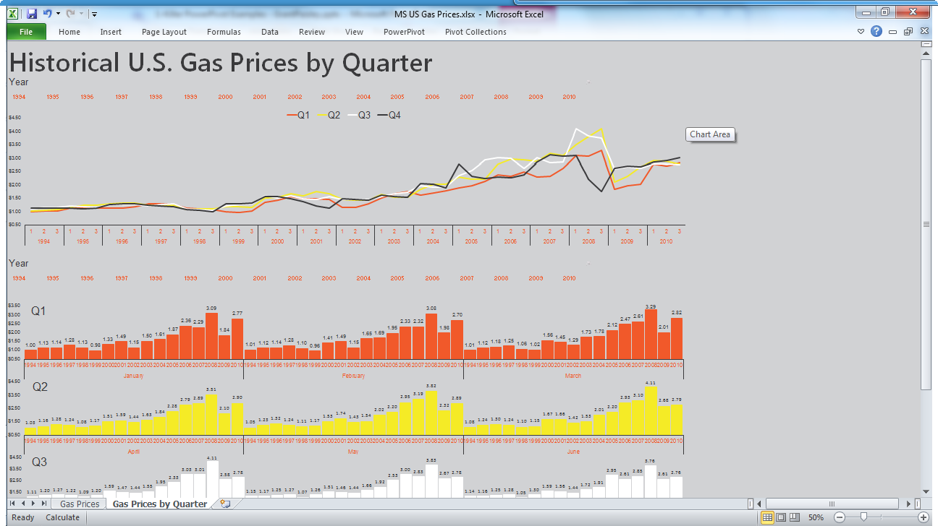

Slide 72
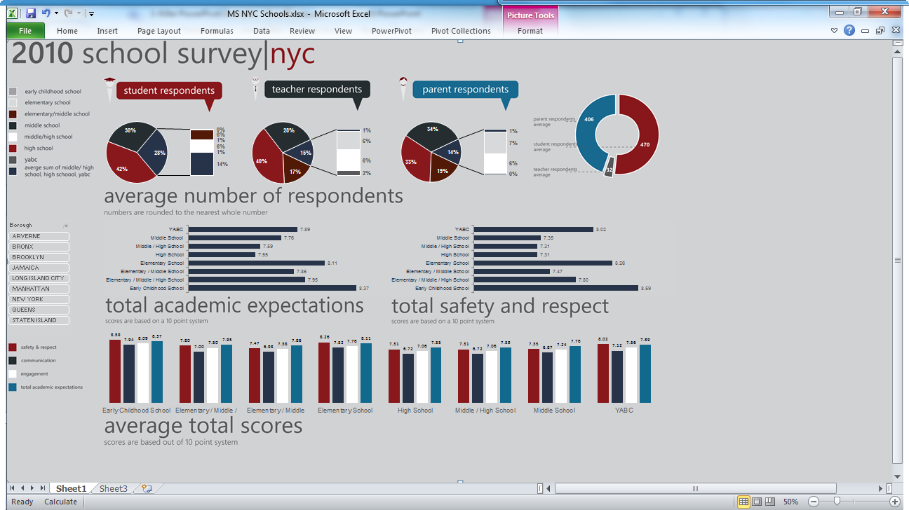

Slide 73
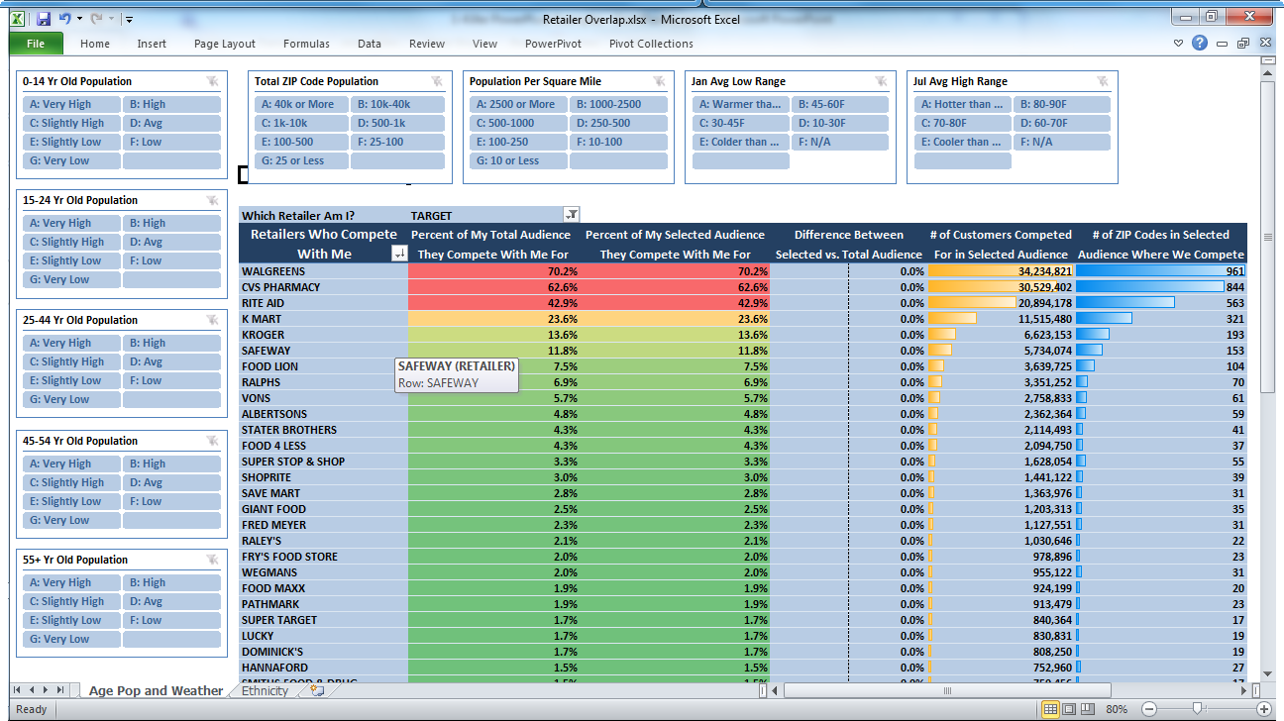

Slide 74
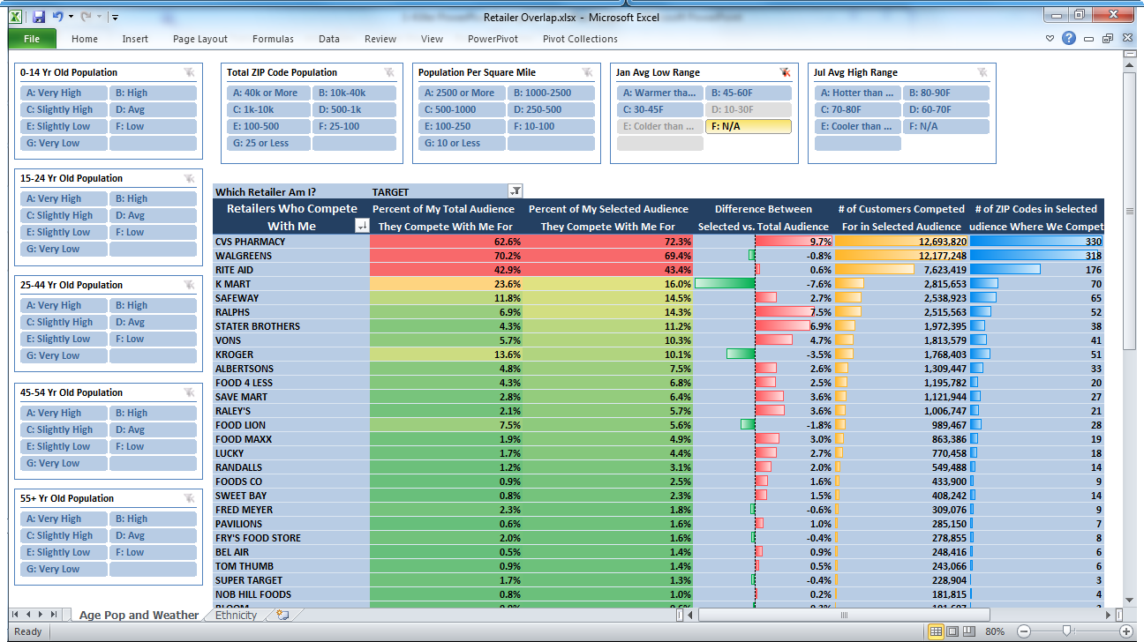

Slide 75
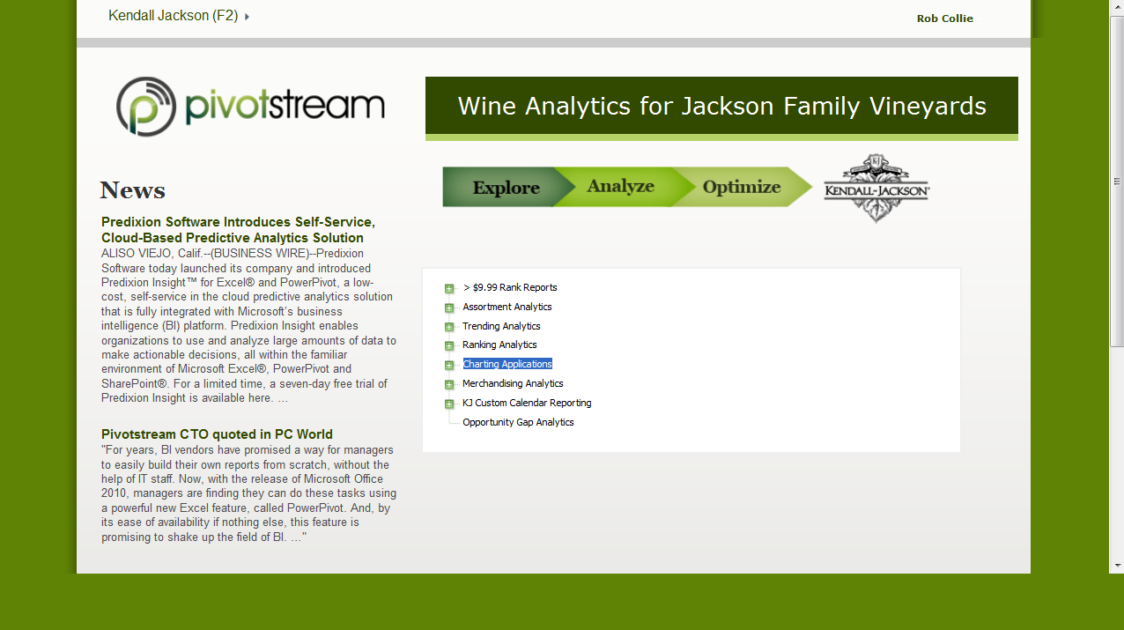

Slide 76
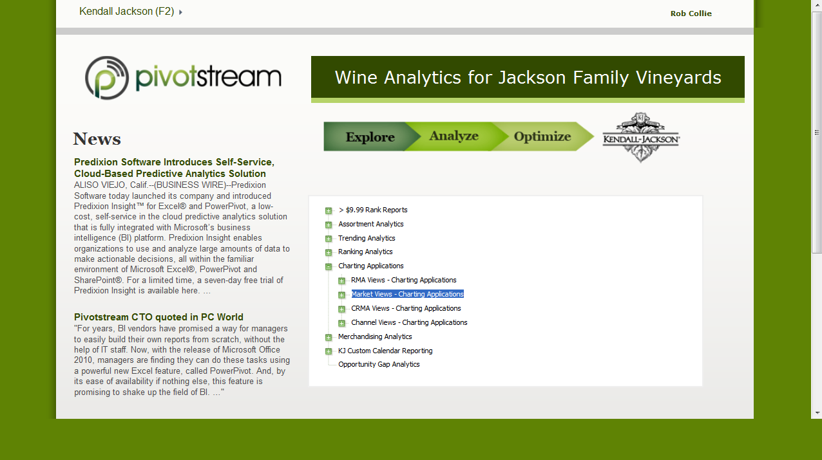

Slide 77
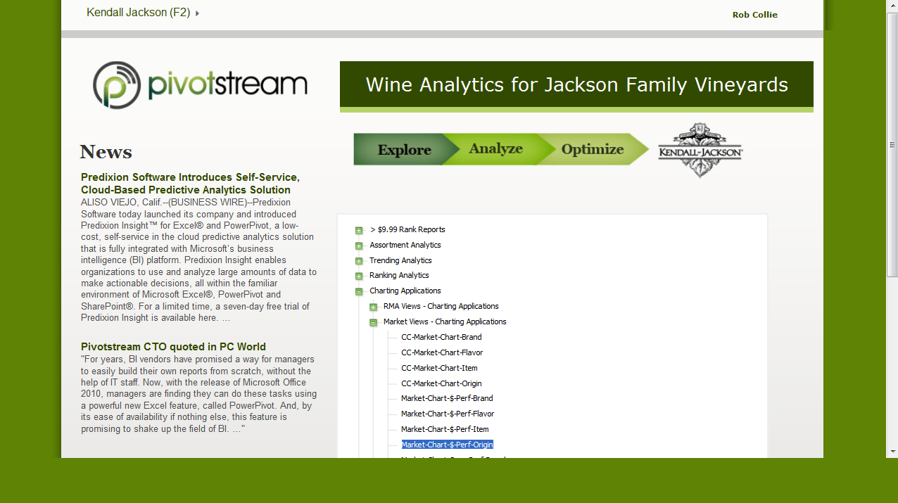

Slide 78
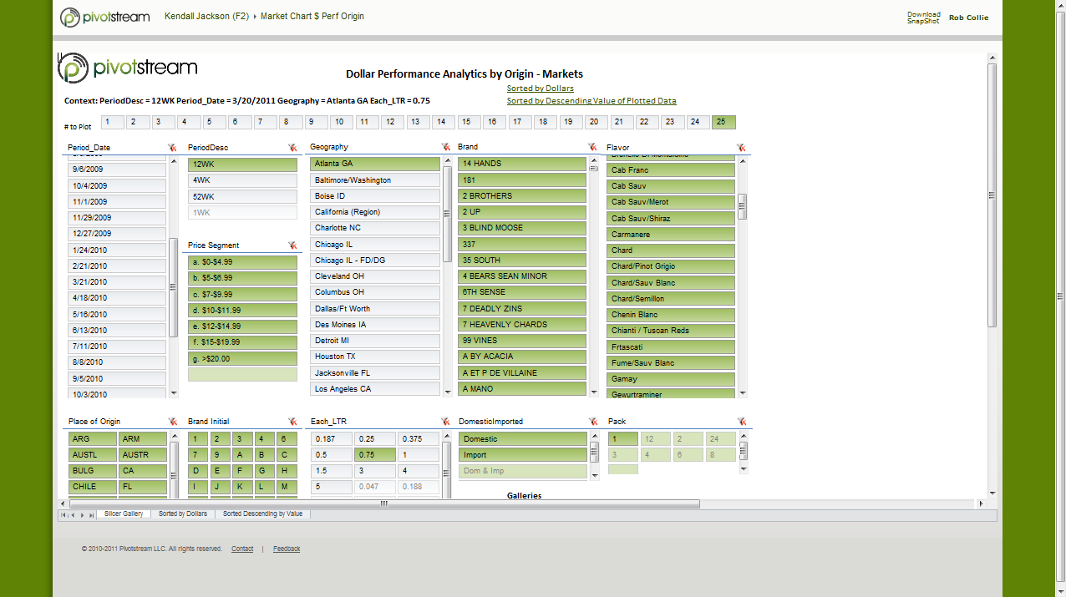

Slide 79
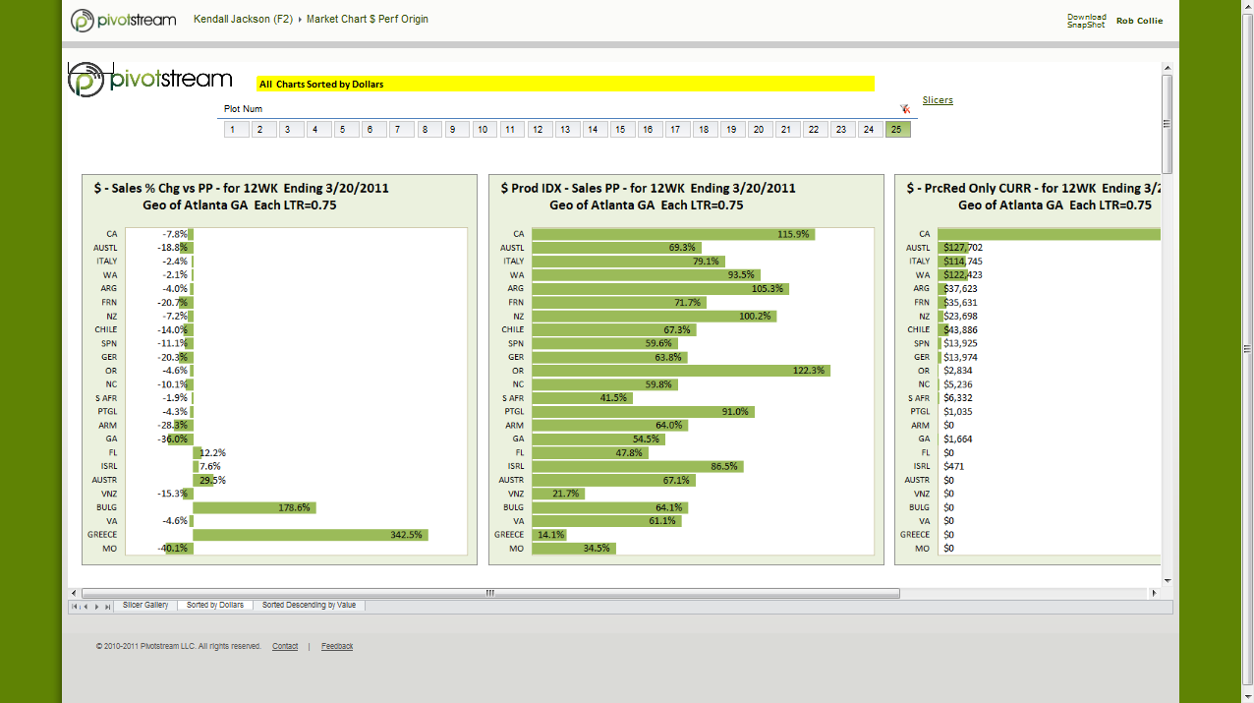

Slide 80
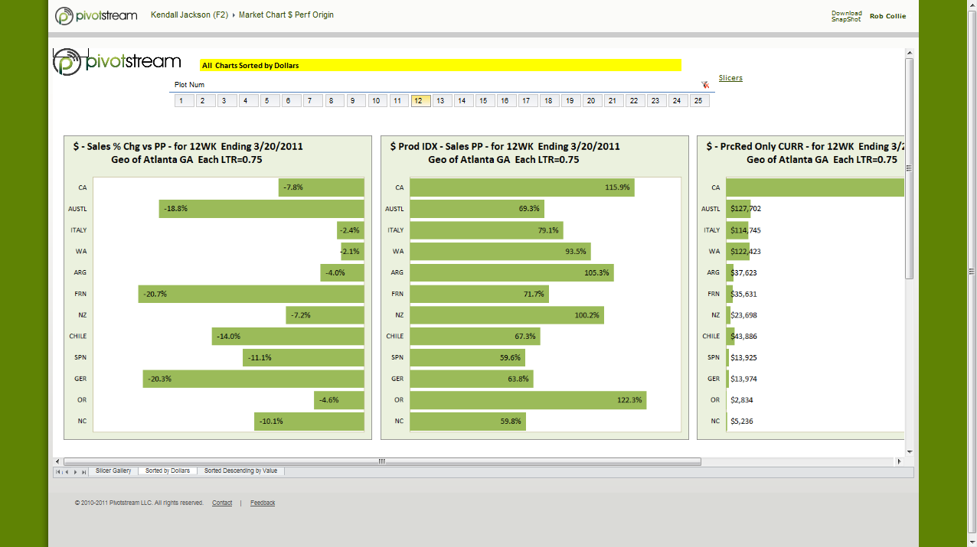

Slide 81


Slide 82
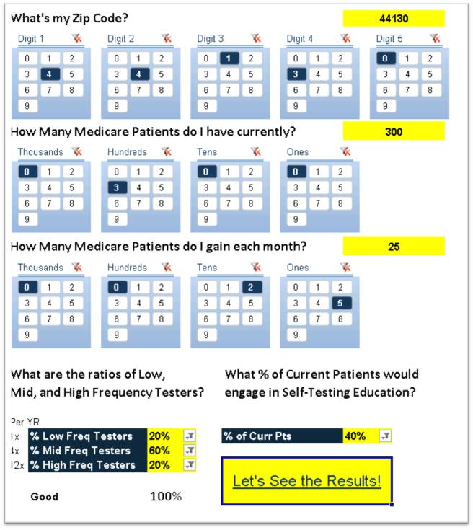

Slide 83
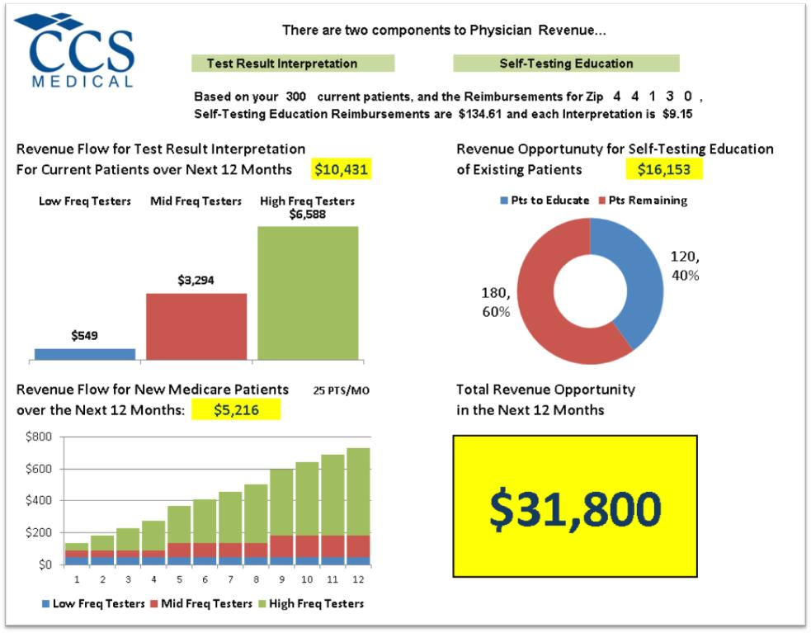

Slide 85


Slide 86


Rules

Slide 87


Slide 88


Slide 89

Simple

Slide 90


Slide 91




LESSONS

Slide 92


Slide 93

What’s new in PowerPivot in Denali?

Slide 94
Powerpivot next
Richer Modelling
Multiple relationships
Hierarchies
Parent-child relationships

Slide 95
Powerpivot next
Richer Modelling
Key performance indicators
Drill-through
Perspectives

Slide 96
Powerpivot next
Data Analysis Expressions (DAX),
Excel formulas, MDX
Relational operators
(Filter, Aggregate, GroupBy, Lookup)
Statistical, time intelligence
(YTD, QTD) functions
Rank, TopN, VisualTotals, DistinctCount

Slide 97



Reporting Competition
+
+
Big Prizes – stay tuned
http://hostedpowerpivot.reportsurfer.com
announcement

Slide 98

Enrol in Microsoft Virtual Academy Today
Why Enroll, other than it being free?
The MVA helps improve your IT skill set and advance your career with a free, easy to access training portal that allows you to learn at your own pace, focusing on Microsoft technologies.
What Do I get for enrolment?
Free training to make you become the Cloud-Hero in my Organization
Help mastering your Training Path and get the recognition
Connect with other IT Pros and discuss The Cloud
Where do I Enrol?
www.microsoftvirtualacademy.com
Then tell us what you think. TellTheDean@microsoft.com

Slide 99




Resources
www.msteched.com/Australia
  Sessions On-Demand & Community
www.microsoft.com/australia/learning
Microsoft Certification & Training Resources
http:// technet.microsoft.com/en-au
  Resources for IT Professionals
http://msdn.microsoft.com/en-au
  Resources for Developers

Slide 100

© 2010 Microsoft Corporation. All rights reserved. Microsoft, Windows, Windows Vista and other product names are or may be registered trademarks and/or trademarks in the U.S. and/or other countries.
The information herein is for informational purposes only and represents the current view of Microsoft Corporation as of the date of this presentation. Because Microsoft must respond to changing market conditions, it should not be interpreted to be a commitment on the part of Microsoft, and Microsoft cannot guarantee the accuracy of any information provided after the date of this presentation. MICROSOFT MAKES NO WARRANTIES, EXPRESS, IMPLIED OR STATUTORY, AS TO THE INFORMATION IN THIS PRESENTATION.

