Slide 2
Denali Always On for Mission Critical Systems
SESSION CODE: # DAT308
Nicholas Dritsas
Principal Program Manager
Microsoft

Slide 3
SQL Server High Availability Retrospective
SQL Server High Availability Today
  Enterprise customers are being successful
    Dell, HP, Bwin, ServiceU, CareGroup, BigHammer
  but
    Solutions fragmented
    Lack important flexibility points
Initiated holistic review of SQL HA and DR
  Looked at customer scenarios (RTO and RPO requirements, Local HA and DR)
  Enterprise blockers
  Mission Critical Needs (online ops, patching, planned and unplanned maintenance)
  Failover requirements and hardware usage
  Future needs

Slide 4


Mission Critical Availability
Integrated
A unified, simplified solution
Easy to deploy and Manage
New AlwaysOn solutions
AlwaysOn Availability Groups
for database protection
AlwaysOn Failover Cluster Instances
for instance level protection
Flexible
Reuse existing investment
SAN versus DAS environments
    Multi-Database Failover
    Multiple Secondaries
    Active Secondaries
    Integrated HA Management
    Multisite Clustering
    Flexible Failover Policy
    Improved Diagnostics
    Built for consolidation scenarios
Cost Effective
  HA hardware Utilization
  No idle systems
Improve IT efficiency
Efficient

Slide 5
AlwaysOn Availability Groups
AlwaysOn Availability Groups is a new feature that enhances and combines database mirroring and log shipping capabilities
Flexible
Integrated
Efficient
  Multi-database failover
  Multiple secondaries
      Total of 4 secondaries
      2 synchronous secondaries
        1 automatic failover pair
  Synchronous and asynchronous
  data movement
  Built in compression and encryption
  Automatic and
  manual failover
  Flexible failover policy
  Automatic Page Repair
  Application failover using virtual name
  Configuration Wizard
  Dashboard
  System Center Integration
  Rich diagnostic infrastructure
  File-stream replication
  Replication publisher failover
  Active Secondary
    Readable Secondary
    Backup from Secondary
  Automation
  using power-shell

Slide 6
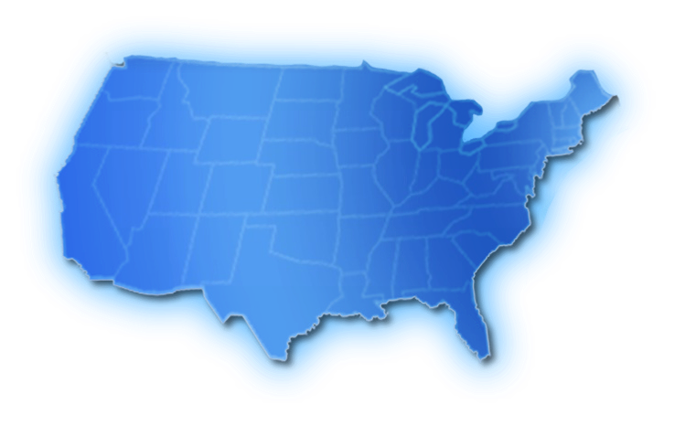








A Flexible Solution
A
A
A
A
A
A
A
Direct attached storage local, regional and geo target
Shared Storage, regional and geo secondaries
AlwaysOn provides the flexibility of different HA configurations
Synchronous
Data Movement
Asynchcronous Data Movement

Slide 7
Mission Critical Requirements
Zero data loss is critical for the business
Fast application recovery during planned and unplanned downtime
Redundancy across 3 datacenters
Application databases and dependencies failover together
Automatic Failover
Database Mirroring
Log Shipping
Log Shipping

Slide 8
Deploying using AlwaysOn Availability Groups
demo

Slide 9
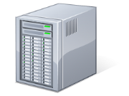


Application Failover
Availability Groups Listener allow applications to failover seamlessly to any secondary
  Application reconnects using a virtual name after a failover to a secondary
Primary
ServerA
ServerB
ServerC
HR
DB
HR
DB
HR
DB
AG_HR
HR_VNN
Secondary
Primary
Secondary
Secondary
Application retry during failover
-server HR_Listener;-catalog HRDB
Connect to new primary once
failover is complete
and the listener is online

Slide 10
What about Server Objects?
Introducing Contained
Databases or CDB’s
    Unit of application
    programmability in Denali
      A DB which establishes a boundary
      between application and server
CDBs sever the
user–login relationship
    Windows users no longer
    need matching logins
    Users with passwords
    replace SQL logins
CDB can be part of an
availability group and can
failover across replicas
Authentication information
moves with the CDB
Limitation
Other objects, like jobs are not contained and has to be managed

Slide 11

Availability Group Architecture
Windows Server Failover Cluster
Database
Active Log Synchronization
Database
Active Log Synchronization
Availability Group uses Windows Server Failover Cluster (WSFC) for
  WSFC Common Microsoft Availability Platform
  SQL Server AlwaysOn Failover cluster instances
  SQL Server AlwaysOn Availability Group
  Microsoft Hyper-V
  Microsoft Exchange
  Built-in WSFC workloads (e.g. file share, NLB, etc) and third party workloads
  Inter-node health detection,
  Failover coordination,
  Primary health detection,
  Distributed data store for settings and state,
  Distributed change notifications

Slide 12
AlwaysOn Active Secondary
IT efficiency and cost-effectiveness is critical for businesses
  Idle hardware is not an option anymore
AlwaysOn Active Secondary enables efficient utilization of high availability hardware resources thereby improving overall IT efficiency
Active Secondary can be utilized for
  Balancing read-only workloads
  Offloading Backup Operations

Slide 13


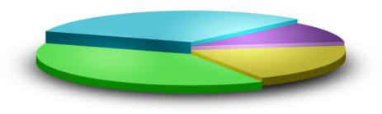
Active Secondary – Making Secondary Readable
Failover
SQLservr.exe
Primary
Secondary
SQLservr.exe
Secondary
Primary
InstanceA
InstanceB
DB1
DB2
DB1
DB2
Reports
Reports
Readable secondary allow offloading read queries to secondary
Close to real-time data, latency of log synchronization
impact data freshness

Slide 14


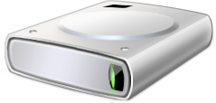
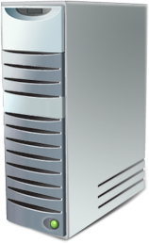
Active Secondary: Enabling Backup On Secondary
R/W workload
Backups
Backups can be done on any replica of a database
Backups on primary replica still works
Log backups done on all replicas form a single log chain
Database Recovery Advisor makes restores simple
Secondary
Backups
Primary
Backups
Secondary

Slide 15
Read-Only Client Connectivity
Read-Only client connection behavior determined by Availability Replica Option+ ApplicationIntent Property
  ApplicationIntent is a connection property
  Replica option determines whether a replica is enabled for read access when in a secondary role
Read-Only Routing enables redirection of client connection to new secondary on role change
  Enable seamless redirection of application connection across replicas without manual intervention

Slide 16
Active Secondary Demo
demo

Slide 17
AlwaysOn Failover Cluster Instances
Providing Instance Availability

Slide 18
Key Enhancements
Fast instance failover
through predictable
database recovery time
Native support for multi-site clustering across subnets enable DR using failover
cluster instances
Flexible Failover Policy
  Eliminates false failover
  Configurable failure
  condition levels
  Better diagnostics
SMB support
enables consolidation of
more than 26 instances
Support TEMPDB on local drive

Slide 19
Introducing Flexible Failover Policy
Flexible Failover Policy provides administrators control over the conditions when an automatic failover should be initiated.
SQL Server 2008 R2
SQL Server Denali
Resource DLL
Resource DLL
Select @@servername
sp_server_diagnostics
Diagnostics
SQL Server
SQL Server
Configurable options eliminate false failover
Improved logging for better diagnostics

Slide 20
Reducing Planned Downtime
Support for Windows Server Core
  Reduce OS patching by as much as 50-60%
Support for rolling upgrade and patching of SQL Server for both Availability Groups and Failover Cluster Instance
Fast failover time for both Availability Groups and Failover Cluster Instances
New online operations supported
  LOB Index
  Adding of column with default

Slide 21
Available Soon
Following feature set that you can test and provide feedback
  AlwaysOn Availability Groups Preview
    Ability to configure availability groups through T-SQL, SSMS, and PowerShell
    Synchronous or Asynchronous commit
    Automatic and Manual failover
    Multiple databases support in availability groups
    Read-only access to the secondary
    Support for Filestream data type
    Failing over client connections using the new connectivity story based on virtual network names and virtual IP addresses
    Including logins in user databases through a Contained Database
    SSMS, Catalog Views, and DMVs to view and monitor state
    Support for multiple availability groups on the same instance
    Support for availability groups on standalone instances and/or failover cluster instances
  AlwaysOn SQL Server Failover Cluster Instance (all features)

Slide 22
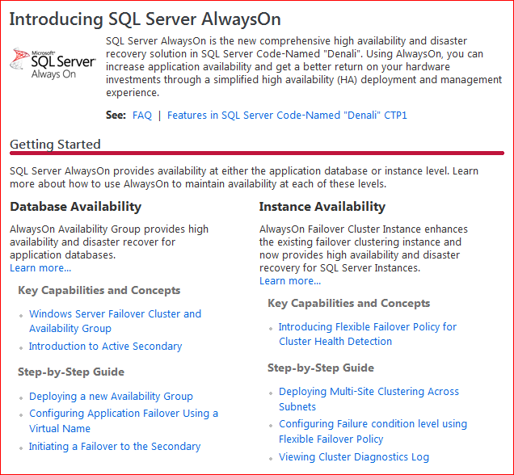
AlwaysOn Resources
“Denali” AlwaysOn Resource Center: http://msdn.microsoft.com/en-us/sqlserver/gg490638(en-us,MSDN.10)
  CTP download
  Documentation
  MSDN forums
  Microsoft Connect
  AlwaysOn Blog

Slide 23
Conclusion
Simpler and Unified
AlwaysOn Availability Groups
AlwaysOn Failover Cluster Instances
Rich built in management experience
AlwaysOn Systems Center Management Pack
Important Gaps Filled
Improved Online Operations
Better health analysis
Less patching via Windows Server Core
Support NAS/Remove drive letter limitations
Consistent, Solid Foundation
AlwaysOn Availability Groups becomes common substrate
for future enhancements, and traditional Enterprise Box business
Denali is a huge leap forward for
customer’s DB HA needs!

Slide 24

Enrol in Microsoft Virtual Academy Today
Why Enroll, other than it being free?
The MVA helps improve your IT skill set and advance your career with a free, easy to access training portal that allows you to learn at your own pace, focusing on Microsoft technologies.
What Do I get for enrolment?
Free training to make you become the Cloud-Hero in my Organization
Help mastering your Training Path and get the recognition
Connect with other IT Pros and discuss The Cloud
Where do I Enrol?
www.microsoftvirtualacademy.com
Then tell us what you think. TellTheDean@microsoft.com

Slide 25

© 2010 Microsoft Corporation. All rights reserved. Microsoft, Windows, Windows Vista and other product names are or may be registered trademarks and/or trademarks in the U.S. and/or other countries.
The information herein is for informational purposes only and represents the current view of Microsoft Corporation as of the date of this presentation. Because Microsoft must respond to changing market conditions, it should not be interpreted to be a commitment on the part of Microsoft, and Microsoft cannot guarantee the accuracy of any information provided after the date of this presentation. MICROSOFT MAKES NO WARRANTIES, EXPRESS, IMPLIED OR STATUTORY, AS TO THE INFORMATION IN THIS PRESENTATION.

Slide 26




Resources
www.msteched.com/Australia
  Sessions On-Demand & Community
www.microsoft.com/australia/learning
Microsoft Certification & Training Resources
http:// technet.microsoft.com/en-au
  Resources for IT Professionals
http://msdn.microsoft.com/en-au
  Resources for Developers

