Slide 2
Data Dashboards using Microsoft BI
SESSION CODE: DAT 311
Dheeraj Chowdhury
Group Leader Digital Media
NSW Department of Education and Communities
Curriculum and Learning Innovation Centre

Slide 3
Agenda
Introduction
Who
What
How
Challenge One – Common user identifier
Challenge Two – Data from different sources
Challenge Three – Complex relationships
Challenge Four – Data reporting formats
Recommendations
Lessons learned
Project highlights
Q&A

Slide 4
Who we are
2200+ Schools in 10 Regions
200+ TAFE Colleges in 10 Regions
70,000+ Full time staff
3 million+ user accounts

Slide 5
Learning Resource Ecosystem
Create
Share
Connect
Collaborate

Slide 6
‘Executive decree’
In God we trust everyone else bring DATA

Slide 7
Where is all the data
We are capturing data from the following sources
Active directory
Oracle IDM
Application databases
Google Analytics

Slide 8
Business challenge
Single point of access to key performance data
Visual representation of data
Interactive and drill down reports
Business user driven reporting
Ability to analyse data

Slide 9
Tools for the trade

Slide 10
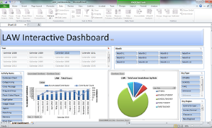
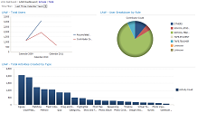
Solution
Microsoft Business Intelligence Suite
Source Systems
BI Data Server
AD
Apps
Extract,
Transform & Load
OLAP Cubes, Multi-Dimensional Data
Staging data Relational data
IDM
MySQL

Slide 11
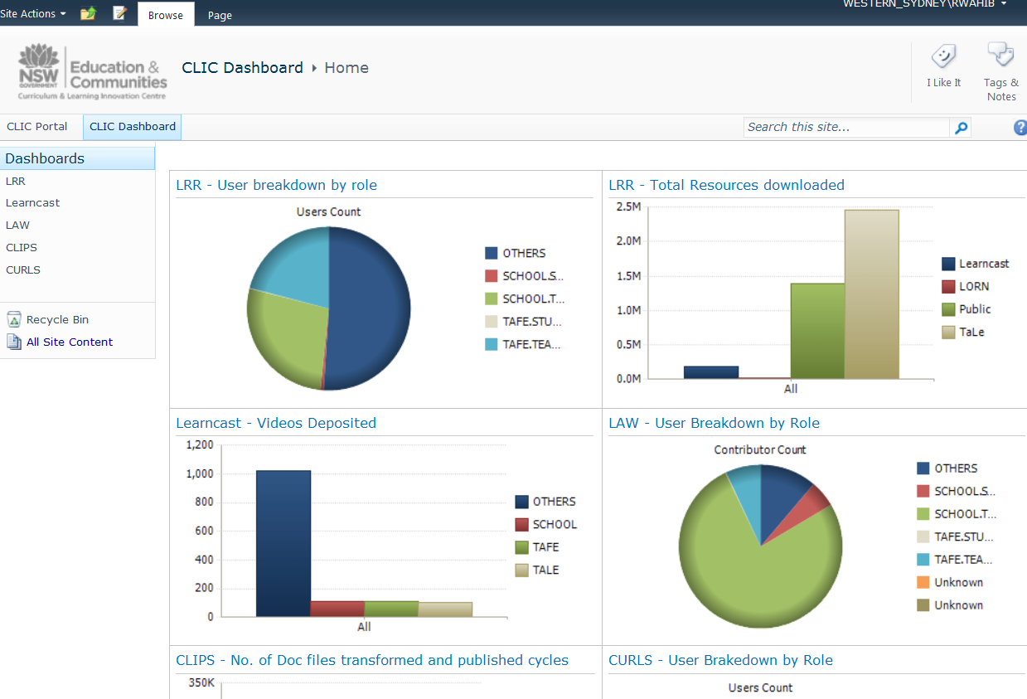
Performance Point Output

Slide 12
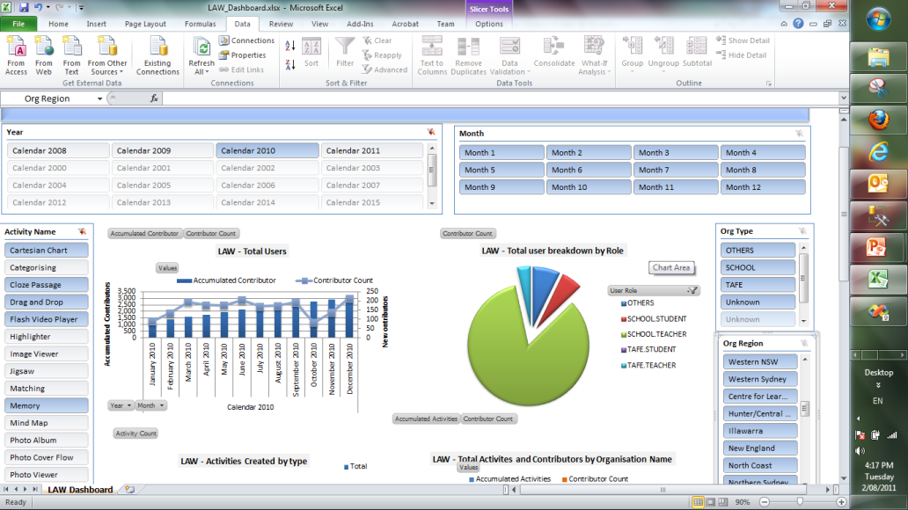
Excel Services Interactive Dashboard

Slide 13
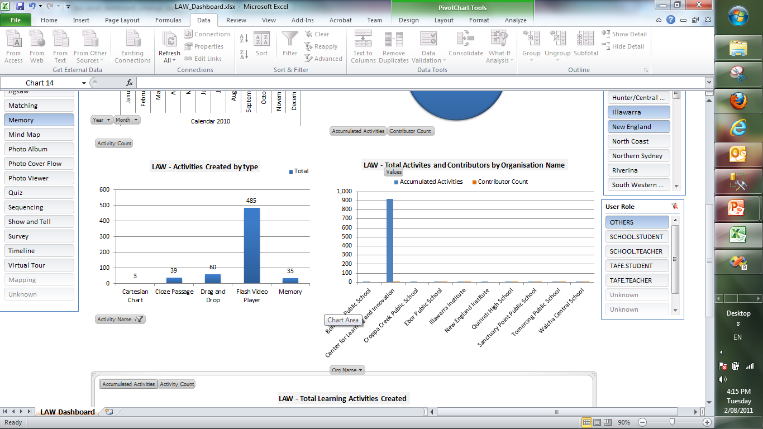
Excel Services Interactive Dashboard

Slide 14
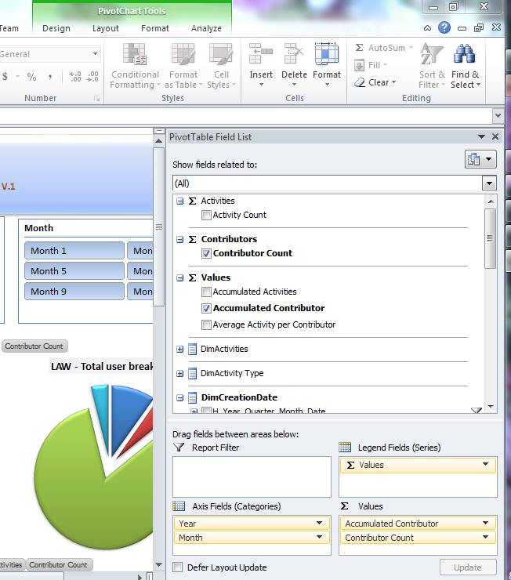
Visualize first Cube : first Excel 2010 pivot table based on cube was straight forward.

Slide 15
Challenge One – Common User Identifier What was the challenge?
User information data from Oracle IDM
User information data from Active Directory
Every source have different set of user data

Slide 16
Challenge One – Common User Identifier What were our options?
Collecting all the data from IDM team
Accessing Oracle database & AD via API
Develop a custom solution

Slide 17
Challenge One – Common User Identifier DET NSW Portal

Slide 18
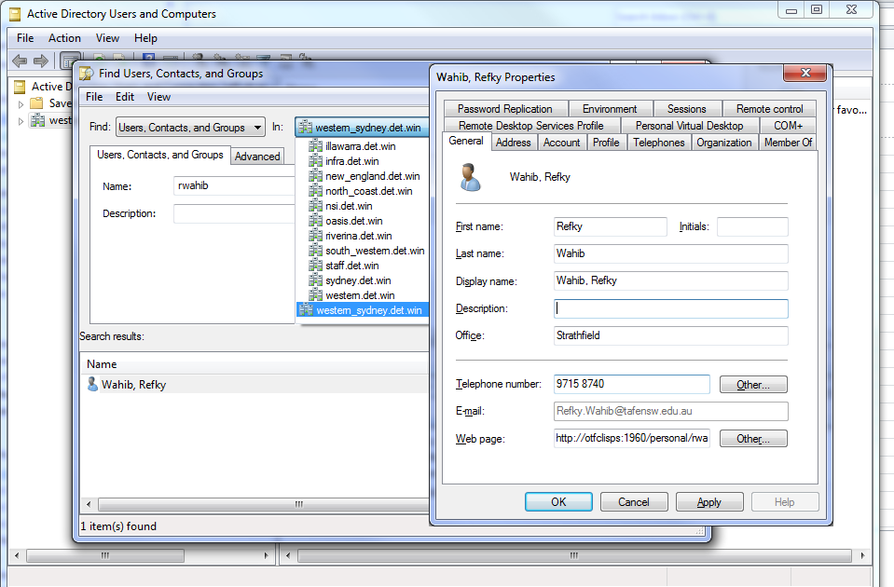
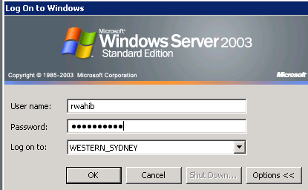
Challenge One – Common User Identifier Windows Accounts & Active Directory

Slide 19
Challenge One – Common User Identifier Which option did we choose and why?
Solution: Console application
Initial upload from Active Directory
Access Oracle IDM services via API
Merge data
Regular update of new users

Slide 20
Challenge One – Common User Identifier How does it work?
User identity Active Directory
IDM (Oracle Database)
MS SQL AD Linked Server
Accessing data via SOAP Webservices
Regular Updates to MS SQL Staging Data for SSAS

Slide 21
Demo
Online demo

Slide 22
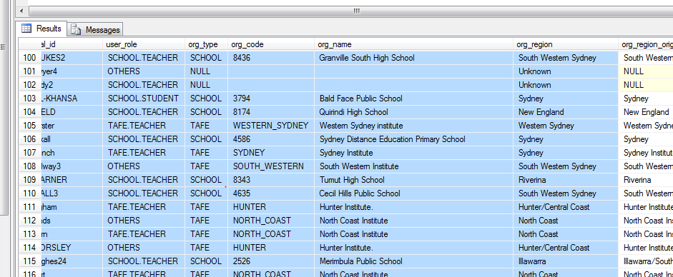
Challenge One – Common User Identifier How does it work?
1 single consolidated table hold all User information

Slide 23
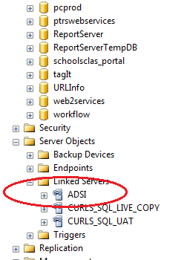
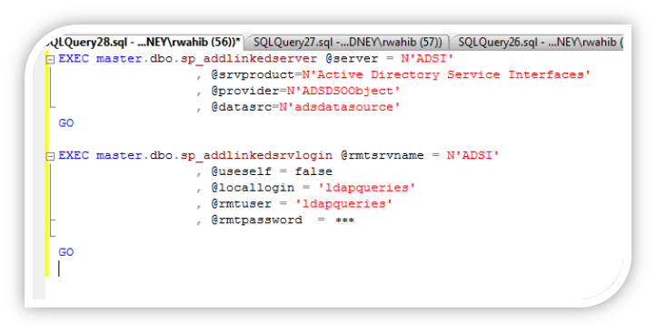
Challenge One – Common User Identifier How does it work?
Creating AD Linked Server.

Slide 24
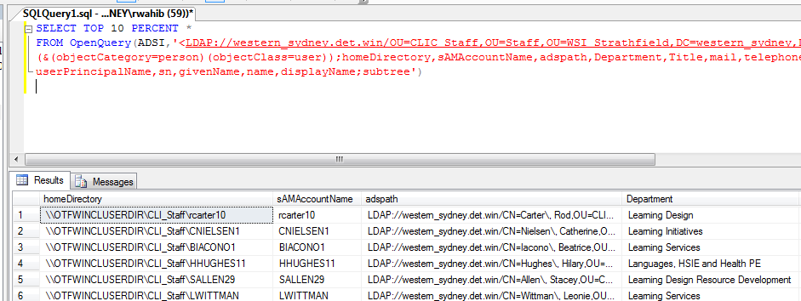
Challenge One – Common User Identifier How does it work?
Initial upload from AD Linked server

Slide 25
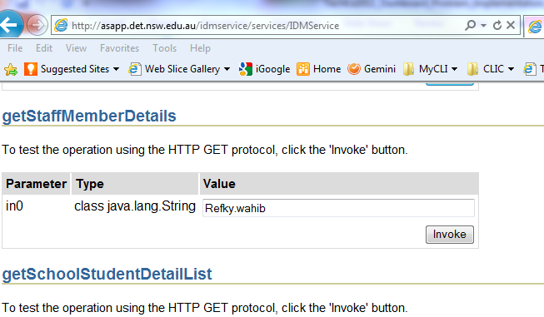
Challenge One – Common User Identifier How does it work?
Access Oracle IDM using SOAP webservice

Slide 26
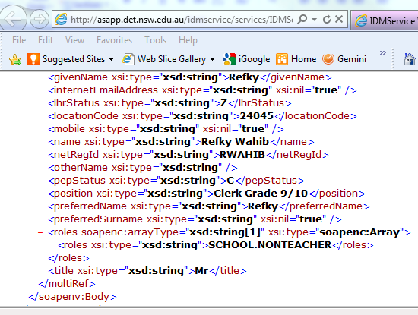
Challenge One – Common User Identifier How does it work?

Slide 27
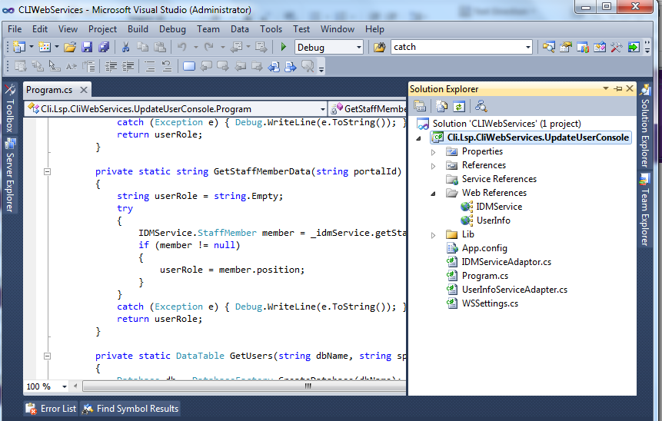
Challenge One – Common User Identifier How does it work?
.NET C# Console app: consuming IDM webservice, and regularly making incremental updates to staging data.

Slide 28
Challenge One - Summary
No access to live user information database (Oracle IDM)
Custom solution
Extract only required user data
Improved processing times through caching
Delta harvesting
Side effect – for another day

Slide 29
Challenge Two – Data from different sources What was the challenge?
Different locations
Internal : accessible via the network
External: hosted outside
Different format
Oracle database
MS SQL Server
MySQL
SharePoint Server 2007

Slide 30
Challenge Two – Data from different sources What were our options?
Accessing Oracle and MySQL data
via ODBC/OLEDB
via MS SQL Linked server
Accessing SharePoint Lists
via SSIS
via SharePoint list SOAP Webservices
Directly from SharePoint database
MS Access Linked Tabled from SharePoint Lists

Slide 31
Challenge Two – Data from different sources Which option did we choose and why?
MySQL: Data extracted via MS SQL Linked Server
Easy to use
Does not need ODBC to be installed in the client machines
We can create views across multiple databases
SharePoint Server 2010 Data extracted via MS Access Linked tables
Simple and straight forward for initial uploading data for testing and developing
ICT had a concerns to use SharePoint database directly
SSIS was not available for us at the beginning. (we consider it as the next step)

Slide 32
Challenge Two – Data from different sources How does it work?
MySQL
Oracle 11g
SharePoint List
MS SQL MySQL ODBC Linked Server
MS SQL Oracle OLEDB Linked Server
Initial test upload via MS Access linked tables
Regular Updates to MS SQL Staging Data for SSAS

Slide 33
Demo
Online demo

Slide 34
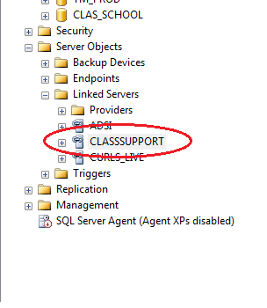
Challenge Two – Data from different sources How does it work?
Creating MS SQL - Oracle OLE linked server

Slide 35
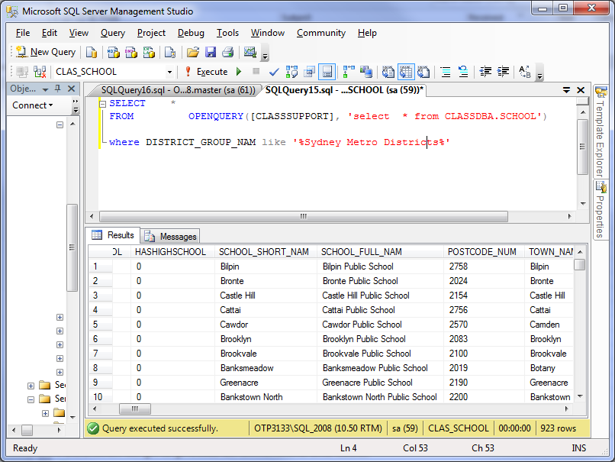
Challenge Two – Data from different sources How does it work?

Slide 36
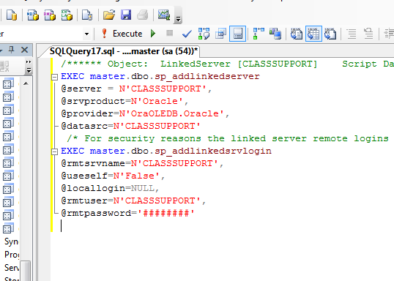
Challenge Two – Data from different sources How does it work?

Slide 37
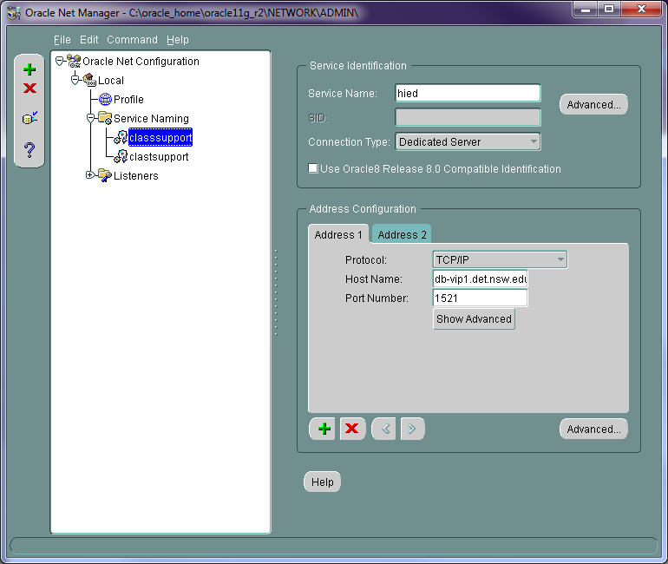
Challenge Two – Data from different sources How does it work?

Slide 38
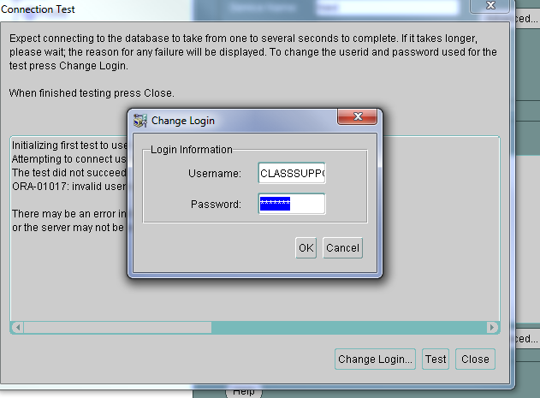
Challenge Two – Data from different sources How does it work?

Slide 39
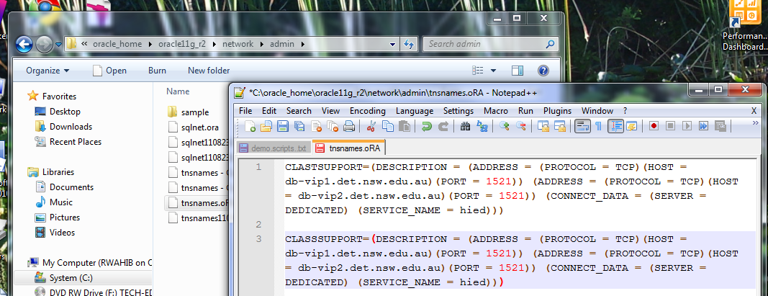
Challenge Two – Data from different sources How does it work?

Slide 40
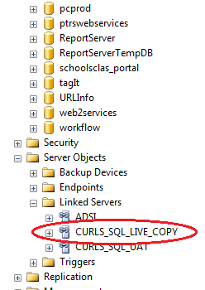
Challenge Two – Data from different sources How does it work?
Creating MS SQL - MySQL ODBC linked server

Slide 41
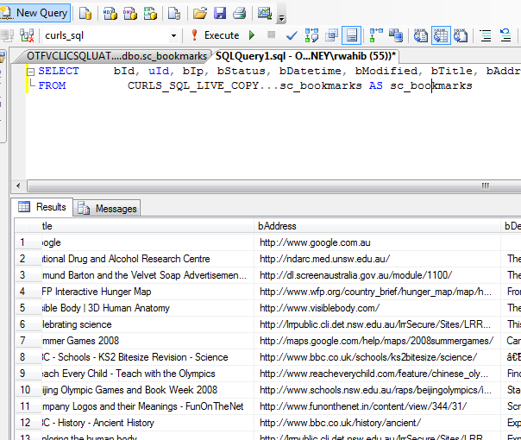
Challenge Two – Data from different sources How does it work?

Slide 42
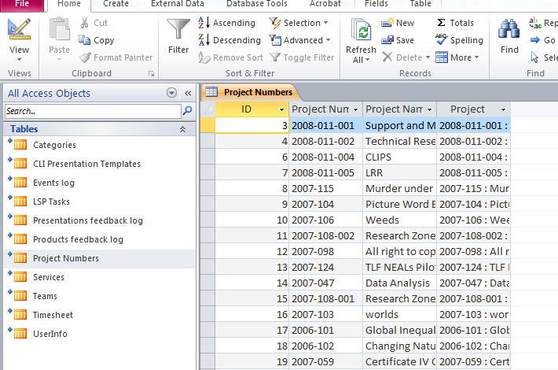
Challenge Two – Data from different sources How does it work?

Slide 43
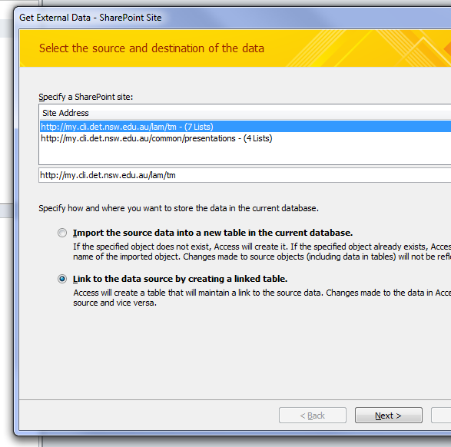
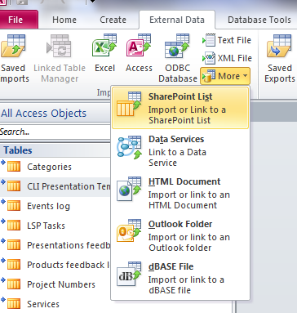
Challenge Two – Data from different sources How does it work?
Exporting SharePoint list via MS Access

Slide 44
Challenge Two - Summary
SSIS is a the way to go for importing and processing data
MS SQL Linked Server is the best solution to link with live data sources

Slide 45
Challenge Three – Complex data relationship What was the challenge?
Handling Many to Many relationships between Facts and Dimensions

Slide 46
Challenge Three – Complex data relationship What was the challenge?

Slide 47
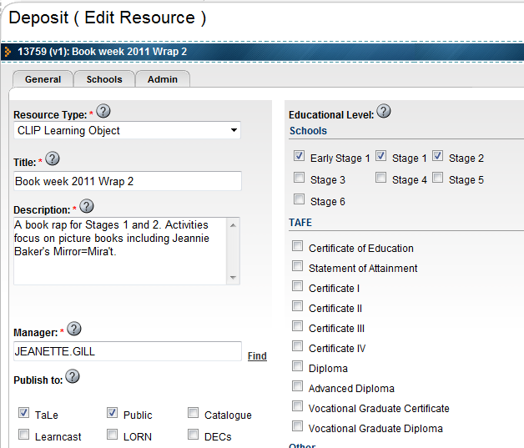
Challenge Three – Complex data relationship What was the challenge?
Each Learning Resource has multiple educational levels
Each educational level can be referenced in multiple learning resources

Slide 48
Challenge Three – Complex data relationship What were our options?
Creating views in the relational database
Merging fact tables with the intermediate table
Use SSAS to define many-many relationships

Slide 49
Demo
Online demo

Slide 50
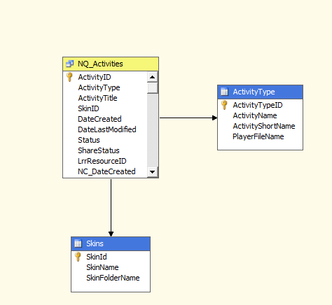
Challenge Three – Complex data relationship How does it work?
Simple relationship (regular relationship)
All master detail tables (or lookup tables based on foreign keys) can be mapped to simple regular relationships in Cubes-Dimension usages.
Fact Table
Dimension Table
Dimension Table

Slide 51
Challenge Three – Complex data relationship How does it work?
Blue (Dimension) tables have the primary key.
Blue (Dimension) tables are the master tables (lookup tables)
Yellow (Fact) tables have the foreign keys.
Yellow (Fact) tables are the detail tables
Fact Table
Dimension Table
Dimension Table

Slide 52
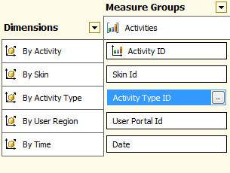
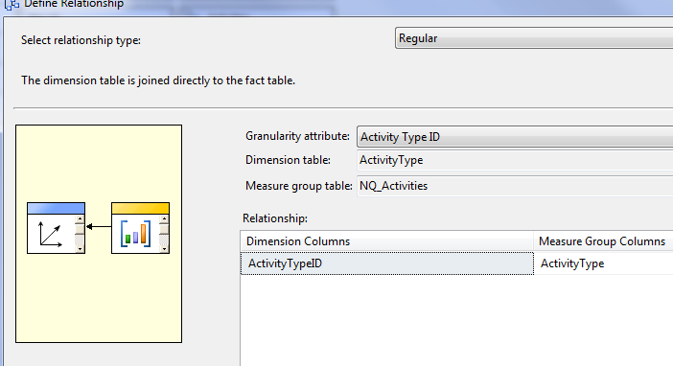
Challenge Three – Complex data relationship Simple relationship (regular relationship)
Measure (Activities)
Dimensions (By Skin, By Activity type)
Regular is the default relationship.
Measure
Dimension
Regular relationship

Slide 53
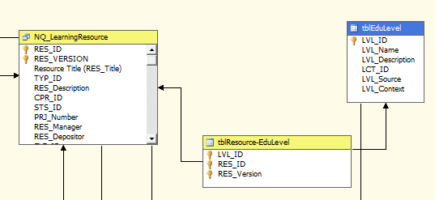
Challenge Three – Complex data relationship How does it work?
Learning Resource & Educational level tables have many-many relationship.
Resource-Educational level table is the many-many relationship table.
many-many relationship table

Slide 54
Challenge Three – Complex data relationship How does it work?
Each Learning Resource has multiple educational levels
Each educational level can be referenced in multiple learning resources

Slide 55
Challenge Three – Complex data relationship How does it work?
Learning Resource table (Fact)
Educational level table (Dimension)
There is no primary-foreign key relationship (master-detail, or lookup table alike patterns)
Fact table
Dimension table
???

Slide 56
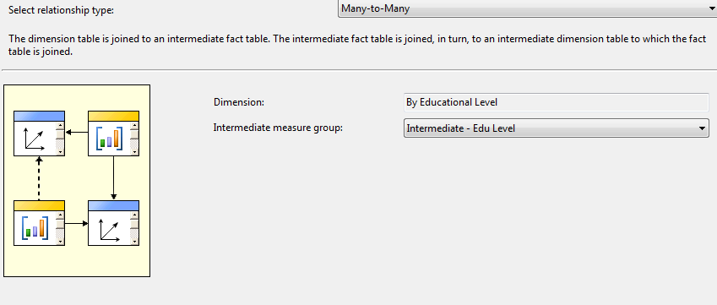
Challenge Three – Complex data relationship How does it work?
Solution: using the SSAS built-in many-many relationship
Fact table
???
Intermediate table
Dimension table
Fact table

Slide 57
Challenge Three – Complex data relationship How does it work?
Creating a bridge (Intermediate Fact table)
Intermediate table
Intermediate table

Slide 58
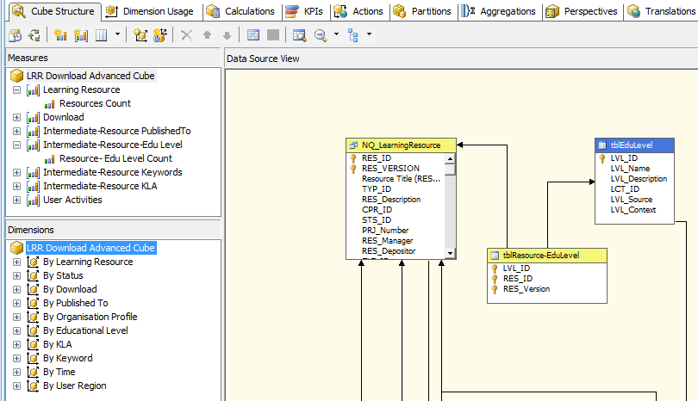
Challenge Three – Complex data relationship How does it work?
Intermediate measures
Intermediate (bridge) Fact table

Slide 59
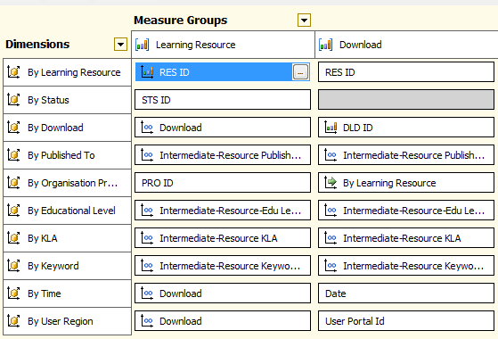
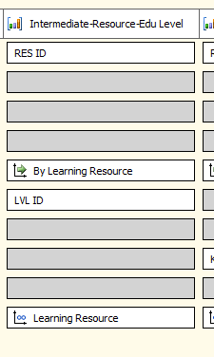
Challenge Three – Complex data relationship How does it work?
Apply intermediate relation first, then the Many-Many relationship
Regular relationship
Many-Many relationship
Many-Many relationship

Slide 60
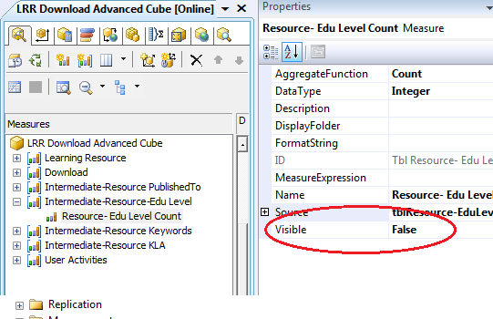
Challenge Three – Complex data relationship How does it work?
All intermediate measures are hidden.

Slide 61
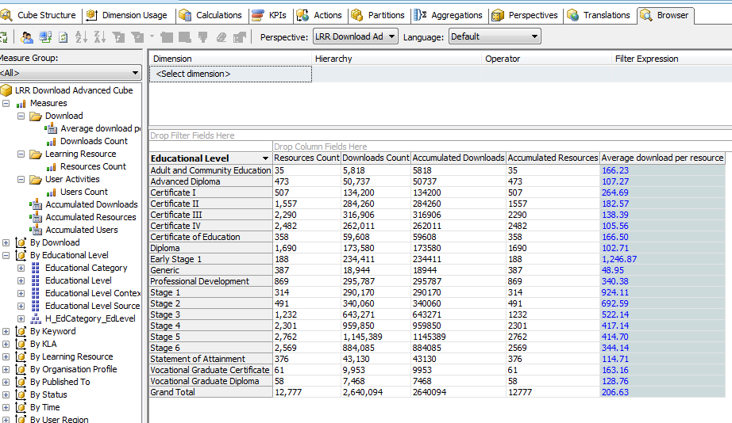
Challenge Three – Complex data relationship How does it work?
All intermediate measures are hidden .

Slide 62
Challenge Three - Summary
Performance gains by using SSAS
Ability to resolve Many – Many to Many relationships
Ability to hide intermediate tables

Slide 63
Challenge Four – Data reporting format What was the challenge?
Creating “accumulated” or total values over time
Controlling generated time dimension range

Slide 64
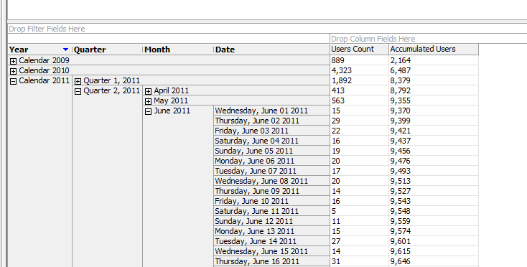
Challenge Four – Data reporting format What was the challenge?

Slide 65
Challenge Four – Data reporting format What were our options?
Creating “accumulated” values over time.
Using aggregations or recursive computed fields on the underlying relational database.
Using MDX with Time dimension hierarchy.
Controlling generated time dimension range.
Extract time range for the transactional datetime fields in underlying relational database.
Using MDX to filter the calculated time range.

Slide 66
Challenge Four – Data reporting format Which option did we choose and why?
Solution: using calculations with MDX
It was easy as single line of code.
It work perfect with dimensions, and hierarchy.
it can control and filter the generated time dimension without any need to be regenerated every time through ETL process.

Slide 67
Demo
Online demo

Slide 68
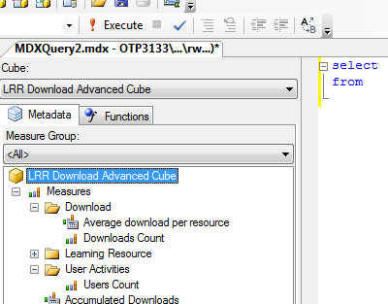
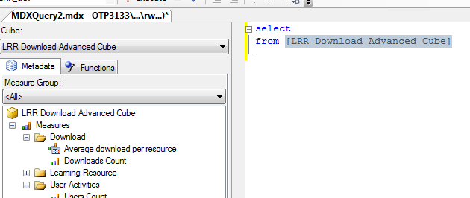
Challenge Four – Data reporting format How does it work?
Using MDX (multi dimensional expression)
Drag cube name to the Editor

Slide 69
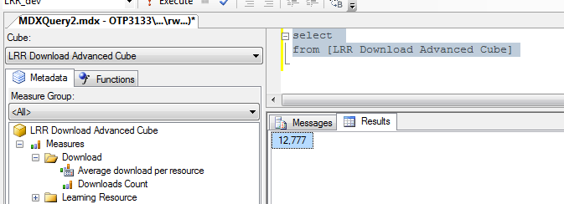
Challenge Four – Data reporting format How does it work?
Result: get the default measure [Measures].[Resources Count]

Slide 70
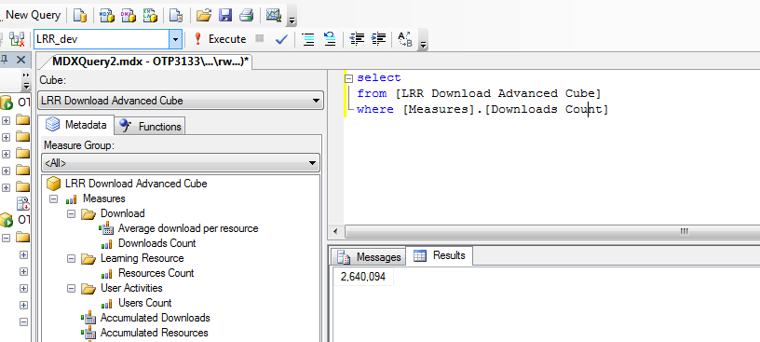
Challenge Four – Data reporting format How does it work?
Using a slicer (where statement)

Slide 71
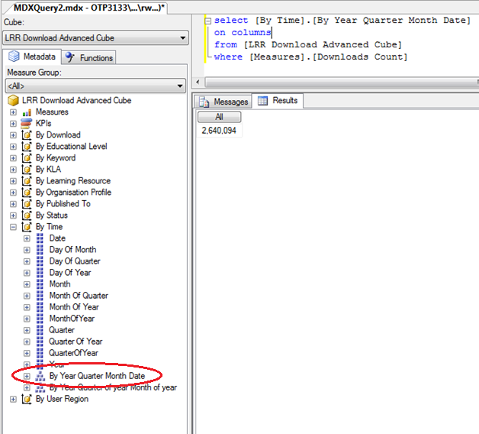
Challenge Four – Data reporting format How does it work?
Using time Hierarchy to get the total value for download count

Slide 72
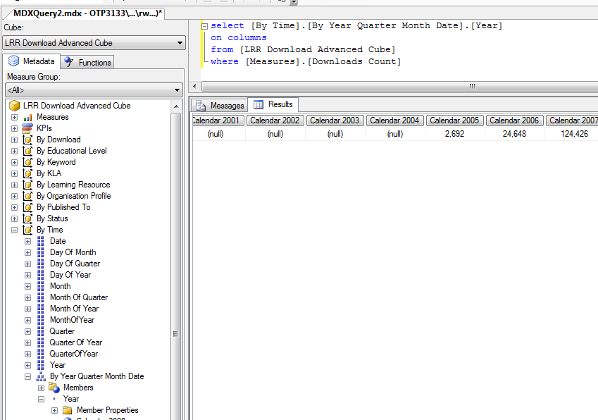
Challenge Four – Data reporting format How does it work?
Using time Hierarchy attribute [Year] to get all download Count per year

Slide 73
Challenge Four – Data reporting format How does it work?
Trim all Null value with “non empty”

Slide 74
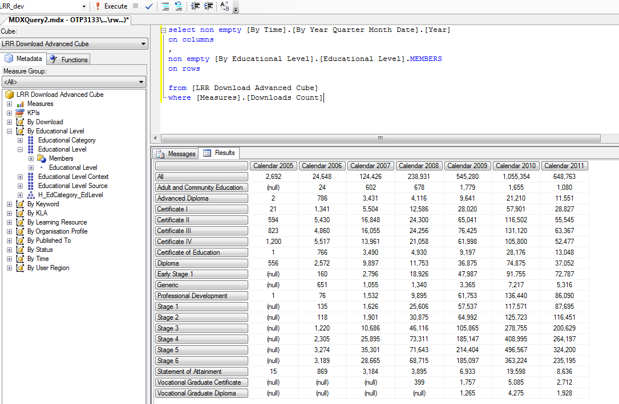
Challenge Four – Data reporting format How does it work?
Use 2 dimensional query

Slide 75
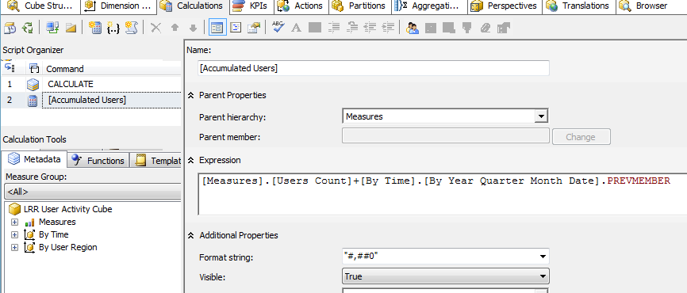
Challenge Four – Data reporting format How does it work?
[accumulated value]=[measure value]+[time dimension hierarchy value].PREVMEMBER

Slide 76
Challenge Four – Data reporting format How does it work?

Slide 77
Challenge Four – Data reporting format How does it work?
[accumulated value]=[measure value]+[time dimension hierarchy value].PREVMEMBER

Slide 78
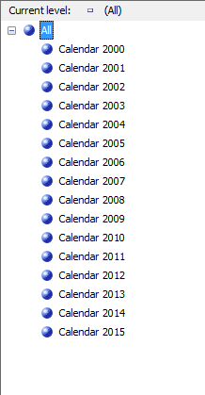
Challenge Four – Data reporting format How does it work?
Time dimensions generated once from 2000 to 2015

Slide 79
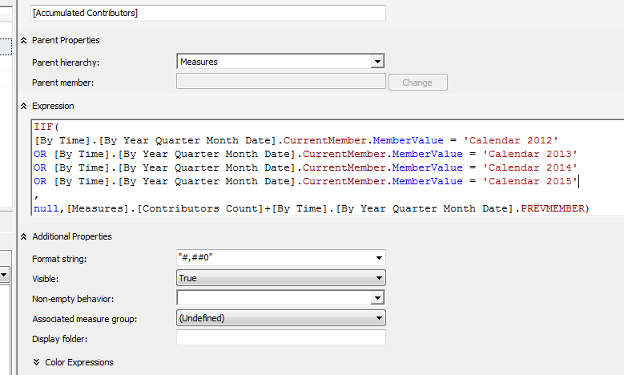
Challenge Four – Data reporting format How does it work?
Using MDX to filter the time range

Slide 80
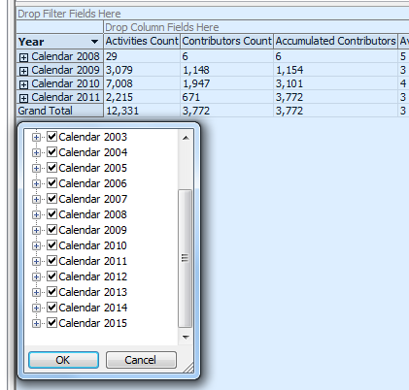
Challenge Four – Data reporting format How does it work?
Using MDX to filter the time range

Slide 81
Challenge Four - Summary
Powerful tool to query multidimensional cubes
Calculate and format complex data sets
Easy to use

Slide 82
Recommendations Lessons learned
ETL process is vital process
Use SQL Linked server with different data source formats if possible
Use SSIS for all transformation like ‘Slowly Changing Dimension’ transformation
Using “Linked dimension” for time and user info dimensions
Using SSAS Enterprise version to create multiple perspectives to personalise the output with every new requirement try to put it in this formula
I want [Something] Break down by [Something]
(I want [Measure(s)] Break down by [Dimension(s)])
SSAS vs relational database queries for aggregated data
Friendly attribute names

Slide 83
Recommendations Project highlights
Easy and user friendly
Minimal training cost
Greater control to business users

Slide 84
Performance Point Output

Slide 85
Enrol in Microsoft Virtual Academy Today
Why Enroll, other than it being free?
The MVA helps improve your IT skill set and advance your career with a free, easy to access training portal that allows you to learn at your own pace, focusing on Microsoft technologies.
What Do I get for enrolment?
Free training to make you become the Cloud-Hero in my Organization
Help mastering your Training Path and get the recognition
Connect with other IT Pros and discuss The Cloud
Where do I Enrol?
www.microsoftvirtualacademy.com
Then tell us what you think. TellTheDean@microsoft.com

Slide 86
© 2010 Microsoft Corporation. All rights reserved. Microsoft, Windows, Windows Vista and other product names are or may be registered trademarks and/or trademarks in the U.S. and/or other countries.
The information herein is for informational purposes only and represents the current view of Microsoft Corporation as of the date of this presentation. Because Microsoft must respond to changing market conditions, it should not be interpreted to be a commitment on the part of Microsoft, and Microsoft cannot guarantee the accuracy of any information provided after the date of this presentation. MICROSOFT MAKES NO WARRANTIES, EXPRESS, IMPLIED OR STATUTORY, AS TO THE INFORMATION IN THIS PRESENTATION.

