Slide 2
Overview of Fast Track and PDW
SESSION CODE: #
Danny Tambs
Architect Appliance CoE
Microsoft

Slide 3
Agenda
Data Warehouse
Fast Track
  Why / What is this ?
  Overview Architecture
  Balanced Architecture Approach for DW
PDW
  Overview and Architecture
  Balanced IO and scaleout

Slide 4
Our Data Warehousing solutions
Tier 1 offerings
Enterprise
Fast Track Data Warehouse (v2.0)
Data Center
Parallel Data Warehouse
Scalable and reliable platform for Data Warehousing on any hardware. | Reference Architectures offering best price performance for data warehousing | Scalable and reliable platform for Data Warehousing on any hardware. | Appliance for high end Data Warehousing requiring highest scalability, performance or complexity
Ideal for data marts or small to mid-sized EDWs | Ideal for data marts or small to mid-sized DWs with scan centric workloads | Ideal for data marts or small to mid-sized EDWs | Offers flexibility in hardware and architecture
Software only | Reference Architectures (Software and Hardware) | Software only | DW Appliance (Fully integrated Software and Hardware)
Scale-Up DW | Scale-Up DW | Scale-Up DW | Scale-Out DW with MPP
10s of TB | 4 – 48 TB | 10s of TB | 10s - 100s of TB
 | $107K - $683K (2 – 8 Procs; includes Hardware) |  | $1.7 - $1.9 million /Rack (includes Hardware)
Tier 1 Services and Support

Slide 5
DW products positioning
PDW with
Hub-and-spoke
Appliance Simplicity
Scale
Complexity
HA by default
SW-HW integration
4
3
PDW
SQL Server 2008
with Fast Track
Reference Architecture
2
SQL Server 2008
1
Start here
Microsoft Confidential

Slide 6

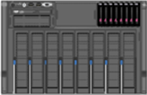
Some SQL Data Warehouses Today
What’s wrong with
this picture???
Get a Big SAN…
Connect it to the biggest Server you can get your hands on.
Hope for the best..

Slide 7
System out of balance !!!
This server CPUs can consume 16 GB/Sec of IO, but the SAN can only deliver 2 GB/Sec.
  Even when the SAN is dedicated to the SQL Data Warehouse, which it often isn’t.
  Lots of disks for Random IOPS BUT
  Limited controllers & Limited IO bandwidth
System is typically IO bound and queries are slow
  Despite significant investment in both Server and Storage
  Result. Disappointed customer turning to tuning to squeeze out a bit more performance.

Slide 8

Potential Performance Bottlenecks
SERVER
CPU CORES
WINDOWS
SQL SERVER
CACHE
FC SWITCH
DISK
DISK
FC
HBA
A
STORAGE
CONTROLLER
CACHE
A
B
LUN
A
A
B
B
DISK
DISK
FC
HBA
A
B
B
LUN
CPU Feed Rate
SQL Server
Read Ahead Rate
HBA Port Rate
Switch Port Rate
SP Port Rate
LUN Read Rate
Disk Feed Rate

Slide 9
The Appliance Engineering Approach
HP & MS Working as partners
Each solution matching and balancing four main elements
Driven by a fundamental understanding of the workload
Architecture followed by and supported by components
Workload
Architecture
Software
Hardware

Slide 10
The Alternative: A Balanced System
Design a server + storage configuration that can deliver all the IO bandwidth that CPUs can consume when executing a SQL Relational DW workload
Avoid sharing storage devices among servers
Avoid overinvesting in disk drives
  Focus on scan performance, not IOPS
Layout and manage data to maximize range scan performance and minimize fragmentation

Slide 11
What is Fast Track Data Warehouse?
A method for designing a cost-effective, balanced system for Data Warehouse workloads… An Architecture..
Reference hardware configurations developed in conjunction with hardware partners using this method.
Best practices for data layout, loading and management
Relational Database Only – Not SSAS, IS, RS

Slide 12





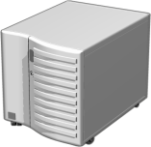
Fast Track Scope
Supporting Systems
BI Data Storage Systems
Presentation Layer Systems
Integration
Services ETL
Analysis Services
Cubes
Web Analytic Tools
Data Path
Reporting Services
Presentation Data
Presentation Data
SharePoint Services
Dedicated SAN, Storage Array
Microsoft Office SharePoint
Data Warehouse
PerformancePoint
Data Staging,
Bulk Loading
Excel Services
Reference Architecture Scope (dashed)

Slide 13






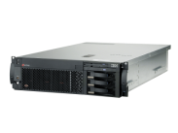


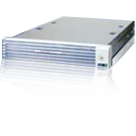


Fast Track Data Warehouse Vendors
Numerous SMP Reference Architectures
FT 2.0
FT 3.0
UCS + EMC

Slide 14

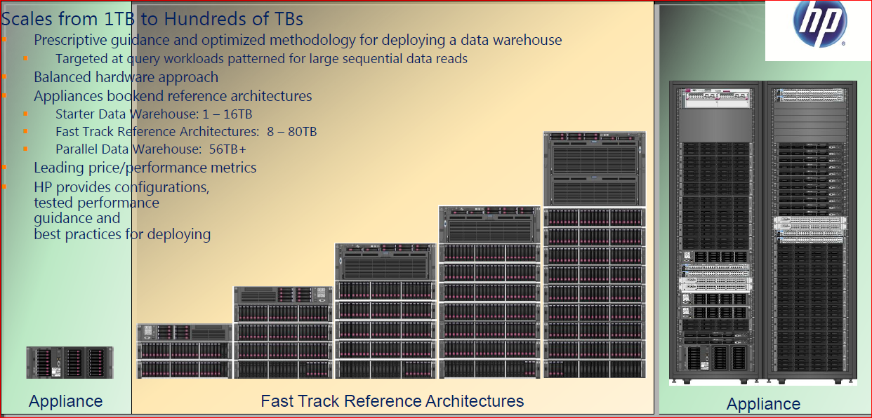
HP and Microsoft Fast Track 3.0
Data Warehousing Continuum: Fast Track G7/G3, Starter DW and PDW
Starter DW ProLiant DL370 (2P) Internal disks (1-6TB) Expansion (12-16TB) | Basic RA ProLiant DL38x (2P) MSA P2000 (8 – 30TB) | Mainstream RAs ProLiant DL58x (4P) MSA P2000 (20 – 60TB) | Premium RA ProLiant DL980 (8P) MSA P2000 (40 – 80TB) | Parallel Data Warehouse Per data rack: 11 x ProLiant DL360 (2P) 10 x MSA P2000 (56 – 125TB) Up to 4 data racks (up to 500TB)

Slide 15
Data Warehouse Workload Characteristics
Scan Intensive
Hash Joins
Aggregations
SELECT L_RETURNFLAG, L_LINESTATUS, SUM(L_QUANTITY) AS SUM_QTY,
SUM(L_EXTENDEDPRICE) AS SUM_BASE_PRICE,
SUM(L_EXTENDEDPRICE*(1-L_DISCOUNT)) AS SUM_DISC_PRICE,
SUM(L_EXTENDEDPRICE*(1-L_DISCOUNT)*(1+L_TAX))
AS SUM_CHARGE,
AVG(L_QUANTITY) AS AVG_QTY,
AVG(L_EXTENDEDPRICE) AS AVG_PRICE,
AVG(L_DISCOUNT) AS AVG_DISC,
COUNT(*) AS COUNT_ORDER
FROM LINEITEM
GROUP BY L_RETURNFLAG,
L_LINESTATUS
ORDER BY L_RETURNFLAG,
L_LINESTATUS

Slide 16
Technical Background
Show me The Math …
Balanced System - CPU
Determine your data consumption rate, per CPU core, for your query mix
  Simple example: Assume TPC-H query 2 is your average query
  Run the query on a test server with data fully cached in memory
    Execute parallel query using MAXDOP 4
    Observe 100% CPU on 4 cores
    Time the query and observe # pages read
      (Set Statistics IO on; Set Statistics Time on)
    Per Core Consumption = (# Logical Reads* 8K)/(CPU Time)

Slide 17
Or you can leave it to us…
We’ve measured a mix of TPC-H queries that reflect a ‘prototype’ Data Warehouse workload
Concluded that SQL Sever 2008 on current x64 cores consume ~300 MB/Sec per core on average for this workload
We use this as a basis for the published reference architectures
Your mileage will vary!
  For precise system sizing, measure your own workload
  POC may be required to demo..

Slide 18
Balanced System
Determine Storage Sizing
CPU core count and consumption rate for workload will determine # of controllers and enclosures need to provide aggregate throughput
# of controllers will determine minimum disk count for delivering the scan bandwidth
Determine desired per-disk capacity based on expected data volume
  Leave enough room for TempDB and for extra copies of the largest tables in the system, for maintenance activities

Slide 19
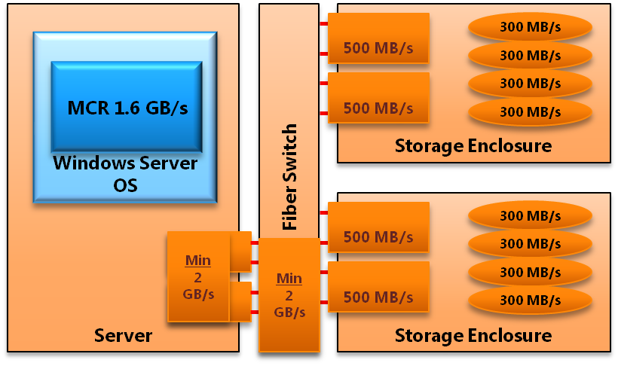
Balanced System
IO Stack
Maximum theoretical throughput for IO stack components sized for an 8 CPU core Fast Track system
Max. Real Throughput Values in a LAB will be slightly less.
Use a 2x quad-core server as a building block / starting point
Ensure that the per-core data consumption rate can be delivered by all elements of the IO stack
CPU Socket
(4 Core)
CPU Socket
(4 Core)

Slide 20
Using a Preconfigured Fast Track Reference Architecture
200 – 300 MB/sec per core for an ‘average’ DW workload
Equates to 800 MB/Sec enclosure per quad-core CPU
Estimate total bandwidth needed under query concurrency
  Derives CPU count
  Derives total Storage profile

Slide 21
Balanced System
Scaling the IO Stack out…
Storage Enclosure
Server
Fiber Switch
Storage Processor
RAID-1
RAID-1
CPU Socket
(4 Core)
CPU Socket
(4 Core)
Storage Processor
RAID-1
RAID-1
RAID-1
Storage Enclosure
CPU Socket
(4 Core)
CPU Socket
(4 Core)
Storage Processor
RAID-1
RAID-1
Storage Processor
RAID-1
RAID-1
RAID-1
CPU Socket
(4 Core)
CPU Socket
(4 Core)
Storage Enclosure
Storage Processor
RAID-1
RAID-1
Storage Processor
RAID-1
RAID-1
RAID-1
CPU Socket
(4 Core)
CPU Socket
(4 Core)
Storage Enclosure
Storage Processor
RAID-1
RAID-1
Storage Processor
RAID-1
RAID-1
HBA
RAID-1
Storage Enclosure
HBA
Storage Processor
RAID-1
RAID-1
Storage Processor
RAID-1
RAID-1
HBA
RAID-1
Storage Enclosure
HBA
Storage Processor
RAID-1
RAID-1
Storage Processor
RAID-1
RAID-1
HBA
RAID-1
Storage Enclosure
HBA
Storage Processor
RAID-1
RAID-1
Storage Processor
RAID-1
RAID-1
HBA
RAID-1
HBA
Storage Enclosure
Storage Processor
RAID-1
RAID-1
Storage Processor
RAID-1
RAID-1
RAID-1

Slide 22
Storage Layout Best Practices for SQL Server
Create a SQL data file per LUN, for every filegroup
TempDB filegroups share same LUNs as other databases
Log on separate disks, within each enclosure
  Striped using SQL Striping
  Log may share these LUNs with load files, backup targets

Slide 23
Storage Layout Best Practices for SQL Server
LUN 1
LUN 2
LUN 3
LUN16
Permanent FG
Permanant_DB
Permanent_1.ndf
Permanent_2.ndf
Permanent_3.ndf
Permanent_16.ndf
Stage Database
Stage FG
Stage_1.ndf
Stage_2.ndf
Stage_3.ndf
Stage_16.ndf
Local Drive 1
TempDB
TempDB.mdf (25GB)
TempDB_02.ndf (25GB)
TempDB_03ndf (25GB)
TempDB_16.ndf (25GB)
Log LUN 1
Permanent DB Log
Stage DB Log

Slide 24
How Scans are Optimized
SQL Server issues a large number of asynchronous read-ahead requests when performing scans
Attempts to issue I/O at rate needed to keep CPUs “busy”
Size of I/O issued is dependent on continuity of underlying data pages
  I/O size can be any multiple of 8K up to 512K
Average request size that will be issued by read-ahead operations can be determined by looking at
  avg_fragment_size_in_pages exposed by sys.dm_index_physical_stats

Slide 25
Techniques to Maximize Scan Throughput
–E startup parameter (2MB Extents and not mixed extents)
Minimize use of NonClustered indexes on Fact Tables
Load techniques to avoid fragmentation
  Load in Clustered Index order (e.g. date) when possible
Index Creation always MAXDOP 1, SORT_IN_TEMPDB
Isolate volatile tables in separate filegroup
Isolate staging tables in separate filegroup or DB
Periodic maintenance

Slide 26
Conventional data loads lead to fragmentation
Bulk Inserts into Clustered Index using a moderate ‘batchsize’ parameter
  Each ‘batch’ is sorted independently… causes fragmentation
Overlapping batches lead to page splits
1:31
1:32
1:33
1:34
1:35
1:31
1:36
1:32
1:37
1:33
1:38
1:34
1:39
1:35
1:40
Key Order of Index

Slide 27
Best Practices for loading
Use a heap
  Practical if queries need to scan whole partitions
or…Use a batchsize = 0
  Fine if no parallelism is needed during load
or…Use a Two-Step Load
  Load to a Staging Table (heap)
  INSERT-SELECT from Staging Table into Target CI
  Resulting rows are not fragmented
  Can use Parallelism in step 1 – essential for large data volumes

Slide 28
Other fragmentation best practices
Avoid Autogrow of filegroups
  Pre-allocate filegroups to desired long-term size
  Manually grow in large increments when necessary
Keep volatile tables in a separate filegroup
  Tables that are frequently rebuilt or loaded in small increments
If historical partitions are loaded in parallel, consider separate filegroups for separate partitions to avoid extent fragmentation

Slide 29
Parallel Data Warehouse
  Overview

Slide 30
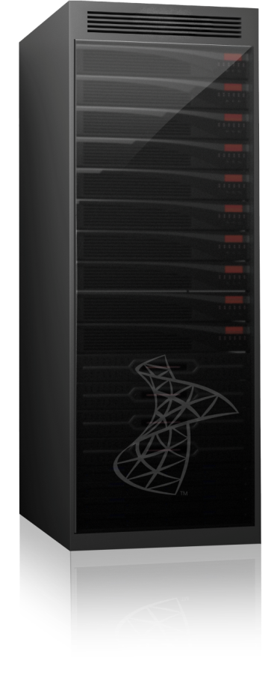
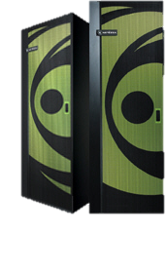
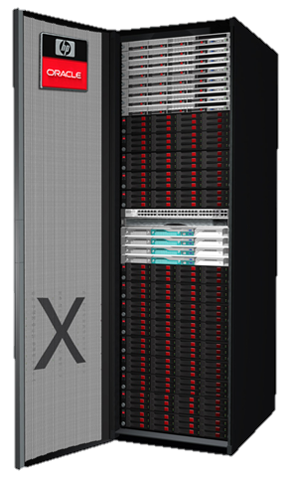
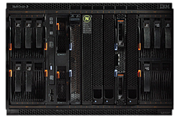
Data Warehouse appliances
A prepackaged or pre-configured balanced set of hardware (servers, memory, storage and I/O channels), software (operating system, DBMS and management software), service and support, sold as a unit with built-in redundancy for high availability positioned as a platform for data warehousing.

Slide 31


Parallel Data Warehouse Node
Compute Node Storage Node
Microsoft Confidential

Slide 32
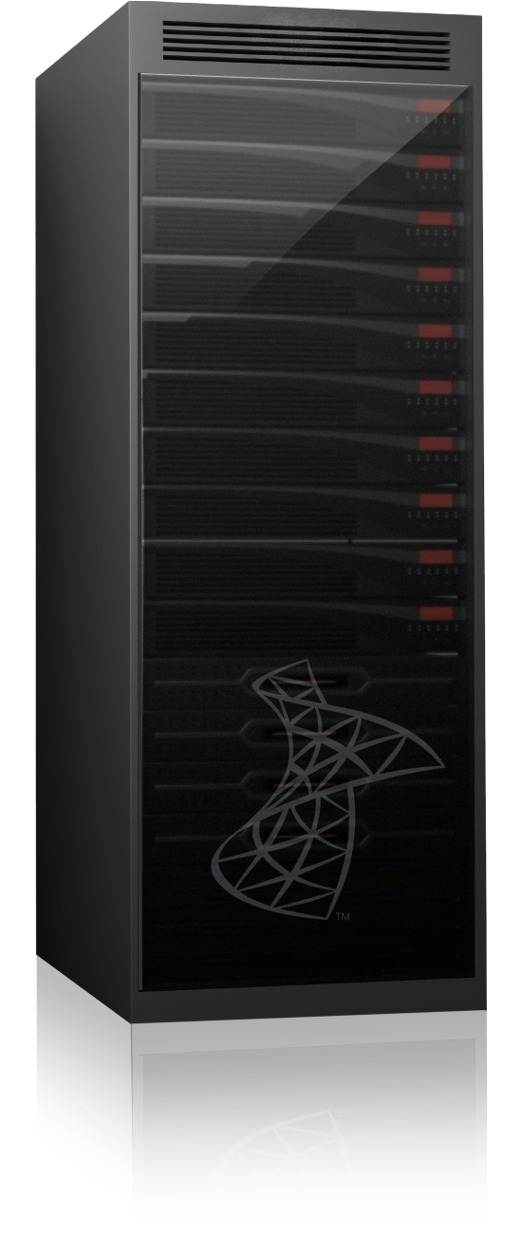



SQL Server Parallel Data Warehouse
A data warehouse appliance with massive scalability
High Scalability from 10s to 100s of TB
High scale through Massively Parallel Processing (MPP) system
Choice of hardware vendor
Low cost through commodity hardware
Deep integration with Microsoft BI
© 2010 Microsoft Corporation. Microsoft Materials - Confidential. All rights reserved. CITA # MSFT101120_A

Slide 33
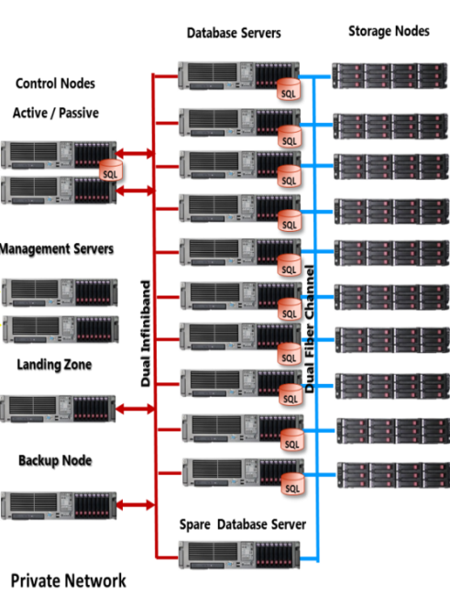

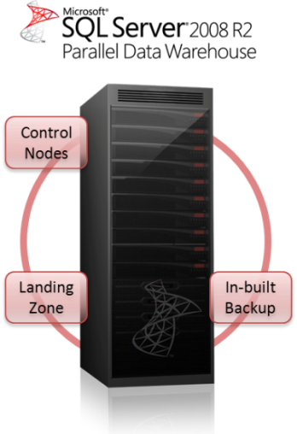
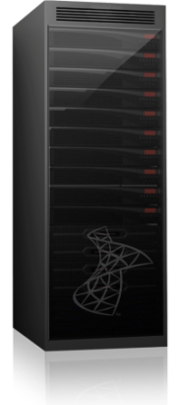

Parallel Data Warehouse
Control Rack
Data
Rack
Data Rack/s
Control Rack

Slide 34

Parallel Data Warehouse Appliance - Hardware Architecture
Corporate Network
Private Network
Database Servers
Storage Nodes
Control Nodes
Active / Passive
SQL
SQL
Client Drivers
SQL
SQL
SQL
Management Servers
SQL
Data Center
Monitoring
SQL
Dual Infiniband
Dual Fiber Channel
Landing Zone
SQL
ETL Load Interface
SQL
Backup Node
SQL
Corporate Backup
Solution
SQL
Spare Database Server

Slide 35
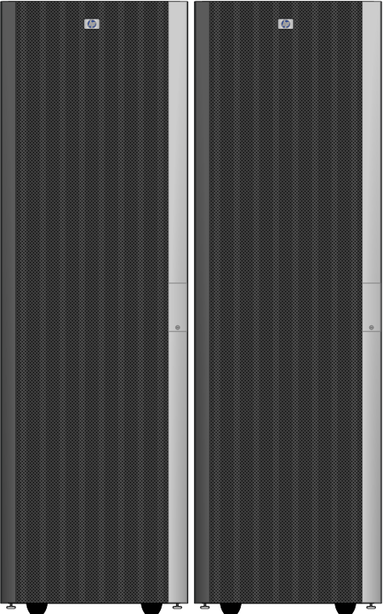

Parallel DW Appliance
Enterprise-class scalability at market-leading $/TB
Comprehensive functionality: Deep integration with Microsoft BI and comprehensive toolset for BI, ETL, MDM and streaming data
Powerful, flexible platform: Leading density, capacity, and performance per rack with choice of deployment options (MPP or SMP) for a range of SLA demands
Low-risk deployment: Optimized, pre-configured solution delivered by Factory Express backed by Tier 1 mission-critical support for low risk
SKUs | Components
Control rack | Servers | Controller supports parallel processing in data nodes
 | Storage | Tuned storage
 | Software | Microsoft SQL Server 2008 R2 Parallel Data Warehouse
 | Infrastructure | Infiniband, FC and Ethernet switching, 42u rack
 | Services | Software technical support
Data rack | Servers | Server & storage nodes support parallel processing
 | Storage | Storage optimized for DW workloads
 | Software | Microsoft SQL Server 2008 R2 Parallel Data Warehouse
 | Infrastructure | Infiniband, FC and Ethernet switching, 42u rack
 | Services | Solution support from basic to Mission Critical PDW Assessment Consulting Services
Expansion SKUs | Grow from 1 – 4 data racks, backup options, test/dev system

Slide 36
What is a Compute Node
Compute Node
SQL
A SQL Server 2008 instance
DB engine nodes autonomous on local data
SQL as primary interface
Each MPP node is a highly tuned SMP node with standard interfaces

Slide 37

Basic Physical DB Design in PDW
“Ultra Shared Nothing”
Larger Fact Table is Hash Distributed Across All Compute Nodes
Time Dim
Product Dim
Date Dim ID
Calendar Year
Calendar Qtr
Calendar Mo
Calendar Day
Prod Dim ID
Prod Category
Prod Sub Cat
Prod Desc
SF-1
SF-1
SF-1
SF-1
SQL
SF-1
SF-1
SF-1
SF-2
Sales Facts
SQL
Date Dim ID
Store Dim ID
Prod Dim ID
Mktg Camp Id
Qty Sold
Dollars Sold
SF-1
SF-1
SF-1
SF-3
SQL
SF-1
SF-1
SF-1
Mktg
Campaign Dim
SF-4
Store Dim
SQL
Store Dim ID
Store Name
Store Mgr
Store Size
Mktg Camp ID
Camp Name
Camp Mgr
Camp Start
Camp End

Slide 38
Basic Physical DB Design in PDW
“Ultra Shared Nothing”
Smaller Dimension Tables are Replicated on Every Compute Node
Time Dim
Product Dim
Date Dim ID
Calendar Year
Calendar Qtr
Calendar Mo
Calendar Day
Prod Dim ID
Prod Category
Prod Sub Cat
Prod Desc
TD
PD
SF-1
SF-1
SF-1
SD
MD
SF-1
SQL
SF-1
TD
PD
SF-1
SF-1
SF-2
Sales Facts
SQL
SD
MD
Date Dim ID
Store Dim ID
Prod Dim ID
Mktg Camp Id
Qty Sold
Dollars Sold
SF-1
TD
PD
SF-1
SF-1
SF-3
SQL
SD
MD
TD
PD
SF-1
SF-1
SF-1
Mktg
Campaign Dim
SF-4
Store Dim
SQL
SD
MD
Store Dim ID
Store Name
Store Mgr
Store Size
Mktg Camp ID
Camp Name
Camp Mgr
Camp Start
Camp End
Result: Fact -Dimension Joins can be performed locally

Slide 39
Control Node & Client Drivers
Client connections always go through the control node
  Clustered to a passive node
Contains no persistent user data
Processes SQL requests
Prepares execution plan
Orchestrates distributed execution
Local SQL Server to do final query plan processing / result aggregation

Slide 40
Landing Zone
Provides high capacity storage for data files from ETL processes
Integration services available on the landing zone
Connected to internal network
Available as sandbox for other applications and scripts that run on internal network.
Source
Landing Zone Files
Data Loader
Compute Nodes
Microsoft Confidential

Slide 41
Backup Node
Coordinated backup across the nodes
Quiesce write activity to synchronize
Database level backup
  Full or differential
  Metadata backup
Can restore to a larger appliance
Up to 524TB of capacity
  Available in XS, S, M, L and XL
Optional item – 1 size per config
Microsoft Confidential

Slide 42
Management Node
Management Node
  Runs the Windows domain controller (Active Directory)
  Used for deploying patches to all nodes in the appliance
  Holds images in case a node needs reimaging
Microsoft Confidential

Slide 43
PDW Software Architecture
Other 3rd Party Tools
MS BI
(AS, RS)
Nexus
Query Tool
Database Server (Compute Nodes)
Compute Nodes
Compute Nodes
DMS
JDBC
OLE-DB
ODBC
Ado.Net
IIS
SQL Server
Control Node
Admin Console
User Data
DMS
PDW Services
Landing Zone
DSQL
Core Engine Services
DMS Manager
DMS
Loader Client
SQL SSIS
SQL OS
Backup Node
SQL OS
DMS
SQL Server
DW Authentication
DW Configuration
DW
Queue
DW Schema
Management Node
HPC
AD

Slide 44
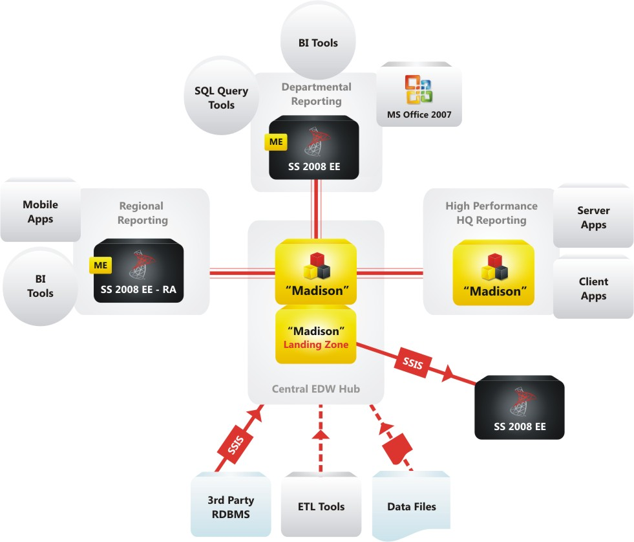

Integration with PDW:
“Hub and Spoke”
PDW
PDW
PDW

Slide 45
Hub-and-Spoke Benefits
Full SQL Server functionality
Distributes the workload
Allows existing/new data marts to be fully and easily integrated into the EDW
Better solution for customers than consolidation
‘Best of both worlds’ solution
Enables publishing
Expand and add spokes without impacting other users
Spokes can be budgeted
Microsoft Confidential

Slide 46
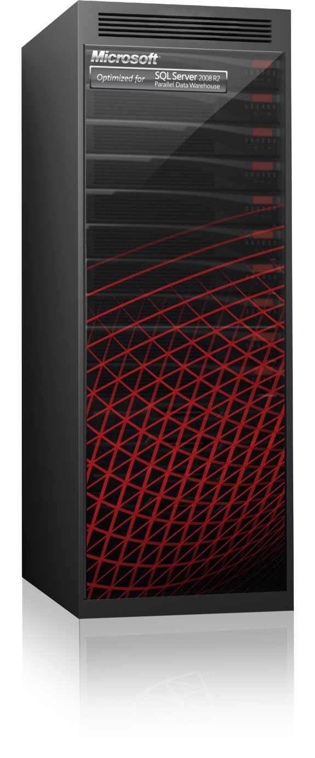


PDW Software Support offerings
With Microsoft SQL Server 2008 R2 Parallel Data Warehouse you can choose from two support packages:
  SA + Premier
  SA + Premier Mission Critical
SA + Premier provides core support
  Recommended for staging/test servers.
    First point of contact for support for the appliance (Microsoft collaborates with the hardware support group )
    Hardware maintenance provided by HP
    Remote Unlimited Break/Fix incidents
    New Product Version rights
    Appliance centric software servicing and support lifecycle
SA + Premier Mission Critical for appliances is designed to maximize business continuity for your most important of solutions:
  Recommended for production PDW appliances
  Maintain
    Dedicated Service Engineer (400hrs per year)
    PDW Health Check
  Restore
    30 minute response (priority phone number access)
    Enhanced Critical Situation escalation process
    Escalation Manager
    Executive incident visibility
    Faster access to the software engineering team

Slide 47

Enrol in Microsoft Virtual Academy Today
Why Enroll, other than it being free?
The MVA helps improve your IT skill set and advance your career with a free, easy to access training portal that allows you to learn at your own pace, focusing on Microsoft technologies.
What Do I get for enrolment?
Free training to make you become the Cloud-Hero in my Organization
Help mastering your Training Path and get the recognition
Connect with other IT Pros and discuss The Cloud
Where do I Enrol?
www.microsoftvirtualacademy.com
Then tell us what you think. TellTheDean@microsoft.com

Slide 48




Resources
www.msteched.com/Australia
  Sessions On-Demand & Community
www.microsoft.com/australia/learning
Microsoft Certification & Training Resources
http:// technet.microsoft.com/en-au
  Resources for IT Professionals
http://msdn.microsoft.com/en-au
  Resources for Developers

Slide 49

© 2010 Microsoft Corporation. All rights reserved. Microsoft, Windows, Windows Vista and other product names are or may be registered trademarks and/or trademarks in the U.S. and/or other countries.
The information herein is for informational purposes only and represents the current view of Microsoft Corporation as of the date of this presentation. Because Microsoft must respond to changing market conditions, it should not be interpreted to be a commitment on the part of Microsoft, and Microsoft cannot guarantee the accuracy of any information provided after the date of this presentation. MICROSOFT MAKES NO WARRANTIES, EXPRESS, IMPLIED OR STATUTORY, AS TO THE INFORMATION IN THIS PRESENTATION.

