Slide 1
Building Hybrid Apps with Dynamics CRM & Windows Azure
SESSION CODE: DEV-DYN-MID306
Guy Riddle & George Doubinski
Dynamics CRM MVP’s

Slide 2
Agenda
leverage cloud technologies to develop advanced business solutions with Microsoft Dynamics CRM
Through demonstrations, how to develop solutions that pull together Microsoft Dynamics CRM 2011, Windows Azure platform and customer portals

Slide 3



Types of Cloud Computing
Public cloud
Hybrid
Private cloud
Software as a service User Productivity
Platform as a service Rapidly Develop Apps
Infrastructure as a service Reduce Management
Reference: http://blogs.office.com/b/office_comics/archive/2011/03/25/the-cloud-marketing-new-office-comic.aspx

Slide 4
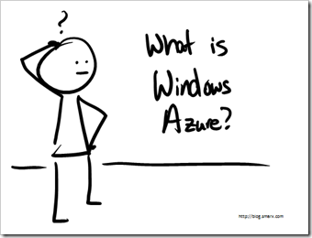
What is Windows Azure Platform really?
Windows Azure & SQL Azure
  Public Cloud Platform
AppFabric
  Hybrid Middleware
Virtual Machine Role
  Infrastructure Services
Data as a Service
  Data Market
Windows Azure “Connect”
  VPN into cloud!
… keeps growing
Utility: Pay for what you use
Reference: http://blog.smarx.com/posts/what-is-windows-azure-a-hand-drawn-video

Slide 5
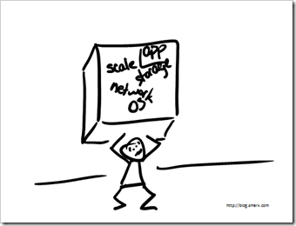
Life without the Cloud
Hardware & OS Maintenance
Deployment
Load balancing
Scalability
Performance
…
So Little Time for the Application!
Reference: http://blog.smarx.com/posts/what-is-windows-azure-a-hand-drawn-video

Slide 6


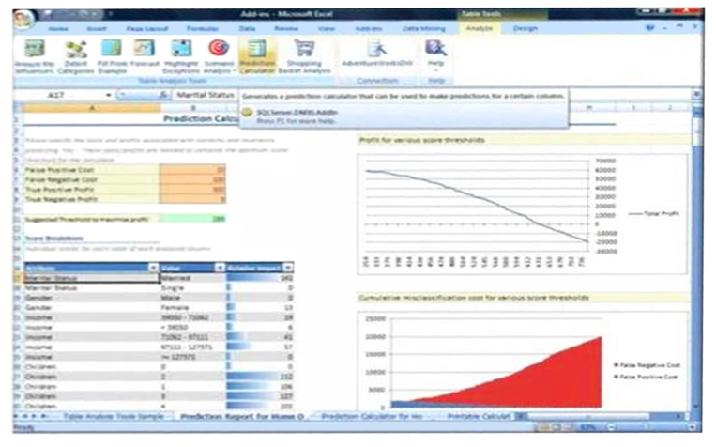











The Evolution From CRM to xRM
xRM= “Any”
Relationship Management
Partner Relationship
Management
Asset Management
Distributor Relationship
Management
Property Management
Reseller Relationship
Management
Fleet Management
Employee Relationship
Management
Case Management
Contractor Relationship
Management
Task Management
Customer Relationship
Management
Supplier Relationship
Management
Event Management
Rapid Application Development
Business Process Management
Business
Intelligence
Office and Web-based User Experiences
Shared Infrastructure
and Services

Slide 7
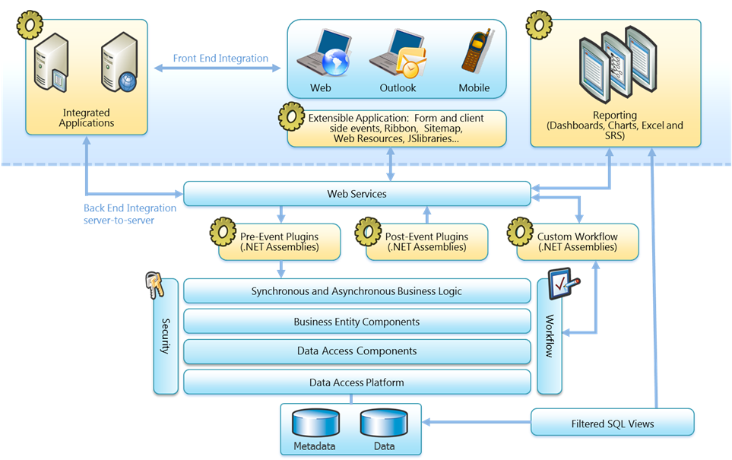
CRM 2011 Platform Architecture

Slide 8
CRM 2011 - for Developers
  .NET 4.0
  Flexible web services (WCF, REST)
  LINQ Provider
  ODATA service
  Web Resources
  Fetch XML for reporting
  Code “Sandbox” in hosted deployments
  Extended Event pipeline via Windows Azure
  Additional authentication methods

Slide 9
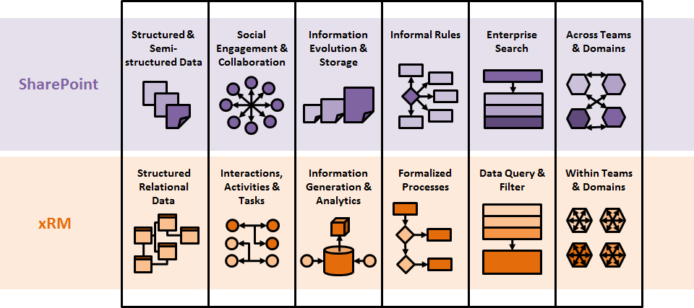
SharePoint and CRM are Complementary
Combined strengths cover broad business needs

Slide 10
Demonstration
Connecting from an Azure website to CRM
Connecting to CRM to SQL Azure

Slide 11



Windows Azure Virtual Network
Secure network connectivity between on-premises and cloud
  Supports standard IP protocols
Enables hybrid apps access to on-premises servers
Simple setup and management
  Web, Worker and VM Roles supported
Use cases include Windows Azure app domain-joined to corporate
Active Directory
Windows Azure
Enterprise

Slide 12
Demonstration
Using Windows Azure “Connect”
Domain joining an Azure Web Role

Slide 13
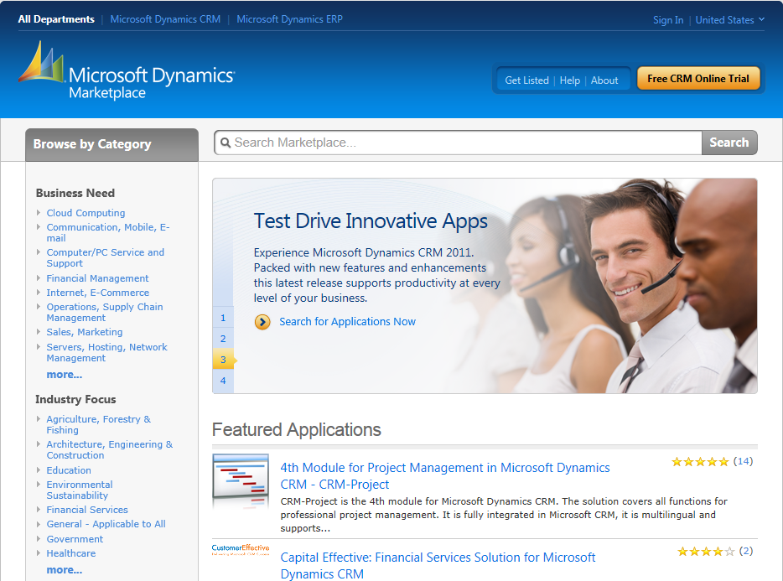
Dynamics Marketplace
http://dynamics.pinpoint.microsoft.com

Slide 14
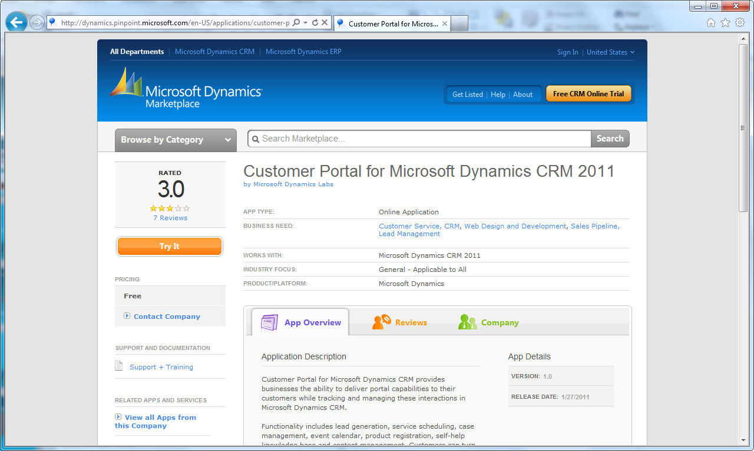
Portal Framework

Slide 15
Websites Powered by Azure & CRM Online
http://xrmvirtual.com
http://www.skibanff.com
http://www.techdays.ca
http://crm.dynamics.com

Slide 16
Demonstration
Azure Portal working with CRM

Slide 17




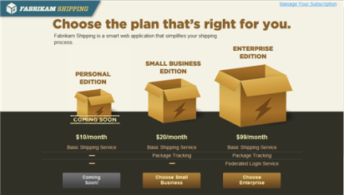





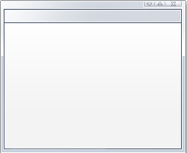






Authenticating Users from Web and Social Providers
Sign-up and claims enrichment

Slide 18
Demonstration
Multiple Portal Sign-On Mechanisms
Access Control Service 2.0

Slide 19
Resources
Developer Training Kits
Presentations, Hands-on Labs & Videos
Whitepapers
Building business apps with CRM 2011
Comparing xRM & Force.com
CRM 2011 Training Kit
Windows Azure Training Kit

Slide 20

Enrol in Microsoft Virtual Academy Today
Why Enroll, other than it being free?
The MVA helps improve your IT skill set and advance your career with a free, easy to access training portal that allows you to learn at your own pace, focusing on Microsoft technologies.
What Do I get for enrolment?
Free training to make you become the Cloud-Hero in my Organization
Help mastering your Training Path and get the recognition
Connect with other IT Pros and discuss The Cloud
Where do I Enrol?
www.microsoftvirtualacademy.com
Then tell us what you think. TellTheDean@microsoft.com

Slide 21




Resources
www.msteched.com/Australia
  Sessions On-Demand & Community
www.microsoft.com/australia/learning
Microsoft Certification & Training Resources
http:// technet.microsoft.com/en-au
  Resources for IT Professionals
http://msdn.microsoft.com/en-au
  Resources for Developers

Slide 22

© 2010 Microsoft Corporation. All rights reserved. Microsoft, Windows, Windows Vista and other product names are or may be registered trademarks and/or trademarks in the U.S. and/or other countries.
The information herein is for informational purposes only and represents the current view of Microsoft Corporation as of the date of this presentation. Because Microsoft must respond to changing market conditions, it should not be interpreted to be a commitment on the part of Microsoft, and Microsoft cannot guarantee the accuracy of any information provided after the date of this presentation. MICROSOFT MAKES NO WARRANTIES, EXPRESS, IMPLIED OR STATUTORY, AS TO THE INFORMATION IN THIS PRESENTATION.

