Slide 2
Over the Fence
Designer Developer workflow
SESSION CODE: DEV203
Jordan & Alex Knight
Directors
Xamling

Slide 3




Jordan Knight
The Developer
Owner of
Microsoft MVP – Silverlight
http://blog.webjak.net

Slide 4


Alex Knight
The Designer
Owner of
Microsoft MVP – Silverlight
Creator of Silverzine.com

Slide 5
Agenda
What’s the problem
  Designers and Developers at war
What is DDW?
Solutions
  How can we fix it
Live Example

Slide 6


What’s the problem

Slide 7

What is Designer/Developer workflow?
The Design
Photoshop Files
JPGs
Wireframes
The Application
User Interface
Code
Final Product

Slide 8

The old way is no good…

Slide 9
The times, they are a-changin’
Silverlight and the Expression suite solve the problem using technology
  And convention/guidance
  Check out a document called “The New Iteration”
  XAML (interface mark-up) – separates interface from developer code ← It all begins here…

Slide 10
Why is this good for Designers?
Holy crap, I’m building an app!
Completely in control of UI and animation
Nudge Nudge Nudge
Developers won’t hate us as much now!

Slide 11
Why is this good for Developers?
Brain don’t hurt no more
Forces good development practice
Concentrate on code
Designers won’t hate us as much now
  Ok, so they might, no promises

Slide 12


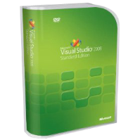

Choose the best method for you!
Designer/Integrator/Developer method
Designer
Developer
New role created
Designer creates assets
Developer creates logic
Integrator merges the two
Integrator
Final Product

Slide 13



Choose the best method for you!
Designer/Integrator/Developer method
Harvest Model
Designer create assets and the developer integrates them
Designer still has overall control of the interaction side of the project
Designer doesn’t need a developer environment to work.
Designer
Developer
Final Product

Slide 14
Choose the best method for you!
Designer/Integrator/Developer method
Collaboration Model
Designer works directly on the project
Has full control of the interface design and overall experience
Nudge, Nudge, Nudge.
Stream lines development process
Designer
Developer
Final Product

Slide 15

Changes to the roles
For Designers
Learn what impact your work has from a software perspective
Learn the tools (Visual Studio, Code repositories
For Developers
Embrace Expression Blend (for the designers sake)
Make you code ‘blendable’

Slide 16
How Silverlight/WPF help with this
Built from the ground up to support DDW
Allows designers to have full control over the design and user experience
Allows developers to focus on the logic behind the application
Most of all! – Speeds up the process

Slide 17
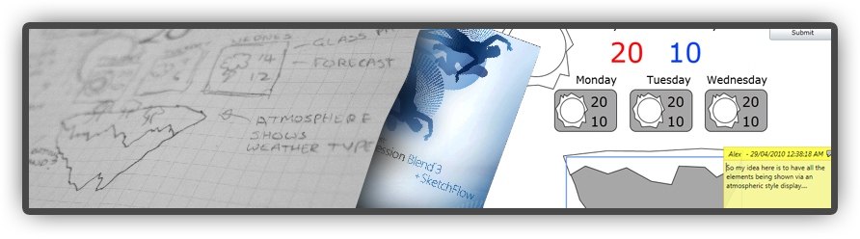
Wireframes and naming conventions
Create detailed wireframes of the application
  Check out sketchflow for rapid prototyping
Working out naming conventions is important for keeping everyone on the same page.

Slide 18
Setting up your project
Work out how each style will be implemented
  Themes
  Resource dictionaries
It not only makes it easier to work with, but helps with changes in the future
Viewable in Blend
Make sure no UI elements are created from C#

Slide 19
Let’s build something!

Slide 20
Questions?
Last minute stuff
Know your tools
Consider the people you are working with
Always keep close contact

Slide 21
Contact us
Jordan Knight
Jordan@xamling.net
Blog.webjak.net
@jakkaj
Alex Knight
Alex@xamling.net
www.Silverzine.net
@agkdesign

Slide 22

Enrol in Microsoft Virtual Academy Today
Why Enroll, other than it being free?
The MVA helps improve your IT skill set and advance your career with a free, easy to access training portal that allows you to learn at your own pace, focusing on Microsoft technologies.
What Do I get for enrolment?
Free training to make you become the Cloud-Hero in my Organization
Help mastering your Training Path and get the recognition
Connect with other IT Pros and discuss The Cloud
Where do I Enrol?
www.microsoftvirtualacademy.com
Then tell us what you think. TellTheDean@microsoft.com

Slide 23




Resources
www.msteched.com/Australia
  Sessions On-Demand & Community
www.microsoft.com/australia/learning
Microsoft Certification & Training Resources
http:// technet.microsoft.com/en-au
  Resources for IT Professionals
http://msdn.microsoft.com/en-au
  Resources for Developers

Slide 24

© 2010 Microsoft Corporation. All rights reserved. Microsoft, Windows, Windows Vista and other product names are or may be registered trademarks and/or trademarks in the U.S. and/or other countries.
The information herein is for informational purposes only and represents the current view of Microsoft Corporation as of the date of this presentation. Because Microsoft must respond to changing market conditions, it should not be interpreted to be a commitment on the part of Microsoft, and Microsoft cannot guarantee the accuracy of any information provided after the date of this presentation. MICROSOFT MAKES NO WARRANTIES, EXPRESS, IMPLIED OR STATUTORY, AS TO THE INFORMATION IN THIS PRESENTATION.

