Slide 1
#auteched
#dev213
Advanced Solutions with Visual Studio® LightSwitch™
Andrew Coates Microsoft
blogs.msdn.com/acoat @coatsy

Slide 2
The simplest way to create
business applications
for the desktop and the cloud

Slide 3
The LightSwitch Development Experience
Start
Refine
Extend
Describe your data
Author business logic
Explore ecosystem components
Create screens for common tasks
Customise screen layouts
Create custom Silverlight controls
Define custom queries
Integrate with custom data sources

Slide 4
Introduction to LightSwitch
demo

Slide 5
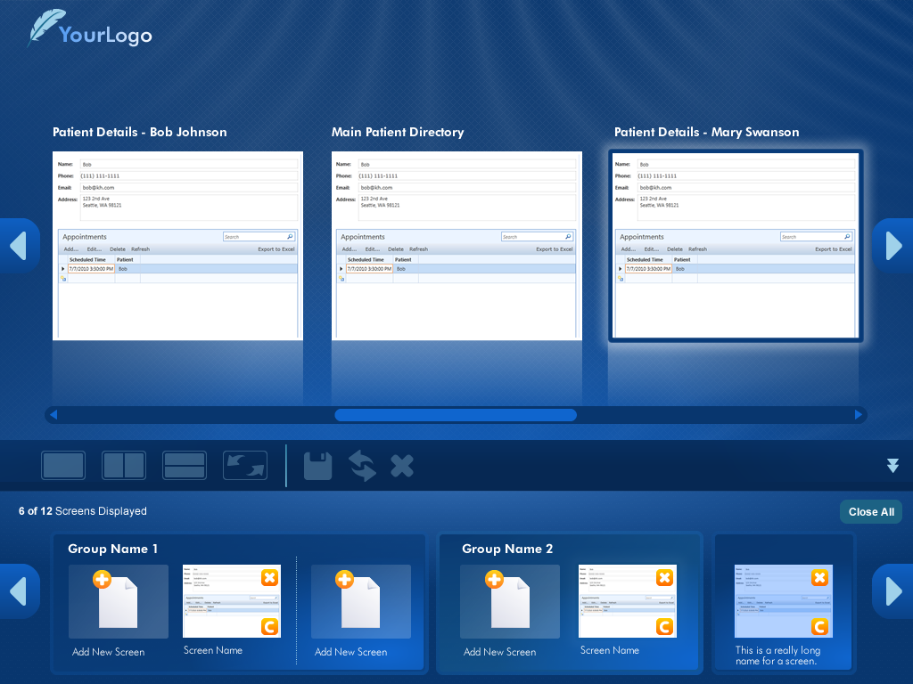
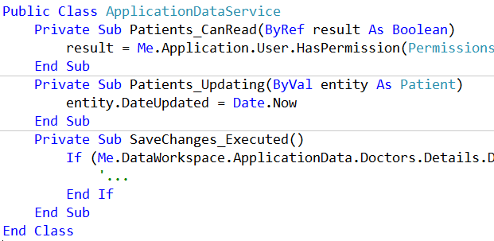
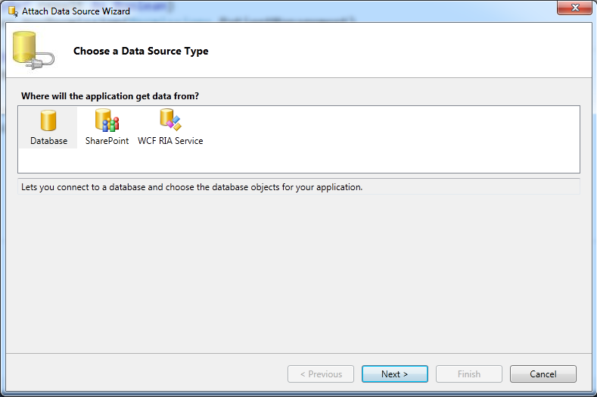
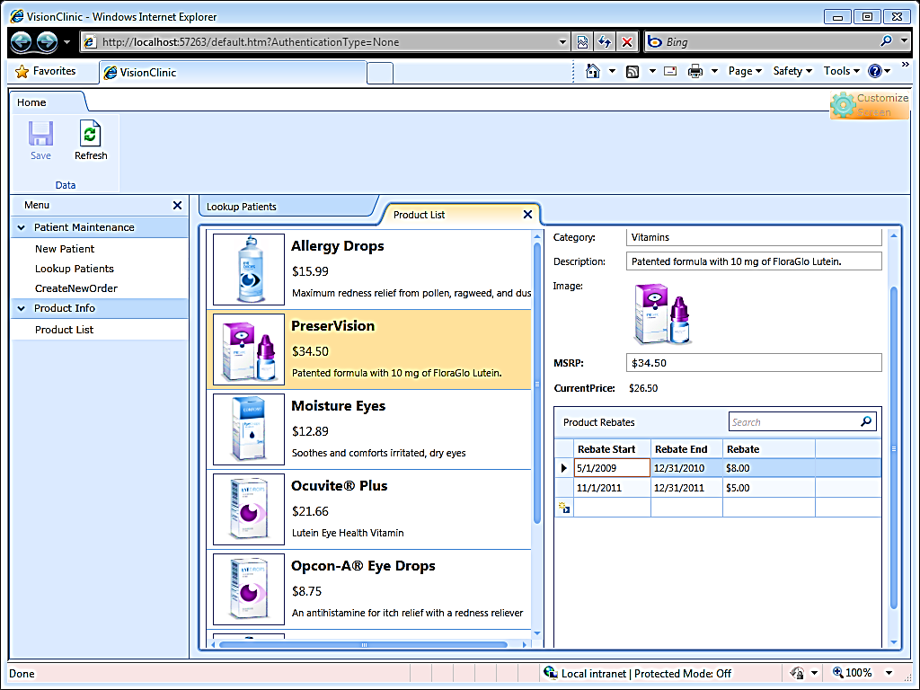
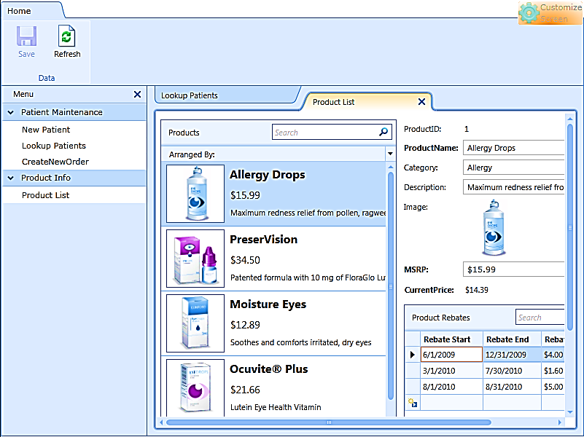
LightSwitch Architecture
Client Tier
Middle Tier
Data Access
Screens
Methods
Controls
Submit Pipeline
Queries
Data Workspace
Data Workspace
WCF RIA Services
WCF RIA Services
Other
SQL Server
SQL Azure
Silverlight 4.0
ASP.NET 4.0
SharePoint
Browser Host
Desktop Host
IIS 6.0/7.0

Slide 6
LightSwitch Building Blocks
LightSwitch
VS Pro
Ecosystem
Screens
Custom WCF Services
Data Providers
Queries
Silverlight Controls
Custom Controls
Entities
Screen Templates
Business Logic
Application Themes
Application Shells
Business Types

Slide 7
The LightSwitch Development Experience
Start
Refine
Extend
Describe your data
Author business logic
Explore ecosystem components
Create screens for common tasks
Customise screen layouts
Create custom Silverlight controls
Define custom queries
Integrate with custom data sources

Slide 8
The LightSwitch Development Experience
Start
Refine
Extend
Describe your data
Author business logic
Explore ecosystem components
Create screens for common tasks
Customise screen layouts
Create custom Silverlight controls
Define custom queries
Integrate with custom data sources

Slide 9
Advanced Customization
demo

Slide 10
With just LightSwitch
Advanced LightSwitch APIs
Silverlight and .NET frameworks
Custom screen layouts & screen workflows
Save pipeline, validation & access control hooks
Complex & composite LINQ queries
Access to client & server project code
COM Interop
Publish to IIS or Windows Azure

Slide 11
With VS Pro
… all of that plus
Custom controls
Data sources
LightSwitch Extensions

Slide 12
The LightSwitch Development Experience
Start
Refine
Extend
Describe your data
Author business logic
Explore ecosystem components
Create screens for common tasks
Customise screen layouts
Create custom Silverlight controls
Define custom queries
Integrate with custom data sources

Slide 13
The LightSwitch Development Experience
Start
Refine
Extend
Describe your data
Author business logic
Explore ecosystem components
Create screens for common tasks
Customise screen layouts
Create custom Silverlight controls
Define custom queries
Integrate with custom data sources

Slide 14
Consuming Extensions
demo

Slide 15
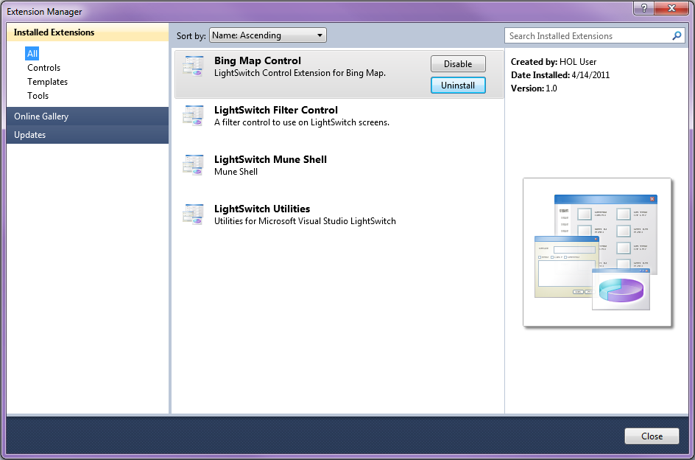
Installing Extensions
LightSwitch developers install extensions via Extension Manager
Or just click on the VSIX package to install

Slide 16
The LightSwitch Development Experience
Start
Refine
Extend
Describe your data
Author business logic
Explore ecosystem components
Create screens for common tasks
Customise screen layouts
Create custom Silverlight controls
Define custom queries
Integrate with custom data sources

Slide 17
The LightSwitch Development Experience
Start
Refine
Extend
Describe your data
Author business logic
Explore ecosystem components
Create screens for common tasks
Customise screen layouts
Create custom Silverlight controls
Define custom queries
Integrate with custom data sources

Slide 18
Integrating a Custom Silverlight Control
demo

Slide 19
LightSwitch Extension Points
Design-time
Client
Middle Tier
Screen Templates
Business Types
Controls
Controls
Themes
Shells

Slide 20
LightSwitch Extensibility
Core Extension Points
Shell: Outer chrome, Windowing, Navigation, etc.
Theme: Color, Style, Shape of individual elements
Business Type: Validation, Presentation of common business elements
Screen Template: Single and multi-screen UI patterns
Data Sources: Access to traditional or service based data
Controls: UI widgets within a screen
Can be packaged individually or combined

Slide 21
Building LightSwitch Extensions
demo

Slide 22
Requirements for Building LightSwitch Extensions
VS 2010 Pro (or higher) + SP1
VS LightSwitch 2011
VS 2010 SP1 SDK (For building VSIX packages)
LightSwitch Extensibility Toolkit
http://msdn.microsoft.com/lightswitch
Upload to VS Gallery
http://visualstudiogallery.msdn.microsoft.com/

Slide 23
Deploying to Windows Azure
demo

Slide 24
Win LightSwitch Clothing!
Tweet http://aka.ms/lsmsau #auteched #lightswitch
LightSwitch T-shirt*
Install the LS trial and show the booth staff
LightSwitch Hoodie*
Deploy a LightSwitch App to Azure and tweet URL
LightSwitch Jacket#
* While Stocks Last # Five jackets available

Slide 25
The simplest way to create
business applications
for the desktop and the cloud

Slide 26
Related Content
DEV201 Introducing Visual Studio LightSwitch
Online at http://australia.teched.com sometime soon-ish
Developer Area Demos
Friday 11:00
Friday 12:30

Slide 27
Next Steps
MSDN LightSwitch Developer Center http://msdn.com/lightswitch
LightSwitch Team Blog
Download LightSwitch Trial
Download the LightSwitch Training Kit
Visit the LightSwitch Forums on MSDN

Slide 28
My Contact Information
andrew.coates@microsoft.com
http://blogs.msdn.com/acoat
http://twitter.com/coatsy
TechQuest Coast to Coates

Slide 29
Question & Answer Session

Slide 30
Complete an Evaluation online and enter to WIN prizes!

Slide 31
© 2011 Microsoft Corporation. All rights reserved. Microsoft, Windows, Windows Vista and other product names are or may be registered trademarks and/or trademarks in the U.S. and/or other countries.
The information herein is for informational purposes only and represents the current view of Microsoft Corporation as of the date of this presentation. Because Microsoft must respond to changing market conditions, it should not be interpreted to be a commitment on the part of Microsoft, and Microsoft cannot guarantee the accuracy of any information provided after the date of this presentation. MICROSOFT MAKES NO WARRANTIES, EXPRESS, IMPLIED OR STATUTORY, AS TO THE INFORMATION IN THIS PRESENTATION.

