Slide 2
Adding Value to Software Projects with VSTO
SESSION CODE: DEV304
Jake Ginnivan
T: @JakeGinnivan
B: jake.ginnivan.net

Slide 3
Open Source
FunnelWeb
MSTest Contrib
DbUp
VSTOContrib

Slide 4
Agenda
Introduction to VSTO
Developing with VSTO
Improving Testability & Maintainability

Slide 5
Terminology
IoC – Inversion of Control
DI – Dependency Injection
Technical Debt
STA/MTA – Single/Multi Threaded Appartments

Slide 6
VSTO?
Office Interop
Unmanaged/ COM Interop
Office Automation
VSTO
Allows hosting of Managed Add-ins
Managed Code

Slide 7
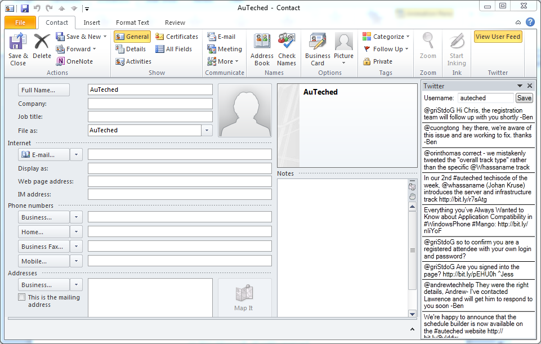
Adding value - Integration

Slide 8
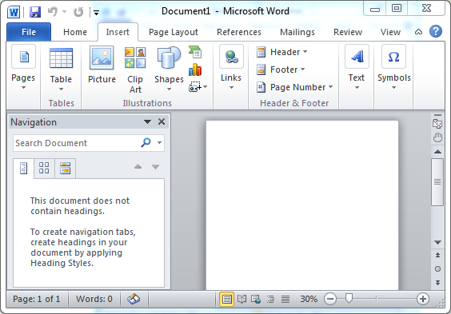
Views, Contexts and Features

Slide 9
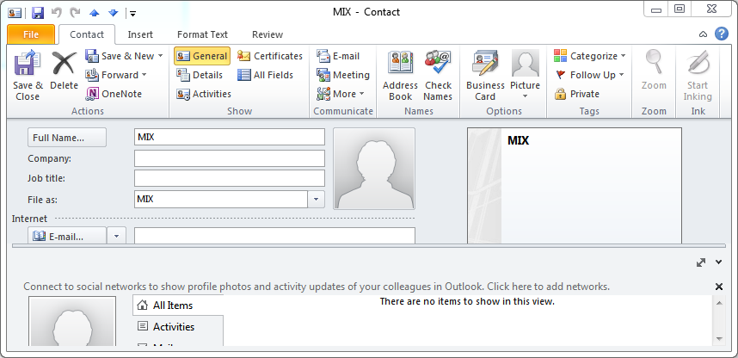
Views, Contexts and Features

Slide 10
Views, Contexts and Features
DEMO

Slide 11
Rules to better VSTO Development
Follow SOLID development principals
Put logic in different project
Understand basics of COM Interop

Slide 12
COM Interop
Unmanaged
Managed
IUnknown
IDispatch
COM Object
RCW
INew
.NET Client
INew

Slide 13
COM Interop
System.Runtime.InteropServices
Marshal.ReleaseComObject()
Marshal.FinalReleaseComObject()
Marshal.IsComObject()
Marshal.GetIUnknown/IDispatch

Slide 14
COM Interop
Managed Process Boundary
Multiple Managed Clients
Non – Deterministic Lifetime
(follows Garbage Collector rules)
.NET Client
.NET Client 2
.NET Client 3
Marshal.ReleaseComObject
RCW
Internal Marshalling Count = 2
Internal Marshalling Count = 3
Internal Marshalling Count = 1
Managed Code
Single Reference count
Unmanaged Code
COM Object
Deterministic Lifetime
(follows COM rules)
Ref Count = 1

Slide 15
COM Interop
3 Rules
(To save you pain)

Slide 16
Code!
Out of the box experience

Slide 17
Ribbon Designer
Pros
Context
Easy, no magic string
Designer Support
Cons
Error Handling Sucks
Encourages Code behind
Limited Features

Slide 18
Ribbon XML
Pros
Flexible/Powerful
More features
Faster
Cons
Single Callback File
No context
Limited hooks

Slide 19
A Better Way?
IoC Container Support
Simplified/Maintainable Model
Testable, Clean Code

Slide 20
Code!
VSTO Contrib – Ribbon Factory

Slide 21
Code!
VSTO Contrib – COM Helpers

Slide 22
Next Steps/Resources
http://vstocontrib.codeplex.com/
http://jake.ginnivan.net/tagged/vsto
http://blogs.msdn.com/b/vsto/
http://msdn.microsoft.com/en-us/office/hh133430

Slide 23
Enrol in Microsoft Virtual Academy Today
Why Enroll, other than it being free?
The MVA helps improve your IT skill set and advance your career with a free, easy to access training portal that allows you to learn at your own pace, focusing on Microsoft technologies.
What Do I get for enrolment?
Free training to make you become the Cloud-Hero in my Organization
Help mastering your Training Path and get the recognition
Connect with other IT Pros and discuss The Cloud
Where do I Enrol?
www.microsoftvirtualacademy.com
Then tell us what you think. TellTheDean@microsoft.com

Slide 24
© 2010 Microsoft Corporation. All rights reserved. Microsoft, Windows, Windows Vista and other product names are or may be registered trademarks and/or trademarks in the U.S. and/or other countries.
The information herein is for informational purposes only and represents the current view of Microsoft Corporation as of the date of this presentation. Because Microsoft must respond to changing market conditions, it should not be interpreted to be a commitment on the part of Microsoft, and Microsoft cannot guarantee the accuracy of any information provided after the date of this presentation. MICROSOFT MAKES NO WARRANTIES, EXPRESS, IMPLIED OR STATUTORY, AS TO THE INFORMATION IN THIS PRESENTATION.

