Slide 2
Heterogeneous Development with Visual Studio 2010
SESSION CODE: #DEV307
Mitch Denny
Chief Technology Officer
Readify

Slide 3
Agenda
What are we going to talk about?
Define: Heterogeneous
Software Development Silos
Professional Preference
Benefits of a Unified ALM Platform
Demo: Team Explorer Everywhere
Beyond Eclipse?
Tips and Tricks
Q&A

Slide 4
Define: Heterogeneous
When a company runs multiple different versions of Windows?
  XP
  Vista
  Windows 7
  Windows Phone

Slide 5
Reality Check
My first “build master gig” targeted:
  Windows (multiple versions)
  AIX
  HPUX
  Solaris
  Linux (multiple distributions)
We used:
  Classic ASP
  Java
  Perl
We achieved it through:
  Blood, sweat, tears, and lots of swearing.

Slide 6
Software Development Silos
Heterogeneous Development with Visual Studio 2010

Slide 7

Version
Control
if your development silo only does version control…

Slide 8

Version
Control
Build
Automation
version control + just CI isn’t much better

Slide 9

alm:
Work Management
Version
Control
Build
Automation
Test Automation
Release Management
Reporting and Analytics

Slide 10
Professional Preference
Heterogeneous Development with Visual Studio 2010

Slide 11
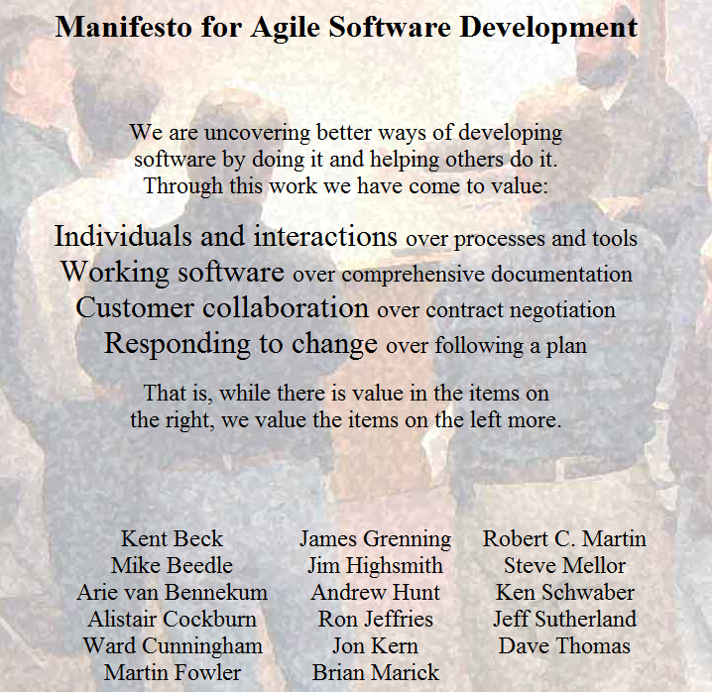
source: http://agilemanifesto.org/

Slide 12
Agile Manifesto (revised)
VALUE MORE
STILL IMPORTANT
Individuals and interactions.
Working software.
Customer collaboration.
Responding to change.
Processes and tools.
Comprehensive documentation.
Contract negotiation.
Following a plan.

Slide 13
Benefits of a Unified ALM platform
Heterogeneous Development with Visual Studio 2010

Slide 14
Individuals and Interactions
User Stories
Tasks
Risks
Sprints
Work Management
Version
Control
Build
Automation
Test Automation
Release Management
Reporting and Analytics

Slide 15

A great agile tool …
don’t forget the
humble whiteboard

Slide 16

but …
distributed collaboration is a reality.

Slide 17
... whiteboard data corruption.
;(
don’t forget the
humble whiteboard

Slide 18
Working Software
Work Management
Version
Control
Build
Automation
Test Automation
Release Management
Reporting and Analytics

Slide 19
Customer Collaboration
Work Management
Version
Control
Build
Automation
Test Automation
Release Management
Reporting and Analytics
Sprint Burndown
Release Burndown
Velocity

Slide 20

give your business users the ability to make informed decisions

Slide 21
Responding to Change
User Stories
Tasks
Risks
Sprints
Work Management
Version
Control
Build
Automation
Test Automation
Release Management
Reporting and Analytics
Sprint Burndown
Release Burndown
Velocity

Slide 22
Team Explorer Everywhere
Heterogeneous Development with Visual Studio 2010

Slide 23
Demo
Work Item Tracking
Version Control
Build Automation

Slide 24
Beyond Eclipse?
Heterogeneous Development with Visual Studio 2010

Slide 25

it is a really game of ALM cluedo…

Slide 26



Eclipse
Team Explorer
Team Build

Slide 27




Team Build?
Xcode
SVN Bridge
Web Access

Slide 28
Tips and Tricks
Heterogeneous Development with Visual Studio 2010

Slide 29
Tips and Tricks
Publish your ALM standards to teams to use.
Automate as much as possible.
Document reusable recipes for build automation etc.
Don’t let target platform become the reason for creating multiple team projects.
Don’t forget the TEE CLI!!!

Slide 30
Question & Answer Session

Slide 31
Resources
To help you with your ALM journey.
Version Control & Build Automation
  http://readify.net/resources/guidance
Team Explorer Everywhere Download (Trial)
  http://www.microsoft.com/download/en/details.aspx?id=4240
Martin Woodward’s blog
  http://www.woodwardweb.com/

Slide 32
Resources (cont’d)
To help you with your ALM journey.
Version Control & Build Automation
  http://readify.net/resources/guidance
Team Explorer Everywhere Download (Trial)
  http://www.microsoft.com/download/en/details.aspx?id=4240
Martin Woodward’s blog
  http://www.woodwardweb.com/

Slide 33

Enrol in Microsoft Virtual Academy Today
Why Enroll, other than it being free?
The MVA helps improve your IT skill set and advance your career with a free, easy to access training portal that allows you to learn at your own pace, focusing on Microsoft technologies.
What Do I get for enrolment?
Free training to make you become the Cloud-Hero in my Organization
Help mastering your Training Path and get the recognition
Connect with other IT Pros and discuss The Cloud
Where do I Enrol?
www.microsoftvirtualacademy.com
Then tell us what you think. TellTheDean@microsoft.com

Slide 34




Resources
www.msteched.com/Australia
  Sessions On-Demand & Community
www.microsoft.com/australia/learning
Microsoft Certification & Training Resources
http:// technet.microsoft.com/en-au
  Resources for IT Professionals
http://msdn.microsoft.com/en-au
  Resources for Developers

Slide 35

© 2010 Microsoft Corporation. All rights reserved. Microsoft, Windows, Windows Vista and other product names are or may be registered trademarks and/or trademarks in the U.S. and/or other countries.
The information herein is for informational purposes only and represents the current view of Microsoft Corporation as of the date of this presentation. Because Microsoft must respond to changing market conditions, it should not be interpreted to be a commitment on the part of Microsoft, and Microsoft cannot guarantee the accuracy of any information provided after the date of this presentation. MICROSOFT MAKES NO WARRANTIES, EXPRESS, IMPLIED OR STATUTORY, AS TO THE INFORMATION IN THIS PRESENTATION.

