Slide 2
THE FUTURE OF C#: GOOD THINGS COME TO THOSE WHO ‘Await’
SESSION CODE: DEV411
Joseph Albahari

Slide 3
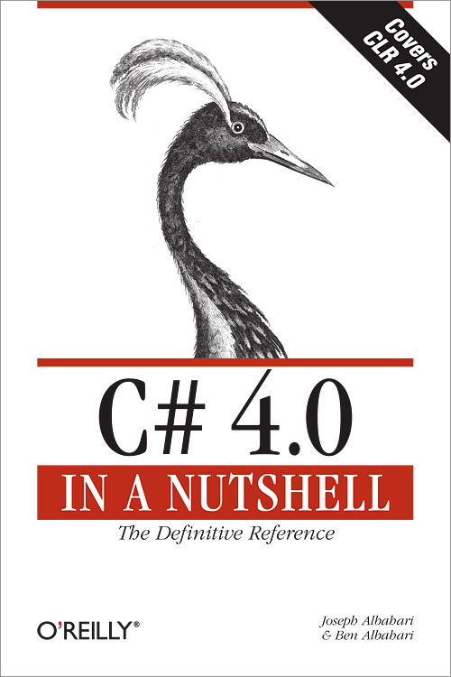
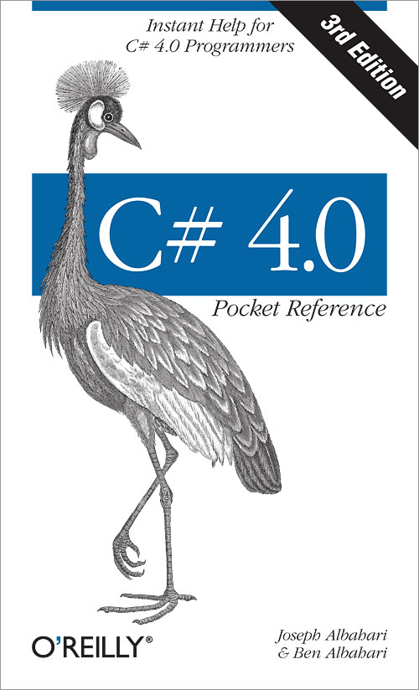
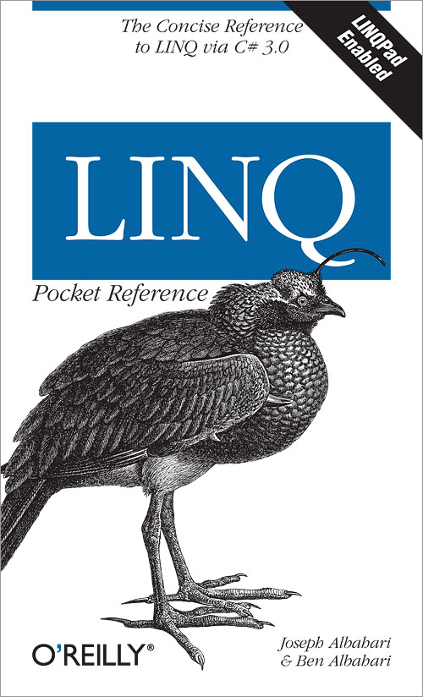

Joe Albahari
www.albahari.com

Slide 4
Asynchronous Programming is the theme of C# 5

Slide 5
Lines of Code – Async Old vs. New

Slide 6
Cyclomatic Complexity – Async Old vs. New

Slide 7


Part1: all about asynchronous programming
Part2: deep dive

Slide 8
History of C#
C# 1
  RTM
C# 2
  Generics
C# 3
  LINQ
C# 4
  Dynamic Programming
CLR 4
  Parallel Programming

Slide 9
Concurrency
Parallel Programming
Latency
Task Parallel Library
PLINQ
Async Functions (C# 5)
Rx
FW 4.0
vNext
Imperative
Functional
Imperative
Functional

Slide 10
Latency is Becoming More of an Issue
Growth of Internet / Cloud Systems
Users demand responsive UIs
Latency has two sources
  Compute-bound
  I/O-bound

Slide 11
What are “Asynchronous Functions” in C# 5?
New language feature in C# / VB (vNext)
Deployable CTP
Patches Compiler, but not CLR
Small DLL
Transparent language support for continuations
Makes asynchronous programming easy

Slide 12

“We’re here to help!”

Slide 13

“Your call is important to us.
Please hold the line!”

Slide 14
“Please enter your phone number and press #”

Slide 15


“We’ll call you back”
20 minutes later…
Continuation
Callback

Slide 16
Sync vs. Async
Synchronous call | Asynchronous call
Caller WAITS for method to complete | Method returns immediately to caller, and executes callback (continuation) when complete
“Blocking” | “Non-blocking”

Slide 17
Speakerphone Concurrency | True Asynchronous Call
Caller manages concurrency | Callee manages concurrency
Caller spins up another thread | No threads required (if I/O bound)
– and WAITS on that thread | No waiting
No callback/continuation required | Callback/continuation usually required

Slide 18
Async Advantages
Allows greater efficiency/scalability
  Avoids blocking threads
Caller is freed from plumbing code
Caller is (usually) freed from thread safety issues
Can abstract concurrency

Slide 19

Waiting is a Synchronous Activity!
If you’re waiting, you’re not doing asynchronous programming!
What’s the asynchronous equivalent of waiting?

Slide 20
What would the simplest possible asynchronous method look like?

Slide 21
string GetWebPage (string uri)
{
...
...
}
void Test()
{
string html = GetWebPage(“...”);
Console.WriteLine (html);
}

Slide 22
void GetWebPageAsync (
string uri,
Action<string> continuation)
{
...
...
}
void Test()
{
GetWebPageAsync(“...”, Console.WriteLine);
}

Slide 23
Task<string> GetWebPageAsync (string uri)
{
...
...
}

Slide 24
Task<TResult> is a
value-added signaling construct
Task<TResult>
Result property
Exception property
ContinueWith() method

Slide 25
Task<string> GetWebPageAsync (string uri)
{
...
...
}
void Test()
{
GetWebPageAsync(“...”).ContinueWith (task =>
Console.WriteLine (task.Result));
}

Slide 26
string GetWebPage (string uri)
{
...
...
}
void Test()
{
for (int i = 0; i < 5; i++)
{
string html = GetWebPage(“...”);
Console.WriteLine (html);
}
}

Slide 27
Task<string> GetWebPageAsync (string uri)
{
...
...
}
int _i = 0;
void Test()
{
GetWebPageAsync(“...”).ContinueWith (task =>
{
Console.WriteLine (task.Result);
if (++_i < 5) Test();
});
}

Slide 28
Task<string> GetWebPageAsync (string uri)
{
...
...
}
async void Test()
{
for (int i = 0; i < 5; i++)
{
string html = await GetWebPageAsync(“...”);
Console.WriteLine (html);
}
}

Slide 29
Continuations are the Root Cause of Evil!
Continuations and imperative code don’t mix!
This is why we need C# language support
aka asynchronous functions

Slide 30
Demos
LINQPad Demo
VS Project Demo

Slide 31
Question & Answer Session
Part1: all about asynchronous programming

Slide 32
Part2: deep dive
Async functions & TCS
Compiler translations
Parallel operations
Asynchronous Lambdas
Combinators
Rx interop

Slide 33

Thinking asynchronously
Stop thinking in terms of threads!
Program synchronously,
then await instead of
waiting

Slide 34
Guidelines
As a rule, await asynchronous methods
If you await, make your method asynchronous (return a Task)
Don’t block

Slide 35
More Demos
Sockets Demo
Animation Demo

Slide 36
Asynchronous Patterns
APM (Asynchronous Programming Model)
EAP (Event-Based Asynchronous Pattern)
TAP (Task-Based Asynchronous Pattern)

Slide 37
Task-Based Asynchronous Pattern
Very Simple!
Just one method
Asynchronous methods should:
  have a name ending in ‘Async’
  return a Task<TResult>
  (optionally) accept CancellationToken
  (optionally) accept IProgress

Slide 38
Conclusion
Asynchronous functions make it easy to do genuine asynchronous programming
Start applying the TAP now
Consider consuming AsyncCtpLibrary.dll now

Slide 39
Resources
CTP: download from MS (search “async CTP”)
MS Async CTP Forum (search “async CTP forum”)
LINQPad Interactive Async Tutorial (click, ‘download more samples’ from LINQPad)

Slide 40
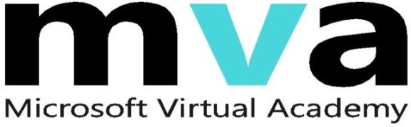
Enrol in Microsoft Virtual Academy Today
Why Enroll, other than it being free?
The MVA helps improve your IT skill set and advance your career with a free, easy to access training portal that allows you to learn at your own pace, focusing on Microsoft technologies.
What Do I get for enrolment?
Free training to make you become the Cloud-Hero in my Organization
Help mastering your Training Path and get the recognition
Connect with other IT Pros and discuss The Cloud
Where do I Enrol?
www.microsoftvirtualacademy.com
Then tell us what you think. TellTheDean@microsoft.com

Slide 41

© 2010 Microsoft Corporation. All rights reserved. Microsoft, Windows, Windows Vista and other product names are or may be registered trademarks and/or trademarks in the U.S. and/or other countries.
The information herein is for informational purposes only and represents the current view of Microsoft Corporation as of the date of this presentation. Because Microsoft must respond to changing market conditions, it should not be interpreted to be a commitment on the part of Microsoft, and Microsoft cannot guarantee the accuracy of any information provided after the date of this presentation. MICROSOFT MAKES NO WARRANTIES, EXPRESS, IMPLIED OR STATUTORY, AS TO THE INFORMATION IN THIS PRESENTATION.

