Slide 2
Microsoft Lync 2010: How to Go Big in Voice
SESSION CODE: EXL309
SBrendan Carius
Principal Consultant
Kloud Solutions
elvan Loganathan
Lync Technology Specialist - Voice
Microsoft

Slide 3
Session Takeaways and Objectives
Understand the Lync Enterprise Voice features and capabilities
Understand the paths available to best move
you or your customer forward with Enterprise Voice
Importance of deployment methodology to successfully deploy Enterprise Voice

Slide 4


Lync – Expect the Best
“Microsoft Lync Server 2010 passed an aggressive SIP Load Torture Test without dropping any calls or reporting errors in the 4,000,000 call attrition test. This sustained operation without error is the best we have seen to date for any Unified Communications / IP PABX product we have tested.”
Miercom (January 2011)

Slide 5
Lync PABX Replacement

Slide 6
Lync Permanent Coexistence

Slide 7







Lync as a Phone
Full set of critical IP-PABX features
Broad choice of cost effective 3rd party phones
Designed for high availability and voice resiliency
Leverages Active Directory, Exchange,
and other existing infrastructure
Anywhere Access
VoIP
PSTN Calling
Departmental Features
E-911
Least Cost Routing
PABX & Network Interoperability
Lync to Lync calling
Lync to Phone calling
Enterprise Calling Features
On Site Networking

Slide 8

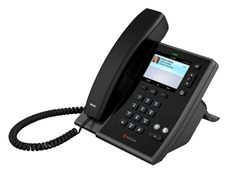
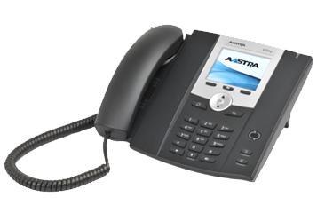
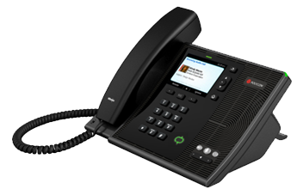

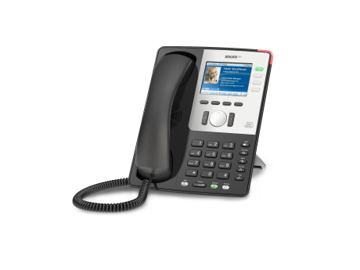
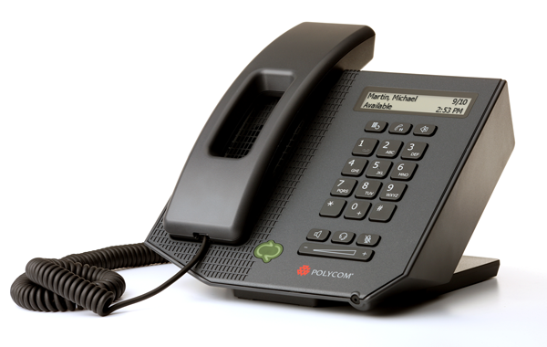


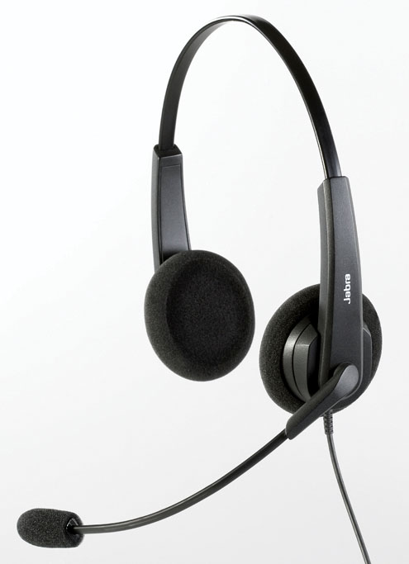



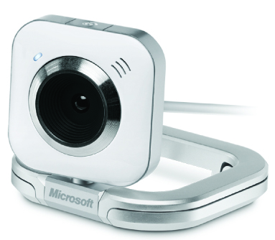
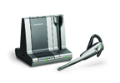
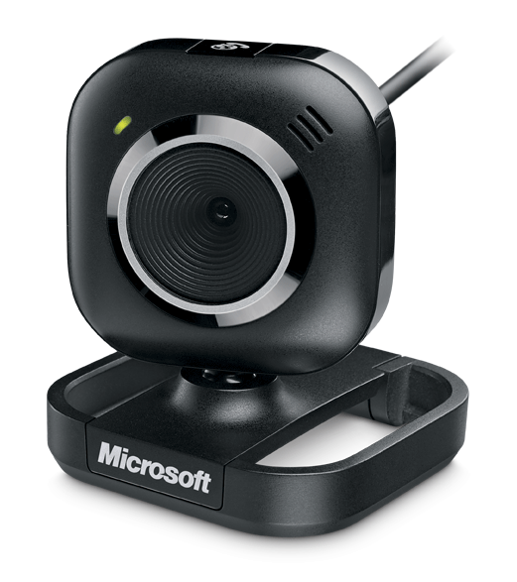
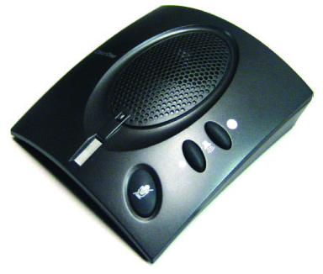

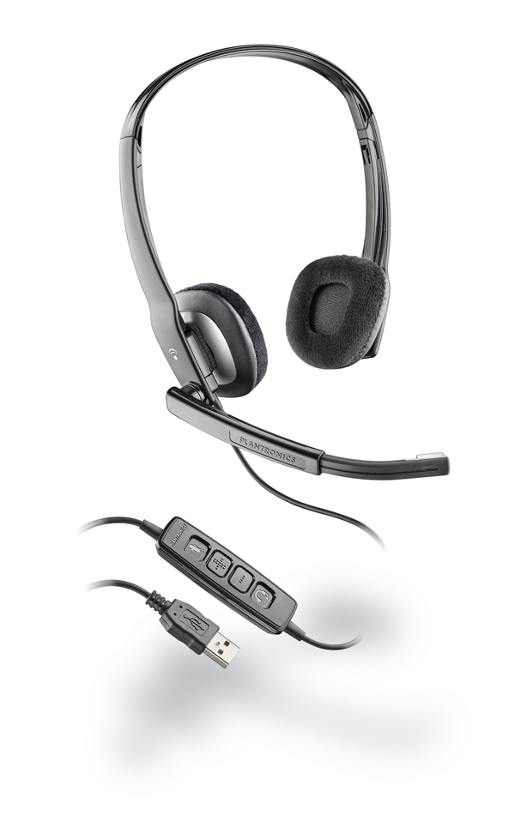

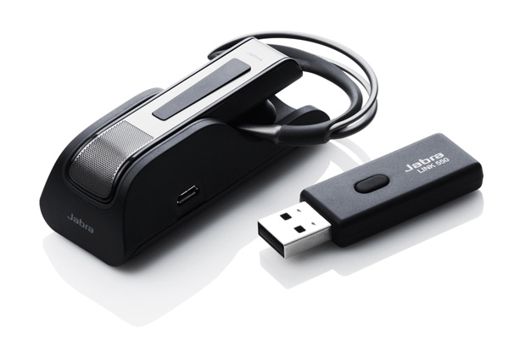
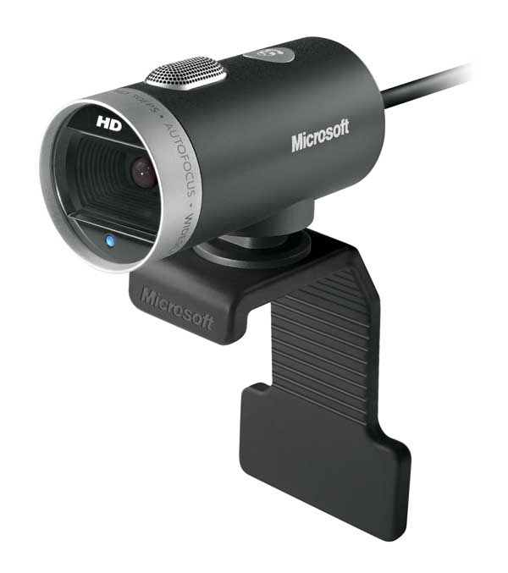


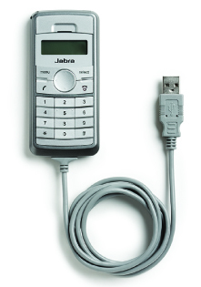



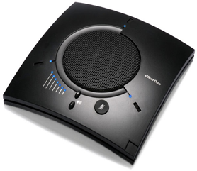
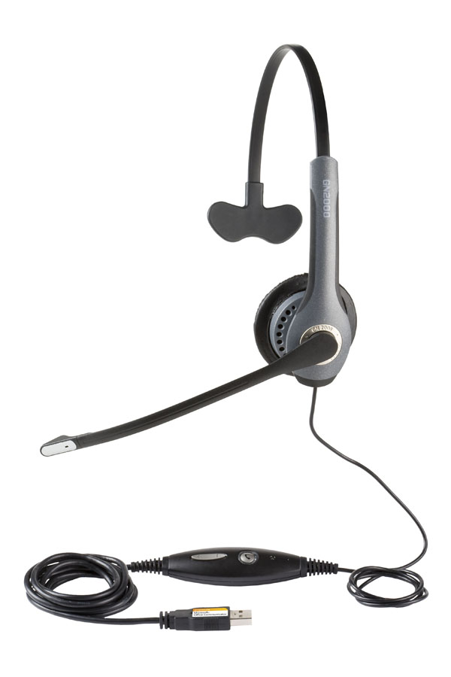

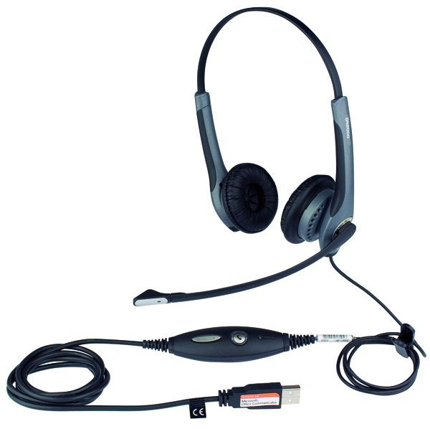


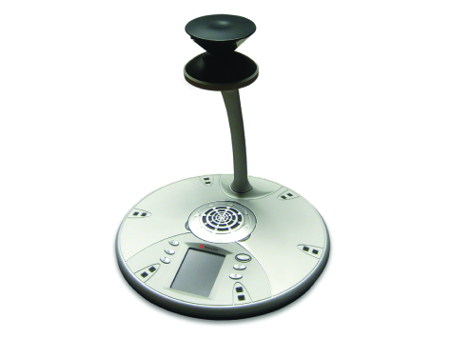
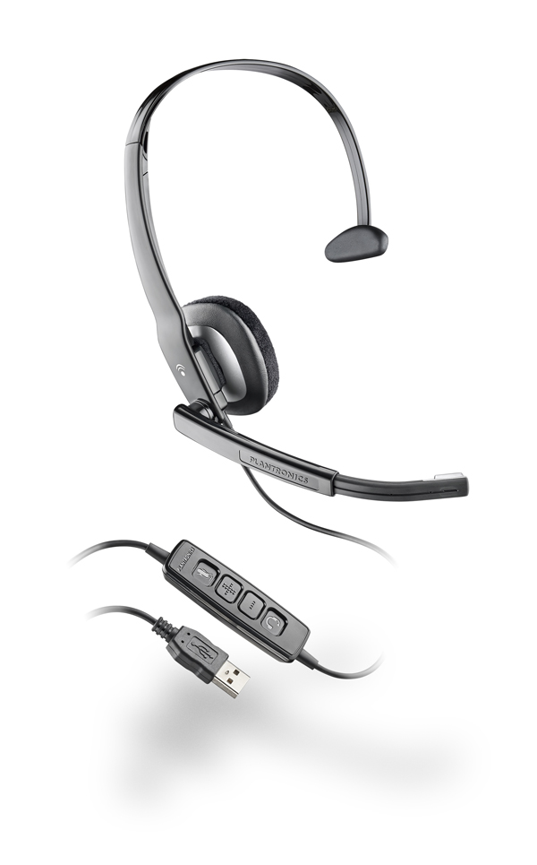

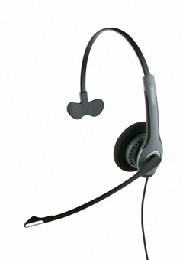









Lync as a Phone
Snom 821
Snom 300
Aastra 6721 iP
Polycom CX600
Aastra 6725 iP
Polycom CX500
$100+
$150-200
$200-300

Slide 9
Go Big with Voice
"Our goal is Enterprise Wide UC as soon as practical"
Replace the PABX
Connect with the PABX
“We love Lync, but I can’t replace everything yet….”
“Lync is our presence platform, but all telephony will remain on the PABX”
Retain the PABX

Slide 10
Retain the PABX
Remote Call Control
PABX Plug-ins to Lync
Call control remains resident on PABX.
Remote Call Control
  Lync controls PABX station set and reflects binary phone presence.
PABX Plug-ins to Lync
  Lync client is the host to a largely headless PABX client

Slide 11
Replace the PABX
Transition from PABX
Media Gateways / SIP Trunks
PABX becomes obviated
Call Routing
  Gateway or legacy PABX controls call routing to Lync and to PSTN
Gateway
  Consider benefits of deploying in front of PABX
  Consider benefits of deploying behind PABX
Determine connectivity to PABX
  Consider intra-PABX call volumes

Slide 12
Connect with the PABX
Direct SIP to IP-PABX
Gateway to TDM PABX
Who moves?
  Locations: Main site first, may make numbering easier.
  Depreciation: Old equipment / stations go first, new ones later.
PABX stays resident
  Does it make sense to reconfigure or replace the Emergency and other analogue phones?
Connectivity
  Newer IP-PABX: Direct SIP
  Old TDM PABX (the big lumps of tin with 4MB RAM): Media Gateway

Slide 13
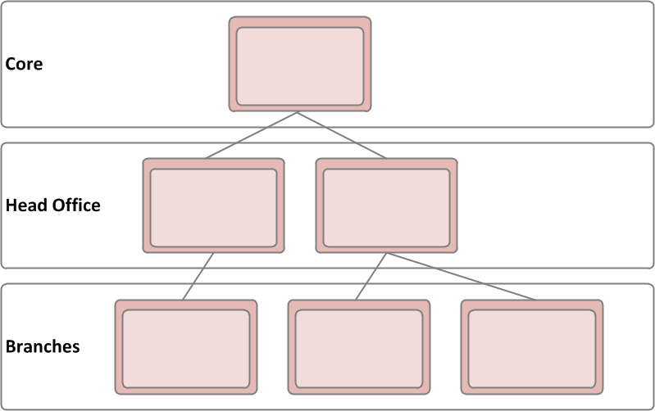
Lync Design Principles
A Core
  A single data centre location
  High availability components within the core
  Scalable to cater for all customer sites
  Centralised management
Head Offices
  Survivable infrastructure to cater for core and/or WAN down
  Minimal administration and management
  Efficient media flow
  Replaceable in the event of failure
Branch Offices
  If required survivable infrastructure to cater for core and/or WAN down
  Low cost units
  Minimal administration and management
  Efficient media flow
  Replaceable units in the event of failure
  Reuse existing branch infrastructure and servers

Slide 14
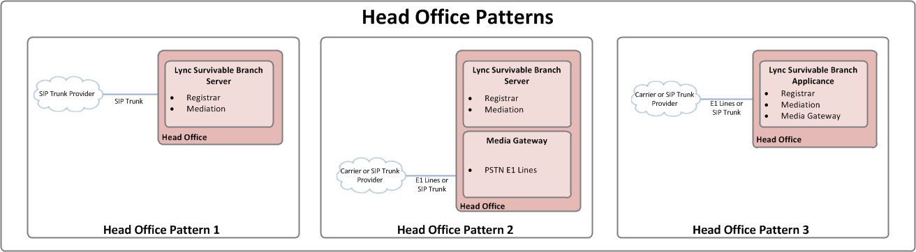
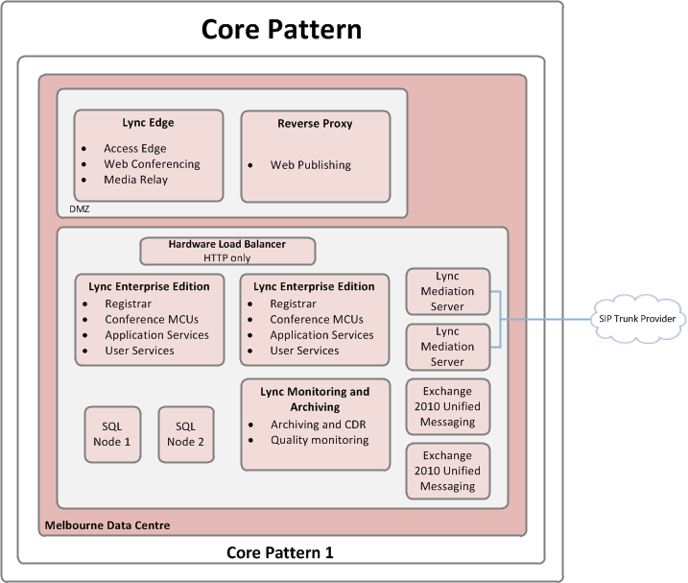
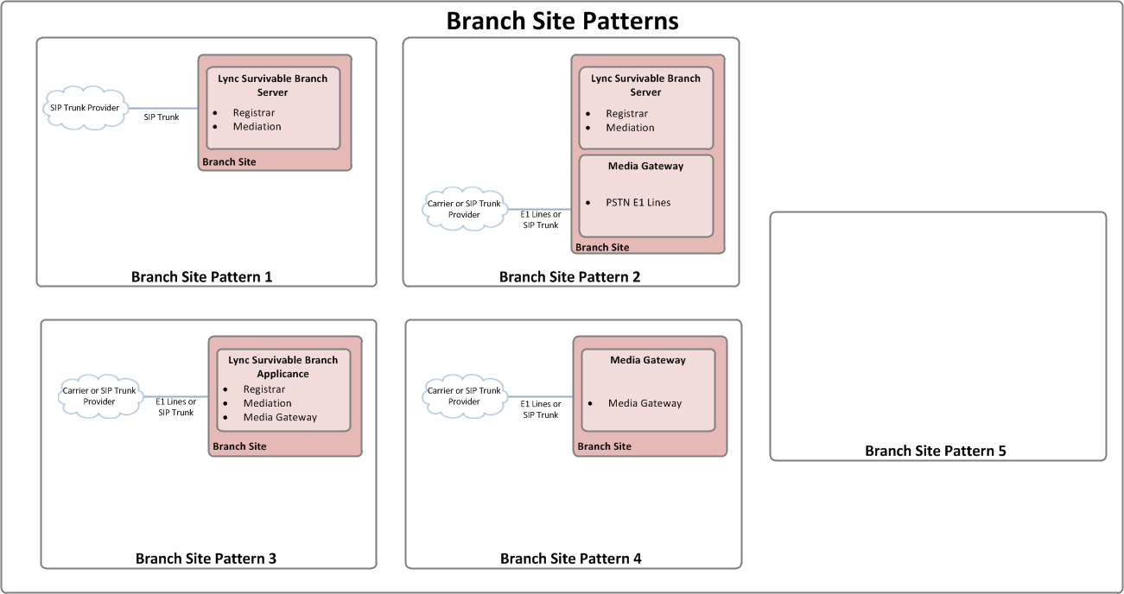
Lync Design Patterns

Slide 15
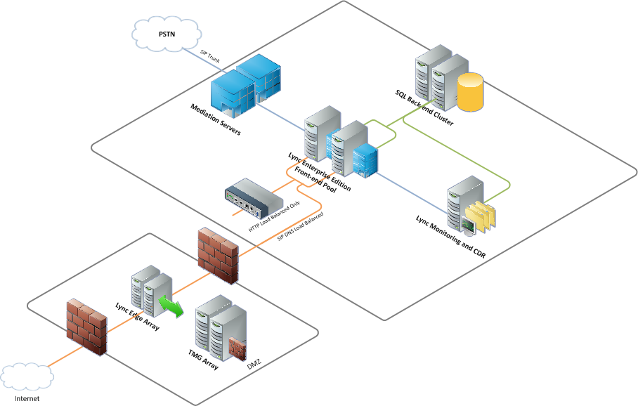
Build the Lync Core

Slide 16
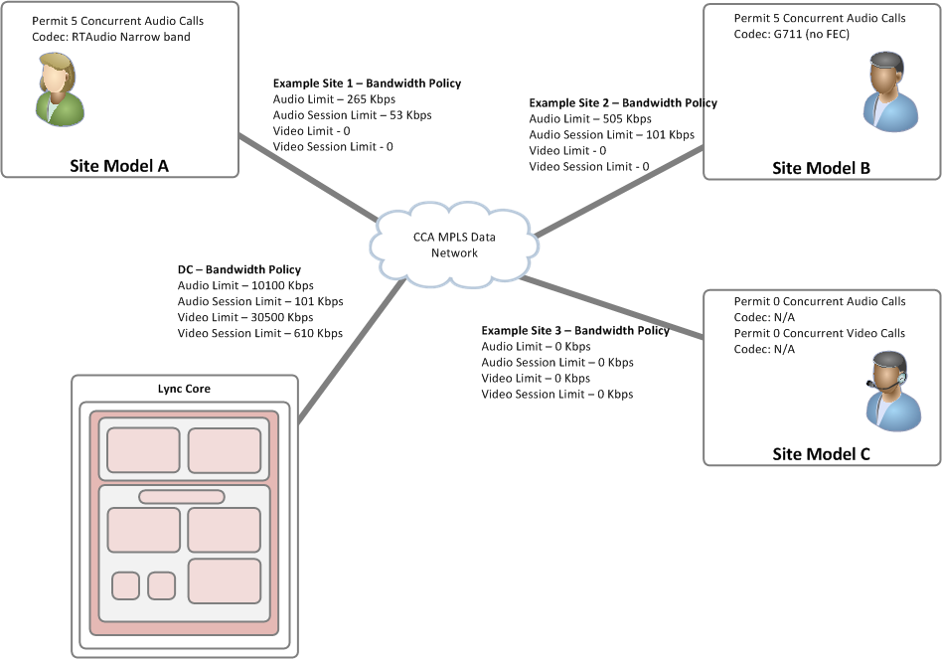
Assess and Configure the Network

Slide 17
Replace the PABX

Slide 18
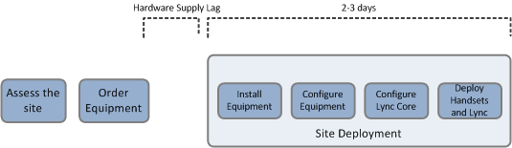
Site Deployment Process

Slide 19
Site Analysis and Considerations
Select a Site Pattern for the location
Assess the site requirements
  How many analogue lines?
  PSTN Connectivity:
    PRIs
    BRIs
    SIP Trunking
Determine the User Experience
  Handsets vs Headsets
Create the Bill of Materials and Order

Slide 20
Application Remediation / Replacement
Assess PABX applications and usage
Analyse hunt group usage
Analyse Call Features
Build replacement capabilities in Lync (native) or extend with third parties
Demo – Response Group meets IVR

Slide 21
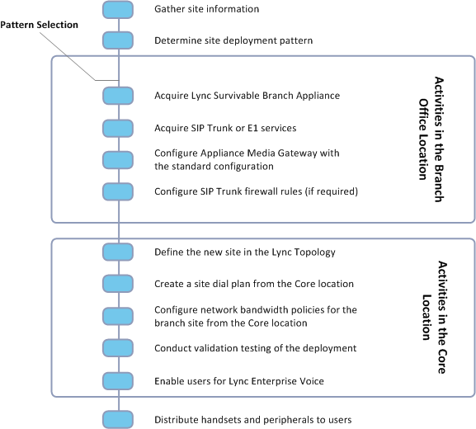
Site Configuration

Slide 22
Connect to the PABX to Retire the PABX

Slide 23
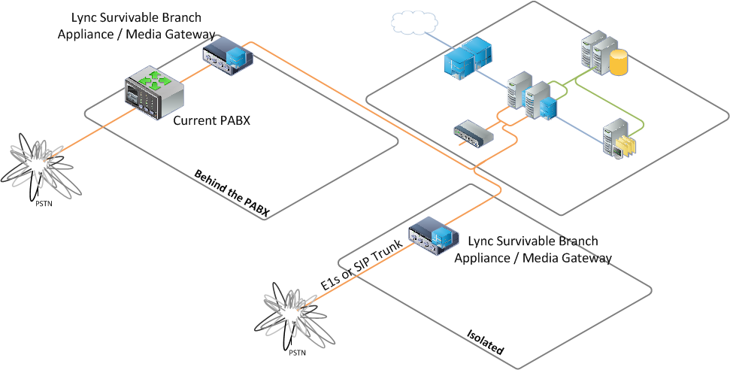
Pilot

Slide 24
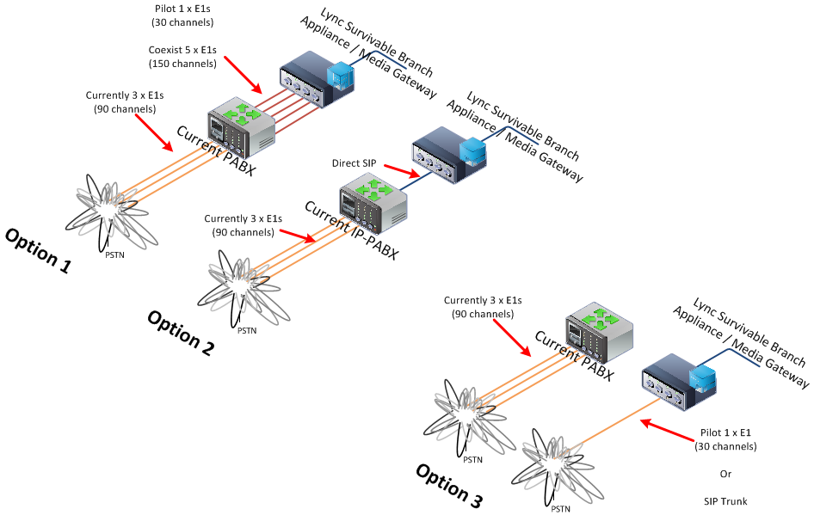
Connectivity to the PABX

Slide 25
Transition People to Lync
Establish a Call Forward on the PABX (or call reroute)
Enable for the user for Lync Enterprise Voice (deploy software)
Conduct User Training
Provide a Lync Headset / Handset
Solicit Feedback

Slide 26
Trends and Lessons Learned

Slide 27
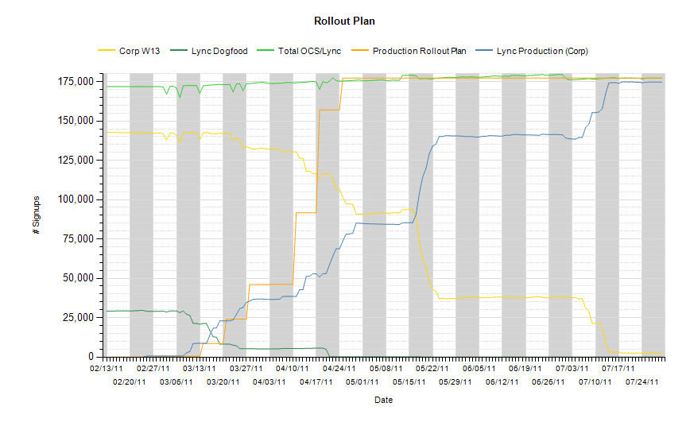
Usage Trends

Slide 28
Deployment Lessons Learned
Architecture
  Hardware Load Balancing
User Experience
  Communications
Project Governance
  3 Way Partnership (IT, Deployment Partner, Business)
Transitioning from Pilot to Production
  Infrastructure Readiness
  QoS and CAC
  DNS, IPSec, FEP, HLB, Firewalls etc.
Fine Tuning

Slide 29
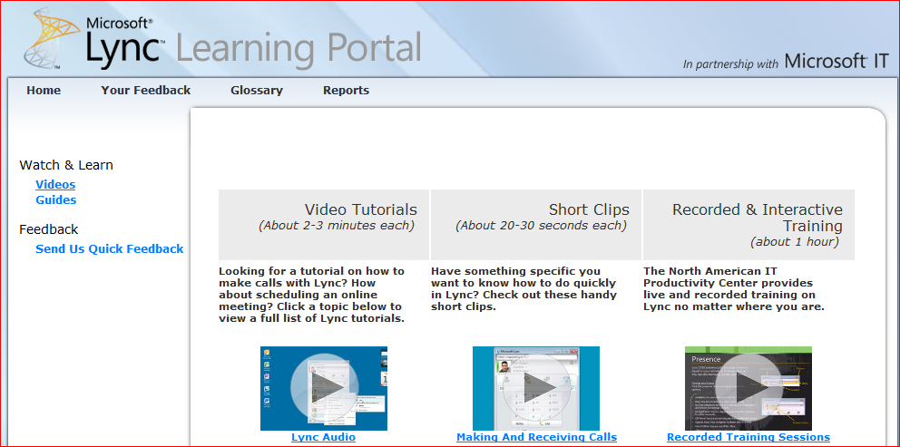
Communications Planning
Self-Guided Modules
Instructor-Led Sessions
  In Person
Instructor-Led Sessions
  Online
Printed Materials
  Lync Adoption and Training Kit

Slide 30
Session Takeaways and Objectives
Understand the Lync Enterprise Voice features and capabilities
Understand the paths available to best move
you or your customer forward with Enterprise Voice
Importance of deployment methodology to successfully deploy Enterprise Voice

Slide 31

Enrol in Microsoft Virtual Academy Today
Why Enroll, other than it being free?
The MVA helps improve your IT skill set and advance your career with a free, easy to access training portal that allows you to learn at your own pace, focusing on Microsoft technologies.
What Do I get for enrolment?
Free training to make you become the Cloud-Hero in my Organization
Help mastering your Training Path and get the recognition
Connect with other IT Pros and discuss The Cloud
Where do I Enrol?
www.microsoftvirtualacademy.com
Then tell us what you think. TellTheDean@microsoft.com

Slide 32




Resources
www.msteched.com/Australia
  Sessions On-Demand & Community
www.microsoft.com/australia/learning
Microsoft Certification & Training Resources
http:// technet.microsoft.com/en-au
  Resources for IT Professionals
http://msdn.microsoft.com/en-au
  Resources for Developers

Slide 33

© 2010 Microsoft Corporation. All rights reserved. Microsoft, Windows, Windows Vista and other product names are or may be registered trademarks and/or trademarks in the U.S. and/or other countries.
The information herein is for informational purposes only and represents the current view of Microsoft Corporation as of the date of this presentation. Because Microsoft must respond to changing market conditions, it should not be interpreted to be a commitment on the part of Microsoft, and Microsoft cannot guarantee the accuracy of any information provided after the date of this presentation. MICROSOFT MAKES NO WARRANTIES, EXPRESS, IMPLIED OR STATUTORY, AS TO THE INFORMATION IN THIS PRESENTATION.

