Slide 2
Converged Exchange: A Blueprint for 2010 deployment
SESSION CODE: EXL313
Tim Jones
Senior Systems Engineer
Hitachi Data Systems

Slide 3
Agenda
Exchange Storage Challenges
Converged Architecture for Exchange 2010
Building an Efficient Storage Architecture
Microsoft Exchange Programs

Slide 4
Agenda
Exchange Storage Challenges
Converged Architecture for Exchange 2010
Building an Efficient Storage Architecture
Microsoft Exchange Programs

Slide 5
Storage challenges
The world’s data doubles every 18 months
Management and governance of data forever?
Managing storage tiers is too costly
Repurpose data every 4 to 5 years?
24 x 7 operation
Not all data is created equal...
Scale, Scale, Scale

Slide 6
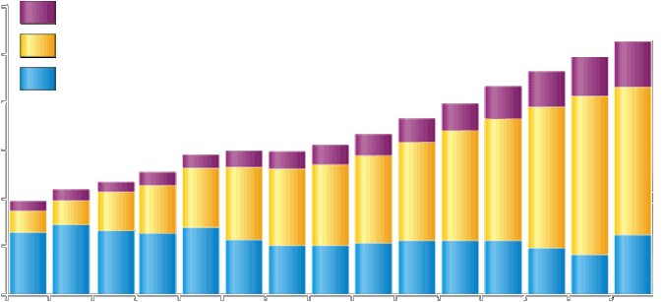
Keeping focus on exchange costs
Spending
(US$B)
$300
Power and cooling costs
x8
$250
HW mgmt. and admin costs
x4
New hardware spending
$200
$150
$100
$50
$0
1996
1997
1998
1999
2000
2001
2002
2003
2004
2005
2006
2007
2008
2009
2010
IT costs are increasing due to operational costs not hardware costs
Aging IT infrastructures create an increasing burden to maintain
Change becomes increasingly more disruptive as volumes increase
Lack of data center agility increase business risk and missed opportunities

Slide 7
Today’s Reality: Business Runs on Email
Email growth accelerating
Email represents a significant portion of an organization’s total data
Many organizations retain email records indefinitely
Service level agreements getting tougher
Access and performance is crucial to conducting business
Corporate compliance and regulatory laws require timely – and secure – access to email records
Exchange environments must be Predictable • Scalable • Flexible

Slide 8
Australian Regulatory Compliance National Archives of Australia
“Email is part of the official business communication of an Australian government agency. Email sent or received contains information about business activities and therefore can function as evidence of business transactions which are part of the official records of an agency. All email messages created using Australian government systems are Commonwealth records and must be managed in accordance with the Archives Act 1983. They are also subject to related legislation such as the Freedom of Information Act 1982, Privacy Act 1988 and the Evidence Act 1995. Courts have accepted electronic communications as a legitimate source of evidence and email is therefore subject to legal processes such as subpoena.”
National Archives of Australia
Archives Advice 20
Issued February 1998 / Revised July 2004
Endorsed methods of capturing and storing e-mail include:
Electronic document management systems (EDMS)
Electronic information management
Knowledge management solutions
Must remain accessible over time as they are migrated across changes in software and hardware platforms
Protected from alteration to retain their value as evidence

Slide 9
Decisions your customers face
Have you evaluated how performance and scalability issues may impact availability and user experience?
Have you evaluated how your architecture may impact the time spent configuring and managing storage?
Will you be able to meet key requirements as usage activity changes and peaks?
Will be able to scale storage smoothly in a way that can avoid waste of resources?
Do you need to consolidate multiple instances of storage for Exchange Servers?
Is 99.999% data availability and recoverability critical to your organization?

Slide 10
Concerns for Maintaining Availability: A brief History of Exchange
Performance Demand
Performance Demand
Performance Demand
Urgent
Capacity Demand
Capacity Demand
Capacity Demand
Shared Disk
Shared Disk
Shared Disk
Windows Clustering
Windows Clustering
Windows Clustering
Necessary
Storage Replication/GeoClustering
Storage Replication/GeoClustering
Storage Replication
Backup Window Relief
Backup Window Relief
Backup Window Relief
Rapid Recovery
Exchange Native Protection
Covered
Offsite Contingency Copies
Offsite Contingency Copies
Offsite Contingency Copies
Application Availability
More Out of the Box!
Excellent, but that’s not the whole ownership picture.
Item Level Backups
Item Level Backups
Item Level Backups
Obsolete
Clone Copies
(Shadow Image)
Clone Copies
(Shadow Image)
Clone Copies
(Shadow Image)
Delta Copies
(Copy on Write)
Delta Copies
(Copy on Write)

Slide 11
Keeping Exchange 2010 Online and Available: addressing failure scenarios
Failure Type | Protection
Hardware, Software, Disk Drive Failure | Multiple Copies (Redundancy) – DAG HA Copy and RAID
Physical Corruption | Single Page Restore – Automatically Enabled
Lost Items | Single Item Recovery – Enable Feature
Logical Corruption | Point In Time Backup – DAG Lag Copy
Virus | AV Scanning (Transport, Client, Store) – Third Party Software
Destructive Loss | Point In Time Backup – Backup Copy
Malicious Action | Isolated Environments, Point In Time Backup – Backup Copy

Slide 12
Exchange 2010 Configuration Methodology - Consultative Approach
Model Exchange Using Microsoft Calculators
Communicate Architecture
Estimate Requirements
Analyze Capacity and Performance Requirements
HDS Clinical Data is created using JetStress
Configure Hardware
Calculate multiple drive configurations
Select the best fit
Configuration generally varies from published examples
Watch Costs!
Floor Space, Power and Cooling
Capital Expenditure
Personnel Expenses

Slide 13
Agenda
Exchange Storage Challenges
Converged Architecture for Exchange 2010
Building an Efficient Storage Architecture
Microsoft Exchange Programs

Slide 14
Hitachi Exchange Converged Solution Overview
Microsoft Exchange 2010
Triple protected high-availability platform support with
Hitachi Blade Servers - Blade Server N+1 cold standby, LPAR
Hitachi Storage - Full Duplex Hitachi Adaptable Modular Storage with RAID
Microsoft Exchange 2010 Mailbox Availability Group (DAG)
Enterprise scale via building block approach (small→ large) – up to 96K users
Pre-validated reference architectures tested for performance and scalability
AMS2000 storage sizing tool for Exchange 2010
HCP integration
Hitachi’s DC solution leverages Microsoft’s Guidance and best practices for Exchange 2010
Microsoft Windows Server 2008 R2
Hitachi Compute
Network
Hitachi Storage
Hitachi Content Platform
Exchange Archive engine

Slide 15
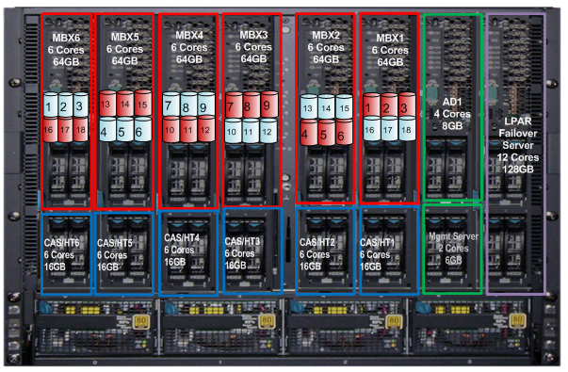
Building Block Approach : Scale up from 8K to 28K
8K: 1x BDS (half populated)
1x AMS2300
1x Datacenter
24K: 1x BDS
1x AMS2500
1x Datacenter
© 2010 Hitachi Data Systems Confidential- Prepared for Comparex.

Slide 16
Building Block Approach : Scale up from 24K to 48K
48K: 2x BDS
2x AMS2500,
2x Datacenter
24K: 1x BDS
1x AMS2500,
1x Datacenter
© 2010 Hitachi Data Systems Confidential- Prepared for Comparex.

Slide 17
Building Block Approach : Scale up from 48K to 96K – DAG Limits
48K: 2x BDS
2x AMS2500
2x Datacenter
96K: 4x BDS
4x AMS2500
2x or 4x Datacenter
© 2010 Hitachi Data Systems Confidential- Prepared for Comparex.

Slide 18
Blade Symphony 2000: N+1 Cold Standby
Automatic Server Repair
Fast (7-8 minutes)
Accurate
Immediate
Reduce HA Copies
Improve Efficiency
Reduce Complexity
Reduce Cost
Capital
Environmental
Labor
CAS
LPAR
CAS
LPAR
CAS
LPAR
CAS
LPAR
CAS
LPAR
CAS
LPAR
CAS
LPAR
HUB
HUB
HUB
HUB
HUB
HUB
HUB
MBX
LPAR
MBX
LPAR
MBX
LPAR
MBX
LPAR
MBX
LPAR
MBX
LPAR
MBX
LPAR
DB
DB
DB
DB
DB
DB
DB
DB
DB
DB
DB
DB
DB
DB
DAG
DAG
DAG
DAG
© 2010 Hitachi Data Systems Confidential- Prepared for Comparex.

Slide 19
Blade Symphony 2000: Logical Partitioning (LPAR)
Hardware Virtualization
Guests Directly Attached to SAN
High Performance
Efficient Server Utilization
Maintains Mailbox/Support Server Balance
Reduced Planning and Complexity
Reduce Cost
Capital
Environmental
Labor
MBX
CAS/HUB
LPAR#1
LPAR#2
Hitachi LPAR
CPU
Core
Core
Core
Core
Core
Core
RAM
64GB
16GB
I/O
Direct Disk Access
© 2010 Hitachi Data Systems Confidential- Prepared for Comparex.

Slide 20
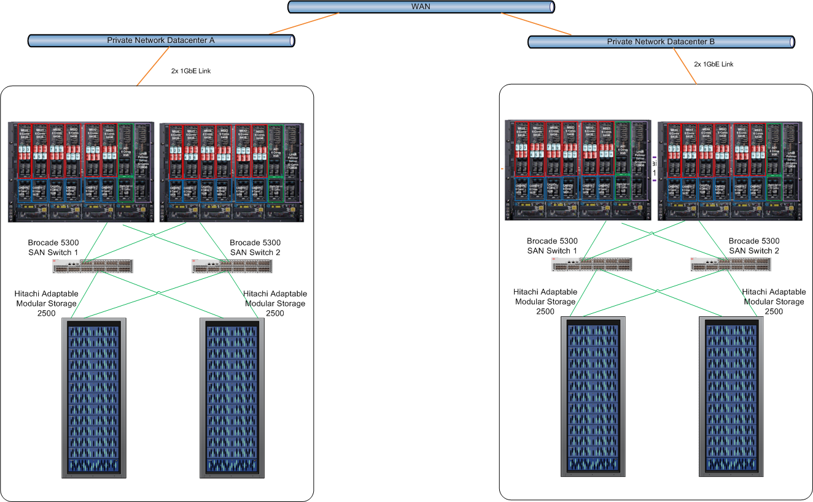
96K User, Highly Available Architecture
Large 2 Datacenters Configuration:
96K users
48K per datacenter
24K per BDS
Active/Active dual DAG HA configuration
2 database copies
3 active and 3 passive databases
4x BDS 2000
4x AMS 2500

Slide 21
Agenda
Exchange Storage Challenges
Converged Architecture for Exchange 2010
Building an Efficient Storage Architecture
Microsoft Exchange Programs

Slide 22
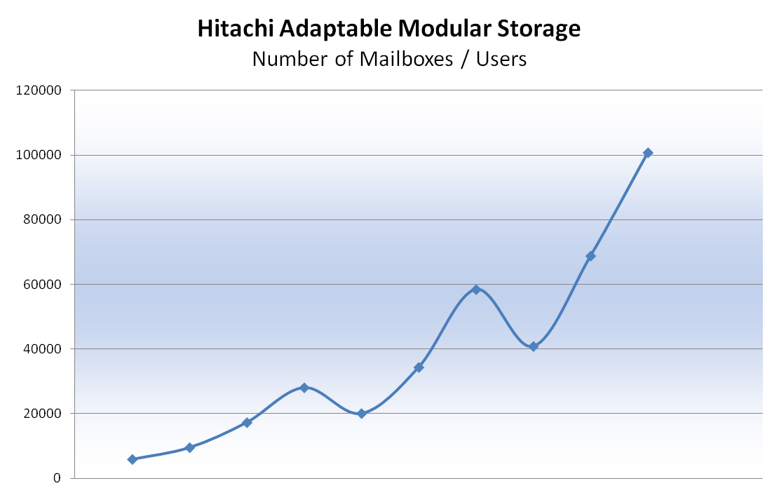
Hitachi– Exchange 2010 Scalability
DAS
Simple Server / Storage Relationship
SAN
Consolidated Server / Storage Relationship
Number of Mailboxes
AMS 2100
AMS 2300
AMS 2500
VSP
Hitachi offers widest choice of best of breed DAS and SAN storage solutions for Exchange 2010

Slide 23
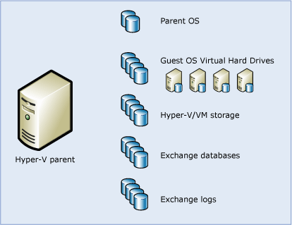
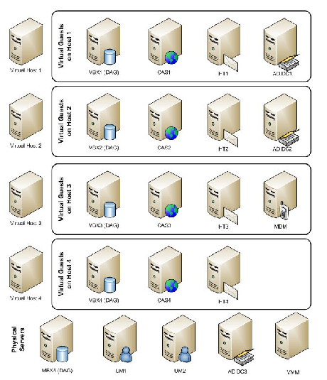
SAN Virtualization: Efficiency, Flexibility, Scale
Supports Exchange 2010 in Hyper-V environments with scalable support of Virtual Machines
Supports Exchange 2010 DAG’s and LAG’s with dynamic provisioning of storage
Source: Microsoft
Source: WindowsITPro
SITE A
DAG
SITE B
LAG
SITE C
Hitachi Storage supports Exchange 2010 in Hyper-V environments offering enterprise class RAS

Slide 24
Anatomy of a Repair: JBOD
Drive Begins to Fail
Errors Are Generated
User Experience Preserved
IT Investigates
Problem Determined
Uninvolved Teams Disengage
Change Control and Team Coordination Active
Hardware Replaced
Hardware Installed in Windows
Database Created
Reseed Completed
Resolution Completed, Normal Operations Resume

Slide 25
Anatomy of a Repair: JBOD
Drive Begins to Fail
90% Predicted, Always Protected
IT and HDS are Notified by Array
No Collateral Impact
Drive is Repaired by HDS
IT Notified
Resolution Completed, Normal Operations Resume

Slide 26
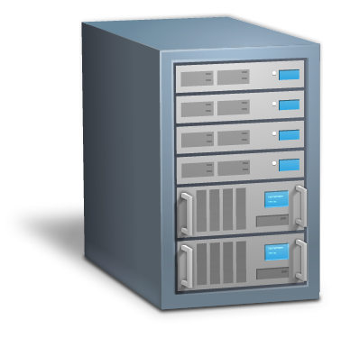
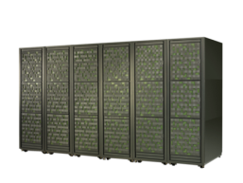
Data Protection Exchange Integration
Images and Snapshots are VSS Based
Hitachi Command Suite provides view from infrastructure to application
SCOM Integration for Arrays
Application
Database
OS
HBA Driver
Hitachi SAN solutions integrate tightly with Microsoft Exchange Environments

Slide 27
Data Protection Solutions That Benefit Your customers
Meet RTO and RPO
Deduplication and archive before backup
Heterogeneous replication and rapid restore
Cost Reduction
Data reduction and space savings
Efficient storage protection management
Improve Regulatory Compliance, Avoid Risk
Enhanced recovery and deduplication
Better support for e-discovery, audit, etc.
Recover Critical Applications
Advanced implementation services
Application consistency and disaster recovery
High-performance storage infrastructure
Policy-based automated data protection
Business Agility

Slide 28
Agenda
Exchange Storage Challenges
Converged Architecture for Exchange 2010
Building an Efficient Storage Architecture
Microsoft Exchange Programs

Slide 29
Services opportunities to Optimize Storage Infrastructure for Microsoft Exchange 2010
Services opportunities abound in Exchange migration, consolidation or re-platforming engagements
Hitachi Data Systems can support your services engagements
Global Solution Services and Hitachi Consulting provide:
Exchange Server Migrations
Data Migration Planning
Design and Implementation of storage for MS Exchange
Archiving and Compliance
Unified Communications
Managed Services
Assessment
and
Consulting
Plan
and
Design
Install
and
Implement
Transition
and
Integrate
Manage
and
Optimize
Support
Education
Hitachi offers a comprehensive list of services for Exchange 2010

Slide 30
ESRP – Storage v 3.0
“The program combines a storage testing harness (Jetstress) with solution publishing guidelines. Microsoft Gold Certified or Certified Storage Partners (storage original equipment manufacturers (OEMs) who are part of the Microsoft Certified Partner Program) can use the ESRP framework provided to test their storage solutions targeted for Microsoft Exchange deployment. Customers can use the solutions published here to help plan/design their own Exchange storage architectures”
This program is only available to Microsoft Gold Certified Partners such as Hitachi Data Systems.

Slide 31
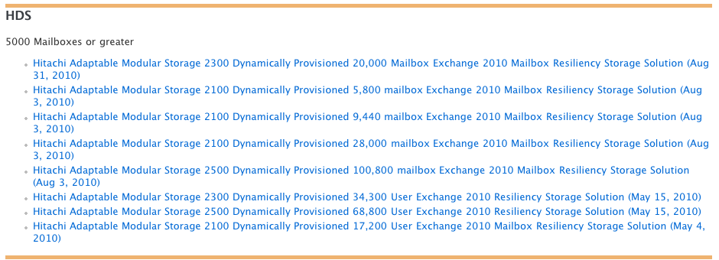
Exchange Solution Reviewed Program (ESRP)
Hitachi Data Systems is an ESRP 3.0 participant
Resource for planning and designing your storage solution
http://technet.microsoft.com/en-us/exchange/ff182054.aspx
Extensive results published with large environment examples
Hitachi Dynamic Provisioning
SAS and SATA drive architectures
1 GB and 3 GB Mailboxes → 5 GB and 10 GB Mailboxes in process
Hitachi has the highest number of ESRP submissions in the last 6 months!

Slide 32
Get visibility with Hitachi IT Operations
Come listen to ‘When is an Exchange problem not an Exchange problem?’ @ 3pm in the blue interactive theatre room on Thursday.
+ the chance to win a very cool RC helicopter!

Slide 33
Enrol in Microsoft Virtual Academy Today
Why Enroll, other than it being free?
The MVA helps improve your IT skill set and advance your career with a free, easy to access training portal that allows you to learn at your own pace, focusing on Microsoft technologies.
What Do I get for enrolment?
Free training to make you become the Cloud-Hero in my Organization
Help mastering your Training Path and get the recognition
Connect with other IT Pros and discuss The Cloud
Where do I Enrol?
www.microsoftvirtualacademy.com
Then tell us what you think. TellTheDean@microsoft.com

Slide 34
© 2010 Microsoft Corporation. All rights reserved. Microsoft, Windows, Windows Vista and other product names are or may be registered trademarks and/or trademarks in the U.S. and/or other countries.
The information herein is for informational purposes only and represents the current view of Microsoft Corporation as of the date of this presentation. Because Microsoft must respond to changing market conditions, it should not be interpreted to be a commitment on the part of Microsoft, and Microsoft cannot guarantee the accuracy of any information provided after the date of this presentation. MICROSOFT MAKES NO WARRANTIES, EXPRESS, IMPLIED OR STATUTORY, AS TO THE INFORMATION IN THIS PRESENTATION.

