Slide 2


Slide 3
Developing Windows Phone 7 Applications for SharePoint
SESSION CODE: OFS202
Chris Johnson
Sr. Technical Product Manager, SharePoint
Microsoft

Slide 4
Who is paying attention?
Prizes!
Intelligent Questions
Intelligent Answers
Yelling MANGO! as loud as you can when you hear me say “Mango”

Slide 5
Objectives
Understand SharePoint Phone Developer Environment Options
Understand Authentication options
Understand APIs and Data Access options
Not covering
  Windows Phone app basics (other sessions for that)

Slide 6
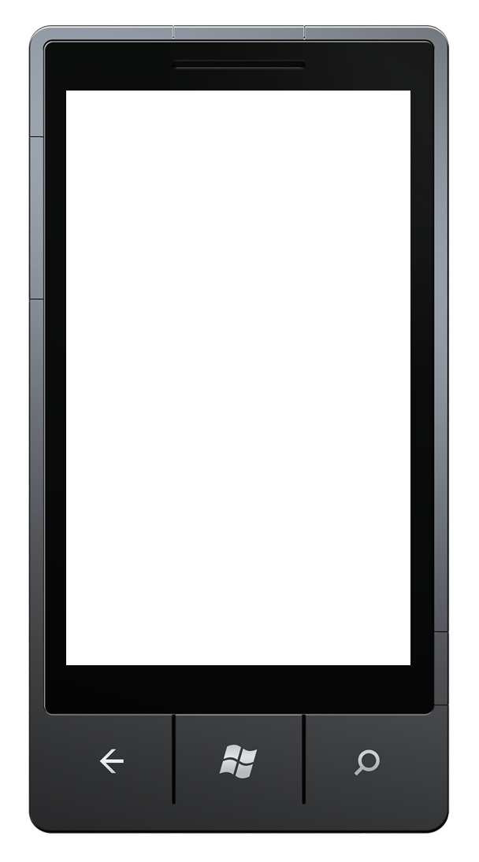
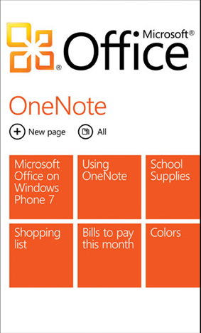
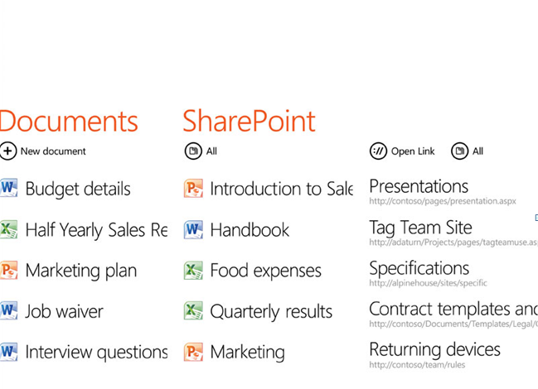

Slide 7
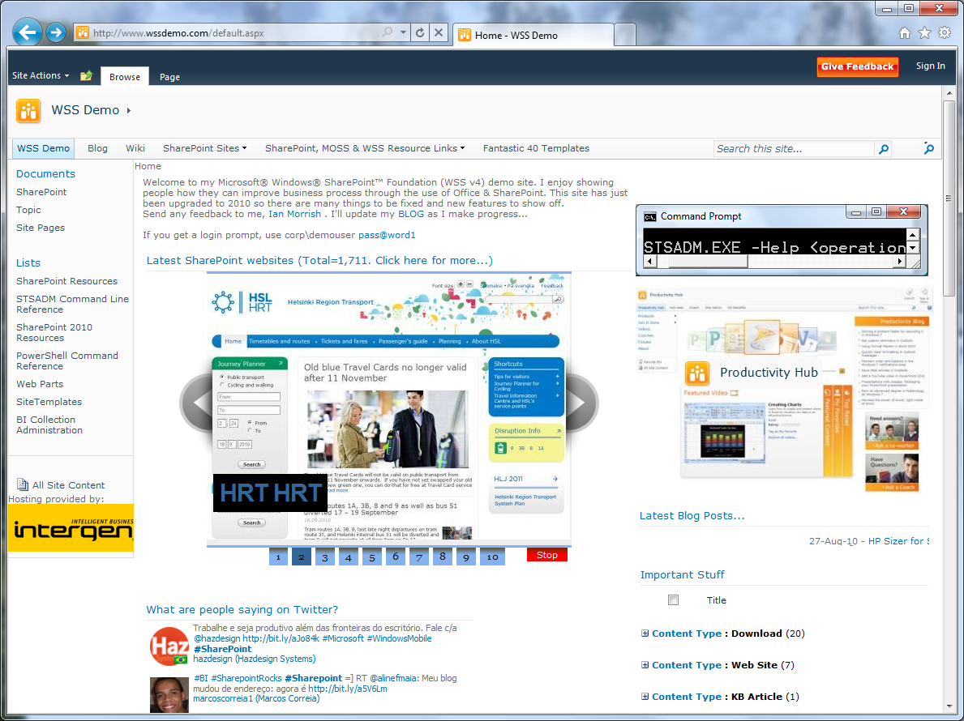
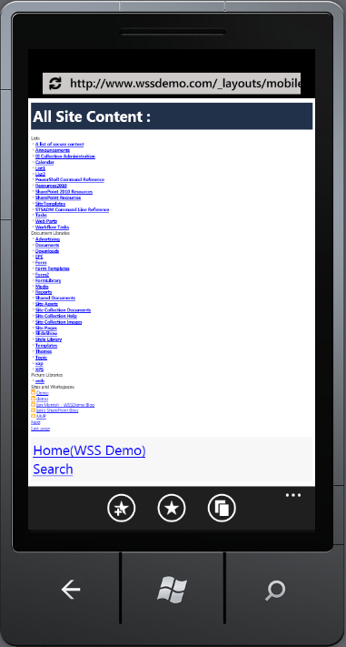
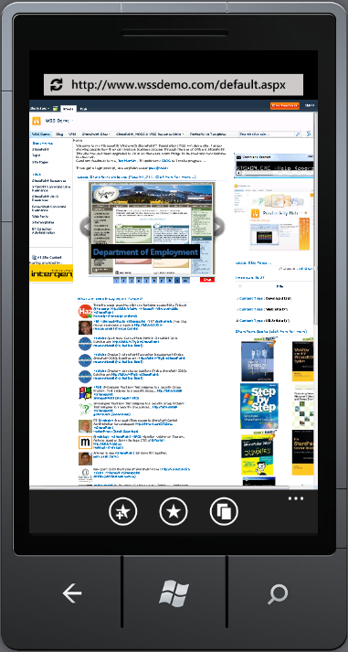

Slide 8
Why go native?
Hardware integration, audio, gyro, camera etc…
Offline options
Hardware acceleration
OS integration options,
  Hub integration
  Background agents
  Notifications, reminders
  Live Tile(s)

Slide 9
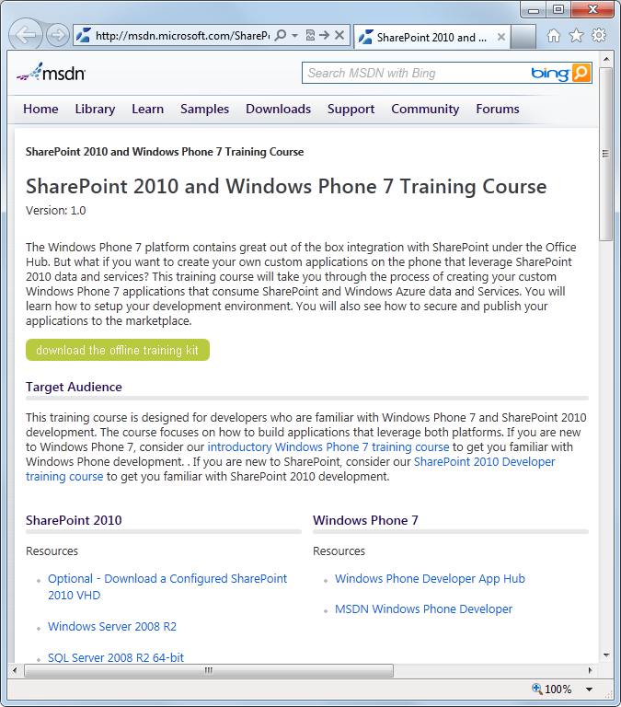
SharePoint and Windows Phone 7
Training Kit
10 Training Units
25 Hands on Labs
Online and Offline
http://msdn.microsoft.com/SharePointAndWindowsPhone7TrainingCourse

Slide 10
Developer Environment

Slide 11
Developer Environment
SharePoint 2010
  X64
Windows Phone 7 Emulator
  Windows 7
  GPU enabled
Azure Compute/Storage Emulator (optional)
Unified Access Gateway (UAG) (optional)
Hyper-V or boot to VHD

Slide 12
SharePoint Developer Workstation
SharePoint Easy Setup
  Automated workstation build
  Downloads products if you need them
  Fully PowerShell based
  Bare metal or Boot to VHD options
+ Windows Phone SDK/tools
  Bing “SharePoint Easy Setup”

Slide 13
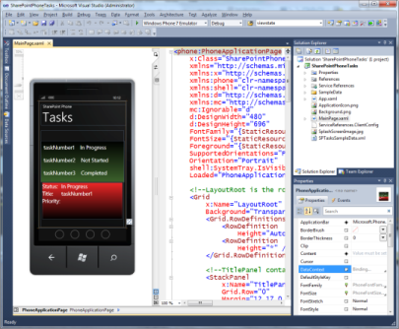

Single Machine
Windows 7
SharePoint
My Favorite!

Slide 14
Multi-machine Developer Setup
Windows 7
Windows Server 2008 R2
SharePoint
VHD
.30
.20
.5
.10
.1
192.168.150.XX

Slide 15
Multi-machine Developer Setup with UAG
Windows 7
Windows Server 2008 R2
.20
.10
.5
UAG
VHD
.5
.10
.1
SharePoint
VHD
192.168.1.XX
192.168.150.XX

Slide 16
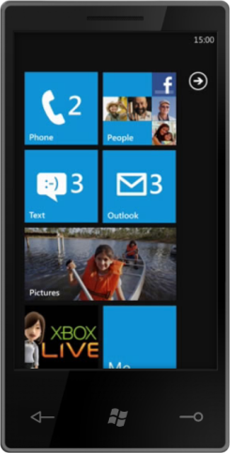


Single Machine Developer Setup with UAG
Windows Server 2008 R2
.10
.5
UAG
VHD
.5
.10
.1
SharePoint
VHD
192.168.1.XX
192.168.150.XX

Slide 17

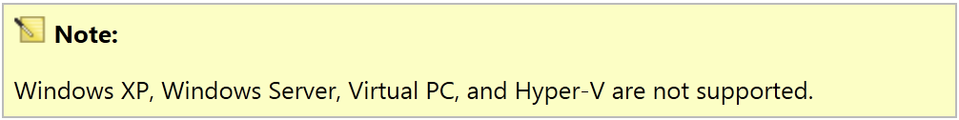
Single Machine Developer Setup with Hyper-V
Windows Server 2008 R2
.10
.5
UAG
VHD
Windows 7 x86 VHD
.5
.10
.1
SharePoint
VHD
192.168.1.XX
192.168.150.XX
http://msdn.microsoft.com/en-us/library/ff626524(v=VS.92).aspx

Slide 18
Authentication

Slide 19
Authentication
No Windows Authentication (NTLM)
  On-Prem impact
Option 1: Forms Based Authentication (FBA)
  Built in SharePoint Support
Option 2: Unified Access Gateway (UAG)
  Forms → NTLM translation
Option 3: Azure Control Services (ACS)
  Service Bus

Slide 20
Identity Normalization
NT Token
Windows Identity
NT Token
Windows Identity
ASP.Net (FBA)
SAL, LDAP, Custom …
SAML
ADFS, Ping, etc.
SAML Token
Claims Based Identity
SPUser

Slide 21
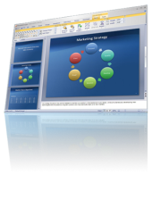

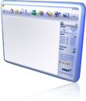



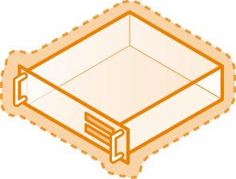

SharePoint Claims Authentication Sign-in
7
Request
Response
with Cookie
8
4
Request
with Cookie
Response
with Cookie
302 Redirect
302 Redirect
1
3
2
5
6
9

Slide 22
Put the Cookie in the Cookie Jar
CookieContainer cookieJar = new CookieContainer();
HttpWebRequest spAuthReq = HttpWebRequest.Create(authServiceUri) as HttpWebRequest;
spAuthReq.CookieContainer = cookieJar;
spAuthReq.Headers["SOAPAction"] = "http://schemas.microsoft.com/sharepoint/soap/Login"; spAuthReq.ContentType = "text/xml; charset=utf-8"; spAuthReq.Method = "POST";

Slide 23
Option 1: Forms Based Authentication
Additional authentication provider added to your site
SharePoint Claims Authentication
Provider Neutral
  e.g. SQL, LDAP etc…
SharePoint Authentication Web Service
  authentication.asmx
  SOAP web service
  Cookies come back, keep these for subsequent requests
SharePoint in DMZ or Reverse Proxy via DMZ

Slide 24
Forms Authentication
demo

Slide 25
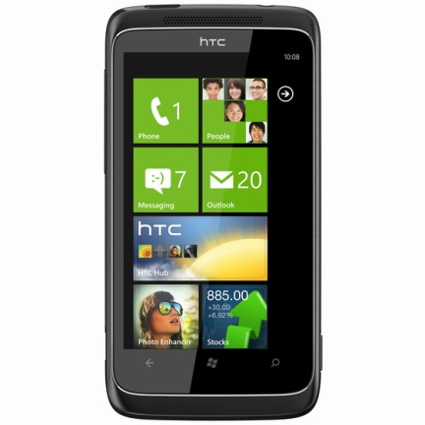

Option 2: UAG
Forefront Unified Access Gateway 2010
Internet
Intranet
UAG
SharePoint
http://www.microsoft.com/forefront/unified-access-gateway/en/us/default.aspx

Slide 26
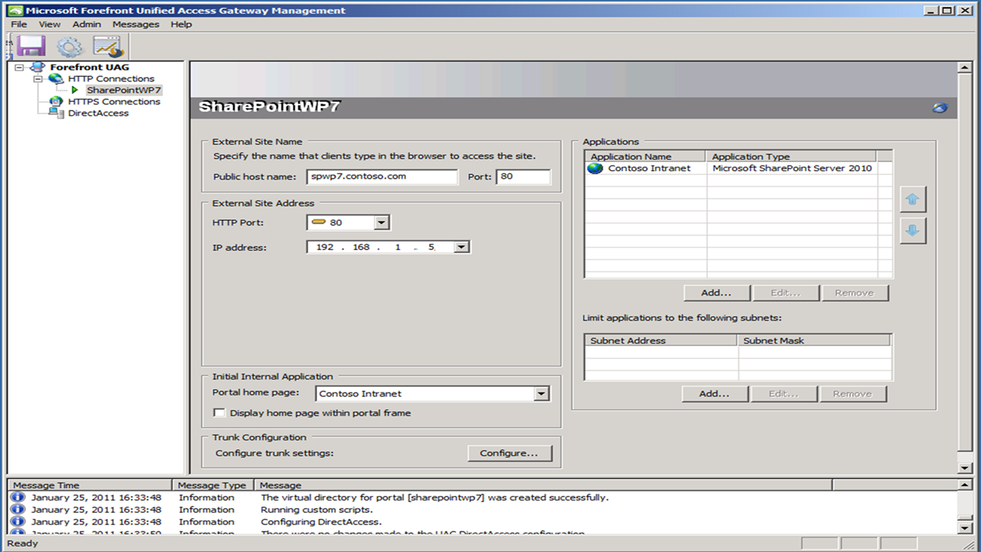

Slide 27
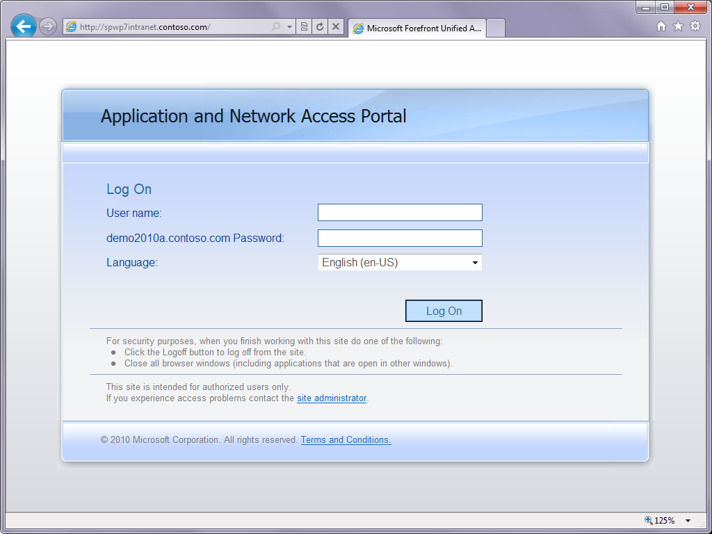

Slide 28
Option 2: UAG
UAG in DMZ
SharePoint in private network
Authenticate with AD
  Forms → NTLM translation
Other protection options

Slide 29
UAG Authentication
demo

Slide 30



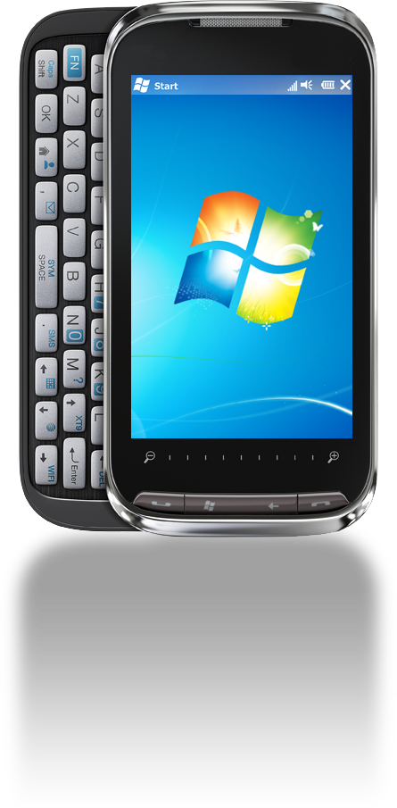

Option 3: AppFabric Service Bus Proxy
On Premises
Create on-premises service
Create service and
deploy to Windows Azure
Connect via Service Bus
Connect via remote device
You can connect and
use the service from any
WCF conversant device,
application or platform
WCF Web Service
Listener Service
WCF
SharePoint
List or LOB
Service Bus

Slide 31
Service Bus
demo

Slide 32
APIs

Slide 33
SharePoint API Access Scenarios
Scenario | Best For
Web Service | Read and Write
RSS | Read
Rest\ODATA | Read* and Write
Client Side OM | Not currently supported
Custom (WCF\ASPX\ATOM) | Read and Write
Note: Windows Phone 7 only supports asynchronous requests.
* The missing CookieContainer in the generated OData Client Library proxy class makes updates more complex when using FBA.

Slide 34
SharePoint Task Application
demo

Slide 35
Next Steps
Build Dev Machine – Easy Setup Script
  Bing “SharePoint Easy Setup”
Download the Windows Phone Developer Tools
  http://create.msdn.com
Start creating your app or game
Purchase an App Hub subscription
Preparing your app to submit to Windows Phone Marketplace

Slide 36

SharePoint 2010 Development with Silverlight
Get early access and send feedback
on Safari Rough Cuts!
http://bit.ly/SPSL_SafariRoughCuts
Download the code on
MSDN Code Gallery
http://code.msdn.com/spsl/
http://www.amazon.com/SharePoint-2010-Development-Silverlight-German/dp/0321769597

Slide 37
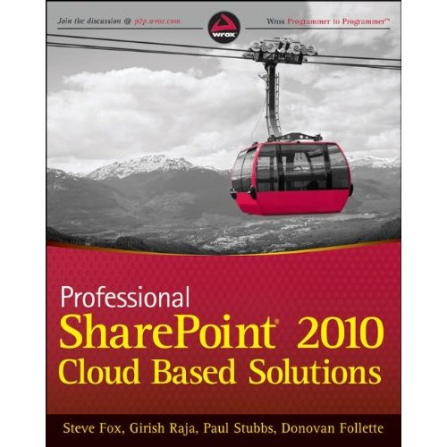
Professional SharePoint 2010 Cloud Based Solutions
Shows developers how to use Microsoft SharePoint 2010 to create scalable, cloud-based solutions
Topics include SQL Azure for data management and BI, building an Azure-based corporate tax service, connecting Linked In and SharePoint profile data, creating a filterable Twitter dashboard, leveraging Bing Maps Geo services, maintaining security, and more
http://www.amazon.com/Professional-SharePoint-Cloud-Based-Solutions/dp/1118076575

Slide 38
october
3–6th
2011
Conference 2011
anaheim, ca

Slide 39

Enrol in Microsoft Virtual Academy Today
Why Enroll, other than it being free?
The MVA helps improve your IT skill set and advance your career with a free, easy to access training portal that allows you to learn at your own pace, focusing on Microsoft technologies.
What Do I get for enrolment?
Free training to make you become the Cloud-Hero in my Organization
Help mastering your Training Path and get the recognition
Connect with other IT Pros and discuss The Cloud
Where do I Enrol?
www.microsoftvirtualacademy.com
Then tell us what you think. TellTheDean@microsoft.com

Slide 40

© 2010 Microsoft Corporation. All rights reserved. Microsoft, Windows, Windows Vista and other product names are or may be registered trademarks and/or trademarks
in the U.S. and/or other countries.
The information herein is for informational purposes only and represents the current view of Microsoft Corporation as of the date of this presentation. Because Microsoft must respond to changing market conditions, it should not be interpreted to be a commitment on the part of Microsoft, and Microsoft cannot guarantee the accuracy of any information provided after the date of this presentation. MICROSOFT MAKES NO WARRANTIES, EXPRESS, IMPLIED OR STATUTORY, AS TO THE INFORMATION IN THIS PRESENTATION.

Slide 41




Resources
www.msteched.com/Australia
  Sessions On-Demand & Community
www.microsoft.com/australia/learning
Microsoft Certification & Training Resources
http:// technet.microsoft.com/en-au
  Resources for IT Professionals
http://msdn.microsoft.com/en-au
  Resources for Developers

