Slide 2

Scaling ECM on SharePoint 2010
SESSION CODE: OFS316
Garth Luke Elaine van Bergen
VP Sales and Country Manager Architect
AvePoint Australia OBS

Slide 3
Agenda
  Scale Points: Overview of the scale points in SharePoint 2010
  Architecture: Overview of the concepts, tools and features at your disposal for putting together your architecture
  Scale Considerations: What to consider when planning your SharePoint Deployments

Slide 4
Key Takeaways
Usability and planning are essential to scalability
  Understand the architectural considerations when scaling SharePoint 2010
  It takes a team to effectively plan and design your SharePoint deployments

Slide 5

Scale Points
Team Site
Team sites acting
in coordination
Managed Library
Virtual folders organize the data
Enterprise Metadata and Content Types
Knowledge Base or Records Center
Number of instances
Tens of millions of docs in a single list
Massive Distributed Archive
Archive on
auto-pilot
Number of items

Slide 6

Scale Point 1: Ad Hoc Team Library
Library size?
100-200 docs
Features Leveraged
  Managed Metadata
  Content Types
Key Takeaways
  SP2010 breaks the Site Collection Boundary
  Automatic participation with enterprise doc lifecycle
Who manages the content?
No manager
How does content get added?
Ad hoc uploads
Examples:
Library for
storing a small team’s work in
progress docs
A library
spun up for a particular project

Slide 7
Scale Point 2: Managed Library
Hundreds or thousands of docs
Library size?
Features Leveraged
  Metadata Navigation
  Content By Query Web parts
Key Takeaways
  Structured taxonomies allows virtual folders and new content
  discovery paradigms
  The system helps the user discover the right metadata
Who manages the content?
Informally by subject owner
How does content get added?
Upload and iterate until finished
Examples:
RFP Response library for a sales force
Spec library for an engineering team
Brand images repository for marketing

Slide 8
Scale Point 3: Repository/Archive
Millions to tens
of millions of docs
Library size?
Features Leveraged
  Information Policies
  Content Organizer
Key Takeaways
  Indices are auto-managed and folder structure is determined by business needs
  Helps users answer broad, unstructured questions
  Ensures structure and policies followed on the backend
Who manages the content?
A dedicated team
of content stewards
How does content get added?
Submission experience
Corporate records archive
Knowledge management repository
Centralized best practices repository
Examples:

Slide 9
Scale Point 4: Massive, Distributed Archive
Library size?
Hundreds of millions of docs
Features Leverages
  FAST Search
  Content Type Syndication
  Drop Sites
Key Takeaways
  Scale is achieved with a distributed architecture
  Taxonomy and Information Architecture is key
Who manages the content?
Dedicated team
How does content get added?
Automated processes
Archive for
a large government agency
Yearly archive of insurance forms
Examples:

Slide 10

Review of Back End Scale Improvements
Internal database improvements (e.g. lock
ordering, throttling, IOPS efficiency)
Compound indexing, index management, and content-by-query optimizations
SQL 2008’s Remote Blob Storage (RBS)
Background
per-item processing throughput maximization
For more info on the back end of scale, see Technet:
http://technet.microsoft.com/en-us/library/cc262787.aspx

Slide 11
SP1 Improvements
Larger Databases now supported
Site recycle Bin
Storage Manager
SQL Filestream RBS support

Slide 12
SharePoint 2010 Architecture

Slide 13
Scale across Content DB’s
Collaboration Sites
Content Databases
200 GB
Large Content Database
200 GB – 4 TB
Archive Sites
Content Databases
4TB

Slide 14
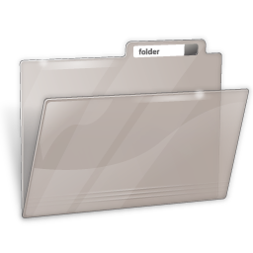

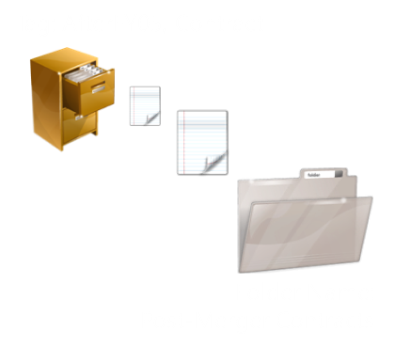


Collaboration to Archive
Site: Teams, Document Centers
Features: Managed Metadata, Document ID Service, Content Types
Site: Team Site/Document Center
Features: Search, Master Drop-off Library, Master Content Organizer
Site: Record Center
Features: Drop-off Library, Content Organizer, Records Library
Information Policies and Content Routing

Slide 15
Data Storage Architecture
  Key Takeaways
  Partition data files based on # of procs
  Put like workloads on same physical spindles
  Maximize throughput of IO intensive DBs (TempDB, SSA DBs) with RAID 10

Slide 16
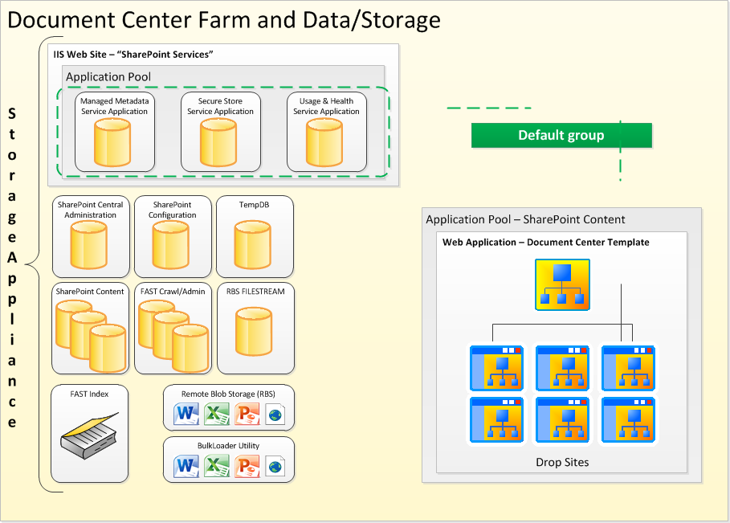
Logical Architecture

Slide 17

Distributed SharePoint Architecture
If created
in FY07…
Hub
FY07
FY08
…
Consistent types and policies across the archive
Enterprise Metadata and Content Types

Slide 18
RBS oVERVIEW

Slide 19
What is Remote Blob Storage?
Introduced in SharePoint 2010
Set of standardized APIs that allow storage/retrieval of BLOBs outside of your main SQL
Built by the SQL Server team
Enables moving bulk data onto cheaper storage than is required for SQL Server
Potential to reduce capital cost while increasing operational cost
ISV’s have built RBS providers

Slide 20
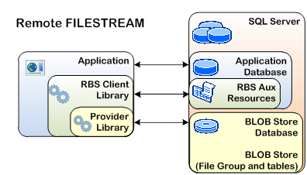
RBS Architecture Overview

Slide 21
RBS Myths Debunked
No SQL License Needed
RBS allows me to store data in the cloud
RBS allows for much larger document storage
RBS improves SharePoint performance
RBS breaks through the software boundaries and limits
RBS avoids having to backup the blobs

Slide 22
Common Questions
Q: Should I use the Microsoft RBS Provider?
  Supported by SharePoint 2010
  FILESTREAM is also supported
  Does not provide enterprise manageability features of third party providers
Q: What are the software pre-requisites for RBS?
  SQL Server 2008 (licensed)
  RBS Feature Pack for SQL Server 2008 R2 – note R2
  SharePoint 2010
Q: Can I use DASD, SAN, NAS with RBS?
  DASD and SAN = Yes
  iSCSI connected NAS = with remote file stream (SP1) or third party

Slide 23

Selecting a BLOB Storage Solution
Unstructured Data
Unstructured Data
Unstructured Data
Solution | Dedicated BLOB Store | File System or File Share | BLOBs in Database
Advantages | Lower cost per GB at scale Scalability & Expandability | Low cost per GB Streaming Performance | Integrated management Data-level consistency
Disadvantages | Complex application development & deployment Separate data management Enterprise-scales only | Complex application development & deployment Integration with structured data | Poor data streaming support File size limitations Highest cost per GB
Example | EMC Centera Fujitsu Nearline | Windows File Servers NetApp | SQL Server VARBINARY(MAX)

Slide 24
Limitations and Constraints
FILESTREAM Provider is limited local storage
  DAS, NAS, SAN are considered remote storage regardless of disk presentation
  Does not support compression, TDE, and other SQL Server capabilities
  Special constraints and limitations apply to BCM scenarios such as Database Mirroring and Log Shipping (see FAQ)
3rd party ISV solutions require SQL Server Enterprise Edition
  NAS storage devices require 20ms TTFB

Slide 25
FAST Search Archicture

Slide 26
Fast Search Overview
FAST needed to scale over 100 million documents
Effective Search
  Queries should be returned in under 5 seconds
  Should be able to support 5QPS+
Physical > Virtualization
DAS > SAN > NAS

Slide 27
FAST 500MM Farm topology

Slide 28
Fast Search Takeaways
A single crawldb can scale to 50M documents with FAST
  Each 50M document crawldb takes up about 270GB of disk space
Networking:
  1Gb/s NICs are acceptable
  Upgrade your switches to 10Gb/s
Use a proven storage configuration
Watch out for CPU bugs (fixed via microcode changes)

Slide 29
Scalability Considerations

Slide 30
IOPS Considerations
Content Database sizing – IOPS sizing much different for other SP and SQL databases
Your mileage will vary
  For “cold” content as little as .25 IOPS/GB
  For “hot” content as much as 2 IOPS/GB
Disk sub-system is essential to meeting IOPS requirements
TEST!!!
  What is your workload? Is it IO Intensive?
  Use SQLIO and SPDiag

Slide 31
Other Considerations
Property Promotion/Demotion
  Off by default on Records Center
  May want to consider if this is necessary in your design
SQL Server
  Pre-grow database files
  Optimize disk sub-system
Document ID Service
  Not 100% guaranteed unique IDs across farm
  Consider Custom Provider if multiple farms

Slide 32
Other Considerations
Virtualization
  May need to disable TaskOffloading
    CPU Optimization switch
    Need to test if necessary
    Enabled by default on virtual NIC when VM is provisioned
    netsh int ip set global taskoffload=disabled
List-throttling
  Watch for this on Managed Metadata Service
  5k limit – Cannot disable just for MMS

Slide 33
Key Takeaways
Usability and planning are essential to scalability
  Understand the architectural considerations when scaling SharePoint 2010
  It takes a team to effectively plan and design your SharePoint deployments

Slide 34
More Information
TechNet Capacity Planning Resource Center
http://technet.microsoft.com/en-us/sharepoint/ff601870.aspx
Boundaries and Limits Document on TechNet
http://technet.microsoft.com/en-us/library/cc262787.aspx
30 Million Item Test on TechNet
http://www.bing.com/search?q=LargeScaleDocRepositoryCapacityPlanningDoc.docx
Managing Mult-Terribyte Databasese
http://technet.microsoft.com/en-us/library/hh307867.aspx

Slide 35

Enrol in Microsoft Virtual Academy Today
Why Enroll, other than it being free?
The MVA helps improve your IT skill set and advance your career with a free, easy to access training portal that allows you to learn at your own pace, focusing on Microsoft technologies.
What Do I get for enrolment?
Free training to make you become the Cloud-Hero in my Organization
Help mastering your Training Path and get the recognition
Connect with other IT Pros and discuss The Cloud
Where do I Enrol?
www.microsoftvirtualacademy.com
Then tell us what you think. TellTheDean@microsoft.com

Slide 36

© 2010 Microsoft Corporation. All rights reserved. Microsoft, Windows, Windows Vista and other product names are or may be registered trademarks and/or trademarks in the U.S. and/or other countries.
The information herein is for informational purposes only and represents the current view of Microsoft Corporation as of the date of this presentation. Because Microsoft must respond to changing market conditions, it should not be interpreted to be a commitment on the part of Microsoft, and Microsoft cannot guarantee the accuracy of any information provided after the date of this presentation. MICROSOFT MAKES NO WARRANTIES, EXPRESS, IMPLIED OR STATUTORY, AS TO THE INFORMATION IN THIS PRESENTATION.

Slide 37




Resources
www.msteched.com/Australia
  Sessions On-Demand & Community
www.microsoft.com/australia/learning
Microsoft Certification & Training Resources
http:// technet.microsoft.com/en-au
  Resources for IT Professionals
http://msdn.microsoft.com/en-au
  Resources for Developers

