Slide 2
SESSION CODE: SEC201
Charles Ponniah Malcolm McCaffery
Senior SOE Architect SOE Architect
Fujitsu Australia New Zealand Fujitsu Australia New Zealand
Charles.Ponniah@au.fujitsu.com Malcolm.McCaffery@au.fujitsu.com
Twitter @deviance25 Twitter @chentiangemalc
Blog http://chentiangemalc.wordpress.com
“Windows XP still powers
60% of corporate desktops”
– Forrester Research (June 2011)
“….most organizations will not be
able to migrate to Windows 7 through usual planned hardware refresh before support for Windows XP ends.” - Gartner
Fujitsu’s User Initiated Windows 7 Migration
(c) 2011 Microsoft. All rights reserved.

Slide 3
Fujitsu’s User Initiated Windows 7 Migration
SESSION CODE: SEC201
Charles Ponniah Malcolm McCaffery
Senior SOE Architect SOE Architect
Fujitsu Australia New Zealand Fujitsu Australia New Zealand
Charles.Ponniah@au.fujitsu.com Malcolm.McCaffery@au.fujitsu.com
Twitter @deviance25 Twitter @chentiangemalc
Blog http://chentiangemalc.wordpress.com

Slide 4
Agenda How Fujitsu Can Assist You…
Save Money
Save Time
Empower Users

Slide 5
Introduction Who Are Fujitsu Desktop Services?
Desktop Management
SOE Engineering Service
Application Packaging Service
Mobile Device Management Service
Virtual Client Services
Test & Certification Service

Slide 6
Why User Initiated?

Slide 7
Design Goals
Quick
Informative
Robust

Slide 8
Demo – Live Migration To Windows 7

Slide 9
Traditional Migration Approaches
Big Bang
Hand held
Cowboy
Swap Out

Slide 10
User Initiated Approach
Join the new movement
Power to the people!

Slide 11
User Initiated Process
I Want Windows 7 Now!
Pre-Flight Check
Fujitsu
Local Pre-stage
Migration Kick-Off
Deployment & Data Migration
MS

Slide 12
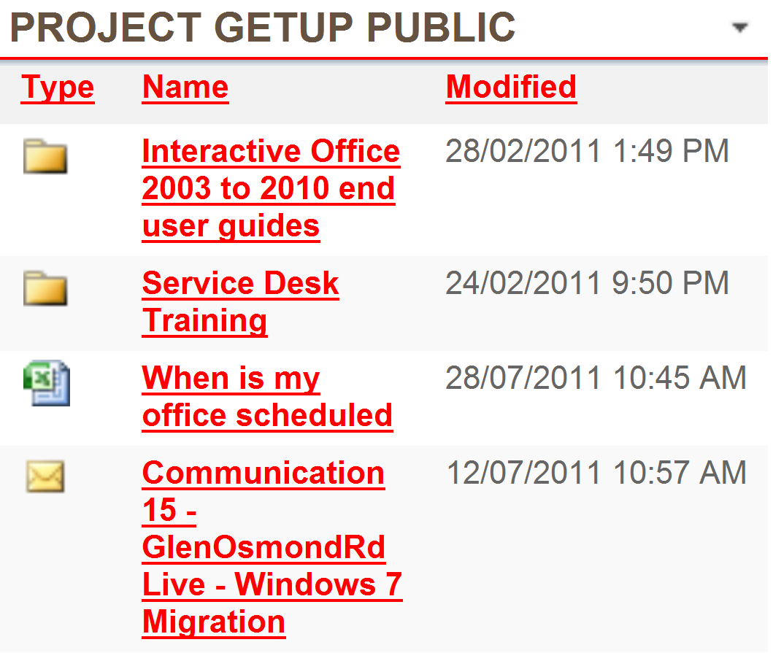
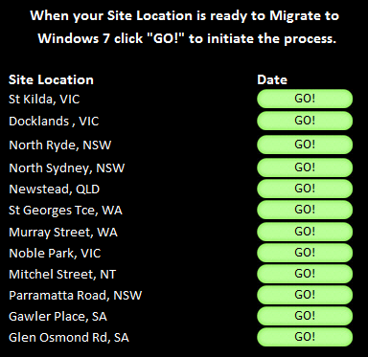
I Want Windows 7 Now!

Slide 13
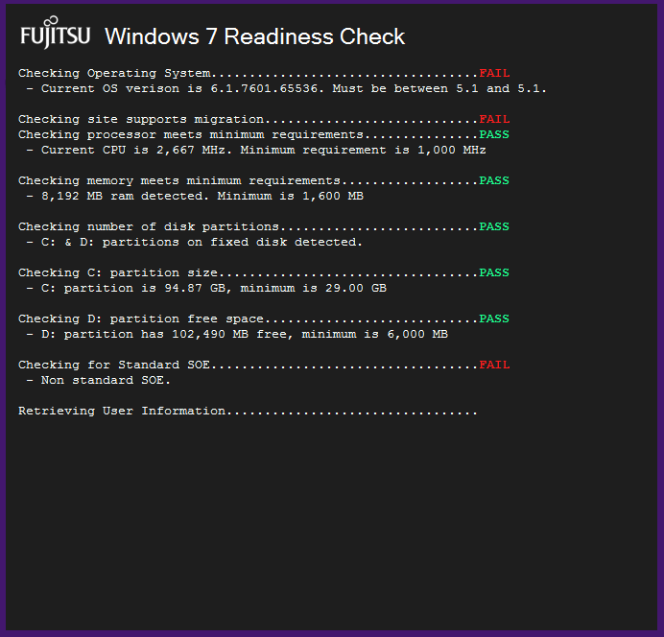
Pre-Flight Check

Slide 14
Local Pre-Stage
Windows 7 Image Copied Locally
Privilege Elevation Service Installed
Desktop Shortcut Installed

Slide 15
Migration Kick-Off

Slide 16
Deployment & Data Migration

Slide 17
Speed Stats
Pre-Stage 49 min
Deploy & Migrate 40 min

Slide 18
Fujitsu Provides the Sugar on Top
Fujitsu Customization
Fujitsu layers its development over Microsoft’s tools, scripts and templates.
MDT 2010 or SCCM

Slide 19
Fujitsu Flavoured Icing
Windows 7 Readiness
User State Migration
Productivity Tools
Mobility Centre

Slide 20
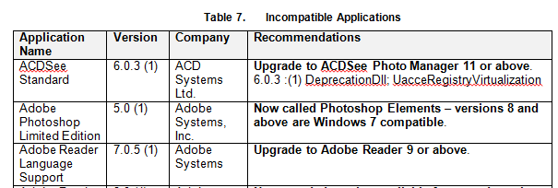
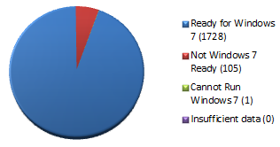
Windows 7 Readiness
Windows 7 Readiness

Slide 21
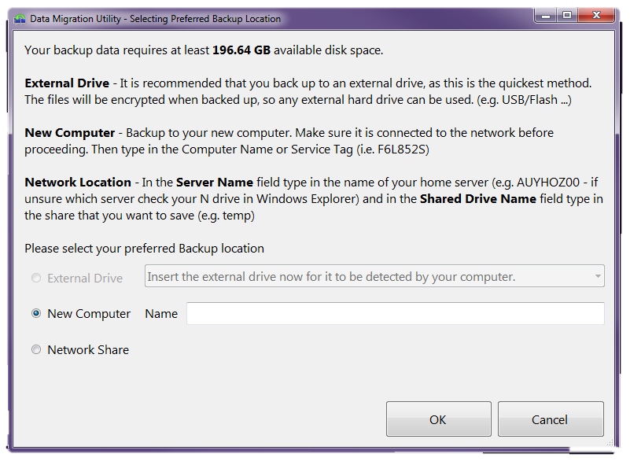
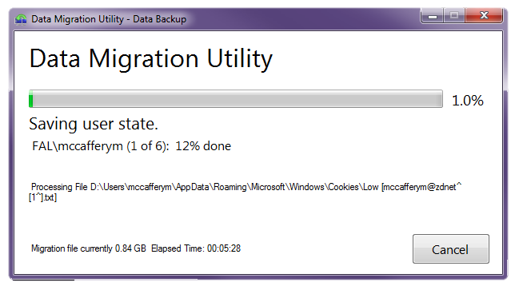
User State Migration
User State Migration

Slide 22
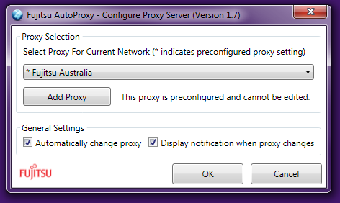
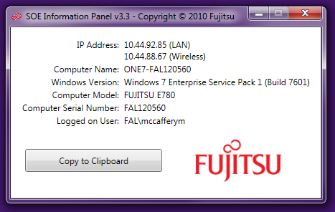
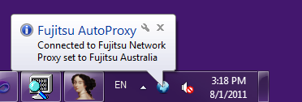
Productivity Tools
Productivity Tools

Slide 23
Mobility Centre

Slide 24
``
Fujitsu’s Use of the Microsoft Technology Stack
Application Compatibility Toolkit
Internet Explorer
Microsoft Assessment & Planning Toolkit 6.0
Microsoft Deployment Toolkit 2010 Update 1
Microsoft Desktop Optimization Pack (i.e. App-V)
Microsoft Office SharePoint Server 2007
User State Migration Tool 4.0
Visual Studio 2010 – C#.NET, WPF, COM, Win32 C++
Windows 7 Enterprise Service Pack 1
Windows PowerShell
Windows Server 2008 R2 (AD, DNS, DHCP, IIS, Hyper-V, etc)

Slide 25
Demo – Migration Completion

Slide 26
Biggest Challenge - Communication

Slide 27
Question & Answer Session

Slide 28
Fujitsu Can Assist You…
Save Money
Save Time
Empower Users

Slide 29
Enrol in Microsoft Virtual Academy Today
Why Enroll, other than it being free?
The MVA helps improve your IT skill set and advance your career with a free, easy to access training portal that allows you to learn at your own pace, focusing on Microsoft technologies.
What Do I get for enrolment?
Free training to make you become the Cloud-Hero in my Organization
Help mastering your Training Path and get the recognition
Connect with other IT Pros and discuss The Cloud
Where do I Enrol?
www.microsoftvirtualacademy.com
Then tell us what you think. TellTheDean@microsoft.com

Slide 30
Fujitsu’s User Initiated Windows 7 Migration
SESSION CODE: SEC201
Charles Ponniah Malcolm McCaffery
Senior SOE Architect SOE Architect
Fujitsu Australia New Zealand Fujitsu Australia New Zealand
Charles.Ponniah@au.fujitsu.com Malcolm.McCaffery@au.fujitsu.com
Twitter @deviance25 Twitter @chentiangemalc
Blog http://chentiangemalc.wordpress.com

Slide 31
© 2010 Microsoft Corporation. All rights reserved. Microsoft, Windows, Windows Vista and other product names are or may be registered trademarks and/or trademarks in the U.S. and/or other countries.
The information herein is for informational purposes only and represents the current view of Microsoft Corporation as of the date of this presentation. Because Microsoft must respond to changing market conditions, it should not be interpreted to be a commitment on the part of Microsoft, and Microsoft cannot guarantee the accuracy of any information provided after the date of this presentation. MICROSOFT MAKES NO WARRANTIES, EXPRESS, IMPLIED OR STATUTORY, AS TO THE INFORMATION IN THIS PRESENTATION.

