Slide 2
Unlock the power of User Device Affinity in SCCM 2012
SESSION CODE: #SEC309
James Bannan
@jamesbannan
www.jamesbannanit.com

Slide 3
#SEC309 Agenda
What is User Device Affinity (UDA)?
What makes UDA possible?
Intelligent Application Deployment

Slide 4
What is User Device Affinity?
“Af-fin-i-ty”, noun:
Similarity of characteristics suggesting a relationship

Slide 5

What is User Device Affinity?
Matches users to workstations
Many/many relationship
Allows elegant and intelligent application delivery

Slide 6

UDA Scenario - The Executive
Business-driven
Doesn’t care about corporate IT
Considers every PC a personal resource

Slide 7

UDA Scenario - The Junior Team
Not allocated individual machines
Share a resource pool

Slide 8
Intelligent Application Delivery
DEMO

Slide 9
What Makes UDA Possible?
User/Device Collection Equivalence
Primary User/Primary Device
New Application Model
Software Catalog (Catalogue! wince…)

Slide 10
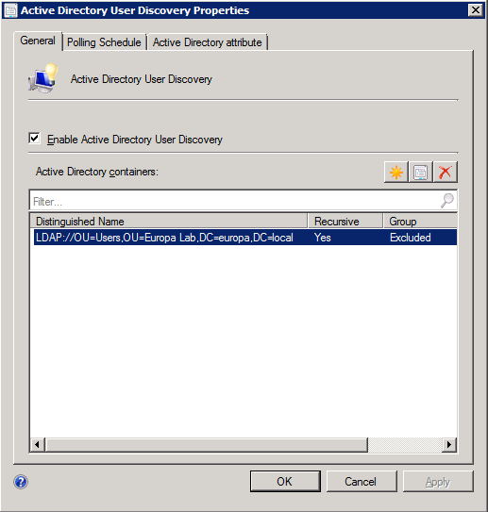
User Collections
Discovery
Polls multiple OUs for users/groups
Delta discovery every 5 minutes
Can discover extended AD attributes

Slide 11
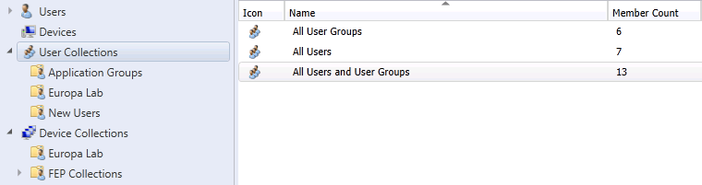
User Collections
Equivalence

Slide 12
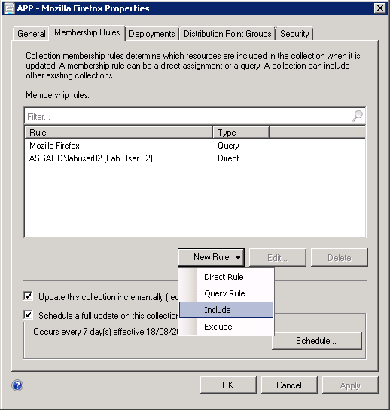
User Collections
Membership
Direct Rule
Query Rule (WQL)
Include (collection)
Exclude (collection)

Slide 13

Primary User/Primary Device
Assignment Options
Admin-specified
User-specified
CM client-specified
OSD-specified

Slide 14
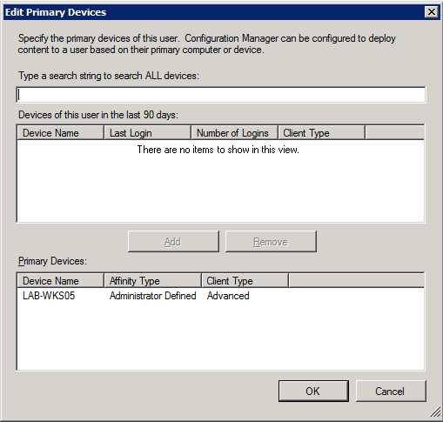
Primary User/Primary Device
Admin-specified
Individual assignments via Admin UI
Bulk CSV import

Slide 15
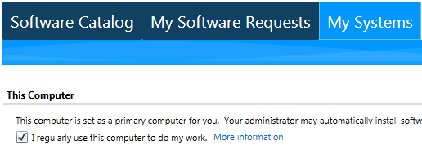
Primary User/Primary Device
User-specified
Self-service via Software Catalog
Controlled via Client Settings (default disabled)

Slide 16
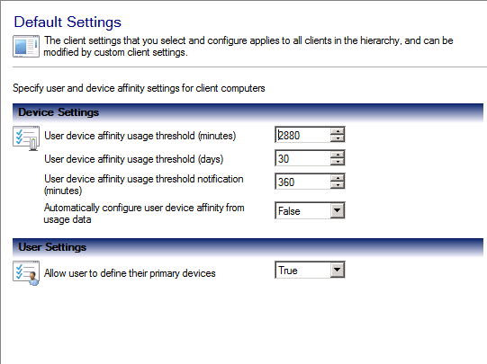
Primary User/Primary Device
CM client-determined
Disabled by default
Usage creates Affinity Requests in Admin UI
Different settings for different collections

Slide 17
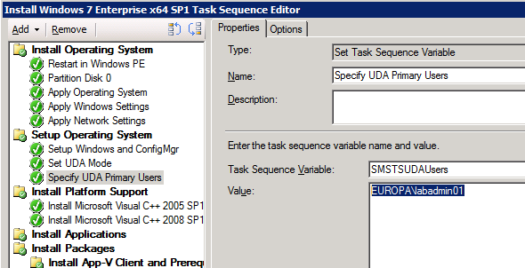
Primary User/Primary Device
OSD-specified
New SCCM variables for UDA:
  SMSTSAssignUsersMode
  SMSTSUDAUsers
“OSD Defined” in Admin UI

Slide 18
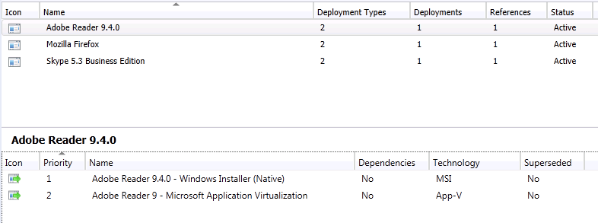
New Application Model
Multiple Deployment Types per application (eg: MSI, App-V)
Deployment Type Priorities
Dependencies
Supercedence

Slide 19
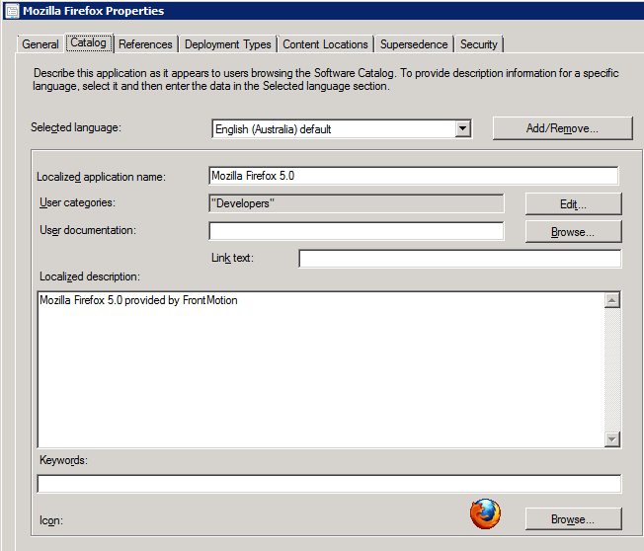
New Application Model
Not available for “Classic” Programs
Custom appearance in Software Catalog

Slide 20
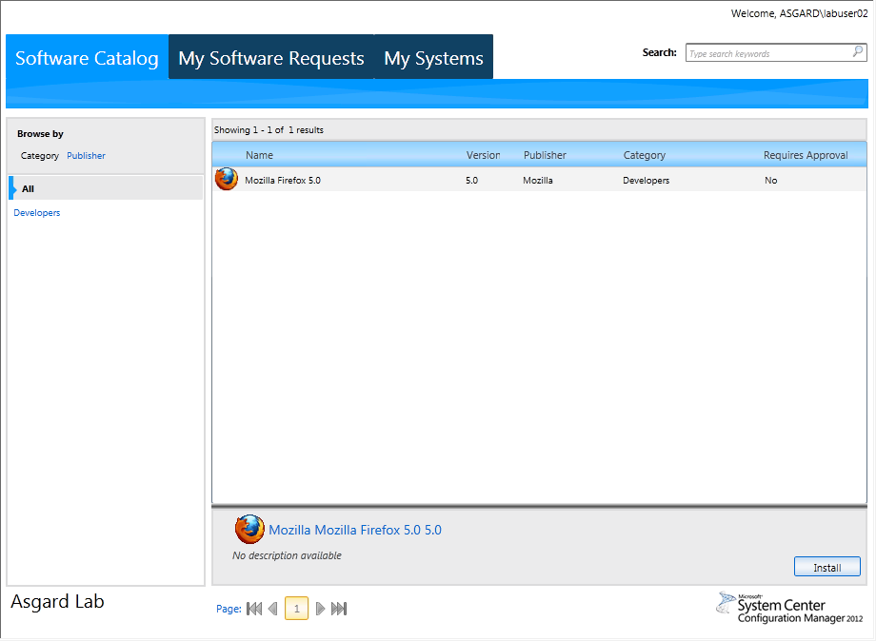
Software Catalog
User’s View
Shows applications assigned to users
Common across all systems
Allows users to install/request applications

Slide 21
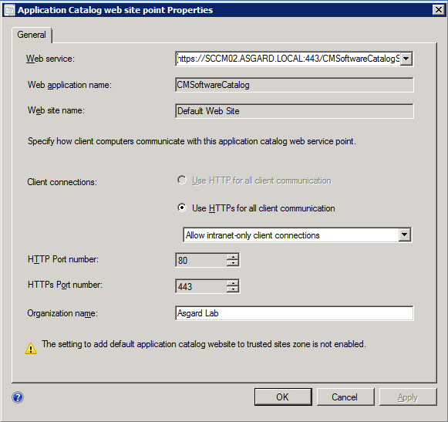
Software Catalog
Infrastructure
Uses Service Point and Site Point server roles
Multiple sites possible
Externally-accessible
Default site controlled by agent and defined in Client Settings

Slide 22
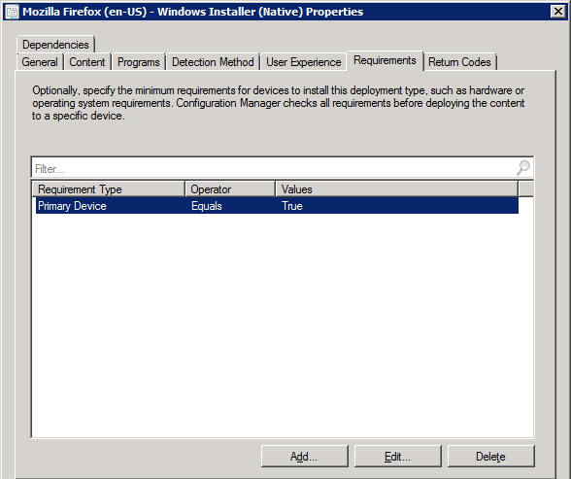
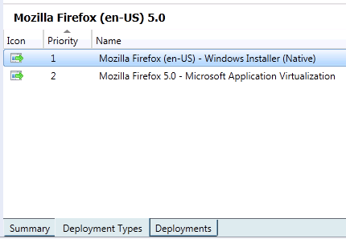
Intelligent Application Deployment
Deploy Application to User Collection
Use Primary Device test to differentiate Deployment Types

Slide 23
Creating a UDA Deployment
DEMO

Slide 24
Satisfied Users FTW

Slide 25

Enrol in Microsoft Virtual Academy Today
Why Enroll, other than it being free?
The MVA helps improve your IT skill set and advance your career with a free, easy to access training portal that allows you to learn at your own pace, focusing on Microsoft technologies.
What Do I get for enrolment?
Free training to make you become the Cloud-Hero in my Organization
Help mastering your Training Path and get the recognition
Connect with other IT Pros and discuss The Cloud
Where do I Enrol?
www.microsoftvirtualacademy.com
Then tell us what you think. TellTheDean@microsoft.com

Slide 26




Resources
www.msteched.com/Australia
  Sessions On-Demand & Community
www.microsoft.com/australia/learning
Microsoft Certification & Training Resources
http:// technet.microsoft.com/en-au
  Resources for IT Professionals
http://msdn.microsoft.com/en-au
  Resources for Developers

Slide 27

© 2010 Microsoft Corporation. All rights reserved. Microsoft, Windows, Windows Vista and other product names are or may be registered trademarks and/or trademarks in the U.S. and/or other countries.
The information herein is for informational purposes only and represents the current view of Microsoft Corporation as of the date of this presentation. Because Microsoft must respond to changing market conditions, it should not be interpreted to be a commitment on the part of Microsoft, and Microsoft cannot guarantee the accuracy of any information provided after the date of this presentation. MICROSOFT MAKES NO WARRANTIES, EXPRESS, IMPLIED OR STATUTORY, AS TO THE INFORMATION IN THIS PRESENTATION.

