Slide 1
Turn Bare Metal Into Silver Lining With SCVMM 2012, Today!
SESSION CODE: SEC313
Mark Rhodes
OBS

Slide 2
Agenda
Introduction
What is new in SCVMM 2012
Demo
Bare Metal Deployment
Fabric Configuration
Adding Hosts
Creating a Private Cloud
Deploying to a Private Cloud
Conclusion
Key Take Aways

Slide 3
Weather Forecast : Cloudy Weather
Clouds are going to become more and more common
Cloud technology is not a new concept
Consumers expect Off the Shelf solutions

Slide 4
Cloud Computing Enables You to Deliver IT as a Service to Your Business
Self-Service
Scalable & Elastic
Metered by Use
Shared
Accelerating the Speed
& Lowering the Cost of IT…
while delivering Reliable Services

Slide 5
SCVMM 2012 Investment Areas
Deployment
Fabric
Cloud
Services
Infrastructure
Enhancements
HA VMM Server
Upgrade
Custom properties
Powershell
Cloud Management
Application Owner Usage
Delegation and Quota
Capacity and Capability
Service Management
Application Deployment
Image Based Servicing
Custom Command Execution
Service Templates
Fabric
Management
Bare Metal Provisioning
Update Management
Hyper-V, VMware, XenServer
Dynamic Optimization
Network Management
Power Management
Storage Management
Cluster Management

Slide 6
SCVMM – Deployment Components
Visio / Graphic goes here.

Slide 7
SCVMM 2012 – Bare Metal Deployment

Slide 8
Using SCVMM 2012 to deploy to bare metal
Demonstration

Slide 9
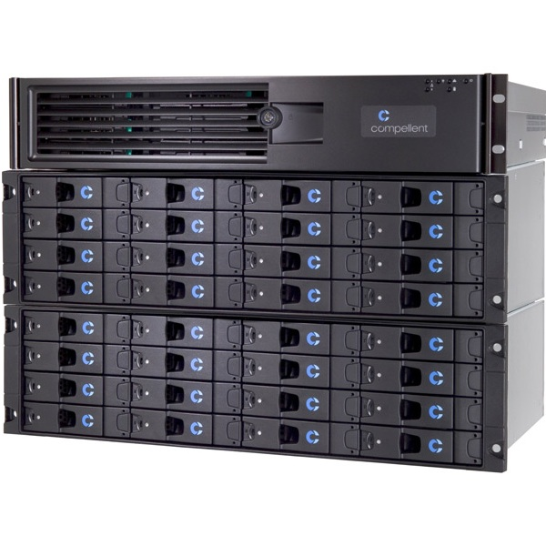
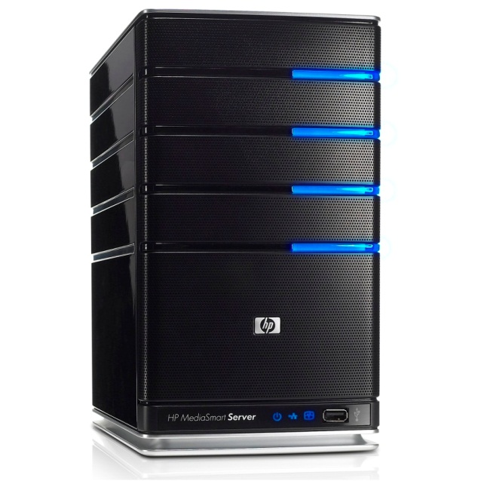
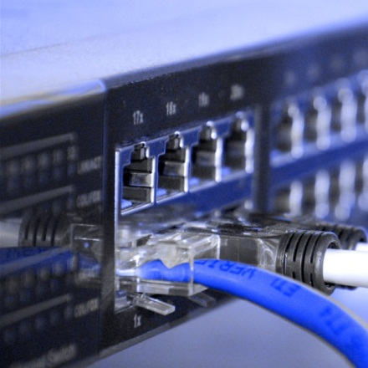
The Concept Of Fabric

Slide 10
Fabric Management
Physical Server
Manage multiple hypervisors – Hyper-V, VMware, Xen
Server hardware management – IPMI, DCMI, SMASH, Custom via Provider
Host provisioning – from baremetal to Hyper-V to Cluster provisioning
Network
Define Logical Networks using VLANs and Subnets per datacenter location
Address management for Static IPs, Load Balancer VIPs and MAC addresses
Automated provisioning of Load Balancers via Provider
Storage
Storage Management using SMI-S
Discover storage arrays and pools
Classify storage based on throughput and capabilities
Discover or configure LUNs and assign to hosts and clusters
Rapid provisioning of VMs using snap cloning of LUNs

Slide 11
Configuring SCVMM Fabric
Demonstration

Slide 12
What is a Private Cloud?
Designed for a Single Organisation
, Elastic and ProvisiScalableoning On Demand
Self-Service that anyone can use

Slide 13
SCVMM 2012 & Private Clouds
A managed pool of resources to consume
Self-Service for fast and convenient provisioning
Offering not just limited to Single Servers

Slide 14
Create a private cloud
Demonstration

Slide 15
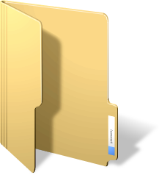
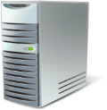
User Roles and Scopes
VMM Admin
Delegated Admin
Read-only Admin
Self-Service User

Slide 16
Configure Security Roles
Demonstration

Slide 17
Controlling Usage by Self Service Users
Revocable actions – fine-grained action control
Author, VM Control, Read-only
Quota – 2 Types of Quota
Shared – total usage of all members of the user role
Per-user – usage of each member of the user role
Dimensions of Quota
vCPUs
Memory
Storage
Number of deployed VMs (VMs in Library are not counted)
Custom Quota (Backwards Compat from VMM 2008 R2)

Slide 18
Self-Service – deploy to private cloud
Demonstration

Slide 19
Key Points
Private cloud within reach of most Administrators
Self-Service is now convenient and accessible
Easy to setup and deploy

Slide 20
Enrol in Microsoft Virtual Academy Today
Why Enroll, other than it being free?
The MVA helps improve your IT skill set and advance your career with a free, easy to access training portal that allows you to learn at your own pace, focusing on Microsoft technologies.
What Do I get for enrolment?
Free training to make you become the Cloud-Hero in my Organization
Help mastering your Training Path and get the recognition
Connect with other IT Pros and discuss The Cloud
Where do I Enrol?
www.microsoftvirtualacademy.com
Then tell us what you think. TellTheDean@microsoft.com

