Slide 2
Top 10 Windows Deployment Service Common Issues and How to Resolve Them
SESSION CODE: SVR301
Rhonda J. Layfield
Sr. Deployment Architect
Deployment Done Right

Slide 3
Rhonda Layfield
IT industry 30 years
Contribute articles to Windows IT Pro mag
Setup and Deployment MVP
Desktop Deployment Product Specialist (DDPS)
Consulting
Training
  Hands on deployment class

Slide 4
What I’ll Cover
WDS – The Basics
  Installing and Configuring WDS
10) DHCP and WDS
9) DNS and WDS
8) Windows Pre Installation Environment “WinPE”
7) Create an OS Image
6) Permissions
5) Pre-Staged Settings Ignored
4) Multicast Issues
3) Automate the Deployment
2) Rename/Move WDS Server

Slide 5
WDS – The basics

Slide 6
WDS Requirements
DHCP
1
AD/DNS
2
3
Bare-Metal
WDS

Slide 7
Install WDS
Install WDS on a 2008 R2 SP1 server
  Server Manager
  Add Roles
  Select Windows Deployment Services from the list of roles

Slide 8
Configure WDS
Choose where to store your images
DHCP Options
PXE Server Settings

Slide 9
Configure WDS
Demo

Slide 10
10 – DHCP and WDS

Slide 11
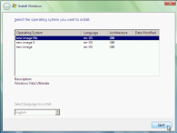
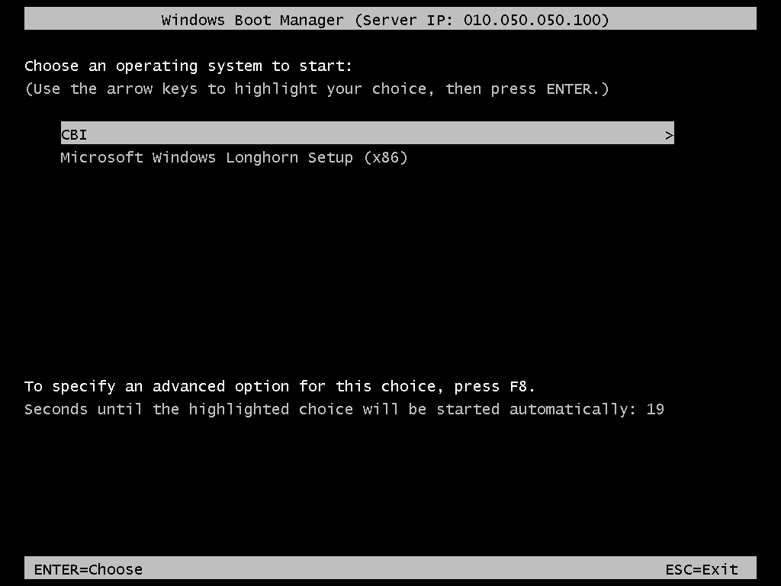
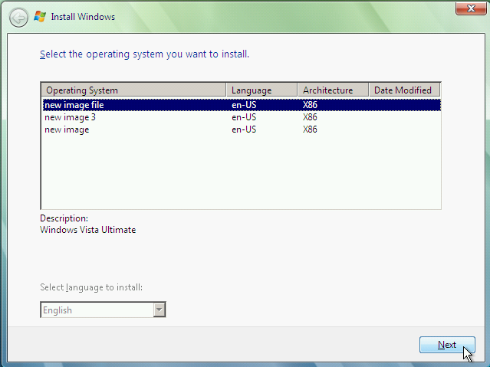
DHCP DORA Process
Discover IP
DHCP/WDS
Bare-Metal
Offer IP/PXE Server
Request
Acknowledge

Slide 12
WDS & DHCP
3 Scenarios
  WDS and DHCP on the same subnet/ different servers
    Client will find WDS by broadcasting
  WDS and DHCP on different subnets
    Client must find WDS through options 66 and 67 set in DHCP
  WDS & DHCP on same server
    Client must find WDS through Option 60 in DHCP

Slide 13
WDS & DHCP Same Subnet
DHCP
Bare-Metal
Request
Acknowledge
Discover IP/PXE Server
Offer IP
Discover IP/PXE Server
WDS
I’m WDS

Slide 14
WDS & DHCP Different Subnets
DHCP
Bare-Metal
Discover IP/PXE Server
Offer IP Option 66 Option 67
Acknowledge
Request
WDS

Slide 15
WDS & DHCP on The Same Server
Discover IP
DHCP / WDS
Bare-Metal
Offer IP Option 60 I’m also WDS
Request
Acknowledge

Slide 16
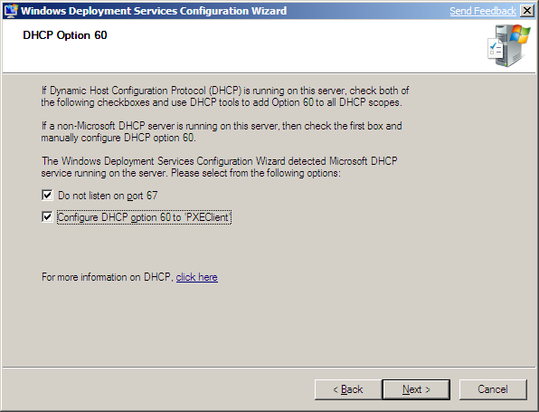
WDS And DHCP on The Same Server?

Slide 17
Notes From the field
Infrastructure team sets up a new DHCP server
De-commission the old one
AND they forget to set the WDS options

Slide 18
DHCP Options

Slide 19
9) WDS and DNS

Slide 20
WDS and DNS
WDS and DNS running on the same server may introduce a problem
  The DNS service binds to all ports needed by WDS
    The default WDS port range is 64,000 to 65,000
I’ve run into this when DNS is installed first
  Like on a DC running DNS
Or after installing MS08-037
To resolve the issue change the ports for WDS

Slide 21
WDS Ports

Slide 22
8) Windows Pre Installation Environment:
WinPE

Slide 23
Windows Pre installation Environment: Winpe
You can create your own custom WinPE
  Using the Windows Automated Installation Kit (WAIK)
    Copype utility
WinPE found on a Windows 7 or Server 2008 R2 DVD (or .ISO)
  \Sources folder
  Named Boot.wim

Slide 24
Which WinPE To Use…
The most current is always best
Windows 7 SP1 Boot.wim can deploy
  Vista SP1
  Windows Server 2003 R2
  Windows 7 & SP1
  Server 2008 & R2 & SP1
Accidently use a Vista or Vista SP1 boot.wim?
  Vista boot.wim cannot deploy W7 or 2K8 R2
  Failure on the Offline servicing pass even if it’s not configured to install patches
  The error looks like this:

Slide 25
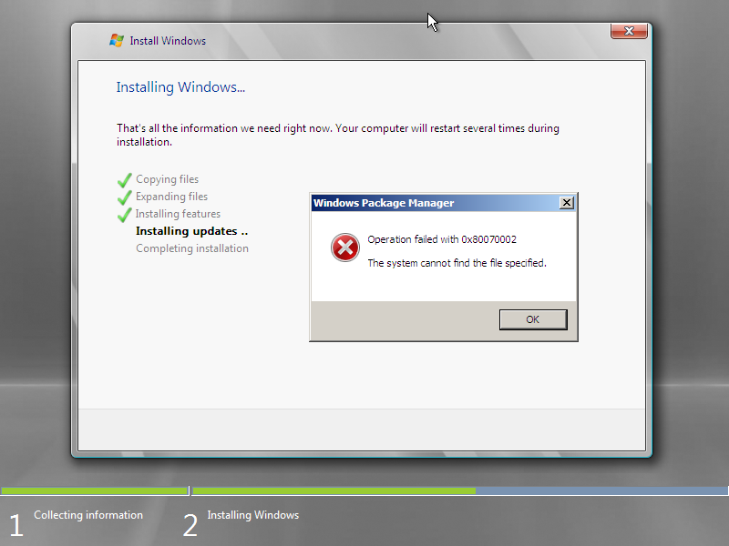
Using an Old Boot.wim

Slide 26
WinPE

Slide 27
WinPE and Architectures
Boot a x86 WinPE
  Both x86 and x64 install images
Boot a x64 WinPE
  Only x64 install images

Slide 28
7) Create an OS image

Slide 29
Create an Image to Deploy
WDSCapture WinPE
  Add boot.wim from a 2K8 Server or Windows 7 .ISO
  Right-click the boot.wim and choose “Create capture image…”
  Add the new .wim file that you just created
Sysprep
  -reseal
  generalize

Slide 30
Create an Image

Slide 31
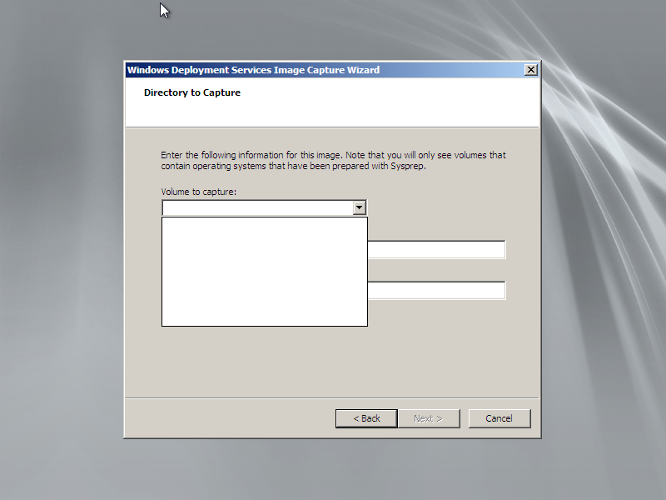
Boot WDS Capture
No Volume to capture?

Slide 32
6) Permissions

Slide 33
Notes From The Field
Domain Administrator account is used all too often
Use least privilege
To that end…

Slide 34
Who Can Deploy Which Images
Default Permissions
Local administrator on the WDS server
  Full Control of the RemoteInstall folder
  Full Control permissions on HKEY_LOCAL_MACHINE\System
Domain administrator (domain where the WDS server resides)
  Full Control permissions on the Service Control Point (SCP) in AD DS for the WDS server.

Slide 35
Permissions Continued
Enterprise administrator
  Dynamic Host Configuration Protocol (DHCP) authorization permissions
Admin Approval
  The computer account is created using the server’s authentication token (not the admins token performing the approval)
  WDSSERVER$ must have “create computer account objects” on the containers / OUs where the approved pending computers will be created

Slide 36
Admin Approval Continued
Admin Approval of Pending Computers
  R/W to the F:\RemoteInstall\MGMT
  contains Binlsvcdb.mdb
Active Directory Users and Computers
  Create a custom task to delegate on OU where the computer account will be created -> Write all properties on Computer Objects

Slide 37
Join a Machine To a Domain
ADUC
  R-click the container or OU and go to Properties
  Click the Advanced button and add a user or group then click the Edit button
  Under Apply to: This object and all descendant objects
  Allow “Create Computer objects” Ok (3x)
BUT now that user can create computer objects and join machines to the domain
What if you only want someone to be able to join a machine to the domain?

Slide 38
The JoinRights Setting Part 1
JoinRights registry setting determines the set of security privileges
located at: HKEY_LOCAL_MACHINE\SYSTEM\CurrentControlSet\Services\WDSServer\Providers\WDSPXE\Providers\BINLSVC\AutoApprove\<arch>
Name: JoinRights
Type: DWORD
Value: 0 = JoinOnly.; 1 = Full

Slide 39
The JoinRights Setting Part 2
The User registry setting determines which users have the right to join the domain
User setting located at: HKEY_LOCAL_MACHINE\SYSTEM\CurrentControlSet\Services\WDSServer\Providers\WDSPXE\Providers\BINLSVC\AutoApprove\<arch>
Name: User
Type: REG_SZ
Value: group or user.

Slide 40
Common Permissions
TASK | Permission
Prestage a computer | ADUC -> Create a custom task to delegate on OU where you are putting the computer account -> Write all properties on Computer Objects
Add/Remove Image or Image Group | FC F:\RemoteInstall\Images\ImageGroup
Disable an image | R/W for the image (on image properties in WDS)
ADD boot image | R/W F:\RemoteInstall\Boot R/W F:\RemoteInstall\Admin (if upgrading from 2K3 server)
Remove boot image | R/W F:\RemoteInstall\Boot

Slide 41
Common Permissions
TASK | Permission
Manage properties on an OS image | R/W on image Res.rwm file found: F:RemoteInstall\Images\<ImageGroup>
Convert a RIPREP image | R original RIPREP image R/W %TEMP% and destination folder
Create Discover / Capture image | R original boot image R/W %TEMP% and destination folder
Create a multicast transmission | FC on: HKEY_LOCAL_MACHINE\SYSTEM\CurrentControlSet\Services\WDSServer\Providers\Multicast R F:\RemoteInstall\Images\<ImageGroup>

Slide 42
5) Pre-Staged Settings Ignored
Ensure there are not duplicate machine accounts pre-staged for the same machine
  Pre-stage using the MAC address
  Swap the NIC to another machine
  Dual Admins
    1st admin creates a computer object in ADUC
    2nd admin pre-stages a computer object with the NIC or GUID
The first one found is used

Slide 43
4) Multicast Issues
Multicast traffic running really slow
Which version of IGMP is being used?
  V3 or v2?
Multiple WDS servers multicast traffic
  Overlapping IP addresses
  WDS snap-in -> Properties of Server -> Multicast tab -> change the IP addresses

Slide 44
3) Automate The Deployment
Unattend .xml scripts (2)
XP & 2K3 vs Vista and later
Unattend.xml does not process settings
  Not named properly
  Not stored in the correct folder

Slide 45
2) Rename/Move WDS Server
Renaming a machine
Moving a machine from one domain to another
You’ll need to uninitialize & reinitialize WDS server
  From a cmd on the WDS server
  Wdsutil /uninitialize-server
  Wdsutil /initialize-server /reminst:E:\RemoteInstall

Slide 46
1) IMHO: Not Integrating WDS With MDT 2012
Microsoft Deployment Toolkit 2012 is a free download
Gives you so much more flexibility
Management of your images is much simpler
To get the most out of your deployments integrate WDS and MDT

Slide 47
MDT & WDS Together
MDT
Deployment Server
W7 DVD
MDT WinPE
Model
Store Image
Download Image
WDS Server
MDT WinPE
MDT can use WDS Multicast feature
F12
Targets
Notes:
47

Slide 48
What We Covered
WDS – The Basics
  Installing and Configuring WDS
10) DHCP and WDS
9) DNS and WDS
8) Windows Pre Installation Environment “WinPE”
7) Create an OS Image
6) Permissions
5) Pre-Staged Settings Ignored
4) Multicast Issues
3) Automate the Deployment
2) Rename/Move WDS Server

Slide 49

Enrol in Microsoft Virtual Academy Today
Why Enroll, other than it being free?
The MVA helps improve your IT skill set and advance your career with a free, easy to access training portal that allows you to learn at your own pace, focusing on Microsoft technologies.
What Do I get for enrolment?
Free training to make you become the Cloud-Hero in my Organization
Help mastering your Training Path and get the recognition
Connect with other IT Pros and discuss The Cloud
Where do I Enrol?
www.microsoftvirtualacademy.com
Then tell us what you think. TellTheDean@microsoft.com

Slide 50




Resources
www.msteched.com/Australia
  Sessions On-Demand & Community
www.microsoft.com/australia/learning
Microsoft Certification & Training Resources
http:// technet.microsoft.com/en-au
  Resources for IT Professionals
http://msdn.microsoft.com/en-au
  Resources for Developers

Slide 51

© 2010 Microsoft Corporation. All rights reserved. Microsoft, Windows, Windows Vista and other product names are or may be registered trademarks and/or trademarks in the U.S. and/or other countries.
The information herein is for informational purposes only and represents the current view of Microsoft Corporation as of the date of this presentation. Because Microsoft must respond to changing market conditions, it should not be interpreted to be a commitment on the part of Microsoft, and Microsoft cannot guarantee the accuracy of any information provided after the date of this presentation. MICROSOFT MAKES NO WARRANTIES, EXPRESS, IMPLIED OR STATUTORY, AS TO THE INFORMATION IN THIS PRESENTATION.

