Slide 2
Building High-Performance Infrastructure for your Applications
SESSION CODE: SVR304
Paul Lamb Louie Haviaridis
South Pacific Presales Manager Technical Specialist
HP HP

Slide 3

The Instant-On Enterprise
IT turns business & government “on,” instantly
Everything & everyone’s connected
Everyone expects immediate gratification & instant results
Enterprise & IT are one and the same
Respond to continuous opportunity & competition
Anywhere, Any time, Any way
Notes:
Coaching tips:
Make sure you drive home that HP has been leading this path with real investments in customer environments today. Paint the big picture of convergence, more than HW, but process, tools all the way to facilities. It is the mega-trend and the right architectural strategy to take maximum advantage of virtualization, cloud/as-a-service, and Green IT and other strategic customer initiatives.

Slide 4

What’s stopping you?
Aging facilities and IT sprawl
30%
New IT Project
Initiatives
70%
Ongoing IT Operations
INNOVATION OPERATIONS
Need to flip the ratio from operations to innovation

Slide 5








Accelerate IT with HP Converged Infrastructure
Storage
AUTOMATE
Servers
HP
Converged Infrastructure
Network
VIRTUALIZE
Power, cooling & facilities
Management software
STANDARDIZE
Security
Services
KEY STEPS
Notes:
Coaching tips:
Make sure you drive home that HP has been leading this path with real investments in customer environments today. Paint the big picture of convergence, more than HW, but process, tools all the way to facilities. It is the mega-trend and the right architectural strategy to take maximum advantage of virtualization, cloud/as-a-service, and Green IT and other strategic customer initiatives.

Slide 6
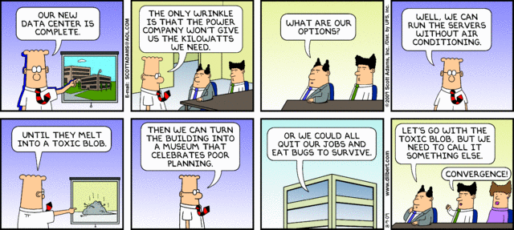
You know you’ve made it when…
6
© Copyright 2011 Hewlett-Packard Development Company, L.P. The information contained herein is subject to change without notice.

Slide 7





The strategic role of the CIO is changing
Becoming a builder and broker of services
Transform
legacy infrastructure and applications and processes
Manage and secure
across legacy applications
and cloud assets
Build
on-premises
cloud services
Consume
off-premises
services securely
Traditional
Private
Public

Slide 8
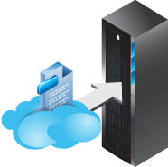



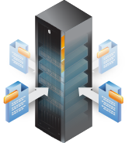
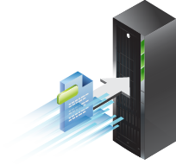
HP Converged Systems
Accelerating time-to-application value
Storage
cloudsystem
Servers
Networking
virtualsystem
Management software
appsystems

Slide 9
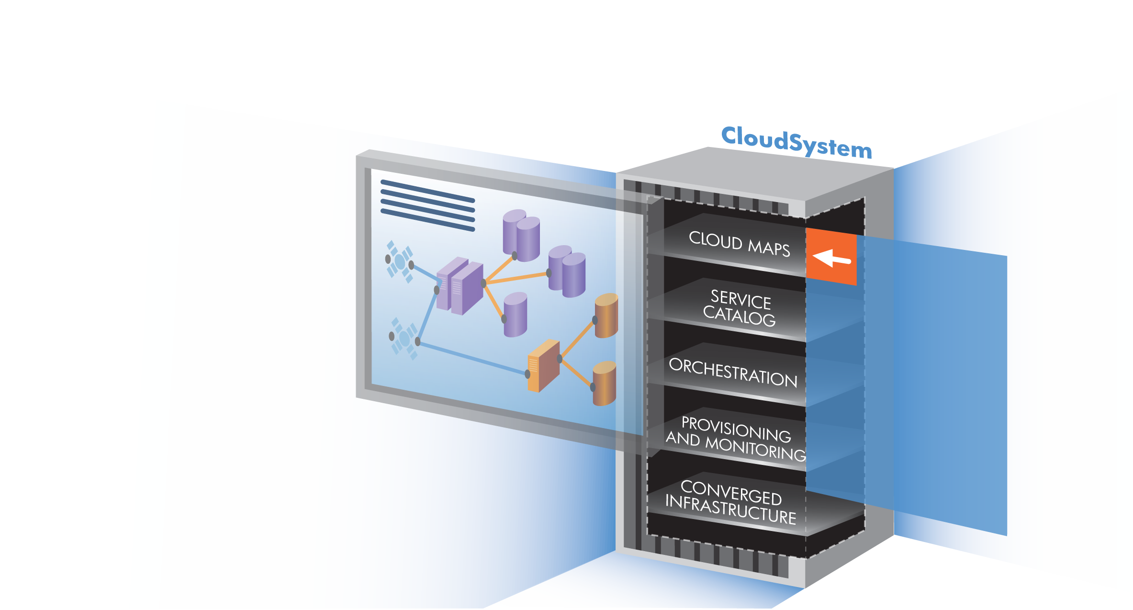







HP Converged Systems – CloudSystem
The most complete, open, integrated system to build and manage clouds
Key differentiators
  Single services view across
  private, public and hybrid cloud
  Multi-hypervisor, multi-OS, heterogeneous infrastructure
  Intelligent automation and lifecycle management application-to-infrastructure
  Scalability with built-in bursting
  Converged Infrastructure
  built for the cloud

Slide 10






HP VirtualSystem
Changing expectations of what virtualised solutions should be
Hypervisor
Highly integrated, highly optimised systems delivered as one
Management
Security
Services
Networking
Best-of-breed partnerships
Storage
Servers

Slide 11




The Power of Converged Infrastructure
Industry-leading technology at every layer of the stack
Applications
HP AppSystems
Management
Networking
Highly optimised appliances delivered as one
Services
Storage
Servers

Slide 12





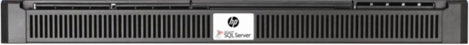
Introducing HP AppSystems for Microsoft environments
Performance-optimised solutions for business-critical applications
Analytics
Data Management
Collaboration
HP Business Decision Appliance
HP Business Data Warehouse
HP Enterprise Data Warehouse
HP E5000 Messaging System

Slide 13
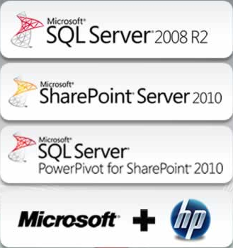
HP Business Decision Appliance
Pre-configured, tested and optimised jointly with Microsoft
  HP ProLiant DL360 Generation 7 + HP Insight Control management suite
  (2 x Intel X5650 6-core CPUs, 96GB RAM, 8 x 300GB disks, RPS, iLO3 management)
  Microsoft Windows Server 2008 R2 Enterprise Edition
  Microsoft SharePoint Server 2010*
  Microsoft SQL Server 2008 R2 Enterprise*
  HP support services for HP and Microsoft components

Slide 14
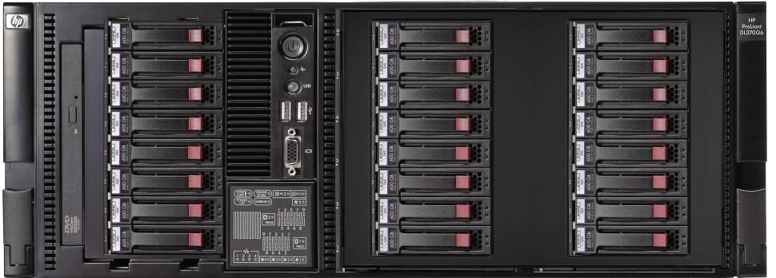

HP Business Data Warehouse Appliance
Purpose configured hardware built around HP-Microsoft best practises
  HP ProLiant DL370 G6 + HP Insight Control management suite
  (2 x Intel X5675 6-core CPUs, 96GB RAM, 2 x 300GB + 22 x 600GB disks, RPS, iLO3)
  Microsoft Windows Server 2008 R2 Enterprise Edition
  Microsoft SQL Server 2008 R2 Enterprise*
  HP Quick Deployment Tool + HP Business Data Warehouse DDL and Data Load Wizard
  HP support services for HP and Microsoft components

Slide 15

HP Enterprise Data Warehouse Appliance
Massive parallel scale-out query processing
  Up to 200x faster queries¹
  HP and Microsoft joint offering with ProLiant infrastructure and MPP software layer to function as a single entity
  10x better scalability than SMP—to 509 TB¹ (1 control rack and up
  to 4 data racks)
  High speed, low latency interconnects (Infiniband)
  SQL Server 2008 R2 Parallel Data Warehouse Edition* + Microsoft HPC Pack*
  Push-button update technology
  Factory integration, site assessment, Installation and Support Services included
1. Compared to existing SMP SQL

Slide 16
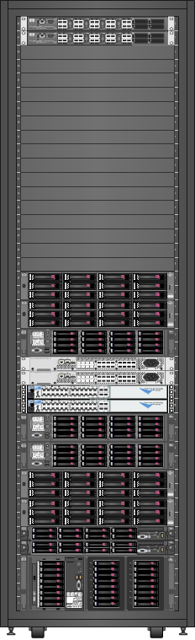
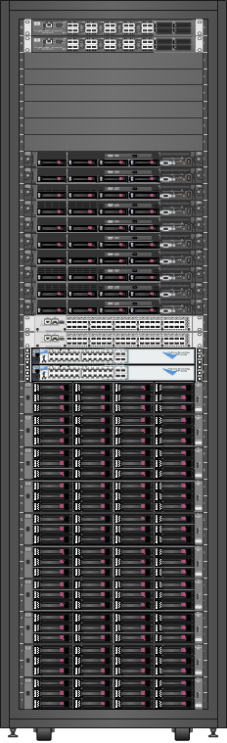
HP Enterprise Data Warehouse Physical View
Management Nodes (2)
Landing Zone (1)
Control Nodes (2)
Backup Node (1)
P2000 G3 Storage (2)
Compute Nodes (11)
P2000 G3 Storage (10)
Control Rack – Front View
Data Rack – Front View

Slide 17
HP Enterprise Data Warehouse Physical View (max. config)
Control Rack (1)
Data Racks (4)

Slide 18
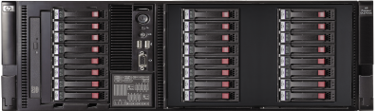

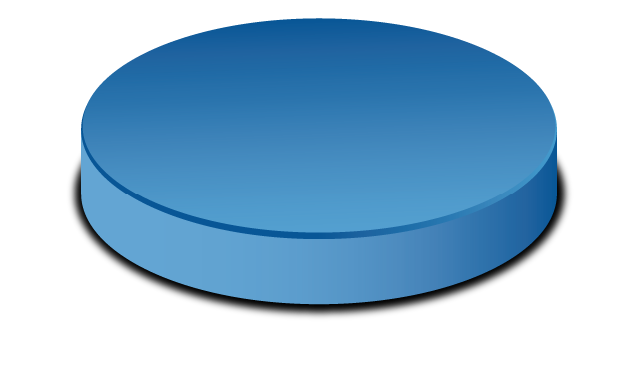
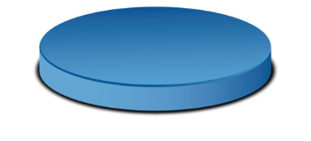

HP Data Warehouse Appliance Scenarios
Spoke in HP Enterprise Data Warehouse “Hub and Spoke” Architecture
Data Mart or Small
Data Warehouse
18
Notes:
18

Slide 19
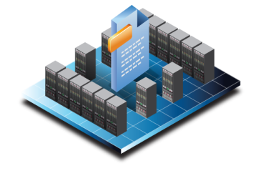

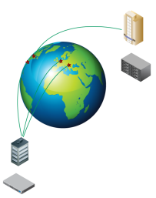



HP E5000 messaging system for Microsoft Exchange 2010
Complete Solution Simplifies Planning & Deployment
Turnkey deployment with pre-sized, tested, and optimised configurations
One part number, single support path
Optimise Operation
Best practices from both Microsoft and HP
Management integration from spindle to application
Agility with Scale
Solutions to scale from 100’s to 1000’s of mailboxes
Single site, Multi-site and Remote Office configurations
Preferred solution for Exchange 2010

Slide 20
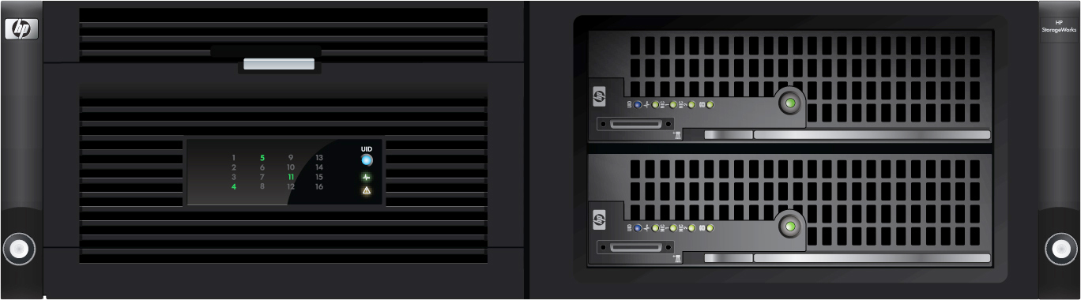

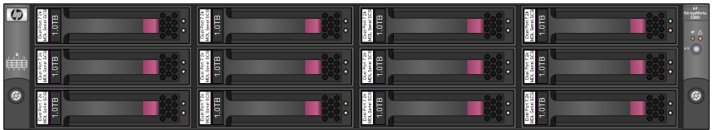
HP E5000 System Enclosure – Front View
The Converged Infrastructure for Exchange 2010
16 LFF hot
swap drives
x86 compute + dense storage array in a single 3U RM chassis
2 x ProLiant
BL460c Blade Servers
Expandable with up to 4 disk shelves

Slide 21
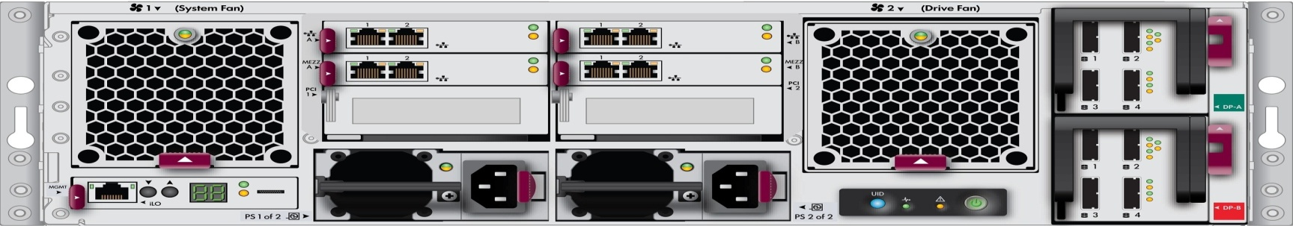
HP E5000 System Enclosure – rear view
The Converged Infrastructure for Exchange 2010
Redundant LOM (LAN on Motherboard) connectors to match the installed server
Redundant 6Gb SAS ports for scale-up capacity expansion using the P1210m controller
iLO enclosure management-health monitor, onboard admin emulation
PCIe expansion
slot for each server
High availability with redundant, hot swap power & cooling using standard ProLiant components

Slide 22


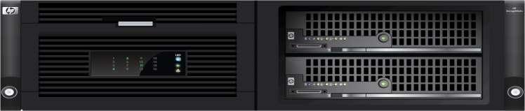


What’s in the box?
HP E5000 all-inclusive configurations
Two Windows Server 2008 R2 Enterprise Edition licenses
Exchange 2010 Server* and quick deployment tools
Single solution support contract
Pre-tested, pre-configured, using best practices from both HP and Microsoft

Slide 23

E5000 Storage and Database Configuration
Pre-formatted RAID groups combined with 2-copy DAG configuration for self-contained high availability
Hot-Spares and Recovery LUNs configured automatically
RAID 1 LUN
RAID 1 LUN
RAID 1 LUN
Recov
LUN
2 Hot
Spares
DB1
DB2
DB3
RAID 1 LUN
RAID 1 LUN
RAID 1 LUN
Recov
LUN
DB1
DB2
DB3
Active copy
Passive copy

Slide 24


HP E5000 product Range
Match your solution requirements
E5300 | 500 mailboxes* 1.75 GB mailboxes w/ 12 TB (12x 1TB drives)
E5500 | 1000 mailboxes* 1.25 GB mailboxes w/ 16 TB model (16x 1TB) 2.50 GB mailboxes w/ 32 TB model (16x 2TB)
E5700 | 3000 mailboxes* 1.25 GB mailboxes w/ 40 TB model (40x 1TB) 2.50 GB mailboxes w/ 80 TB model (40x 2TB) Includes 2 x E5000 disk nodes Scale-up to 4 disk shelves
E5000 disk nodes | 12 & 24TB Expansion Nodes
*Not limited to this; mailbox sizes and send/receive are configurable using the HP Sizer for Microsoft Exchange
*Microsoft Exchange and Client Access Licenses purchased separately from Microsoft

Slide 25
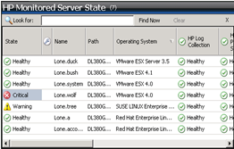
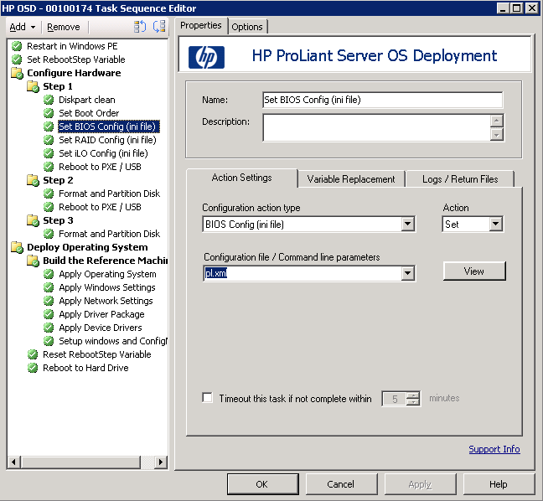
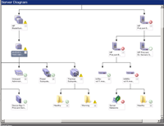
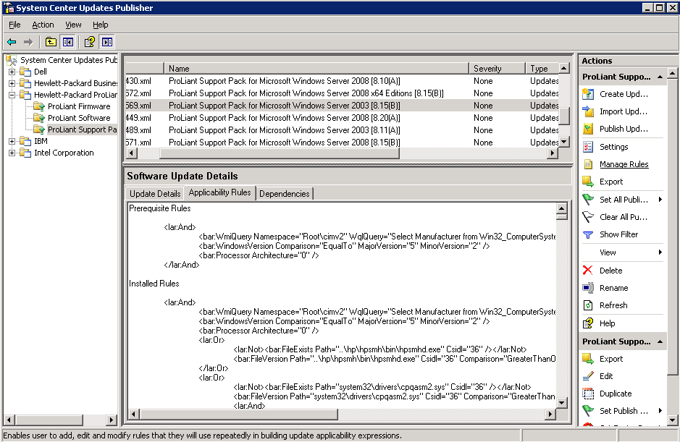
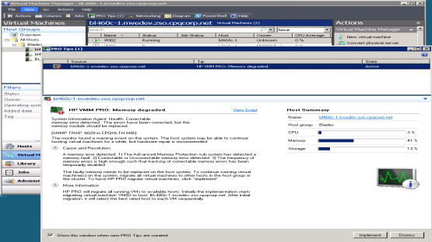
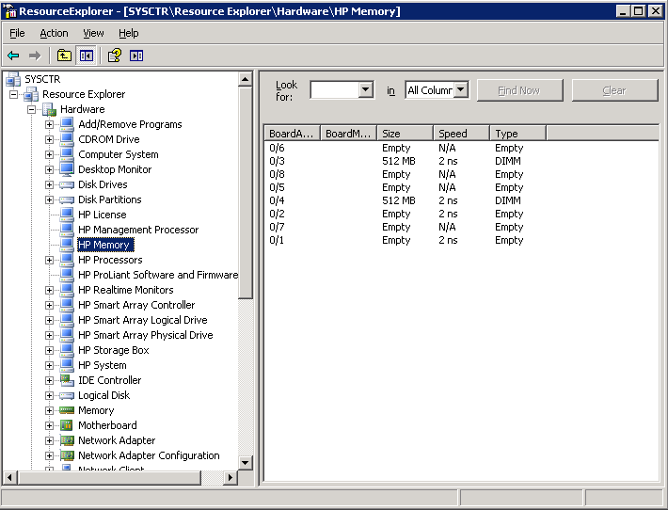
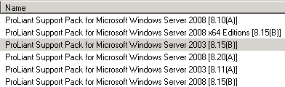
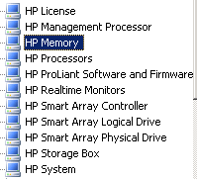
Power of Insight Control delivered to System Center
Bare Metal OS Deployment
Linux and VMware Host Monitoring
New!
Comprehensive
Health Monitoring
Automated Virtual Machine Management
Detailed HP Inventory
Driver and Firmware Updates

Slide 26
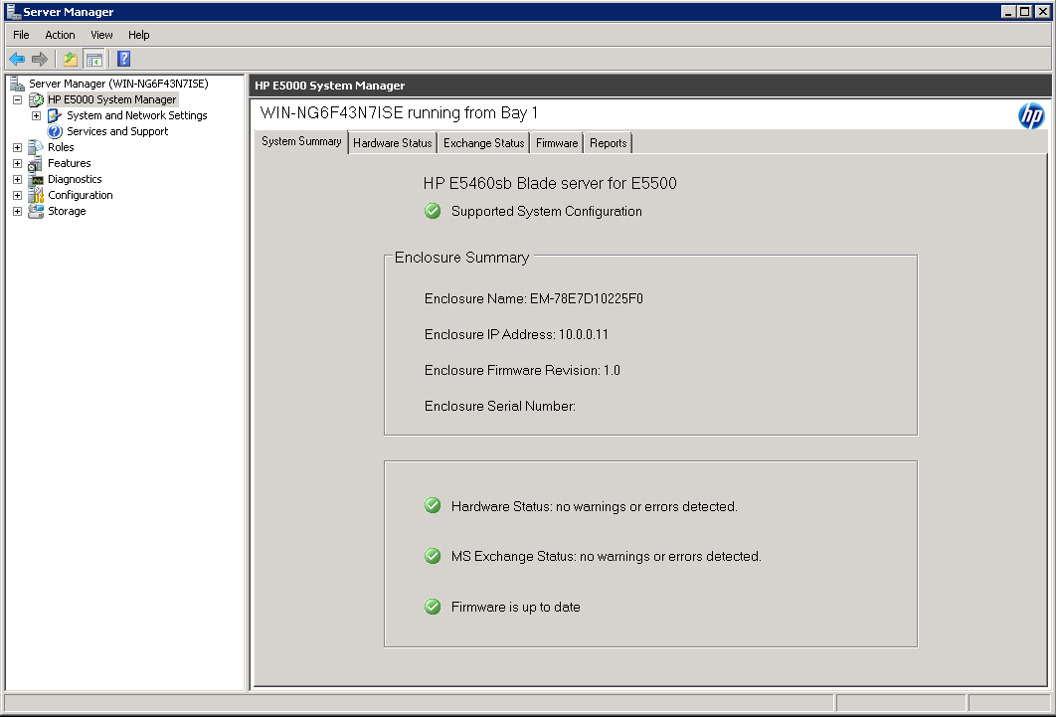




E5000 System Manager (Dashboard)
Communicating high level solution health
System Summary | Hardware Status | Exchange Status | Firmware | Reports
High level solution health
Drill down into each area
  Hardware
  Exchange
  Firmware
Generate ‘trouble ticket’ report to submit to HP

Slide 27
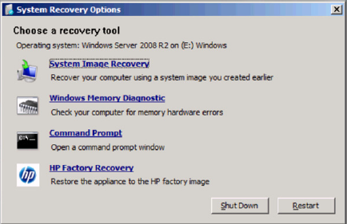
Integrated HP Image Recovery

Slide 28
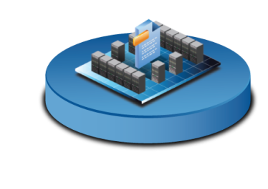
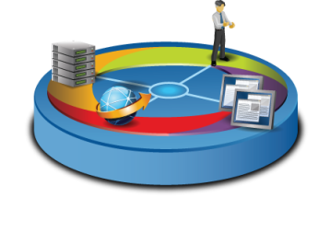

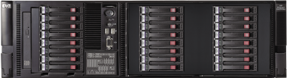
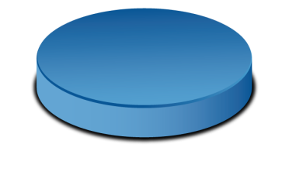

Common HP AppSystem characteristics
  End-to-end HP and Microsoft integrated solutions
Complete
  Converged application solution designed, tested and tuned by Microsoft and HP
  Services delivered by HP
Optimised
  Balanced design, high I/O
  performance
  Integrated driver, firmware and management tested as a single entity for optimum performance
  Unique infrastructure designed for applications
Agile
  Unique Quick Deployment Tools reduce implementation time to hours
  Industry standard components provide flexibility for growth
  Standard integrated recovery tools
  Insight Control integration into System Center for central management point
28
Compared to existing reference architecture

Slide 29

Enrol in Microsoft Virtual Academy Today
Why Enroll, other than it being free?
The MVA helps improve your IT skill set and advance your career with a free, easy to access training portal that allows you to learn at your own pace, focusing on Microsoft technologies.
What Do I get for enrolment?
Free training to make you become the Cloud-Hero in my Organization
Help mastering your Training Path and get the recognition
Connect with other IT Pros and discuss The Cloud
Where do I Enrol?
www.microsoftvirtualacademy.com
Then tell us what you think. TellTheDean@microsoft.com

Slide 30


© 2010 Microsoft Corporation. All rights reserved. Microsoft, Windows, Windows Vista and other product names are or may be registered trademarks and/or trademarks
in the U.S. and/or other countries.
The information herein is for informational purposes only and represents the current view of Microsoft Corporation as of the date of this presentation. Because Microsoft must respond to changing market conditions, it should not be interpreted to be a commitment on the part of Microsoft, and Microsoft cannot guarantee the accuracy of any information provided after the date of this presentation. MICROSOFT MAKES NO WARRANTIES, EXPRESS, IMPLIED OR STATUTORY, AS TO THE INFORMATION IN THIS PRESENTATION.

Slide 31




Resources
www.msteched.com/Australia
  Sessions On-Demand & Community
www.microsoft.com/australia/learning
Microsoft Certification & Training Resources
http:// technet.microsoft.com/en-au
  Resources for IT Professionals
http://msdn.microsoft.com/en-au
  Resources for Developers

