Slide 2
Diagnosing the Diseases of DNS
SESSION CODE: SVR305
Rick Claus
Sr. Technical Evangelist
Microsoft Canada, eh?
rick.claus@microsoft.com
Twitter: RicksterCDN

Slide 3
Introduction
Both software like AD and humans like us much prefer to refer to network systems by names than by IP addresses
As you know, the thing that translates host names into addresses is DNS
So when DNS fails, anything can break
In this session, we'll do some quick review and then get intermediate/advanced in how DNS works and how to troubleshoot it

Slide 4
Agenda
Review: queries and recursion in DNS
Examine a particular query in-depth: Ports, TXIDs and more
How DNS uses UDP versus how it uses TCP
Tracking DNS with Network Monitor
DNS details: a Q and three A's
EDNS, Extensions to DNS
DNS tools that are way better than nslookup

Slide 5
First: DNS Logs
Let's take a look at an actual log from a running DNS server
You do not get this log by default; rather, you get it by enabling it in the DNS server's properties

Slide 6
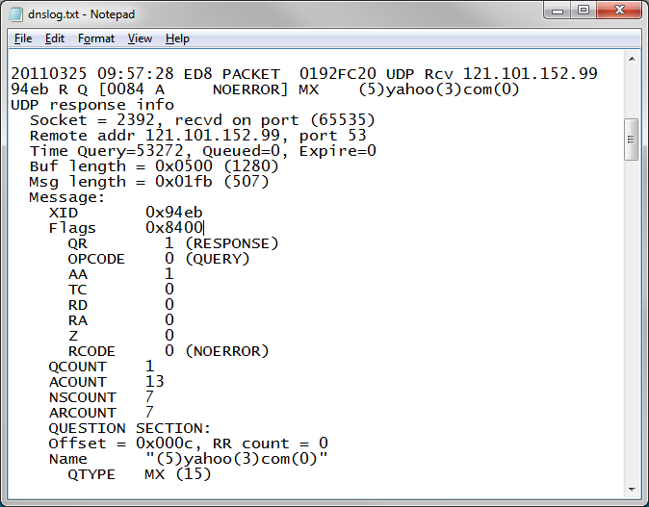

Slide 7
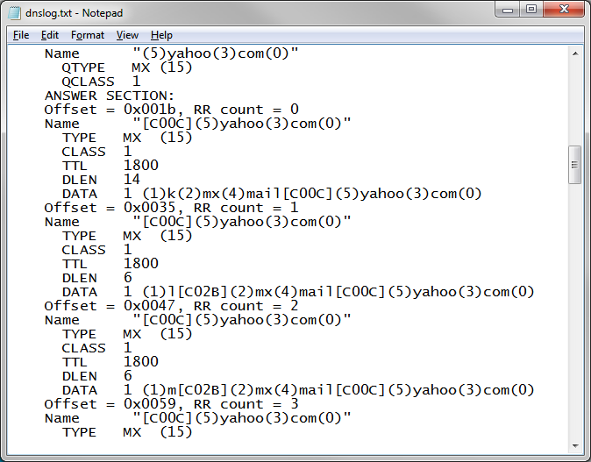
Clear as a bell, eh?
Actually, it is, once you know how DNS "thinks," under the hood, so in this talk we're going to spend some time making this sort of thing both familiar and readable.

Slide 8
DNS Queries and Recursion
Hmmm… to make sense of that log, we need some more background
Let's say that PC1 wants to look up the IP address of "a.bigfirm.com"
We'll see two things:
  How many queries and how many DNS servers are involved in answering the question
  What's inside each DNS query

Slide 9
The DNS Hierarchy: Review
The public DNS system comprises zillions of DNS servers in a pyramid-like hierarchy
At the top are the root servers ("."), which point to the next level down
The next level down are the Top Level Domains (TLDs), like .com, net, .us, .biz, .tv etc … all of them have DNS servers and they point to the next-lower level of domans

Slide 10
The Public DNS Hierarchy
. (root)
Top level domains
.com
.org
.net
.gov
.ca
.uk
Second level domains
minasi.com
microsoft.com
doj.gov
hq.minasi.com
waco.doj.gov
mswatch.doj.gov
test.minasi.com
“sub-domains” or “child domains”

Slide 11
The DNS Hierarchy: Review
The next level down are the domains that organizations and individuals use, like minasi.com, manybooks.net, google.cn, bigfirm.biz and so on
And you may have seen organizations further subdivide their domains with subdomains/child domains like technet.microsoft.com… those subdomains need DNS servers as well
A single DNS server can serve many domains

Slide 12
Quick Quiz
Suppose I set up a DNS server inside my home's network behind a NAT router, and the DNS server has an address like 10.1.1.17
I do no other configuration than to simply enable the DNS role on the server
I then query that DNS server to resolve, say www.yahoo.com… can my new DNS server resolve it?

Slide 13
Recursion and DNS Queries
PC1 finds its local DNS server (call it DNS5), which is either configured statically or via DHCP
PC1 asks DNS5 to look up the IP address for a.bigfirm.com
DNS5 goes to the top of the DNS hierarchy first, asking one of the 13* DNS root servers, "what's the IP address for a.bigfirm.com?"
* (it's not really 13 but we'll see that in a bit)

Slide 14
Recursion and DNS Queries
The root servers have no time to do DNS5's work, so they brush it off, saying "I dunno… why not go ask the .com DNS servers? Here are their names and addresses"
So DNS5 asks one of the .com DNS servers, "what's a.bigfirm.com's IP address?"

Slide 15
Recursion and DNS Queries
The .com DNS server isn't about to do DNS5's job either, and replies, "I dunno… why not ask bigfirm.com's DNS servers? Here are their names and addresses"
DNS5 now asks one of bigfirm.com's DNS servers, web2.minasi.com
Web2.minasi.com actually has a copy of all of the bigfirm.com DNS info on its hard disk, and answers the question
Now DNS5 can answer PC1

Slide 16
Review: "Authoritative"
The root and .com servers knew where to find the a.bigfirm.com record, but they did not have the record
So DNS searches until it finds the DNS server that contains a copy of the bigfirm.com zone right on its hard drive
That DNS is said to be "authoritative" for a.bigfirm.com; in other words, it was the first server that didn't have to "guess" where it was

Slide 17
So How Many Queries?
PC1 -> DNS5
DNS5 -> root
root -> DNS5
DNS5 -> .com DNS
.com DNS -> DNS5
DNS5 -> web2.minasi.com
web2.minasi.com -> DNS5
DNS5-> PC1

Slide 18
Inside a Query: Ports and TXIDs
Let's look at just one of those queries, the one from DNS5 to web2.minasi.com
DNS5 chooses a "transient port," a TCP or UDP port above 1024, and asks web2.minasi.com a question from that port to the other server's port 53
DNS5 also keeps track of the question – because DNS servers often have many outstanding questions – by assigning a random "transaction ID" or TXID

Slide 19

What's the IP address for a.bigfirm.com? Send it to my port 3351 and specify transaction ID (TXID) 279 when you do.
(The port number and TXID are random numbers with values ranging up to 65,535.)
web2.minasi.com
"Answer: 73.165.73.5"
DNS5
sent to port 3351, TXID 279

Slide 20
TCP and UDP
DNS is sort of unusual in that it's a protocol that is equally capable of functioning over TCP port 53 or UDP port 53
What makes it even more unusual is that for most of its work, DNS heavily favors UDP, partly because of the sheer volume of DNS traffic and in particular the load on the root servers

Slide 21
TCP and UDP policy effects
Ever noticed that you never see more than 13 DNS servers, even on a big site?
It's because early RFCs (883 and 1035) mandated a max packet size on UDP DNS comms of 512 bytes, and that's just about a safe size to store 13 host names and addresses
(That's only basically a safe size, there are exceptions)

Slide 22
TCP and UDP secondary effects: firewall troubles
512 byte UDP packets should never fragment, and most DNS traffic is UDP, leading to some firewall rules like
  If it claims it's a DNS packet but it's fragmented, block it
  If it claims it's a DNS packet but it's TCP, block it
  If it claims it's a DNS UDP packet but it's larger than 512 bytes, block it
We'll see some effects of this later

Slide 23
Okay, One Quick Example…
(based on a true story)
On Monday, folks at Bigfirm.com could resolve yahoo.com addresses
Tuesday, no more… but they could resolve all other Internet addresses
So what happened?

Slide 24
Answer
A few years ago, Yahoo briefly added a 14th publicly-advertised DNS server
That pushed them over the top from a 512 byte UDP packet, forcing any DNS queries for anything.yahoo.com to use TCP
But Bigfirm's firewall folks had never built a "DNS using TCP is OK" rule, thinking that simple DNS lookups never need TCP
I've actually seen this happen a few times both on inside and outside DNS

Slide 25
The Magic Troubleshooting Key wait, don't run away…
The way to crack DNS problems is oftimes to drill down to the actual network traffic
The logs (if you check the boxes) are pretty good
But the ultimate answer is to use Network Monitor
Honest, it's not that bad

Slide 26
The Setup
Create a Server 2008 R2 system
Add the DNS role
Point the server to itself for DNS
And then let's cut down the network chatter…

Slide 27
Shutting down IPv6 just to keep things clean
Simplify the NIC list and some of the network chatter by zapping IPv6 entirely
No, not forever, just for testing, and the GUI can't really do this… you need the Registry
reg add hklm\system\currentcontrolset\services\tcpip6\parameters /v DisabledComponents /t REG_DWORD /d 255
Needs reboot; zero it to re-enable

Slide 28
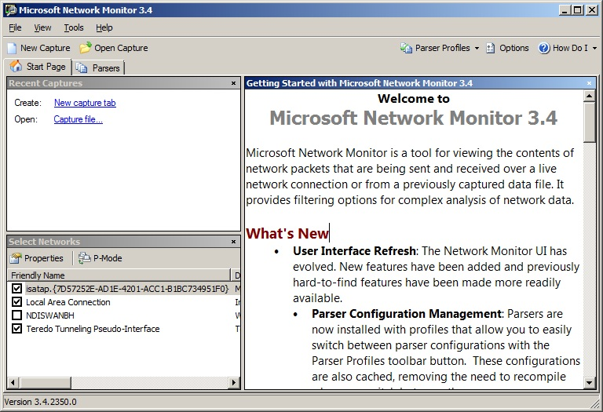
Then, start up Network Monitor and see a screen that looks something like this (without the Teredo NIC):
Select the NICs you care about and whether or not you want "promiscuous mode" (which is not nearly as much fun as it sounds, trust me)

Slide 29
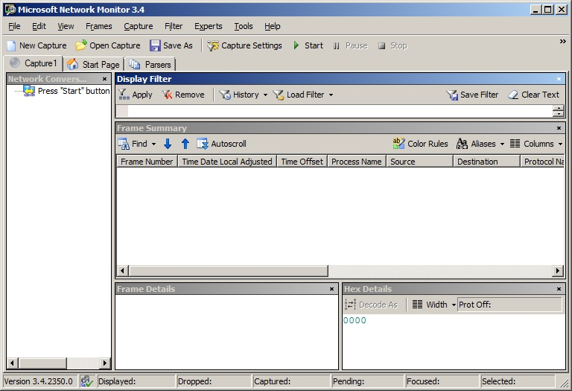
Phase 2: window cleanup

Slide 30
Now to work…
Do whatever you want to do to try out DNS; a simple ping –n 1 a.bigfirm.com is fine
(Remember to first do a "ipconfig /flushdns" beforehand so you get DNS traffic)
Clean up the columns to your liking – I zap "process," "time offset," and "TimeDateLocalAdjusted"
AND you want to remove the clutter, so it's time for filters

Slide 31
The Big Netmon Magic
Build a DNS-only filter:
  Click in the "Display Filter" text field; it's a "pane" in the Netmon windows
  Type "DNS" and click "Apply"
This says, "only show me packets that are recognizably part of DNS communication"
Things then clarify….

Slide 32
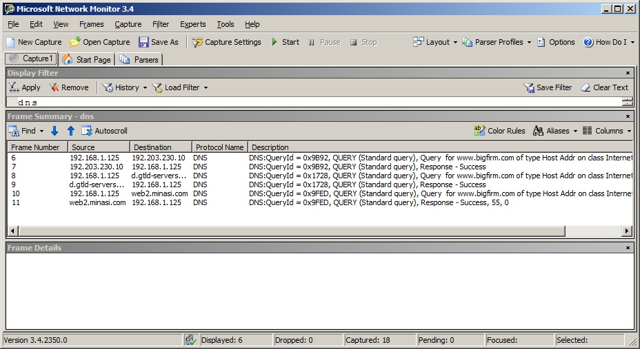
Just the good stuff.

Slide 33
Sidebar: Root Servers
Note the traffic to 192.203.230.10… it's not a non-routable address, it's one of the 13 IP addresses where you can find the root servers
In actuality there are (as of 19 April 2011) 242 root servers sharing those addresses
You can get more details on them at www.root-servers.org… scroll to the bottom of the page to get the actual root server total

Slide 34
Drilling Down Further
Here, we're resolving "a.bigfirm.com," so we see
  A request to a root server and response
  A request to a .com server and response
  A request to the bigfirm.com DNS server and response
So let's look at the details and how they're formatted by DNS

Slide 35
DNS Details: Q & The Three A's
Every DNS packet has zero or more of four parts:
  "Question" section
  "Answer" sections: the answer
  "Authority" sections (Netmon calls them "Name server"): relevant name servers
  "Additional" sections: extra information, answers to questions raised by the original question

Slide 36
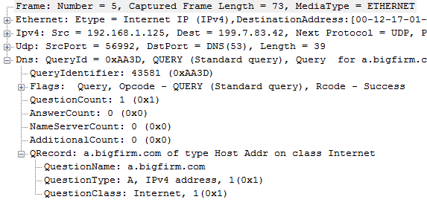
Query to Root
One question, no answers, no authority ("Name ServerCount," no additionals
The Question!
Question: "hey, root, ever heard of a.bigfirm.com?"

Slide 37
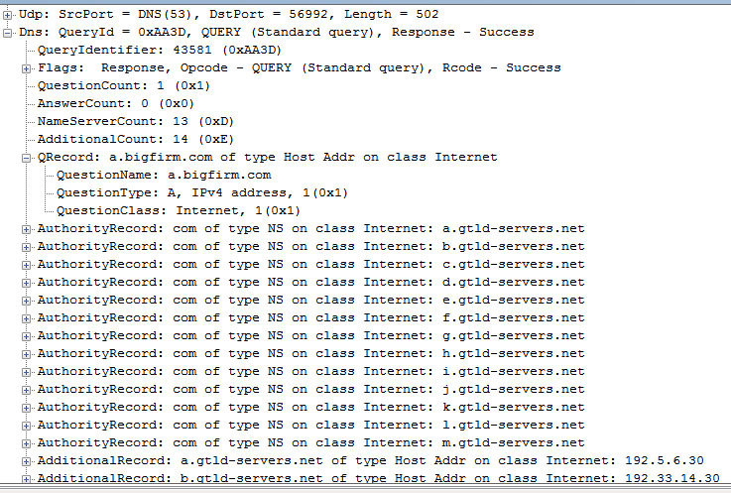
Response from Root
The question count just parrots back the question.
There is no answer.
The "authority section" offers hints about where to ask the question NEXT with the .com DNS server names.
The "additional" section saves you the trouble of having to look up their IPv4 and IPv6 addresses.
Response: "um, no, but you should next check the .com DNS servers – here are their names and IP addresses"

Slide 38
Next…
DNS server makes an identical query for an A record for a.bigfirm.com, but this time to a .com DNS server
That .com DNS server will respond with the names of any DNS servers for "bigfirm.com"
The QAAA tally will be similar to before – 1Q, no A's on the question, 1Q, no answer, two authorities (bigfirm has only two DNS servers), two additional (IP addresses)

Slide 39
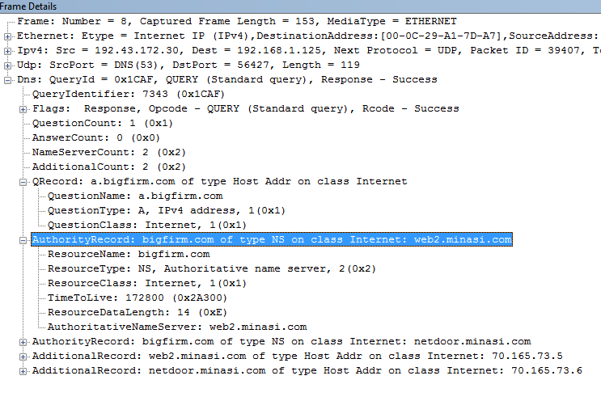
Response From .com DNS Srvr
"I don't have the answer, but go ask web2.minasi.com, it will be able to answer your question"

Slide 40
Finally…
Now that the system knows where to find the DNS server for bigfirm.com, it queries that
Then the response arrives, and now the original DNS query is resolved
The general approach with Netmon is to build and test a properly working query
Keep that as a reference and compare it when examining a troubled system

Slide 41
Example 2: DDNS Registration
Now we're ready to tackle an AD-related DNS annoyance: dynamic DNS registration
Dynamic DNS registration fails either because of security (an AD issue, if the zone is AD-integrated) or a DNS failure
So try out a dynamic DNS registration on Network Monitor
Here are the steps

Slide 42
DDNS registration
Query for SOA record for domain
Query for IP address of primary DNS server
Query to local DNS server
Response from local DNS server
(Why isn't there the query to root and .com or other TLD?)
SOA returns name of "primary" DNS server
Query to local DNS server
Response from local DNS server
DDNS Registration
DDNS request to primary DNS server
Success/failure response

Slide 43
Extensions to DNS
a 2008 R2 issue, sort of

Slide 44
Understanding Extended DNS
DNS needs to grow and add functionality
Doing that, however, means changing protocol format and that could break tens of billions of network operations world-wide
So 1999 introduced RFC 2671, "Extension Mechanisms for DNS" or "EDNS"
Windows DNS has supported it since 2003, but it's been blamed (wrongly) for problems in 2008R2, so here's the story

Slide 45
EDNS Goals
Original DNS leaves seven bits for flags
All but one are used up now
EDNS creates space for more flags
UDP limits of 512 bytes are goofy in today's Internet
EDNS lets EDNS-aware DNS servers negotiate larger UDP packet sizes
(Remember why UDP is so important to DNS and the annoying 13-server limit)

Slide 46
How EDNS Works
EDNS-aware DNS servers want to find other EDNS-aware servers
Again, that method can't break EDNS-dumb DNS servers
Answer: always add an extra query record called an "OPT" record which shows up in the "additional" section
If the responder answers the OPT query, it's EDNS-aware; otherwise, it just ignores it

Slide 47
Example
I created a host "a.bigfirm.com" and gave it 50 A records, so there's no way the "A" record query for a.bigfirm.com can fit in 512 bytes
Here are some bits from the Netmon trace of the lookup

Slide 48
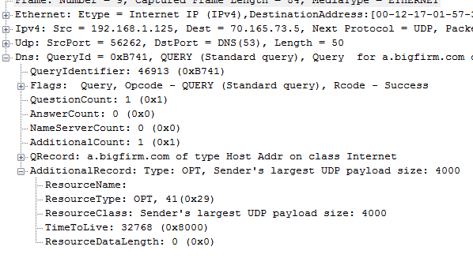
Original Query OPT Section

Slide 49
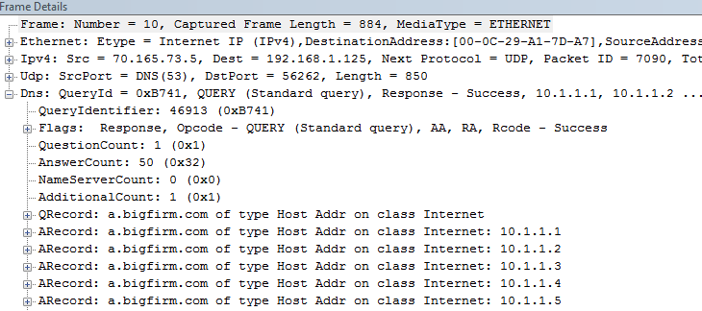
Response, Part 1

Slide 50
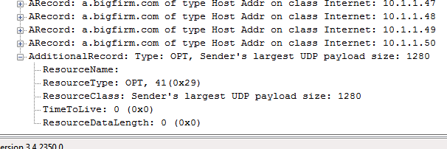
OPT Response on EDNS System

Slide 51
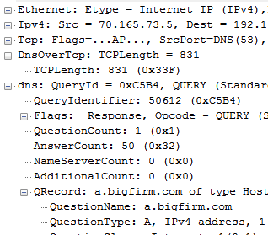
Compare w/non-EDNS
Note the "DnsOverTcp" protocol reference

Slide 52
EDNS-Related Problem
Suppose EDNS negotiates a UDP packet larger than 512 bytes
Then suppose it runs into one of those routers with a stupid firewall rule
Result: you can't resolve things like Yahoo, Microsoft or the like
The problem is the firewall, but EDNS gets blamed for it

Slide 53
Supposed "Workaround"
dnscmd /config /enabeednsprobes 0
(Note: I strongly recommend you not do this!)
This causes your DNS server to never offer OPT records, but it doesn't stop it from responding to them
Only 2008R2 difference is that now R2 DNS servers have probes set to "1," not "0"
Don't disable EDNS probes, find out what firewall or router is causing the problem

Slide 54
Why Bother? several reasons, actually
On 31 March of this year, a really big thing happened: VeriSign finished signing the .com domain, paving the way to making DNS hijacking flatly impossible via DNSSEC
The 512-byte "soft" limitation is silly in 2011
DNSSEC and OPT let us get past these old problems
But you need EDNS to make those things possible

Slide 55
Tools
Some DNS test tools, quickly

Slide 56
Dump Nslookup, Get DIG
Windows comes with NSLOOKUP, but it's got any number of problems
The non-Windows world has been using a better tool called the "Domain Internet Groper" or "DIG," and you can do that as well
Go to http://www.isc.org/downloads and get the latest version of BIND
Extract its files and keep the DLLs, dig.exe and dig.html – put them all on the path

Slide 57
Basic Dig Syntax
dig record [@dnsserver] [recordtype] [+option1, +option2…]
examples:
dig www.bigfirm.com
  queries for www.bigfirm.com's A record
dig bigfirm.com mx
  Gets bigfirm's MX record

Slide 58
More Dig Examples
dig minasi.com mx +norecurse
  asks the DNS server not to recurse and to just respond with what it knows (note that the server may choose to ignore that command)
dig minasi.com mx +trace
  Tells dig to do the recursion and track every step along the way
dig –h
  Gets help on other Dig options

Slide 59
Some Dig Options
+vc: force TCP
+novc: force UDP
+dnssec: request DNSSEC-related records
+nocdflag: related to above
+fail: don't try next DNS server in search list if the first fails

Slide 60
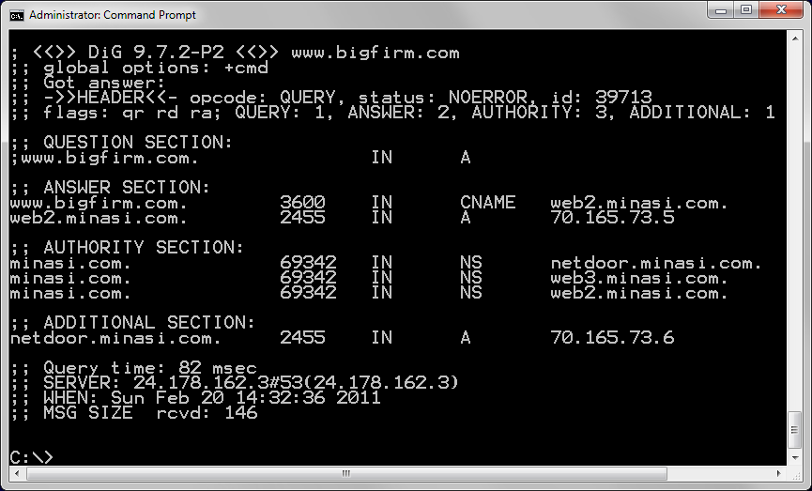
Basic DIG

Slide 61
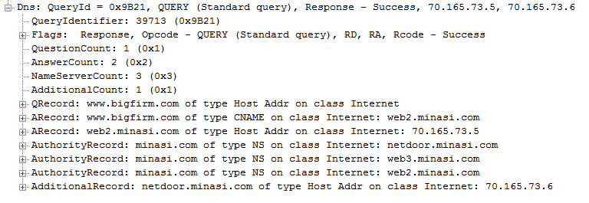
NetMon Frame for Comparison

Slide 62
DIG's Reported Status Values
On ->>HEADER<<-, you'll see "STATUS"
  NOERROR: no error
  NXDOMAIN: "no such record" query fail
  SERVFAIL: some DNS server configuration error
  NOIMP: "not implemented," server doesn’t understand something
  REFUSED: query refused by queried server

Slide 63
Nice DNS diag tool
dnslint /d domainname
If split-brain, specify the DNS server to ask with /s: dnslint /d domainname /s dnsip
ex: dnslint /d bigfirm.biz /s 192.168.0.2
Or check a DC’s SRV records:
dnslint /ad /s localhost /v
Add /y to automatically overwrite old output
KB 231045 has download link

Slide 64
DCDIAG and DNS
Offers (since 2003 SP1!) a series of useful tests targeted at DNS and AD
Basic syntax:
dcdiag /test:DNS [/e] [/dnstestoption1]….
Be careful about /e… it means to run those tests on every DC in the forest
Uses a lot of remote control and therefore requires RPC access

Slide 65
DCDIAG
Simplest command:
dcdiag /test:dns /v
  pings DNS server, checks it's in AD
  Checks access to forwarders or, if no forwarders, the root servers
  creates a dynamic entry in DNS
  Looks for certain SRV records
IPv6 can throw false warnings
External DNS servers can also

Slide 66
More Resources – Mark Minasi
DNS articles in Windows IT Pro over the years
newsletter 30 (how to set up an AD-friendly DNS subsystem)
Newsletter 31 (Island DNS)
presentation last year on DNSSEC

Slide 67
Q and
SESSION CODE: SRV305
X
A?
eh?
Rick Claus
Sr. Technical Evangelist
Microsoft Canada
rick.claus@microsoft.com
Twitter: RicksterCDN

Slide 68
Enrol in Microsoft Virtual Academy Today
Why Enroll, other than it being free?
The MVA helps improve your IT skill set and advance your career with a free, easy to access training portal that allows you to learn at your own pace, focusing on Microsoft technologies.
What Do I get for enrolment?
Free training to make you become the Cloud-Hero in my Organization
Help mastering your Training Path and get the recognition
Connect with other IT Pros and discuss The Cloud
Where do I Enrol?
www.microsoftvirtualacademy.com
Then tell us what you think. TellTheDean@microsoft.com

Slide 69

© 2010 Microsoft Corporation. All rights reserved. Microsoft, Windows, Windows Vista and other product names are or may be registered trademarks and/or trademarks in the U.S. and/or other countries.
The information herein is for informational purposes only and represents the current view of Microsoft Corporation as of the date of this presentation. Because Microsoft must respond to changing market conditions, it should not be interpreted to be a commitment on the part of Microsoft, and Microsoft cannot guarantee the accuracy of any information provided after the date of this presentation. MICROSOFT MAKES NO WARRANTIES, EXPRESS, IMPLIED OR STATUTORY, AS TO THE INFORMATION IN THIS PRESENTATION.

