Slide 2
Virtualizing Microsoft Sql server with hyper-v
SESSION CODE: VIR309
Shashank Pawar
SQL Server Technology Specialist
Microsoft
spawar@microsoft.com
http://blogs.technet.com/sqlman
Reid Purvis
Data Center Technology Specialist
Microsoft
Reid.Purvis@microsoft.com

Slide 3

Agenda
Why Hyper-V & System Center ?
Optimize SQL Server for Private Cloud
  Consolidation
  Elasticity
  Self Service
  Control & Customization
Next Steps & Resources

Slide 4





Microsoft Virtualization for Server Applications
Business Critical Applications
Management Platform
Enterprise Applications
Line of Business (LOB) Custom Applications
Microsoft Server Applications
Databases:
Collaboration:
Communication:
Virtualization Platform
Microsoft Virtualization
Windows Server 2008 R2 Hyper-V & System Center

Slide 5


Microsoft Virtualization: The Best Choice for Microsoft Server Applications
Built
for
Windows
Complete
Management
Solution
Low Cost
Complete
Solution
*Built-in Virtualization with one-stop support
*Deep Application Knowledge
*A comparable solution can cost almost 4 times more†
*Large Partner
Ecosystem
*Physical & Virtual Management
*Lower On-going
Costs
Increased Deployment Options
*Cross-Platform & Hypervisor Support
Virtualization-Friendly Licensing
*Only available with Microsoft Virtualization
†Based on a comparison of Microsoft® System Center Server Management Suite Datacenter with VMware® vSphere Enterprise Plus with VMware vCenter Server.. Assumes a five host configuration, 2 processors on each host, 2 years support costs for both products, and no operating system costs included.. The Microsoft solution can use either the free Microsoft Hyper-V Server 2008 R2 hypervisor or an existing Windows Server 2008 R2 hypervisor. Based on Microsoft estimated retail prices and published VMware prices available at https://www.vmware.com/vmwarestore as of 08/04/2009 for purchases in the United States. Actual reseller prices may vary.

Slide 6



2011 ESG Test Lab - Virtual
SQL Server
SQL Server
SQL Server
SQL Server
Application: SQL Server 2008 R2
VM configuration: 4 vCPU, 16 GB RAM
Guest OS: Windows Server 2008 R2 SP1
Hyper-V R2
Hypervisor: Microsoft Hyper-V R2
Physical OS: Windows Server 2008 R2 SP1
Virtual machine images: Fixed VHD
SQL data and logs: Fixed VHD
http://download.microsoft.com/download/2/7/8/278EAE45-3AB4-4787-A640-B8FFA907E1AB/ESG%20Preso%20Microsoft%20Hyper-V%20Performance%20SQL%20Server%20Mar%2011_Wide.pdf

Slide 7
Performance & Scalability

Slide 8
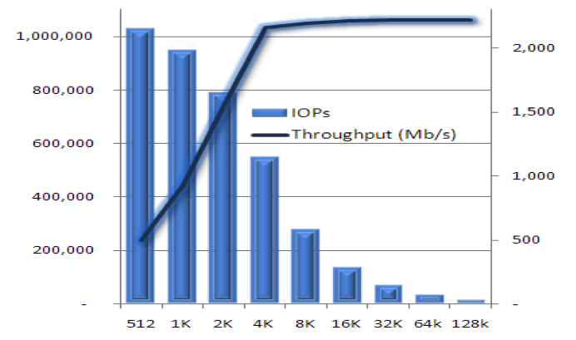
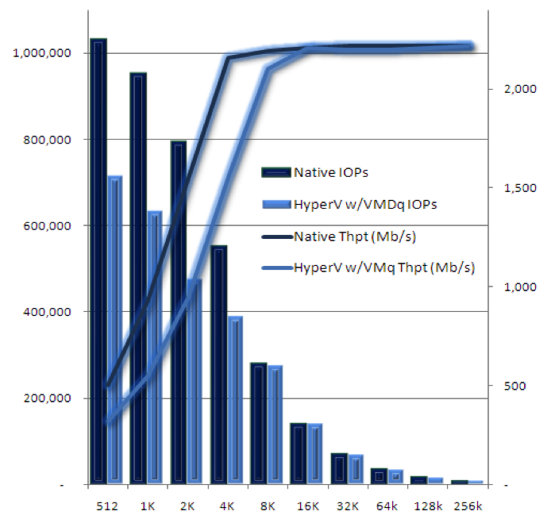
Performance & Scalability
Native Performance
In-Guest VM Performance
IOPS
IOPS
Throughput (Mb/s)
Throughput (Mb/s)
SQL Server Recommended
Block size
Block size

Slide 9
2011 SQL Workload Results
http://download.microsoft.com/download/2/7/8/278EAE45-3AB4-4787-A640-B8FFA907E1AB/ESG%20Preso%20Microsoft%20Hyper-V%20Performance%20SQL%20Server%20Mar%2011_Wide.pdf

Slide 10
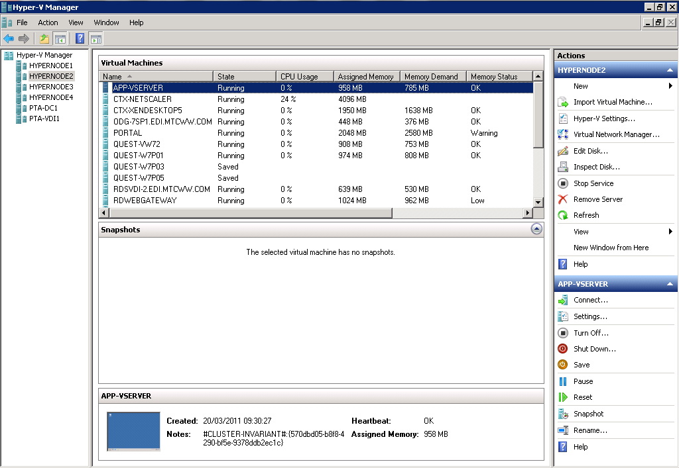
Windows Server 2008 R2 SP1
Many of the scenarios discussed leverage features new to R2 and R2 SP1
Live Migration & HA
New Processor Support
  Improved Performance & Lower Costs
Enhanced Scalability
  Greater VM density & Lower TCO
Networking enhancements
  Improve performance & 10 Gb/E ready
Dynamic VM capabilities
Enhancements to Server Core
  Ease management & Lower TCO
Dynamic Memory & Remote FX
in SP1

Slide 11

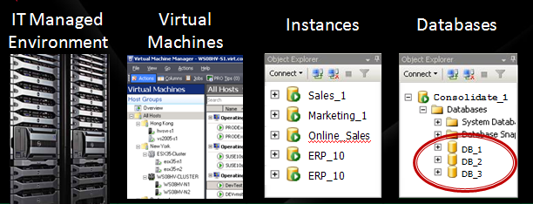

Options for SQL Server Implementations
Off Premise
On Premise
SQL Azure
Appliances

Slide 12
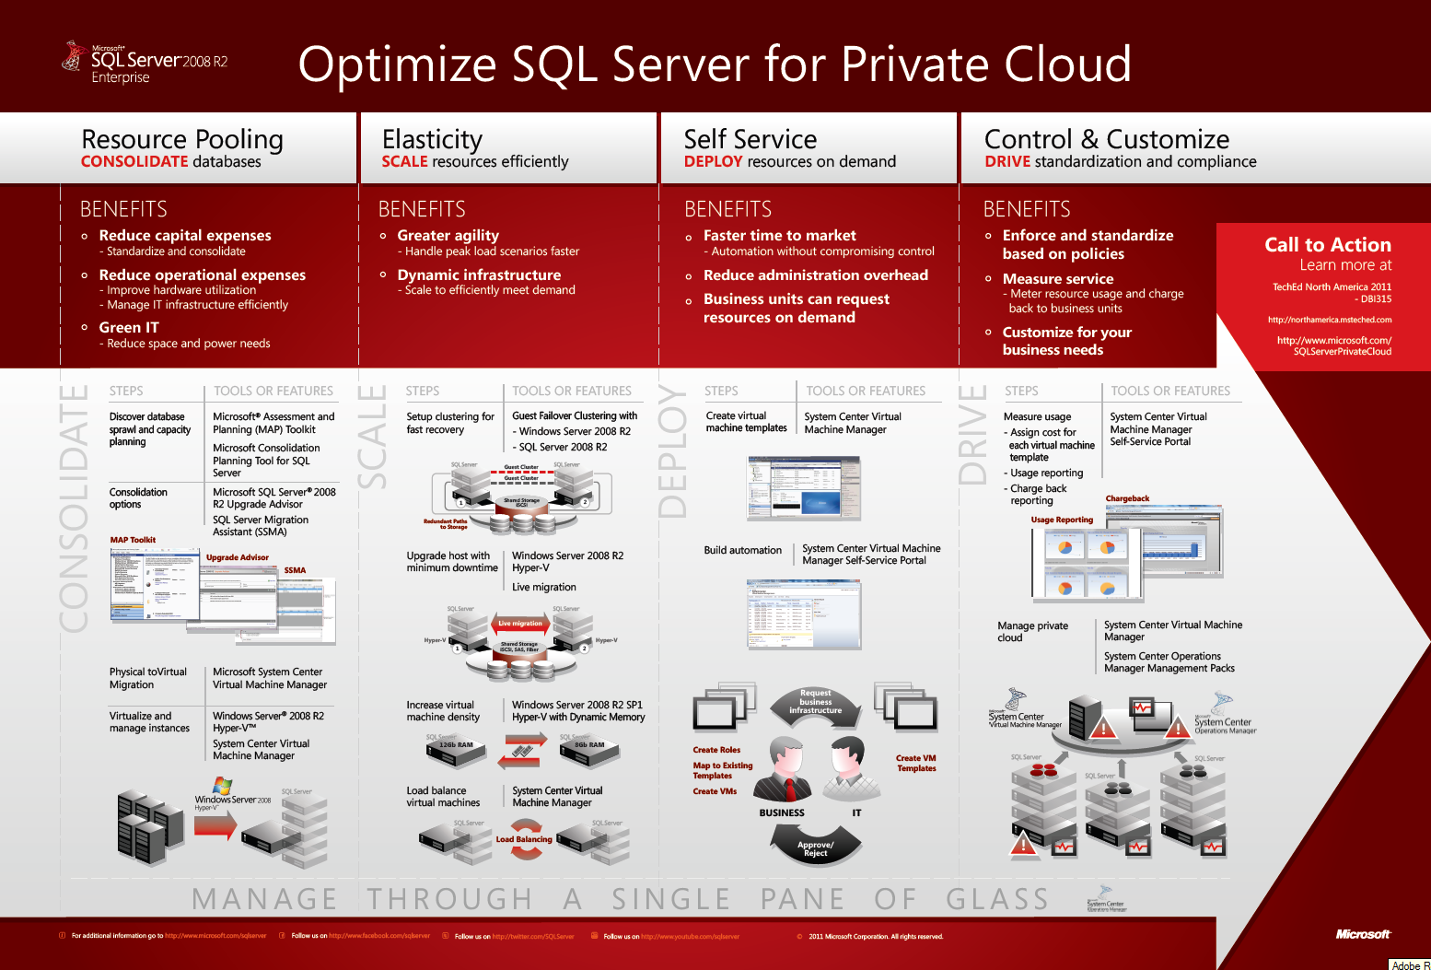
Optimize SQL Server for Private Cloud
http://www.microsoft.com/sqlserver/en/us/solutions-technologies/cloud-computing/private-cloud.aspx

Slide 13
Why Private Cloud?
Manage Growth
Manage Data
Manage Environment

Slide 14
PRIVATE CLOUD DRIVERS
Resource Pooling
Elasticity
Self - Service
Control & Customize

Slide 15
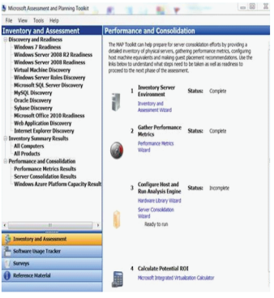

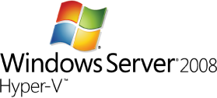

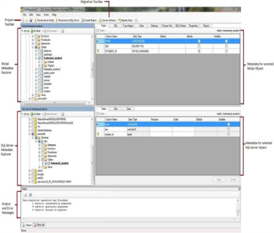
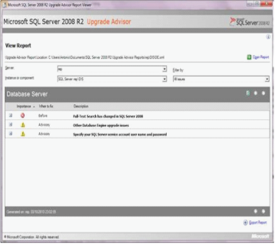

Resource Pooling Key Steps
Consolidate databases
STEPS | TOOLS OR FEATURES
Discover SQL sprawl and capacity planning | Microsoft® Assessment and Planning (MAP) Toolkit 6.0 Microsoft Consolidation Planning Tool for SQL Server v1.0
Consolidation options | Microsoft SQL Server® 2008 R2 Upgrade Advisor SQL Server Migration Assistant (SSMA)
STEPS | TOOLS OR FEATURES
Physical-to-Virtual Migration | Microsoft System Center Virtual Machine Manager 2008 R2
Virtualize and manage instances | Windows Server® 2008 R2 Hyper-V™ System Center Virtual Machine Manager 2008 R2
CONSOLIDATE
MAP Toolkit
Upgrade advisor
SSMA
SQL Server

Slide 16
Resource Pooling
Demo

Slide 17
When to virtualize and when not to virtualize SQL Server?
Virtualize SQL Server
  Start from smallest workload
  Continue to larger workload over time with experience
  Microsoft support SQL Server virtualization http://support.microsoft.com/?id=956893
Consider Options
  CPU: Need more than 4 logical processors
  Memory: Need more than 64 GB per virtual machine
Start small, learn, and continue to virtualize as you test and learn how to manage.

Slide 18
Virtualisation best practices
Hardware Support
  Second Level Address Translation (SLAT)
Hypervisor Support
  Hyper-V - Windows Server 2008 R2 Service Pack 1
  Don’t Overcommit CPU and Memory
Hard drive Configuration
  Use Fixed VHDs
  Consolidated workload – creates lot of randomised I/O so optimise disk subsystem for random I/O, so need to separate data, log, tempdb
For more best practices - Onboarding SQL Server Private Cloud Environments

Slide 19
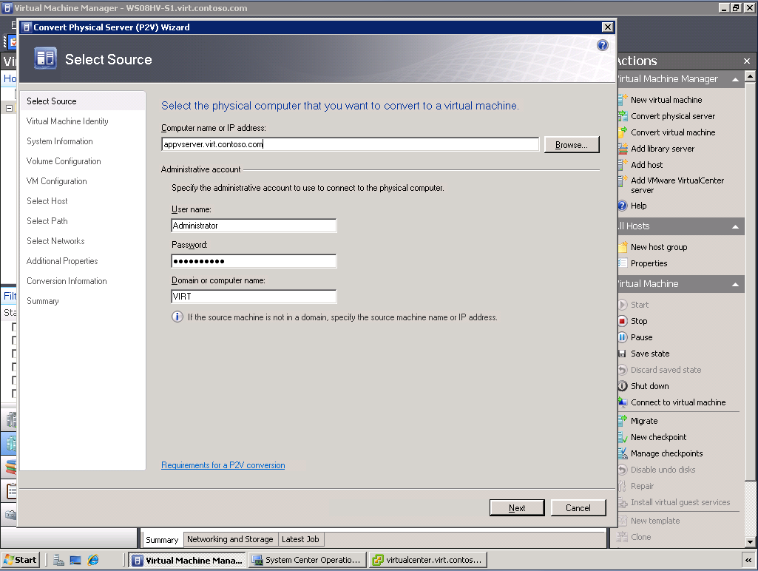
Physical to Virtual
Intuitive and easy to use
  Wizard-based
  Reconfigure storage, memory, CPU, etc.
  Preserves network settings and MAC addresses
  Script-able through PowerShell
Supported platforms
  Live: Windows XP, Windows Server 2003, Windows Vista, Windows 7, Windows Server 2008/R2
  Offline: Windows Server 2000

Slide 20
PRIVATE CLOUD DRIVERS
Resource Pooling
Elasticity
Self - Service
Control & Customize

Slide 21






Elasticity Key Steps
Scale resources efficiently
STEPS | TOOLS OR FEATURES
Setup clustering for fast recovery | Guest Failover Clustering with Windows Server 2008 R2 SQL Server 2008 R2
STEPS | TOOLS OR FEATURES
Increase virtual machine density | Windows Server 2008 R2 SP1 Hyper-V with Dynamic Memory
SQL Server
Guest Cluster
SQL Server
SQL Server
SQL Server
Guest Cluster
12Gb
8Gb
Shared Storage
iSCSI, SAS, Fiber
SCALE
Redundant Paths
to Storage
Virtual machine load balancing | System Center Virtual Machine Manager 2008 R2
Upgrade host with minimum downtime | Windows Server 2008 R2 Hyper-V Live Migration
SQL Server
Live Migration
SQL Server
SQL Server
SQL Server
Load Balancing
Hyper-V
Shared Storage
iSCSI, SAS, Fiber
Hyper-V

Slide 22
Elasticity
Demo

Slide 23
Dynamic Memory Findings and Best Practices
Consideration: Adjusting memory weight of VMs may be necessary for Live Migrations to an overcommitted server.
Recommendation: Reduce SQL Server memory using ‘max server memory’ sp_configure setting prior to Live Migrations. May not always be possible.
Best Practice: Grant SQL Server service accounts ‘Lock Pages in Memory’.
  Prevents SQL Server memory from being paged out.
  Reduces overall impact on VM when the Guest OS has memory removed by relying on SQL Server memory management to release memory vs. having the working set paged out by Windows.
  Let SQL do the memory management when possible.
These settings combined, avoid performance drop offs for SQL Server, specifically in DM configurations, where Live Migrations occur with movement to an overcommitted host.
Whitepaper: SQL Server on Hyper-V Dynamic Memory Technical White Paper.

Slide 24



How does Dynamic Memory Benefit SQL Server?
Without Dynamic Memory VMs would have to be sized at 7.5GB (static).
More memory = Less I/O
Same SQL Throughput with only about 60% of the total IOPs.
Remember: This will be workload dependent.
8 VMs with 12GB Memory
8 VMs with 12GB Memory
VS.
8 VMs with 7.5GB Memory
8 VMs with 7.5GB Memory
Live
Migration
Live
Migration
1
1
1
1
Host cluster
Host cluster
Shared Storage
iSCSI, SAS, Fibre
Shared Storage
iSCSI, SAS, Fibre
~12,500 SQL Batches/sec
~7500 Sustained Read IOPs
(~11-13ms response time)
~12,500 SQL Batches/sec
~12,000 Sustained Read IOPs
(~11-13ms response time)

Slide 25
PRIVATE CLOUD DRIVERS
Resource Pooling
Elasticity
Self - Service
Control & Customize

Slide 26

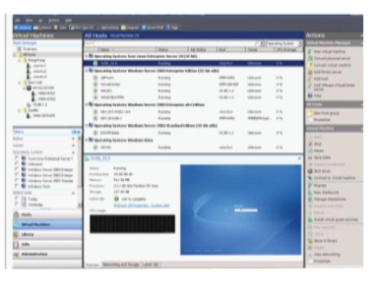


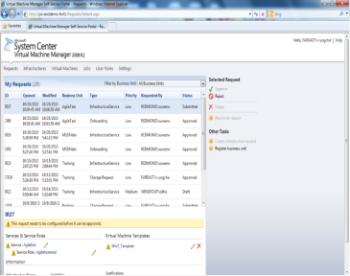
Self Service Key Steps
Deploy resources on demand
STEPS | TOOLS OR FEATURES
Virtual machine templates | System Center Virtual Machine Manager 2008 R2
Request business infrastructure
Create Roles
Map to Existing Templates
Create VMs
Create VM Templates
DEPLOY
Build automation | System Center Virtual Machine Manager Self-Service Portal 2.0
BUSINESS
IT
Approve/
Reject

Slide 27
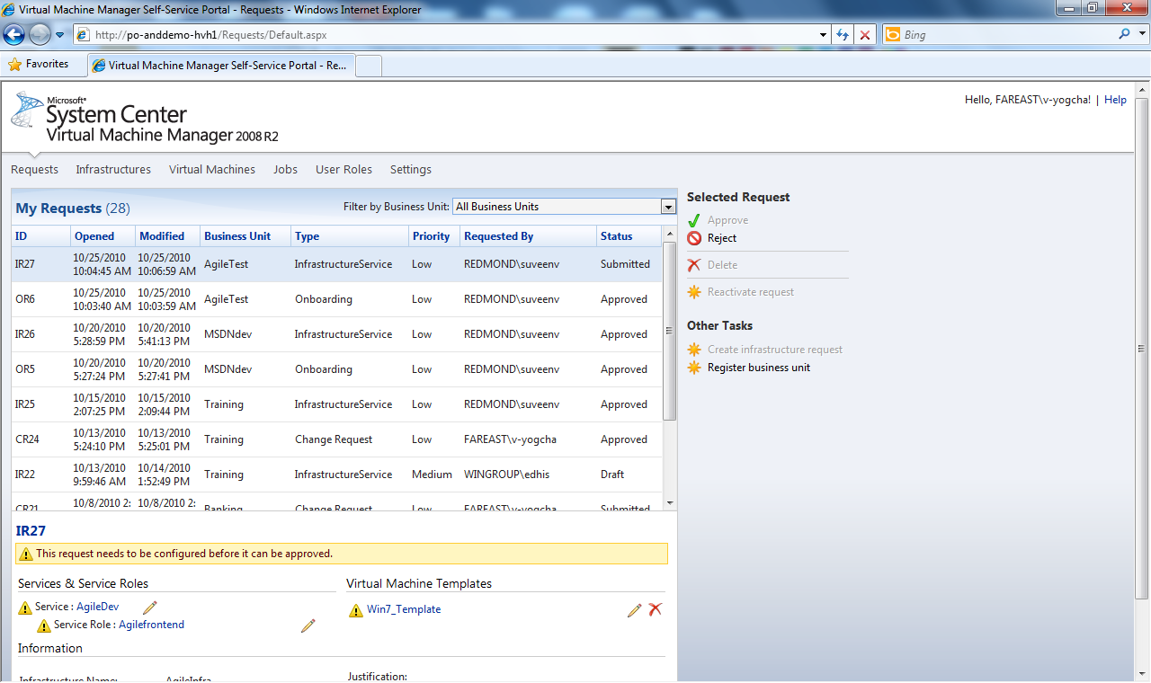
Self-Service Portal 2.0
IT Admin:
  Pooling resources
  User role management
  Create VM templates
  Validate requests from users
  Configure chargeback data
Business users:
  Request business infrastructure
  VM self-service (creates, remove, manage)

Slide 28
Self-Service
Demo

Slide 29
PRIVATE CLOUD DRIVERS
Resource Pooling
Elasticity
Self - Service
Control & Customize

Slide 30
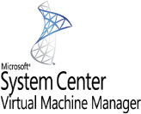

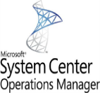


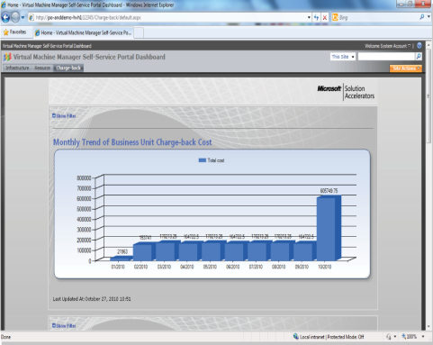
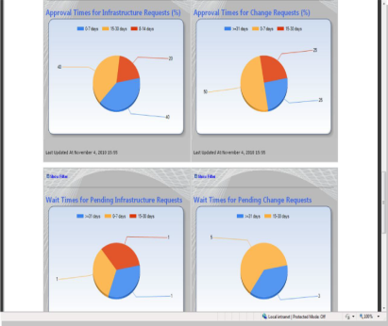


Control & Customize Key Steps
Drive standardization and compliance
STEPS | TOOLS OR FEATURES
Measure usage - Assign cost for each virtual machine template - Usage reporting - Charge back reporting | System Center Virtual Machine Manager Self-Service Portal 2.0
STEPS | TOOLS OR FEATURES
Manage private cloud | System Center Virtual Machine Manager 2008 R2 System Center Operations Manager 2007 R2 Management Packs
DRIVE
Chargeback
Usage Reporting
SQL Server
SQL Server
SQL Server

Slide 31
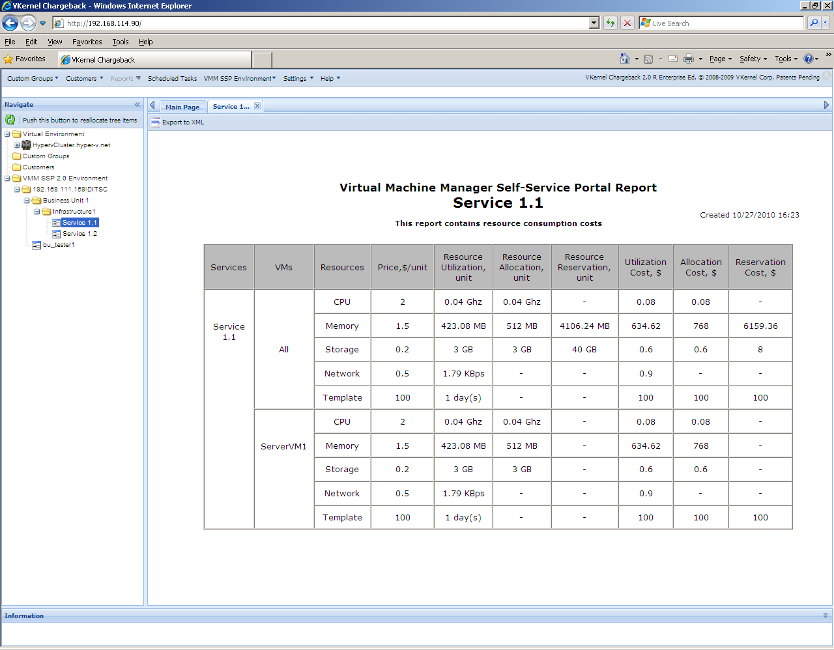
Advanced Measure Usage – vKernel plugin
Allocated and actual (utilized) costs
Custom fields for additional costs (power, space, cooling, support, etc.)
Automated, scheduled reporting via email
www.vkernel.com

Slide 32
Control & Customization
Demo

Slide 33
Lessons Learnt
Background
  ~3000 virtualized servers.
  364 of them are virtualized SQL Servers.
Encountered difficulties in customer and vendor buy-in
  Early on there was immediate push back from customers and vendors against virtualization
Replacing older physical resources with fewer faster virtual resources was a difficult sell
Post-VM errors are always attributed to the VM regardless of their actual cause
DBA's must change the way they manage and think about SQL Server provisioning
Backup teams, storage teams, and database teams must work well together
  Virtualization alters traditional backup and recovery methods

Slide 34

Next Steps
TODAY: Build and deploy SQL Server for Private Cloud
  All software are available today for immediate deployment
  www.microsoft.com/SqlServerPrivateCloud
COMING SOON:
  Optimized Database Consolidation Reference Architecture
LATER THIS YEAR:
  Optimized Database Consolidation Appliance
    Faster Time To Market – all software/hardware configured and tuned at factory
    Optimized for DB OLTP performance
    Can also run non-DB workloads
    Single point of contact for support

Slide 35
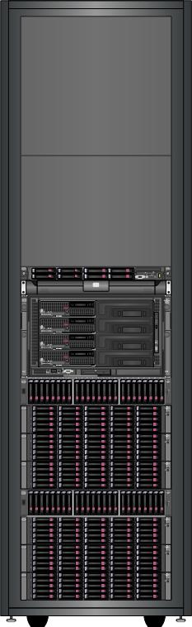
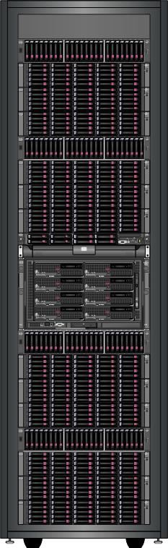
HP DBC Appliance - Concept Hardware
Base Configuration
Full Configuration
Storage Block:
1 x P2000 Disk Array
3 x D2700 Disk Racks
(99 spindles in block)
4 Storage Blocks in
Full Configuration
HP C3000 Enclosure with
4x BL 465c G7 Blades (2P)
• 16x8GB (=128GB) RAM ea
• 2x72GB (=144GB) HDD ea
HP C3000 Enclosure with
8x BL 465c G7 Blades (2P)
• 16x8GB (=128GB) RAM ea
• 2x72GB (=144GB) HDD ea
2 Storage Blocks in
Base Configuration
Storage Block:
1 x P2000 Disk Array
3 x D2700 Disk Racks
(99 spindles in block)

Slide 36
How does the appliance work?
Existing Servers
VM
Live Migration
Server #1
VM
Server #2
Live Migration
SQL Server EE 2005
VM
SQL Server Std 2008
Live Migration
Server #3
VM
VM
Windows Server, Hyper-V, System Center VMM
SQL Server 2008 Std R2
VM
Newly created VMs.
Can reuse existing ‘IT template’ VMs.
Room to grow
Bank of VMs
VM1
VM2
VM3

Slide 37

Enrol in Microsoft Virtual Academy Today
Why Enroll, other than it being free?
The MVA helps improve your IT skill set and advance your career with a free, easy to access training portal that allows you to learn at your own pace, focusing on Microsoft technologies.
What Do I get for enrolment?
Free training to make you become the Cloud-Hero in my Organization
Help mastering your Training Path and get the recognition
Connect with other IT Pros and discuss The Cloud
Where do I Enrol?
www.microsoftvirtualacademy.com
Then tell us what you think. TellTheDean@microsoft.com

Slide 38

© 2011 Microsoft Corporation. All rights reserved. Microsoft, Windows, Windows Vista and other product names are or may be registered trademarks and/or trademarks in the U.S. and/or other countries.
The information herein is for informational purposes only and represents the current view of Microsoft Corporation as of the date of this presentation. Because Microsoft must respond to changing market conditions, it should not be interpreted to be a commitment
on the part of Microsoft, and Microsoft cannot guarantee the accuracy of any information provided after the date of this presentation. MICROSOFT MAKES NO WARRANTIES, EXPRESS, IMPLIED OR STATUTORY, AS TO THE INFORMATION IN THIS PRESENTATION.

Slide 39
Resources
Topic | Resource (Why consolidate)
Benefits on SQL Server consolidation/virtualization | SQL Server 2008 R2 Consolidation Datasheet SQL Server 2008 Consolidation Whitepaper SQL Server 2008 R2 Virtualization Datasheet SQL Server 2008 R2 Licensing and web site Support policy for SQL Server virtualization SQL Server Consolidation Guidance
Topic | Resource (Comparison)
Compare | Cost Comparison Calculator Hyper-V Calculator Why Hyper-V for existing VMware customers? Hyper-V vs. VMware operational cost comparison Hyper-V vs. VMware cost comparison white paper Hyper-V vs. VMware cost comparison video Hyper-V vs. VMware ongoing cost comparison Debunk VMware cost calculator from Taneja Group Hyper-V is the best virtualization for SQL Server
Topic | Resource (How to Plan & Deploy)
Windows / Hyper-V | Windows Server Virtualization Guide Hyper-V VM Processor Compatibility
Partner resources | SQL Server Consolidation on IBM x3`850 servers NetApp SQL Server Consolidation/Virtualization
Tools | Consolidation Planning Tool for SQL Server MAP Toolkit Offline Virtual Machine Servicing Tool 2.1
Plan & Deploy | Consolidation using SQL Server 2008 SQL Server Virtualization with Hyper-V Managing SQL Server Virtual Appliances Analysis Services Consolidation Guidance Onboarding SQL Server Private Cloud Environment

Slide 40
Resources
Topic | Resource (What to consider)
Security | Hyper-V Security Guide
HA | Hyper-V Live Migration Architecture
Resource Management | Server Memory Options Affinity mask Option Resource Governor Whitepaper Managing SQL Server with Resource Governor Support Statement for Dynamic Memory in SQL Server Virtualization
Manageability | System Center VMM Self-Service Portal 2.0 P2V in System Center VMM Virtualization with Hyper-V How to: Extract a DAC
Storage Requirements | Data Compression Strategy for SQL Server 2008 SQL Server Compression Datasheet SQL Server Compression Whitepaper Unicode compression in SQL Server 2008 R2 Pre-deployment I/O Best Practices Disk Alignment Best Practices for SQL Server
Performance & Scalability | SQL Server in Hyper-V Best Practice High Performance SQL Server on Hyper-V Virtual Hard Disk Performance White Paper Hyper-V R2 Performance By ESG Hyper-V R2 SP1 Workload Performance By ESG
Web site:
SQL Server for Private Cloud
Blogs:
Windows Virtualization Team Blog SQLOS Team Blog

Slide 41
Why Hyper-V is the best virtualization for SQL Server (mission critical workloads)
On-par Performance – SQL Server on Hyper-V or VMware
  Very close to native performance for Hyper-V and VMware running SQL Server
  Both products uses the latest features from Intel (EPT) and AMD chip (NPT)
Windows Clustering is the Key HA Technology
  Windows Clustering is a mature technology and part of Windows Server
  More SQL Server customers implemented Failover Clustering for SQL Server over DB Mirroring & Log Shipping (especially in high-end mission critical SQL Server applications)
  Upcoming SQL Server “Denali” HA (AlwaysOn) make use of Windows Clustering
Customers Lose Key VMware Features in Failover Clustering*
  VM mobility: No vMotion (Key reason to virtualize http://www.vmware.com/virtualization/why-virtualize.html )
  Dynamic Resource Allocation:
    No automation level for VMware DRS (Dynamic Resource Scheduling)
    No Virtual Machine Restart Priority
  Zero-loss: No VMware Fault Tolerance
  Virtual SAN: No N-Port ID virtualization (NPIV)
  Memory overcommit not recommended
Customers Retain ALL Hyper-V Features in Failover Clustering – Live Migration, NPIV^, Dynamic Memory, Mixed Guest/Host Clustering, and many more
Hyper-V is best for SQL Server
Customer ready white paper
*VMware publication (page 11) http://www.vmware.com/pdf/vsphere4/r41/vsp_41_mscs.pdf
^Needs SCVMM for NPIV support

