Slide 2
Understanding Server App-V, Sequencing and Deploying Datacenter Applications
SESSION CODE: #VIR302
Amit Pawar
Enterprise Technology Strategist
Microsoft Corporation

Slide 3
Session Overview
Server App-V
  Understand the scenarios
  Application support
Sequencing
  Review of the sequencing process
  Demo
Configuration
  Automatic and manual discovery of configuration
  Demo
Deployment
  PowerShell cmdlets & VMM 2012
  Demo

Slide 4
Agenda
Session Objectives and Takeaways
Understand the benefits of Server App-V
Review the sequencing process with Server App-V Sequencer
Grasp the benefits of deployment configuration and how to discover configuration for your virtual application
Review virtual application deployment
Understand how the application and its state is separated, and how you can easily service a deployment
Review how you can use existing tools with Server App-V
We will NOT cover Server App-V/Azure scenarios

Slide 5
What is Server Application Virtualization?
An Introduction and Scenario Overview

Slide 6
What is Server App-V?
Technology that enables virtualization of Server Applications
Ships as a feature of System Center Virtual Machine Manager (SCVMM) 2012

Slide 7
What Problems Does Server App-V Solve?
“My team tells me we have a 146 page application install guide”
“When I move my application from Dev to Test to Staging to Production, it’s NEVER the same experience and frequently error-prone”
“It takes a long time and a lot of effort to push out OS patches or Application upgrades”
“Virtual Machines helped reduce my hardware costs – but I still need to pay the cost of deploying and servicing each node individually”

Slide 8
What Problems Does Server App-V Solve?
Dramatically simplify the deployment and management of Data Center applications by providing a consistent, predictable experience without requiring a rewrite.

Slide 9
Server App-V - Key Scenarios
Application Sequencing: Create configurable application images from app installers or installation procedures
Application Deployment: Deploy and configure applications in a reliable and repeatable way
Application Servicing: Easily update applications that have previously been deployed
Image Based OS Servicing: Allow lab-based updating of the underlying operating system without losing deployed application state

Slide 10
Server App-V - Key Scenarios
Application Sequencing
Application Deployment
Application Servicing
Image Based OS Servicing
Application Management
Create configurable application images from app installers or installation procedures
Deploy and configure applications in a reliable and repeatable way
Manage Server App-V apps like natively installed apps
Easily update applications that have previously been deployed
Allow lab-based updating of the underlying operating system without losing deployed application state

Slide 11
How Does Server App-V Work?
Through the sequencing process, server applications are converted to images, which can be copied and started without installation
Application configuration and locally persisted state are separated from the underlying operating system
Manage the application
See the services, the web sites

Slide 12
How Does it Solve these Problems?
Image Creation
Server Application
Services (IIS, Windows Services)
Resources (COM, COM+, DCOM, Java, WMI, SSRS, Local Users and Groups, Environment Variables, Performance Counters)
Configuration (Registry, Files)
Sequencer
Server App-V Package
SFT Package file
Package Manifest
Configuration

Slide 13
How Does it Solve these Problems?
Declarative Deployment and Instance-specific Configuration
Configuration A
SFT Package File
Package Manifest
Configuration
SAV Agent
Application Instance
Machine A
Server App-V Package
SAV Agent
Application Instance
Configuration B
Machine B

Slide 14
How Does it Solve the Problem?
State Management Operations
Backup State
Restore State
Machine A
Machine B
Application
State
Application
State
OS
OS

Slide 15
What kinds of Applications can you virtualize with Server App-V
Application Support

Slide 16

Application Compatibility
Application Classes
Server Applications
SharePoint Server
Project Server
Collaboration
SQL
Oracle
SSRS
Dynamics AX
Business
Operations Mgr
SCCM
Management
Database
Example
Apps:
Green application classes are the highest priority targets for Server App-V
These classes represent 28% of all installed workloads
Source: MS Server Tracker, G7 Main MYR08

Slide 17

Application Compatibility
Applications
Apache
BuildTracker Server and client
Business Objects Xi 3.1 (SAP)
Commerce Server 2007
DasBlog
Dexterity Sample Application (Dynamics GP)
DotNetNuke
Drupal
Dynamics AX
Dynamics GP
Dynamics NAV
Dynamics Point of Sales
Dynamics Retail Management System
eScrum
Harmony(Sliq)
IBM DB2
Malevinch Code Review
MySQL
WS_FTP Server
Applications
Petshop
PHP 5.3.3
PHPMyAdmin
PostgreSQL
SQL Server Express
SQL Server Web Data Administrator
SSRS 2005
SSRS 2008
StockTrader
WordPress
Real Server G2
AppV Management Server
Diskeeper Server Edition
HP OpenView 8.1
IBM Tivoli Workload Scheduler
Lieberman - Enterprise Randmon Password Manager
Print Queue Manager (PQM)
Tivoli Storage Manager(IBM)
XenApp(Citrix)
Focus on Business Applications
Test groups of applications that have similar architecture and subsystems
  Not feasible to test each and every application

Slide 18
Supported Virtualization Subsystems
Server App-V has expanded virtualization support
Hosts
Windows Services
IIS Applications
Resources
COM+/DCOM
Text-based config
WMI providers
SSRS
Local users and groups
Env variables
Performance Counters
Other
Registry
COM
Java
.Net
State persisted to local disk

Slide 19
IIS Virtualization Subsystem
Support web applications that run on top of IIS 6, IIS 7, IIS 7.5
Enable admins to virtualize IIS sites, applications, and virtual directories
Dependency on Web Deploy
No support for virtualizing the IIS workload

Slide 20
Windows Services Virtualization Subsystem
Core Windows Services supported
Virtualized Windows Services are registered with the Service Control Manager (SCM)
All types of user accounts (LocalSystem, Network Service, Domain Accounts) are supported

Slide 21
Other Virtualization Subsystem Support
COM/COM+/DCOM
SSRS 2005 and 2008
Application WMI Providers
  WSMAN server NOT included in VE
  WMI providers become part of the virtual environment
  Providers exposed outside VE for remote management scenarios
Local Users and Groups
  Local users and groups created during application installation are brought into the virtual environment
  ACL preservation is maintained

Slide 22
Postponed from V 1.0 Release
Hosts
  SharePoint
  J2EE Application Servers
  SQL Server
  Exchange Server
Out of Scope
  OS Components
  Device Drivers

Slide 23
Server App-V vs. App-V
No streaming
  Data center management solutions like SCVMM will deliver the Server App-V packages
File System – NTFS
Better integration
  Components like Services, IIS, WMI, COM, Perf Counters etc. are natively registered
  Application files are visible
  Registry & file system mappings are still in the bubble
Limited multi-tenancy support
  Web app support only
  Single purpose OS instances address scenario needs for most customers due to security, increase in attack surface.

Slide 24
Integration With Existing Tools And Native System
Web sites, app pools – IIS Manager
Windows Services – Service Control Manager, sc
Management Packs – SCOM 2012
Performance Counters – perfmon
Event logs – Event Viewer
Local users / groups – file ACLs preserved
WMI providers – Local / remote management

Slide 25
Application Sequencing

Slide 26
Server App-V Sequencer
What is it?
Tool that converts applications to images
What you would you use it for?
To create application images
To identify instance-specific configuration

Slide 27
Sequencing applications using the graphical interface
demo

Slide 28
Key Sequencing Artifacts
SFT file: Immutable application image
SPRJ file: Virtual application project file
Deploymentconfig.xml: Virtual application configuration
Report.xml: Identified sequencing issues

Slide 29
Server App-V Sequencer PowerShell Cmdlets
New-ServerAppVSequencerPackage
Create a package by running an msi, script or exe
Update-ServerAppVSequencerPackage
Upgrade an existing Server App-V package

Slide 30
Sequencing applications using PowerShell
demo
Petshop

Slide 31
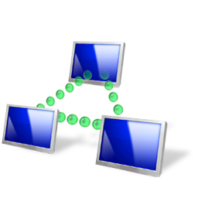
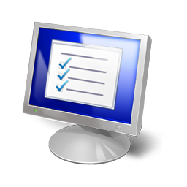
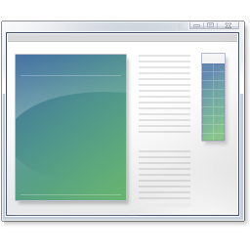
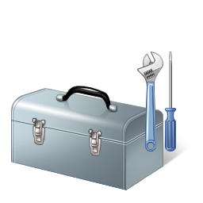
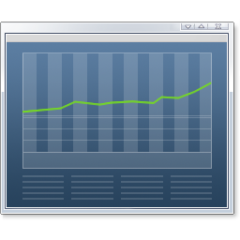
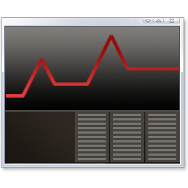
Deployment Configuration
Increased flexibility in application configuration
Benefits
  Identify discovered configuration
  Search and find configuration
Target Scenarios
  Sequence once and deploy to many
Features
  Search text, registry, XML and config files
  Add scripts for the virtual and local environment

Slide 32
Detecting Sequencing Issues
Prepare Computer report
  Pending reboots
  VM not reverted
  Services (Antivirus, Defender, Indexing, Defrag, SCCM)
  Applications
Installation Report
  Excluded files
  Drivers
  System Differences
  SxS Conflicts
  Shell Extensions
report.xml

Slide 33


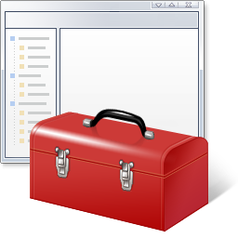
Sequencing Guidelines
Candidates needing assistance to virtualize
Interface with system
  Device drivers
  Windows Roles and Features
  Server level settings
Application and subsystem
dependencies
  Web Deploy
Custom configuration
  Script configuration
  Machine configuration
Deploy at runtime or with OS Service Template
Use VMM to deploy application dependencies
Custom scripts can be delivered using deployment configuration

Slide 34
Application Deployment

Slide 35
Environments and Scenarios
“Dev/ Test” Environment
Validate Deployment and Management of Server App-V packages using Server App-V PowerShell Interface
Datacenter/Private Clouds
VMM 2012 Service Update Workflows
Windows Azure Public Cloud
Packaging Server App-V applications for Azure
Deployment of Server App-V apps in Azure
Image-based
Create image of Server app using Server App-V Sequencer
VMM 2012 Service Creation Workflow
Conventional

Slide 36
Server App-V Deployment Mechanisms
PowerShell
App Instance
in
Dev/Test/Prod
Configuration
Server Application
Server App-V Package
App Instance
in
Private Cloud
VMM 2012
Sequencer
Configuration
Packaging Tool + Azure Portal
App Instance
in
Public Cloud
Configuration

Slide 37
Server App-V Agent PowerShell Cmdlets
Server App-V Agent PowerShell Cmdlets
  Exposed by the Server App-V agent WMI Provider
  Support for local and remote scripting
What you would you use it for
  To quickly determine validity of a package after sequencing
  To quickly determine deployment environment readiness
  To script (self-orchestrated) deployments to a datacenter
Feature Support
  Application lifecycle operations (Deploy, Upgrade, Retire)
  Application runtime operations (Configure, Start, Stop)
  Application state management operations (Backup, Restore)
Does not include
  Orchestration across tiers
  General operations like package copy

Slide 38
Test Your Virtual Application
Deploy using Server App-V PowerShell cmdlets
Add-ServerAppvPackage
Adds a package to your target server
Set-ServerAppvPackage
Applies settings in deploymentconfig to configure a package
Start-ServerAppvPackage
Stop-ServerAppvPackage
Starts a package after it’s been added and configured i.e. an application’s service is started
Operation to stop a running deployed package
Remove-ServerAppvPackage
Removes a package deployed on a server

Slide 39
Deploying Server App-V Apps using PowerShell
demo
Quick deployment using Agent PowerShell Cmdlets

Slide 40
Server app-v in the datacenter
System Center Virtual Machine Manager 2012

Slide 41
System Center VMM 2012
What it is
New product that moves customers towards a more dynamic datacenter
Server App-V is a feature of VMM 2012
VMM handles fabric management, service definition and orchestration; Server App-V handles creating and managing state-separated apps
What you would you use it for
To visualize, deploy and manage your datacenter

Slide 42
App Deployment and Management in VMM2012
Key Concepts: Services and Templates
Service
Ties fabric resources and apps
Supported application types:
Web Applications (WebDeploy)
Database Applications (SQL DAC)
Updates to services must be applied by changing the template first
Deployed services always linked to templates
Starting point for service creation & servicing
Template
Virtual Applications (Server App-V Package)

Slide 43
Service Lifecycle Management in VMM 2012
Create Service Template
Deploy
Service
Update
Service Template
Customize
Deployment
Apply to Service Instances

Slide 44
How Server App-V fits into Service Creation
Image Composition and Configuration
VM (Hardware, OS) Image
Server App-V App Image
Dynamically created instance of an app tier
Hardware, OS Configuration
App Deployment Configuration

Slide 45
Service Creation Workflow
Create Service Template
Create or use existing Machine Template
Define Hardware, OS, App Profiles
Customize Profiles
Hardware, OS
App Profile:
App Package
Installation scripts for Server App-V and pre-reqs
App configuration
Deploy Service
1-button deployment

Slide 46
VMM2012 Service Creation Workflow
demo
User Experience

Slide 47
Service Management in VMM2012
Service Update Workflow

Slide 48
How Server App-V fits into Service Update
State Management Operations
Backup State
Restore State
Machine A
Machine B
Application
State
Application
State
OS
OS’

Slide 49
Updating a Service
  Update process
  Clone and update the Service template
  Apply to deployed services
Update Types
  Conventional/ Regular updating
    Changes applied without replacing OS image.
    e.g. change memory, update applications
  Image based updating
    Replaces old OS image with new OS image, reinstalls apps, restores state
    e.g. moving from WS08 to WS08 R2

Slide 50
VMM2012 Service Update Workflow
demo
User Experience

Slide 51
In Review: Session Objectives and Takeaways
Benefits of Server App-V
Differences between Server App-V vs. App-V
Application support
Sequencing process
Deployment configuration
Virtual application deployment
  PowerShell Cmdlets
  VMM
State separation and servicing
Using existing tools with Server App-V

Slide 52
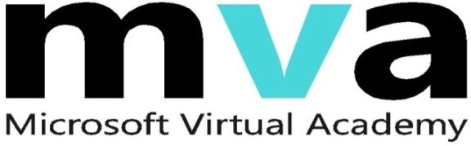
Enrol in Microsoft Virtual Academy Today
Why Enroll, other than it being free?
The MVA helps improve your IT skill set and advance your career with a free, easy to access training portal that allows you to learn at your own pace, focusing on Microsoft technologies.
What Do I get for enrolment?
Free training to make you become the Cloud-Hero in my Organization
Help mastering your Training Path and get the recognition
Connect with other IT Pros and discuss The Cloud
Where do I Enrol?
www.microsoftvirtualacademy.com
Then tell us what you think. TellTheDean@microsoft.com

Slide 53




Resources
www.msteched.com/Australia
  Sessions On-Demand & Community
www.microsoft.com/australia/learning
Microsoft Certification & Training Resources
http:// technet.microsoft.com/en-au
  Resources for IT Professionals
http://msdn.microsoft.com/en-au
  Resources for Developers

Slide 54

© 2010 Microsoft Corporation. All rights reserved. Microsoft, Windows, Windows Vista and other product names are or may be registered trademarks and/or trademarks in the U.S. and/or other countries.
The information herein is for informational purposes only and represents the current view of Microsoft Corporation as of the date of this presentation. Because Microsoft must respond to changing market conditions, it should not be interpreted to be a commitment on the part of Microsoft, and Microsoft cannot guarantee the accuracy of any information provided after the date of this presentation. MICROSOFT MAKES NO WARRANTIES, EXPRESS, IMPLIED OR STATUTORY, AS TO THE INFORMATION IN THIS PRESENTATION.

