Slide 2
FAilover Clustering and Hyper-V: Planning Your Highly-Available Virtualization Environment
SESSION CODE: VIR-SEC303
Harris Schneiderman
Technology Strategist
Microsoft Australia
Philip Duff
Datacenter Technology Specialist
Microsoft Australia

Slide 3

Agenda
Planning a high availability model
Validate and understanding support policies
Understanding Live Migration
Deployment Planning
VM Failover Policies
Datacenter Manageability

Slide 4
Planning your Availability Model

Slide 5


Failover Clustering & Hyper-V for Availability
Foundation of your Private Cloud
VM mobility
Increase VM Availability
  Hardware health detection
  Host OS health detection
  VM health detection
  Application/service health detection
  Automatic recovery
Deployment flexibility
Resilient to planned and unplanned downtime

Slide 6






Host vs. Guest Clustering
Host Clustering
Guest Clustering
Cluster service runs inside (physical) host and manages VMs
VMs move between cluster nodes
Cluster service runs inside a VM
Apps and services inside the VM are managed by the cluster
Apps move between clustered VMs
Cluster
Cluster
SAN
iSCSI

Slide 7

What Host Clustering Delivers
Avoids a single point of failure when consolidating
  “Do not put all your eggs in 1 basket”
Survive Host Crashes
  VMs restarted on another node
Restart VM Crashes
  VM OS restarted on same node
Recover VM Hangs
  VM OS restarted on same node
Zero Downtime Maintenance & Patching
  Live migrate VMs to other hosts
Mobility & Load Distribution
  Live migrate VMs to different servers to load balance

Slide 8
What Guest Clustering Delivers
Application Health Monitoring
  Application or service within VM crashes or hangs then moves to another VM
Application Mobility
  Apps or services moves to another VM for maintenance or patching of guest OS
Cluster
iSCSI

Slide 9
Guest vs. Host: Health Detection
Fault | Host Cluster | Guest Cluster
Host Hardware Failure
Parent Partition Failure
VM Failure
Guest OS Failure
Application Failure

Slide 10
Host vs. Guest Clustering Summary
Host Clustering
VM’s move from server to server
Zero downtime to move a VM
Works with any application or guest OS
Guest Clustering
Apps move from VM to VM
Traditionally downtime when moving applications
Requires double the resources – 2 VM’s for single workload

Slide 11
Combining Host & Guest Clustering
Best of both worlds for flexibility and protection
  VM high-availability & mobility between physical nodes
  Application & service high-availability & mobility between VMs
Cluster-on-a-cluster does increase complexity
Guest Cluster
CLUSTER
CLUSTER
iSCSI
SAN
SAN

Slide 12
Mixing Physical and Virtual in the Same Cluster
Mixing physical & virtual nodes is supported
  Must still pass “Validate”
Requires iSCSI storage
Scenarios:
  Spare node is a VM in a farm
  Consolidated Spare
iSCSI

Slide 13
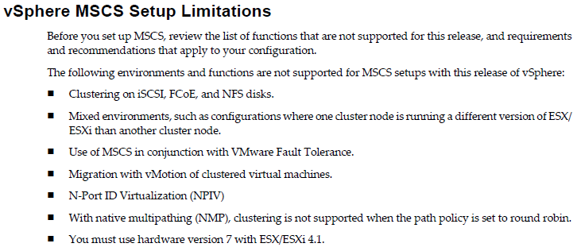
Guest Clustering on top of VMware
VMware Support Policy
Microsoft Support Policy
Guest Clustering on top of VMware has additional considerations
See VMware’s guide: http://www.vmware.com/pdf/vsphere4/r41/vsp_41_mscs.pdf
Solution must still be logo’d or pass Validate
See this blog for additional information: http://blogs.msdn.com/b/clustering/archive/2010/07/27/10042799.aspx
 | ESX 3.5 or earlier | vSphere 4.0 | vSphere 4.1
Windows NT Server 4.0 | No | No | No
Windows 2000 Server | No | No | No
Windows Server 2003 | No | Yes (limited hardware configurations) | No
Windows Server 2008 | No | Yes (See VMware restrictions) | Yes (See VMware restrictions)
Windows Server 2008 R2 | No | Yes (See VMware restrictions) | Yes (See VMware restrictions)

Slide 14
Planning for Workloads in a Guest Cluster
SQL
  Host and guest clustering supported for SQL 2005 and 2008
  Supports guest live and quick migration
  Support policy: http://support.microsoft.com/?id=956893
File Server
  Fully Supported
  Live migration is a great solution for moving the file server to a different physical system without breaking client TCP/IP connections
Exchange
  Exchange 2007 SP1 HA solutions are supported for guest clustering
  Support Policy: http://technet.microsoft.com/en-us/library/cc794548.aspx
  Exchange 2010 SP1
  Support Policy: http://technet.microsoft.com/en-us/library/aa996719.aspx
Other Server Products: http://support.microsoft.com/kb/957006

Slide 15
Configuring a highly available VM
demo

Slide 16
Validate and Support Policies

Slide 17

Failover Cluster Support Policy
Flexible cluster hardware support policy
You can use any hardware configuration if
  Each component has a Windows Server 2008 R2 logo
    Servers, Storage, HBAs, MPIO, DSMs, etc…
  It passes Validate
It’s that simple!
  Commodity hardware… no special list of proprietary hardware
  Connect your Windows Server 2008 R2 logo’d hardware
  Pass every test in Validate
    It is now supported!
  If you make a change, just re-run Validate
Details: http://go.microsoft.com/fwlink/?LinkID=119949

Slide 18
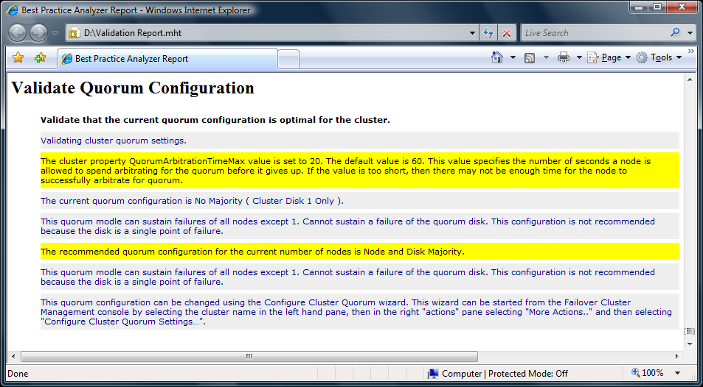
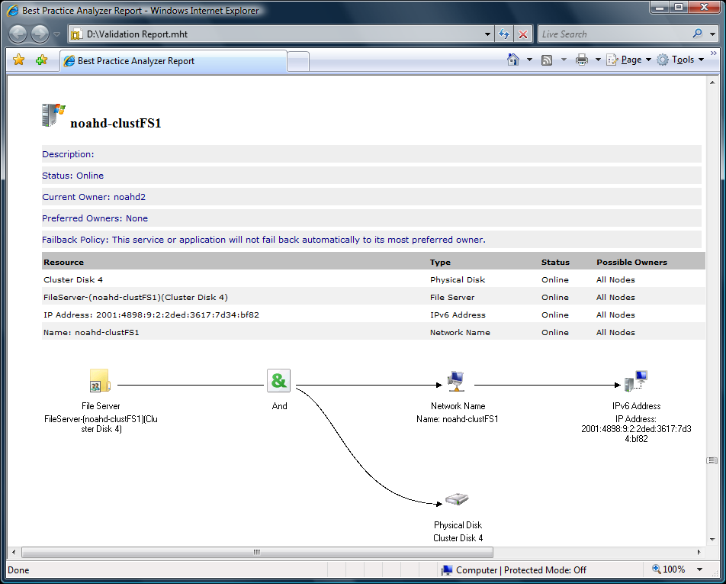
Validating a Cluster
Functional test tool built into the product that verifies interoperability
Run during configuration or after deployment
  Best practices analyzed if run on configured cluster
Series of end-to-end tests on all cluster components
  Configuration info for support and documentation
  Networking issues
  Troubleshoot in-production clusters
More information
http://go.microsoft.com/fwlink/?LinkID=119949

Slide 19
Cluster Validation
demo

Slide 20


PowerShell Support
Improved Manageability
  Run Validate
  Easily Create Clusters & HA Roles
  Generate Dependency Reports
  Built-in Help (Get-Help Cluster)
    As well as online here
Hyper-V Integration
Replaces cluster.exe
as the CLI tool
Action | CMDlet
Make VMs Highly-Available | Add-ClusterVirtualMachineRole
Quick Migration | Move-ClusterGroup
Live Migration | Move-ClusterVirtualMachineRole
Add a Disk to CSV | Add-ClusterSharedVolume
Move CSV Disk | Move-ClusterSharedVolume
Update VM Configuration | Update-ClusterVirtualMachineConfiguration

Slide 21
Understanding Live Migration

Slide 22


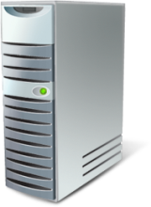




Live Migration - Initiate Migration
Client accessing VM
Live Migrate this VM to another physical machine
SAN
IT Admin initiates a Live Migration to move a VM from one host to another
VHD

Slide 23
Live Migration - Memory Copy: Full Copy
Memory content is copied to new server
VM pre-staged
SAN
The first initial copy is of all in memory content
VHD

Slide 24
Live Migration - Memory Copy: Dirty Pages
Client continues accessing VM
Pages are being dirtied
SAN
Client continues to access VM, which results in memory being modified
VHD

Slide 25
Live Migration - Memory Copy: Incremental
Recopy of changes
Smaller set of changes
SAN
Hyper-V tracks changed data, and re-copies over incremental changes
Subsequent passes get faster as data set is smaller
VHD

Slide 26
Live Migration - Final Transition
Partition State copied
VM Paused
SAN
Window is very small and within TCP connection timeout
VHD

Slide 27
Live Migration - Post-Transition: Clean-up
Client directed to new host
Old VM deleted once migration is verified successful
SAN
ARP issued to have routing devices update their tables
Since session state is maintained, no reconnections necessary
VHD

Slide 28
Deployment Planning

Slide 29
Choosing a Host OS SKU
No guest OS licenses
4 guest OS licenses
Unlimited guest licenses
Hyper-V Server
Windows Server Enterprise
Windows Server Datacenter
Host OS is Free
Licensed per Server
Licensed per CPU
All include Hyper-V, 16 node Failover Clustering, and CSV

Slide 30
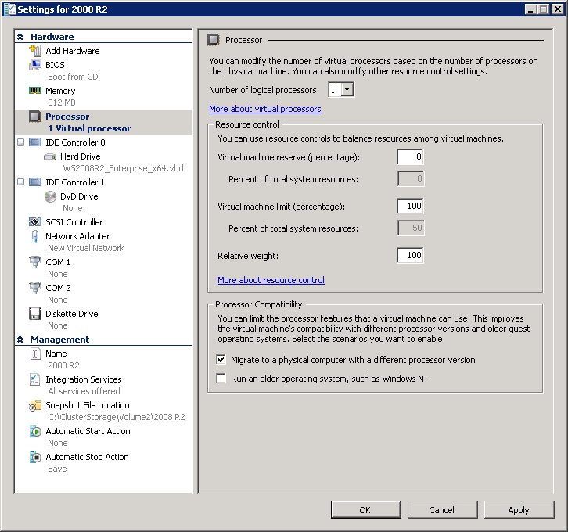
Planning Server Hardware
Ensure processor compatibility for Live Migration
Processors should be from the same manufacturer in all nodes
  Cannot mix Intel and AMD in the same cluster
Virtual Machine Migration Test Wizard can be used to verify compatibility
  http://archive.msdn.microsoft.com/VMMTestWizard
‘Processor Compatibility Mode’ can also be used
if you have processors not compatible with each
other for live migrating (all Intel or all AMD)

Slide 31

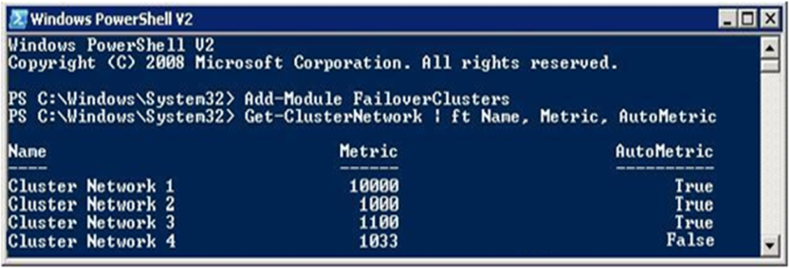
Planning Network Configuration
Minimum is 2 networks:
  Internal & Live Migration
  Public & VM Guest Management
Best Solution
  Public network for client access to VMs
  Internal network for intra-cluster communication & CSV
  Hyper-V: Live Migration
  Hyper-V: VM Guest Management
  Storage: iSCSI SAN network
Use ‘Network Prioritization’ to configure your networks

Slide 32



Guest vs. Host: Storage Planning
Storage | Host Cluster | Guest Cluster
Fibre Channel (FC)
Serial Attached SCSI (SAS)
Fibre Channel over Ethernet (FCoE)
iSCSI
3rd party replication can also be used

Slide 33
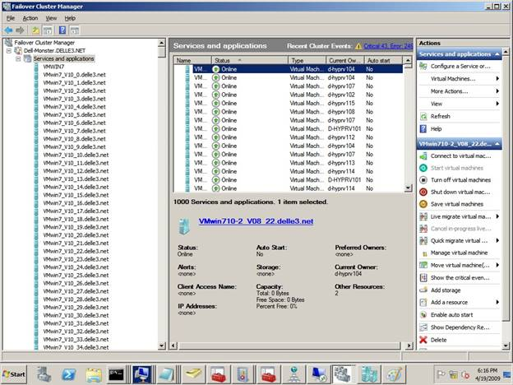
Planning Virtual Machine Density
1,000 VMs per Cluster supported
Deploy them all across any number of nodes
  Recommended to allocate spare resources for 1 node failure
384 VM per node limit
512 VP per node limit
  12:1 virtual processors per logical
  (# processors) * (# cores) * (# threads per core) * 12 = total
Up to 16 nodes in a cluster
Planning Considerations:
  Hardware Limits
  Hyper-V Limits
  Reserve Capacity

Slide 34
Cluster Shared Volumes (CSV)
Allows multiple servers simultaneous access to a common NTFS volume
Simplifies storage management
Increases resiliency
SAN

Slide 35
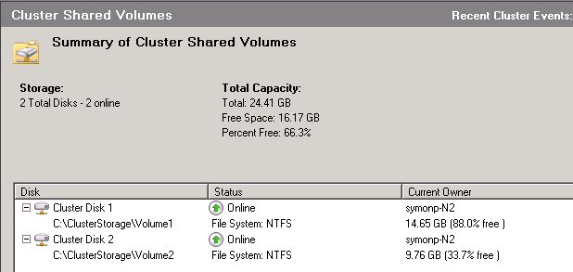
Cluster Shared Volumes
Distributed file access solution for Hyper-V
Concurrent access to disk from any node
VMs do not know their host
VMs no longer bound to storage
VMs can share a CSV disk to reduce LUNs

Slide 36
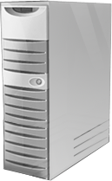


Cluster Shared Volume Overview
Concurrent access to a single file system
SAN
Single Volume
Disk5
VHD
VHD
VHD

Slide 37
CSV Compatibility
CSV is fully compatible with what you have deployed today with Win2008!
  No special hardware requirements
  No file type restrictions
  No directory structure or depth limitations
  No special agents or additional installations
  No proprietary file system
    Uses well established traditional NTFS
    Simple migrations to CSV

Slide 38
Configuring a CSV
demo

Slide 39



I/O Connectivity Fault Tolerance
I/O Redirected via network
VM running on Node 2 is unaffected
Coordination Node
SAN
SAN Connectivity Failure
VM’s can then be live migrated to another node with zero client downtime
VHD

Slide 40


Node Fault Tolerance
Node Failure
VM running on Node 2 is unaffected
Brief queuing of I/O while volume ownership is changed
SAN
Volume relocates to a healthy node
VHD

Slide 41
Network Fault Tolerance
Metadata Updates Rerouted to redundant network
VM running on Node 2 is unaffected
Volume mounted on Node 1
Network Path Connectivity Failure
SAN
Fault-Tolerant TCP connections make a path failure seamless
VHD

Slide 42

Planning Number of VMs per CSV
There is no maximum number of VMs on a CSV volume
Performance considerations of the storage array
  Large number of servers, all hitting 1 LUN
  Talk to your storage vendor for their guidance
How many IOPS can your storage array handle?

Slide 43

Active Directory Planning
All nodes must be members of a domain
Nodes must be in the same domain
Need an accessible writable DC
DCs can be run on nodes, but use 2+ nodes (KB 281662)
Do not virtualize all domain controllers
  DC needed for authentication and starting cluster service
  Leave at least 1 domain controller on bare metal

Slide 44
VM Failover Policies

Slide 45
Keeping VMs off the Same Host
Scenarios:
  Keep all VMs in a Guest Cluster off the same host
  Keep all domain controllers off the same host
  Keep tenets separated
AntiAffinityClassNames
    Groups with same AntiAffinityClassNames
    value try to avoid being hosted on same node
    http://msdn.microsoft.com/en-us/library/aa369651(VS.85).aspx

Slide 46
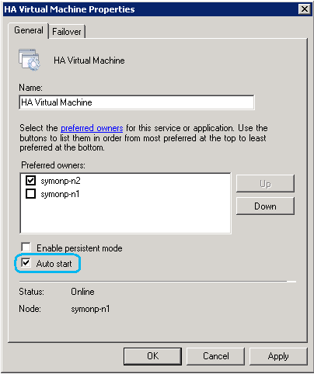
Disabling Failover for Low Priority VMs
‘Auto Start’ setting configures if a VM should be automatically started on failover
  Group property
  Disabling mark groups as lower priority
  Enabled by default
Disabled VMs needs manual
restart to recover after a crash

Slide 47
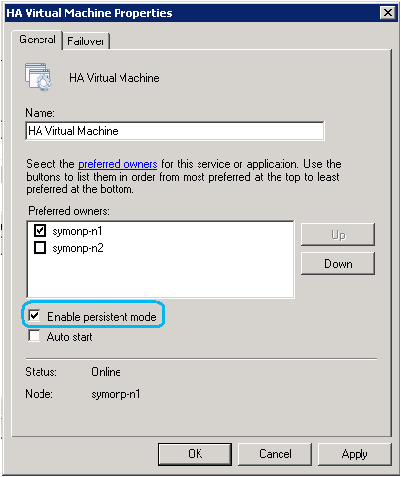
Starting VMs on Preferred Hosts
‘Persistent Mode’ will attempt to place VMs back on the last node they were hosted on during start
  Only takes affect when complete cluster is started up
  Prevents overloading the first nodes that startup with large numbers of VMs
Better VM distribution after cold start
Enabled by default for VM groups

Slide 48
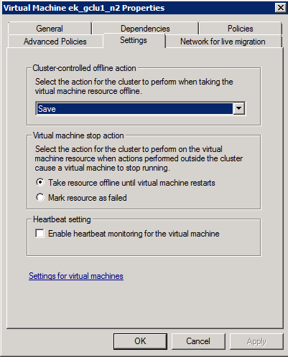
Enabling VM Health Monitoring
Enable VM heartbeat setting
    Requires Integration Components (ICs) installed in VM
Health check for VM OS from host
    User-Mode Hangs
    System Crashes
CLUSTER
SAN

Slide 49
Configuring Thresholds for Guest Clusters
Configure heartbeat thresholds when leveraging Guest Clustering
Tolerance for network responsiveness during live migration
SameSubnetThreshold & SameSubnetDelay
  SameSubnetDelay (default = 1 second)
    Frequency heartbeats are sent
  SameSubnetThreshold (default = 5 heartbeats)
    Missed heartbeats before an interface is considered down

Slide 50
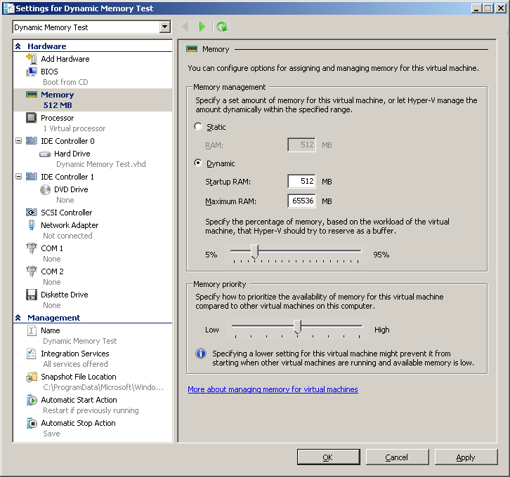
Dynamic Memory
New feature in Windows Server 2008 R2 Service Pack 1
    Upgrade the Guest Integration Components
Higher VM density across all nodes
Memory allocated to VMs is
dynamically adjusted in real time
    “Ballooning” makes memory pages non-
    accessible to the VM, until they are needed
    Does not impact Task Scheduler or other
    memory-monitoring utilities
Memory Priority Value is configurable per VM
    Higher priority for those with higher performance requirements
Ensure you have enough free memory
on other nodes for failure recovery

Slide 51
Root Memory Reserve
Root memory reserve behavior changed in Service Pack 1
Windows Server 2008 R2 RTM
  The cluster property, RootMemoryReserved, watches host memory reserve level during VM startup
  Prevent crashes and failovers if too much memory is being committed during VM startup
  Sets the Hyper-V registry setting, RootMemoryReserve (no ‘d’) across all nodes
  Cluster default: 512 MB, max: 4 GB
  PS > (get-cluster <cluster name>).RootMemoryReserved=1024
Windows Server 2008 R2 Service Pack 1
  Hyper-V will use a new memory reservation setting for the parent partition, MemoryReserve
    Based on “memory pressure” algorithm
    Admin can also configure a static reserve value
  The cluster nodes will use this new value for the parent partition
  Configuring RootMemoryReserved in the cluster does nothing

Slide 52
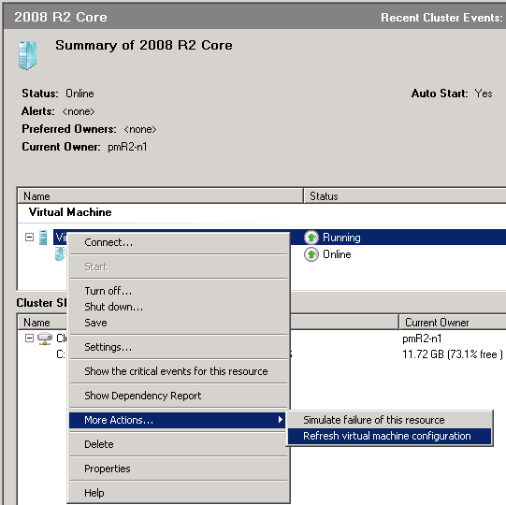
Refreshing the VM Configuration
Make configuration changes through Failover Cluster Manager or SCVMM
    Hyper-V Manager is not cluster aware, changes will be lost
“Refresh virtual machine configuration”
    Looks for any changes to VM or Cluster configuration
    PS > Update-
    ClusterVirtualMachineConfiguration
Storage
    Ensures VM on correct CSV disk with updated paths
Network
    Checks live migration compatibility
Several other checks performed

Slide 53
Clustering Overview of Win2008 R2 SP1
Cluster Changes
  24 fixes / hotfixes
  1 feature with enhanced asymmetric storage detection
Networking fixes (that help clusters)
  Many core networking fixes that improve network communication
    979612 - A hotfix is available that improves TCP loopback latency and UDP latency in Windows Server 2008, Windows Server 2008 R2, Windows Vista, and Windows 7
    981889 - A Windows Filtering Platform (WFP) driver hotfix rollup package is available for Windows Vista, Windows Server 2008, Windows 7, and Windows Server 2008 R2
Critical: Apply hotfix KB 2531907 after upgrading to SP1

Slide 54
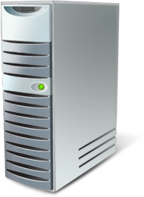



Multi-site Cluster Enhancements
Asymmetric Storage
Node Vote Weight
Optimized to allow storage only visible to a subset of nodes
Improves multi-site cluster experience
Granular control of which nodes have votes in determining quorum
Flexibility for multi-site clusters
Post-SP1 hotfix KB 2494036
No Vote

Slide 55
Datacenter Manageability

Slide 56
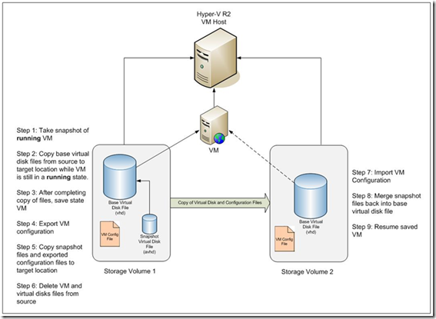
SCVMM: Quick Storage Migration
Ability to migrate VM storage to new location
Minimizes downtime during transfer
Simple single-click operation

Slide 57
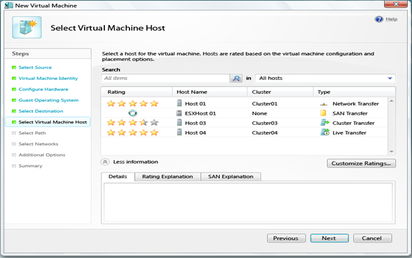
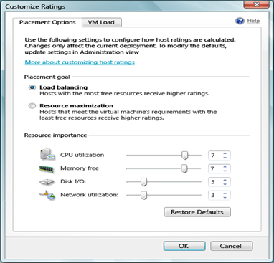
SCVMM: Intelligent Placement
Capacity planning improves resource utilization
Spreads VMs across nodes
“Star-Rated” results for easy decision making
Customizable algorithm

Slide 58

New Cluster Features in SCVMM 2012
Configure SCVMM for highly available on a Failover Cluster
Simplified setup & deployment
  Cluster setup / deployment from bare metal
Easy automated maintenance
  Cluster patch orchestration
Dynamic Optimization
  Load balance VMs across the cluster
Power Optimization
  Turns off nodes when they are under utilized

Slide 59
Summary
High availability and virtualization go hand-in-hand
Hyper-V and Failover Clustering are tightly integrated
Host clustering enables you to achieve zero downtime for planned maintenance
Highly scalable to large numbers of VMs and datacenter management with System Center Virtual Machine Manager

Slide 60
Failover Cluster Resources
Cluster Team Blog:
http://blogs.msdn.com/clustering/
Clustering Forum:
http://forums.technet.microsoft.com/en-US/winserverClustering/threads/
Cluster Resources:
http://blogs.msdn.com/clustering/archive/2009/08/21/9878286.aspx
Cluster Information Portal:
http://www.microsoft.com/windowsserver2008/en/us/clustering-home.aspx
Clustering Technical Resources:
http://www.microsoft.com/windowsserver2008/en/us/clustering-resources.aspx
Windows Server 2008 R2 Cluster Features:
http://technet.microsoft.com/en-us/library/dd443539.aspx

Slide 61

Enrol in Microsoft Virtual Academy Today
Why Enroll, other than it being free?
The MVA helps improve your IT skill set and advance your career with a free, easy to access training portal that allows you to learn at your own pace, focusing on Microsoft technologies.
What Do I get for enrolment?
Free training to make you become the Cloud-Hero in my Organization
Help mastering your Training Path and get the recognition
Connect with other IT Pros and discuss The Cloud
Where do I Enrol?
www.microsoftvirtualacademy.com
Then tell us what you think. TellTheDean@microsoft.com

Slide 62

© 2010 Microsoft Corporation. All rights reserved. Microsoft, Windows, Windows Vista and other product names are or may be registered trademarks and/or trademarks in the U.S. and/or other countries.
The information herein is for informational purposes only and represents the current view of Microsoft Corporation as of the date of this presentation. Because Microsoft must respond to changing market conditions, it should not be interpreted to be a commitment on the part of Microsoft, and Microsoft cannot guarantee the accuracy of any information provided after the date of this presentation. MICROSOFT MAKES NO WARRANTIES, EXPRESS, IMPLIED OR STATUTORY, AS TO THE INFORMATION IN THIS PRESENTATION.

Slide 63




Resources
www.msteched.com/Australia
  Sessions On-Demand & Community
www.microsoft.com/australia/learning
Microsoft Certification & Training Resources
http:// technet.microsoft.com/en-au
  Resources for IT Professionals
http://msdn.microsoft.com/en-au
  Resources for Developers

Slide 64




Tech·Ed Bling
  Email Signature
  Blog Bling
Email Signature
  Blog Bling

