Slide 2
Server Virtualisation: business needs and cost benefits a case study from The Barossa Council
SESSION CODE: VOC207
Ryan England
Manager, ICT
The Barossa Council

Slide 3
Session overview…
What this session is...
  Case study of a recent server virtualisation & consolidation project
  Highlight of benefits achieved from server virtualisation
What this session is NOT...
  An in-depth technical presentation on Hyper-V

Slide 4

My life Vs. What I want…

Slide 5
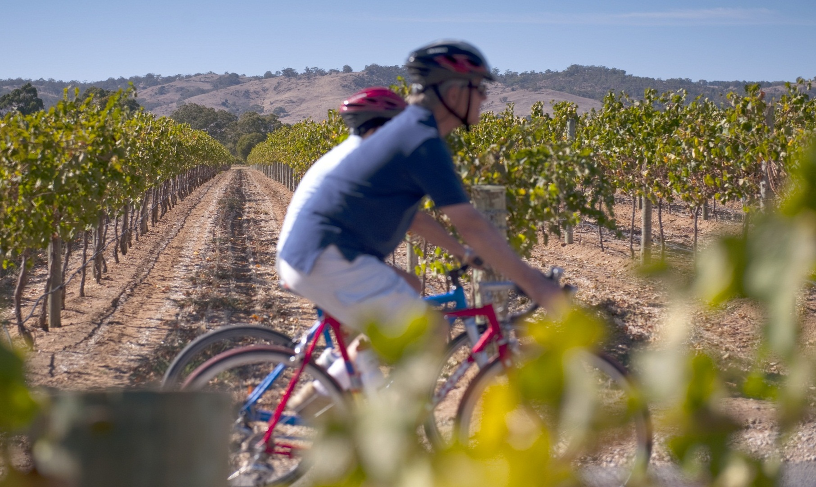
My life Vs. What I want…
(c) SATC

Slide 6

My life Vs. What I want…

Slide 7
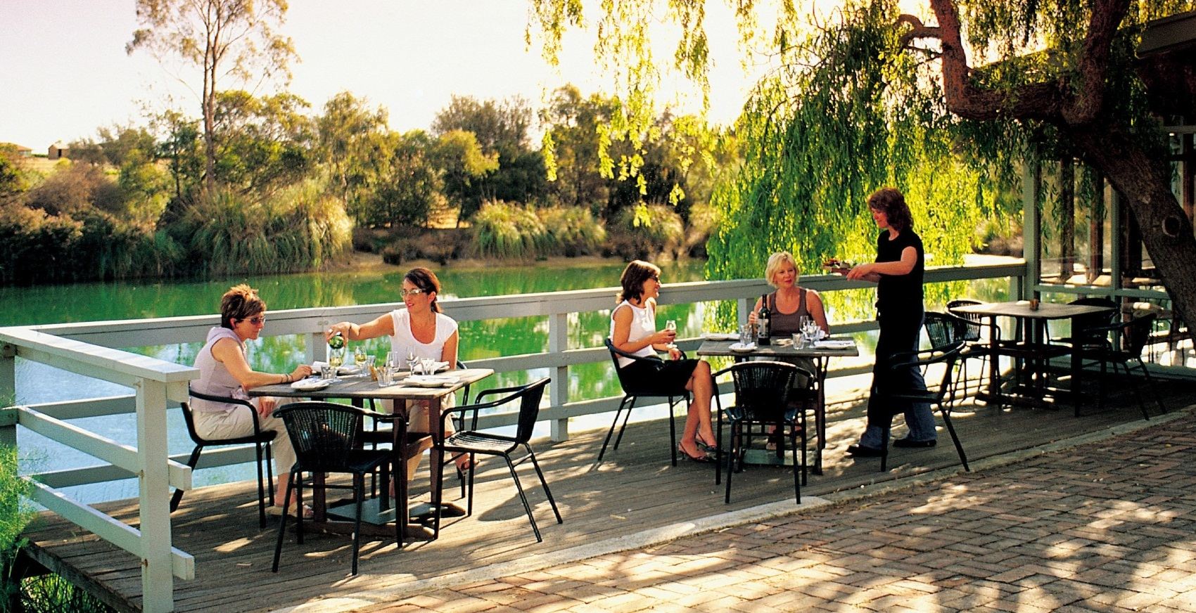

My life Vs. What I want…

Slide 8
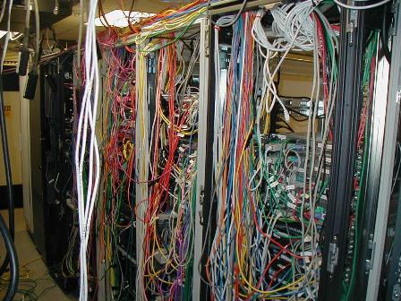
My life Vs. What I want…

Slide 9
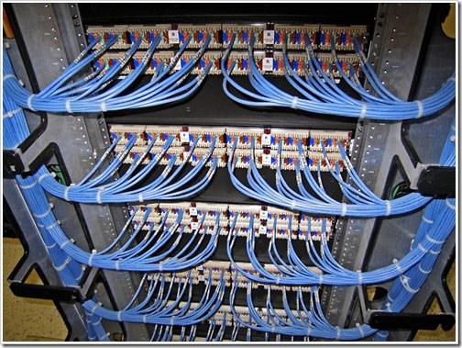
My life Vs. What I want…

Slide 10
Agenda
Our problems
Our solution
Implementation plan
Benefits
Lessons learnt
Next Steps
Q & A

Slide 11
Our problems…
Server infrastructure age
Complex server management
Physical space limitations
Excessive power consumption
Lack of High availability
No replication to DR site

Slide 12

Video…

Slide 13
Our solution…
Virtual platform running Hyper-V on Windows Server 2008 R2
Cluster running across four physical servers
System Centre VMM used for P2V conversion of existing servers
Replication to DR site using System Centre DPM

Slide 14




Hardware configuration…
.VHD
.VHD
DR Site
.VHD
.VHD

Slide 15
Implementation plan…
Plan
Production
Pilot

Slide 16
Benefits…
Power
No additional $’s
Centralized Management
Consolidation
Physical Space
Replication to DR site

Slide 17
Lessons learnt…
Document
Compatibility
Backups / Test Environment
Planning

Slide 18

My life what it was…

Slide 19

My life is…

Slide 20










Next steps…
Service Pack 1

Slide 21
Summary…

Slide 22
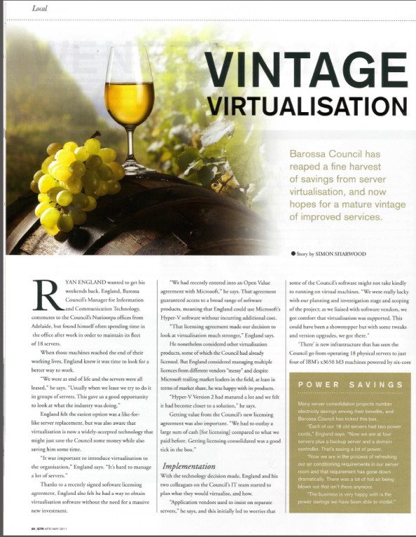
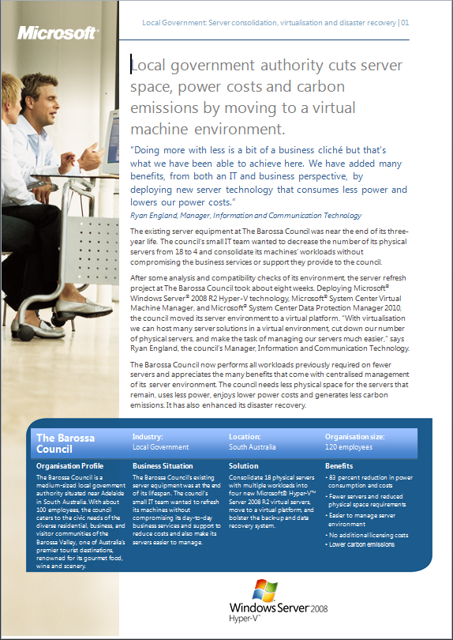
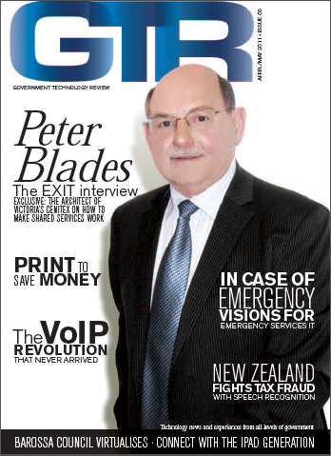
Further information…

Slide 23


Contacting me…
Ryan England
Manager, ICT
The Barossa Council
www.barossa.sa.gov.au
Ryan.England@barossa.sa.gov.au

Slide 24

Enrol in Microsoft Virtual Academy Today
Why Enroll, other than it being free?
The MVA helps improve your IT skill set and advance your career with a free, easy to access training portal that allows you to learn at your own pace, focusing on Microsoft technologies.
What Do I get for enrolment?
Free training to make you become the Cloud-Hero in my Organization
Help mastering your Training Path and get the recognition
Connect with other IT Pros and discuss The Cloud
Where do I Enrol?
www.microsoftvirtualacademy.com
Then tell us what you think. TellTheDean@microsoft.com

Slide 25

© 2010 Microsoft Corporation. All rights reserved. Microsoft, Windows, Windows Vista and other product names are or may be registered trademarks and/or trademarks in the U.S. and/or other countries.
The information herein is for informational purposes only and represents the current view of Microsoft Corporation as of the date of this presentation. Because Microsoft must respond to changing market conditions, it should not be interpreted to be a commitment on the part of Microsoft, and Microsoft cannot guarantee the accuracy of any information provided after the date of this presentation. MICROSOFT MAKES NO WARRANTIES, EXPRESS, IMPLIED OR STATUTORY, AS TO THE INFORMATION IN THIS PRESENTATION.

