Slide 1
The Science of Great UI
Mark Miller
Chief Scientist
DevExpress
Twitter: @MillerMark
Email: markm@devexpress.com
Blog: devexpress.com/mark

Slide 3
The Science of Great UI
SESSION CODE: #VOC208
Mark Miller
Chief Scientist
DevExpress

Slide 4
How Can We Fix This?

Slide 5
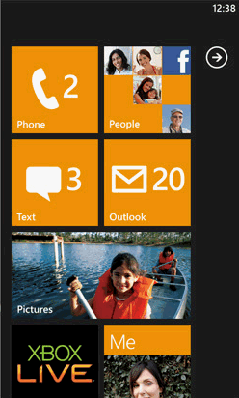
How Can We Fix This?

Slide 6
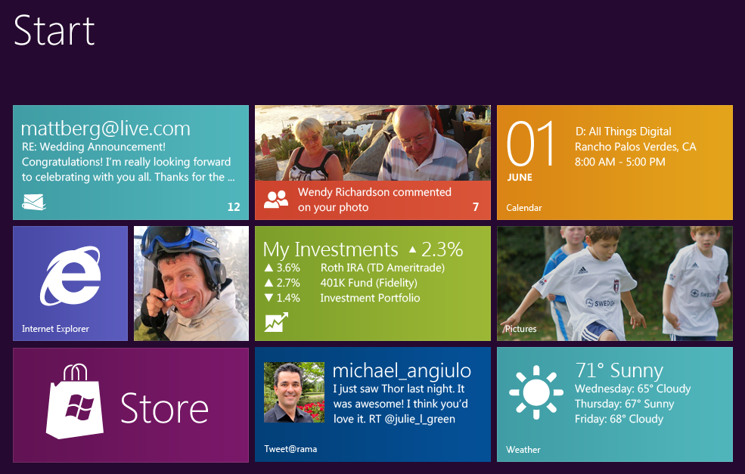
How Can We Fix This?

Slide 7
Why Should We Care About UI?
Small changes can make big difference
Customers can become:
Efficient
Productive
Satisfied
That can mean more money in your pocket

Slide 8
What Developers Say
“UI is subjective”
“I’m not an artist”
“We can’t fix the UI”
“Good UI is not worth the effort”
Notes:
Contrary to the popular myth, good UI is *not* subjective. Even if you’re not an artist, you can measure good UI using standard criteria. Knowing the “formula” to good UI is important; it allows us to identify problems in the presentation layer and also provides guidance in how to correct them. The only rationalization of a lame UI is “We don’t care about the user.”
This session is organized to follow these rationalizations.
We can’t fix the UI… – our application is too complex, or we’re already doing all we can.

Slide 9
“UI is subjective.”
Measuring Quality…

Slide 10
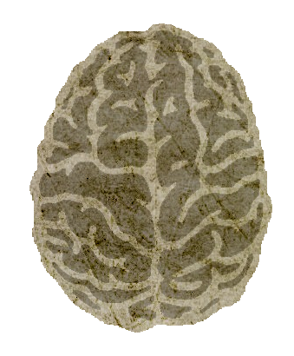
Cost of Interaction
Physical
Mental
Finger travel
Keystrokes
Time/effort to:
Finger taps
Understand
Mouse travel
Gestures
Mouse clicks
Recall
Gaze shift
Filter
Voice
Emotional State

Slide 11
Example – Measuring Keystrokes
We could count keys pressed
However…
Some keys are easier to hit than others
Create a point scale based on difficulty?

Slide 12
Example – Measuring Keystrokes
Examples
Key | Points
Space | 0.4
Tab | 0.7
Letter keys | 1.0
Number keys | 1.1
[]\;’,./-=` | 1.1
Arrow keys | 1.1
F1..F12 | 1.2
Extended keys | 1.3
Shift, Ctrl | 1.5
Alt | 1.7
Num pad keys | 1.8
Chorded keys | +1.0 per chord
Key Binding | Total Points
Ctrl+K, Ctrl+C | 6.0
Ctrl+K, Ctrl+U | 6.0
Ctrl+Alt+X | 4.2
{ | 2.6
( | 2.6
+ | 2.6
Ctrl+S | 2.5
- | 1.1
[ | 1.1
/ | 1.1
f | 1.0

Slide 13
Measuring Mouse Interaction
Pixels dragged
Number of clicks
Button duration down (as in a drag)

Slide 14
Mouse Travel Distance
Measured in pixels
Example: Breaking on exceptions
When debugging, it usually goes like this…
No clue on the shortcut, so I grab the mouse
Click on Debug menu, then click “Exceptions…”
Then I’m faced with the following…

Slide 15
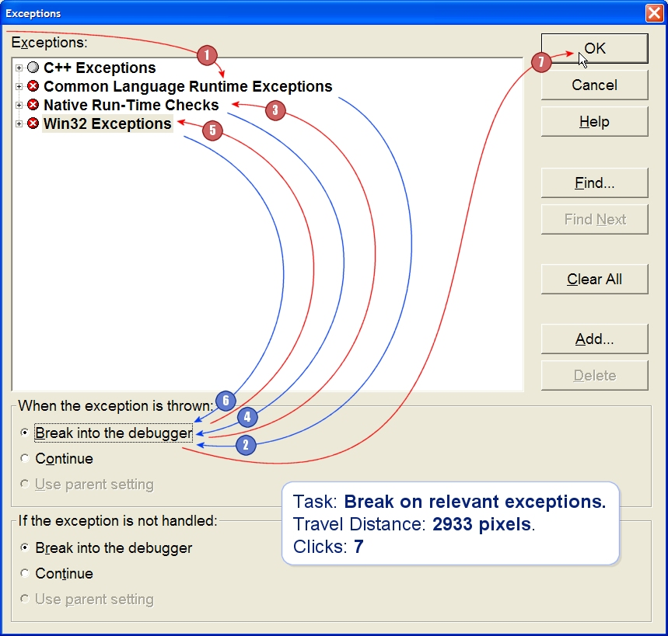
Example: Mouse Travel Distance
Notes:
This the minimum travel distance, gathered by measuring straight lines between click points. Actual travel distance will be greater. Making your customers run mouse marathons will stress them out.

Slide 16
Mouse & Keyboard
Both driven by the hands
Difficult to use both fully simultaneously
As a result, there are transitions…

Slide 17
Where are the Hands?
On the keyboard and/or mouse
Home keys
Home keys + extended navigation keys
Home keys + numeric keypad
Home keys + mouse
Transitional cost
Reaching for the mouse
Returning hand to the keyboard
Notes:
Demo – pasting from an HTML page in a new email in Outlook. Shortcut discoverability at that point requires the MOUSE.

Slide 18
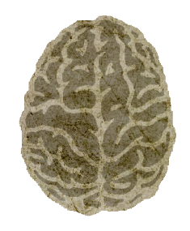
Transitions…
Demonstration
Notes:
Demo 1: In Outlook, create a new email. Grab some formatted text from a web site and paste it into the email. Press the Ctrl key, and show how there is no apparent way to select the paste option.

Slide 19
Physical Effort – Precision and Path

Slide 20
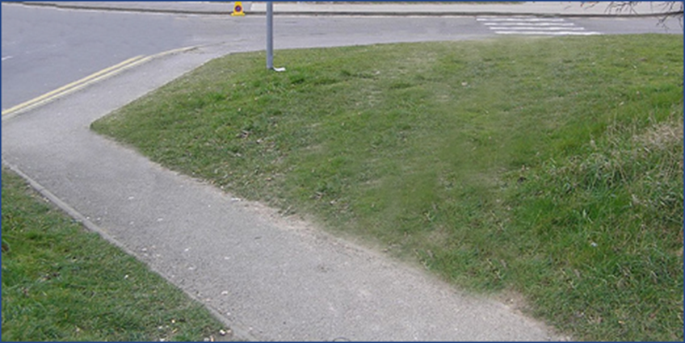
Key Concept - Path
Actions taken to perform a task

Slide 21
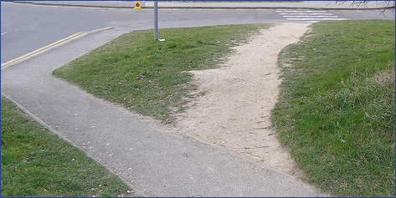
Key Concept - Path
Actions taken to perform a task

Slide 22
Path
Attributes
Length – how many steps/duration
Width – the precision required for each step
What do users want?
Users want a short & wide path.

Slide 23
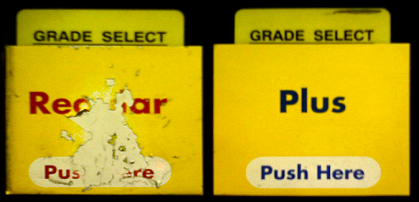
Path to Selecting Fuel
Notes:
Show Ribbon (larger buttons for more frequent items)
Show thin Splitter for in Windows Explorer.

Slide 24
Path to the Casino
Notes:
Show Ribbon (larger buttons for more frequent items)
Show thin Splitter for in Windows Explorer.

Slide 25
Path…
Demonstration Intellisense, Auto-correct & the Splitter
Notes:
Demo 1: Misspelling in word (type “mispelling“ in Word).
Demo 2: Show thin Splitter in Windows Explorer.

Slide 26
Brain Suckers
Awkward key combos, excessive steps
Is the user facing simplicity or complexity?
Distractions, user mistakes (e.g., misspelling, syntax)
Narrow/wide path?
Hunting for functionality
Are features easily discoverable?
Tedium
Is the user wading through noise or sailing through clarity?
Stacked UIs
Is the user interface stacked or flat?
Orienteering costs
Stupid user tricks just to get around?
Variance from user model
Is the presentation familiar or foreign?

Slide 27
Key Concept - User Model
It’s what the user expects
Often based on a familiar item in the physical world
Example: A checkbook
Sometimes computer history is convention

Slide 28
Sucking Brain Power…
Demonstration
Notes:
Demo 1: Try to find an event in Visual Studio inside Program.cs of the ComboBox program. Notice the physical and mental effort required to wade through the noise. The tiny window increases the precision necessary to get the event into view. The path is long and precise.
Demo 2: What’s the shortcut to Encapsulate a Field? Try to encapsulate the field using keyboard shortcuts in FrmComboListComparison.cs.

Slide 29
Sucking Brain Power
When software sucks on customer brains:
Reduces ability to focus
Decreases productivity
Increases stress / tension
Provokes a negative emotional response
Frustration → Rage

Slide 30
Is UI Really Subjective?
UI effectiveness can be measured;
Lots of criteria to choose from:
Physical effort
Mental effort
Other goals (e.g., orders placed on a web site)…
So...
If we can measure UI, we can compare;
If we can compare, we can pick a winner;
=> Great UI is not subjective.

Slide 31
Takeaways
Strong Correlations:
Noise
Precision
Physical effort
Mental effort
Steps
As interfaces evolve, this is likely to remain true.
Notes:
Noise: Mental – must filter. Physical – more data to physically move past.
Precision: Mental – more effort. Physical – more muscle strain and time exerting.
Steps: Mental – more to keep track of. Physical – more movement.
Big takeaway: The rules you learn in this session should be applicable for existing as well as future UIs.

Slide 32
Interactions
Navigating Big Data
Working with Layers
The Trouble with ComboBoxes
Discoverability

Slide 33
Interactions
Documents and Views
Showing Big Data (in a tiny window)
Navigating Big Data
Working with Layers
Why the ComboBox Must Die
Discoverability

Slide 34
Documents and Views
Document
The data to present and explore
View
A perspective into the document
Caret
Marks the insertion point for text
Cursor/Selection
Marks a selected item or range of data

Slide 35
Showing Big Data
It’s essentially a scaling problem
Lots of information
Small window to that information
Notes:
Filtering positively impacts performance and can reduce noise.
Demo – Google maps.

Slide 36
Showing Big Data - Strategies
Crop
Scrollbars
Scale
Aspect ratio lock
Zoom
Combination of Scaling + Scrollbars
Filter
Show more relevant details
Filtering UI
Notes:
Filtering positively impacts performance and can reduce noise.

Slide 37
Showing Big Data…
Demonstration – Google Maps
Notes:
Demo 1: Show Google Maps. Talk about how there’s a massive amount of data but we’re only seeing a small (yet relevant) portion of that data.

Slide 38
Navigation
Change the view over time
Restore previous/subsequent views
Highlight interesting data
Bookmark interesting views
Move interesting data into view (e.g. “Find”)
Move through related sibling views
Drill into and out of child views
Asynchronous scrolling – don’t do this!

Slide 39
Let’s play a game…
It’s called: “Find the caret”
Demonstration
Notes:
Prep: disable DevExpress | Options | Navigation | Markers | Locator Beacons.
Open

Slide 40
Highlighting Interesting Data
Demonstration
Notes:
Demo 1: Find in Chrome

Slide 41
Bookmarking Views
Demonstration
Notes:
Demo 1: Show bookmarks in Visual Studio

Slide 42
Drilling In & Popping Out
Demonstration
Notes:
Demo 1: Jump to Definition in Visual Studio

Slide 43
Asynchronous Scrolling
Demonstration
Notes:
Demo 1: Scrolling in Microsoft Outlook

Slide 44
Layered Interactions
Challenges
Relevant background data can be obscured
User may need to disassemble layers to finish task

Slide 45
Working with Layers
Demonstration
Notes:
Demo 1: Find in Notepad, VS, and Excel

Slide 46
The Trouble with ComboBoxes
Advantages
Small screen footprint
Disadvantages
Requires a precise click before user can:
Scan list
Find item to click
Move mouse to item
Scrolls in a constant velocity
List window is often too small

Slide 47
Combo Box Click - Path
This box from Office 2010 – is 14x22:
That’s 308 total pixels.
2500 of those fit on a 1024x768 monitor.

Slide 48
Combo Boxes
Demonstration
Notes:
Demo 1: Run the ComboBoxes demo program from the Science of Great UI solution.
Demo 2: Show ComboBoxes on the iPhone – in Safari, browse to is.gd/GeorgeTill

Slide 50
Human Interface Devices

Slide 51
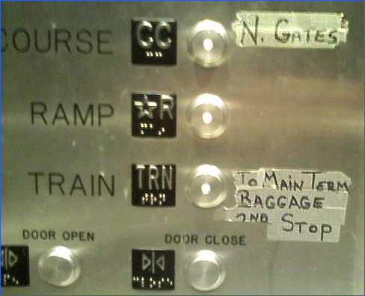
Key Concept - Discoverability
Ease of discovery
Notes:
Why is discoverability important? Because a lot of people trying to catch their plane are pressing the “R” button to get the ramp, and it’s clearly pissing off someone who works at Seatac.

Slide 52
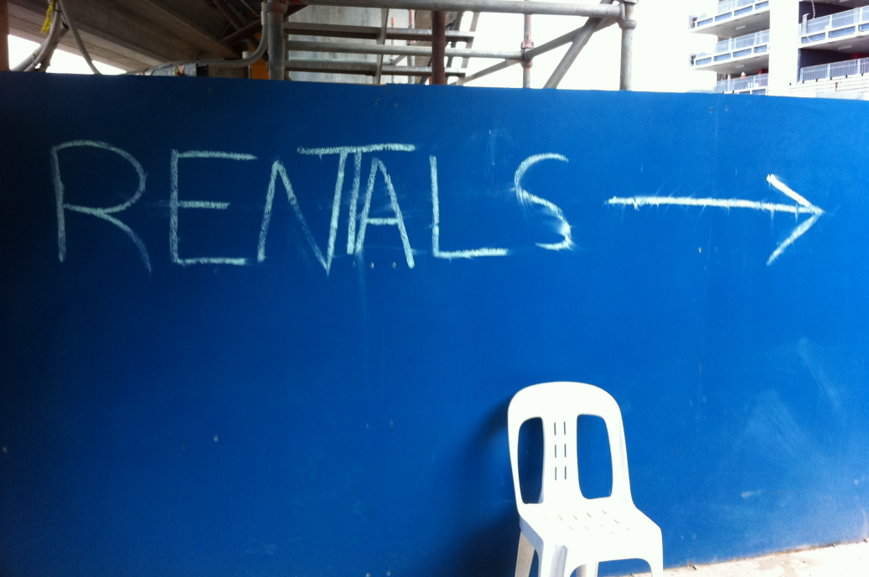
Key Concept - Discoverability
Ease of discovery
Notes:
Why is discoverability important? Because a lot of people trying to catch their plane are pressing the “R” button to get the ramp, and it’s clearly pissing off someone who works at Seatac.

Slide 53
Is Discoverability Important?
From the New York Times, 29 Dec 2010:
“In Missouri… 76 patients were over-radiated because a medical physicist did not realize that the smaller radiation beam used in radiosurgery had to be calibrated differently than the larger beam...” “Last year, [the software company responsible] promised to devise… a decidedly low-tech solution: a decal to stick on the machines, warning operators to be extra careful in setting the radiation field.”
We’re talking about software, kids.

Slide 54
Discoverability
Initial discovery
Remove barriers to the very first try
Retention
Memorable path
Repetition

Slide 55
Keystroke Binding Observation
App complexity leads to binding complexity
Example:
Ctrl+K, Ctrl+C to comment code in VS
Unfortunately, user burden increases
Users must allocate memory for the keys
Makes the learning curve steeper
Distracts from the task at hand
Unnecessarily complex
Notes:
As application complexity increases, so too do to the key bindings.

Slide 56
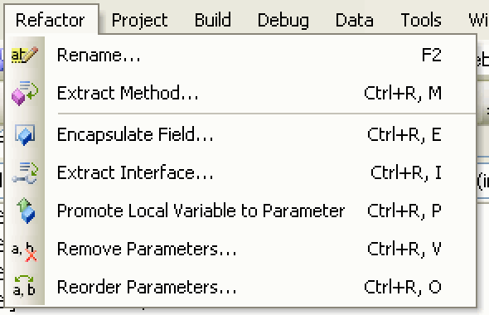
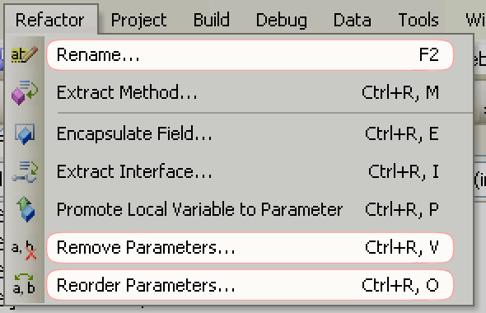
Keystroke Binding Observation

Slide 57
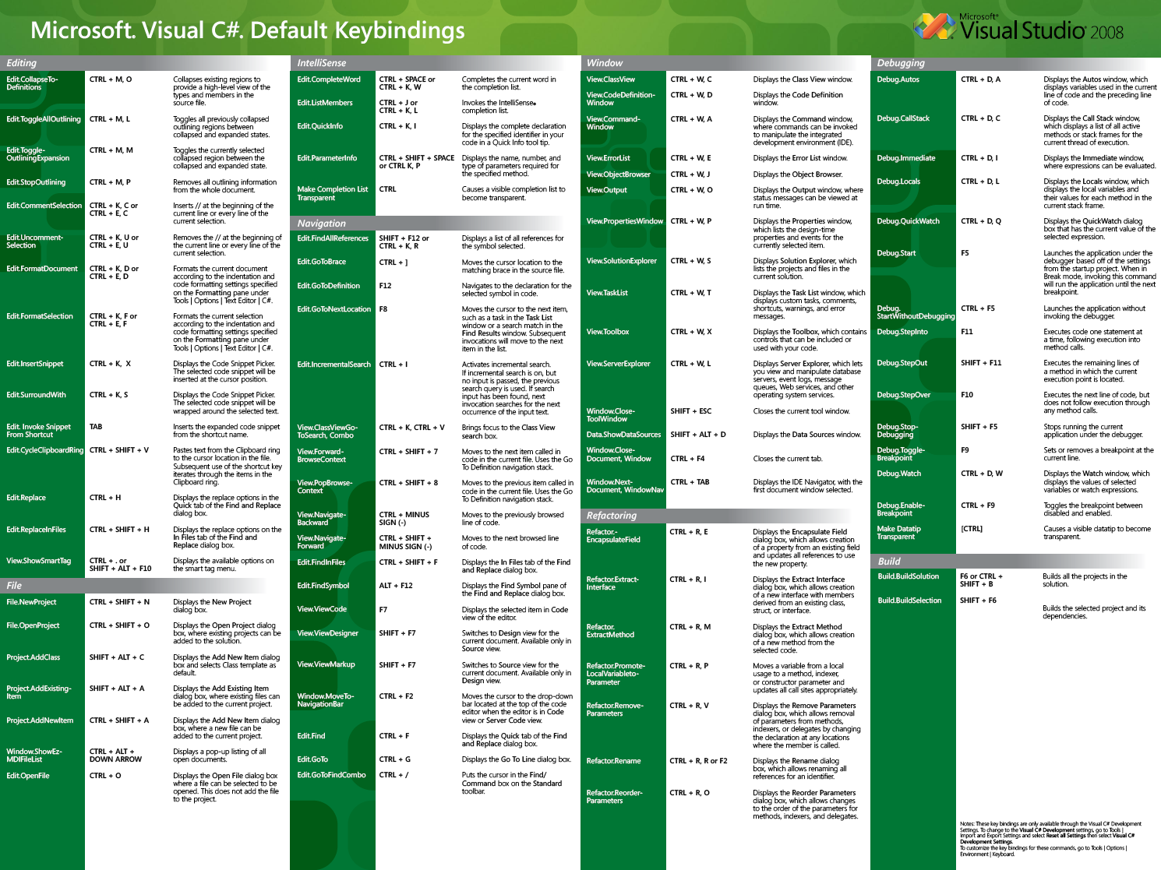
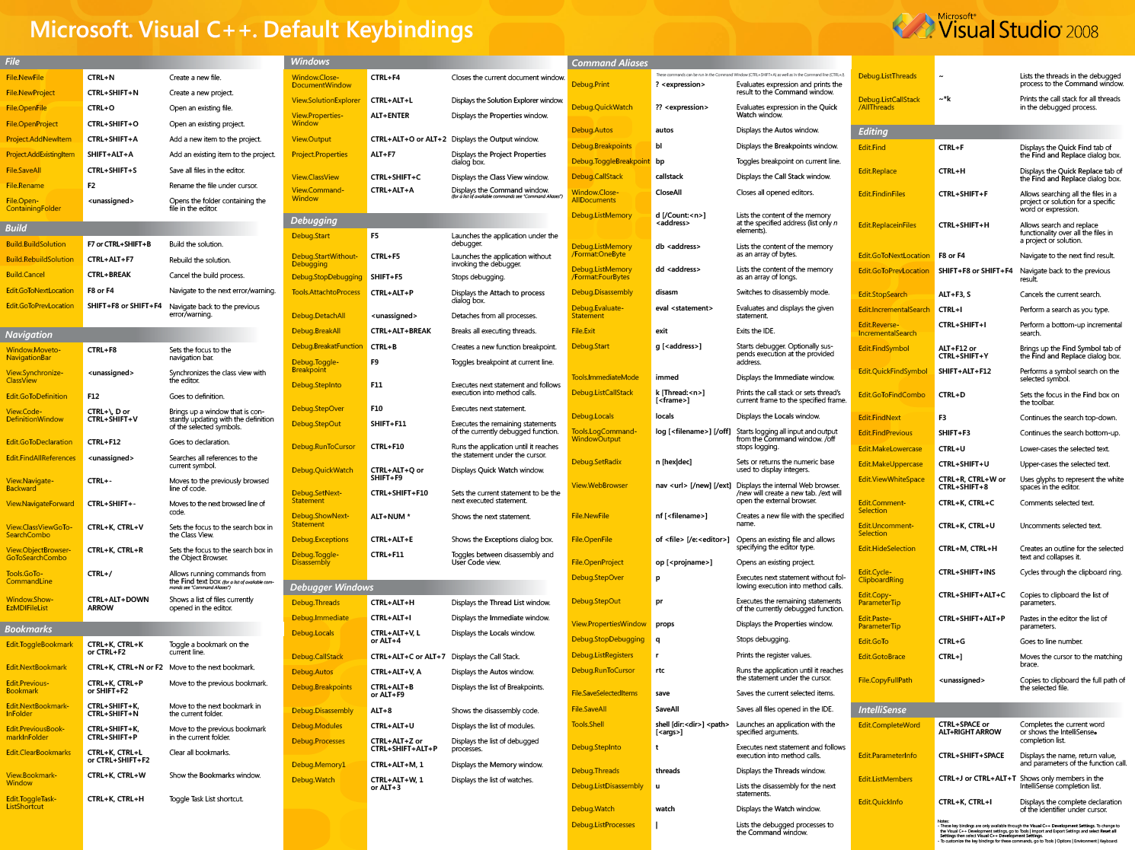
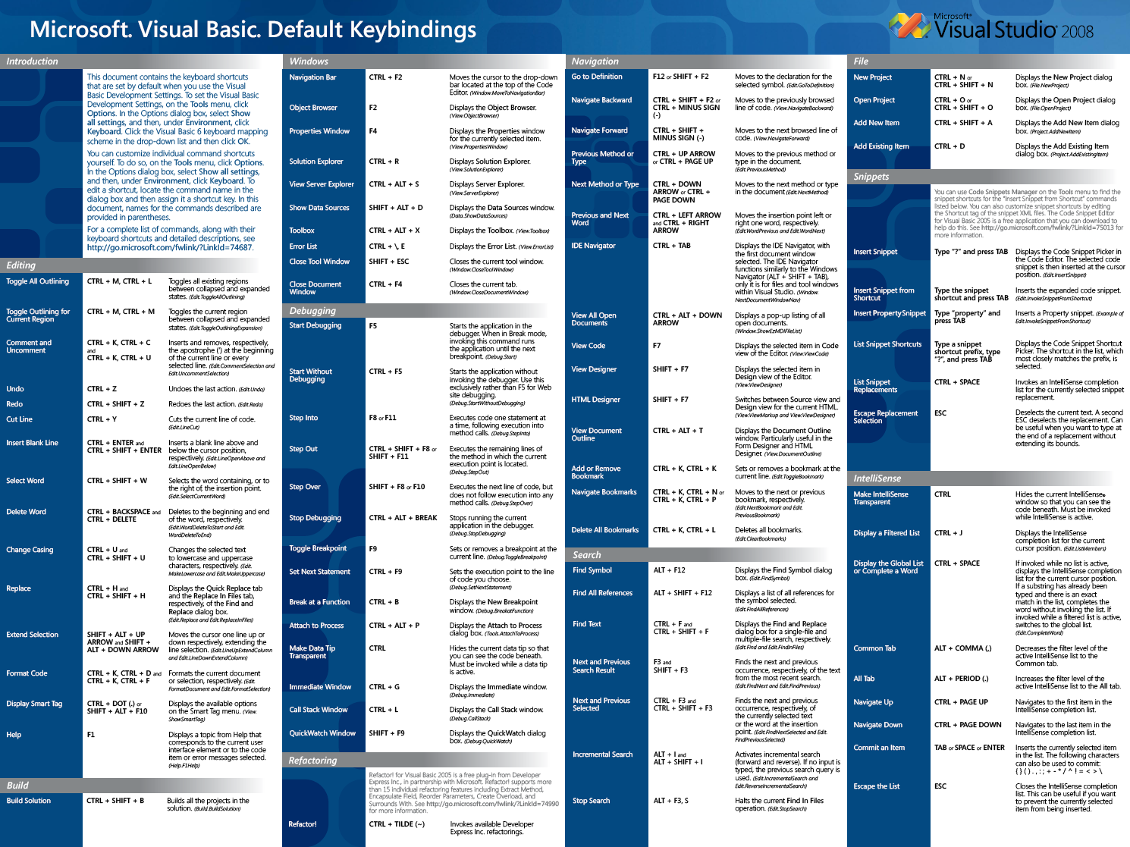
Discoverability – Shortcuts

Slide 58
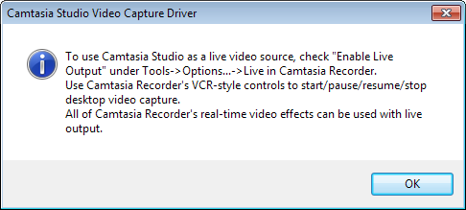
Discoverability Innovations
The manual
Shortcuts poster
Tech support
The help file
Modal instructional dialogs
Undo/redo
Menu item shortcuts
Tool tips
Training windows
Preview hinting

Slide 59
Brain Power
Discoverability
Demonstration
Notes:
Demo 1: Show preview hinting in CodeRush.
Demo 2: Discoverability in Office – show tooltips, press F1 for help, and show preview hinting.

Slide 60
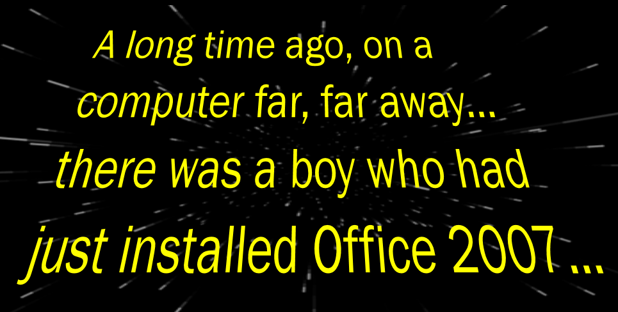
A Discoverability Story

Slide 61
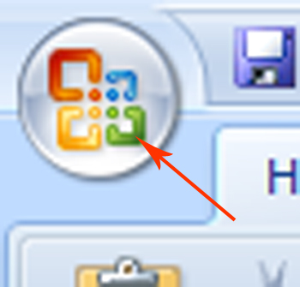
A Discoverability Story
That boy just wanted to print. But he couldn’t find the print button.
For days he crafted his sweet document.
But alas, no print button or menu could be found.
Meanwhile, there was a glowing image in the upper left…

Slide 62
A Discoverability Story
The boy cursed the glowing image: “Oh glowing icon: how can you glow like that when I am unable to find the print button? Surely you mock me with your animated brightness.”
In response the image glowed brighter, and so the angry boy turned to the dark side.
And that boy was me.

Slide 63
Discoverability
Benefits
Deeper customer immersion in your features
Increased customer satisfaction
Fewer calls to tech support
Fewer returns
More renewals/upgrades
Costs
Often a surprising hit on the schedule

Slide 64
Discoverability Takeaway
If you’re creating new UI, * plan* for discoverability issues cropping up later.
Notes:
Discuss the timeline

Slide 65
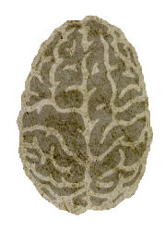
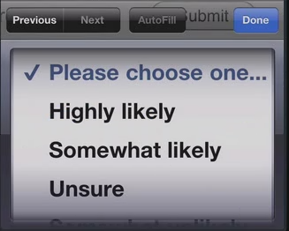
Key Concepts
Noise
14 pixels
Existing controls could be better.
Precision
Physical effort
Mental effort
User model
Steps
Discoverability
Tooltips in the wild.
Shorter path
Wider path

Slide 66
“I’m not an artist.”

Slide 67
Key Concept – Information Relevance
Everything onscreen is information
Not all information is equally important
=> Information Relevance

Slide 68
Present Information with Clarity
Smallest effective difference
Information in parallel
Noise
Tools of the UI Masters
Graphic language

Slide 69
Edward Tufte is a Genius
Edward Tufte’s Visual Explanations: Images and Quantities, Evidence and Narrative.
ISBN 0961392126

Slide 70
Smallest Effective Difference
s
s

Slide 71
Smallest Effective Difference
Rephrased: Don’t overdo it!
Tufte: Use smallest effective difference
I say: Increase contrast about 10%-15%
Monitor quality can vary
Test on the lowest-quality display you can find
Old laptop or projector
Next up: Information in Parallel

Slide 72
Information in Parallel
Serial

Slide 73
Information in Serial
Evaluated

Slide 74
Information in Serial
over

Slide 75
Information in Serial
time...

Slide 76
Information in Serial
User

Slide 77
Information in Serial
connects

Slide 78
Information in Serial
new

Slide 79
Information in Serial
information

Slide 80
Information in Serial
with

Slide 81
Information in Serial
memory

Slide 82
Information in Serial
of

Slide 83
Information in Serial
old

Slide 84
Information in Serial
information.

Slide 85
Information in Serial

Slide 86
Information in Parallel
Serial
Evaluated over time
User connects new information with memory of old information
Parallel
Evaluated instantly
Viewer controls pace
No need to remember previous views
Rephrased: Show relevant data!

Slide 87
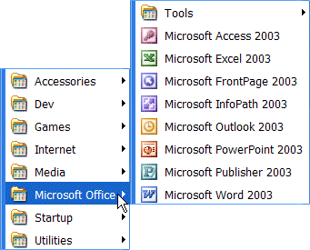
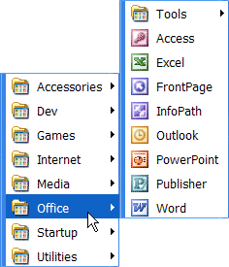
Noise
Erodes productivity
Hides important details
Work to identify and suppress it
Noise
Clarity

Slide 88
Noise

Slide 89
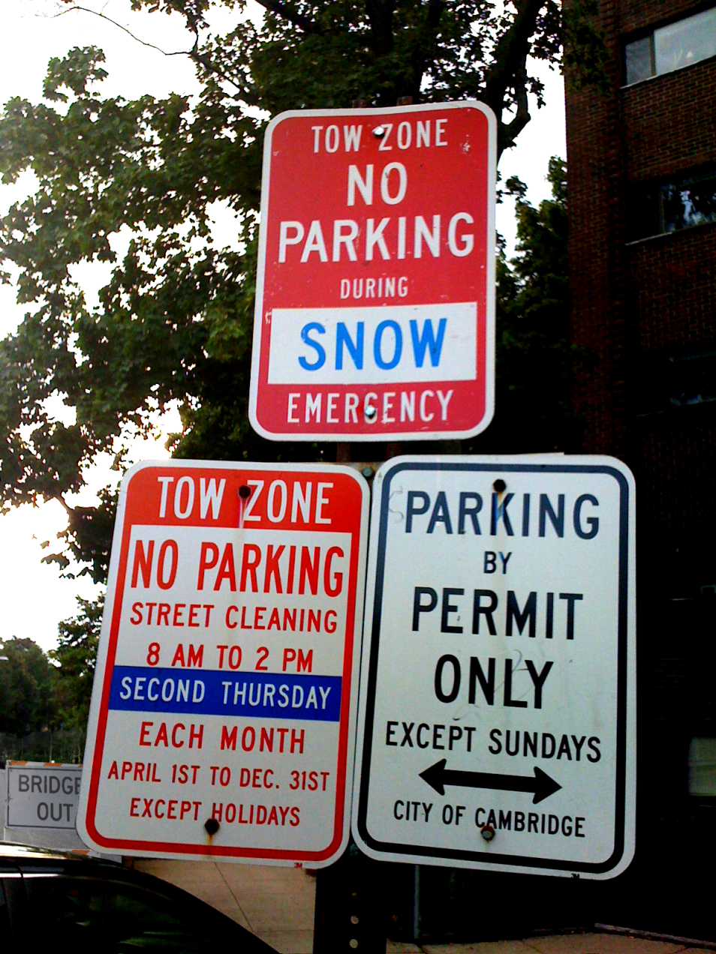
Noise – Where’s the signal?

Slide 90
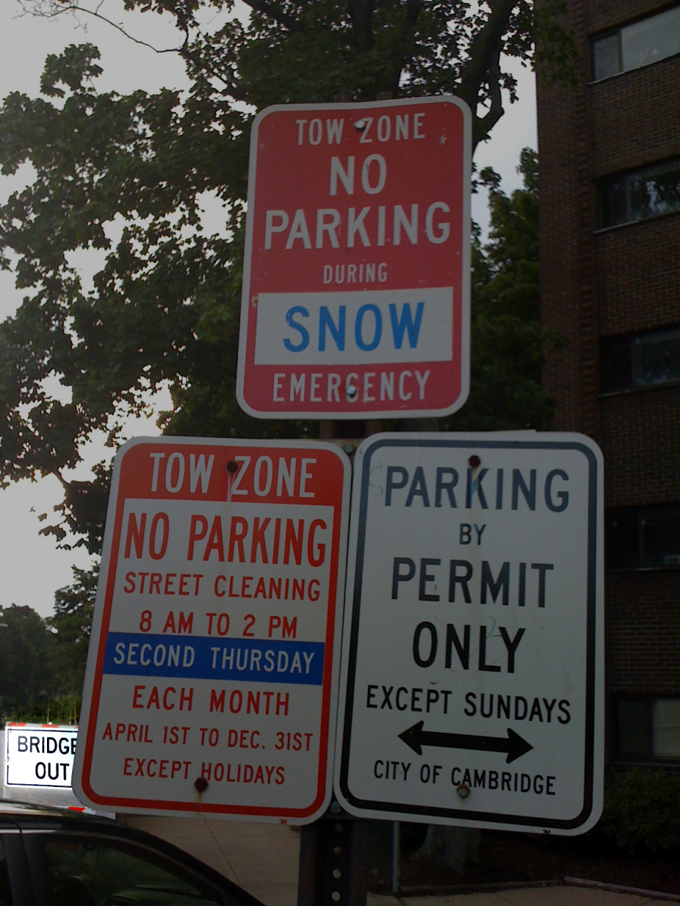
Noise – Where’s the signal?

Slide 91
Signal

Slide 92
Tools of the UI Masters
Contrast
Borders
Size
Color
Motion
Opacity
Shadow
Gradient
Proximity
Fonts

Slide 93
Contrast
Eyes are attracted to great contrast
Contrast should fit information relevance
Important information: high contrast
Less relevant details: lower contrast

Slide 94
Border Comparison
Item | Units | Cost | Total
Pencil | 95 | 1.99 | 189.05
Binder | 50 | 19.99 | 999.50
Pencil | 36 | 4.99 | 179.64
Pen | 27 | 19.99 | 539.73
Pencil | 56 | 2.99 | 167.44
Binder | 60 | 4.99 | 299.40
Pencil | 75 | 1.99 | 149.25
Pencil | 90 | 4.99 | 449.10
Item | Units | Cost | Total
Pencil | 95 | 1.99 | 189.05
Binder | 50 | 19.99 | 999.50
Pencil | 36 | 4.99 | 179.64
Pen | 27 | 19.99 | 539.73
Pencil | 56 | 2.99 | 167.44
Binder | 60 | 4.99 | 299.40
Pencil | 75 | 1.99 | 149.25
Pencil | 90 | 4.99 | 449.10

Slide 95
Border Comparison
Item | Units | Cost | Total
Pencil | 95 | 1.99 | 189.05
Binder | 50 | 19.99 | 999.50
Pencil | 36 | 4.99 | 179.64
Pen | 27 | 19.99 | 539.73
Pencil | 56 | 2.99 | 167.44
Binder | 60 | 4.99 | 299.40
Pencil | 75 | 1.99 | 149.25
Pencil | 90 | 4.99 | 449.10
Item | Units | Cost | Total
Pencil | 95 | 1.99 | 189.05
Binder | 50 | 19.99 | 999.50
Pencil | 36 | 4.99 | 179.64
Pen | 27 | 19.99 | 539.73
Pencil | 56 | 2.99 | 167.44
Binder | 60 | 4.99 | 299.40
Pencil | 75 | 1.99 | 149.25
Pencil | 90 | 4.99 | 449.10

Slide 96
Border Comparison
Item | Units | Cost | Total
Pencil | 95 | 1.99 | 189.05
Binder | 50 | 19.99 | 999.50
Pencil | 36 | 4.99 | 179.64
Pen | 27 | 19.99 | 539.73
Pencil | 56 | 2.99 | 167.44
Binder | 60 | 4.99 | 299.40
Pencil | 75 | 1.99 | 149.25
Pencil | 90 | 4.99 | 449.10
Item | Units | Cost | Total
Pencil | 95 | 1.99 | 189.05
Binder | 50 | 19.99 | 999.50
Pencil | 36 | 4.99 | 179.64
Pen | 27 | 19.99 | 539.73
Pencil | 56 | 2.99 | 167.44
Binder | 60 | 4.99 | 299.40
Pencil | 75 | 1.99 | 149.25
Pencil | 90 | 4.99 | 449.10

Slide 97
Border Comparison
Item | Units | Cost | Total
Pencil | 95 | 1.99 | 189.05
Binder | 50 | 19.99 | 999.50
Pencil | 36 | 4.99 | 179.64
Pen | 27 | 19.99 | 539.73
Pencil | 56 | 2.99 | 167.44
Binder | 60 | 4.99 | 299.40
Pencil | 75 | 1.99 | 149.25
Pencil | 90 | 4.99 | 449.10
Item | Units | Cost | Total
Pencil | 95 | 1.99 | 189.05
Binder | 50 | 19.99 | 999.50
Pencil | 36 | 4.99 | 179.64
Pen | 27 | 19.99 | 539.73
Pencil | 56 | 2.99 | 167.44
Binder | 60 | 4.99 | 299.40
Pencil | 75 | 1.99 | 149.25
Pencil | 90 | 4.99 | 449.10

Slide 98
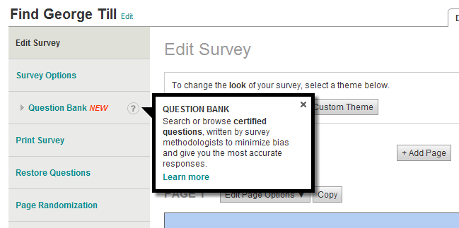
Border Example

Slide 99
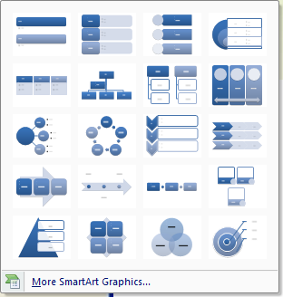
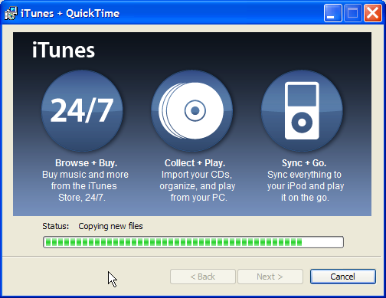
Color
Notes:
Two hues are used here with varying degrees of saturation and lightness. The red hue is 8 and the blue hue is 158. Highlights are in white and black.

Slide 100
Color Blind Users

Slide 101
Color Blind Users
Use red and blue to differentiate
Avoid red and green…

Slide 102
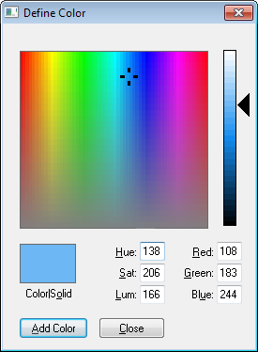
Tips for Working with Color
Work with HSL instead of RGB
Easier to adjust hue, saturation, and lightness
Useful for creating a palette of complementary colors

Slide 103
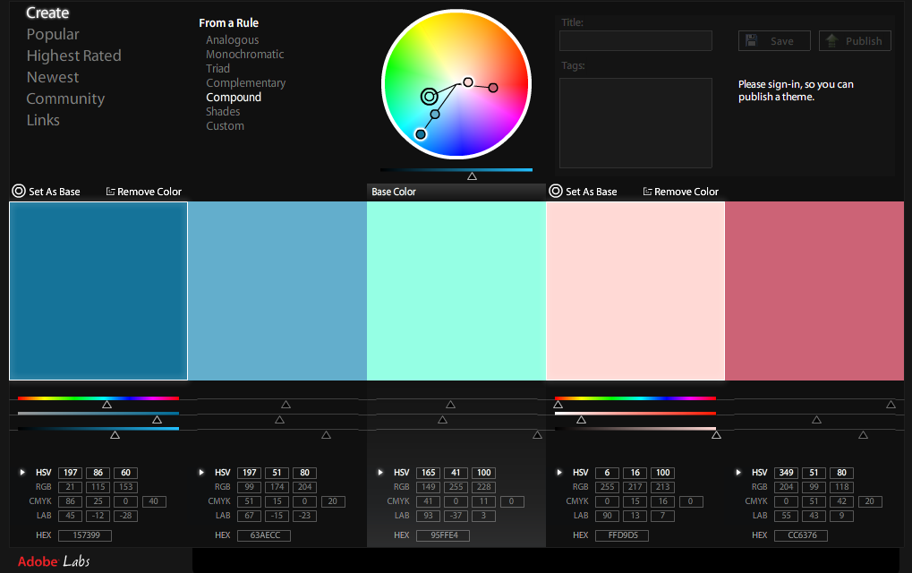
Color Palettes
kuler.adobe.com

Slide 104
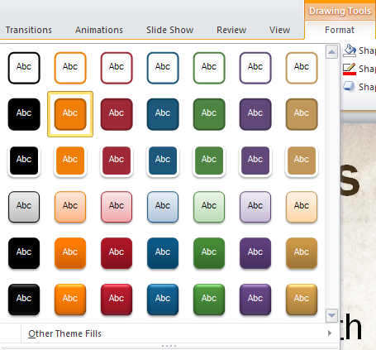
Color Tips
Use saturation like contrast:
Relevant information has a higher saturation
Offer users fewer color choices

Slide 105
Color Example
Bad:
Confirm Order
Cancel
Better:
Confirm Order
Cancel

Slide 106
Shape
In .NET, use GraphicsPaths
Assign to Region, if it’s a window
Paint, if you have a Graphics object
In WPF, use Path
Opportunity to:
Follow/simulate user models
Create smaller footprints
Insult your customers

Slide 107
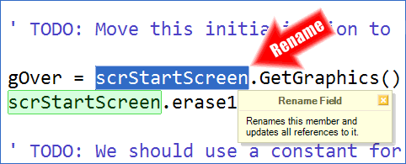
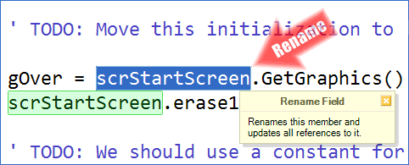
Opacity/Transparency
Vary transparency over time for soft transition effects
Examples: fade in/out
Use transparency to soften high-contrast shapes with sharp edges

Slide 108
Size
Combine large size with low contrast to:
Attract eye
Let it move on

Slide 109
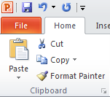
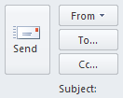
Size
Like contrast, more relevant data can be larger
More frequently-hit controls can be larger – (widen the path)

Slide 110
Size Example
Bad:
Cancel
Confirm Order
Better:
Confirm Order
Cancel

Slide 111
Motion / Animation
Smallest effective difference rules apply
Acceleration/deceleration are both good
Can animate appearance/exit without motion (e.g. fade in/out)
Notes:
Demos – Reorder Parameters
Pandora Sign-in

Slide 112
Gradient
Can draw eye in to interesting areas
Use with hard edge to emphasize important areas

Slide 113
Shadow
Great for floating UI elements
Set them apart from the data below

Slide 114
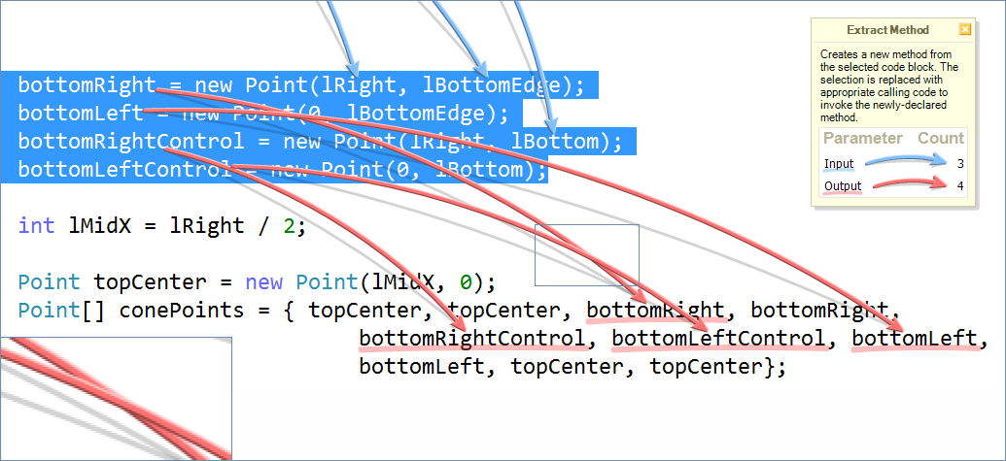
Shadow Example - Crossing Lines

Slide 115
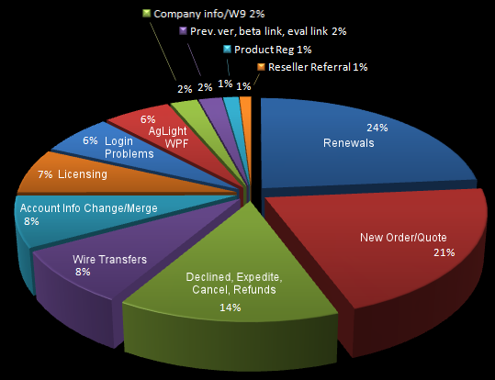
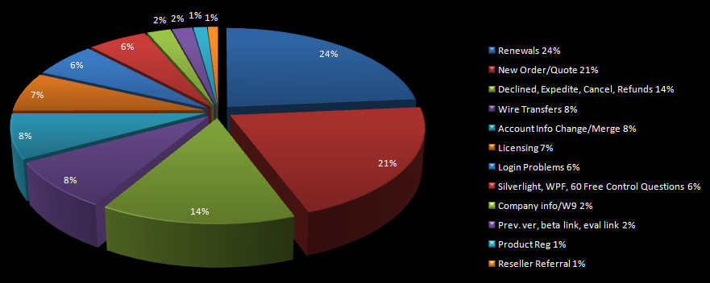
Proximity

Slide 116
Proximity
Related elements should be close
Unrelated elements should be far

Slide 117
Proximity Example
Bad:
Save
Lose Everything
Better:
Save
Lots of space
Lose Everything

Slide 118
Proximity Example

Slide 119
Proximity Example

Slide 120
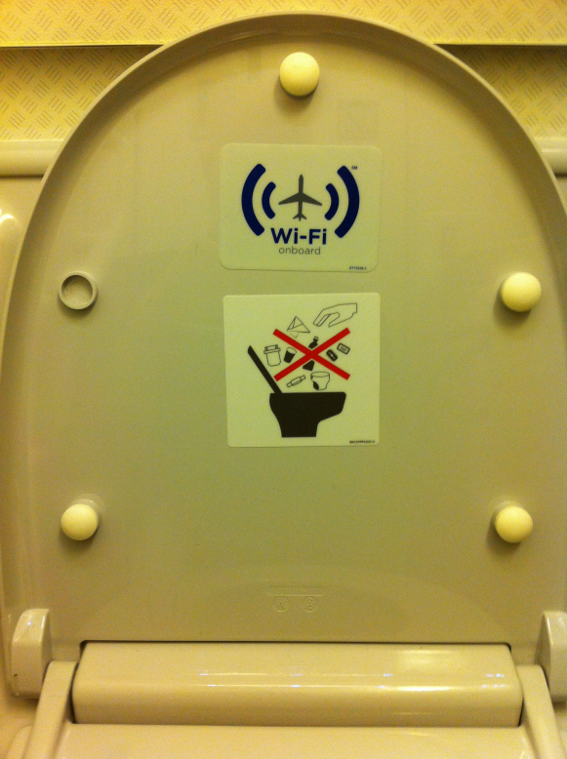
Proximity Example

Slide 121
Text
Which is font is most readable?

Slide 122
Fonts
Serifs, Sans-serifs
Fixed Pitch, Variable Width
Weight, Italics, Underline
Size

Slide 123
Font Comparison
Serif – “Georgia”
Sans-serif “Arial”
This
This

Slide 124
Font Comparison
Serif – “Georgia”
Sans-serif “Arial”
This session is
This session is

Slide 125
Font Comparison at 24pt
Serif – “Georgia”
Sans-serif “Arial”
This session is designed to shatter the popular myth that UI is subjective. You'll see how the quality of user interfaces can actually be quantified and a winner can be selected based on agreed-upon criteria.
This session is designed to shatter the popular myth that UI is subjective. You'll see how the quality of user interfaces can actually be quantified and a winner can be selected based on agreed-upon criteria.

Slide 126
Font Comparison at 12pt
Serif – “Georgia”
Sans-serif “Arial”
This session is designed to shatter the popular myth that UI is subjective. You'll see how the quality of user interfaces can actually be quantified and a winner can be selected based on agreed-upon criteria.
This session is designed to shatter the popular myth that UI is subjective. You'll see how the quality of user interfaces can actually be quantified and a winner can be selected based on agreed-upon criteria.

Slide 127
Font Comparison at 20pt
Variable Width – “Trebuchet MS”
Fixed Pitch - “Consolas”
This session is designed to shatter the popular myth that UI is subjective. You'll see how the quality of user interfaces can actually be quantified and a winner can be selected based on agreed-upon criteria.
This session is designed to shatter the popular myth that UI is subjective. You'll see how the quality of user interfaces can actually be quantified and a winner can be selected based on agreed-upon criteria.

Slide 128
Font Comparison at 24pt
“Trebuchet MS”
“Arial”
This session is designed to shatter the popular myth that UI is subjective. You'll see how the quality of user interfaces can actually be quantified and a winner can be selected based on agreed-upon criteria.
This session is designed to shatter the popular myth that UI is subjective. You'll see how the quality of user interfaces can actually be quantified and a winner can be selected based on agreed-upon criteria.

Slide 129
Font Comparison at 12pt
Serif – “Trebuchet MS”
Sans-serif “Arial”
This session is designed to shatter the popular myth that UI is subjective. You'll see how the quality of user interfaces can actually be quantified and a winner can be selected based on agreed-upon criteria.
This session is designed to shatter the popular myth that UI is subjective. You'll see how the quality of user interfaces can actually be quantified and a winner can be selected based on agreed-upon criteria.

Slide 130
Current Advice
For print:
Serif fonts - they are easier to read
For displays:
Serif fonts are okay for titles
San serif fonts are more readable for text
But does this advice still hold true today?
Notes:
Discuss how san serif fonts such as Arial or Helvetica look better on lower resolution devices, but since titles are bigger, serif fonts like Times New Roman are okay to use.

Slide 131
Best Font for Text
What’s happening with display resolution?
Well, it’s reasonable to conclude it’s increasing
But by how much?

Slide 132
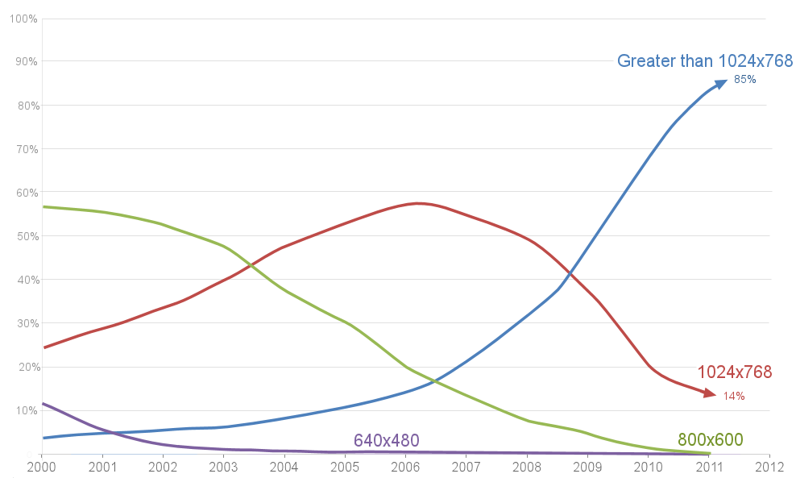
Browser Display Resolution
Source: http://www.w3schools.com/browsers/browsers_display.asp
Notes:
This slide is just a red herring. It turns out browser display resolution has little to do with font choice. The real factor is PPI, or Pixels Per Inch.

Slide 133
Best Font for Text
OK, so display resolution is increasing…
What’s up with this “Retina Display” thing?

Slide 134
What’s a “Retina Display”?
“It turns out there’s a magic number right around 300 pixels per inch, that when you hold something around to 10 to 12 inches away from your eyes, [it’s] the limit of the human retina to differentiate the pixels.”
Steve Jobs
Notes:
Discuss the connection between ppi and distance from eyes.

Slide 135
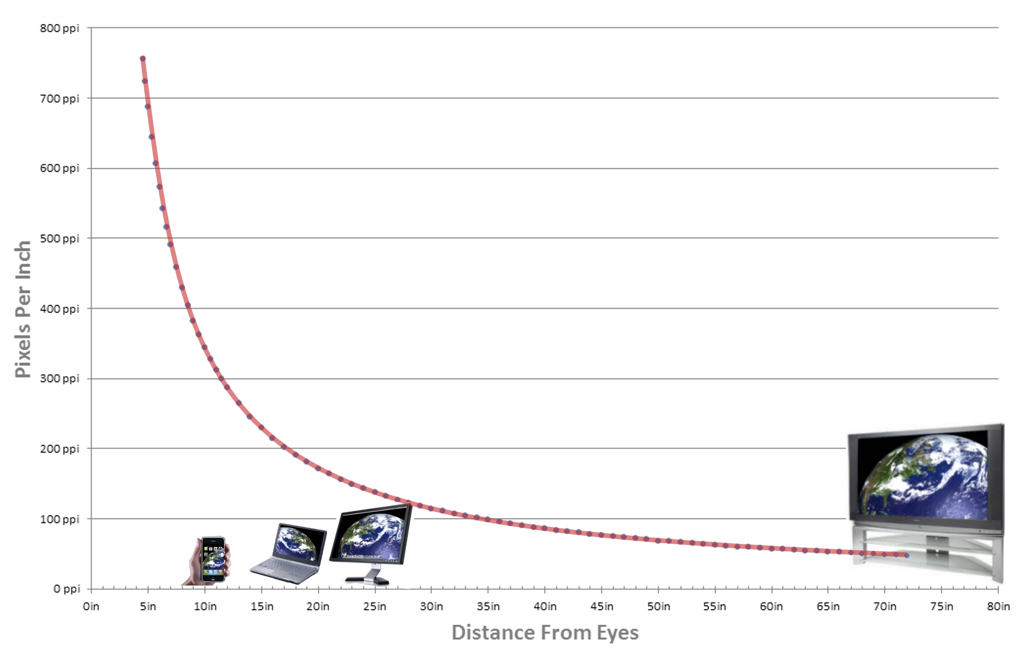
Retina Display Curve
Source: http://theelaborated.net/blog/2011/4/13/consider-the-retina-display.html

Slide 136
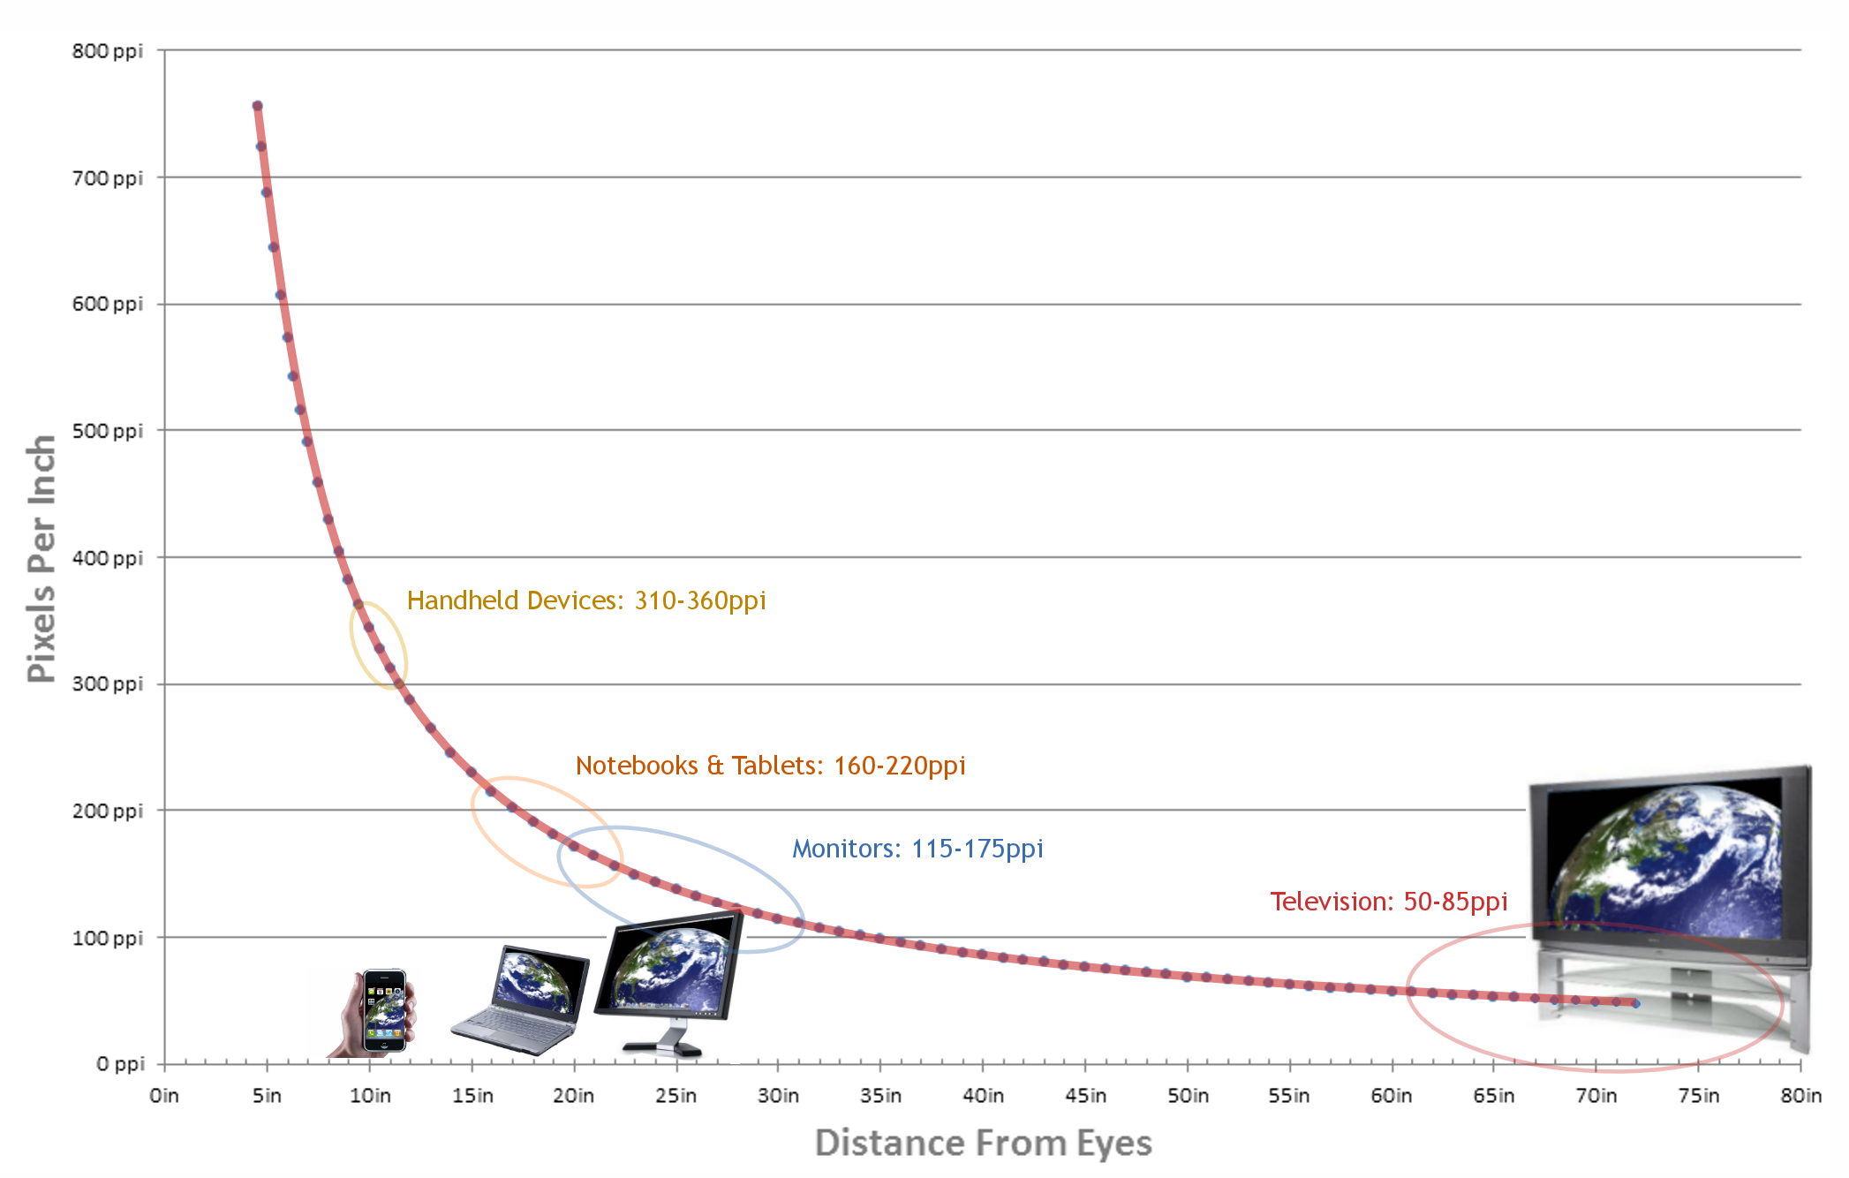
Retina Display Curve
Source: http://theelaborated.net/blog/2011/4/13/consider-the-retina-display.html

Slide 137
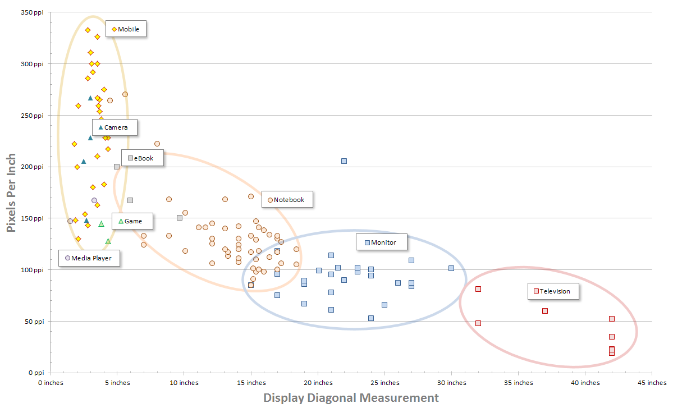
PPI and Display Devices
Source: http://en.wikipedia.org/wiki/List_of_displays_by_pixel_density
Notes:
Top left mobile device is the LG-LU1400. Its 2.8 inch display is 800x480, and has a PPI of 333.
To the lower right of this is the iPhone 4, with a 3.5 inch display at 640x960, and a PPI of 326.
Below that is the Toshiba Portege G900 and Sony Ericsson XPERIA X1, its 3-inch display is 480x800, and has a PPI of 311.

Slide 138
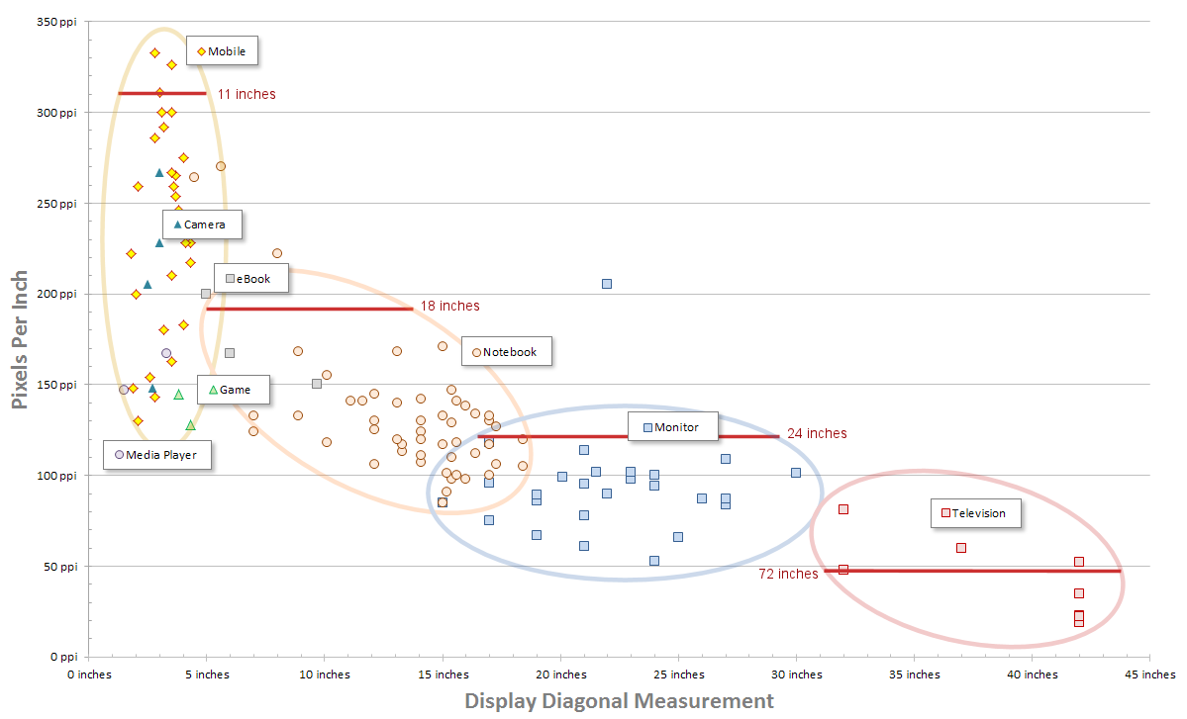
PPI and Display Devices
What’s this?
Source: http://en.wikipedia.org/wiki/List_of_displays_by_pixel_density
Notes:
The outlier on the Monitor series is the “IBM T220/T221 LCD monitor”, known as Big Bertha and introduced in June of 2001.
http://en.wikipedia.org/wiki/IBM_T220/T221_LCD_monitors

Slide 139
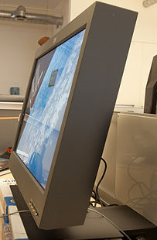
PPI and Display Devices
IBM’s Big Bertha
• Introduced in 2001
• 3840×2400
• 22.2 inch diagonal
• Four DVI channels
• Two power supplies
Source: http://en.wikipedia.org/wiki/List_of_displays_by_pixel_density
Notes:
The outlier on the Monitor series is the “IBM T220/T221 LCD monitor”, known as Big Bertha and introduced in June of 2001.
http://en.wikipedia.org/wiki/IBM_T220/T221_LCD_monitors

Slide 140
PPI Conclusion
Currently only a small portion of display devices are capable of “Retina Display”

Slide 141
Best Font Advice
For print:
Serif fonts - they are easier to read
For displays:
Serif fonts are okay for titles
San serif fonts are more readable for text
Still True
Notes:
However… we’re on the precipice of change.

Slide 142
Key Concept – Graphic Language

Slide 143
Key Concept – Graphic Language
We can derive meaning from graphic elements.

Slide 144
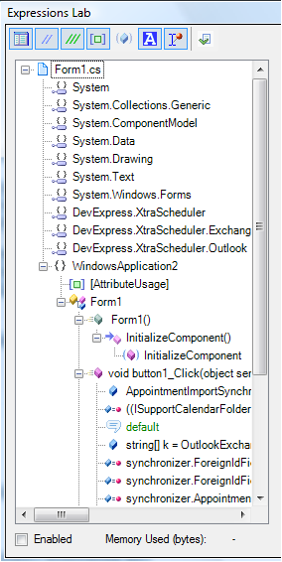
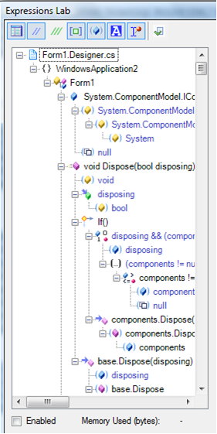
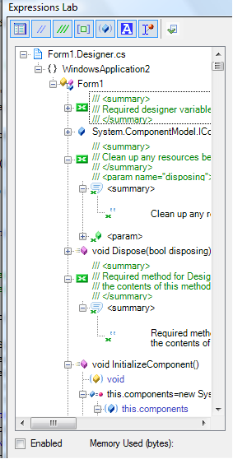
Key Concept – Graphic Language

Slide 145
The Essence of Clarity
Adjust these to fit information relevance:
Contrast
Saturation
Size
Match Emphasis to Information Relevance

Slide 146
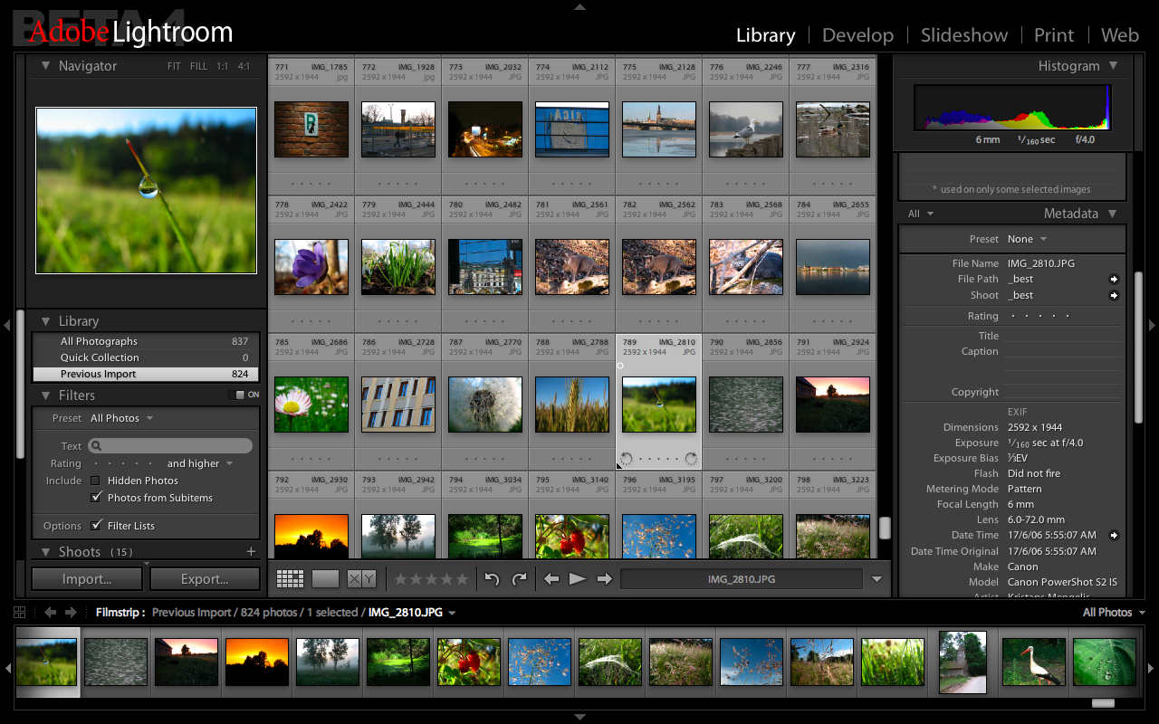
Clarity Example

Slide 147
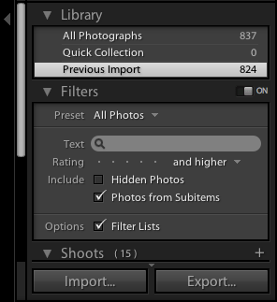
Clarity Example

Slide 148
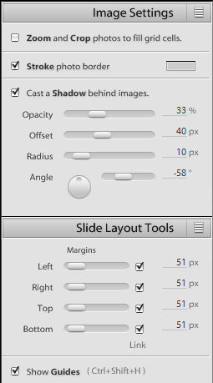
Clarity Example

Slide 149
Clarity Example

Slide 150
Putting it all Together…
Challenge: Limited Screen Real Estate

Slide 151
Limited Screen Real Estate
Remember the display resolution chart?
How can we compress this information?
Notes:
Challenge – how can we compress the data here?

Slide 152
Limited Screen Real Estate
Start with essential data:
Notes:
Challenge – how can we compress the data here?

Slide 153
Limited Screen Real Estate
Add important details:
Notes:
Challenge – how can we compress the data here?

Slide 154
Limited Screen Real Estate
Add chart data back in:
Notes:
Challenge – how can we compress the data here?

Slide 155
Limited Screen Real Estate
Visually connect essential data:
Notes:
Challenge – how can we compress the data here?

Slide 156
Limited Screen Real Estate
Visually connect important details:
Notes:
Challenge – how can we compress the data here?

Slide 157
Sparklines
High-resolution, data-intense, design-simple, word-sized graphics
Succinct, memorable, and located where they are discussed
Lots of detail packed into a small space
Ideal for handheld devices or limited screen real estate scenarios
Enable easy parallel comparisons
Created by Edward Tufte

Slide 158
Sparkline Examples
Embedding letter-height graphics in text is not new. Galileo does it to describe Saturn as seen through his telescope.

Slide 159
Borders, Revisited

Slide 160
“We can’t fix the UI.”

Slide 161
Reduce the Cost of Interaction
Key binding strategies
Mouse travel distance strategies
Respecting and directing gaze
Anti-zombie serum for your app

Slide 162
Simplifying Shortcuts
Distill commands into groups:
Functionally similar commands
Functionally opposite (toggle) commands
Focus on what the user wants to do, not how.
Declare something
Refactor something
Use context to infer customer intent
Create new command for each distilled group
Select appropriate command based on context
Notes:
As application complexity increases, so too do to the key bindings.

Slide 163
Here’s That Key Point Table…
Key | Points
Space | 0.4
Tab | 0.7
Letter keys | 1.0
Number keys | 1.1
[]\;’,./-=` | 1.1
Arrow keys | 1.1
F1..F12 | 1.2
Extended keys | 1.3
Shift, Ctrl | 1.5
Alt | 1.7
Num pad keys | 1.8
Chorded keys | +1.0 per chord

Slide 164
Distilling Key Bindings – Ex. 1
Group commands:
Create new command: CommentToggle
Define context: (e.g., two or more lines selected)
Create new binding:
Functionality | Binding | Pts
Comment | Ctrl+K,Ctrl+C | 6.0
Uncomment | Ctrl+K,Ctrl+U | 6.0
 | Total: | 12.0
Functionality | Binding | Pts
CommentToggle | / | 1.1
(10 times easier)

Slide 165
Distilling Key Bindings – Ex. 2
Before
After
Functionality | Binding | Pts
ToggleOutliningExpansion | Ctrl+M, Ctrl+M | 6.0
Functionality | Binding | Pts
ToggleOutliningExpansion | (space) | 0.4
(15 times easier)

Slide 166
Key Bindings & Context
Summary
Understand the cost of key bindings
As complexity increases, use fewer bindings
Consolidation
Context
Expose context to customers if you like
Default bindings accessible on all keyboards?

Slide 167
Mouse Travel Distance
If you’re going to support the mouse…
Minimize travel distance for common tasks

Slide 168
Mouse Travel – Suggestion #1
Position UI elements *closer* to the mouse

Slide 169
Mouse Travel – Suggestion #1
Position UI elements *closer* to the mouse
Example…
In the form designer, try this:
Align selected controls to the left
Select the Volume label

Slide 170
Mouse Travel – Suggestion #2
If a click moves UI below it, move the mouse.
That’s right: move the mouse.
Programmatically
Examples:
Expanding bottom node of tree view
Scroll the control so children are in view?
What should we do with the mouse?
Hovering UI (demo)
Find in Excel

Slide 171
Minimizing Travel – Demo #1
Current behavior:
Consider this:
Notes:
FrmCylinderVolume.cs – Reorder parameters in the ReorderThis() method.

Slide 172
Minimizing Mouse Travel
Zooming
Demonstration
Notes:
Demo 1: Zoom in PaintShop Pro.
Demo 2: Zoom in Google maps.

Slide 173
Minimizing Mouse Travel
Closing Tabs
Demonstration
Notes:
Demo 1: Closing Tabs in Visual Studio vs. Closing Tabs in Chrome

Slide 174
Minimizing Mouse Travel
Layered Interactions
Demonstration
Notes:
Find in Visual Studio, watch the find dialog move when text below it is found. Do the same in Excel.

Slide 175
Mouse Clicks
Fewer is better
Don’t mess with user models

Slide 176
Mouse Travel & Clicking
Summary
Watch for mouse travel issues on common tasks involving large data entry forms
Bring controls closer to mouse
Move mouse if a click moves UI below it
Bias to mouse or keyboard if it makes sense

Slide 177
Directing Gaze
Our eyes are attracted to:
Motion
Size
Contrast
Texture
Depth
To control focus, use:
Animation
Greater contrast
Larger size
Don’t overdo it (smallest effective difference)
Effective combination: large size at low contrast

Slide 178
Directing Gaze
Use motion
You may also use:
Acceleration (often worth the effort)
Fade in / out
Vary contrast / opacity
Notes:
Acceleration – two bonuses: 1. Long and short travel distances can have similar times. 2. Effectively hides jumpy animation on slow machines if start and end are slow and middle is fast.

Slide 179
Directing Gaze
Low Contrast
+ Animation
Demonstration
Notes:
Collecting Markers (also might want to mention transition of reorder parameters)

Slide 180
Watching the Eyes
Summary
Figure out where your customer is looking
Don’t hide background data
Control gaze with contrast, size & motion
Solve one-shot focus issues with low contrast

Slide 181
Reducing Brain Power
Eliminate obvious UI barriers
Modal dialogs, chorded keys, long travel distance
Reduce frictional forces
Reduce customer motion (e.g., hands & eyes)
Reduce keystrokes
Reduce mouse travel and click count
Reuse keystrokes
Increase clarity (fit emphasis to information relevance)
Exploit opportunities to explain functionality
Watch customers carefully

Slide 182
Brain Power
Orienteering
Demonstration
Notes:
Note your distraction and recovery time
While you watch, observe necessary brain power

Slide 183
Lower Brain Power Requirements
Stop sucking, and your customers:
Totally focus on the task
Increase productivity
Relax
Experience positive emotional response:
Satisfaction → Euphoria

Slide 184
How Can We Fix This?

Slide 185
Where We’ve Been…
“UI is subjective”
“I’m not an artist”
“We can’t fix the UI”
UI can be measured
You can present with clarity
Use smallest effective difference
Present information in parallel
Reduce noise
Use color, contrast, opacity, shadow, motion, etc. with intent
We can fix the UI
Reduce keystrokes
Reduce mouse travel
Reduce brain power
There is no box (just think)
Distill commands
Move the UI
Move the mouse

Slide 186
“Good UI is not worth
the effort.”

Slide 187
How much does a click cost?

Slide 188
Lost Productivity
T, time wasted, 2 seconds
R, waste repetition per hour, 3
N, number of users, 300
S, average salary of users, $40K
Solve for C, productivity cost
C = T * R * N * S
Notes:
25K

Slide 189
Lost Market Share
Market Share, North America
70%
60%
“Windows mobile… soon acquiring 60% to 80% of the smartphone market”
– Steve Ballmer, January 2007
50%
40%
“We have reinvented the phone.”
30%
20%
Steve Jobs
January 10, 2007
10%
2007
2008
Q1
Q2
Q3
Q4
Q1
Q2
“There's no chance that the iPhone is going to get any significant market share. No chance.”
Steve Ballmer
April 30, 2007
Notes:
82% of iPhone customers reported being “Very Satisfied” with their cell phones.
Compare that with 36% of Samsung customers.

Slide 190
Lost Market Share
Market Share, North America
70%
60%
“Windows mobile… soon acquiring 60% to 80% of the smartphone market”
– Steve Ballmer, January 2007
50%
40%
“We have reinvented the phone.”
30%
20%
Steve Jobs
January 10, 2007
10%
2007
Device | Carrier | Cost
Windows Mobile | Any | $99
iPhone | ATT | $399
2008
Q1
Q2
Q3
Q4
Q1
Q2
“There's no chance that the iPhone is going to get any significant market share. No chance.”
Steve Ballmer
April 30, 2007
Notes:
82% of iPhone customers reported being “Very Satisfied” with their cell phones.
Compare that with 36% of Samsung customers.

Slide 191
Lost Market Share
Market Share, North America
70%
60%
“Windows mobile… soon acquiring 60% to 80% of the smartphone market”
– Steve Ballmer, January 2007
50%
40%
“We have reinvented the phone.”
30%
$99 Windows Mobile
$399 iPhone
20%
Steve Jobs
January 10, 2007
10%
2007
Device | Carrier | Cost
Windows Mobile | Any | $99
iPhone | ATT | $399
2008
Q1
Q2
Q3
Q4
Q1
Q2
“There's no chance that the iPhone is going to get any significant market share. No chance.”
iPhone ships
June 29, 2007
Steve Ballmer
April 30, 2007
Notes:
82% of iPhone customers reported being “Very Satisfied” with their cell phones.
Compare that with 36% of Samsung customers.

Slide 192
Lost Market Share
Market Share, North America
70%
User Experience
60%
“Windows mobile… soon acquiring 60% to 80% of the smartphone market”
– Steve Ballmer, January 2007
Device | Carrier | Cost
Windows Mobile | Any | $99
iPhone | ATT | $399
iPhone
50%
Forwarding an email
40%
Device | Taps
Windows Mobile | 6
iPhone | 2
30%
“We have reinvented the phone.”
20%
Steve Jobs
January 10, 2007
10%
2007
2008
Q1
Q2
Browsing Experience
Q3
Q4
Q1
Q2
Windows Mobile
“There's no chance that the iPhone is going to get any significant market share. No chance.”
iPhone ships
June 29, 2007
Steve Ballmer
April 30, 2007
Notes:
82% of iPhone customers reported being “Very Satisfied” with their cell phones.
Compare that with 36% of Samsung customers.

Slide 193
Lost Market Share
Market Share, North America
70%
60%
“Windows mobile… soon acquiring 60% to 80% of the smartphone market”
– Steve Ballmer, January 2007
50%
40%
“We have reinvented the phone.”
30%
$99 Windows Mobile
$399 iPhone
20%
Steve Jobs
January 10, 2007
10%
2007
2008
Q1
Q2
Q3
Q4
Q1
Q2
“Very Satisfied”
80%
60%
40%
20%
0%
“There's no chance that the iPhone is going to get any significant market share. No chance.”
iPhone ships
June 29, 2007
iPhone Samsung
iPhone Samsung
Cell Phone Satisfaction
October, 2007
Steve Ballmer
April 30, 2007
Notes:
82% of iPhone customers reported being “Very Satisfied” with their cell phones.
Compare that with 36% of Samsung customers.

Slide 194
Three years, and over
500 million dollars later…

Slide 195
How Can We Fix This?

Slide 196
How Can We Fix This?
Notes:
BTW, does this slide remind you of any slides you’ve seen before in this session?

Slide 197
Border Comparison
Item | Units | Cost | Total
Pencil | 95 | 1.99 | 189.05
Binder | 50 | 19.99 | 999.50
Pencil | 36 | 4.99 | 179.64
Pen | 27 | 19.99 | 539.73
Pencil | 56 | 2.99 | 167.44
Item | Units | Cost | Total
Pencil | 95 | 1.99 | 189.05
Binder | 50 | 19.99 | 999.50
Pencil | 36 | 4.99 | 179.64
Pen | 27 | 19.99 | 539.73
Pencil | 56 | 2.99 | 167.44

Slide 198
Meanwhile, over in Cupertino…

Slide 199
And a year and another
100 million dollars later…

Slide 200
How Can We Fix This?
Notes:
Does this slide remind you of anything?

Slide 201
Does Color Convey Meaning?

Slide 202
If you think this race isn’t about UI, you’re wrong.

Slide 203
A great user experience
is worth the effort.

Slide 204
Question & Answer Session
Email: markm@devexpress.com Twitter: @MillerMark Blog: devexpress.com/mark
Tufte’s Visual Explanations…, ISBN 0961392126

Slide 205
Complete an Evaluation online and enter to WIN these prizes!
<Prizes & Process TBC>

Slide 206
© 2010 Microsoft Corporation. All rights reserved. Microsoft, Windows, Windows Vista and other product names are or may be registered trademarks and/or trademarks in the U.S. and/or other countries.
The information herein is for informational purposes only and represents the current view of Microsoft Corporation as of the date of this presentation. Because Microsoft must respond to changing market conditions, it should not be interpreted to be a commitment on the part of Microsoft, and Microsoft cannot guarantee the accuracy of any information provided after the date of this presentation. MICROSOFT MAKES NO WARRANTIES, EXPRESS, IMPLIED OR STATUTORY, AS TO THE INFORMATION IN THIS PRESENTATION.

Slide 207
Questions
Email: markm@devexpress.com Twitter: @MillerMark Blog: devexpress.com/mark
Tufte’s Visual Explanations…, ISBN 0961392126

Slide 208
Tensions
Relevance/Contrast
Mismatch
Large
Data
Sets
Ease of
Orientation
noise
Clarity
Variance from
the User Model
Tiny Views
Into Long Lists
Efficiency
Stacked or
Serial UIs
Discoverability
Shortcut
Complexity
Ease of Command
Legend
Has a disruptive effect on the target.
Has an enhancing effect on the target.
Notes:
Note that sometimes it’s possible for Variance from the User Model to have a *POSITIVE* impact on Efficiency.
Stacked or Serial UIs can sometimes have a NEGATIVE impact on Discoverability and Ease of Orientation.
Noise can impact efficiency by simply making it harder to work and see the data.

