Slide 2
Responsive Web Design: The View of the World Depends on the Glasses I Wear
SESSION CODE: WEB101
Thomas Lewis
Principal Technical Evangelist
Microsoft
@tommylee | asimplepixel.tumblr.com

Slide 3
How we viewed the web
The Desktop Browser

Slide 4
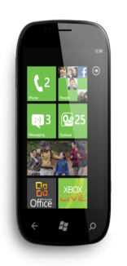
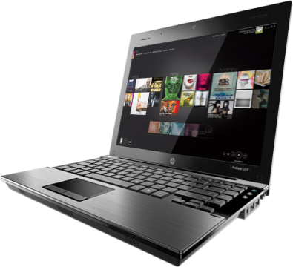
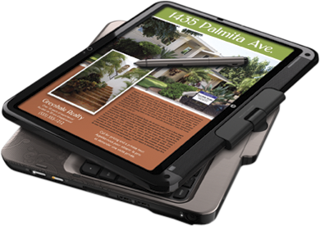
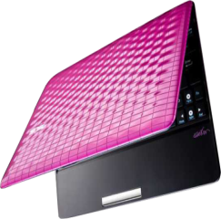
How we view the web today
The Desktop Browser
Mobile Browsers
Tablet form-factors
Televisions
Game Consoles
More…
Yeah, so what’s the problem?

Slide 5
The Anti-Pattern
demo

Slide 6
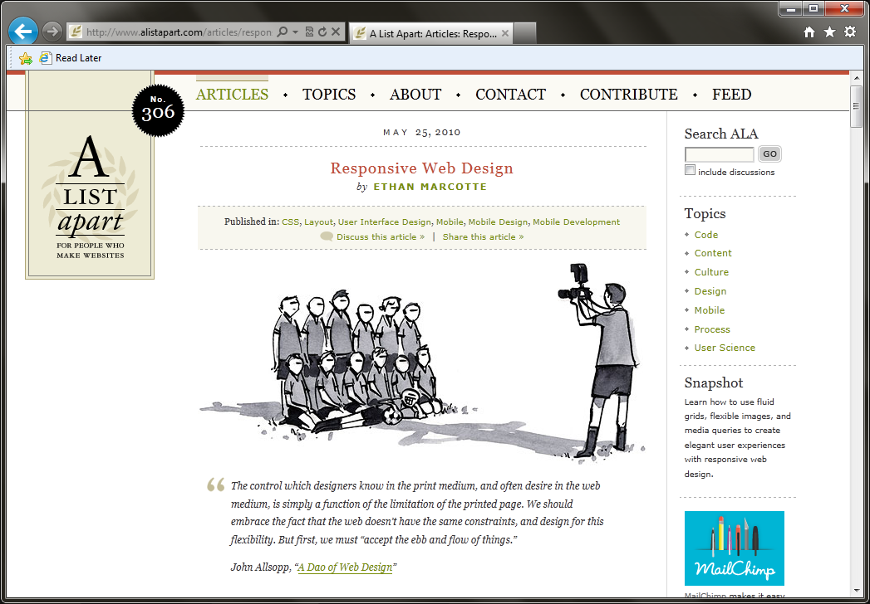

Slide 7
Responsive Web Design
Thinking of the user’s needs instead of ours.
Adapt to various device capabilities instead of configurations.
Help future-proof our sites.

Slide 8
demo

Slide 9
Elements of Responsive Web Design
A flexible, grid-based layout,
Flexible images and media, and
Media queries.
Something else.

Slide 10
Flexible, Grid-based Layout

Slide 11
Ok, so what’s the problem?
Non-responsive sites are no fun.
Fixed-width sites are not the best experiences.
Design tools tend to use pixels.
Sometimes a pixel does not equal a pixel.
So how do we turn pixels to their em counterparts?

Slide 12
The Solution
Pixel = $\frac{Δy}{Δx}≈\lim_{n→∞}{{\left(1+\frac{1}{n}\right)}^{n}}×\frac{−b±\sqrt{b^{2}−4ac}}{2a}±f\left(x\right)=a_{0}+\sum_{n=1}^{∞}{\left(a_{n}\cos{\frac{nπx}{L}}+b_{n}\sin{\frac{nπx}{L}}\right)}$ = em

Slide 13
The Algorithm & Calculation
target
context
result
$$÷$$
$$=$$

Slide 14
The Algorithm & Calculation
Responsive Web Design READ MORE >>
h1 {
font-size: 24px;
}
h1 {
font-size: 1.5em;
}
em
24 / 16 = 1.5
h1 a {
font-size: 24px;
}
h1 a {
font: 0.458333333+;
}
%
11 / 24 = 0.458333333+
1
2
3
target
$$÷$$
context
$$=$$
result

Slide 15
Didn’t You Say Something About a Grid?
#page {
margin: 36px auto;
width: 960px;
}
.blog {
margin: 0 auto 53px;
width: 900px;
}
.blog .main {
float: left;
width: 566px;
}
.blog .other {
float:right;
width: 331px;
}
.blog {
width: 900/960;
}
.blog .main {
width: 566/900;
}
.blog .other {
width: 331/900;
}
#page {
margin: 36px auto;
width: 90%;
}
.blog {
margin: 0 auto 53px;
width: 93.75%;
}
.blog .main {
float: left;
width: 62.88+%;
}
.blog .other {
float:right;
width: 36.77+%;
}
target
$$÷$$
context
$$=$$
result

Slide 16
Flexible Images and Media

Slide 17
A Simple Solution
img {
max-width: 100%;
}
Works on images, as well as other media like <video>.

Slide 18
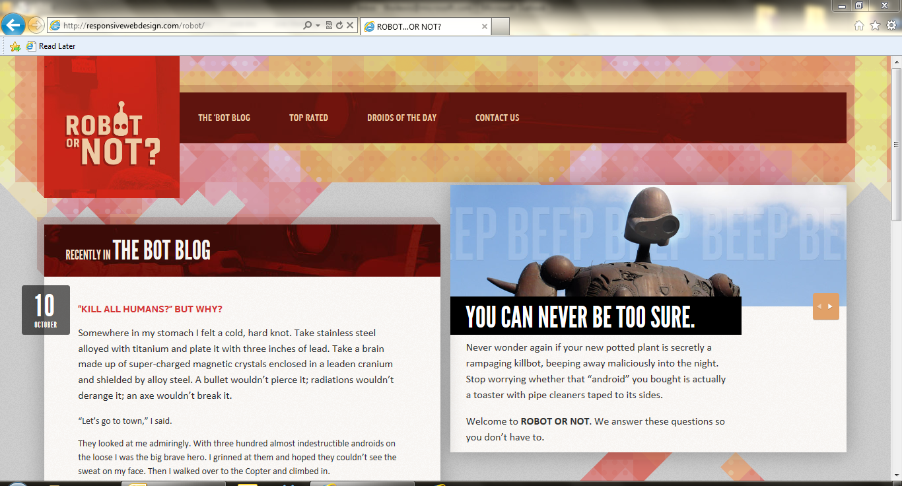
Demo

Slide 19
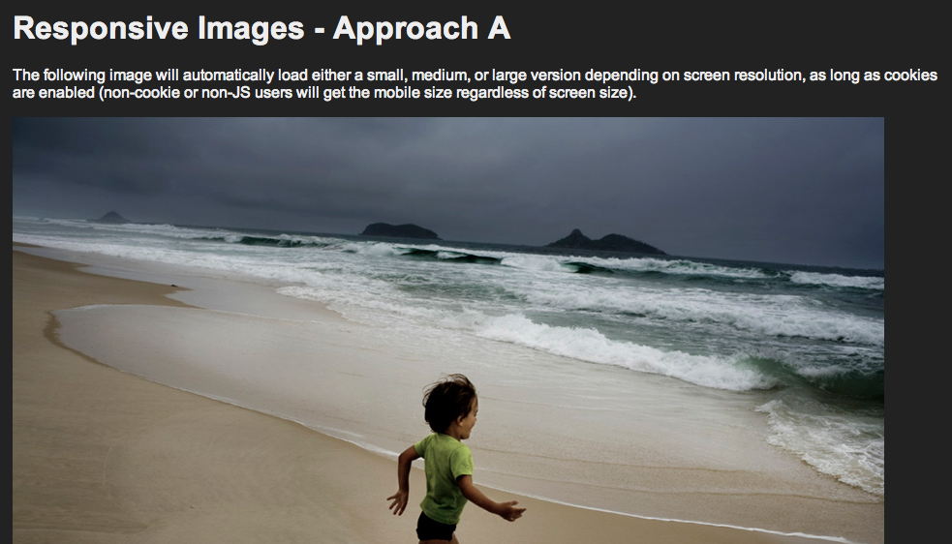
Another possibility
Filament Group – depends on cookies and JavaScript

Slide 20
Media Queries

Slide 21
In CSS 2.1…
We could define media types: screen and print.
But not easily respond to the user’s display.
Lots of grunt work.
Didn’t spend much time thinking about mobile devices.

Slide 22
CSS3 Media Queries
The CSS3 Media Queries Module specifies methods to enable web developers to scope a style sheet to a set of precise device capabilities.

Slide 23
Simple Example
@media screen and (max-width: 600px) {
body {
font-size: 80%;
}
}

Slide 24
Other Queries
@media screen and (min-width:320px) and (max-width:480px)
@media not print and (max-width:600px)
@media screen (x) and (y), print (a) and (b)

Slide 25
Can Be Declared…
In the Stylesheet
Import Rule
@import url(mq.css) only screen and (max-width:600px)
link Element
<link rel=“stylesheet” media=“only screen and (max-width:800px)” href=“mq.css”>

Slide 26
Supported Media Properties
min/max-width
min/max-height
device-width
device-height
orientation
aspect-ratio
device-aspect-ratio
color
color-index
monochrome
resolution

Slide 27
Let’s take a look…
Demo

Slide 28
What about devices?
viewport meta tag
<meta name=“viewport” content=“width=device-width”>
device-width vs. width
maximum-zoom

Slide 29
What about non-supportive browsers?
css3-mediaqueries-js by Wouter van der Graaf
Just include the script in your pages
Parses the CSS and applies style for positive media tests

Slide 30
What else to think about?
Adjust elements to make them more touch-friendly.
Adjusting text for more readability.
Show jump links to eliminate lengthy scrolling.
Image swapping.
Customized print styling.

Slide 31
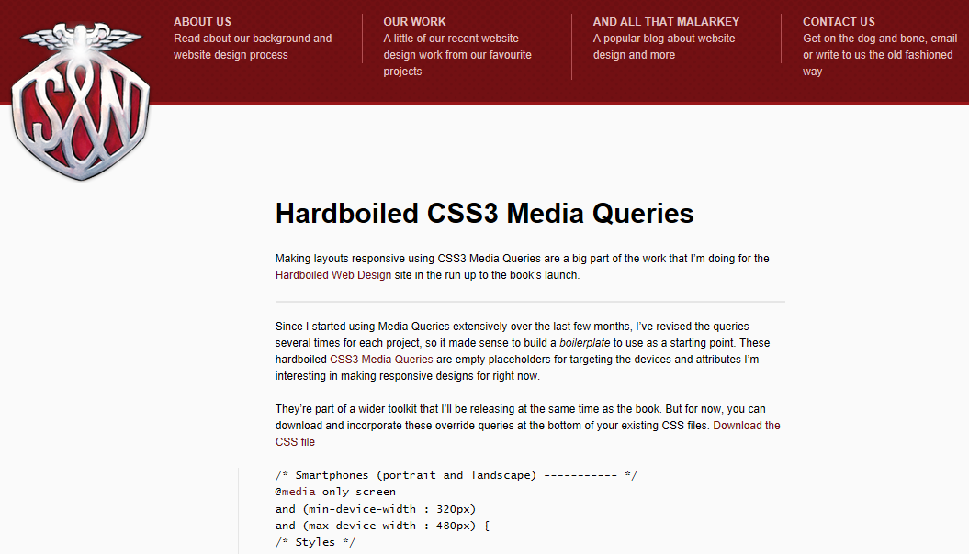
Ummm, is there something I can already use?
Yes! Andy Clarke did some of the work for you!

Slide 32
The Book – Stunning CSS3
http://stunningcss3.com

Slide 33
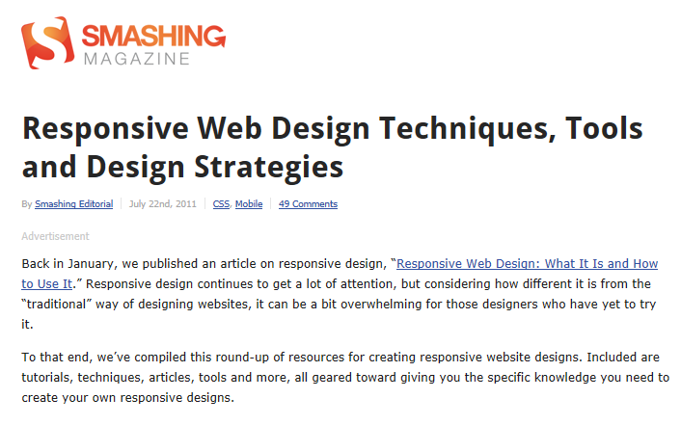
Responsive Web Design Techniques, Tools and Design Strategies
http://www.smashingmagazine.com/2011/07/22/responsive-web-design-techniques-tools-and-design-strategies/

Slide 34
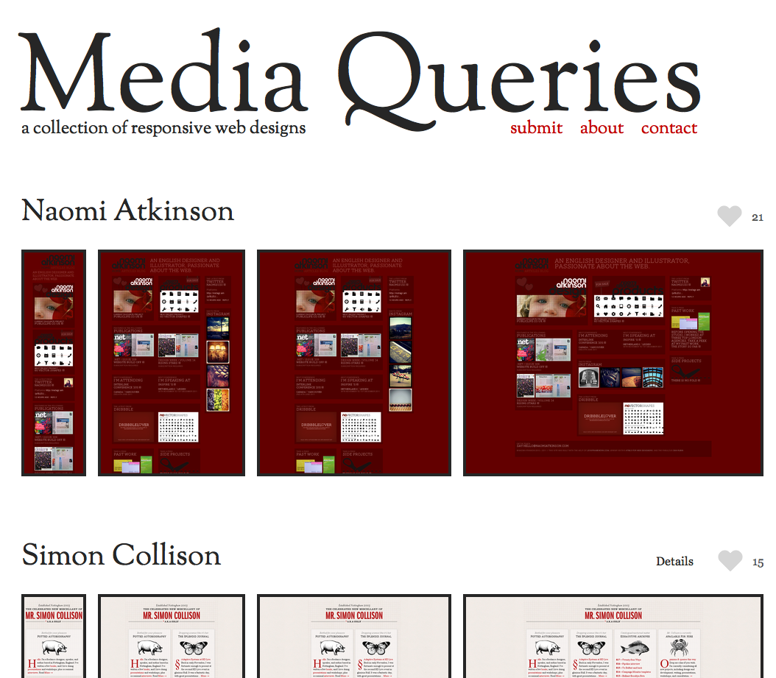
The Enthusiast Site
http://mediaqueri.es

Slide 35
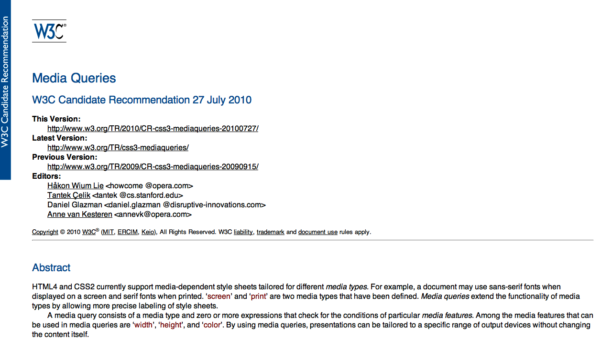
The Spec
http://www.w3.org/TR/css3-mediaqueries/

Slide 36
Hey, what was that something else?
Design.
Do we start with mobile-first?
Is it best that all sites are responsive?
Do we need or want to do visual comps for every device?
Don’t dismiss mobile as walking and looking something up.
We are at the beginning, that’s what makes this interesting!

Slide 37
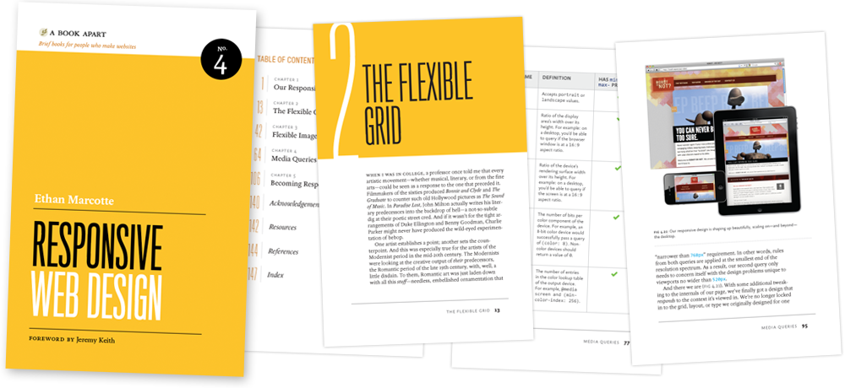
The Book – Responsive Web Design
http://abookapart.com

Slide 38
Thank You!
Deck, demos, links are at: asimplepixel.tumblr.com
Also, follow @tommylee if you like the HTML5, CSS3, Design, Brutality and Pets

Slide 39
Enrol in Microsoft Virtual Academy Today
Why Enroll, other than it being free?
The MVA helps improve your IT skill set and advance your career with a free, easy to access training portal that allows you to learn at your own pace, focusing on Microsoft technologies.
What Do I get for enrolment?
Free training to make you become the Cloud-Hero in my Organization
Help mastering your Training Path and get the recognition
Connect with other IT Pros and discuss The Cloud
Where do I Enrol?
www.microsoftvirtualacademy.com
Then tell us what you think. TellTheDean@microsoft.com

Slide 40
© 2010 Microsoft Corporation. All rights reserved. Microsoft, Windows, Windows Vista and other product names are or may be registered trademarks and/or trademarks in the U.S. and/or other countries.
The information herein is for informational purposes only and represents the current view of Microsoft Corporation as of the date of this presentation. Because Microsoft must respond to changing market conditions, it should not be interpreted to be a commitment on the part of Microsoft, and Microsoft cannot guarantee the accuracy of any information provided after the date of this presentation. MICROSOFT MAKES NO WARRANTIES, EXPRESS, IMPLIED OR STATUTORY, AS TO THE INFORMATION IN THIS PRESENTATION.

