Slide 2
There is no web
SESSION CODE: #WEB308
Paul Glavich
Chief Technology Officer
Saasu.com

Slide 3
Who Am I?
Paul Glavich
ASP.NET MVP 6 years & ASPInsider
Co-author 3 books
CTO at Saasu.com
http://weblogs.asp.net/pglavich
@glav - paul@saasu.com

Slide 4

What you will get from this
A look at how NoSQL technology can provide benefits
Tips on HTML5 offline & local storage features for developers
Using this new tech for “code-once” domain model, JS and schema mapping

Slide 5
Agenda
Why - The problem
Demo
  Looking at the end product
How
  The tech behind the solution
Comparison between typical practices
The Ideal situation
  Audience applause and jaw dropping astonishment

Slide 6
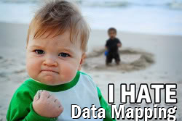
Why?
A Few Problems
Typical multi tier web application
Data Entities mapped from browser (JS) to Server (Domain) to DB
Has always been a
“data/mapping disconnect”
Server
Entities, Objects, Classes
Browser
Javascript, JSON
DB
Schema

Slide 7
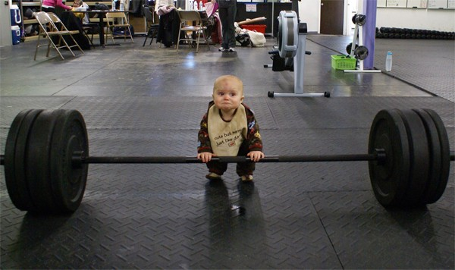
Some More Problems
Web applications typically don’t like being offline
Generally, don’t handle offline very well
Offline == too hard or just no worky

Slide 8
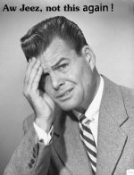
Design Challenges
Server side
ORM’s try and solve the DB → Server Tier disconnect
  Entity Framework, Nhibernate, Lightspeed etc.
“Monster Repositories”
Managing changes?
  New fields, collection etc.

Slide 9
Design Challenges
Client Side
Offline is one thing, but what about just your site being down?
How to tell the browser what to do?
Again with the data mapping thing
  Json, Xml to server objects

Slide 10

The Ideal
Define our domain model /Entity / Classes/Objects – once only – no mapping
Web app can cope with offline scenario AND domain model changes
  Not necessarily fully
  functional

Slide 11
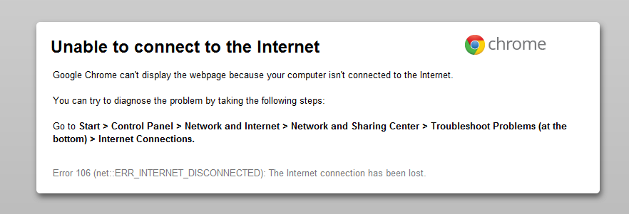
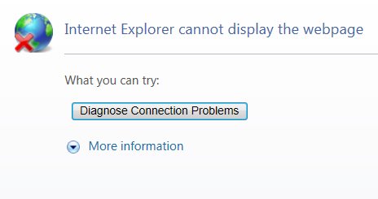
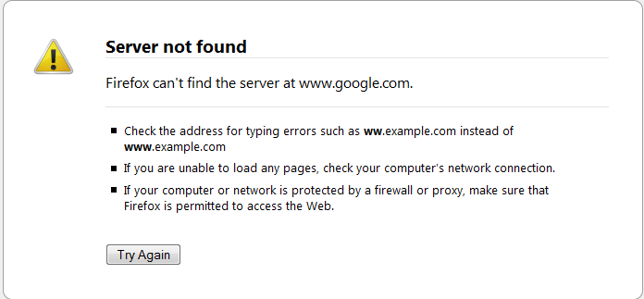
What is “coping” with offline?
Offline support can mean different approaches
  link redirection, partial or full functionality
Generally, it means not this:

Slide 12
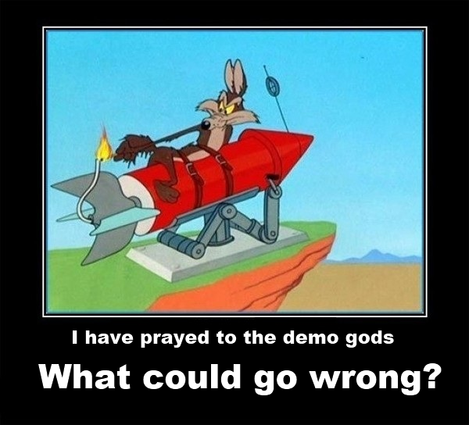
Demo
Before we look at the how
Looking at the concept in action

Slide 13
The How
Database/Persistence
RavenDB provides persistence via document based storage (NoSQL)
Schema-less. Documents are blobs - JSON
Supports transactions
Dynamic Indexes, Linq queries
Spatial Queries, Replication
Lucene Based

Slide 14
Demo
Starting RavenDB (stand-alone / service)
Implementation of RavenDB repository
Admin Interface

Slide 15

The How
Server
Simple POCO within domain model
One generic<T> repository
MVC 3
  Utilising Dependency Injection support

Slide 16
The How
Client / Browser
Browser client utilises HTML 5 Features
Local Storage
Detection of offline capability
Offline application Manifest
  Application Cache

Slide 17
Offline
Application Manifest
<html manifest="cache.manifest">
Must be served with correct mime type
  mime-type ”text/cache-manifest”
  Need to manually add into your web server
Manifest file structure is simple but very specific
FF3.5+, Safari 4+,Chrome 5+, Opera10.6+, iPhone 2.1+, Android 2+(No IE)

Slide 18
Offline
How do you tell?
HTML 5 new online /offline events
  $(document.body).bind("online", function (e) { … });
  $(document.body).bind(“offline", function (e) { … });
Note: They can lie ☺
All latest browsers support this
  May need to augment this via good old fashioned polling.

Slide 19
Offline
A look at the cache
DOM/API Support
  window.applicationCache
Supports many events and method
  cached, checking, progress, downloaded etc..
Typically need to create a helper class to manage the state changes

Slide 20
Offline
Browser Local Storage
Similar to Blob concept of RavenDB/NoSQL
Store JSON Blob, Get JSON Blob
Use it directly or create a thin DAL over it
3rd party tools
  http://amplifyjs.com/

Slide 21
Demo – The End Game
Putting it all together…
Add something to your domain model
Then just use it….
Changes propagated to all tiers
No need to add water …

Slide 22
What have we done? A Recap
Made the domain model the source of truth
  Propagated changes to all tiers
Created a web app to use that model
Online and Offline operation is catered for
  Data entry (on/offline)
  Link redirection (offline)
  Includes when only the site/origin is unreachable
Glued all this together with NoSQL, MVC and HTML5

Slide 23
Question & Answer Session

Slide 24
Resources
http://ravendb.net/
  RavenDB Home
http://amplifyjs.com/
  Javascript library wrapping DOM storage (among other things)
http://weblogs.asp.net/pglavich
  My Blog ☺
https://bitbucket.org/glav/journaliser/
  The app

Slide 25
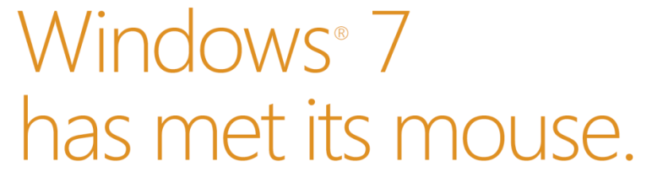
Win a Touch Mouse!
Complete your session evaluation on Schedule Builder for your chance to win a Windows 7 Touch Mouse
Exclusive for Windows 7
Eleven multi touch gestures
Contoured shape for superior comfort
10 prizes drawn every day!*
*Please see Registration for full terms and conditions

Slide 26

Enrol in Microsoft Virtual Academy Today
Why Enroll, other than it being free?
The MVA helps improve your IT skill set and advance your career with a free, easy to access training portal that allows you to learn at your own pace, focusing on Microsoft technologies.
What Do I get for enrolment?
Free training to make you become the Cloud-Hero in my Organization
Help mastering your Training Path and get the recognition
Connect with other IT Pros and discuss The Cloud
Where do I Enrol?
www.microsoftvirtualacademy.com
Then tell us what you think. TellTheDean@microsoft.com

Slide 27




Resources
www.msteched.com/Australia
  Sessions On-Demand & Community
www.microsoft.com/australia/learning
Microsoft Certification & Training Resources
http:// technet.microsoft.com/en-au
  Resources for IT Professionals
http://msdn.microsoft.com/en-au
  Resources for Developers

Slide 28

© 2010 Microsoft Corporation. All rights reserved. Microsoft, Windows, Windows Vista and other product names are or may be registered trademarks and/or trademarks in the U.S. and/or other countries.
The information herein is for informational purposes only and represents the current view of Microsoft Corporation as of the date of this presentation. Because Microsoft must respond to changing market conditions, it should not be interpreted to be a commitment on the part of Microsoft, and Microsoft cannot guarantee the accuracy of any information provided after the date of this presentation. MICROSOFT MAKES NO WARRANTIES, EXPRESS, IMPLIED OR STATUTORY, AS TO THE INFORMATION IN THIS PRESENTATION.

