Slide 2
Multi-tasking and Application Services in Windows Phone 7.5
SESSION CODE: WPH305
Chris Walsh
@ChrisWalshie
blog.walshie.me
Jake Ginnivan
@JakeGinnivan
Jake.ginnivan.net

Slide 4
“iRevolutionary”

Slide 6
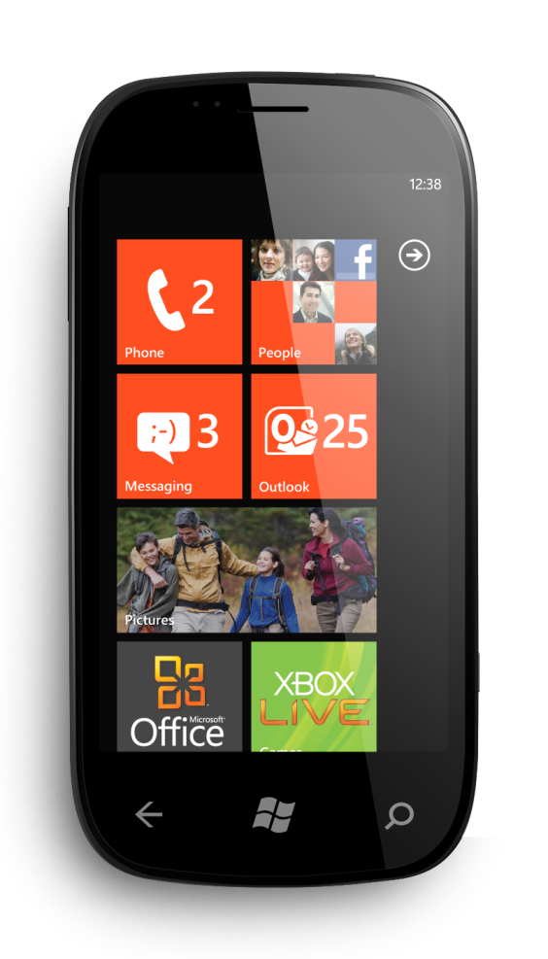

Slide 7
Agenda
Multi-tasking
Background Agents
Fast App Resume
Background Transfer Service
Enhanced push notifications and Live Tiles
Search Extras

Slide 8
Multi-tasking the experience
Fast Application Resume
Ability to resume apps that have been recently used
Background Agents
Ability to run items behind the scenes
Notifications
Ability to create alarms and reminders
Background Transfer Service
Queue up transfers behind the scenes

Slide 9
Multi-tasking the flow
Running
Deactivated
Dormant
Activated
Re-load state ONLY if tombstoned
Application is resident in memory; system detaches resources and pauses threads
Tombstoned
Save but do not dispose of state

Slide 10
Multi-tasking the experience
Demo

Slide 11
Background Agents
Agents
Periodic
On Idle
May have one or both
Initialized in foreground, run in background
Persisted across reboots
User control through CPL
Up to a maximum of 18
Synchronize with foreground through mutex
Agent runs for up to 14 days

Slide 12
Background Agent Types
On Idle Agents
Occurrence
External power, non-cellular network
Duration
10 minutes
Periodic Agents
Occurrence
Every 30 mins
Duration
25 seconds

Slide 13
Background Agents Demo

Slide 14
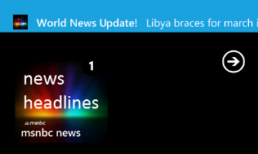
Push Notifications user experience components
Toast notifications
Tile notifications
Default tile pinned
Count, Title & Background
7
Count
Background
Title
Title

Slide 15
Live Tile Enhancements
Back of tile updates
Full control of tiles from both foreground and background apps
Content, Title & Background
Flips from front to back at random intervals
Content string is bigger
Content
Background
Title
Title

Slide 16
Push Nofications Demo

Slide 17
What’s Search Extras?
Added functionality your applications provide for Bing search
Four item types:
Products
Places
Movies
Events
Uri Mapping

Slide 18
Search Extras Demo

Slide 19
Call to Action
Get the tools now!
http://create.msdn.com
Get a free marketplace account
http://is.gd/windowsphone_au_teched
Windows Phone MVC
http://jake.ginnivan.net

Slide 20
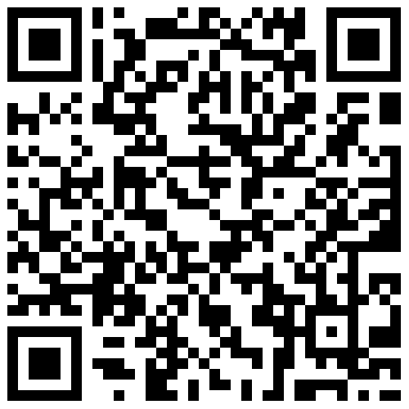
Marketplace Accounts

Slide 21
Windows phone “mango” RTM’ed 27/07/2011!!!!
Get started now – http://create.msdn.com

Slide 22
Enrol in Microsoft Virtual Academy Today
Why Enroll, other than it being free?
The MVA helps improve your IT skill set and advance your career with a free, easy to access training portal that allows you to learn at your own pace, focusing on Microsoft technologies.
What Do I get for enrolment?
Free training to make you become the Cloud-Hero in my Organization
Help mastering your Training Path and get the recognition
Connect with other IT Pros and discuss The Cloud
Where do I Enrol?
www.microsoftvirtualacademy.com
Then tell us what you think. TellTheDean@microsoft.com

Slide 23
© 2010 Microsoft Corporation. All rights reserved. Microsoft, Windows, Windows Vista and other product names are or may be registered trademarks and/or trademarks in the U.S. and/or other countries.
The information herein is for informational purposes only and represents the current view of Microsoft Corporation as of the date of this presentation. Because Microsoft must respond to changing market conditions, it should not be interpreted to be a commitment on the part of Microsoft, and Microsoft cannot guarantee the accuracy of any information provided after the date of this presentation. MICROSOFT MAKES NO WARRANTIES, EXPRESS, IMPLIED OR STATUTORY, AS TO THE INFORMATION IN THIS PRESENTATION.

