Slide 2

Technical Comparison
Eduardo Kassner
Enterprise Technology Architect
Microsoft Corporation
Session Code: CLI301-SUN

Slide 3
Welcome and,
Thank you for being here
ON A SUNDAY
We really appreciate you choosing to spend your time on this session

Slide 4
What are we facing

Slide 5
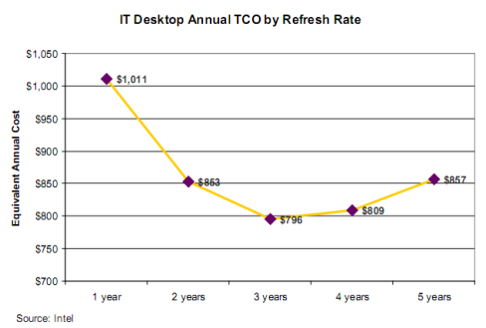
What is the recommended HW / SW refresh cycle?
Sources:
MACQUARIE EQUIPMENT FINANCE, “Desktop Refresh Cycles”, MAY 2008
Forrester Document #32736; Available for a fee at www.forrester.com/research/legacyIT/excerpt
Intel IT Document #3000827-002; Available at www.intel.com
Forrester Document #35832; Available for a fee at www.forrester.com/research/document/excerpt
Wipro Technologies Document #303149-001US; Available at www.wipro.com or www.intel.com/info/stableplatform or www.microsoft.com/desktopdeployment
Robert Francis Group Document; Available for a fee at www.rfgonline.com
Gartner Document #G00153148; Available for a fee at www.gartner.com/it
Source | Core/Focus | Cost-of-Money Considerations | End User Computing Costs? | Recommended
Giga | Standardization; Costs and Risks | No | No | 3 years
Intel | Very ‘Hard’ Cost | Some | No | 3 years
Forrester | Survey Data | No | No | 3 years
Wipro | Standardization | No | No | 2-3 years
Robert Francis Group | Very ‘ Hard’ Cost; NPV | Yes | No | 3 years
Gartner | Technology Substrate | No | Yes | 2-5 years (varies)

Slide 6


Windows XP End of Sales
Key dates around the coming retirement
of Windows XP
    Retail and OEM partners: June 30, 2008
    System builders: January 30, 2009
Customers will still be able to get XP as part of downgrade rights, both via
    Volume license agreements (companies can
    get with as few as 5 licenses)
    When purchasing Windows Vista Ultimate and Windows Vista Business (downgrade rights are part of the license)
This does not impact technical support. Technical support will continue to be available through
    Mainstream: through 2009
    Extended: through April 2014

Slide 7

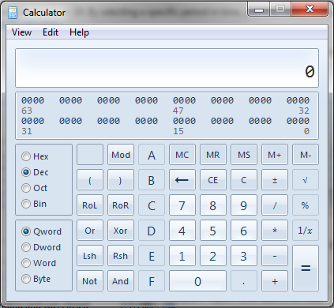
Lets have a look at a summary of what Wikipedia has to say… just for kicks.
Windows 7 includes a number of new features, such as:
Handwriting recognition, support for virtual hard disks, improved performance on multi-core processors, improved boot performance, DirectAccess, Windows PowerShell included, kernel improvements, as well as support for systems using multiple heterogeneous graphics cards from different vendors.
Many new items have been added to the Control Panel, including ClearType Text Tuner, Display Color Calibration Wizard, Gadgets, Recovery, Troubleshooting, Workspaces Center, Location and Other Sensors, Credential Manager, Biometric Devices, System Icons, and Display.
Windows Security Center has been renamed to Windows Action Center (Windows Health Center and Windows Solution Center in earlier builds) which encompasses both security and maintenance of the computer.
Improved media features, the XPS Essentials Pack, and a redesigned Calculator
The taskbar has seen the biggest visual changes with buttons for pinned applications, Jump Lists, Aero Peek, Aero Snap
Windows 7 now adds libraries, arrangement view and search filters

Slide 8

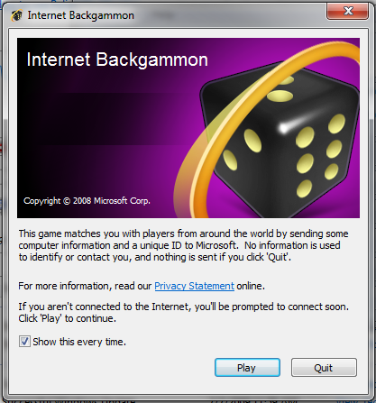
Lets have a look at a summary of what Wikipedia has to say… just for kicks……. Cont.
For developers, Windows 7 includes a new networking API with support for building SOAP-based web services in native code
New features to shorten application install times, reduced UAC prompts, simplified development of installation packages, and improved globalization support through a new Extended Linguistic Services API. Color depths of 30-bit and 48-bit would be supported in Windows 7 along with the wide color gamut scRGB
Better support for Solid State Drives and Windows 7 will be able to identify a Solid State Drive uniquely.
Internet Spades, Internet Backgammon and Internet Checkers, which were removed from Windows Vista, were restored in Windows 7.
Windows 7 will include Internet Explorer 8 (except in Europe where IE is not included at all) and Windows Media Player 12.
Windows 7 will allow users to disable Internet Explorer, users will also be able to disable many more Windows components than was possible in Windows Vista.
Includes 13 additional sound schemes
It allows multiple Windows environments, including Windows XP Mode, to run on the same machine, requiring the use of Intel VT-x or AMD-V.
Furthermore Windows 7 supports to mount a virtual hard disk (VHD) as a normal data storage, and the bootloader delivered with Windows 7 can boot the Windows system from a VHD.
The Remote Desktop Protocol (RDP) of Windows 7 is also enhanced to support real-time multimedia application including video playback and 3D games. That means the Direct X 10 can be used in a remote desktop environment.
So… not too bad
Right
http://en.wikipedia.org/wiki/Windows_7
http://en.wikipedia.org/wiki/Features_new_to_Windows_7

Slide 9
Agenda
Concerns
Response
Press and Analyst Coverage
Press coverage in line with
previous OS releases
Business Value
Lowest Mobile TCO,
Greenest, Fastest Selling
Quality
Highest quality Microsoft OS
Hardware Compatibility
Over 79,000 devices supported
Application Compatibility
200+ LOB apps unblocked 5M+ seats 99% of NPD top consumer apps work
So how does it compare with Vista and XP
Technical Feature Comparison

Slide 10
Press and Analyst Coverage

Slide 11
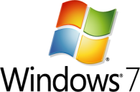







What the Press Is Saying ...
“We checked out an early beta … the improvements to everything from user interface to memory management look
highly promising.”
“Microsoft is on the right path with Windows 7, focusing on ease of use, compatibility, better ways of interacting with the PC and managing the
personal data.”
“One thing becomes obvious after only a few minutes of playing with the new interface: The Windows 7 design team has paid an enormous amount of attention to small details and have focused on workflows and end-to-end experiences, not just
on dialog boxes and feature sets.”
“Microsoft has put together a well thought-through ecosystem, which eases enterprise deployment and administration and yet also gives end-users a desktop OS they can love.”

Slide 12













“delightful”
“faster”
  cnet
“a pleasure”
  New York Times
  Wall Street Journal
“Seven is simply beautiful”
  eWeek
“best version yet”
“don’t wait”
  Financial Times, UK
Gartner

Slide 13


What the press is saying ...
CIO Magazine
“Windows 7 RC1 Adds Speed, UI Improvements
Windows 7 Release Candidate 1 is a polished piece of work and arrives with a variety of nifty new changes to the interface and some important refinements under the hood.”
By Preston Gralla , April 28, 2009
http://www.cio.com/article/491014/Windows_RC_Adds_Speed_UI_Improvements
CIO Magazine
“Windows 7 and Windows 2008 Server R2 Combo a Win-Win
Microsoft's Windows 7 and Windows 2008 Server R2 combination offers a big payoff in terms of virtualization and administrative policy controls.”
By Tom Henderson and Brendan Allen, Mon, June 01, 2009
http://www.cio.com/article/493794/Review_Windows_and_Windows_Server_R_Combo_a_Win_Win

Slide 14
What Analysts Are Saying ...
"Early reports suggest that Ballmer's baby should enjoy a successful and prosperous life, meaning that Microsoft's customers and partners and the greater IT marketplace will find much to like and even more to gain in Windows 7."
—Charles King, Pund-IT Principal Analyst
"Most importantly, Windows 7's feature set was 98 percent locked early in the process.
So no pet features crept in to subsequent build."
—Roger Kay, Founder and President of Endpoint Technologies Associates

Slide 15

Five Windows 7 Features IT Must Prep For Now
CIO Magazine Article , by Shane O'Neill , April 22, 2009
“Benjamin Gray, analyst for Forrester Research, wrote recently in a research report called "Getting Ready for Windows 7" that "major independent software vendors are looking to phase out support for Windows XP later this year by adding support for Windows 7 early next year. Companies dont want to be caught running an operating system that is no longer supported by their vendors."
Gray encourages companies to start planning now by either migrating to Vista as a bridge to Windows 7, or at least test applications and hardware for compatibility against Windows Vista — which will ease eventual upgrades to Windows 7 because both operating systems are built on the same code base.
The Forrester report reiterates previous warnings about the perils of skipping Vista, but it is one of the first reports to highlight specific features within Windows 7.”
http://www.cio.com/article/490324/Five_Windows_Features_IT_Must_Prep_For_Now
http://www.forrester.com/Research/Document/Excerpt/0,7211,54275,00.html

Slide 16
Business Value

Slide 17





Customer who have already benefited from
Logica is an IT services provider with locations in 36 countries. …Logica upgraded 1,000 computers by May 2009 and will continue the rollout companywide to 40,000 computers. Logica is already benefiting from streamlined information access, improved employee productivity, and reduced costs.
United Kingdom
“Windows 7 is just faster overall. It starts faster, resumes faster, and responds faster than anything I’ve seen, so users know they can accomplish more in less time. This system is really a win-win for everyone.“ Vivek Gupta, Founder and Director, Ablaze Infosys
Benefits
~4,000 hours saved annually
~70% of tickets solved remotely
~30% faster resolution time TTR
India
“The outstanding stability of Windows 7 is the chief benefit for us. This will improve user productivity across the company.”
Arne Bergersen, Program Manager, ErgoGroup (3700 Employees)
Norway
“ Our employees use mobile storage devices, and Windows 7 gives us the ability to do all that we can to ensure we’re securing our corporate data, no matter what type of device it’s on. “ Ryan McCune, Director of Global Solutions, Avanade (9000 Employees)
United States
http://www.microsoft.com/casestudies/Case_Study_Search_Results.aspx?Type=1&ProTaxID=11188

Slide 18

Customer who have already benefited from
“The Windows 7 migration features are a huge improvement over Windows Vista. Users do not lose 40 minutes figuring out where things are when they log on to the new operating system for the first time. Everything is familiar so they can get to work right away.”
—Kevin Reeuwijk, Principal Technical Consultant, Getronics, The Netherlands
“Using Windows 7 and App-V together gives us an optimized desktop environment that is tuned to users and easy to manage. We have reduced help-desk costs by 26 percent with application streaming, which frees our staff for more valuable activities.”
—Anders Grönlund, Marketing and Alliance Manager, Zipper, Sweden
“We felt that Windows 7 would help us better safeguard our computers, improve IT management, and provide users with more efficient computers. Taking advantage of Windows 7 is the best way for us to help safeguard ourselves and our customers.”
—Roy Iversen, Senior Technical Engineer, Mamut, Norway
“Our customers are very concerned about security, and many do not accept documents that are not encrypted. With BitLocker to Go, we can easily encrypt documents and take them to customer sites without any problems.”
—Wolfgang Aigner, Chief Executive Officer,
NTx BackOffice Consulting Group, Austria

Slide 19
Quality

Slide 20

Windows 7 & Server 2008 R2 Development Process
New approach for Windows development and disclosure
  Spend more time on planning & vision phase analyzing trends and needs before building features.
  Focus on end-to-end business scenarios – not just new features and technologies.
Planning
  Give our customer and partners a timeframe for the release and stick to our plan – 3 years for Windows 7.
  Disclose with higher degree of certainty and minimize changes
Over 8,000,000 Downloads
Of the Beta / RC
Predictability
  Engaging with partners earlier and more closely to enable seamless experiences and compatibility across hardware, software and services
Ecosystem
We are here
Vision Development & Test Pre-Beta Beta Release

Slide 21



Windows 7 Builds on Windows Vista
Deployment, Testing, and Pilots Today Will Continue to Pay Off
  Similar Compatibility:
  Most software that runs on Windows Vista will run on Windows 7. Exceptions will be low level code (AV, Firewall, Imaging, etc).
  Hardware that runs Windows Vista well will run Windows 7 well.
Few Changes: Focus on quality and reliability improvements
Deep Changes: New models for security, drivers, deployment, and networking

Slide 22
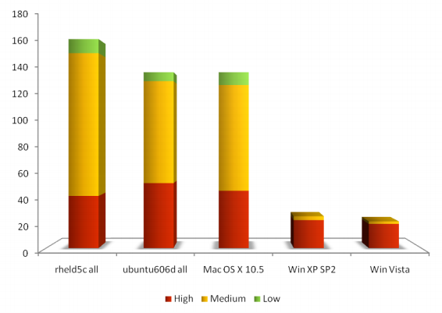
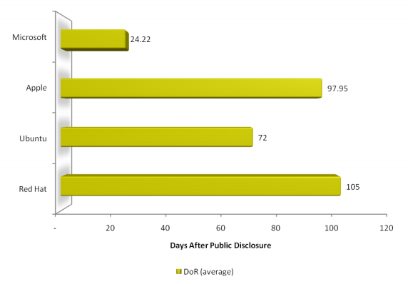
Most Secure http://blogs.technet.com/security/archive/2008/10/27/download-h1-2008-desktop-vuln-report.aspx
Average Days at Risk by Vendor 1H08
http://blogs.technet.com/security/archive/2008/10/27/download-h1-2008-desktop-vuln-report.aspx
THE KEY FINDINGS FOR 1H08:
Microsoft had the lowest average Days of Risk for all vulnerabilities fixed at 24.22 days, with the next closest vendor at 72 days.
For desktop OS vulnerabilities, Windows Vista had the fewest vulnerabilities in 1H08 at 21. The next lowest number was Windows XP SP2 at 26.
Windows Vista customers experienced full or partial mitigation for 46% of the 26 vulnerabilities affecting Windows XP SP2 in 1H08, but also experienced one additional vulnerability in new code.
Source: Jeff Jones Security Blog

Slide 23
Hardware Compatibility

Slide 24
Device Coverage Continues To Grow Rapidly; 700K new Compatible Hardware IDs added since November 2006
Over 2.3 million devices
are supported by Windows Vista, between In-Box and
WU drivers, covering the
vast majority of devices
Number of Logoed Devices exceeds 10,000
and growth is outpacing Windows XP
Millions of device IDs supported
Number of logoed system submissions

Slide 25

Windows 7 out of the box is more compatible
More devices supported
More drivers shipping in box
Better plug & play support
Minimizing wait (Device Stage)
Improved Program Compatibility Assistant
Faster deployment
Improved management
  Result: works the way you want

Slide 26

What does the media say …
Windows 7: An impressive upgrade
ZDNet: Posted by Ed Bott
Benchmarks: Windows 7 RTM versus Vista, XP
“Microsoft has succeeded in providing an OS that’s likely to meet the performance requirements of consumers and business users alike.”
Source ZDNet, Posted by Andy Smith, August 3rd, 2009
7 RTM vs. Vista SP1 vs. XP SP3 - Shootout, Part 1
“My test results here match up closely to the results I got when Windows 7 was both in beta and RC stage - that Windows 7 clearly, and conclusively, outperforms both Vista and XP. No ifs, no buts.”
Source ZDNet: Posted by Adrian Kingsley-Hughes, August 5th, 2009

Slide 27
Application Compatibility

Slide 28
Microsoft Is Making Steady Progress Resolving Application Compatibility Issues
Engaging with ISVs – driving weekly
“wins” in getting major applications
work on Windows Vista
  50 out of 50 of NPD’s top selling
  applications are compatible with
  Windows Vista (per internal testing
  and/or vendor statements)
Hundreds of applications tested and
remediated by ISVs visiting our ISV
app compatibility lab for a
week-long engagement
Robust tools at OS Launch to help
assess and mitigate application
compatibility problems
  Over 900 enterprise IT administrators
  with our enterprise customers trained
  on Application Compatibility Toolkit 5 usage and application remediation
Over 80 Key Enterprise Application Blocking Deployments have been Remediated
More than 2000 applications
have the Windows Logo
Logoed Applications

Slide 29
Technical Differences between Win7 vs Vista SP1 and XP SP3

Slide 30
Main Differences between
Vista SP1 and Windows XP SP3… and Windows 7
Feature | Windows XP SP3 | Windows Vista SP1 | Windows 7
Windows PowerShell™ 2.0 | Download | Download | Included
Scripting of Group Policy Settings – Requires Remote Server Administration Tools for Windows 7 | No | No | Yes
Group Policy Preferences | Download | Download | Included
Windows Recovery Environment | No | Yes | Improved
Windows Troubleshooting Platform | No | No | New
Unified Tracing | Yes | Yes | Improved
Problem Steps Recorder | No | No | New
Remote Access to Reliability Data | No | No | New
Management differences between Vista SP1 and XP SP3
Group Policy Settings
    Windows Vista has more than 500 additional Group Policy settings than Windows XP.
    In Windows Vista, Group Policy settings are better targeted at specific scenarios, such as wireless networking, power management, and printer management.
  Standard User Accounts
    Windows Vista makes using standard user or least‐privilege user accounts more practical than in the past.
    UAC notifies standard users and administrators before an administrative action is performed.
    File and registry redirection helps ensure that applications write to user‐specific
  Troubleshooting and Diagnostics
    Windows Vista automatically detects and repairs more support problems, helping reduce support costs.
  Event Manager
    Windows Vista introduces event forwarding, a new Event Viewer, and event automation.
    Windows Vista consolidates events from most Windows components in the event log instead of in text files.
  Task Scheduling
    Windows Vista enables IT pros to script tasks.
    Windows Vista provides new scheduling options and the ability to run tasks in sequence.

Slide 31
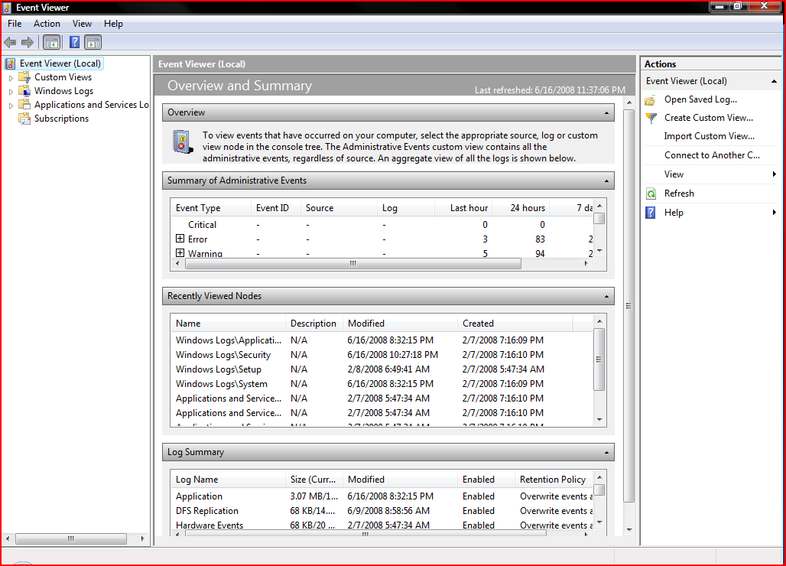
Event Viewer

Slide 32
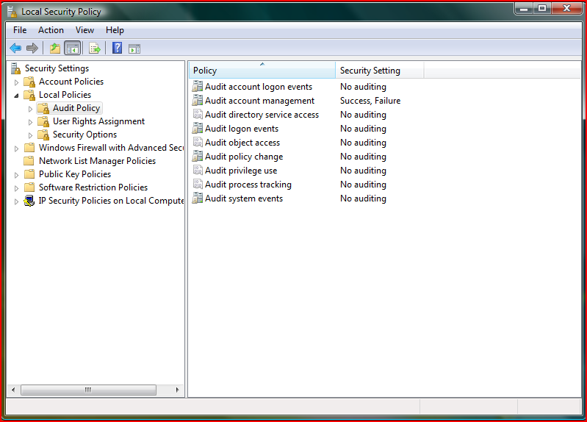
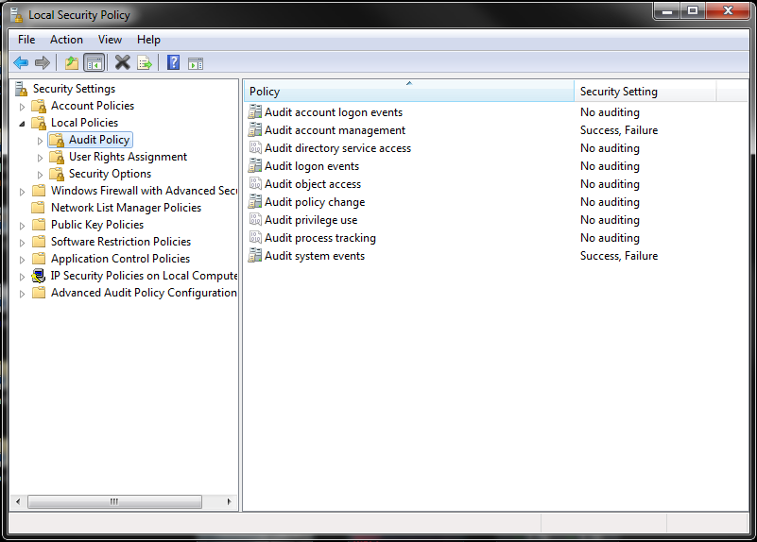
Local Security Policy
New for Windows 7

Slide 33
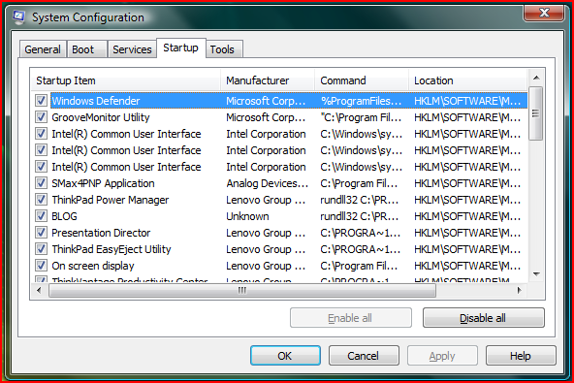
System Configuration

Slide 34
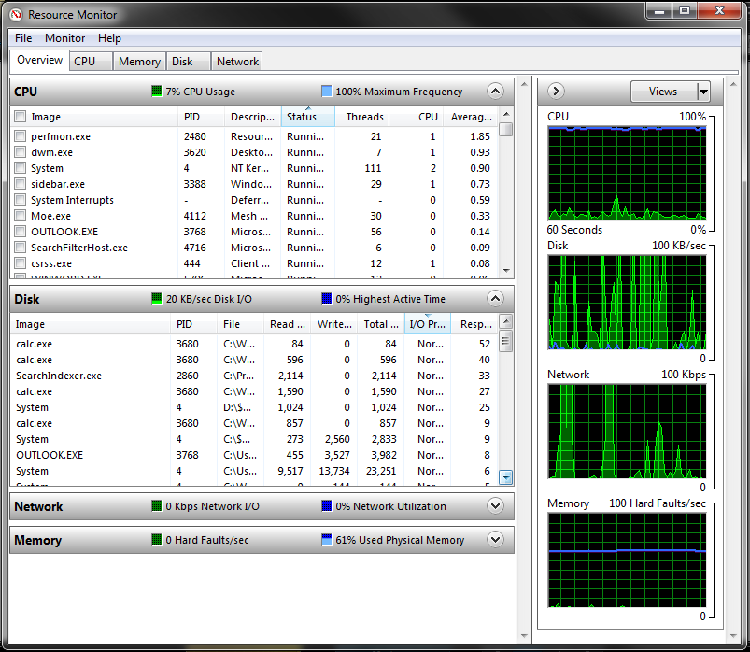
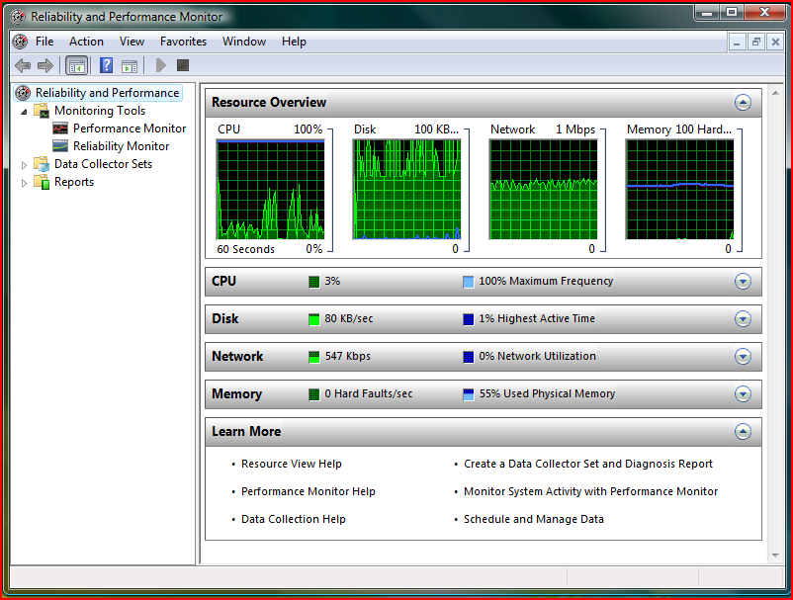
Reliability and Performance Monitor

Slide 35
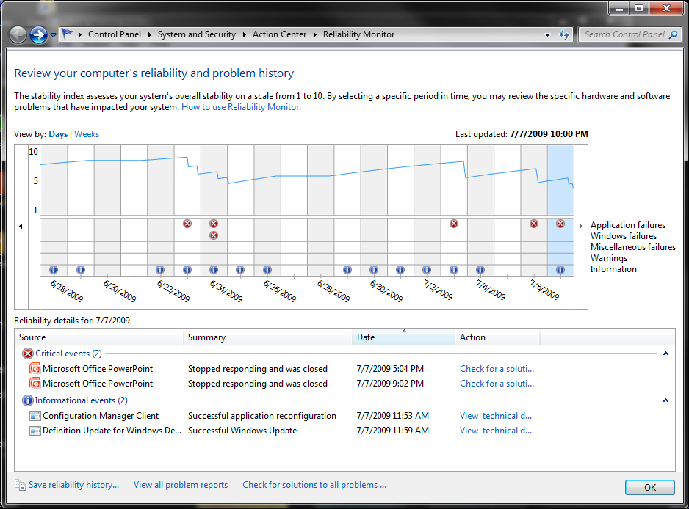
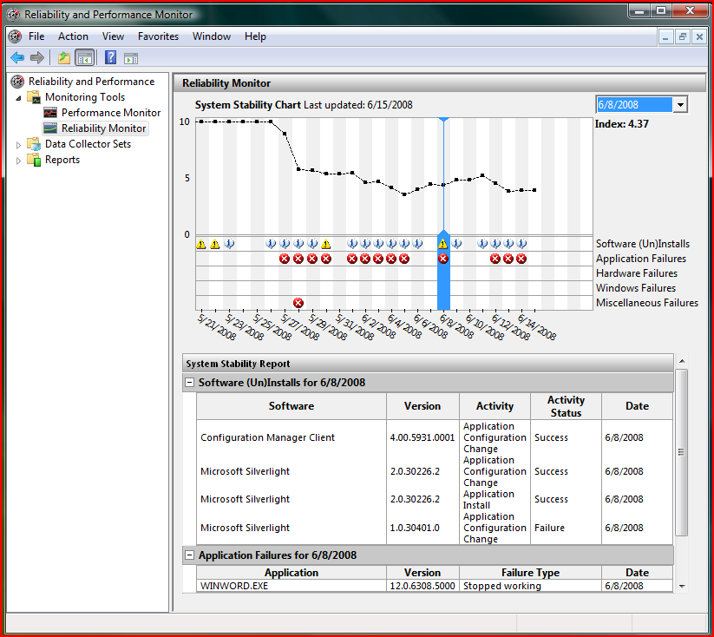
Reliability and Performance Monitor

Slide 36
Main Differences between
Vista SP1 and Windows XP SP3… and Windows 7
Feature | Windows XP SP3 | Windows Vista SP1 | Windows 7
Deployment Image Servicing & Management | No | Yes | Improved
Dynamic Driver Provisioning | No | No | New
Volume Activation | No | Yes | Improved
Multicast Multiple Stream Transfer | No | No | New
User State Migration Tool | Yes | Yes | Improved
VHD Image Management & Deployment | No | No | New
Rich Remoting Experience (Multimedia, Bi‐directional Audio, Multi‐Monitor) | No | No | New
VHD Boot | No | No | New
  Deployment
  Image based Setup (IBS)
    Windows Vista is distributed as a WIM image file and installed by using IBS, resulting in a quicker and more streamlined installation process.
    Windows XP is not distributed as a WIM image, nor does it use IBS; however, Microsoft tools support creating WIM images of Windows XP but without the offline‐servicing benefits of Windows Vista images.
  Installation Tools
    Windows Vista imaging and installation tools support IBS and are far more advanced than Windows XP deployment tools, supporting more deployment scenarios with less cost.
  Windows Setup
    Windows Vista uses IBS and supports more deployment scenarios than Windows XP.
    Windows Vista uses a single XML‐based answer file, providing a more consistent installation, while Windows XP uses multiple text‐based answer files.
    Windows SIM supports all the settings that Windows Vista exposes for deployment for all configuration passes, while Setup Manager only supports a subset of Windows XP settings.
  World-wide single image deployment
    Windows Vista enables organizations to create and deploy a single worldwide image, while Windows XP often requires numerous images for a worldwide deployment.
    • MDT enables companies to use thin‐imaging techniques to reduce both Windows XP and Windows Vista image counts.

Slide 37
Main Differences between
Vista SP1 and Windows XP SP3… and Windows 7
  Security
  Security Development Lifecycle (SDL)
    Windows Vista is a more secure operating system than Windows XP using defense‐in‐depth approaches.
  Windows BitLocker™ Drive Encryption
    Windows Vista helps secure data on portable computers by providing whole‐volume encryption and protection of early boot components.
  Windows Firewall
    Both operating systems include firewall functionality, but Windows Vista includes inbound and outbound filtering, whereas Windows XP only includes inbound filtering.
    Windows Firewall in Windows Vista can dynamically apply rules based on the current network type, making the computer more secure on public networks.
  Windows Defender
    In Windows Vista, Windows Defender is enabled by default; however, Windows Defender is an optional download for Windows XP.
  Internet Explorer 7 Protected Mode
    In Windows Vista, browsing the Internet with Internet Explorer 7 is more secure than in Windows XP.
  Microsoft ActiveX® Installer Service
    With Windows Vista, organizations can deploy, update, and manage ActiveX controls in environments that use standard user accounts.
    In Windows Vista, organizations can use Group Policy to manage the installation of ActiveX controls.
  Defense in Depth
    In Windows Vista, DEP is enabled by default for most components, and the operating system enables developers to enable DEP in their code.
    Windows Vista includes ASLR, which makes it difficult for malicious code to exploit system functions.
    Windows Vista introduces service hardening, which restricts the rights available to some system services.
Feature | Windows XP SP3 | Windows Vista SP1 | Windows 7
BitLocker™ Drive Encryption‐ Requires Windows Vista or Windows 7 Enterprise | No | Yes | Improved
BitLocker To Go™‐ Requires Windows 7 Enterprise | No | No | New
AppLocker™‐ Requires Windows 7 Enterprise | No | No | New
Multiple Active Firewall Profiles | No | No | New
Granular Audit | No | Yes | Improved
User Account Control | No | Yes | Improved
Domain Name System Security Extensions | No | No | New
Smart Card Support | Yes | Yes | Improved
Biometric Support | 3rd Party | 3rd Party | New

Slide 38
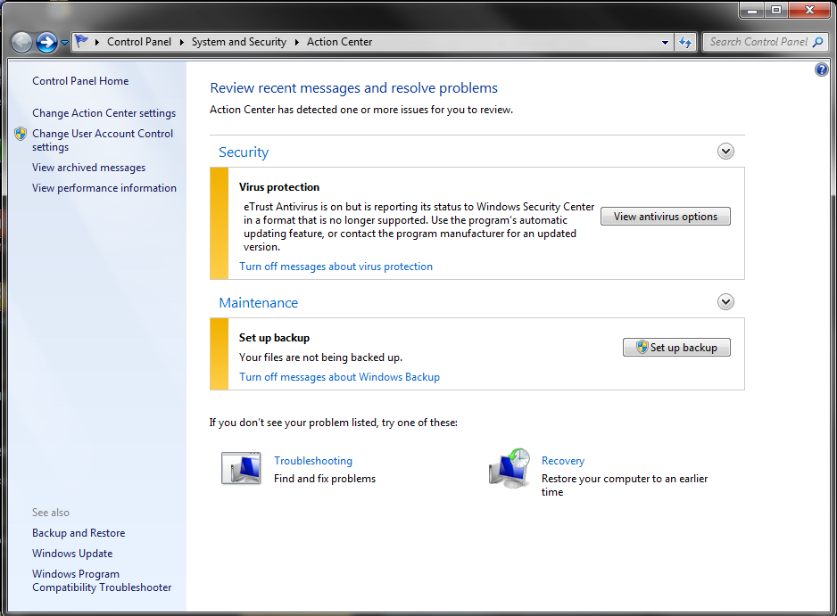
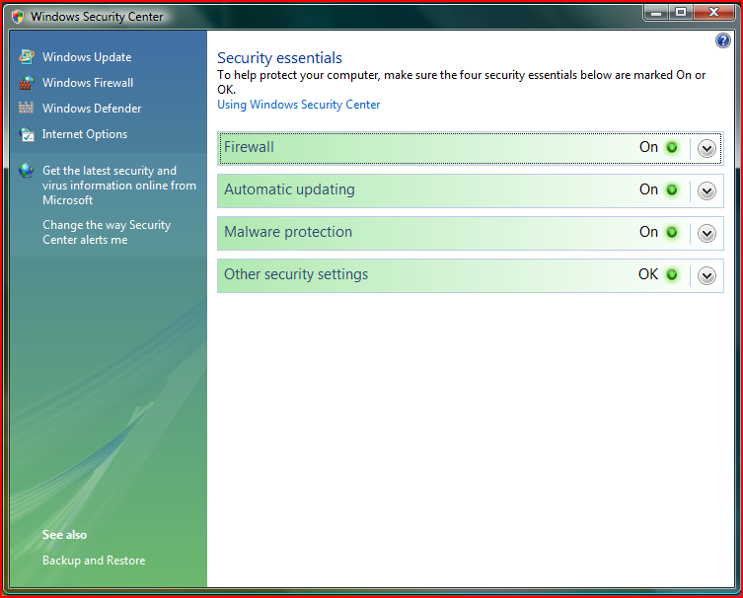
Windows Security Center

Slide 39
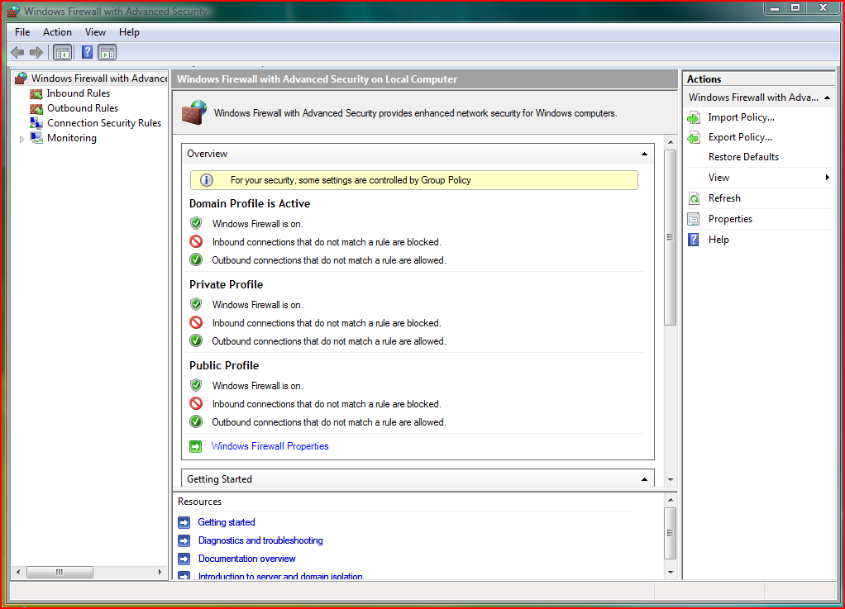
Windows Firewall and Advanced Security

Slide 40
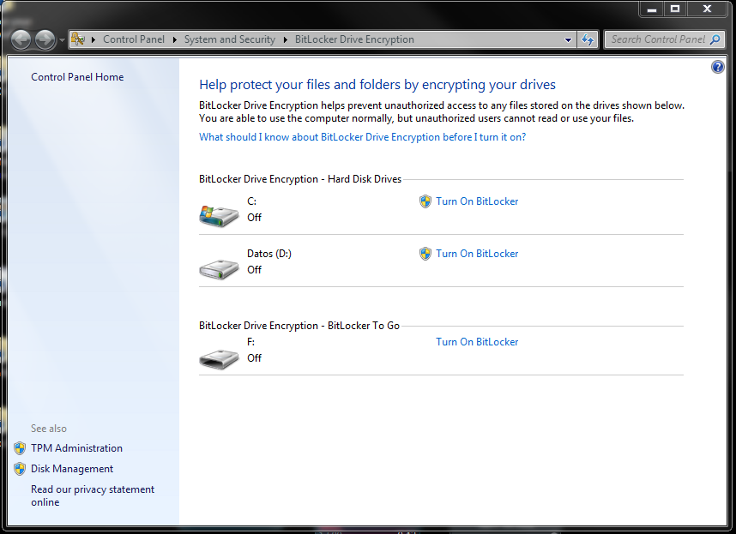
Windows Bitlocker and Bitlocker To Go

Slide 41
Main Differences between
Vista SP1 and Windows XP SP3… and Windows 7
  Mobility
  Windows Mobility Center
    Windows Vista provides one location for managing common mobility settings, while Windows XP requires users to open various Control Panel items to change the same settings.
  Sync Center
    Windows Vista provides a single location for managing sync relationships, whereas Windows XP users must rely on different programs for different devices.
  Offline Files
    Synchronizing changes in offline files and folders is much faster in Windows Vista than in Windows XP.
    Windows Vista supports ghosting, which provides a context for offline files and folders.
    Windows Vista provides an improved UI for using and managing offline files and folders.
  Windows Meeting Space
    Windows Vista enables users to collaborate in new ways.
  Secure Sockets Tunnel Protocol (SSTP)
    By supporting SSTP, Windows Vista enables users to create VPN connections in locations where they can’t connect when using Windows XP.
  Power Management
    Windows Vista reduces power consumption.
    Windows Vista provides more accurate reports about remaining power.
    Windows Vista enables standard users to change power settings.
    Windows Vista enables Group Policy management of power settings.
  Wireless Networking
    In Windows Vista, Network Awareness automatically chooses the best network connection to use when multiple connections are available to applications.
    Windows Vista helps protect users from connection to malicious wireless networks that masquerade as public wireless networks.
    Windows Vista has an improved UI for creating and managing wireless network connections.
Category | Feature | Windows XP SP3 | Windows Vista SP1 | Windows 7
File Organization and Search | Desktop Search | Separate Download | Yes | Improved
 | Libraries | No | No | New
 | Search Federation | No | No | New
 | Enterprise Search Scopes ‐ Requires Windows 7 Enterprise | No | No | New
Remote Access | DirectAccess – Requires Windows 7 Enterprise, Windows Server® 2008 R2 | No | No | New
 | VPN Reconnect | No | No | New
 | BranchCache™ ‐ Requires Windows 7 Enterprise, Windows Server 2008 R2 | No | No | New
 | Mobile Broadband | No | No | New
 | RemoteApp & Desktop Connections | No | No | New

Slide 42
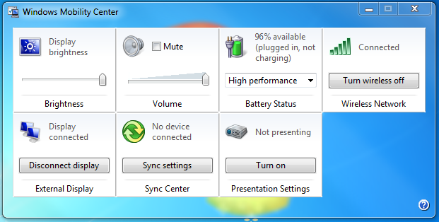
Windows Mobility Center

Slide 43
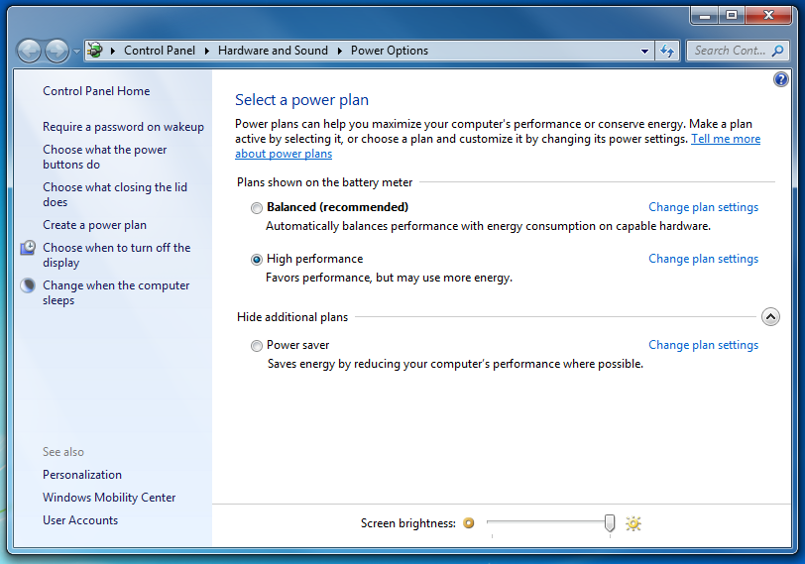
Power Options

Slide 44
Concluding Thoughts

Slide 45



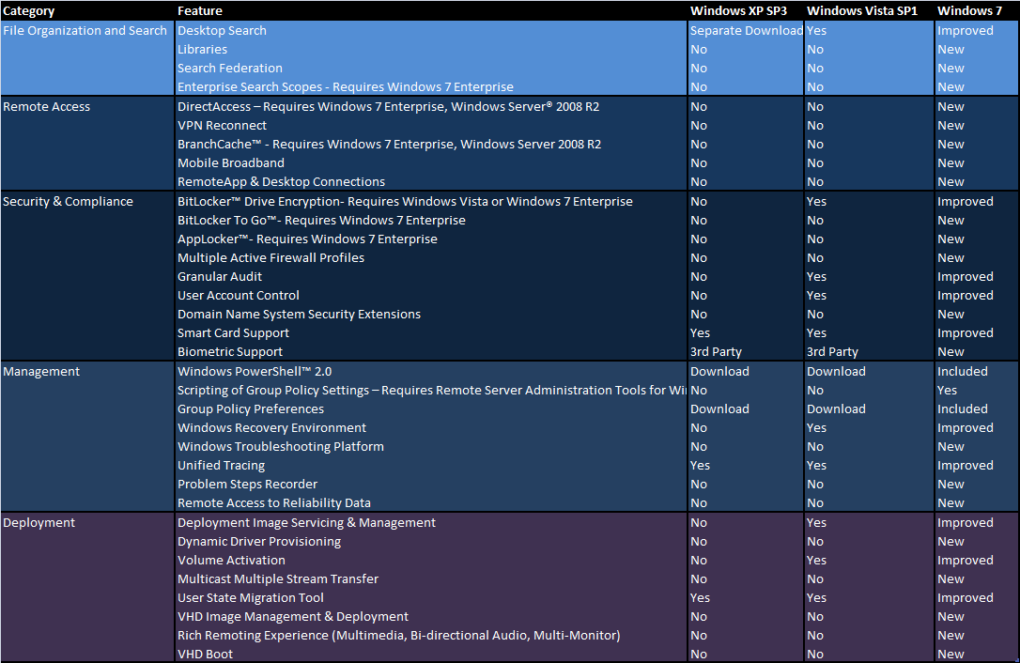



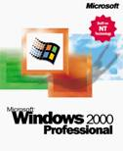


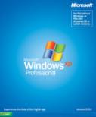
Key Reasons To Upgrade to
Current Platform
Key Reasons
Win 2000
Win XP
Win Vista
More Secure and Dependable
  User Account Protection, more secure boot, anti-spyware and anti-phishing
  Restart Manager (fewer reboots)
  Instant-on and quick-launch/open
Deployable and Manageable
  Image creation and migration tools
  Enhanced software distribution, management tools and instrumentation
Search, Organize and Share
  Fast search and new ways to visualize and organize - lists, virtual folders and filters
  Easy sharing and ad hoc meetings
Mobile and Connected
  Anywhere, anytime access
  Synchronization manager, mobile transitions
Next Generation Platform
  Smart, connected applications
○
○
●
○
○
●
○
○
●
34 Strong Reasons
To consider Windows 7
○
○
●
○
◒
●
○
○
●
○
○
●
○
◒
●
○
◒
●
○
●
●

Slide 46




Next Steps
  Review your application compatibility process and startegy
  Lets build a pilot and a Windows 7 golden image that can be deployed to that pilot
  Let us provide methods to develop an integrated implementation roadmap

Slide 47
Thank You

Slide 48
question & answer

Slide 49




Resources
Required Slide
Speakers,
TechEd 2009 is not producing
a DVD. Please announce that
attendees can access session
recordings at TechEd Online.
www.microsoft.com/teched
  Sessions On-Demand & Community
www.microsoft.com/learning
Microsoft Certification & Training Resources
http://microsoft.com/technet
  Resources for IT Professionals
http://microsoft.com/msdn
  Resources for Developers

Slide 50
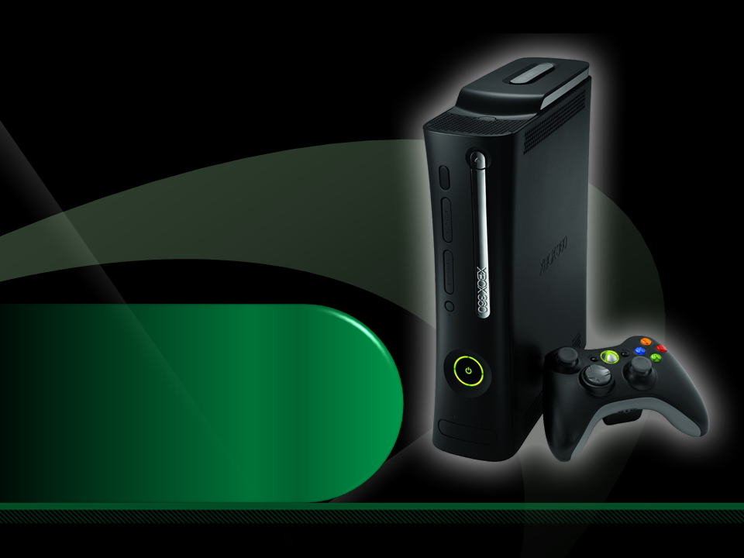
Complete an evaluation on CommNet and enter to win an Xbox 360 Elite!

Slide 52

Required Slide
© 2009 Microsoft Corporation. All rights reserved. Microsoft, Windows, Windows Vista and other product names are or may be registered trademarks and/or trademarks in the U.S. and/or other countries.
The information herein is for informational purposes only and represents the current view of Microsoft Corporation as of the date of this presentation. Because Microsoft must respond to changing market conditions, it should not be interpreted to be a commitment on the part of Microsoft, and Microsoft cannot guarantee the accuracy of any information provided after the date of this presentation. MICROSOFT MAKES NO WARRANTIES, EXPRESS, IMPLIED OR STATUTORY, AS TO THE INFORMATION IN THIS PRESENTATION.

