Slide 2
Windows 7 GP Changes
Michael Kleef
Program Manager
Microsoft
Blogs.technet.com/mkleef
Session Code:

Slide 3
Session Objectives
Session Objective(s):
  Quick review of new GP features in Windows Server 2008 & Windows Vista SP1.
  In depth understand what Group Policy changes have been made to Windows 7
  How to get from Windows XP/2003 to Windows 7/R2
Takeaway
  GP in Windows 7 / Windows Server 2008 R2 is incremental, not major change

Slide 4
















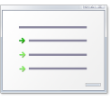






Background
How Group Policy works now...
Group Policy Service
GP now runs in a shared service
Hardened Service, more reliable
Windows Vista/Windows Server 2008
Group Policy Process
Part of Winlogon
Group Policy Templates
ADM Templates now in
ADMX files (ADMX, ADML)
Templates
ADM templates difficult to manage
ADM
ADM
ADM
ADM
ADM
ADMX
ADM
Local GPOs
Limited flexibility with a single local GPO
Multiple Local GPOs
Settings
~1,800 policy settings in XP
Incomplete coverage means missing key scenarios
Group Policy Settings
Over 800 new policy changes
with Windows Vista
Extended GP for new Windows
Vista features
LGPO’s
LGPO’s
LGPO
LGPO
Local Computer Policy
Local Computer Policy
Admin
Admin/Non-Admin Group Policy
User
User Specified Group Policy
Network
Limited awareness of changing network conditions
Network Location
Awareness (NLA)
NLA service provides the latest
network information
Applications can query or register with
NLA for network change indications
Templates and Replication
Journal Wrap anyone? Bloated SYSVOL?
Group Policy Central Store
Centralized repository for ADMX
Created in the Sysvol on DC
in each domain
New Replicator with DFS-R
ADMX
ADML
Group Policy Logging
Administrative log
Applications and Services log
XML based event logs
New Tools - GPOLogView
SysVol
Troubleshooting
User.env log
GP Result
DC
DC
SysVol
+
Policies
+
GUID
+
ADM
+
Policy Definitions
FRS/DFS-R
ADMX, ADML Files

Slide 5
Creating a Central Store
Creating LGPO
Demo

Slide 6
Overview
What is new in Windows 7?
GP PowerShell features
  Adding to GP scripts extensions
  PowerShell cmdlets to perform GP operations
Starter GPOs in-box in Windows 7
  Best practices that map to the security guide
ADMX enhancements
GP Preferences enhancements
  GP Preferences, new in Windows Server 2008
  New items added to support new OS functionality

Slide 7
Powershell In and Out
PowerShell Scripting inside GP
  Extend current reach of GP Script Extension to include PowerShell for logon/logoff, startup/shutdown scripts
Powershell Cmdlets for GPMC operations
  Full lifecycle: create, link, rename, backup, copy, remove
  Enables interesting new scenarios for customers
Powershell Cmdlets that write and read registry settings to GPO(s)
  Values can be written to either Policy or Preferences
  Settings can accept more value types

Slide 8
GPO Lifecycle With Cmdlets
New
Link
Copy / Rename
Backup / Restore
Report / RSoP
Remove
Edit
Permissions
* Registry settings
GP Object

Slide 9
GP Powershell Cmdlets
Import-module GroupPolicy
get-help *-gp*
New
New-GPLink
Get
Get-GPInheritance
Set
Set-GPInheritance
New-GPO
New-GPStarterGPO
Get-GPO
Get-GPOReport
Get-GPPermissions
Get-GPPrefRegistryValue
Get-GPRegistryValue
Get-GPResultantSetofPolicy
Get-GPStarterGPO
Set-GPLink
Set-GPPermissions
Set-GPPrefRegistryValue
Set-GPRegistryValue
Remove
Remove-GPLink
Remove-GPO
Remove-GPPrefRegistryValue
Remove-GPRegistryValue
Misc
Backup-GPO
Copy-GPO
Import-GPO
Rename-GPO
Restore-GPO

Slide 10
PowerShell Examples
Backup all GPO’s in current domain to directory
Backup-GPO –all –path ‘C:\BackupFiles\’
Get RSOP for local computer and logged on user in html form
Compare values across GPO’s
Get-GPResultantSetofPolicy -ReportType -html -Path D:\ConfigDocuments\Reports\
$A =get-GPRegistryValue –Name GPO1 –key $reg_keypath –ValueName ScreenSaveTimeOut
$B =get-GPRegistryValue –Name GPO2 –key $reg_keypath –ValueName ScreenSaveTimeOut
$reg_keypath = “HKCU\Software\Policies\Microsoft\Windows\Control Panel\Desktop”
$A[0].equals($B[0])
Grant permission to ‘Apply’ to a GPO for all users belonging to a group
Get-ADGroupMember DlgtdAdmins | where {$_.objectclass -eq "user"} | %{Set-GPPermissions -Name 'Test GPO' -PermissionLevel Apply -TargetName $_.SamAccountName -TargetType User}

Slide 11
Powershell
demo

Slide 12
Starter GPOs
Easy experience out-of-the-box
  Embody best practices that map to Microsoft security guide
8 System Starter GPOs:
  User and Computer case
  Available for Vista and XP SP2
  Enterprise Client (EC) and Specialized Security Limited Functionality (SSLF)
System vs Custom
  Static / Editable
  ADMX / Security Settings

Slide 13
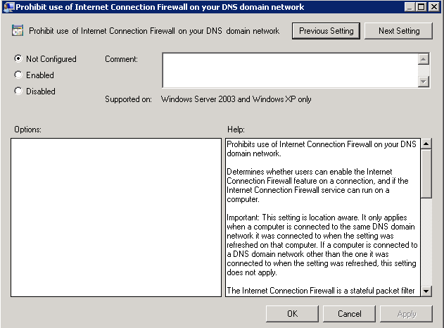
ADMX Improvements
  New UI: More intuitive, integrated help content, no more tabs
  Support for:
  REG_MultiSZ
  REG_QWORD

Slide 14
Starter GPOs & ADMX UI
demo

Slide 15
GP Preferences
Preference Settings
  Not true “Policy”
More control of desktop – more settings!
  Not limited to policy-aware applications
Ease of administration through rich UI
Better targeting
New in Windows 7
  Support for new Power Plan settings
  Support for new Schedule task triggers, actions, etc.

Slide 16
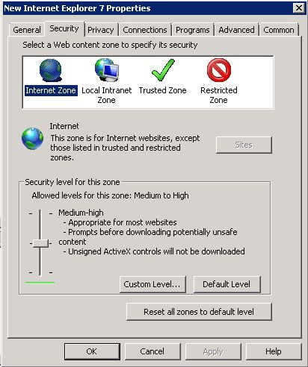
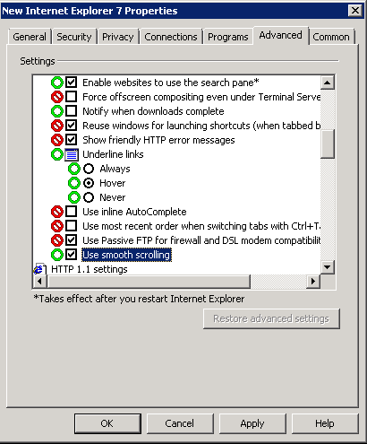
Richer UI
Familiar Experience
  Clearer to understand
  and find
  Easy to manage
  Better control of individual
  settings – Red/Green
Powerful browsers
  Avoids typing errors
  Configure settings quicker

Slide 17
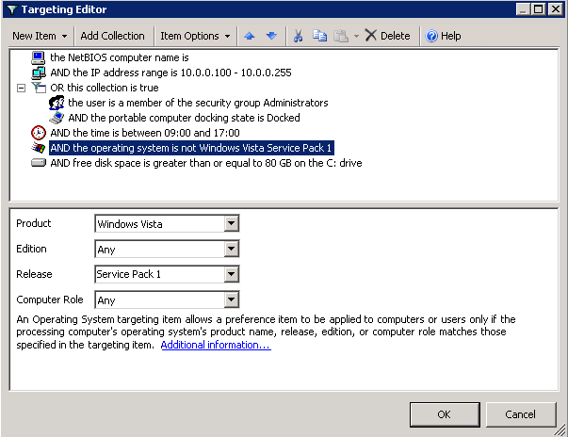
Better Targeting
Robust targeting
29 types
Boolean logic (And, Or, Not)
Collections
Item level targeting, not GPO level
Intuitive UI
No need to learn query languages

Slide 18
Preferences and IE UI
demo

Slide 19
What is new in ADMX
3000 Total ADMX settings
300 new ADMX settings
  IE more than 140 new
  Bitlocker
  Taskbar
  Power
  Terminal Services rebranded
  “Remote Desktop Services”
Settings Spreadsheet

Slide 20
What about Security Settings?
12 settings added under Security Options
  Restrict NTLM (multiple)
  Kerberos encryption types
  Local System null session fallback
Only supported on Windows 7 & Windows Server 2008 R2
Settings Spreadsheet

Slide 21
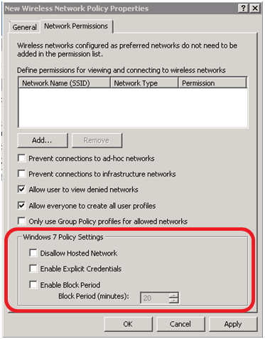
Anything else?
Wireless Network (IEEE 802.11) Policies
Public Key Policies
  Certificate Services Client - Certificate Enrollment Policy
  BitLocker Drive Encryption
Network Access Protection
  Enforcement Clients: Removed RAQ EC and TS Gateway
  Enforcement Clients: Added RD Gateway QEC
Application Control Policies – AppLocker
  More info
Advanced Audit Policy Configuration
  More info
Name Resolution Policy

Slide 22
Recommendations
DFS-R replicating SYSVOL
The GP team recommends this strongly
FRS Issues
  File Based Replication
  Does not self heal
  Does not tell you when its broken
DFS-R for SYSVOL requires:
  Windows 2008 Domain Functional
  All Windows Server 2008 DC’s minimum
http://blogs.technet.com/notesfromthefield/archive/2008/04/27/upgrading-your-sysvol-to-dfs-r-replication.aspx

Slide 23
Recommendations
Excessive GPOs
Have heard up to 11,000 GPOs
Not best practice
  GPMC has perf issues loading
  Management difficulties
  Troubleshooting difficulties
  Migration difficulties
Recommendation:
  Consolidate
  AGPM is tested up to 2000 GPOs

Slide 24
Will my current policies work with Windows 7?
FAQ – Demo

Slide 25
FAQ’s
DC’s, Domains and Forests
Any impact for co-existence between Windows Server 2003 GP, Windows Server 2008 and R2 in the same domain?
Are there any schema changes required?
Are there any DomainPrep considerations?
Does policy itself replicate any differently?
Do you still use the same tools to diagnose replication issues like Ultrasound (FRS)?
Is policy stored any differently?

Slide 26
FAQ’s
ADMX and Authoring
Does ADMX make policy different?
What about the Vista Central Store?
Will ADMX create an impact on my policies?
Can I use ADM at all?
Ok then, can I drop ADM files into the Central Store?

Slide 27
FAQ’s
Miscellaneous
With the move from Winlogon to a service does this mean users can deny policy applying?
Do we have plans to provide an updated GPMC/GPOE to support Windows XP administrative PC’s with ADMX and the Central Store?
Is there any way to restrict editing GPOs from certain OS versions ? i.e.: restrict editing from anything below W2K3 ?
Is it a good idea to separate Vista/W7 GPOs from the Windows XP GPO‘s

Slide 28
Deployment
Guidance
Applocker Policy
  Will only apply on Windows 7 Ultimate and Enterprise
  Best Practice: Separate Policy for Windows Vista/7 machines
SRP Policy
  Can apply on Windows 7 and previous
  When W7 sees both SRP and Applocker it only applies Applocker
  Best Practice: Separate Policy for Windows Vista machines and previous
Three methods for policy separation
  Grouping (Read/Apply control)
  Separate OU with GPO link
  WMI Filter
    Select * FROM <WMI_CLASS> WHERE <WMI Property>=<value>
    Select * FROM Win32_OperatingSystem WHERE Caption="Microsoft Vista" AND CSDVersion="Service Pack 2"

Slide 29
Deployment
Guidance
Firewall Policy
  Will apply the most permissive rule
  Best Practice: Separate Policy for Windows Vista/7 machines
IPSEC Policy
  Old UI for pre-Vista
  New UI for Vista
  Best Practice: Separate Policy for Windows Vista machines
Three methods for policy separation
  Grouping (Read/Apply control)
  Separate OU with GPO link
  WMI Filter
    Select * FROM <WMI_CLASS> WHERE <WMI Property>=<value>
    Select * FROM Win32_OperatingSystem WHERE Caption="Microsoft Windows XP Professional" AND CSDVersion="Service Pack 2"

Slide 30
Deployment
Guidance
Auditing Policy
  Totally different in XP to Vista
  Fine Grained (Vista/W7) as opposed to clumsy and awful (XP)
  Separate it
Auditing Differences between Vista and Windows 7
  Fundamentally the same (fine grained)
  No GP enablement in Windows Vista
  Vista uses auditpol.exe

Slide 31
Community Tools
ADMX Migrator (FullArmor)
  http://www.microsoft.com/downloads/details.aspx?familyid=0F1EEC3D-10C4-4B5F-9625-97C2F731090C&displaylang=en
Sysprosoft ADM Template Editor
  www.sysprosoft.com
PolicyPak
  Enhancements to GP
  www.policypak.com
ILTEditor
  http://www.gruppenrichtlinien.de/tools/ILTEditor.zip

Slide 32
question & answer

Slide 33




Resources
Required Slide
Speakers,
TechEd 2009 is not producing
a DVD. Please announce that
attendees can access session
recordings at TechEd Online.
www.microsoft.com/teched
  Sessions On-Demand & Community
www.microsoft.com/learning
Microsoft Certification & Training Resources
http://microsoft.com/technet
  Resources for IT Professionals
http://microsoft.com/msdn
  Resources for Developers
www.microsoft.com/learning
Microsoft Certification and Training Resources

Slide 34
Helpful Information
Link to Group Policy TechNet page
http://www.microsoft.com/technet/grouppolicy
Group Policy Team Blog
http://blogs.technet.com/grouppolicy
Deploying Group Policy Using Windows Vista
http://go.microsoft.com/fwlink/?LinkId=77080
Group Policy Settings Reference Windows Vista
http://go.microsoft.com/fwlink/?LinkId=54020
Step-by-Step Guide to Managing Multiple Local Group Policy Objects http://go.microsoft.com/fwlink/?LinkId=73434
How to troubleshoot Group Policy using Event logs
http://go.microsoft.com/fwlink/?LinkId=74139

Slide 35

Required Slide
© 2009 Microsoft Corporation. All rights reserved. Microsoft, Windows, Windows Vista and other product names are or may be registered trademarks and/or trademarks in the U.S. and/or other countries.
The information herein is for informational purposes only and represents the current view of Microsoft Corporation as of the date of this presentation. Because Microsoft must respond to changing market conditions, it should not be interpreted to be a commitment on the part of Microsoft, and Microsoft cannot guarantee the accuracy of any information provided after the date of this presentation. MICROSOFT MAKES NO WARRANTIES, EXPRESS, IMPLIED OR STATUTORY, AS TO THE INFORMATION IN THIS PRESENTATION.

Slide 36

Complete an evaluation on CommNet and enter to win an Xbox 360 Elite!

