Slide 2
Inside Panther - The Windows Setup Engine
Johan Arwidmark
Chief Technical Architect
TrueSec
Johan.arwidmark@truesec.com

Slide 3


I live here...

Slide 4
Agenda
The Windows 7 Setup Engine
  Image Based Setup and Automation
  Configuration Passes
  Component Based Servicing
Device Drivers in Windows 7
  Image Servicing
  Device Driver Ranking
Troubleshooting
  Logfiles

Slide 5
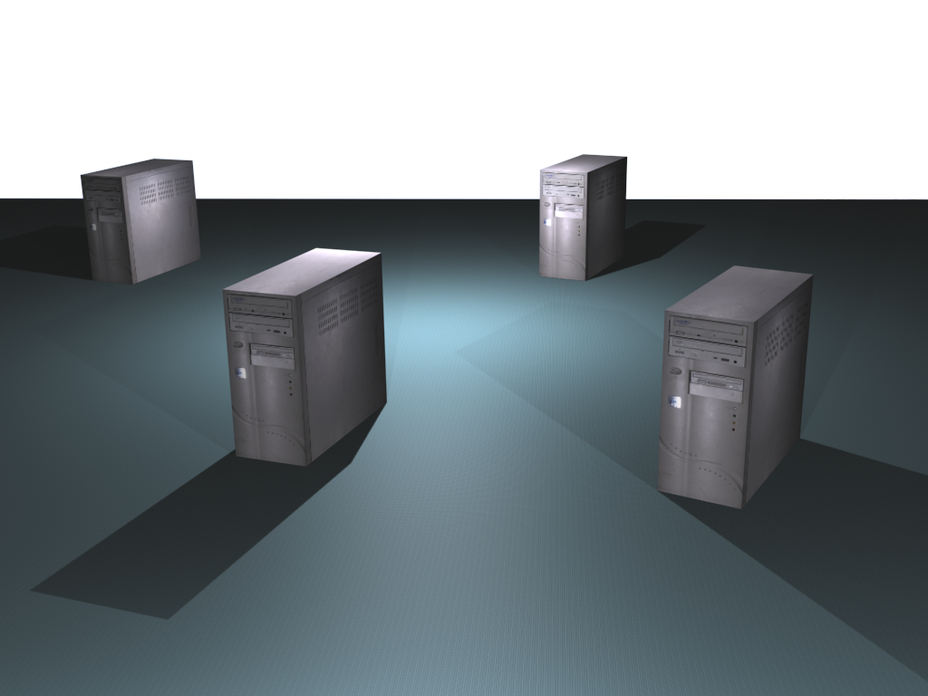
Demo Environment
Hyper-V R2, 8 GB RAM, 1 TB HDD
DC01
DC and DNS
DC02
DC and DNS
MDT01
MDT 2010
WDS, WSUS and DHCP
SQL 2008 Express SP1
CM01
MDT 2010
SQL 2008 SP1
WDS, WSUS and DHCP
ConfigMgr 2007 SP2

Slide 6
Windows 7 Setup
Setup is exclusively image-based
  32- or 64-bit executable
  Automated via unattend.xml
  New boot from VHD option
  One image can support all hardware
WinPE 3.0 drives the Deployment
  Using Setup or Imaging Utility

Slide 7
Windows 7 Setup, continued.
Larger images
  Branch Office scenarios
Windows Recovery
Offline Servicing
Bitlocker

Slide 8
Following a Windows 7 setup…
demo
Johan Arwidmark
Chief Technical Architect
TrueSec

Slide 9
Automating the Setup
Unattend.xml is the key…
WSIM (from WAIK 2.0) it’s creator…
  WIM Files and Catalog Files
  Distribution Share
  Adding Packages
  Adding Drivers

Slide 10
Windows 7 Configuration Passes
Windows PE
Windows Setup
Sysprep
WindowsPE
Windows PE
Generalize
offlineServicing
Specialize
AuditSystem
AuditUser
OobeSystem

Slide 11
Automating the Setup
demo
Johan Arwidmark
Chief Technical Architect
TrueSec

Slide 12

Setup and Modern Deployment
Setup is only on of many actions
  Sometimes overlapping
Patch
Drivers
Apply OS
RAID Array
Part/Format

Slide 13
Offline Servicing
Before or during Deployment
Using Deployment Imaging and Servicing (DISM)
Adding Packages
Adding Drivers

Slide 14
Component based servicing
Kernel Transaction
Manager (KTM)
Systems Management Infrastructure (SMI)
Component Management Infrastructure (CMI)
Driver Management and Install (DMI)
Component Based Servicing (CBS)
Component Servicing Infrastructure (CSI)

Slide 15
Offline Servicing
demo
Johan Arwidmark
Chief Technical Architect
TrueSec

Slide 16
Windows 7 Setup Logfiles
Locations depend on the setup phase
Locations (See KB 927521 for details)
  C:\WINDOWS\
  C:\WINDOWS\PANTHER
  C:\WINDOWS\INF
  C:\$WINDOWS.~BT\Sources\Panther
  X:\$WINDOWS.~BT\Sources\Panther

Slide 17
Windows 7 Setup Logfiles, cont.
Key Logfiles
  Setupact.log
  setuperr.log
  setupapi.dev.log
  setupapi.app.log

Slide 18
Troubleshooting Windows 7 Setup
demo
Johan Arwidmark
Chief Technical Architect
TrueSec

Slide 19
Windows 7 Device Drivers
DirectX
The Windows 7 Driver Store
  PNP Service
  Driver ranking
  Device Driver signing
Offline Servicing using DISM

Slide 20
Windows 7 Device Drivers
demo
Johan Arwidmark
Chief Technical Architect
TrueSec

Slide 21
Resources
Free Tutorials and Training Videos
  www.deploymentcd.com
Blogs on Deployment
  www.deployvista.com
  www.myitforum.com
  http://blogs.technet.com/msdeployment
  http://blogs.technet.com/deploymentguys
  http://blogs.technet.com/mniehaus

Slide 24

© 2008 Microsoft Corporation. All rights reserved. Microsoft, Windows, Windows Vista and other product names are or may be registered trademarks and/or trademarks in the U.S. and/or other countries.
The information herein is for informational purposes only and represents the current view of Microsoft Corporation as of the date of this presentation. Because Microsoft must respond to changing market conditions, it should not be interpreted to be a commitment on the part of Microsoft, and Microsoft cannot guarantee the accuracy of any information provided after the date of this presentation. MICROSOFT MAKES NO WARRANTIES, EXPRESS, IMPLIED OR STATUTORY, AS TO THE INFORMATION IN THIS PRESENTATION.

Slide 25
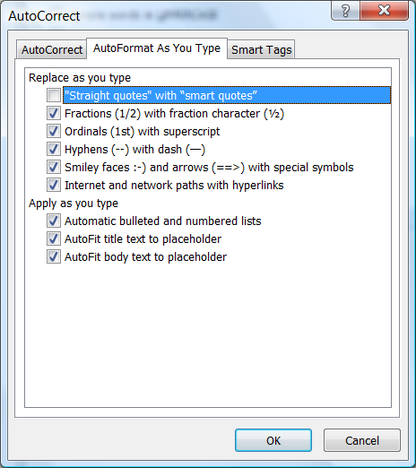
Slide for Showing Software Code
Use this layout to show software code
  The font is Consolas, a monospace font
  The slide doesn’t use bullets but levels can be indented using the “Increase List Level” icon on the Home menu
  To use straight quotes " instead of
  smart quotes ”, do this:
  Click on the Office Button in the upper left corner
  At the bottom of the menu, choose PowerPoint Options
  From the left pane, select Proofing
  Click on the AutoCorrect Options button
  Select the AutoFormat As You Type tab,
  and deselect “Straight quotes” with “smart
  quotes”. Then Click OK.

Slide 26
question & answer

Slide 27




Resources
Required Slide
Speakers,
TechEd 2009 is not producing
a DVD. Please announce that
attendees can access session
recordings at TechEd Online.
www.microsoft.com/teched
  Sessions On-Demand & Community
www.microsoft.com/learning
Microsoft Certification & Training Resources
http://microsoft.com/technet
  Resources for IT Professionals
http://microsoft.com/msdn
  Resources for Developers

Slide 28

Complete an evaluation on CommNet and enter to win an Xbox 360 Elite!

Slide 29

Required Slide
© 2009 Microsoft Corporation. All rights reserved. Microsoft, Windows, Windows Vista and other product names are or may be registered trademarks and/or trademarks in the U.S. and/or other countries.
The information herein is for informational purposes only and represents the current view of Microsoft Corporation as of the date of this presentation. Because Microsoft must respond to changing market conditions, it should not be interpreted to be a commitment on the part of Microsoft, and Microsoft cannot guarantee the accuracy of any information provided after the date of this presentation. MICROSOFT MAKES NO WARRANTIES, EXPRESS, IMPLIED OR STATUTORY, AS TO THE INFORMATION IN THIS PRESENTATION.

