Slide 2
What's New in Microsoft SQL Azure
David Robinson
Senior Program Manager
Microsoft
DAT204

Slide 3
Agenda
(Re) Introducing SQL Azure
Demo: Quick “Lap Around”
Going Deeper – What’s happening under the hood
Business Model
Call to Action - Sign up for the CTP today!

Slide 4
(Re) Introducing: SQL Azure Database
What a long, strange trip it’s been…
What SQL Azure is…
A massively scaled, multi-tenant relational database service built on commodity hardware
A symmetric extension to a uniquely powerful data platform
What it isn’t…
Database hosting
Done

Slide 5
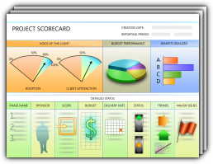
Extending SQL Data Platform to Cloud
Relational Database service (Windows Azure Platform)
Key differentiator for SQL Server platform
SQL Azure
Browser
SQL Azure
(Windows Azure Compute)
High-Level Features
Self-provisioning and capacity on demand
Automatic high-availability
Automated management (infrastructure)
Symmetry with on-premises platform
Simple, flexible pricing model – pay for what you use
New, differentiated capabilities…
SOAP/REST
HTTP/S
Astoria/REST - EDM
HTTP/S
App Code
(ASP.NET)
Windows Azure
Compute
SQL Server Report Server
(on-premises)
T-SQL (TDS)
Web & Departmental Applications
SaaS ISVs (SMB)
Enterprise SIs
& Internal MS Properties
T-SQL (TDS)
SQL Azure
MS
Datacenter

Slide 6
Service Provisioning Model
Each account has zero or more servers
Azure wide, provisioned in a common portal
Billing instrument
Each server has one or more databases
Contains metadata about the databases
Unit of authentication
Unit of Geo-location
Each database has standard SQL objects
Unit of consistency
Contains users, tables, views, indices, etc…
Account
Server
Database

Slide 7
Lap around SQL Azure
Demo

Slide 8
Under the hood
What’s Happening

Slide 9
SQL Azure Network Topology
Applications use standard SQL client libraries: ODBC, OLEDB, ADO.Net, …
Application
Internet
Azure Cloud
TDS (tcp)
Load balancer forwards ‘sticky’ sessions to TDS protocol tier
Security Boundary
LB
TDS (tcp)
Gateway
Gateway
Gateway
Gateway
Gateway
Gateway
Gateway: Service protocol gateway, enforces AUTHN/AUTHZ policy; proxy to SQL nodes
TDS (tcp)
SQL
SQL
SQL
SQL
SQL
SQL
Scalability and Availability: Fabric, Failover, Replication, and Load balancing

Slide 10
Database Servers
SQL Azure provides a logical database server
Each SQL Azure (SA) server provides
Geo-location (has a unique DNS name)
A zone for administration policy
A unit of billing and reporting
When should I create a new server?
Balance the trade off between geo/admin/billing
Best practice: co-locate server with Windows Azure app role (if using) to reduce latency

Slide 11
Server Management
Portal
Add/Drop server
Setup SA credentials
Report usage
Master Database as a connection point
Network access configuration (firewall)
User logins
Usage and metrics reporting (billing)
Database lifecycle

Slide 12
Server: Network Access Control
Each server defines a set of firewall rules
Determines access policy based on client IP
By default, there is NO ACCESS to server
Controlled using Firewall API (masterDB)
sys.firewall_rules, sys.sp_merge_firewall_rule and sys.sp_delete_firewall_rule
ID | Name | Start IP | End IP | Create | Modify
1 | Office | 12.1.2.0 | 12.1.2.255 | 2009-09-18 … | 2009-09-18 …
2 | Home | 12.2.2.5 | 12.2.2.5 | 2009-09-20 … | 2009-09-21 …

Slide 13
Security: AUTHN and AUTHZ
SQL Azure uses SQL authentication (UID/PWD)
Authorization model fully compatible with SQL
Some differences in administration role
Master database is effectively ‘read only’
SA roles has permission for
CREATE/DROP database
CREATE/DROP/ALTER login
GRANT/REVOKE rights

Slide 14
Server: Billing and Reporting
Usage metrics from views:
sys.bandwidth_usage
sys.database_usage
Bandwidth shows ingress/egress/type in KB
Database shows number/type
Time | Database | Direction | Class | Time_period | Quantity
2009-09-17 19:00 | TPCH | Egress | Internal | Peak | 55598
2009-09-17 19:00 | TPCH | Ingress | Internal | Peak | 76026
… | … | … | … | … | …

Slide 15
Connection Management
Applications connect directly to a database
No support for context switching (USE <db>)
Connection may drop due to:
Network connectivity blips
Idle connection
Long running transactions (holding resources)
Throttling (taking too many resources)
Database failover activity
Firewall policy/rules

Slide 16
Connection Policies
Current policies
Idle connection if > 5 minutes
Long running transaction if > 5 minutes
Throttling policy determined by amount of I/O load on the service at each node
Load balancing used to ensure ‘fairness’ across service
Goal is to return actionable error
Only received if client is ‘pulling’ on connection

Slide 17
Tracing Connectivity Problems
Each session assigned a unique ‘sessionId’
Tracks session state and service errors
Can help to uniquely identify root cause
Retrievable from CONTEXT_INFO()
Save this with each connection
Helper class makes this simple and accessible

Slide 18
Tracing Helper Pattern
// Static session cache
private static Dictionary<SqlConnection, Guid> _cache = new Dictionary<SqlConnection, Guid>();
// Create connection and add handler
using (SqlConnection conn = new SqlConnection(cs))
{
conn.StateChange += new StateChangeEventHandler( OnConnectionStateChange);
…
}
// Extension method for sugar syntax SqlConnection::SessionId()
public static Guid SessionId(this SqlConnection conn)
{
return _cache[conn];
}

Slide 19
Tracing Helper Pattern (2)
// Connection state change handler
public static void OnConnectionStateChange(object sender, StateChangeEventArgs e)
{ switch (e.CurrentState)
{ case ConnectionState.Broken:
case ConnectionState.Closed:
_cache.Remove(); break;
case ConnectionState.Open:
SqlConnection conn = (SqlConnection) sender;
using (SqlCommand cmd = conn.CreateCommand())
{
cmd.CommandText = "SELECT CONVERT(NVARCHAR(36), CONTEXT_INFO())";
_cache[conn] = new Guid(cmd.ExecuteScalar().ToString());
} break;
}
}

Slide 20
Connections: Retry on failure
Buffer application from transient failures
What to do on failure?
Reconnect immediately (if idle or network blip)
Back off (delay) after failure
Breakup workload (if it takes too long)
What about repeated failures?
Increasing delay between retries ex: 5s, 10s, 30s, …
Check on service health (via. Portal)

Slide 21
Connectivity: Network Latency
Connections across Internet
high latency with lower reliability
Consider impact on coding patterns
Can run in either ‘code near’ or ‘code far’
Only difference is latency tolerance
SQL supports batching and pooling
Consider implications of many small interactions vs. batching patterns

Slide 22
Getting Data In and Out
Many options for data load/export
BCP – SQL bcp.exe bulk load/export tool
SSIS – SQL integration server
Roll-your-own (SqlBulkCopy API)
Tooling enabled in recently released Oct CTP

Slide 23
Example: Azure BCP Loader
Browser
Load blobs to Azure
BCP from Azure worker
Uses BCP.EXE utility
Reduced latency ➔ improved throughput
Azure WebRole
PutBlob
NewJob
Jobs
Azure Blobs
GetJob
Target DB
BCP
Azure WorkerRole
GetBlob

Slide 24
Feature Summary
Highly scaled out relational database service
Massively scaled commodity hardware
Delivered as a SaaS model
Self-provisioning
Automatic high-availability and fault tolerance
Built on SQL Server foundation (T-SQL/TDS)
High compatibility at database scope
Automatic physical data administration

Slide 25
Business Model

Slide 26
Business Model & Service Level
Initial Offers
Standard Consumption
Database Availability
Introductory Offer (promotion)
Free developer starter offer
Limit one per customer
Standard Consumption Offer
Optimized for cloud elasticity
Subscription Offers (promotion)
Predictable and discounted price
MSDN Premium Offer (promotion)
Available to MSDN Premium subscribers
Limit one per subscription
Low barrier to entry and flexible. Optimized to enable cloud elasticity. Additional promo and program offers to drive early adoption
Database will be available/reachable, external connectivity
Proper requests will be processed successfully
All usage at standard rates
No limit in the number of subscriptions
Charged only for what you use
Web Edition
1 GB DB space
$9.99
Business Edition
10 GB DB space
$99.99
Additional 5% promotional
discount available to partners
(Except storage and bandwidth)
> 99.9%
+ BW
World-wide presence in CY’09: Asia Pacific, EMEA, North America (2)
Additional data centers scheduled for 1H CY’10

Slide 27
Call to Action – Sign up for CTP Today!
Developers: start investigating the ability to leverage SQL Azure in building/deploying departmental apps
IT Pros: start investigating how and when SQL Azure can help you provide a “cloud option” to your business units
ISV Partners: start investigating how you can use SQL Azure to extend your applications and delivery new capabilities to increase your market reach

Slide 28
SQL Azure Launch with Windows Azure
Nov 17th at PDC ‘09!

Slide 29
question & answer

Slide 30
Resources
Required Slide
Speakers,
TechEd 2009 is not producing
a DVD. Please announce that
attendees can access session
recordings at TechEd Online.
www.microsoft.com/teched
Sessions On-Demand & Community
www.microsoft.com/learning
Microsoft Certification & Training Resources
http://microsoft.com/technet
Resources for IT Professionals
http://microsoft.com/msdn
Resources for Developers

Slide 31
Related Content
Breakout Sessions
ARC201 - 11/09/2009 09:00-10:15 [David Chappell] The Windows Azure Platform: When And Why To Use It
SVR202 - 11/10/2009 09:00-10:15 [Jan Schenk] Windows Azure Flight Tour – Looking At The Clouds From Above
INT305 - 11/10/2009 13:30-14:45 [Kurt Claeys] Code Walkthrough of a Cloud Application Running on the Windows Azure Platform
DAT303 - 11/11/2009 13:30-14:45 [David Robinson] Building Applications with Microsoft SQL Azure and Windows Azure
DEV304 - 11/11/2009 15:45-17:00 [Bhushan Nene; Grzegorz Gogolowicz] Deep Dive Into Developing Line-of-Business Applications Running In The Cloud

Slide 32
Track Resources
Required Slide
Track PMs will supply the content for this slide, which will be inserted during the final scrub.
Register for CTP Access
SQL Azure MSDN Developer Center
Download Azure Platform Training Kit
SQL Azure Team Blog

Slide 33
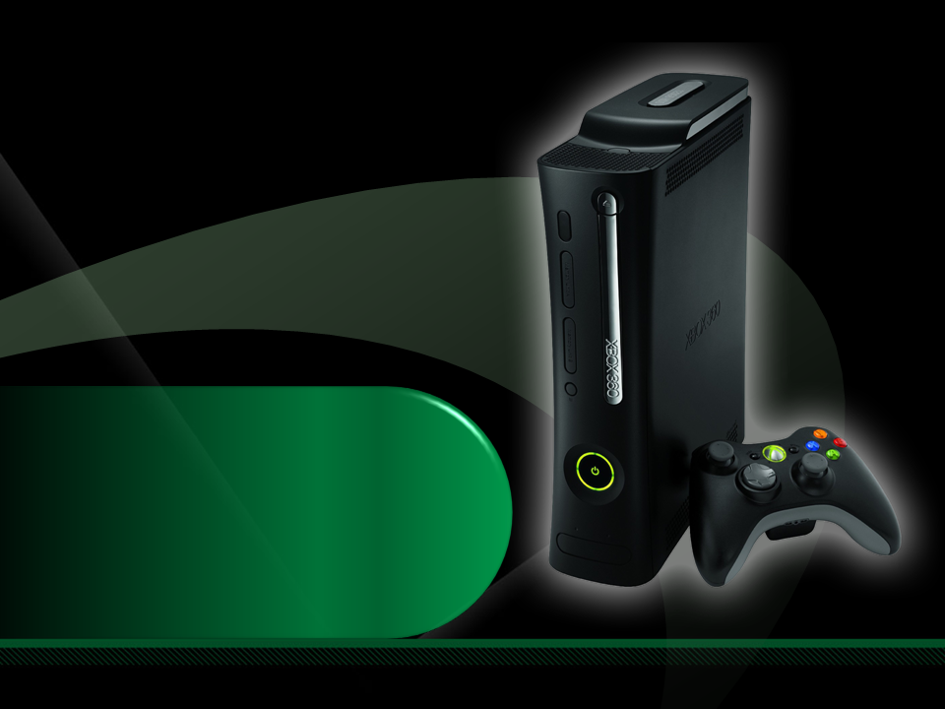
Complete an evaluation on CommNet and enter to win an Xbox 360 Elite!

Slide 34
Required Slide
© 2009 Microsoft Corporation. All rights reserved. Microsoft, Windows, Windows Vista and other product names are or may be registered trademarks and/or trademarks in the U.S. and/or other countries.
The information herein is for informational purposes only and represents the current view of Microsoft Corporation as of the date of this presentation. Because Microsoft must respond to changing market conditions, it should not be interpreted to be a commitment on the part of Microsoft, and Microsoft cannot guarantee the accuracy of any information provided after the date of this presentation. MICROSOFT MAKES NO WARRANTIES, EXPRESS, IMPLIED OR STATUTORY, AS TO THE INFORMATION IN THIS PRESENTATION.

