Slide 2
Microsoft's Future Vision of Data Warehousing
Anthony Howcroft
DW Category Manager EMEA
Microsoft
DAT205

Slide 3





The Future
Clear in the short-term
Minor changes will occur
Less clear further out
Acquisition Market Crash Accident

Slide 4



The Future as a vision
Aspirational goal
Underlies Vendors Product Roadmaps
Drives Continuous Innovation
Disruptive changes means it never looks quite like we thought….

Slide 5

Dystopia

Slide 6

Utopia

Slide 7


Our Long Term Approach To Innovation
FY10: $9.5B
TOTAL FY09 R&D INVESTMENT
FY09: $9.1B
$6.3B
$4.9B
$5.2B
SOURCE: 10K & 20K SEC Filings 12/31/08 Except Oracle 5/31/09, RIM, Sony and Nintendo 3/31/09
$2.8B
$2.8B
$.7B
$1.1B
$.4B
Nintendo
RIM
Apple
Google
Oracle
Sony
Cisco
IBM
Microsoft

Slide 8




















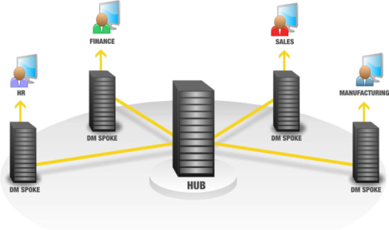










Today: A Typical Enterprise DW Environment

Slide 9
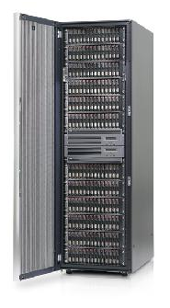

Some SQL Data Warehouses today
Big SAN
Big 64-core Server
Connected together
What’s wrong with this picture?

Slide 10
Answer: system out of balance
This server can consume 16 GB/Sec of IO, but the SAN can only deliver 2 GB/Sec
  Even when the SAN is dedicated to the SQL Data Warehouse, which it often isn’t
  Lots of disks for Random IOPS BUT
  Limited controllers → Limited IO bandwidth
System is typically IO bound
Queries are slow
Result: significant investment, not delivering performance

Slide 11
The Alternative: A Balanced System
Design a server + storage configuration that can deliver all the IO bandwidth that CPUs can consume when executing a SQL Relational DW workload
Avoid sharing storage devices among servers
Avoid overinvesting in disk drives
  Focus on scan performance, not IOPS
Layout and manage data to maximize range scan performance and minimize fragmentation

Slide 12
SQL Server Fast Track Data Warehouse
A method for designing a cost-effective, balanced system for Data Warehouse workloads
Reference hardware configurations developed in conjunction with hardware partners using this method
Best practices for data layout, loading and management
Relational Database Only – Not SSAS, IS, RS

Slide 13






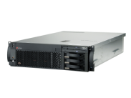


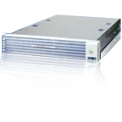






Fast Track Data Warehouse 2.0
Solution to help customers and partners accelerate their data warehouse deployments
Twelve SMP Reference Architectures
SI Solution Templates

Slide 14
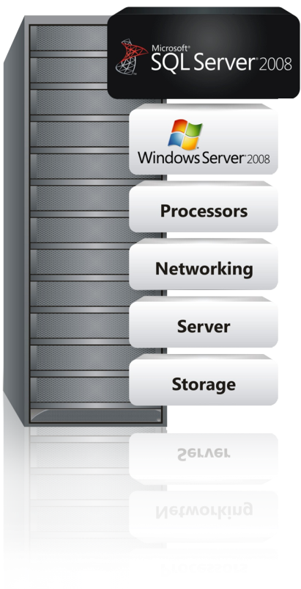
Fast Track Data Warehouse Components
Software:
SQL Server 2008 Enterprise
Windows Server 2008
Configuration guidelines:
Physical table structures
Indexes
Compression
SQL Server settings
Windows Server settings
Loading
Hardware:
Tight specifications for servers, storage and networking
‘Per core’ building block

Slide 15
Balanced System: CPU
Determine your data consumption rate, per CPU core, for your particular query mix.
Simple example: Assume TPCH query 2 is your average query
Run the query on a test server with data fully cached in memory
  Execute parallel query using MAXDOP 4
  Observe 100% CPU on 4 cores
  Time the query and observe # pages read
  Per Core Consumption = (# Logical Reads* 8K)/(CPU Time)

Slide 16
You can get more sophisticated…
Queries performing complex calculations, format conversions, multi-dimension hash joins, etc. will be more cpu-intensive
  i.e. complex queries will consume data at a slower per-core rate than simpler queries
Therefore: measure per-core data consumption for a variety of queries, and take the weighted average

Slide 17
Or you can leave it to us…
We’ve measured a mix of TPCH queries that reflect a ‘prototype’ Data Warehouse workload
Concluded that SQL Sever 2008 on current x64 cores consume ~200 MB/Sec per core on average for this workload
We use this as a basis for the published reference architectures
Your mileage will vary!

Slide 18
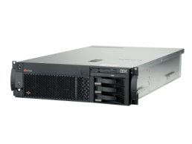
New Fast Track Data Warehouse 2.0 for IBM
2 Processor Configuration
  Server: IBM System x3650 M2 with 2 Quad-core Intel Xeon CPUs
  Storage server: IBM System Storage DS3400
  Scalability: 4 – 8 TB
4 Processor Configuration
  Server: IBM System x3850 M2 with 4 6-core Intel Xeon CPUs
  Storage server: IBM System Storage DS3400
  Scalability: 12 – 24 TB
8 processor Configuration
  Server: IBM System x3950 M2 with 8 Quad-core Intel Xeon CPUs
  Storage server: IBM System Storage DS3400
  Scalability: 16 – 32TB

Slide 19


SQL Server Fast Track Data Warehouse 2.0
HP – now on G6 Platform
2 Processor Configuration
  Server: HP ProLiant DL385 G6 with 2 6-core AMD Opteron CPUs
  Storage server: MSA Storage
  Scalability: 4 – 12 TB
4 Processor Configuration
  Server: HP ProLiant DL 585 G6 with 4 6-core AMD Opteron CPUs
  Storage server: MSA Storage
  Scalability: 12 – 24 TB
8 processor Configuration
  Server: HP ProLiant DL 785 G6 with 8 6-core AMD
  Opteron CPUs
  Storage server: MSA Storage
  Scalability: 24 – 48TB

Slide 20

SQL Server Fast Track Data Warehouse 2.0 for DELL
2 Processor Configuration
  Server: Dell Power Edge R710 with 2 Quad-core Intel Xeon processors
  8 CPU Cores
  32GB Memory
  Storage server: EMC CLARiiON AX4
  Scalability: 4 – 8 TB
4 Processor Configuration
  Server: Dell Power Edge R900 with 4 6-core Intel Xeon processors
  24 CPU Cores
  96 GB Memory
  Storage server: EMC CLARiiON AX4
  Scalability: 12 – 24 TB

Slide 21

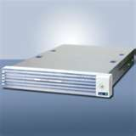
SQL Server Fast Track 2.0 Data Warehouse for BULL
2 Processor Configuration
  Server: Bull Novascale R460 E2 with 2 Quad-core Intel Xeon processors
  Storage server: EMC CLARiiON AX4
  Scalability: 4 – 8 TB
4 Processor Configuration
  Server: Bull Novascale R480 E1 with 4 6-core Intel Xeon processors
  Storage server: EMC CLARiiON AX4
  Scalability: 12 – 24 TB
Also included in the Rack:
  SQL Server Analysis Services
  SQL Server Reporting Services
  SQL Server Integration Services
  HA Server
  Administration Server (with Management Studio, Backup Server)

Slide 22
Fast Track Case Study - Environment
Current Environment
  Teradata 4-node (5450 model) with 6TB of user data
  BI: Business Objects
  ETL: Informatica and BTEQ scripts
Proposed Microsoft Platform
  SQL Server Fast Track Data Warehouse
  HP DL580 Server - 4 Quadcore Processors (16 core total)
  256 GB Memory
  SAN Storage: MSA 2000 (Qty 4) – 8TB User Data Capacity
  BI: Business Objects
  ETL: SQL Server and SSIS

Slide 23
Fast Track Case Study – Results
 | Teradata | SQL Server Fast Track DW | Comparison
Loading Subject Area 1 | 5:10:21 total time | 0:51:31 total time | R 6x faster
Loading Subject Area 2 | 4:36:08 total time | 1:50.01 total time | R 2.5x faster
Query times Subject Area 1 | 3:03 avg query time (using 9 benchmark queries) | 0:15 avg query time (using 9 benchmark queries) | R 12x faster
Query times Subject Area 2 | 56:44 avg query time (using 4 benchmark queries) | 8:09 avg query time (using 4 benchmark queries) | R 7x faster

Slide 24
Fast Track Case Study - Pricing
Fast Track Pricing* (at List)
  Hardware (8TB capacity) $152,500
  SQL Server – 2 options
    Server CAL (100) License $26,119
        Total SW & HW* $178, 619
        Price per TB (8TB) – CAL $22,327
  Expand to 16 TB
    Additional Hardware* $37,016
      Total Price w/CAL license $215,635
        Price per TB (16TB) – CAL $13,477
*NOTE: The above calculation is based on Microsoft estimated retail price for SQL Server 2008 Enterprise, Windows Server 2003, and published hardware prices available through participating resellers as of May 2009. Actual reseller prices may vary.

Slide 25





Fast Track Data Warehouse Timeline
Fast Track vNext
Enterprise ETL Services
Star Join Query Optimizations
Data Compression
Partitioned table parallelism
Fast Track Data Warehouse 2.0
Future Partners to create new Validated Reference Architectures with Test Harness
Incorporates SQL vNext
New Reference Architectures from IBM
Updated Configurations from HP, Dell and Bull
EMC as a Service Partner for Fast Track
2008
2009
2010
Beyond
Fast Track Data Warehouse
Test Harness for Partners
Microsoft to create Test Harness for validation of new Fast Track configurations
NEC to validate new Reference Architectures
DW Reference Architectures
Predictable performance at low cost
Faster time to solution
?
?
?

Slide 26






Fast Track Data Warehouse Benefits
Appliance-like time to value
Reduces DBA effort; fewer indexes,
much higher level of sequential I/O
Choice of HW Platforms
Dell, HP, Bull, EMC and IBM – more in future
Low TCO Through
Commodity Hardware and value pricing; Lower storage costs.
High Scale
New reference architectures scale up to 48TB (assuming 2.5x compression)
Reduced Risk
Validated by Microsoft; better choice of hardware; application of Best Practice

Slide 27

Formerly known as Project “Madison”
Scale-Out of SQL Server: 10s TB ►100s TB ►PB
Reference Architectures from HP, Bull, EMC, Dell, IBM
Low cost of ownership
Simplified deployment and maintenance via appliance model
Integration with existing SQL Server 2008 data warehouses via Hub & Spoke Architecture
Available 1HCY10
Preview program running

Slide 28
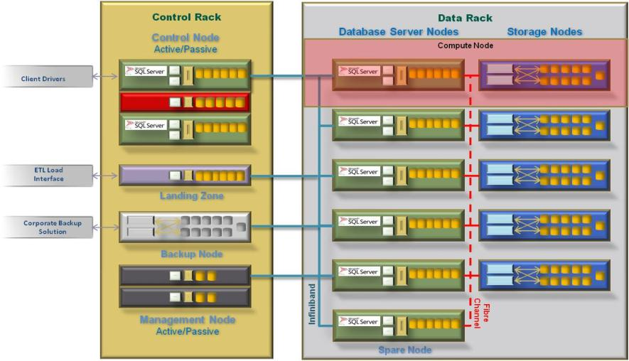
SQL Server Parallel Data Warehouse Architecture At A Glance

Slide 29
Case Study: First Premier Bankcard
Existing
Environment
Current
Challenges
Madison
Highlights
Hardware
16 CPU HP 8620 Itanium
Hitachi Storage 27TB Raw SATA 21 LUNS
Software
Windows 2003 SP2
SQLServer 2008
SSIS/SSRS
Data Warehouse
18 Terabytes
Star Schema
80 Fact Tables
500 + Dimensions
Data Load Speeds
Analytic Capacity
Analytic Speed
Mixed Workload
Total Cost of Ownership
Improved by 300%
30TB/160 Cores
Query Speeds 70X Improvement
Concurrency Mixed Workload
TCO Lowered by 50%

Slide 30
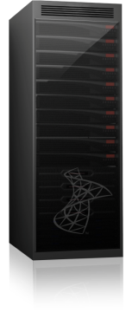
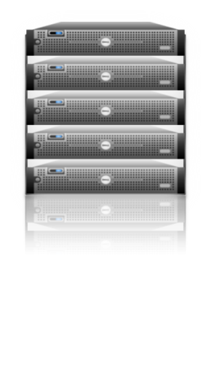








Hub and Spoke – Flexible Business Alignment
Parallel database copy technology enables rapid data integration and consistency between hub and spokes
Support user groups with very different SLAs; hot, warm and cold data; different requirements on data loading, etc.
Create SQL Server 2008, Fast Track Data Warehouse, and SQL Server Analysis Services spokes
A Hub and Spoke solution gives you the flexibility to add/change diverse workloads/user groups, while maintaining data consistency across the enterprise
Departmental data marts enable mixed workloads, but make it difficult to consolidate information across the enterprise
EDW provides “single version of truth” but makes it difficult to support mixed workloads and multiple user groups, each requiring SLAs

Slide 31
Innovations
SSD / Flash
Columnar in-memory databases
Natural language UI
Task-oriented search
Cloud
Virtualisation
Commodity RFID
?

Slide 32






Microsoft BI Vision
BI for Everyone
BI for a
Few

Slide 33













Information Platform Vision
Empowered IT
Pervasive Insight
Dynamic Development
Mission Critical Platform
Desktop & Mobile
Server & Datacenter
Cloud

Slide 34


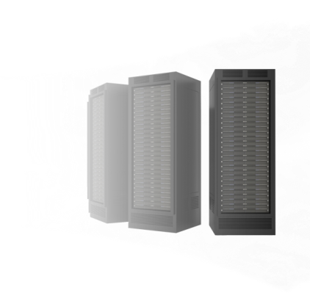












Rethinking On-Premises
Traditional
Datacenter
Virtualized
Datacenter
Private
Cloud
Public
Cloud
Utilization
Increases to >50%
Management
Costs Decrease
Management Costs
Decrease Significantly
Scale-out
Development Expense
Capacity on Demand
Global Reach

Slide 35
Relevant Information is Everywhere
IM/chat
Spreadsheets
Scorecards
Meetings
Scorecards
Newspapers
Spreadsheets
IM/chat
Financial reports
Newspapers
Financial reports
Documents
Meetings
Documents
Email
Email
Portals
Slide decks
Portals
Slide decks
Business books
Webcasts
Business books
Webcasts
Presentations
RSS feeds
Presentations
Project plans
Project plans
Intranet
Intranet
RSS feeds
Blogs
Dashboards
Dashboards
Magazines
Analytic applications
Analytic applications
Magazines
Internet
Television reports
Television reports
Blogs
Internet
Charts and graphs
Charts and graphs

Slide 36


Managed Self-Service BI
Power-user IW
IT Professional
BI solution authors
Access to good data
Better experience
BI solution governors
Oversight on data
Insight into activity

Slide 37
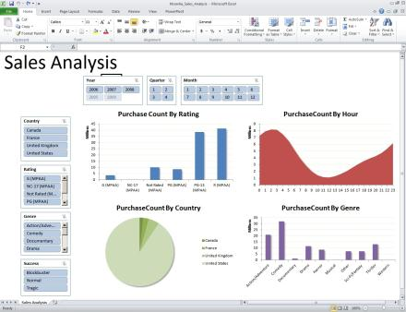
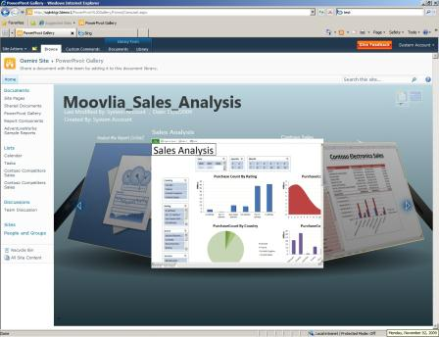



Familiar Tools, New Experiences
PowerPivot for Excel
PowerPivot for SharePoint

Slide 38

Future Productivity
“The vision is not an attempt to predict the future, but an attempt to articulate the kinds of software experiences we want to be able to deliver to our customers in the future.”
Real-time language translation
Low-cost, multi-touch displays
E-Ink
Natural user interfaces
Dynamic data visualizations
Semantic meta-data
Location-based services
Sensor networks
Contextual information retrieval
Augmented reality
Seamless and secure connections
Rich and natural expressions
Precise and anticipative insights
http://www.microsoft.com/video/en/us/details/e7728af1-3fe4-4e25-a907-3dbf689fe11a

Slide 39
Next Steps
Visit www.microsoft.com/fasttrack
Visit www.microsoft.com/madison
Visit the SQL Server DW Portal on TechNet
  http://technet.microsoft.com/en-gb/sqlserver/dd421879.aspx
  Download 4 new white papers on EDW architecture
Attend the DAT206 Madison Deep Dive session

Slide 40




Resources
www.microsoft.com/teched
  Sessions On-Demand & Community
www.microsoft.com/learning
Microsoft Certification & Training Resources
http://microsoft.com/technet
  Resources for IT Professionals
http://microsoft.com/msdn
  Resources for Developers

Slide 41
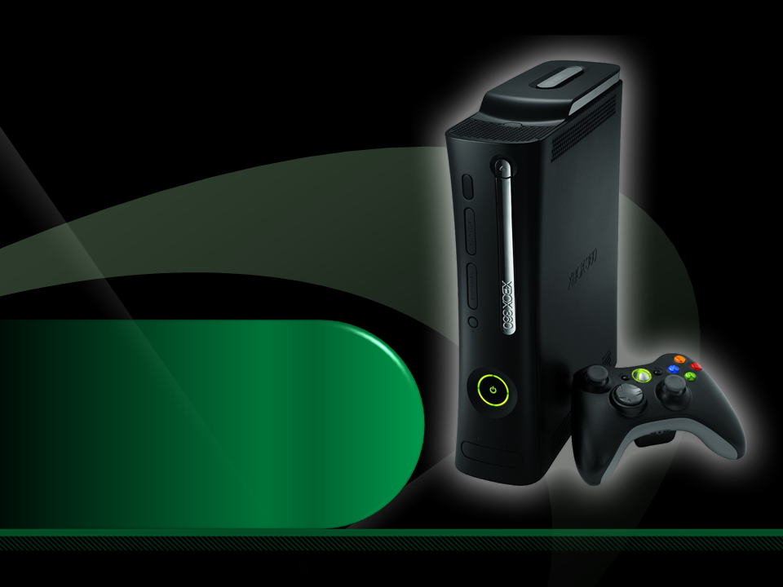
Complete an evaluation on CommNet and enter to win an Xbox 360 Elite!

Slide 42

Required Slide
© 2009 Microsoft Corporation. All rights reserved. Microsoft, Windows, Windows Vista and other product names are or may be registered trademarks and/or trademarks in the U.S. and/or other countries.
The information herein is for informational purposes only and represents the current view of Microsoft Corporation as of the date of this presentation. Because Microsoft must respond to changing market conditions, it should not be interpreted to be a commitment on the part of Microsoft, and Microsoft cannot guarantee the accuracy of any information provided after the date of this presentation. MICROSOFT MAKES NO WARRANTIES, EXPRESS, IMPLIED OR STATUTORY, AS TO THE INFORMATION IN THIS PRESENTATION.

