Slide 1
Top 10 Best Practices for Microsoft SQL Server 2008 Analysis Services
Markus Raatz
General Manager
ixto GmbH
Session Code: DAT302

Slide 2
A Brief History Of Best Practices
For Analysis Services 2005, design hints were hard to find:
Project REAL
Microsoft Whitepapers
Several blogs: Chris Webb, Mosha Pasumansky, Marco Russo, Darren Gosbell, Vidas Matelis, many many more
Design best practices are built into Analysis Services 2008:
AMO Design Warnings are part of the object model for creating and modifying cubes
Reference Implementation, End-to-End, At Scale, Lots of Users
http://www.microsoft.com/SQL/BI/ProjectREAL

Slide 3
Best Practices in Detail Some statistics on the 48 design warnings

Slide 4
User-Defined Hierarchies: Create attribute relationships between the levels
Unfavorable (Default!):
Beneficial:
Day
Day
Month
Month
Quarter
Quarter
Year
Year
1

Slide 5
User-Defined Hierarchies: Avoid hierarchies without attribute relationships
“Natural hierarchies” should always be supported by 1:n attribute relationships between every pair of adjacent levels
“Reporting hierarchies” are built on the fly during queries
Customers by Geography
Customers by Demographics
Country
Marital
State
Gender
City
Customer
Customer
1

Slide 6
Attributes and Attribute Relationships: Define attribute relationships as “Rigid”
Rigid v/s flexible relationships (default is flexible)
Customer -> City, Customer -> PhoneNo are flexible
Customer -> BirthDate, City -> State are rigid
When you ProcessUpdate a dimension with flexible attribute relationships, all aggregations are dropped and must be recreated using
ProcessFull
ProcessIndexes
Process Affected Objects
Lazy Processing
2

Slide 7
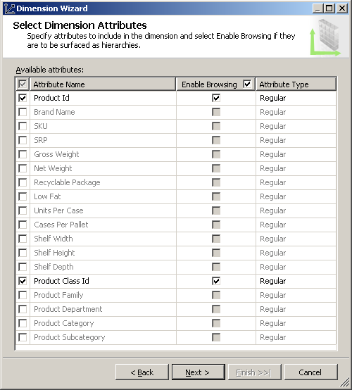
Attributes and Attribute Relationships: Use numeric key columns for attributes
Makes your dimensions smaller and faster to query
Will also speed up processing!
Create Attributes Sparingly
See the modified default behavior of the dimension wizard
3

Slide 8
Best Practices Hints for Attribute Relationships
demo
Markus Raatz
General Manager
ixto GmbH

Slide 9
Dimensions: No more than 3 parent-child dimensions per database
Employee | Manager
The Board | <None>
SteveB | The Board
BillG | The Board
JimAll | SteveB
PaulMa | SteveB
BobMu | SteveB
TodN | PaulMa
DavidV | PaulMa
PaulFle | DavidV
Parent-child dimensions don‘t use aggregations on intermediate levels
Custom rollups, unary operators and semi-additive measures add to the complexity
BOL: „to prevent poor query performance, those parent-child dimensions should only be used when necessary“
4

Slide 10
Dimensions: Unary operators and custom rollups
+
Profit
Account Dimension
ID | Name | Parent | Op | Rollup
1 | Profit | (null) | +
2 | Income | 1 | +
3 | Expense | 1 | -
4 | Taxes | 1 | -
5 | Headcount | (null) | ~ | [Account].&[HC]
+
Income
-
Expense
-
Taxes
~
Headcount
Unary operators can also be *, / and any numerical value
Custom member formulas can contain any MDX statement
4

Slide 11
Dimensions: Avoid large parent-child dimensions
Parent-child dimensions with more than 500.000 members are considered large
Normalize them, create attributes and hierarchies
If your client application supports it, create ragged hierarchies using the HideMemberIf-property of a level in the hierarchy
No states!
5

Slide 12
ROLAP and MOLAP Storage: Don’t use ROLAP together with unary operators or custom rollups
MOLAP is much faster than ROLAP in any case
Main reason: data compression and indexing
Caveat: requires cube processing
ROLAP actually creates a SQL query against the source database
Enables “real-time OLAP”
Users can modify custom member formulas immediately
Even with medium size data sets, it’s just too slow!
6

Slide 13
Parent-Child Dimensions with the Works
demo
Markus Raatz
General Manager
ixto GmbH

Slide 14
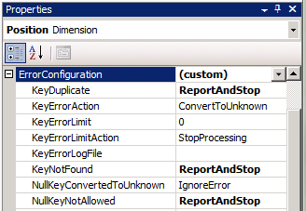
Error Handling: Do not ignore duplicate key errors
Duplicate, null, incorrect or missing keys are detected during processing
Specify the ErrorConfiguration of the object in the project rather than in the processing task
Default for KeyDuplicate is IgnoreError
Use this only during prototyping!
7

Slide 15
Measures and Measure Groups: Avoid creating identical measure groups, restrict to 15
Mind the design alternatives:
one cube for all, with many measure groups, or
one cube per measure group
connected via linked measure groups?
Obvious reason for “split cubes”, besides performance: Standard Edition doesn’t have perspectives!
Sales
Sales
Pur-chase
Pro-duction
Purchase
Production
„split cubes“
Company Cube
„Virtual“ Company Cube
8

Slide 16
Cube Partitions: Too many partitions, not enough partitions
A partition should have between 2 million and 20 million rows
A partition should be between 50 MB and 250 MB in size
Near real-time demands might require partitions that are often too small!
2007
2008
Week 48
Week 52
Week 49
Week 51
Week 2
Week 4
Week 50
Q3
Week 1
Week 3
Week 5
Q2
…
…
Q1
9

Slide 17
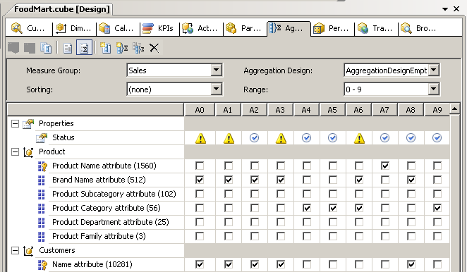
Aggregations: Design aggregations for partitions larger than 500,000 rows
The default is 0% aggregations
Don’t spend too much time in the new Aggregations Designer
Check if your aggregations are really being used, in SQL Server Profiler
10

Slide 18
Summary
Watch out for the „blue sqiggly“!
Open your SSAS 2005 projects in BIDS 2008
Don‘t take it too seriously….
Analysis Services design hints don‘t cover everything:
MDX calculations
Hardware layout and configuration
AggregationUsage for attributes
Better keep reading blogs and good books!

Slide 19
question & answer

Slide 20
Resources
Required Slide
Speakers,
TechEd 2009 is not producing
a DVD. Please announce that
attendees can access session
recordings at TechEd Online.
www.microsoft.com/teched
Sessions On-Demand & Community
www.microsoft.com/learning
Microsoft Certification & Training Resources
http://microsoft.com/technet
Resources for IT Professionals
http://microsoft.com/msdn
Resources for Developers

Slide 21
Complete an evaluation on CommNet and enter to win an Xbox 360 Elite!

Slide 22
Required Slide
© 2009 Microsoft Corporation. All rights reserved. Microsoft, Windows, Windows Vista and other product names are or may be registered trademarks and/or trademarks in the U.S. and/or other countries.
The information herein is for informational purposes only and represents the current view of Microsoft Corporation as of the date of this presentation. Because Microsoft must respond to changing market conditions, it should not be interpreted to be a commitment on the part of Microsoft, and Microsoft cannot guarantee the accuracy of any information provided after the date of this presentation. MICROSOFT MAKES NO WARRANTIES, EXPRESS, IMPLIED OR STATUTORY, AS TO THE INFORMATION IN THIS PRESENTATION.

