Slide 2
Microsoft SQL Server 2008 Reporting Services Best Practices
Chris Baldwin
Program Manager
Microsoft Corporation
Session Code: DAT306

Slide 3
Session Goals
Present a broad view of the major areas of SQL Server 2008 Reporting Services
Educate on the best practices and lessons learned for each area
Provide information to enable you to do things better!

Slide 4
Agenda
Reporting Services 2008 architecture
Best practices
  Server deployment
  Report design and layout
  Data visualization

Slide 5












Reporting Services Architecture
SharePoint
Report Viewer
SSMS
Report Viewer
Web Part
Web Service Proxy
SharePoint
Databases
Data Sources
Web Services & URL Access
Report Server
Security Services
Report Engine
Output Formats
Data Processing
Security
Delivery Targets
(E-mail, SharePoint, Custom)
Rendering
Scheduling & Delivery
Custom
Visualization
Custom Report Item
RDCE
Customized RDL
SQL Server Catalog

Slide 6
Best Practices
Server & Deployment

Slide 7
Backup/Restore
Importance | Items to Backup
Critical | Report Server Databases Symmetric Key SharePoint Databases Custom Extensions
Important | Configuration Files RSTempDB IIS Settings for RS 2005
Nice to Have | RDLs SSL Certificates
Report Server Databases
  Standard backup/restore SQL database techniques
  Do not need the content of RSTempDB
  Don’t forget to backup your SharePoint databases as well!
  Ensure RSExec Role is created when restoring DBs

Slide 8
Backup/Restore
Configuration files
  Recover by COPYING settings into default .config files
  Use RS Configuration Tool or WMI to recover:
    RSDB connection information (stored encrypted)
    URL & SSL Settings (stored also in HTTP.SYS)
Symmetric Key
  Encrypts report data source settings
  Use Report Services Configuration Tool or rskeymgmt.exe to backup/restore
  Keep backup in secure place and do not forget the password!
Rsreportserver.config Rswebapplication.config Reportingservicesservice.exe.config Web.config (for RS & RM) | Rssvrpolicy.config Rsmgrpolicy.config Machine.config

Slide 9
Security
Data and Data Sources
Start with focusing on data security
  Do not expose sensitive data in data centers
  Expose the minimum set of data required
  Audit data access
Report data sources
  Be careful which credentials are stored in report data sources
    Use read-only accounts!
    We wary of unnecessary use of Windows Integrated
    Review credentials options to ensure report authors are not abusing user’s credentials
  Use Shared Data Sources
    Control connection strings & credentials
    Minimize management overhead
Data level security
  Use Kerberos delegation if you need end to end data security
  Use User!UserId in reports to identify the user within a report
  Parameters are not a security mechanism!

Slide 10
Monitoring & Planning
Capacity Planning & Optimization
Understand your scenarios and reports
  Scenarios are defined by user personas & usage patterns
  Reports are either test reports or actual reports
  Tests should isolate Report Server from other systems
Reports can overload underlying data source
  Determine which reports are most impactful
  Optimize these reports – retrieve only required data
Use appropriate execution options for reports
  Reports run “live” by default
  Enable caching for frequently run reports
  Execution Snapshots are often overlooked
    Can be scheduled to run in off peak hours
Execute Performance Tests – before production!
  Using Visual Studio 2005 to Perform Load Testing on a SQL Server 2005 Reporting Services Report Server
  Database tools (SQL Profiler, sqlcmd scripts, SQL Scaler, etc.)
  Synthetic test tools (e.g. VSTS, Precise Insight, etc.)

Slide 11
Monitoring & Planning
Execution Log Reporting
Report Catalog (RSDB) contains ExecutionLog and ExecutionLog2
  Which reports are long running?
  Subscriptions/Interactive?
  Live Data or Snapshots?
  Balanced across scale out?
  Patterns for a report
  Health of Reports
Server Management Report Samples
  Populates separate tables / database
  Provides SSIS package to extract and populate data
  Follow instructions to setup schema and create job
  Provides three reports for you to view report activity

Slide 12
Deployment Topology
Considerations
Most common deployment is One-Box
  SSRS and SQL Server Relational Engine
  Great for developing and building something quick (and budget!)
    Good performance & scale if not mission critical
  But not so good when it comes to production deployments
Test environment should be as close to production as possible
  Replicate security, configuration, hardware, software, network
  Clustering / High availability scenarios
Emphasize the need for performance testing
  Identify bottlenecks (e.g. Report Catalog, large drop downs, large reports, etc.)
  Do Massive Data volume testing
  Using Visual Studio 2005 to Perform Load Testing on a SQL Server 2005 Reporting Services Report Server
Protect your underlying data sources!
  Reports can cause significant load on report data sources
  Planning for reporting load up front will save you time

Slide 13
Best Practices
Report Layout & Design

Slide 14
Agenda
Understanding Tablix
Report performance analysis and optimizations

Slide 15
How to think about a tablix
Table
Matrix
Sales Person | Sales
Canada | 5,022
Saraiva, Jose | 3,074
Vargas, Garrett | 1,949
Southwest | 9,404
Ito, Shu | 3,416
Mitchell, Linda | 5,988
Total | 14,426
Territory | Sales Person | 2003 | 2004 | Total
Canada | Saraiva, Jose | 1,838 | 1,236 | 3,074
 | Vargas, Garrett | 1,378 | 570 | 1,949
 | Total | 3,216 | 1,807 | 5,022
Southwest | Ito, Shu | 2,339 | 1,076 | 3,416
 | Mitchell, Linda | 4,102 | 1,886 | 5,988
 | Total | 6,442 | 2,962 | 9,404
Total |  | 9,657 | 4,769 | 14,426

Slide 16
How to think about a tablix
Sales Person | Sales
Canada | 5,022
Saraiva, Jose | 3,074
Vargas, Garrett | 1,949
Southwest | 9,404
Ito, Shu | 3,416
Mitchell, Linda | 5,988
Total | 14,426
Header row
Group header row
Detail row
Footer row

Slide 17
How to think about a tablix
Sales Person | Sales
Canada | 5,022
Saraiva, Jose | 3,074
Vargas, Garrett | 1,949
Southwest | 9,404
Ito, Shu | 3,416
Mitchell, Linda | 5,988
Total | 14,426
Detail row repeats
This is the Sales Person group.
Groups
SalesPerson

Slide 18
How to think about a tablix
Sales Person | Sales
Canada | 5,022
Saraiva, Jose | 3,074
Vargas, Garrett | 1,949
Southwest | 9,404
Ito, Shu | 3,416
Mitchell, Linda | 5,988
Total | 14,426
Group header row repeats
This is the Territory group. It is the parent of the SalesPerson group.
Indent = child group
Groups
Territory
SalesPerson
SalesPerson

Slide 19
How to think about a tablix
X
Sales Person | Sales
Canada | 5,022
Saraiva, Jose | 3,074
Vargas, Garrett | 1,949
Southwest | 9,404
Ito, Shu | 3,416
Mitchell, Linda | 5,988
Total | 14,426
Header row
Header and footer rows do not repeat. Why?
Because they’re not part of a group!
X
Footer row

Slide 20
How to think about a tablix
Remember this:
A tablix is a bunch of rows and columns.
Some rows/columns belong to groups.
Some don’t.
Groups can repeat.
X
Sales Person | Sales
Canada | 5,022
Saraiva, Jose | 3,074
Vargas, Garrett | 1,949
Southwest | 9,404
Ito, Shu | 3,416
Mitchell, Linda | 5,988
Total | 14,426
X

Slide 21
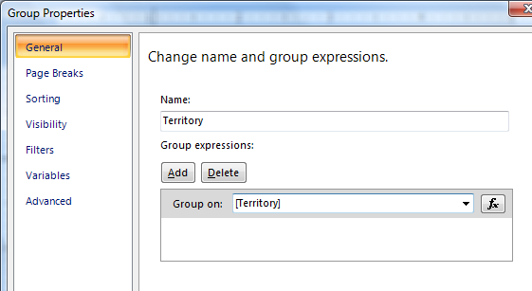
How to think about a tablix
Why does a “group” repeat?
Sales Person | Sales
Canada | 5,022
Saraiva, Jose | 3,074
Vargas, Garrett | 1,949
Southwest | 9,404
Ito, Shu | 3,416
Mitchell, Linda | 5,988
Total | 14,426
Territory has 2 values, so group occurs twice
It groups the underlying data based on the group expression, and then repeats itself once for each value.

Slide 22
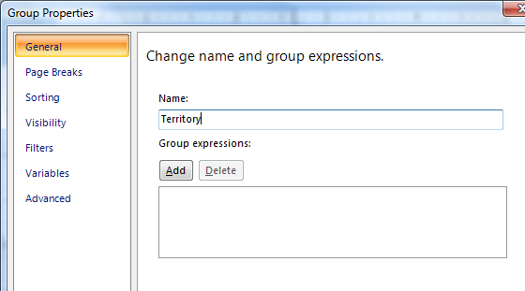
How to think about a tablix
Why does a “group” repeat?
Sales Person | Sales
Canada | 5,022
Saraiva, Jose | 3,074
Vargas, Garrett | 1,949
Southwest | 9,404
Ito, Shu | 3,416
Mitchell, Linda | 5,988
Total | 14,426
X
If there is no group expression, the group repeats once for each row in the underlying data.
This is called showing “detail” data.

Slide 23
How to think about a tablix
So, what about content?
Sales Person | Sales
Canada | 5,022
Saraiva, Jose | 3,074
Vargas, Garrett | 1,949
Southwest | 9,404
Ito, Shu | 3,416
Mitchell, Linda | 5,988
Total | 14,426
Some cells just have labels in them.

Slide 24
How to think about a tablix
Sales Person | Sales
Canada | 5,022
Saraiva, Jose | 3,074
Vargas, Garrett | 1,949
Southwest | 9,404
Ito, Shu | 3,416
Mitchell, Linda | 5,988
Total | 14,426
Some cells show data.
They do this because the text box value is a field reference.
Examples:
[Territory]
[SalesPerson]

Slide 25
How to think about a tablix
This is the SUM of all the Sales values where Territory = “Canada”
Sales Person | Sales
Canada | 5,022
Saraiva, Jose | 3,074
Vargas, Garrett | 1,949
Southwest | 9,404
Ito, Shu | 3,416
Mitchell, Linda | 5,988
Total | 14,426
These are subtotals. Subtotals are calculated.
How?
Every group defines a scope. A scope is a subset of the underlying data.
A subtotal adds all the values for a field within a particular scope.

Slide 26
How to think about a tablix
Sales Person | Sales
Canada | 5,022
Saraiva, Jose | 3,074
Vargas, Garrett | 1,949
Southwest | 9,404
Ito, Shu | 3,416
Mitchell, Linda | 5,988
Total | 14,426
QUIZ: Is this number calculated by adding all the values in the column above it?
ANSWER: No. It’s the sum of all the values in its scope.
The sum is always calculated from the underlying data. It is independent of what may or may not be visible elsewhere in the tablix.
We’ll see more of this later…

Slide 27
How to think about a tablix
Sales Person | Sales
[Territory] | [SUM(Sales)]
[SalesPerson] | [SUM(Sales)]
[SalesPerson] | [SUM(Sales)]
[Territory] | [SUM(Sales)]
[SalesPerson] | [SUM(Sales)]
[SalesPerson] | [SUM(Sales)]
Total | [SUM(Sales)]
This view shows the actual field references and calculations

Slide 28
How to think about a tablix
Sales Person | Sales
[Territory] | [SUM(Sales)]
[SalesPerson] | [SUM(Sales)]
This is the design-time view of a table.
[SalesPerson] | [SUM(Sales)]
[Territory] | [SUM(Sales)]
[SalesPerson] | [SUM(Sales)]
[SalesPerson] | [SUM(Sales)]
Total | [SUM(Sales)]
Let’s simplify…

Slide 29
How to think about a tablix
Layout
Sales Person | Sales
[Territory] | [SUM(Sales)]
[SalesPerson] | [SUM(Sales)]
Total | [SUM(Sales)]
Report!
Sales Person | Sales
Canada | 5,022
Saraiva, Jose | 3,074
Vargas, Garrett | 1,949
Southwest | 9,404
Ito, Shu | 3,416
Mitchell, Linda | 5,988
Total | 14,426
Data
Territory | Sales Person | Sales
Canada | Saraiva, Jose | 3,074
Canada | Vargas, Garrett | 1,949
Southwest | Ito, Shu | 3,416
Southwest | Mitchell, Linda | 5,988

Slide 30
How to think about a tablix
What did we learn?
A tablix is a bunch of rows and columns.
    Some belong to groups.
    Some don’t.
Groups can repeat…
    Once for each value of the group expression, or
    Once for each row in the underlying data
Content can be labels, data, or calculations.
A group defines a scope, or subset of the data.
A subtotal is a calculation that adds all the values in a scope.

Slide 31
How to think about a tablix
Table
Matrix
Sales Person | Sales
Canada | 5,022
Saraiva, Jose | 3,074
Vargas, Garrett | 1,949
Southwest | 9,404
Shirts | 3,416
Helmets | 5,988
Total | 14,426
Territory | Sales Person | 2003 | 2004 | Total
Canada | Saraiva, Jose | 1,838 | 1,236 | 3,074
 | Vargas, Garrett | 1,378 | 570 | 1,949
 | Total | 3,216 | 1,807 | 5,022
Southwest | Ito, Shu | 2,339 | 1,076 | 3,416
 | Mitchell, Linda | 4,102 | 1,886 | 5,988
 | Total | 6,442 | 2,962 | 9,404
Total |  | 9,657 | 4,769 | 14,426

Slide 32
How to think about a tablix
(no column area)
Matrix
Column grouping area
Corner
Sales Person | Sales
Canada | 5,022
Saraiva, Jose | 3,074
Vargas, Garrett | 1,949
Southwest | 9,404
Shirts | 3,416
Helmets | 5,988
Total | 14,426
Body
Row
grouping area
Body
(required)
QUIZ: Which tablix area(s) does a “table” use?
ANSWER: Body (+ row grouping area sometimes)

Slide 33
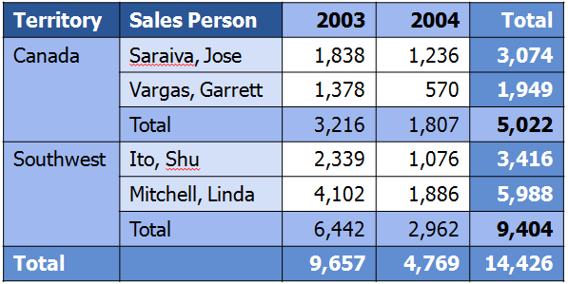
How to think about a tablix
Footer column?
Header row
Group footer row
Footer row

Slide 34
How to think about a tablix
Now we have groups that repeat on BOTH axes
Row Groups
Column Groups
Territory
Year
SalesPerson

Slide 35
How to think about a tablix
X
X
These don’t repeat
X
Row Groups
Column Groups
Territory
Year
SalesPerson

Slide 36
How to think about a tablix
These don’t repeat within the Territory group
X
X
Row Groups
Column Groups
Territory
Year
SalesPerson

Slide 37
How to think about a tablix
What’s special about the grouping areas?
Grouping cells that span the rows generated by a child group
* This is called the “blocked” look.
Row Groups
Column Groups
Territory
Year
SalesPerson

Slide 38
How to think about a tablix
Territory | Sales Person | [Year] | [Year] | Total
[Territory] | [SalesPerson] | [SUM(S | [SUM(S | [SUM(S
 | [SalesPerson] | [SUM(S | [SUM(S | [SUM(S
 | Total | [SUM(S | [SUM(S | [SUM(S
[Territory] | [SalesPerson] | [SUM(S | [SUM(S | [SUM(S
 | [SalesPerson] | [SUM(S | [SUM(S | [SUM(S
 | Total | [SUM(S | [SUM(S | [SUM(S
Total |  | [SUM(S | [SUM(S | [SUM(S
Field references and calculations

Slide 39
How to think about a tablix
Territory | Sales Person | [Year]
[Territory] | [SalesPerson] | [SUM(S
[Year]
[SUM(S
[SUM(S
[SUM(S
Total
[SUM(S
[SalesPerson] | [SUM(S | [SUM(S | [SUM(S
Simplified…
 | Total | [SUM(S
[SUM(S
[Territory] | [SalesPerson] | [SUM(S | [SUM(S | [SUM(S
 | Total | [SUM(S | [SUM(S | [SUM(S
[SalesPerson] | [SUM(S | [SUM(S | [SUM(S
Total |  | [SUM(S
[SUM(S

Slide 40
How to think about a tablix
Territory | Sales Person | [Year] | Total
[Territory] | [SalesPerson] | [SUM(S | [SUM(S
 | Total | [SUM(S | [SUM(S
Total |  | [SUM(S | [SUM(S
This is the design-time view of a matrix
Row Groups
Column Groups
Territory
Year
SalesPerson

Slide 41
How to think about a tablix
What did we learn?
A “matrix” uses all four tablix areas: the body, the row and column grouping areas, and the corner.
A tablix can have groups on both axes.
Grouping cells span the rows generated by a child group.

Slide 42
Subreport Performance
Subreports are convenient for reuse, but bad for performance when there are many subreport instances at runtime
Performance:
Avoid subreports, unless there is no other way to achieve join across different data sources

Slide 43
Subreport Redesign
Move subreport layout up into main report
Merge main report and sub report datasets
  Easiest case: duplicate data already retrieved
  Restructure queries or use stored procedure to merge data
  Heterogeneous data source joins:
    If on same SQL Server instance, use three-part name (catalog.schema.objectname) to execute queries in other databases
    Consider linked server feature
    Consider open row set functionality
Also consider Drillthrough Reports or Nesting of Data Regions if applicable

Slide 44
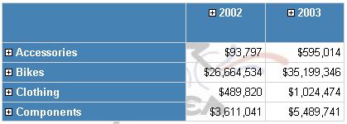
Large Drill-Down Reports
Very few users drill down in every hierarchy
Very few users drill down to the innermost level in more than one path
Underlying Dataset likely retrieves detail data with many rows
But most users view fraction of data space only

Slide 45
Drill-Down Reports Redesign
Runtime analysis in ExecutionLog2
  Identify reports with Toggle interactivity events
  For those reports check RowCount and resource consumption
Redesign report:
  Initial report should only retrieve pre-aggregated data for one or two levels of drill-down
  Create conditional, parameterized drillthrough actions on innermost drill-down level of initial report
  Drillthrough report has original detail data set, but now parameterized to only retrieve subset of data based on drilldown path (e.g. Time = 2008 Q2, Product = Bikes)

Slide 46
Report Optimization Tips & Tricks
Recursive Hierarchies
  Don‘t set Parent property on Group if you just want regular nested groupings!
  More info on how to use recursive hierarchies
Subreports, Drill-Down Reports
  See earlier discussion
  Keep number of subreport instances low
Images
  Currently embedded images fastest

Slide 47
Report Optimization Tips & Tricks
Dataset Sizes and Row Counts
  Perform sorting / filtering / pre-aggregation already in database
  Don‘t retrieve unneccessary data
Use default parallel dataset execution
  Force sequential execution only if needed (e.g. limiting number of parallel connections to data source)
  More info on dataset execution order

Slide 48
Report Optimization Tips & Tricks
Page Header/Footer
  Referencing total page count or complex expressions requires full pagination to show first page
On-Demand Expression Evaluation
  Textboxes, styles, etc. are evaluated at the time the page is rendered
  Cache custom assembly or external values (e.g. Exchange rate retrieved via web service call) in report and group variables
  More info:
    On-Demand Processing
    Group Variables

Slide 49
Report Optimization Tips & Tricks
Post-Sort Aggregates
  Ex: Previous, RunningValue, First, Last
  More expensive to calculate than other aggregates
Interactive Sort
  Has a performance impact, particularly when sorting many group instances or detail instances
Use default parallel dataset execution
  Force sequential execution only if needed (e.g. limiting number of parallel connections to data source)
  More info on dataset execution order

Slide 50
Best Practices
Data Visualization

Slide 51
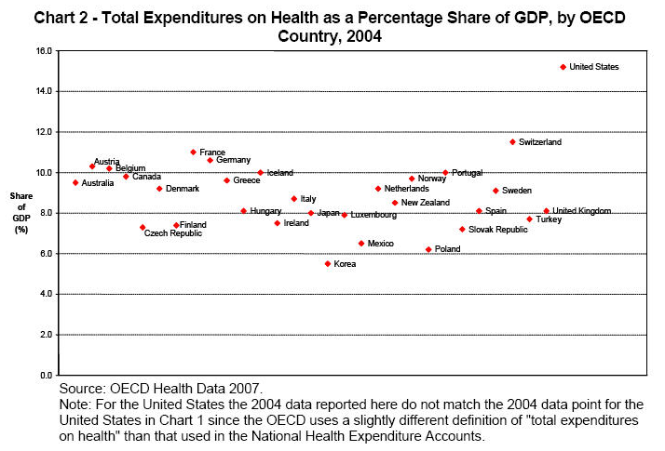
Examples of Poor Visualizations

Slide 52
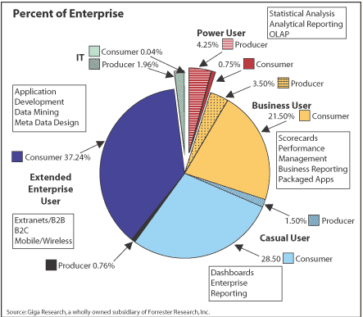
Examples of Poor Visualizations

Slide 53
The Value of Data Visualization
Good Data Visualization...
  Shows the data
  Represents large quantities of data coherently and efficiently
  Help the user to discern relationships in the data
  encourages the eye to compare different pieces of data
  does not distort what the data has to say

Slide 54
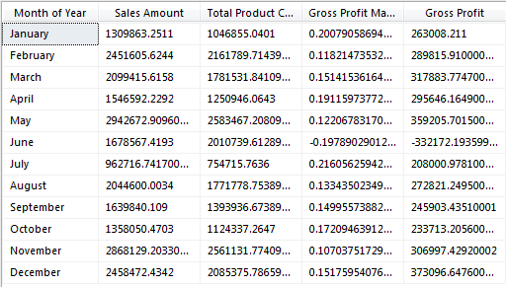
The Value of Data Visualization

Slide 55
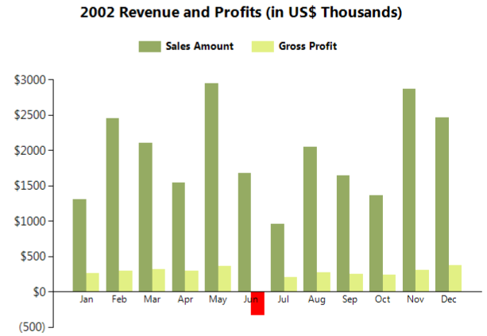
The Value of Data Visualization

Slide 56
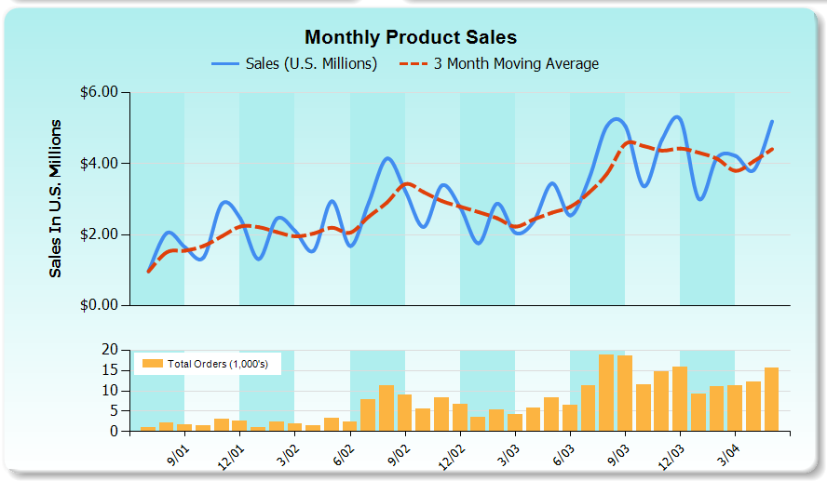

Building Blocks: Chart Features
Multiple Legends
Calculated Series
Striplines
Multiple Chart Areas

Slide 57
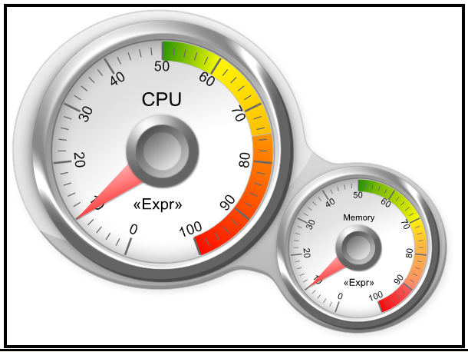
Building Blocks: Gauge Parts
Gauge Panel
Panel BackFrame
Scale
Ranges
Pointer
Gauge

Slide 58
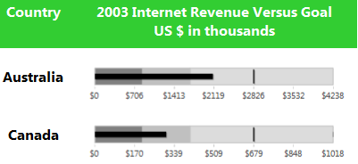
Building Blocks: Gauge Parts
Pointer
Pointer
Ranges
Gauge
Scale
Gauge Panel

Slide 59
Common Visualization Mistakes
Inappropriate display media
  Pie charts, 3-D charts
Poorly designed display media
  Using fill patterns, line styles, and fully saturated/bright colors.
Encoding quantitative data inaccurately
Crowded charts
Variety for the sake of variety
Adding visual flair

Slide 60
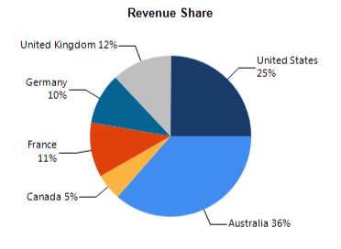
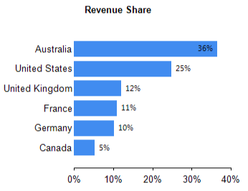
Part to Whole Relationships
Use Bar or Column chart instead of a Pie chart

Slide 61
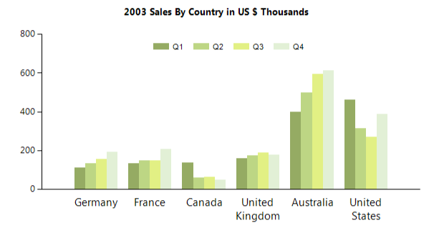
Part to Whole (Continued)

Slide 62
Line Charts: Best Practices
Lines should mostly be used to connect values along an interval scale
  Couple of notable exceptions (Pareto)
Intervals should be equal in size
Lines should only directly connect values in adjacent intervals
  If the data is missing, indicate it’s missing.

Slide 63
Line Charts: Empty Points
When series are automatically generated based on the series field, the “column” group values are the union of all series.
Property grid only
  Provides support for Empty Point formatting options
  Empty Point Value can be set to zero or average in custom attributes on the series.

Slide 64
Bar Charts: Best Practices
Orientation
  Horizontal for ranking scenarios
Proximity
  Set the width of white space separating contiguous bars equal to 100% the width of the bars, plus or minus 50%
  Do not overlap bars (unless bullet graph like)
Fills
  Avoid pattern lines
  Use distinct, but soft colors
    Reserve intense colors for highlighting

Slide 65
Bar Charts: Best Practices
Borders
  Avoid, except for highlights
Bases
  Always start at the axis unless it’s a range bar chart.

Slide 66
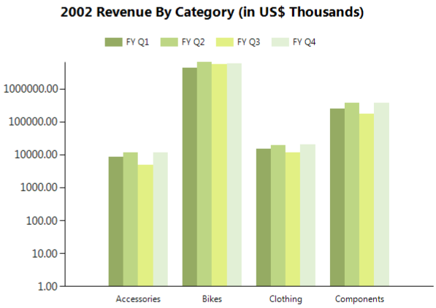
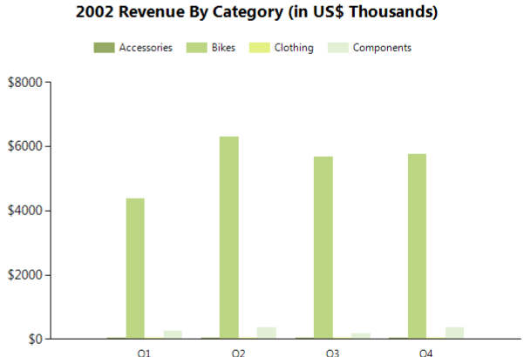
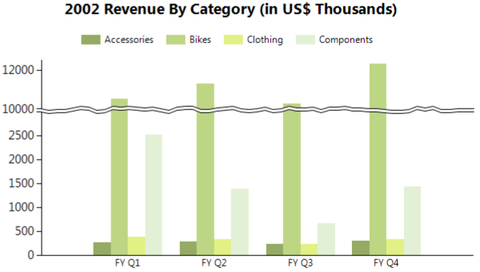
Disparate Values
Logarithmic Axis, or
Scale breaks

Slide 67
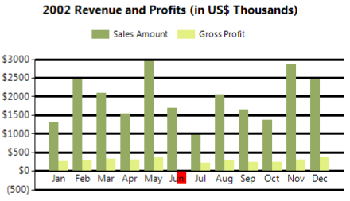
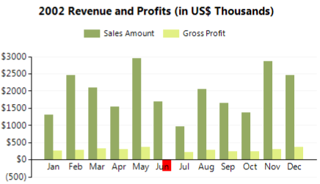
Gridlines
Use for value look-up, perceive differences
Subtle is best

Slide 68
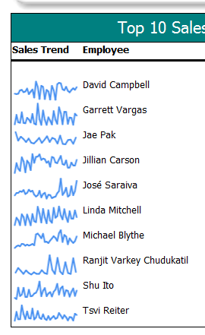
Sparklines
Definition:
  “Data-intense, design simple, word-size graphics”
  Provide quick sense of historical context
Add a chart to main body of the report
Remove and/or hide all visual elements except the series.

Slide 69
Bullet Graphs
Consist of…
  a key measure (value)
  Comparative measure (goal)
  and qualitative ranges (good, bad, or exceed)
Can be oriented horizontally or vertically
Perfect for KPIs

Slide 70
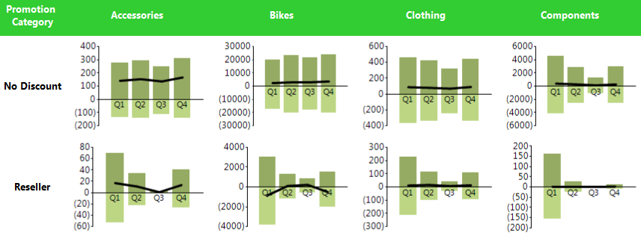
Small Multiples
Small sets of charts arranged in
  Tables
  Matrices

Slide 71
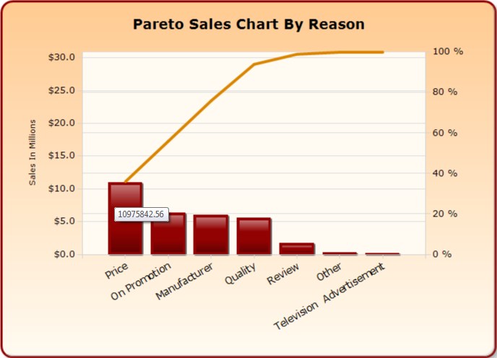
Pareto Charts
Commonly used in quality control scenarios.
Set the Chart Type = Column
Custom Attributes
  ShowColumnAs Property = “Pareto”
Remove the Axis Title on the Secondary Axis by Selecting the Chart Area → Value Axis in the Property Grid

Slide 72
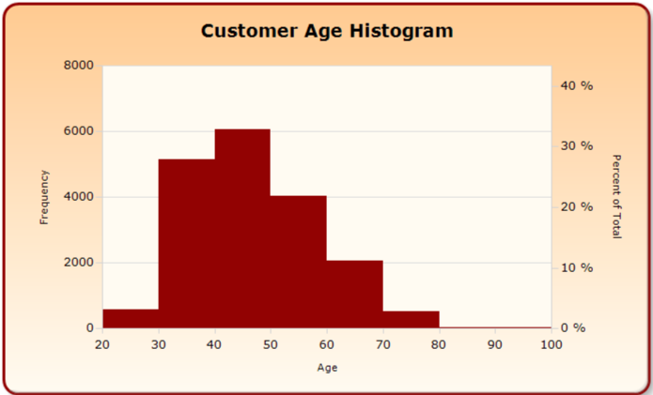
Histogram Charts
Set the series type = Column
Custom Attributes
  HistogramSegmentIntervalNumber
  HistogramSegmentIntervalWidth
  HistogramShowPercentOnSecondaryAxis

Slide 73
question & answer

Slide 74




Resources
Required Slide
Speakers,
TechEd 2009 is not producing
a DVD. Please announce that
attendees can access session
recordings at TechEd Online.
www.microsoft.com/teched
  Sessions On-Demand & Community
www.microsoft.com/learning
Microsoft Certification & Training Resources
http://microsoft.com/technet
  Resources for IT Professionals
http://microsoft.com/msdn
  Resources for Developers

Slide 75

Complete an evaluation on CommNet and enter to win an Xbox 360 Elite!

Slide 76

Required Slide
© 2009 Microsoft Corporation. All rights reserved. Microsoft, Windows, Windows Vista and other product names are or may be registered trademarks and/or trademarks in the U.S. and/or other countries.
The information herein is for informational purposes only and represents the current view of Microsoft Corporation as of the date of this presentation. Because Microsoft must respond to changing market conditions, it should not be interpreted to be a commitment on the part of Microsoft, and Microsoft cannot guarantee the accuracy of any information provided after the date of this presentation. MICROSOFT MAKES NO WARRANTIES, EXPRESS, IMPLIED OR STATUTORY, AS TO THE INFORMATION IN THIS PRESENTATION.

