Slide 2
SSIS Best Practices
Donald Farmer
donald.farmer@microsoft.com
Session Code: DAT310

Slide 3
Stating the obvious
All data comes from somewhere
Read / Write sets the limits of performance
All data goes somewhere

Slide 4
Look outside of SSIS for perf
Better drivers
Driver configuration
I/O and Network optimization

Slide 5
Measure twice – cut once

Slide 6
Demo
Baselining performance

Slide 7
Understand Your Hardware
How many CPU cores?
How much memory?
How fast is the I/O subsystem
Use SQLIO to measure
Understand how spindles map to LUNs
How fast is the network?
How many NIC do you available?
What is network topology?

Slide 8
The basic topology
Source
Transport
Transformation
Transport
Destination

Slide 9
ETL Topology
Source
SSIS Data Flow
Destination
Extract
Transform
Load

Slide 10
ETL Topology
For
Any source
No source processing
Flexible transformations
Any destination
No destination processing
Against
Potentially inefficient extracts
Row based transformations only
Easily hybridized

Slide 11
ELT Topology
Source
SSIS Data Flow
Destination
Extract
Load
Transform

Slide 12
ELT Topology
For
Any source
No source processing
Against
Potentially inefficient extracts
Database destinations only
Transformations managed in the database
Easily hybridized
Set-based transformations

Slide 13
TEL Topology
Source
SSIS Data Flow
Destination
Transform
Extract
Load
Minimal demand at the destination

Slide 14
TEL Topology
For
Database sources only
Against
Database sources only
Any destination
Transformations managed in the database
Easily hybridized
Set-based transformations
May increase demand on operational systems

Slide 15
The basic topology - again
Source
Transport
Transformation
Transport
Destination

Slide 16
3 Box ETL Topology
Source
Transport
Transformation
Transport
Destination

Slide 17
Co-located ETL Topology
Source
Transport
Transformation
Transport
Destination

Slide 18
Co-located ETL Topology
Source
Transport
Transformation
Transport
Destination

Slide 19
Demo
Comparing topologies

Slide 20
3 basic principles
Efficient transformations
Efficient transport
Reduced resource contention
Find the best tool for the job
Move the minimum of data
Maximize performance

Slide 21
Watch Resources with Perfmon
CPU
Process\ % Processor Time (DTExec)
Process\ % Processor Time (SQLServr)
Memory
Process\ Working Set (DTExec)
Process\ Private Bytes (DTExec)
SQLServer:Memory Manager\ Total Server Memory
Memory\ Page Reads/sec
Network
Network Interface\ Current Bandwidth
Network Interface\ Bytes Total/sec
SSIS disk activity
Logical Disk\ Avg Disk Sec/Transfer
Logical Disk\ Read and Write Bytes/Sec
SQLServer:SSIS Pipeline 10.0\ Buffers spooled

Slide 22
A bag of tricks …

Slide 23
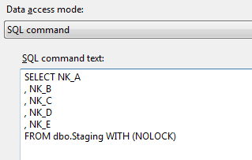
Optimize SQL Data Source
Use the NOLOCK hint to remove locking overhead
SELECT only columns you need

Slide 24
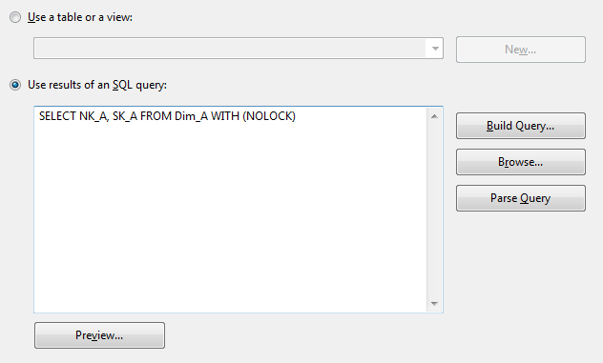
Optimize Lookup Transformation
Change SELECT statement to only use the columns you need
Optimizes memory usage
Consider adding NOLOCK
In SSIS 2008:
Use Shared Lookup Cache

Slide 25
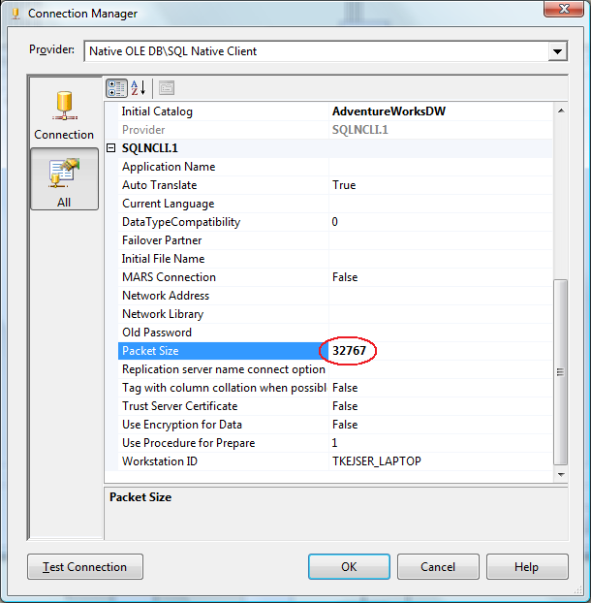
Network Tuning
Change the network packet size in the connection manager
Higher values typically yield faster throughput
Max value: 32767
Experiment with Shared Memory vs. TCP/IP
If using Win 2008
Network affinity
Enable Jumbo Frames on the Network
Consult your network specialists

Slide 26
Data Types
Make data types as narrow as possible
Do not perform excessive casting
Watch precision issues with money, float and decimal
Look out for date conversions

Slide 27
Optimize SQL Targets
Use SQL Destination instead of OLEDB
But must be co-located
Commit size 0 is fastest
If not 0, use highest possible
Heap insert is typically faster than cluster index
Drop indexes and rebuild if changing large part of table
Use partitions and partition SWITCH

Slide 28
More tips
Don’t Sort unless absolutely necessary
Use SQL Server indexes and mark source as sorted with ORDER BY statement
Sometimes T-SQL is faster
Set based UPDATE statement instead of row by row OLEDB
Large Aggregations (GROUP BY/SUM)
Take advantage of new SQL Merge statement
Right tool for the right job
Reduce delta detection
Delta > 10%? Reload!
Minimally log operations
Data flow in bulk mode
TRUNCATE instead of DELETE
SWITCH and partitioning

Slide 29
Demo
Some tips and tricks

Slide 30
Complete an evaluation on CommNet and enter to win an Xbox 360 Elite!

Slide 31
© 2008 Microsoft Corporation. All rights reserved. Microsoft, Windows, Windows Vista and other product names are or may be registered trademarks and/or trademarks in the U.S. and/or other countries.
The information herein is for informational purposes only and represents the current view of Microsoft Corporation as of the date of this presentation. Because Microsoft must respond to changing market conditions, it should not be interpreted to be a commitment on the part of Microsoft, and Microsoft cannot guarantee the accuracy of any information provided after the date of this presentation. MICROSOFT MAKES NO WARRANTIES, EXPRESS, IMPLIED OR STATUTORY, AS TO THE INFORMATION IN THIS PRESENTATION.

