Slide 1
Doing It Right
Planning and Tracking Projects with TFS 2010
Stephanie Saad Cuthbertson
Group Program Manager
Microsoft
Session Code: DEV 202

Slide 2
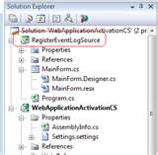
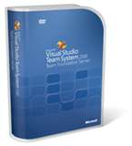
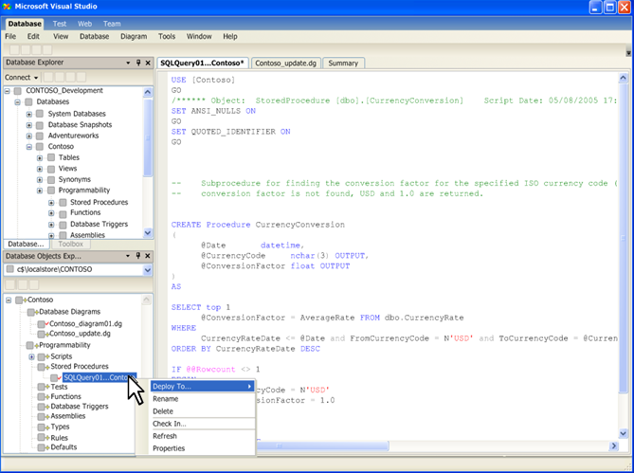
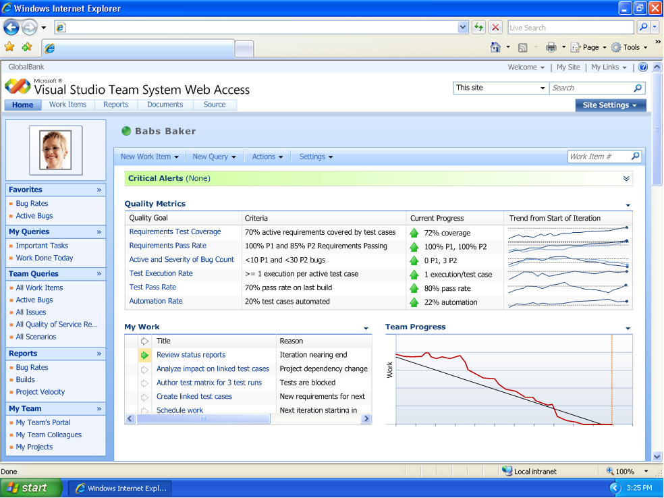
About Me
Group Program Manager, Microsoft
  Team Foundation Server
6 Years Building Visual Studio
  Product Planner for VSTS 2010
  Product Planner for VSTS 2008
  Product Planner for TeamData
  VS 2005 Core Project System
2 Years on Systems Center
Originally from Acquantive

Slide 3
Agenda
Running Scrum Teams
Running Formal Projects (MS Project)
Customizing Project Templates
Building Dashboards & Reports
New 2010 SharePoint Supported Configurations
Using TFS 2010 w/Older Servers & Clients

Slide 4
Agenda
Running Scrum Teams
Running Formal Projects (MS Project)
Customizing Project Templates
Building Dashboards & Reports
New 2010 SharePoint Supported Configurations
Using TFS 2010 w/Older Servers & Clients

Slide 5
Scrum Planning with TFS 2010
demo
Notes:
If you would like to host your demo on the Virtual Server, please use the myVPC demo slide, not this slide.

Slide 6
Agile Guidance in TFS 2010
demo
Notes:
If you would like to host your demo on the Virtual Server, please use the myVPC demo slide, not this slide.

Slide 7
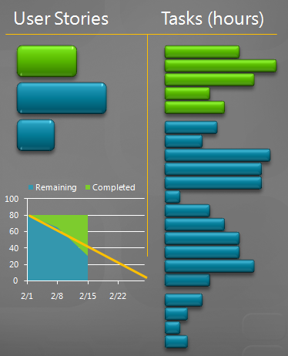
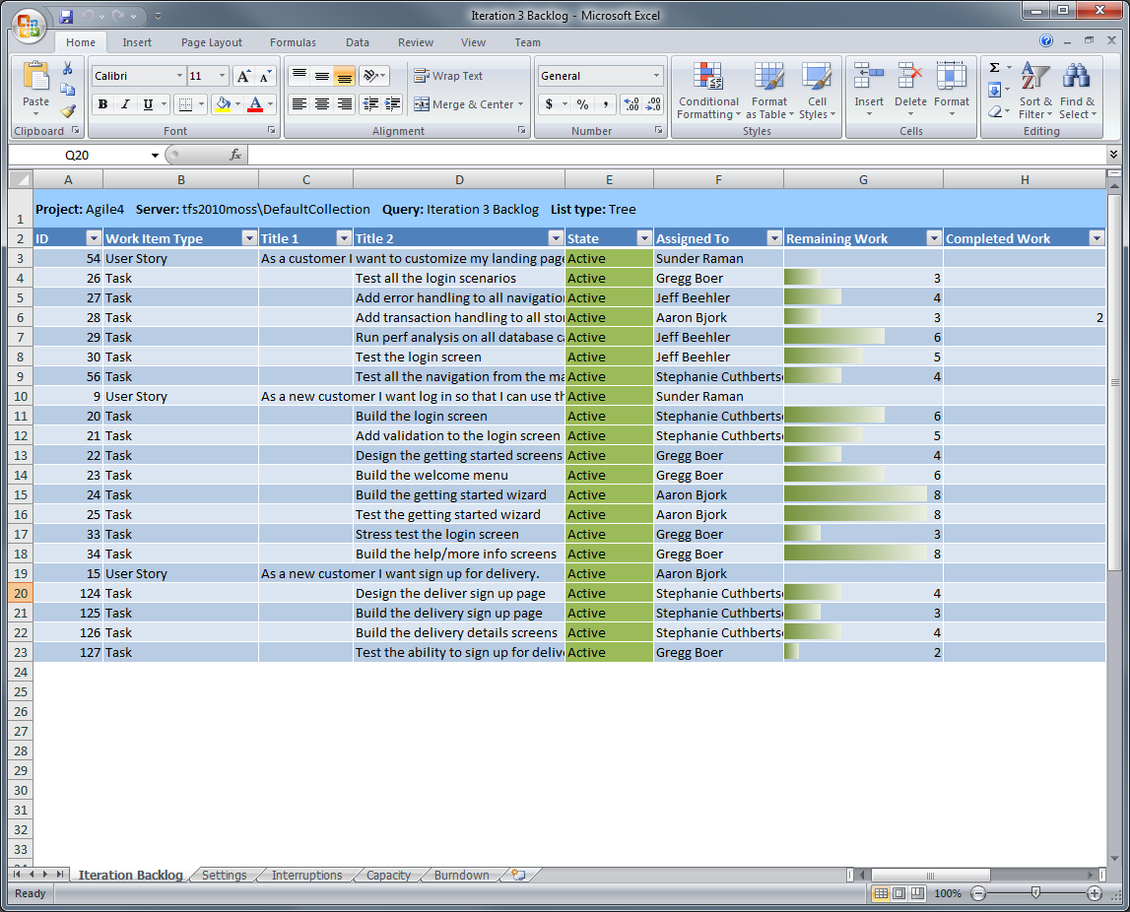
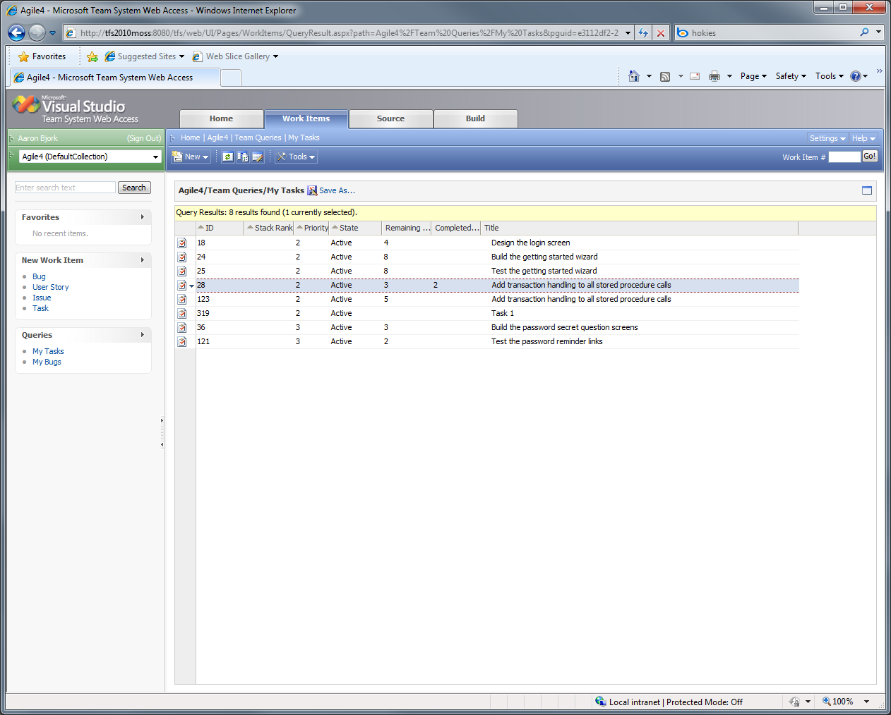
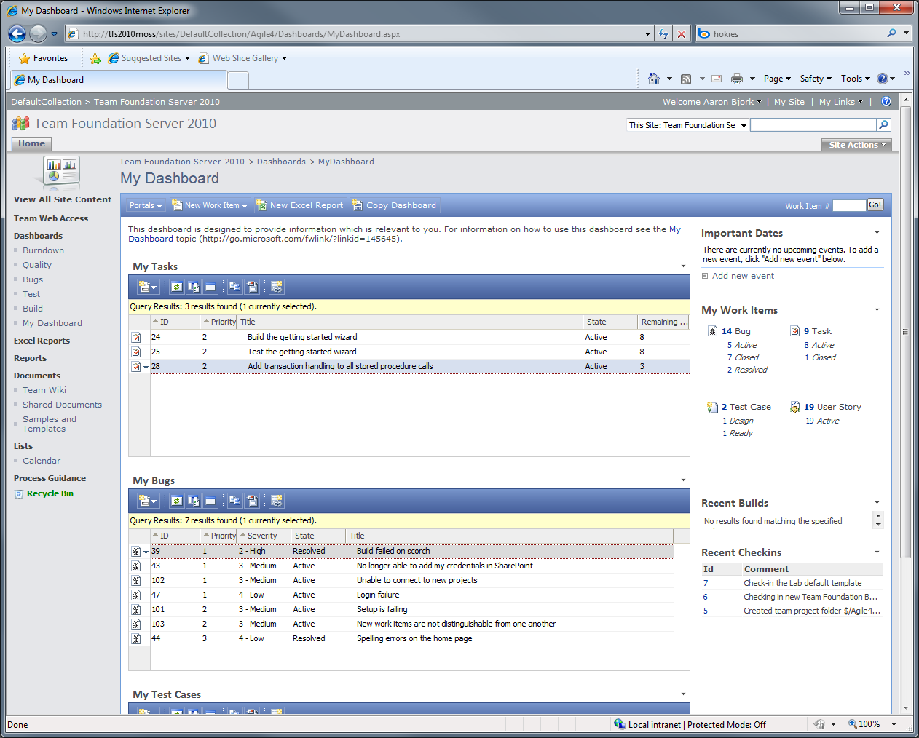
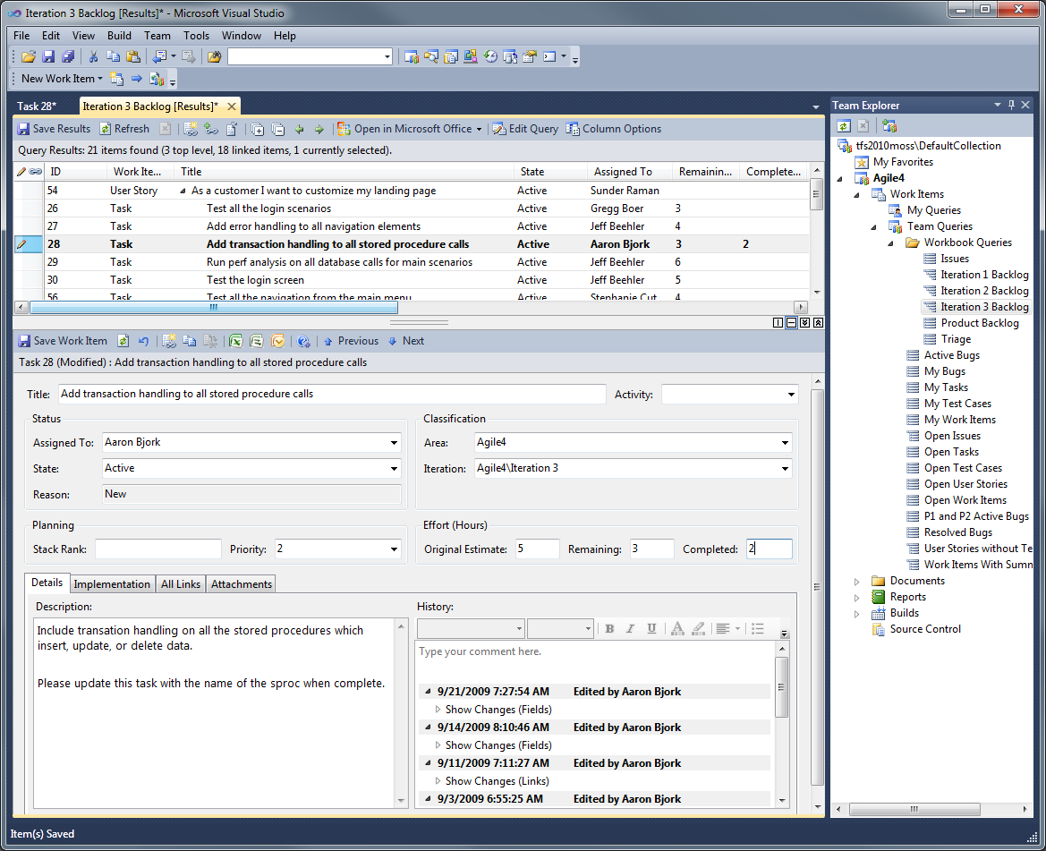
Updating Tasks
Multiple interfaces for updating work items

Slide 8
Updating Tasks
Team Explorer

Slide 9
Updating Tasks
Iteration Backlog workbook

Slide 10
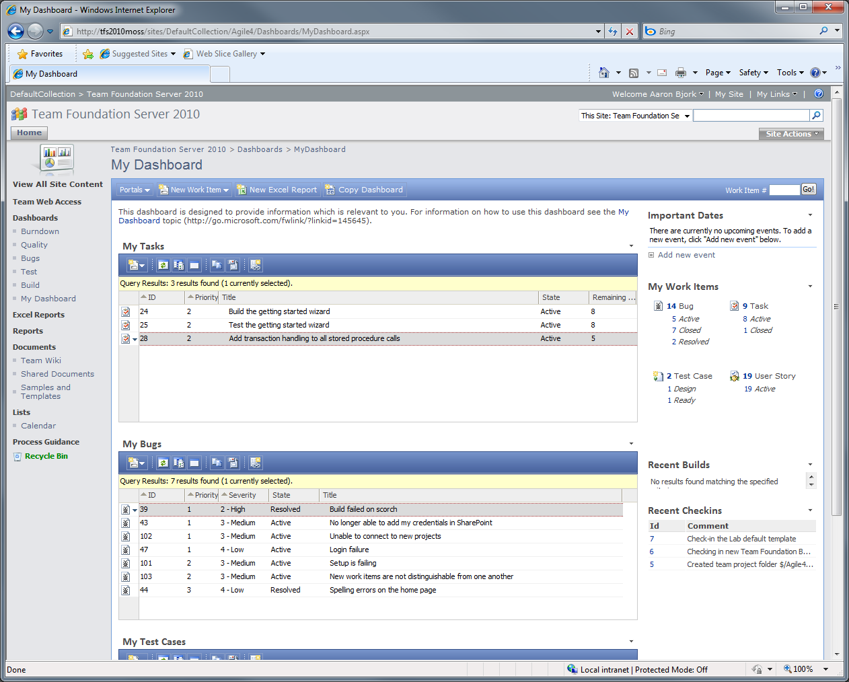
Updating Tasks
Team Project portal

Slide 11
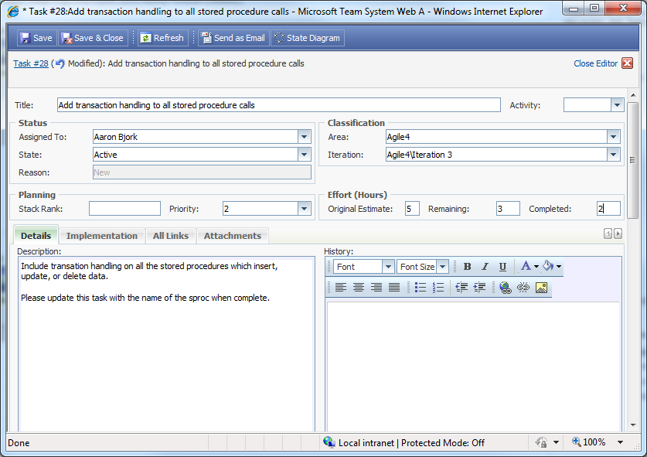
Updating Tasks

Slide 12
Updating Tasks

Slide 13
Updating Tasks
Team System Web Access

Slide 14
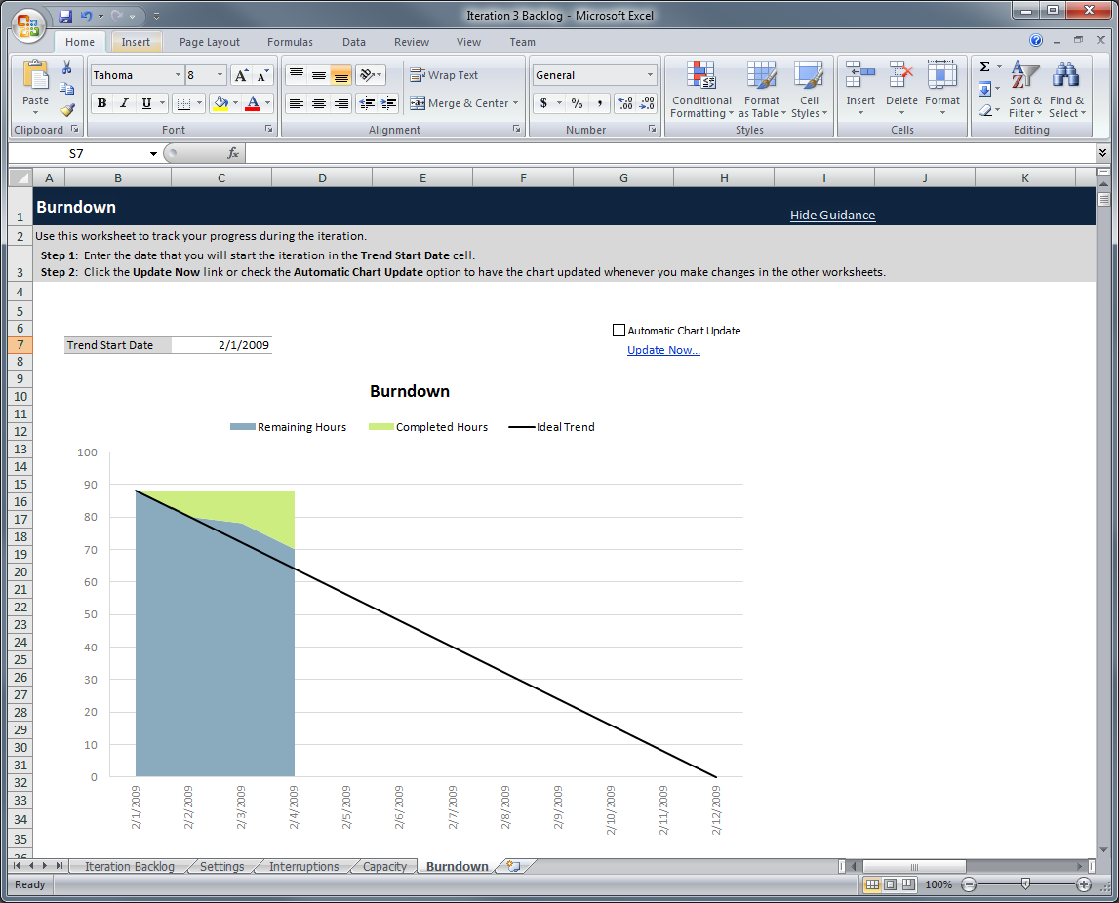
Tracking Progress
Burndown chart tracks remaining and completed work

Slide 15
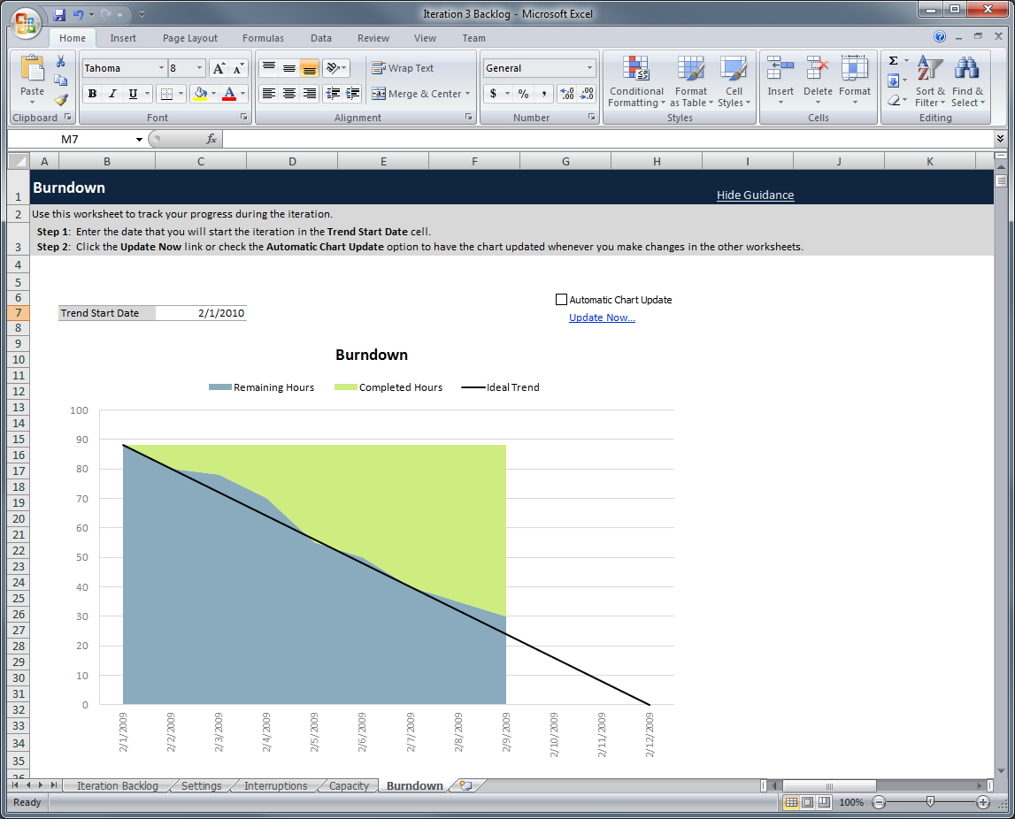
Tracking Progress

Slide 16
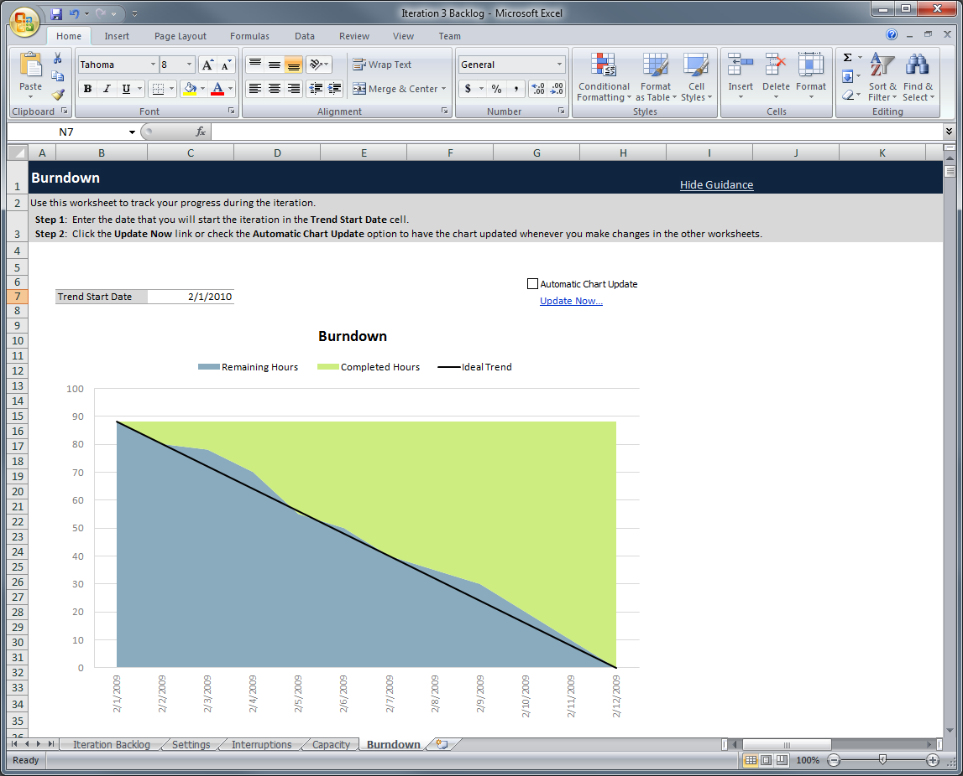
Tracking Progress

Slide 17
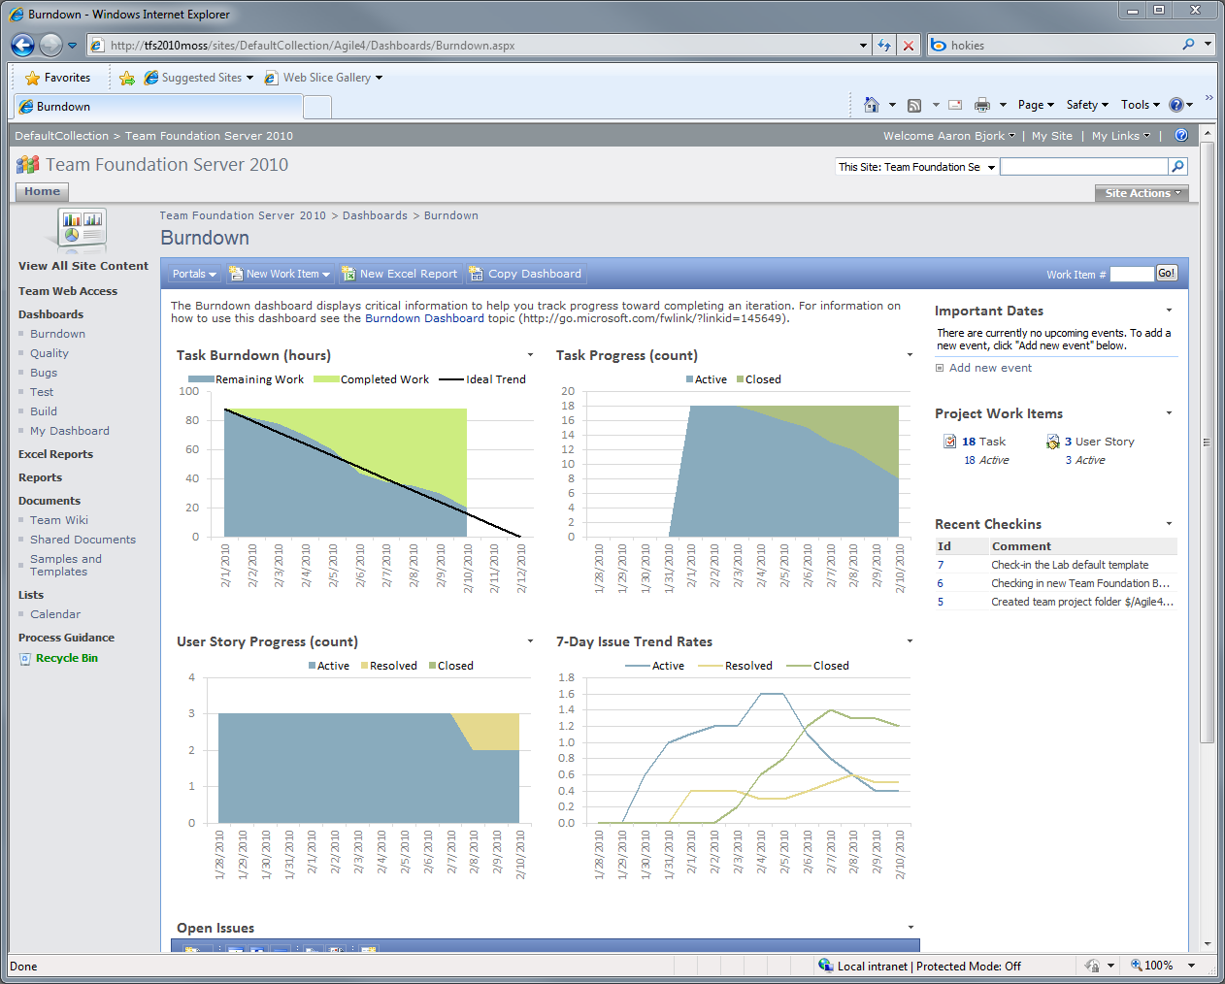
Tracking Progress
Detailed sprint progress is tracked on the project portal
The burndown shows the team on track…
And almost half of the tasks remain open
But the team hasn’t closed any of the three stories…

Slide 18
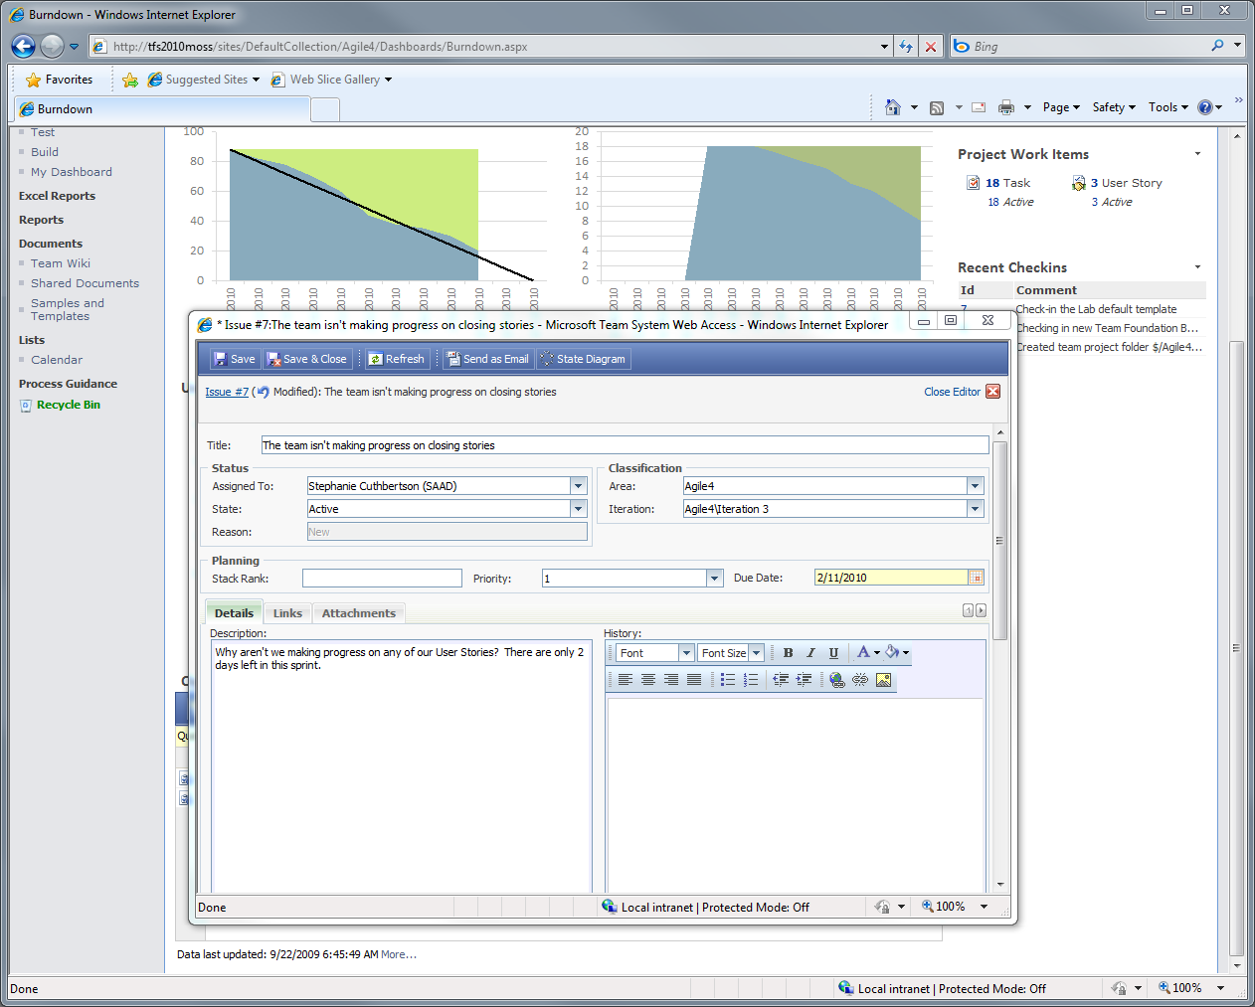
Tracking Progress
The Scrummaster opens an issue to track the problem the portal has identified

Slide 19
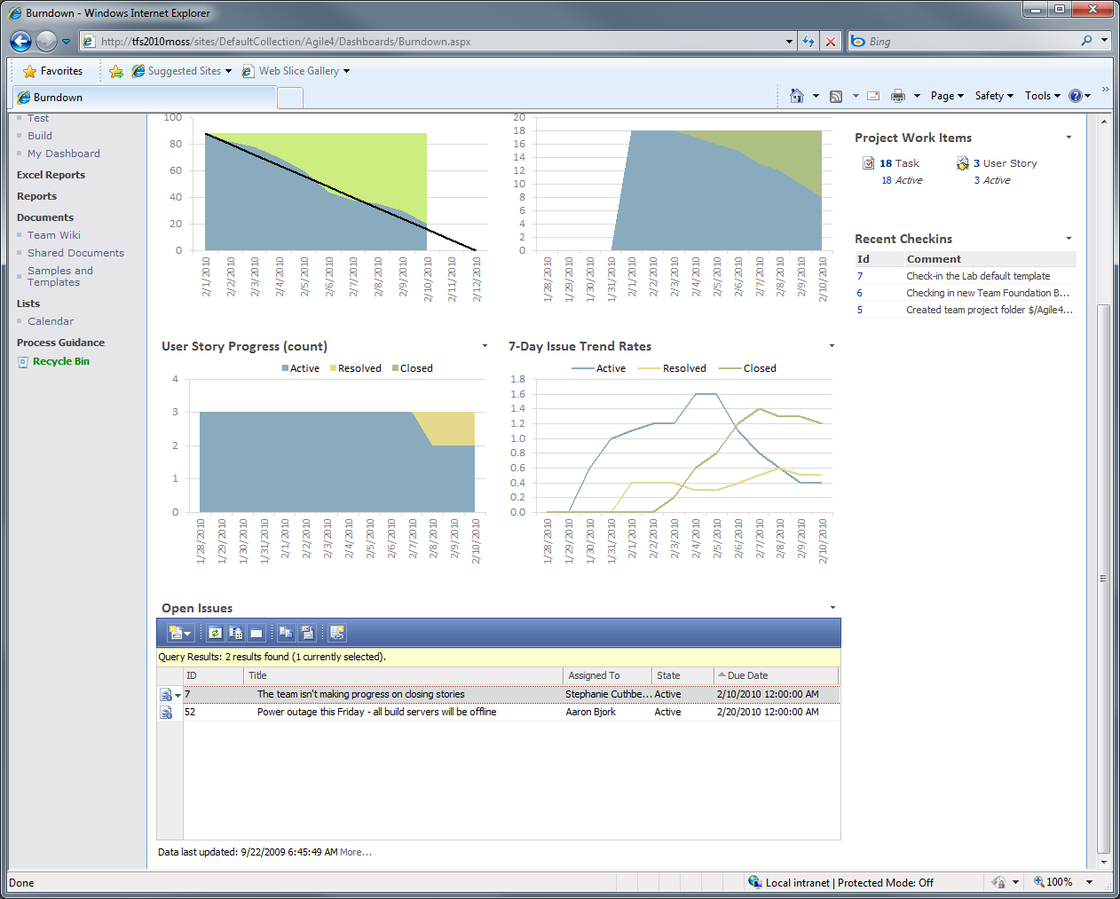
Tracking Progress
The issue is opened and tracked in TFS

Slide 20
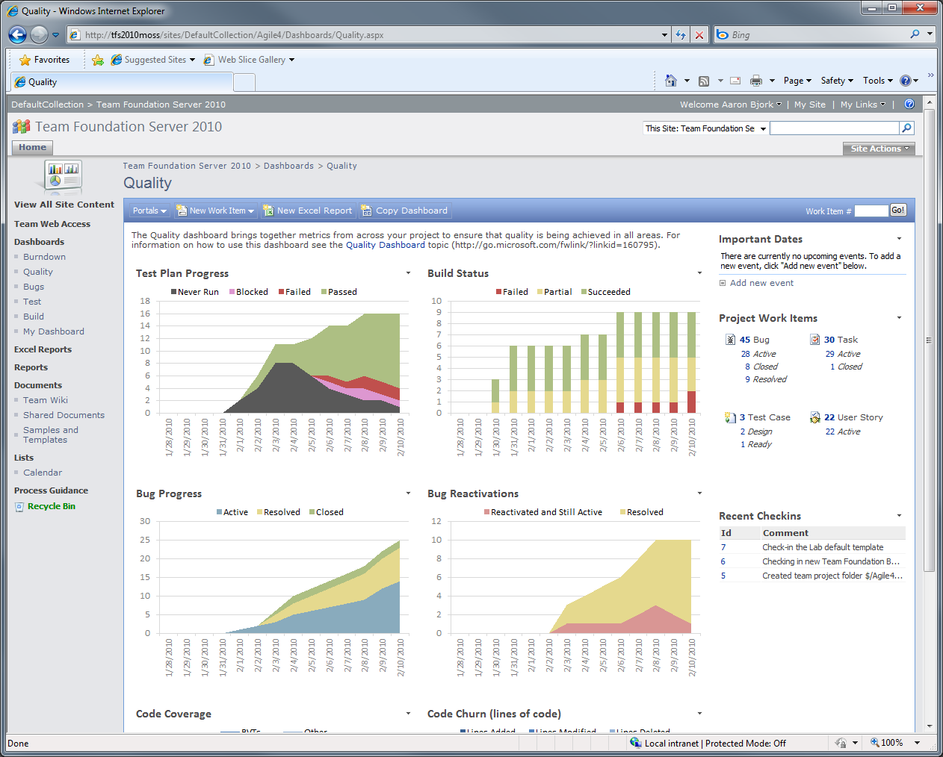
Tracking Progress
The portal brings data together so it can be analyzed to ensure success on a sprint
Test are passing…
But bugs are climbing steadily

Slide 21
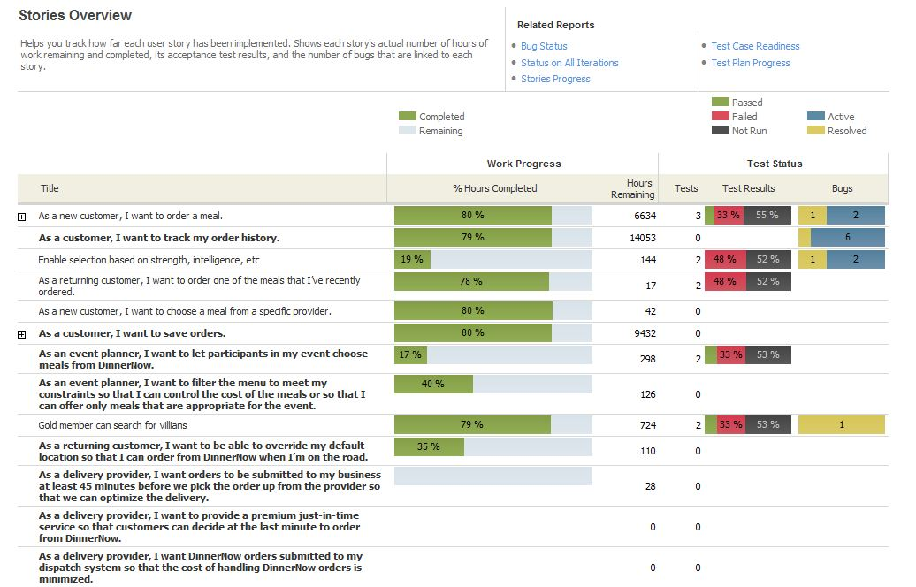
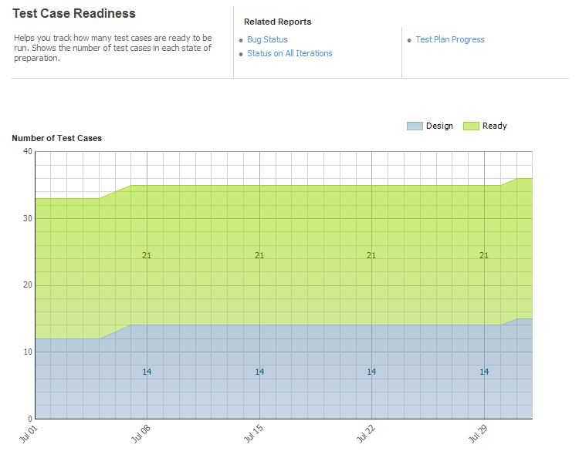
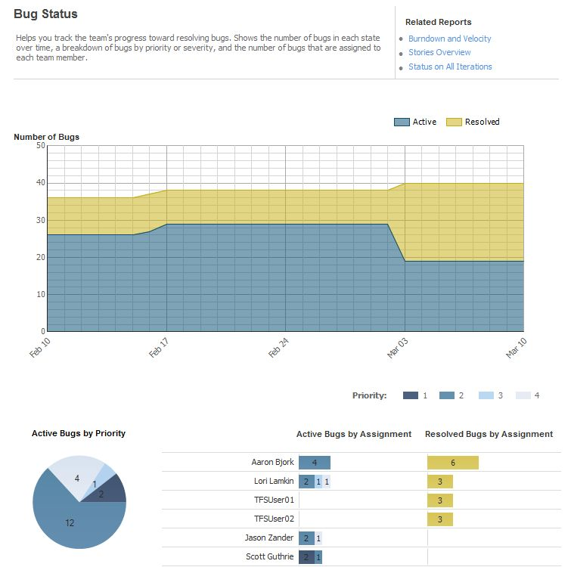
Tracking Progress
Rich set of reports track progress

Slide 22
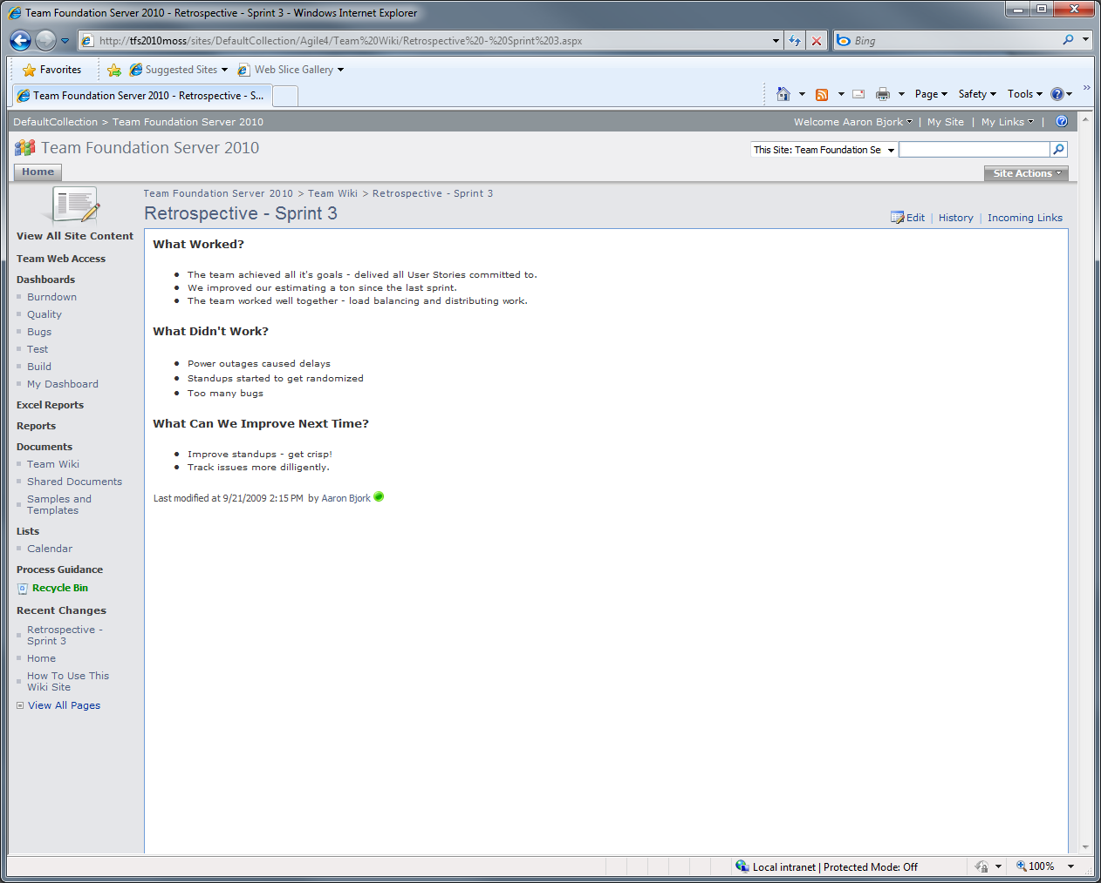
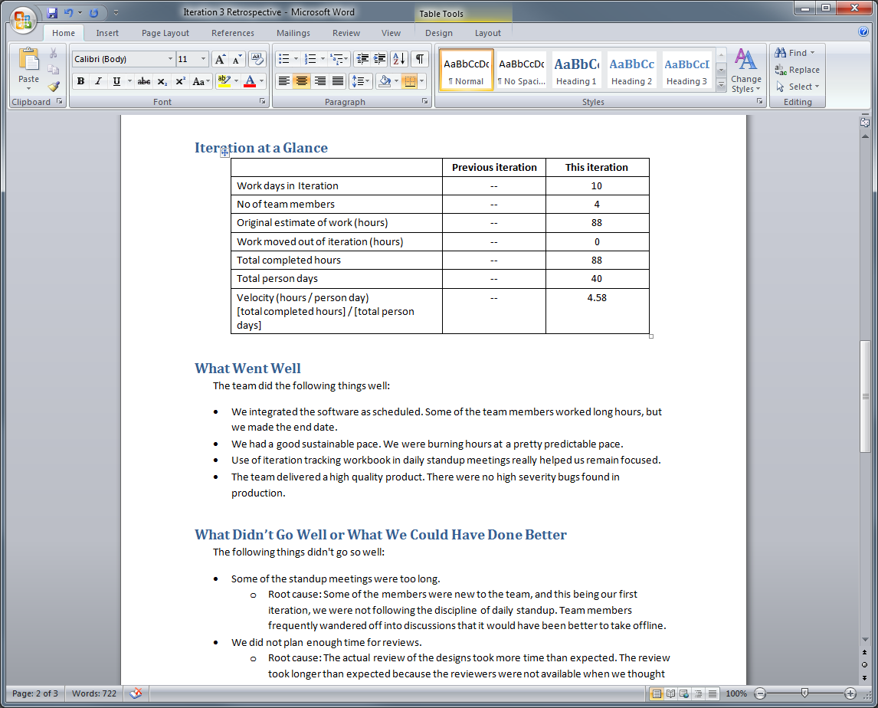
Retrospective
Capture retrospectives using the Team wiki on the Project Portal
Sample documents are provided as a guide

Slide 23
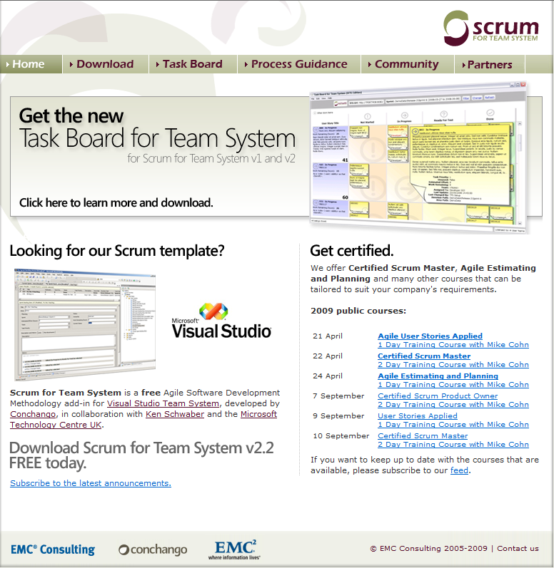
Another Option
EMC’s Scrum for Team System
2010 Currently in Beta
Includes Optional Scrum Board
Integrated with Guidance by Ken Schwaber
Training Partnership with Ken Schwaber

Slide 24
Agenda
Running Scrum Teams
Running Formal Projects (MS Project)
Customizing Project Templates
Building Dashboards & Reports
New 2010 SharePoint Supported Configurations
Using TFS 2010 w/Older Servers & Clients

Slide 25
Formal Planning with Project 14
demo
Notes:
If you would like to host your demo on the Virtual Server, please use the myVPC demo slide, not this slide.

Slide 26

Office Support in TFS 2010
Table Title
 | TFS 2008 | TFS 2010
Excel 12
Project 12
SharePoint 12
Excel 14 *
Project 14 *
SharePoint 14 *
* Currently in Beta

Slide 27
Agenda
Running Scrum Teams
Running Formal Projects (MS Project)
Customizing Project Templates
Building Dashboards & Reports
New 2010 SharePoint Supported Configurations
Using TFS 2010 w/Older Servers & Clients

Slide 28
Advanced Customization with the Process Template Editor for 2010
demo

Slide 29
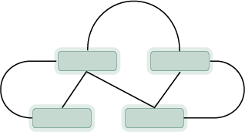
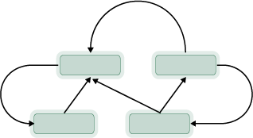
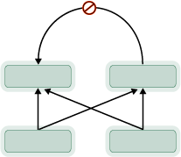
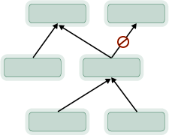
Link Topology Types
Network
Directed Network
Dependency
Tree

Slide 30

Process Template Editor Power Tool
2010 Beta 2 Update
  Use SxS with PTE 2008
  Support 2010 Work Item features
  Quality: Fix data loss, crashing bugs
Stack | Description | Pri
1 | Create/edit link types | 1
2 | Edit query folders | 1
3 | Edit query permissions (RTM) | 1
4 | Edit Link Control settings | 1
5 | Create/edit Webpage Control | 1
6 | Create/edit Label Links | 1
7 | Create/edit Labels Controls | 1
8 | Create/edit WIT Categories | 1
9 | Edit query definitions using a query designer | 3
2010 RTM Release
  Visual editor for query permissions
  Add, configure, preview custom controls
  Configure default permissions for Lab, Test, VC
  Configure settings for VC
  Quality: Warn when user action will invalidate Process Template

Slide 31
Agenda
…
Building Dashboards & Reports
  New MOSS Dashboards
  New Excel Reporting
  Ad-Hoc Reporting
  New Relational Reporting
  What to Use
  Under the Covers
…

Slide 32
TFS 2010 Dashboards
demo
Notes:
If you would like to host your demo on the Virtual Server, please use the myVPC demo slide, not this slide.

Slide 33
TFS 2010 Excel Ad-Hoc Reporting
walkthrough
Notes:
If you would like to host your demo on the Virtual Server, please use the myVPC demo slide, not this slide.

Slide 34
Agenda
…
Building Dashboards & Reports
  New MOSS Dashboards
  New Excel Reporting
  Ad-Hoc Reporting
  New Relational Reporting
  What to Use
  Under the Covers
…

Slide 35
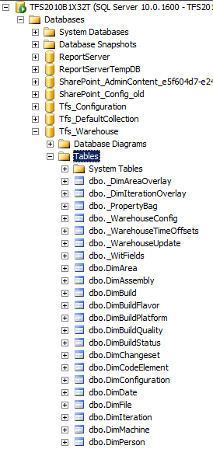
Relational Reporting
Reporting against relational warehouse is supported!
… instead of this
-- MDX --
SELECT
{
[Measures].[DateValue],
[Measures].[Work Item Count]
} ON COLUMNS,
{
CrossJoin(
[Date Range],
[Work Item].[System_State].[System_State]
)
} ON ROWS
FROM
(
SELECT
CrossJoin(
StrToSet(@AreaParam),
StrToSet(@IterationParam),
StrToSet(@StateParam),
StrToSet(@PriorityParam),
StrToSet(@SeverityParam)
) ON COLUMNS
FROM [Team System]
)
Write this…
-- SQL--
SELECT history.[System_Id] AS ID, MAX(history.[System_ChangedDate]) AS Latest
FROM @Hierarchy hierarchy INNER JOIN [WorkItemHistoryView] history ON hierarchy.ID = history.[System_Id]
WHERE (history.[System_ChangedDate]&lt; @ChangeDate)
GROUP BY history.[System_Id]

Slide 36
Relational Reporting
What’s supported?
Tables in the warehouse database that have names that don’t start with ‘_’ E.g. DimWorkItem.
There are a set of helper views – view names that don’t start with ‘v’ E.g. CurrentWorkItemView.
All Table-Valued Functions
What’s not?
Tables starting with ‘_’ and views starting with ‘v’ are only for system use i.e. subject to change in future release

Slide 37
Agenda
…
Building Dashboards & Reports
  New MOSS Dashboards
  New Excel Reporting
  Ad-Hoc Reporting
  New Relational Reporting
  What to Use
  Under the Covers
…

Slide 38



Tools and reports
Business Intelligence Development Studio (BIDS)
Complex RS report
Power
Report
Builder
RS report for sharing with team on SharePoint Foundation dashboard
Upload to team project reporting site that you can subscribe to
Excel
Sharing chart in an email
Shared with team on SharePoint Server dashboard
Learning curve
Notes:
Lower barrier to entry: Excel, share on dashboards
RDL: Report Builder and BIDS

Slide 39
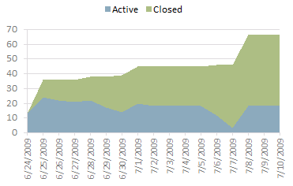
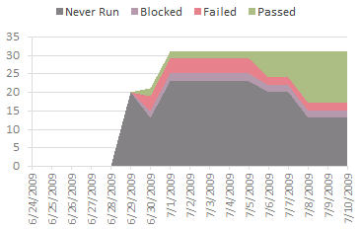
What kind of reports can I build using these tools?
Individual current or trend charts
Excel

Slide 40
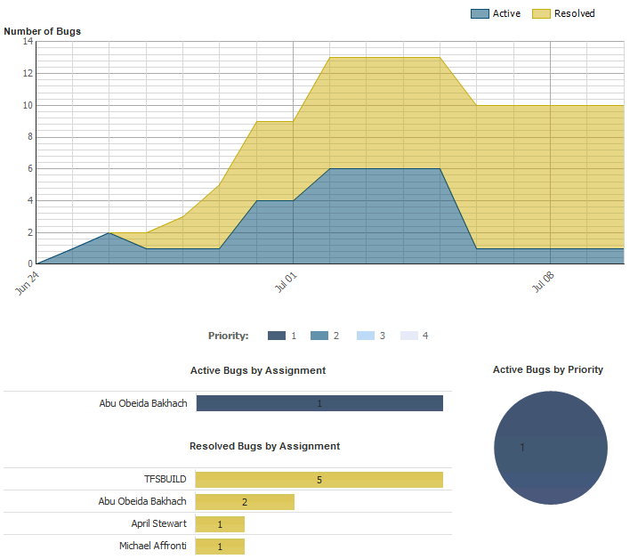
What kind of reports can I build using these tools?
Multiple charts showing data in a single RS report
Report
Builder

Slide 41
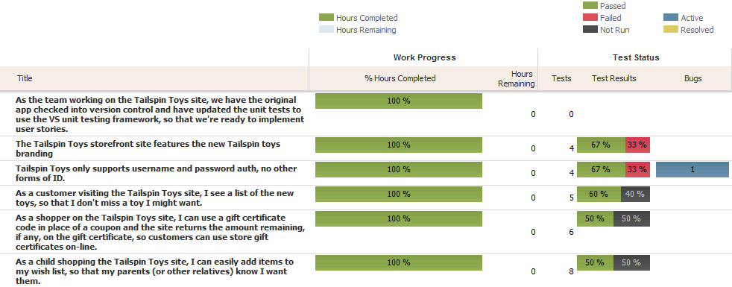
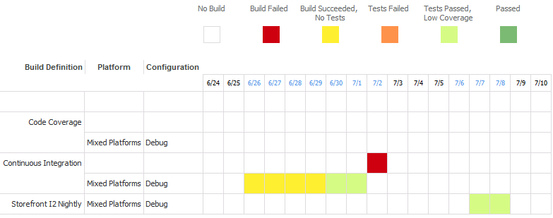
What kind of reports can I build using these tools?
Business Intelligence Development Studio (BIDS)
Complex RS reports with custom visualization

Slide 42
Reporting Out of the Box - Summary
Dashboards
  Sharepoint WSS
  Sharepoint Office Server System
Reports
  Create Excel Report from Query
  Ad-Hoc Excel Reporting
  SQL Report Designer
  SQL BI Studio
Data Availability
  Data Warehouse (MDX, Excel Reporting)
  Relational Warehouse (SQL)
  Extensibility Layer to Import External Data into Warehouse

Slide 43
Agenda
…
Building Dashboards & Reports
  New MOSS Dashboards
  New Excel Reporting
  Ad-Hoc Reporting
  New Relational Reporting
  What to Use
  Under the Covers
…

Slide 44
How data moves through TFS
Team Foundation Server
Application Tier (AT)
Data Tier (DT)
Developer / Tester / PM
Team Project Collection DBs
Adapters
Common Store
Test
Build
Version Control
WIT
Warehouse
Cube
Notes:
New concept of TPC in 2010, zoom in

Slide 45
Cross collection reporting
Team Foundation Server
Application Tier (AT)
Data Tier (DT)
Team Project Collection DBs
FIELD name=“Priority" refname=“Acme.Priority" type="String“ reportable=“dimension”
FIELD name=“Priority" refname=“Acme.Priority" type="String“ reportable=“dimension”
WIT Adapter
FIELD name=“Priority" refname=“Acme.Priority" type="String“ reportable=“dimension”
Warehouse
Notes:
Schema merge

Slide 46
Agenda
Running Scrum Teams
Running Formal Projects (MS Project)
Customizing Project Templates
Building Dashboards & Reports
New 2010 SharePoint Supported Configurations
Using TFS 2010 w/Older Servers & Clients

Slide 47
SharePoint Integration
Team Foundation Server 2010 supports integration with:
  Windows SharePoint Services (WSS) 3.0 and 4.0
  Microsoft Office SharePoint Server (MOSS) 2007 and 2010
MOSS provides easy and powerful reporting with Excel services

Slide 48

Topologies
Single Server
Separate Servers
SharePoint
Team Foundation Server
Team Foundation Server
SharePoint

Slide 49
Overview
Team Foundation Server 2010 supports integration with:
  Windows SharePoint Services (WSS) 3.0 and 4.0
  Microsoft Office SharePoint Server (MOSS) 2007 and 2010
MOSS provides easy and powerful reporting with Excel services

Slide 50
Key Concepts: SharePoint
A SharePoint site serves as a central point of collaboration for a group of people
Site

Slide 51
Key Concepts: SharePoint
A SharePoint site collection (or “top-level site”) serves as a container for sub-sites
Site Collection
Site
Site

Slide 52
Key Concepts: SharePoint
A SharePoint web application can hold multiple site collections
Web Application
Site Collection
Site
Site
Site Collection
Site

Slide 53
Key Concepts: TFS
A team project serves as a central point of collaboration for team members on a software project
Team Project

Slide 54
Key Concepts: TFS
A team project collection is a logical container that holds multiple team projects
Team Project Collection
Team Project
Team Project

Slide 55
Key Concepts: TFS
A Team Foundation Server holds multiple team project collections
Team Foundation Server
Team Project Collection
Team Project
Team Project
Team Project Collection
Team Project

Slide 56
Key Concepts: Mappings
A TFS team project associates with a SharePoint site as its “portal” for rich integration
Team Foundation Server
Team Project Collection
Team Project
Site
Team Project
Site
Team Project Collection
Team Project
Site

Slide 57
Key Concepts: Mappings
A TFS team project collection maps to a SharePoint site collection, simplifying back up and restore
Team Foundation Server
Team Project Collection
Site Collection
Team Project
Site
Team Project
Site
Team Project Collection
Site Collection
Team Project
Site

Slide 58
Key Concepts: Mappings
A Team Foundation Server maps to one or more web applications
Team Foundation Server
Web Application
Team Project Collection
Site Collection
Team Project
Site
Team Project
Site
Team Project Collection
Site Collection
Team Project
Site

Slide 59
Key Concepts: Mappings
Team Foundation Server
Web Application
Team Project Collection
Site Collection
Team Project
Site
Team Project
Site
Team Project Collection
Site Collection
Team Project
Site

Slide 60
Scenarios
Single Server
Separate Servers
TFS can install WSS 3.0 for you
You can integrate with an existing SharePoint products installation
As a TFS administrator, you are in charge of SharePoint
As a TFS administrator, you are not in charge of SharePoint

Slide 61
TFS Installs WSS 3.0
Single Server
Your Server
Windows SharePoint Services 3.0
Team Foundation Server
TFS installs
Windows SharePoint Services 3.0

Slide 62
TFS Installs WSS 3.0
Single Server
Your Server
Windows SharePoint Services 3.0
Team Foundation Server
Web Application
TFS creates a SharePoint web application

Slide 63
TFS Installs WSS 3.0
Single Server
Your Server
Windows SharePoint Services 3.0
Team Foundation Server
Web Application
TFS installs an “Extensions” footprint, which extends the SharePoint installation to enable integration
Team Foundation Extensions

Slide 64

TFS Installs WSS 3.0
Single Server
Your Server
Windows SharePoint Services 3.0
Team Foundation Server
Web Application
TFS creates a mapping between itself and a web application to enable integration
Team Foundation Extensions

Slide 65
TFS Installs WSS 3.0
Single Server
Your Server
Windows SharePoint Services 3.0
Team Foundation Server
Web Application
Team Project Collection 1
Site Collection 1
When creating a team project collection, TFS automatically creates a corresponding site collection
Team Foundation Extensions

Slide 66
TFS Installs WSS 3.0
Single Server
Your Server
Windows SharePoint Services 3.0
Team Foundation Server
Web Application
Team Project Collection 1
Site Collection 1
Team Project 1
Site1
Team Project 2
Site 2
When creating a team project, TFS automatically creates a corresponding site
Team Foundation Extensions

Slide 67

TFS Installs WSS 3.0
Single Server
Your Server
Windows SharePoint Services 3.0
Team Foundation Server
Web Application
Team Project Collection 1
Site Collection 1
Team Project 1
Site1
Team Project 2
Site 2
Team Foundation Extensions

Slide 68
Scenarios
Single Server
Separate Servers
TFS can install WSS 3.0 for you
You can integrate with an existing SharePoint products installation
As a TFS administrator, you are in charge of SharePoint
As a TFS administrator, you are not in charge of SharePoint

Slide 69
Scenarios
Single Server
Separate Servers
TFS can install WSS 3.0 for you
You can integrate with an existing SharePoint products installation
As a TFS administrator, you are in charge of SharePoint
As a TFS administrator, you are not in charge of SharePoint

Slide 70
In Charge of SharePoint
Separate Servers
Server A
Server B
SharePoint Products
Web Application
Notes:
And TFS takes care of the rest

Slide 71
In Charge of SharePoint
Separate Servers
Server A
Server B
SharePoint Products
Web Application
Farm Administrators:
TFS service account
User that is configuring TFS
Add these accounts as farm administrators

Slide 72
In Charge of SharePoint
Separate Servers
Server A
Server B
SharePoint Products
Web Application
Install extensions
Team Foundation Extensions

Slide 73
In Charge of SharePoint
Separate Servers
Server A
Server B
SharePoint Products
Team Foundation Server
Web Application
Install TFS
Team Foundation Extensions

Slide 74
In Charge of SharePoint
Separate Servers
Server A
Server B
SharePoint Products
Team Foundation Server
Web Application
Run the configuration wizard to create the mapping
Team Foundation Extensions

Slide 75
In Charge of SharePoint
Separate Servers
Server A
Server B
SharePoint Products
Team Foundation Server
Web Application
Team Project Collection 1
Site Collection 1
TFS can now automatically create corresponding site collections…
Team Foundation Extensions

Slide 76
In Charge of SharePoint
Separate Servers
Server A
Server B
SharePoint Products
Team Foundation Server
Web Application
Team Project Collection 1
Site Collection 1
Team Project 1
Site1
Team Project 2
Site 2
...and sites
Team Foundation Extensions

Slide 77
In Charge of SharePoint
Separate Servers
Server A
Server B
SharePoint Products
Team Foundation Server
Web Application
Team Project Collection 1
Site Collection 1
Team Project 1
Site1
Team Project 2
Site 2
Team Foundation Extensions

Slide 78
Scenarios
Single Server
Separate Servers
TFS can install WSS 3.0 for you
You can integrate with an existing SharePoint products installation
As a TFS administrator, you are in charge of SharePoint
As a TFS administrator, you are not in charge of SharePoint

Slide 79
Not in Charge of SharePoint
Separate Servers
Server A
Server B
SharePoint Products

Slide 80
Not in Charge of SharePoint
Separate Servers
Server A
Server B
SharePoint Products
Web Application
SharePoint administrator creates a web application for use with TFS

Slide 81
Not in Charge of SharePoint
Separate Servers
Server A
Server B
SharePoint Products
Web Application
Enable self-service site creation
SharePoint administrator enables self-service site creation

Slide 82
Not in Charge of SharePoint
Separate Servers
Server A
Server B
SharePoint Products
Web Application
SharePoint administrator installs the extensions
Team Foundation Extensions

Slide 83
Not in Charge of SharePoint
Separate Servers
Server A
Server B
SharePoint Products
Team Foundation Server
Web Application
TFS administrator installs TFS
Team Foundation Extensions

Slide 84
Not in Charge of SharePoint
Separate Servers
Server A
Server B
SharePoint Products
Team Foundation Server
Web Application
The SharePoint administrator grants access to TFS
Team Foundation Extensions

Slide 85
Not in Charge of SharePoint
Separate Servers
Server A
Server B
SharePoint Products
Team Foundation Server
Web Application
The TFS administrator grants access to SharePoint
Team Foundation Extensions

Slide 86
Not in Charge of SharePoint
Separate Servers
Server A
Server B
SharePoint Products
Team Foundation Server
Web Application
Site Collection 1
Because self-service site creation is enabled, the TFS administrator can manually create site collections
Team Foundation Extensions

Slide 87
Not in Charge of SharePoint
Separate Servers
Server A
Server B
SharePoint Products
Team Foundation Server
Web Application
Team Project Collection 1
Site Collection 1
New team project collections associate with an existing site collection
Team Foundation Extensions

Slide 88
Not in Charge of SharePoint
Separate Servers
Server A
Server B
SharePoint Products
Team Foundation Server
Web Application
Team Project Collection 1
Site Collection 1
Team Project 1
Site1
Team Project 2
Site 2
Corresponding SharePoint sites are then automatically created when team projects are created
Team Foundation Extensions

Slide 89
Not in Charge of SharePoint
Separate Servers
Server A
Server B
SharePoint Products
Team Foundation Server
Web Application
Team Project Collection 1
Site Collection 1
Team Project 1
Site1
Team Project 2
Site 2
Team Foundation Extensions

Slide 90
Architecture - Extensions
Team Foundation Server Extensions for SharePoint Products
  Allows TFS to communicate with SharePoint
  Must install on each web front end in a SharePoint farm

Slide 91
Architecture - Extensions
What’s installed with the Extensions?
  Web application level SharePoint features
  Site level SharePoint features
    Site templates
    Dashboards
  Web service
  Timer job
Notes:
Web app level: stores mapping to TFS
Web service: used by TFS to create sites, activate features, checking permissions
Timer job: used by TFS to update

Slide 92
Flexibility
TFS can map to multiple web applications
SharePoint integration is optional; certain team projects can choose not to integrate
Team project portal can be easily configured to point to any site, not just SharePoint

Slide 93
Agenda
Running Scrum Teams
Running Formal Projects (MS Project)
End to End Traceability
Customizing Project Templates
Building Dashboards & Reports
New 2010 SharePoint Supported Configurations
Using TFS 2010 w/Older Servers & Clients

Slide 94

Compatibility with Older Clients
Servers
 | TFS 2005 Server | TFS 2008 Server | TFS 2010 Server
VS 2010 Client
VS 2008 Client (Updated)
VS 2005 Client (Updated)
VS 2008 Client
VS 2005 Client
New
VS 2008 Client Update: http://www.microsoft.com/downloads/details.aspx?displaylang=en&FamilyID=cf13ea45-d17b-4edc-8e6c-6c5b208ec54d
Full Compatibility Matrix: http://blogs.msdn.com/teams_wit_tools/archive/2009/10/19/compatibility-matrix-for-2010-beta-2-team-foundation-server-to-team-explorer-2008-and-2005.aspx

Slide 95
Some More New Features
Usability Features
  Use Off-Box Reporting Services Server
  Work Item Destroy (cmd line)
  Query Folders & Query Folder Permissions
  Handle Display Name Change
  Folder organization in Warehouse
Performance & Scalability
  Team Project Collections
  Connect to Project moved to background thread
Extensibility
  Warehouse Extensibility
  Link Type Extensibility
  Custom Controls
  Sharepoint Dashboards
Administration
  64-bit Server support
  Kerberos Support
  Client cert support for Web Access

Slide 96
Agenda
Running Scrum Teams
Running Formal Projects (MS Project)
End to End Traceability
Customizing Project Templates
Building Dashboards & Reports
New 2010 SharePoint Supported Configurations
Using TFS 2010 w/Older Servers & Clients

Slide 97
More Information
Install Beta 2: http://msdn.microsoft.com/en-us/vstudio/dd582936.aspx
Send Feedback: http://connect.microsoft.com/
Read/Post to Forums: http://social.msdn.microsoft.com/Forums/en-US/category/visualstudioprerelease

Slide 98

Complete an evaluation on CommNet and enter to win an Xbox 360 Elite!

Slide 99

Required Slide
© 2009 Microsoft Corporation. All rights reserved. Microsoft, Windows, Windows Vista and other product names are or may be registered trademarks and/or trademarks in the U.S. and/or other countries.
The information herein is for informational purposes only and represents the current view of Microsoft Corporation as of the date of this presentation. Because Microsoft must respond to changing market conditions, it should not be interpreted to be a commitment on the part of Microsoft, and Microsoft cannot guarantee the accuracy of any information provided after the date of this presentation. MICROSOFT MAKES NO WARRANTIES, EXPRESS, IMPLIED OR STATUTORY, AS TO THE INFORMATION IN THIS PRESENTATION.

Slide 100
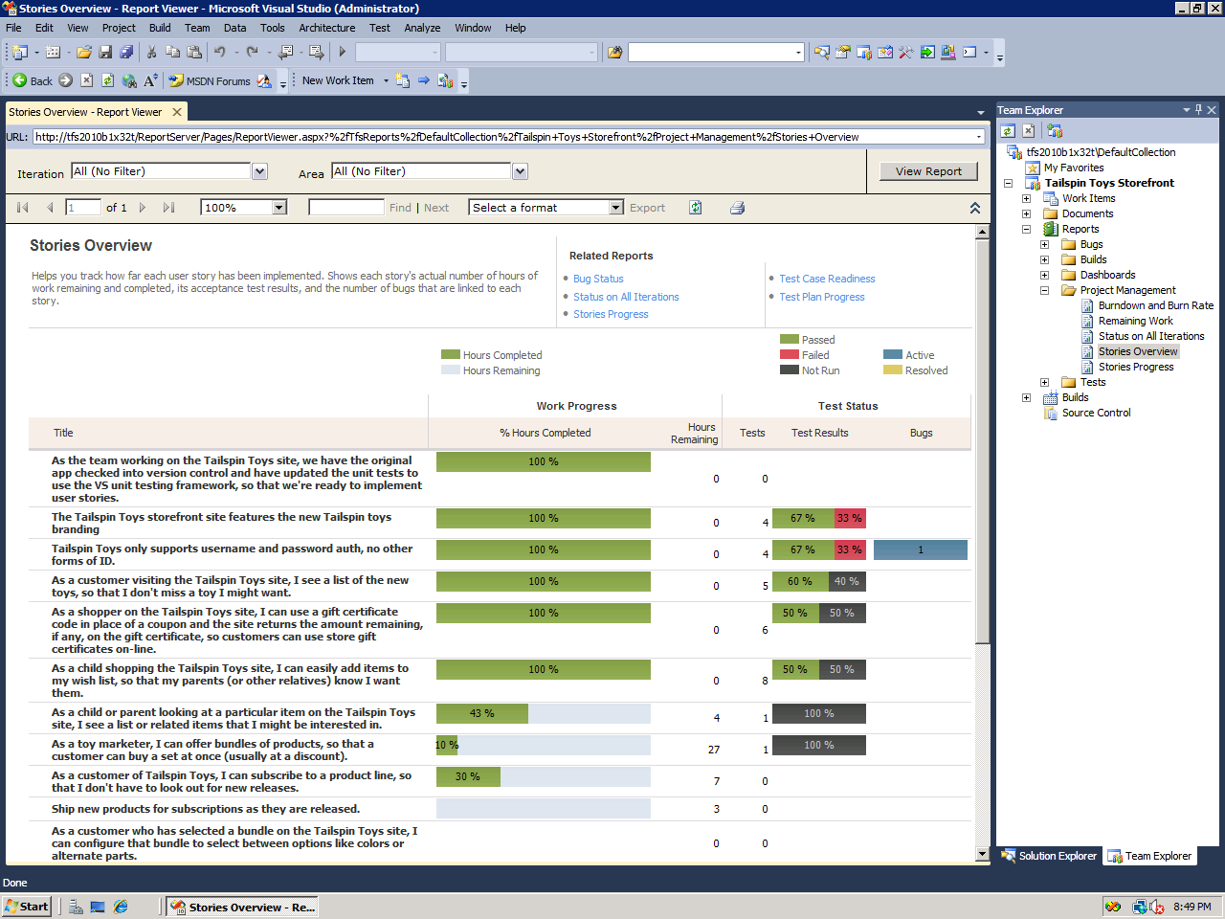
All the while, the team can see progress on requirements as well as the quality of the requirements!
Notes:
The key points about this report:
You can see progress roll-up on requirements/user stories – the cube does a roll-up of the remaining work and completed work
You can see quality of the requirements because of the traceability from requirements to tests and because of the testing that is happening on the tests
You can also see bugs linked to the requirements because of the requirements-test case-bug traceability

