Slide 2
Visual C++ 2010: The Accelerated Way of Developing Modern Windows Applications
Marian Luparu
Program Manager
Microsoft
Session Code: DEV308

Slide 3
Agenda
Theme of the talk
Visual C++ 2010
Demo
Q & A

Slide 4
Visual C++ 2010 and Windows 7
Windows enables building modern user experiences for client applications
Visual C++ is the best tool to take advantage of Windows and develop high-performance modern code

Slide 5
Manage Large Scale Applications
Scalable IntelliSense/Browsing Engine
SQL-backed symbol store | One-time symbol parse | IntelliSense - O(1) with solution size
MSBuild-based Build System
Build diagnostics | Incremental build | Enlistment consistency

Slide 6
Write Code Faster
C++ Code Editor
Navigate To | #include auto-complete | Inline code errors | Class Wizard | Find all references | Call Hierarchy
Debugger
Threads window (search, grouping) | Data-tips | Symbol loading | String functions
Migration
Native Multi-targeting

Slide 7
Write Modern Code
TR1 Support
shared_ptr | unique_ptr | regex | tuple | array, etc.
C++-0x Support
Lambdas | r-value references | auto | decltype | static_assert
Concurrency
Parallel algorithms | Tasks | Agents API | Thread-safe containers

Slide 8
Build Modern Applications
MFC Light-up to Windows 7
Taskbar Preview | Taskbar Jump-list| Restart Manager & Application Recovery | High-DPI
MFC Support for Windows 7 API
Multi-touch & Gestures | Ribbon | Find & Organize | Live Icons & Rich Preview | Task Dialogs
Windows 7 API
Direct2D | DWrite | XPS | Direct Ribbon Support | Web Services API

Slide 9
Key Takeaways
Code focused
Modern code
Parallel code
Code today ☺

Slide 10
question & answer
mluparu@microsoft.com
http://blogs.msdn.com/vcblog

Slide 11
Resources
Required Slide
Speakers,
TechEd 2009 is not producing
a DVD. Please announce that
attendees can access session
recordings at TechEd Online.
www.microsoft.com/teched
Sessions On-Demand & Community
www.microsoft.com/learning
Microsoft Certification & Training Resources
http://microsoft.com/technet
Resources for IT Professionals
http://microsoft.com/msdn
Resources for Developers

Slide 12
Related Content
Required Slide
Speakers,
please list the Breakout Sessions, TLC Interactive Theaters and Labs that are related to your session.
Breakout Sessions (session codes and titles)
Day |  | Room | Session | Presenter
Today | 13:30 | Keynote Hall 25 | DEV-GEN Developer General Session - Visual Studio 2010: New Challenges, New Solutions | Jason Zander
Tue | 12:30 | Budapest Hall 7-2b | DEV02-DEMO Face-Lifting MFC Applications on Windows 7 | Damien Watkins
Wed | 15:45 | Europa 2 Hall 7-3b | DEV309 The Windows API Code Pack: How Managed Code Developers Can Easily Access Exciting New Windows Vista and Windows 7 Features | Kate Gregory
Thu | 15:15 | Berlin 1 Hall 7-3a | DEV401 Building High Performance Parallel Software | Steve Teixeira
Interactive Theater Sessions (session codes and titles)
Day | Time | Room | Title | Presenter
Today | 13:30 - 14:45 | Keynote Hall 25 | DEV-GEN Developer General Session - Visual Studio 2010: New Challenges, New Solutions | Jason Zander
Tuesday | 12:30 - 13:00 | Budapest Hall 7-2b | DEV02-DEMO Face-Lifting MFC Applications on Windows 7 | Damien Watkins
Wednesday | 15:45 - 17:00 | Europa 2 Hall 7-3b | DEV309 The Windows API Code Pack: How Managed Code Developers Can Easily Access Exciting New Windows Vista and Windows 7 Features | Kate Gregory
Thursday | 15:15 - 16:30 | Berlin 1 Hall 7-3a | DEV401 Building High Performance Parallel Software | Steve Teixeira
Hands-on Labs (session codes and titles)
Hands-on Labs (session codes and titles)

Slide 13
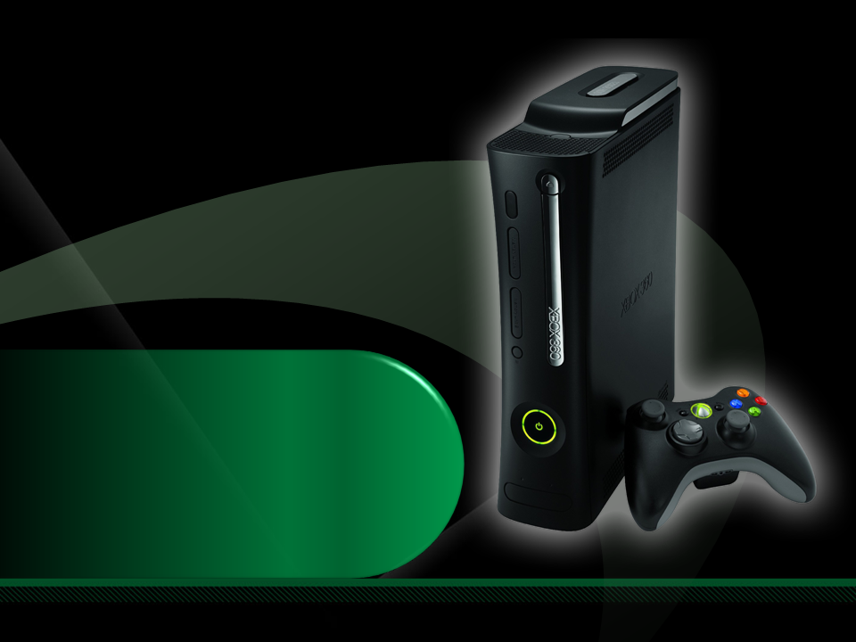
Complete an evaluation on CommNet and enter to win an Xbox 360 Elite!

Slide 14
Required Slide
© 2009 Microsoft Corporation. All rights reserved. Microsoft, Windows, Windows Vista and other product names are or may be registered trademarks and/or trademarks in the U.S. and/or other countries.
The information herein is for informational purposes only and represents the current view of Microsoft Corporation as of the date of this presentation. Because Microsoft must respond to changing market conditions, it should not be interpreted to be a commitment on the part of Microsoft, and Microsoft cannot guarantee the accuracy of any information provided after the date of this presentation. MICROSOFT MAKES NO WARRANTIES, EXPRESS, IMPLIED OR STATUTORY, AS TO THE INFORMATION IN THIS PRESENTATION.

