Slide 2
Windows Embedded Standard 2011: How to Embed Windows 7 into Devices
Randy Rockinson
Program Manager
Microsoft
Session Code: EMB 303

Slide 3
Session Goals
Introduction
  Windows Embedded Standard 2011
Demonstration
  Build a Kiosk device
    Rapid Development – Image Builder Wizard (IBW)
    Advanced Development – Image Configuration Editor (ICE)
    Embedded Runtime Capture and Deployment (ImageX)
Questions

Slide 4
Session Roadmap
Introduction
  Why Windows Embedded Standard 2011?
  Windows Embedded Standard 2011 – The Building Blocks
  Windows Embedded Standard 2011 Developer Toolkit

Slide 5

Why Windows Embedded Standard 2011?
Customized Win7 OS for Specialized Devices
  Delivers the power of Windows 7 in a componentized form
  Features specific to Embedded Scenarios (Embedded Enabling Features)
  Enterprise server and tools integration
Win32 and .NET application compatibility
Large developer and partner community
Off-the-shelf hardware and drivers (x86 and x64)
Localizable for many markets
Sample device types:
  Kiosks, thin clients, point of service, automation, gaming, medical imaging,
  DVR, headless devices

Slide 6

Bringing the Power of Windows 7
Features to Embedded
Rich User Experiences
  Windows Touch, Windows Aero, 64 Bit, Windows Presentation Foundation,
  Windows Sensor and Location platform
Security
  BitLocker and BitLocker to Go, AppLocker, Biometric Framework,
  DirectAccess, BrancheCache
Power Reduction (Green)
  Reduced idle power consumption, Timer Coalescing API
Performance
  Boot time, SuperFetch
And More …
  Internet Explorer 8, Windows Media Player 12, RDP 7, .NET 3.5, PowerShell V2

Slide 7
The Windows Embedded Family

Slide 8
Session Roadmap
Introduction
  Why Windows Embedded Standard 2011?
  Windows Embedded Standard 2011 – The Building Blocks
  Windows Embedded Standard 2011 Developer Toolkit

Slide 9



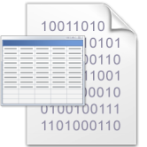




A “Composable” OS
Feature Packages
Update Package
Embedded Core
(Bootable)
Enhanced
Write Filter
Internet
Explorer
Lang Packs/
Driver Packs
3rd Party
Software
Installer
OS Updates
Embedded Developer Tools
Embedded Runtime OS

Slide 10




Embedded Core and Features
  Embedded Core
    Foundation of every embedded OS
    Contains a core set of functionality
Embedded
Core
            Features
              Internet Explorer 8
              Windows Media Player 12
              Windows Firewall

Slide 11





Hardware and Language Support
  Hardware Support
    About 400 driver packages inbox
    Installable post-build
    Printer drivers packaged per manufacturer
            Language Support
              Target is to release ~40 languages and LIPS
              Installable post-build

Slide 12
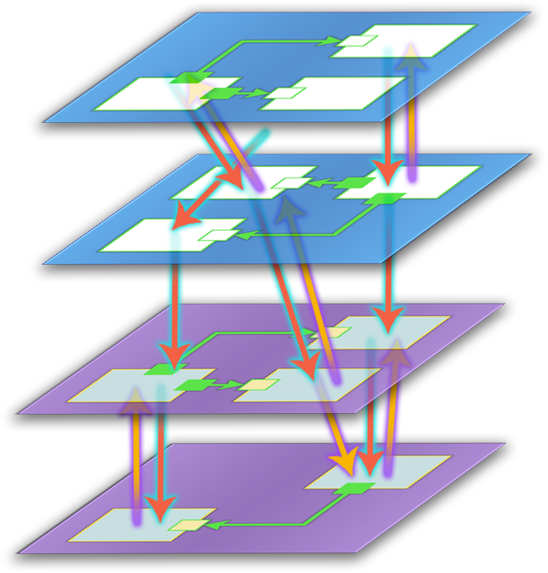
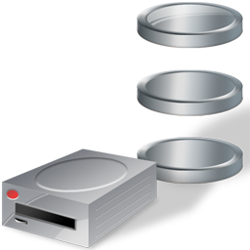
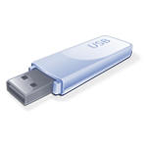

Embedded Enabling Features
  Write Filters
    Enhanced Write Filter
    File-based Write Filter
            Media Boot Support
              USB Boot
              VHD Boot
              DVD Boot

Slide 13

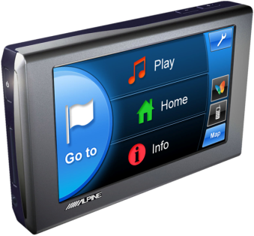
Embedded Enabling Features
  Message Blockers
    Dialog filter
    Message Box Auto Reply
            Custom Shell Support
              Unbranded Startup Screens
              Custom Logon Desktop Background Images
              Shell Launcher

Slide 14
Session Roadmap
Introduction
  Why Windows Embedded Standard 2011?
  Windows Embedded Standard 2011 – The Building Blocks
  Windows Embedded Standard 2011 Developer Toolkit

Slide 15
A “Composable” OS
Feature Packages
Update Package
Embedded Core
(Bootable)
Enhanced
Write Filter
Internet
Explorer
Lang Packs/
Driver Packs
3rd Party
Software
Installer
OS Updates
Embedded Developer Tools
Embedded Runtime OS

Slide 16

Embedded Device Development Model
Device Concept
Application
Hardware
Platform eval and selection
Form factor
Embedded req definition
Board design, bios selection
Application design and dev
Services
Drivers development
Development Model
Integration
Custom WE OS design
Application and Hardware integration
Device testing

Slide 17
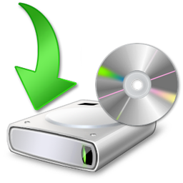



Fundamental Development Tools
Image Builder Wizard (IBW)
Contained Toolkit – Bootable Development Experience
Streamlined - focus less on tweaking and more on functionality
Image Configuration Editor (ICE)
    Advanced embedded development scenarios
Allows greater customization offline
ImageX and Sysprep
Sysprep allows generalization of the OS
ImageX allows capture and deployment of WIM files.

Slide 18

Session Roadmap
Demonstration
  Building the Kiosk at the Windows Embedded Booth
  Image Builder Wizard (IBW) - Rapid Development
  Image Configuration Editor (ICE) – Advanced Development
  Sysprep and ImageX – Capture the OS for deployment
  IBW and ImageX - Deployment

Slide 19
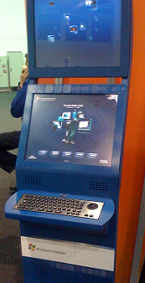
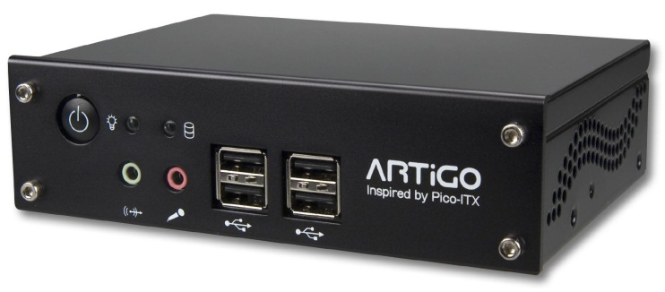
Embedded Device Development Model
Kiosk
WE Standard Kiosk App
Via Artigo A 1000
  WPF Application
  VIA C7 1GHz Processor
Media Rich - WMP
1 GB DDR2
  Touch Enabled
  2.5” SATA Hard Disk
Development Model
Embedded OS
Custom Shell
Custom Startup Screens
Device testing

Slide 20
Session Roadmap
Demonstration
  Building the Kiosk at the Windows Embedded Booth
  Image Builder Wizard (IBW) - Rapid Development
  Image Configuration Editor (ICE) – Advanced Development
  Sysprep and ImageX – Capture the OS for deployment
  IBW and ImageX - Deployment

Slide 21
Building a Kiosk enabled device using Image Builder Wizard (IBW)
demo
Randy Rockinson
Program Manager
Microsoft Corporation

Slide 22





IBW – The Wizard Experience
Capture /Deploy
Image Builder Wizard (IBW) for Rapid Development
Online Develop
Build /Install
Offline Develop
WIM
Boot
Sysprep, imagex
Sysprep to generalize
ImageX to capture .WIM
IBW to deploy .WIM
IBW: Image building engine
Builds and installs embedded OS
Customization may be done on the embedded OS itself
Advanced Scripting
Import .PMQ
Advanced feature selection
WinPE
IBW
Contains all Embedded resources
1
2
3
4
5

Slide 23
Session Roadmap
Demonstration
  Building the Kiosk at the Windows Embedded Booth
  Image Builder Wizard (IBW) - Rapid Development
  Image Configuration Editor (ICE) – Advanced Development
  Sysprep and ImageX – Capture the OS for deployment
  IBW and ImageX - Deployment

Slide 24
ICE Demo Outline
1. Add Kiosk Application Support
2. Customize image through settings
3. Add support for drivers
4. Create bootable installation media
5. Build, Install, and Run

Slide 25
ICE Demo Detail
1. Add Kiosk Application Support
  Find Kiosk Application dependencies using Static Dependency Analyzer (SDA)
  Add the Kiosk Application to our Distribution Share (embedded resource repository)
  Instruct the build system to include the Kiosk Application MSI on the runtime OS
  Add additional OS functionality ( MSI support, Unbranded Startup Screens, and Custom Shell Support)
  Resolve feature dependencies

Slide 26
ICE Demo Detail
2. Customize image through settings
  Install: Instruct build system to install MSI
  Shell: Instruct image to use Kiosk application as the shell
  Script: Use a template to create a touchless build and install

Slide 27
ICE – Typical Passes
Boot WinPE
First Boot
OOBE
Sysprep/Generalize
Run Image Builder
WinPE Pass
Specialize Pass
OOBE Pass
Generalize Pass
Partition
Language Set
Set Display
Process Answer File Settings
Format
Timezone
Create Users
Prepare to Build Image
Computer Name
Run First Logon Commands
Process Generalize Providers
BCD Edit
IE Configuration
Join Domain
Set IE Proxy
Offline Servicing Pass
Run Scripts
First Login
Shutdown
Build and Installation
Reboot
Reboot (possible)
Online Tweaking
Capture with ImageX

Slide 28
ICE Demo Detail
3. Add support for drivers
  Static: Add driver packages using a .PMQ file
  Dynamic: Add a setting to tell build system to automatically run TAP.exe and map inbox drivers

Slide 29
ICE Demo Detail
4. Create bootable installation media
  Use ICE to create a custom set of bootable files used to build and install Kiosk Image

Slide 30
ICE Demo Detail
5. Build, Install, and Run
  Use ICE to create a custom set of bootable files used to build and install Kiosk Image
  Boot and run resulting embedded Kiosk device
  Will skip the build and install step due to time

Slide 31
ICE – Advanced Configuration
Capture /Deploy
Image Configuration Editor (ICE) on Developer Machine
Online Develop
Build /Install
Create Boot Media
WIM
Offline Develop
Sysprep, imagex
Sysprep to generalize
ImageX to capture .WIM
IBW to deploy .WIM
IBW: Image building engine
Uses Answer File fcreated by ICE
Customization may be done on the embedded OS itself
Use ICE menu option
Supports multiple Scenarios
Support for Settings / Scripting
3rd party SW and driver support
1
2
3
4
5

Slide 32
Session Roadmap
Demonstration
  Building the Kiosk at the Windows Embedded Booth
  Image Builder Wizard (IBW) - Rapid Development
  Image Configuration Editor (ICE) – Advanced Development
  Sysprep and ImageX – Capture the OS for deployment
  IBW and ImageX - Deployment

Slide 33
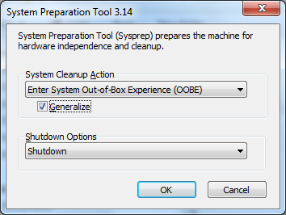
Sysprep: Decoupling the OS
C:\Windows\System32\sysprep>
sysprep.exe /generalize /OOBE /shutdown
/unattend:“E:\answerfile.xml”

Slide 34
ImageX: Capturing a .WIM
C:>imagex /capture C: E:\EmbeddedKiosk.WIM “Embedded Kiosk”

Slide 35
Session Roadmap
Demonstration
  Building the Kiosk at the Windows Embedded Booth
  Image Builder Wizard (IBW) - Rapid Development
  Image Configuration Editor (ICE) – Advanced Development
  Sysprep and ImageX – Capture the OS for deployment
  IBW and ImageX - Deployment

Slide 36
ImageX: Deploy a .WIM
C:>imagex /apply E:\EmbeddedKiosk.WIM 1 C:\

Slide 37
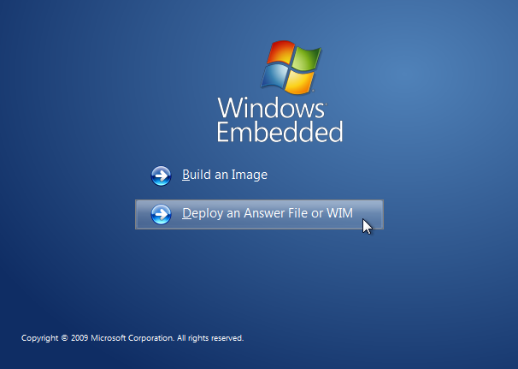
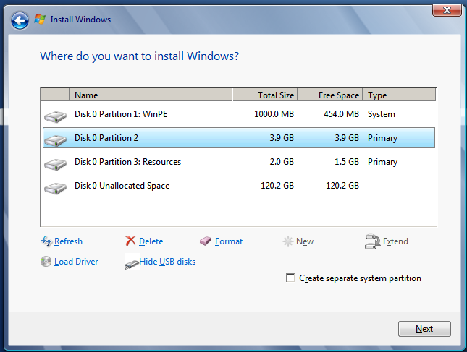
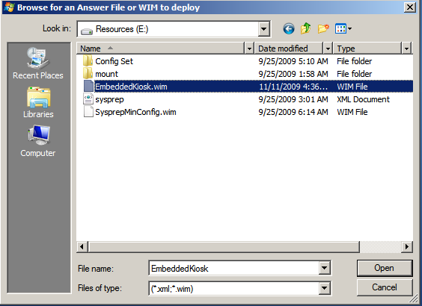
IBW: Deploy a .WIM

Slide 38
question & answer

Slide 39
Breakout Sessions
General
  EMB202: What a desktop developer needs to know to develop for Windows Embedded
  EMB304: Windows Embedded: from sensors to servers
  EMB310: Windows Embedded: "Demos only“
Windows Embedded CE
  EMB301: Technical introduction to the new Windows Embedded CE 6.0 R3
  EMB307: Windows Embedded CE6.0: Tools and Techniques to Face the Embedded Development Challenges
  EMB201: Windows Embedded CE and Connectivity
  EMB305: From Expression Blend to Windows Embedded CE: build the UI of next generation devices
Windows Embedded Standard and POSReady
  EMB303: Windows Embedded Standard 2011: How to Embed Windows 7 into Devices
  EMB309: Create a Multitouch and Gesture Aware Device Using Windows Embedded Standard 2011
  EMB308: Componentization Architecture in Windows Embedded Standard 2011
  EMB306: Using Windows PowerShell on Windows Embedded Standard
  EMB302: Deploying Windows Embedded with Style
  EMB203: Using Windows Deployment Services And Microsoft System Center To Deploy And Manage A Point-of-Service (POS)

Slide 40
HOLs, Interactive, Sunday and Demo Sessions
Interactive sessions
  EMB01-IS: Delivering Applications as Appliances
  EMB02-IS: Windows for Devices: Learn about the Future of Windows Embedded
  EMB03-IS: The Schtick: Solving Real-Time Challenges, connectivity and GUI with Windows Embedded CE
  EMB04-IS: Deploying and maintaining Windows Embedded Standard with different
Hands On Lab
  Higher Fidelity internet experience with Internet Explorer Embedded
  Introduction to Connection Manager
  Creating a custom Windows Embedded Standard 2011 operating system image for an application
  New Servicing and Deployment Scenarios in Windows Embedded Standard 2011
  Embedded Enabling Features in Windows Embedded Standard 2011
  Configuring and Using PowerShell to Manage Windows Embedded Standard 2011 Devices
Sunday and Demo Session
  EMB101-SUN: Windows Embedded101
  EMB01-Demo: Embedding Windows Seven into devices

Slide 41
Useful URLs
Microsoft Web sites
  http://windowsembedded.com
  http://msdn.microsoft.com/en-us/windowsembedded/ce/default.aspx
  http://msdn.microsoft.com/en-us/windowsembedded/standard/default.aspx
  http://technet.microsoft.com/en-us/windowsembedded/posready/default.aspx
Blogs
  http://blogs.msdn.com/obloch
  http://blogs.msdn.com/mikehall
  http://blogs.msdn.com/jcoyne
Other
  http://windowsfordevices

Slide 42




Resources
www.microsoft.com/teched
  Sessions On-Demand & Community
www.microsoft.com/learning
Microsoft Certification & Training Resources
http://microsoft.com/technet
  Resources for IT Professionals
http://microsoft.com/msdn
  Resources for Developers

Slide 43
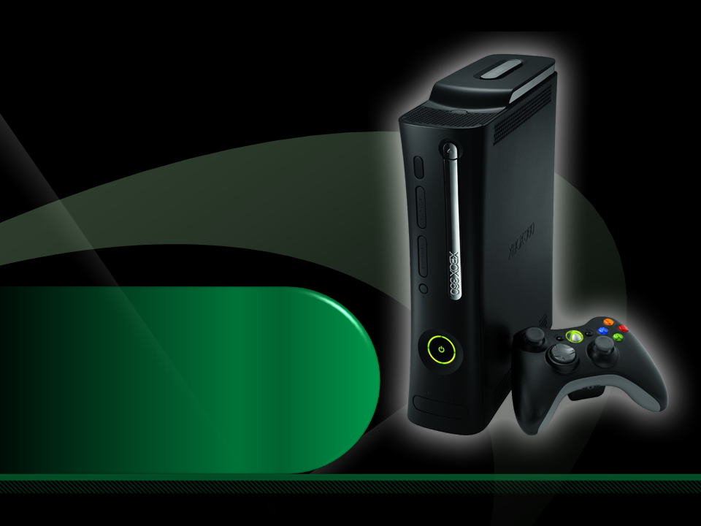
Complete an evaluation on CommNet and enter to win an Xbox 360 Elite!

Slide 44

© 2009 Microsoft Corporation. All rights reserved. Microsoft, Windows, Windows Vista and other product names are or may be registered trademarks and/or trademarks in the U.S. and/or other countries.
The information herein is for informational purposes only and represents the current view of Microsoft Corporation as of the date of this presentation. Because Microsoft must respond to changing market conditions, it should not be interpreted to be a commitment on the part of Microsoft, and Microsoft cannot guarantee the accuracy of any information provided after the date of this presentation. MICROSOFT MAKES NO WARRANTIES, EXPRESS, IMPLIED OR STATUTORY, AS TO THE INFORMATION IN THIS PRESENTATION.

