Slide 2

Tools & Techniques to face the embedded development challenges
Thierry JOUBERT
C.T.O.
THEORIS
Session Code: EMB307

Slide 3


partner

Slide 4
Embedded Development
Some specific constrains …
Cross Development tool chain
  Augmented complexity
Device has reduced functionalities
  You cannot count on usual “System Tools”
Resources are limited
  64 MB of RAM makes a big difference!
Robustness is mandatory
  No “User Default Exception Handler”

Slide 5
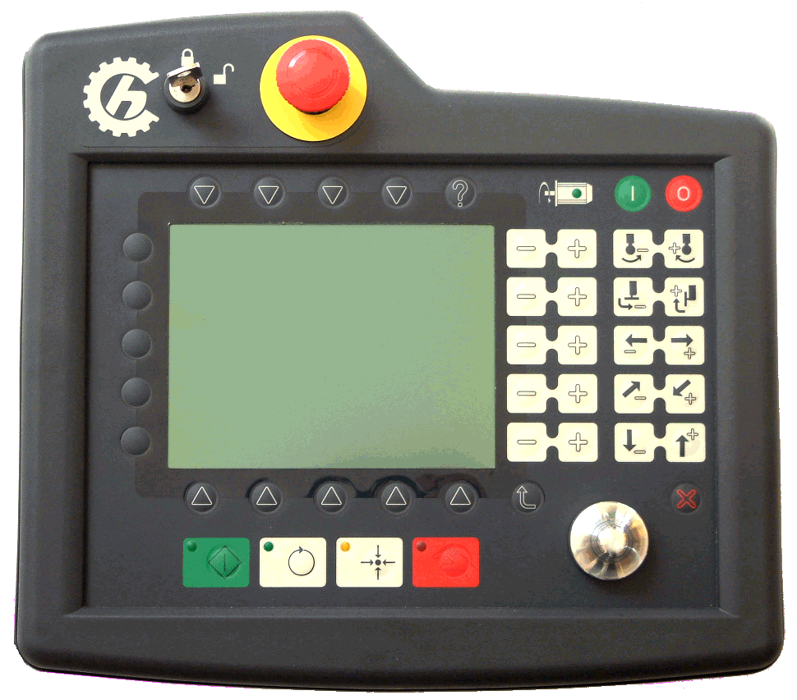
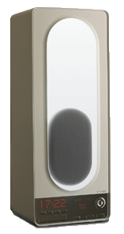
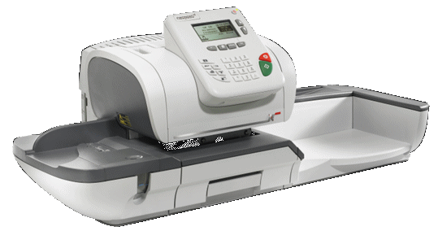
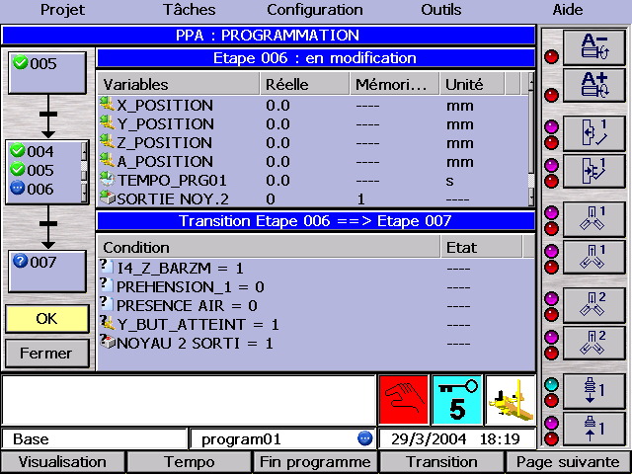
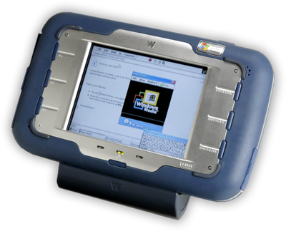
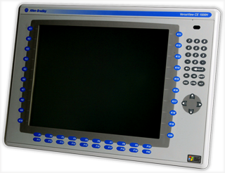
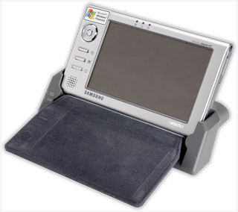


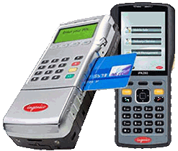
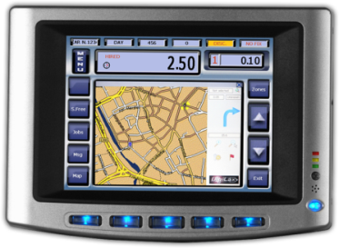
Windows Embedded Compact
40 recent projects
ingenico iPA280

Slide 6
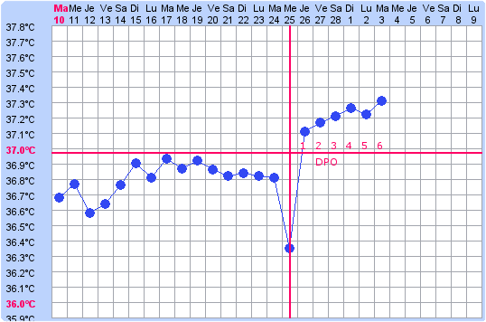

Man Machine Interface
One project out of five is HeadLess
Panels have specific interaction model
All devices require high availability
ingenico iPA280

Slide 7
High Determinism
One project out of three requires high determinism
  Sensors & Actuators control
  High impact on device productivity

Slide 8




Cross development Toolchain
A unified toolchain
  Visual Studio for Kernel & Applications
  A unique API for all projects (including drivers)
  Native & Managed applications
Kernel design time = Platform Builder
Application design time = Smart Devices

Slide 9

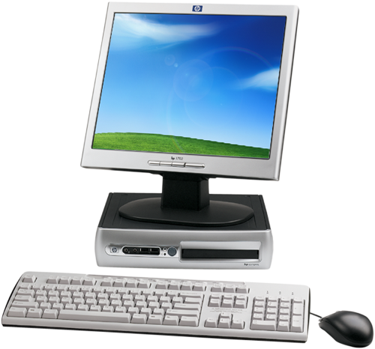


CE Kernel & SDK
Visual Studio
Application
sources
.h .lib .chm
Platform
SDK
Platform
Builder
SDK.msi
WinCE
& drivers sources
Application development
OS Development
CE
Binary
.exe .dll
NK.bin
Target

Slide 10

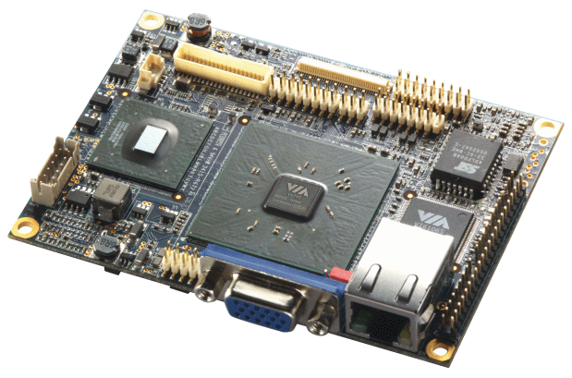


Embedded Project processus
Hardware
Software
Eval Board
Prototype
Final
High Level
of parellism
→ High pressure
OS Development
Application Development
Factory Tests
Ship!
Field Tests

Slide 11
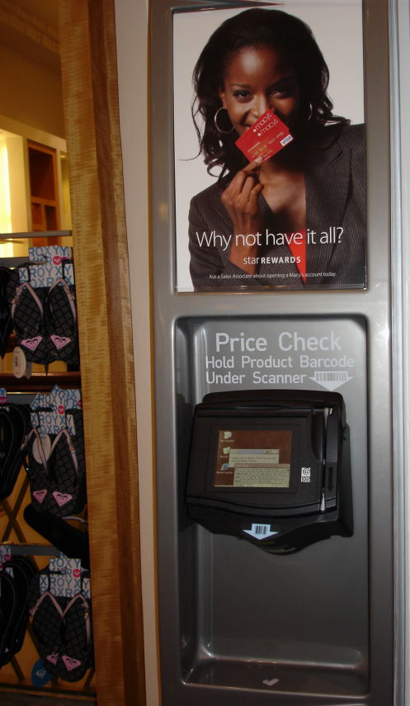
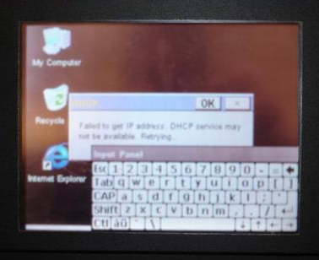
Ship too early…
Seattle
2009
Extreme processus
    Device is not responding
    Final users are unsatisfied
    Difficult to make corrections
    Costs go up, revenue goes down
Ship!
Final Hardware
Application

Slide 12



Dependencies & Tools
Hardware
Software
I need Ethernet!
Eval Board
Prototype
Final
Too bad…
I need logs
Oups…
Gimme Kernel Debug
OS dev.
No way…
App. Dev.
Factory
Field

Slide 13
Tools for everyone
OS development
  KITL, Kernel debug
Application Development
  Corecon, User debug, Remote Tools
Factory tests
  Remote display, Celog, Shell
Field tests
  Toolhelp, IP utilities, Telnet, Error Report
OS development
Application Development
Factory tests
Field tests

Slide 14
Let’s talk about protocols
Host – Target connectivity
  Corecon is for developers
  KITL is for OS builders
Corecon
User level
KITL
Kernel level

Slide 15

Establish Core connectivity
Target side implementation
  <Vol>:\Program Files\<Common>\Microsoft shared\Corecon\1.0\target\wce400\<CPU>\
  Copied during the installation of Visual Studio
  Host & Target versions must match!...
 Tools
  Options
    Devices
Corecon
ConmanClient2.exe
+
(
Configure TCP transport
CMAccept.exe
OR
)
Connect!
HLKM\System\CoreConOverrideSecurity=1

Slide 16
Tools using Corecon
Visual Studio “Smart Devices” projects
  Applications Deployment & Debug
Visual Studio “Remote Tools”
  <Vol>:\Program Files\CE Remote Tools\5.01\bin\
  Remote File Viewer ccfilevw.exe
  Remote Registry Editor ccregedt.exe
  Remote Process Viewer ccpview.exe
  Remote Heap Walker ccheapwk.exe
  Remote Spy ccspy.exe
  Remote Zoom In cczoom.exe

Slide 17
Visual Studio output via Corecon
Dedicated transport for VS “Debug Mode”
  DEBUGMSG … Debug build
  RETAILMSG … Release build
Corecon
…
DEBUGMSG(“-DEBUG-”)
RETAILMSG(“-RETAIL-”)
-DEBUG-
-RETAIL-
-RETAIL-

Slide 18
Factory testing
Specific constrains …
Visual Studio is not available
  A dedicated host is available for multiple target
  No developers around
Need to configure the target
  Parameters in the Registry (IP, security, launch, etc.)
  Manipulate the file system (Upload & Download, etc.)
Launch Tests and control their execution
  Write & launch scripts
  Create Logs and analyze them
  Get runtime statistics

Slide 19
CE Remote Display
“Remote Zoom In“ provides screen captures
    Great for User Manuals… that’s all
Remote Display Client & Host
    Dedicated protocol over TCP/IP
    Targets Broadcast their presence
    Framework provided by Platform Builder
      Launch “CERDISP.exe” on the device
    PB→CoreOS services/Debugging Tools/Remote Display Application
      Launch “CERHOST.exe” on the workstation
    <WCEROOT>/PLUBIC/Common/OAK/BIN/i386

Slide 20
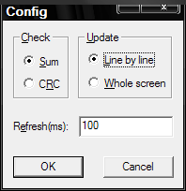
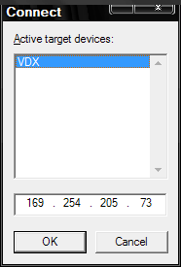
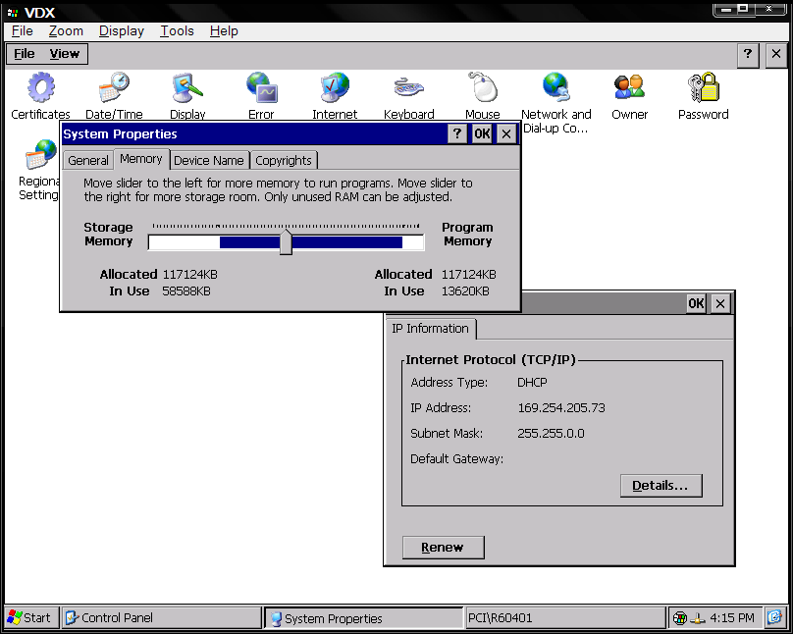
Remote Display usage
cerhost
cerdisp -c
Windows CE desktop
Ethernet

Slide 21
Core Connectivity & Remote Display
demo
Thierry Joubert
CTO
THEORIS

Slide 22
Logging system activity
CELOG framework on the Target
  Collects events in Kernel, Drivers & Applications
  Configuration from Registry or Command Line Shell
  Two stand-alone applications: CeLogFlush & OSCapture
  Data is stored in a file for upload
READLOG application on the Host
  Display and filter the data
Offline Visualization in Kernel Tracker
  Graphical display
  Timeline tools
  System objects identification

Slide 23

Log Threading
Threading is great, but it is opaque
  Virtual CPU (registers & stack duplication)
  Parallelism is not in the programming language
  Scheduler policy allocates the real CPU
Threading Pitfalls
  STARVATION… a thread never runs
  ATOMICITY … shared data is corrupted
  DEADLOCK … synchronization fails
Do not expect exceptions here!

Slide 24

Log Virtual Memory
Windows CE 6.0 Virtual Memory
  Each Process may claim up to 1.2 GB
  RAM is limited to 512 MB (most devices have less!...)
  No page file is available when you hit the limit
Good news
  Stacks & Heaps are created small
  Page Pooler runs in the background
  CE System & CE-Win32 API do not consume much space
Avoid Congestion!

Slide 25
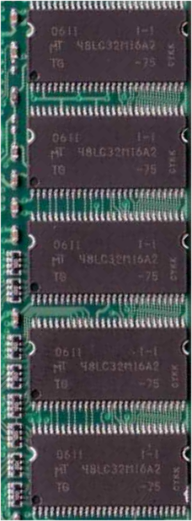
Virtual Memory Mapping
4GB
KERNEL
Virtual space
Real pressure
On the RAM
2GB
Physical
RAM
mapping
Reserved
File Mapping
Shared DLLs
MMU
USER
2GB
1GB
EXE
Heap + Stack
Code + Data
0x0000 0000

Slide 26
Memory status API
  void GlobalMemoryStatus(
  LPMEMORYSTATUS lpBuffer);
  typedef struct _MEMORYSTATUS {
  DWORD dwLength;
  DWORD dwMemoryLoad;
  DWORD dwTotalPhys;
  DWORD dwAvailPhys;
  DWORD dwTotalPageFile;
  DWORD dwAvailPageFile;
  DWORD dwTotalVirtual;
  DWORD dwAvailVirtual;
  } MEMORYSTATUS, *LPMEMORYSTATUS;
Calling Process

Slide 27
CeLogFlush
Continuous logging
Parameters (Registry or Command line)
  Size of the event Buffer
  Flush period
  File name
  Optimisation
  Log Zones
    CELZONE_RESCHEDULE
    CELZONE_CRITSECT
    CELZONE_BOOT_TIME
    CELZONE_INTERRUPT
    CELZONE_SYNCH
    CELZONE_VIRTMEM
    CELZONE_DEMANDPAGE
    Etc…
CeLogFlush.exe
Buffer
Log
File
Period

Slide 28
OSCapture
Snapshot logging
Parameters (Registry or Command line)
  Sampling buffer size
  Timeout between flushes
  Number of flushes in RAM
  File name
  Log Zones
  Trigger → oscapture –c
Convenient for monitoring
  Small impact
  Take a “photo” of the system
OSCapture.exe
Buffer
Log
File
Trigger

Slide 29
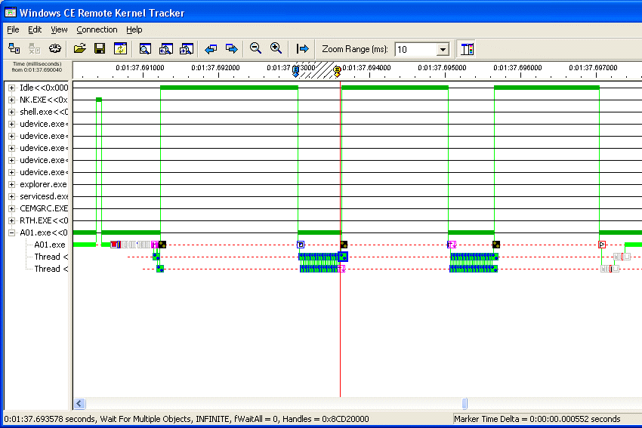
Analyzing the log files
ReadLog Application
  Convert .CLG file to Text
  Prepare Oscapture .CLG files with OS symbols
  Readlog -sync celog.clg newfile.clg
  → this requires the OS symbols in FLATRELEASEDIR
  Load .CLG file in Kernel Tracker

Slide 30
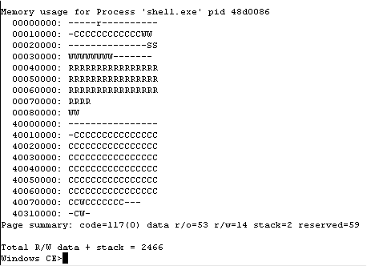
CE Shell
SHELL.EXE application
  Local command shell: “shell –c”
  View Process, Threads & Modules
  gi [proc] [thrd] [heap] …
  Launch and Kill EXE
  s app.exe, kp procnum
  View Memory usage
  mi [full] [kernel]
  Control CELog activity
  log …

Slide 31
Factory testing
demo
Thierry Joubert
CTO
THEORIS

Slide 32
Field testing
Specific constrains …
No dedicated host
  Access through the device interface (if not Headless)
  Access with a standard PC
Need to do field configuration
  Administrator access
  Dedicated automaton
Collect data
  Execution logs
  System Dump on exceptions

Slide 33
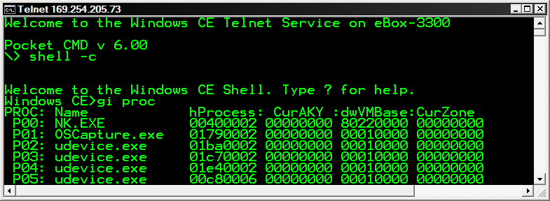
Telnet utility
Remote terminal over TCP/IP
  Telnet component + registry settings for security
  Build on CMD
    File redirection
    run .BAT files
  Console redirection for printf, scanf and SHELL.exe!

Slide 34
Error Report framework
Post Mortem analysis
Error Report Generator
  Reserves a memory pool for Dump creation
  Exception!→ Creates the Dump in memory
Error Report Transfer Driver
  Handles the memory transfer
    Copy on disk
    Call the transfer application (optionnal)

Slide 35
Error Report framework
Post Mortem analysis
Impacts the Size reserved at startup
Error Report Generator
  Reserves a memory pool
  HKLM\System\ErrorReporting\DumpSettings – “DumpType”
  Exception! Dump context to memory pool
Error Report Transfer Driver
  Handles the memory transfer
    Copy Dump memory pool to a file
    HKLM\System\ErrorReporting\DumpSettings – “DumpDirectory“
    → HKLM\System\ErrorReporting\DumpFiles - “…File name…”
    Call transfer application (optionnal)
    HKLM\System\ErrorReporting\DumpSettings - “UploadClient”

Slide 36
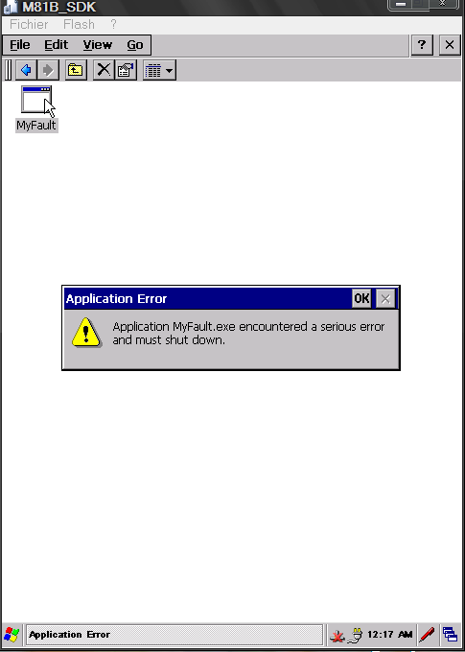
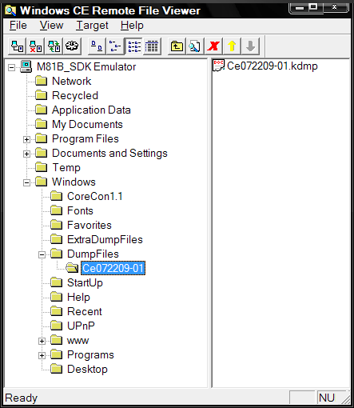
Exception & Dump File
Device

Slide 37
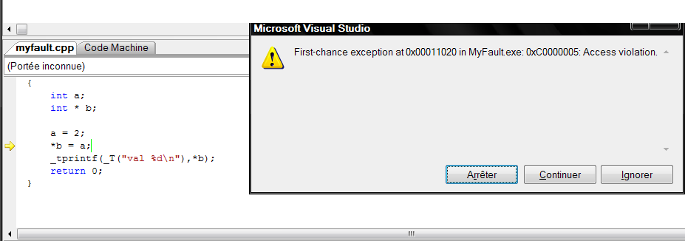
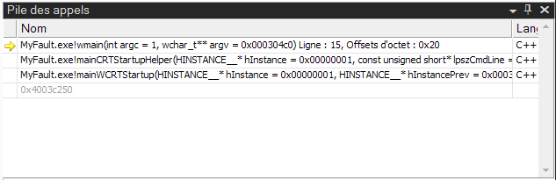
Post Mortem file Analysis
Copy the .KDMP file on the host
  In the project directory with .PDB files
Open .KDMP file with VS in project mode
  Launch a new debugger instance
Call Stack
Name

Slide 38
ToolHelp library
Snapshot (initialization)
  CreateToolhelp32Snapshot, CloseToolhelp32Snapshot
Process
  Process32First, Process32Next
Thread
  Thread32First, Thread32Next
Heap
  Heap32First, Heap32ListFirst, Heap32ListNext, Heap32Next
Module
  Module32First, Module32Next
  Toolhelp32ReadProcessMemory

Slide 39
ToolHelp strucrtures
  typedef struct tagPROCESSENTRY32
  {
  DWORD dwSize;
  DWORD cntUsage;
  DWORD th32ProcessID;
  ULONG_PTR th32DefaultHeapID;
  DWORD th32ModuleID;
  DWORD cntThreads;
  DWORD th32ParentProcessID;
  LONG pcPriClassBase;
  DWORD dwFlags;
  TCHAR szExeFile[MAX_PATH];
  } PROCESSENTRY32 … ;
  typedef struct tagTHREADENTRY32
  {
  DWORD dwSize;
  DWORD cntUsage;
  DWORD th32ThreadID;
  DWORD th32OwnerProcessID;
  LONG tpBasePri;
  LONG tpDeltaPri;
  DWORD dwFlags;
  }THREADENTRY32,… ;

Slide 40
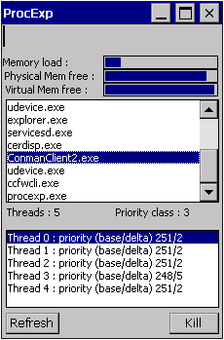
List image names for all Processes
#include <toolhelp.h>
int _tmain(int argc, _TCHAR* argv[])
{
HANDLE hSnap;
PROCESSENTRY32 OneProcess;
hSnap = CreateToolhelp32Snapshot(
TH32CS_SNAPPROCESS, 0);
if (Process32First(hSnap, &OneProcess))
{
_tprintf(_T("%s\n"), OneProcess.szExeFile);
while (Process32Next(hSnap, &OneProcess))
{
_tprintf(_T("%s\n"), OneProcess.szExeFile);
}
}
}

Slide 41
Target utilities
And best practice
Visit embedded MVPs blogs
  http://geekswithblogs.net/BruceEitman
    Technical posts, Downloads for tools & Samples
  http://www.embedded101.com
    Autolaunch, and more to come!
  http://guruce.com/blog
  http://geekswithblogs.net/ThierryJoubert
Visit MS teams blogs
  http://blogs.msdn.com/cebase
  http://blogs.msdn.com/cenet
  http://blogs.msdn.com/HoppeRx
… and more on useful URLs slide

Slide 42
Field Testing
demo
Thierry Joubert
CTO
THEORIS

Slide 43
Tools & Usage
Legend ☑ Highly applicable
✓ Applicable
Windows Embedded Compact Tools*
 | KITL | CoreCon | Msg | Rdisp | Celog | Shell | Telnet | ToolHelp | KDMP
OS Dev | ☑ |  | ✓ |  |  | CESH
App Dev | Passive | ☑ | ☑ | ✓
Factory | Passive | ✓ | ✓ | ☑ | ☑ | ☑ | ☑ | ✓ | ✓
Field | Passive |  |  | ✓ | ✓ | ✓ | ☑ | ☑ | ☑
Ship | Passive | CMAccept |  | Manual | OSCapture |  | login | ✓ | ✓
OS Dev
App Dev
Factory
Field
Ship!
*This table gives “best cases”, all the tools may be used in any situation!

Slide 44
question & answer

Slide 45
Breakout Sessions
Required Slide
Track PMs will supply the content for this slide,
which will be inserted during
the final scrub.
General
  EMB202: What a desktop developer needs to know to develop for Windows Embedded
  EMB304: Windows Embedded: from sensors to servers
  EMB310: Windows Embedded: "Demos only“
Windows Embedded CE
  EMB301: Technical introduction to the new Windows Embedded CE 6.0 R3
  EMB307: Windows Embedded CE6.0: Tools and Techniques to Face the Embedded Development Challenges
  EMB201: Windows Embedded CE and Connectivity
  EMB305: From Expression Blend to Windows Embedded CE: build the UI of next generation devices
Windows Embedded Standard and POSReady
  EMB303: Windows Embedded Standard 2011: How to Embed Windows 7 into Devices
  EMB309: Create a Multitouch and Gesture Aware Device Using Windows Embedded Standard 2011
  EMB308: Componentization Architecture in Windows Embedded Standard 2011
  EMB306: Using Windows PowerShell on Windows Embedded Standard
  EMB302: Deploying Windows Embedded with Style
  EMB203: Using Windows Deployment Services And Microsoft System Center To Deploy And Manage A Point-of-Service (POS)

Slide 46
HOLs, Interactive, Sunday and Demo Sessions
Required Slide
Track PMs will supply the content for this slide,
which will be inserted during
the final scrub.
Interactive sessions
  EMB01-IS: Delivering Applications as Appliances
  EMB02-IS: Windows for Devices: Learn about the Future of Windows Embedded
  EMB03-IS: The Schtick: Solving Real-Time Challenges, connectivity and GUI with Windows Embedded CE
  EMB04-IS: Deploying and maintaining Windows Embedded Standard with different
Hands On Lab
  Higher Fidelity internet experience with Internet Explorer Embedded
  Introduction to Connection Manager
  Creating a custom Windows Embedded Standard 2011 operating system image for an application
  New Servicing and Deployment Scenarios in Windows Embedded Standard 2011
  Embedded Enabling Features in Windows Embedded Standard 2011
  Configuring and Using PowerShell to Manage Windows Embedded Standard 2011 Devices
Sunday and Demo Session
  EMB101-SUN: Windows Embedded101
  EMB01-Demo: Embedding Windows Seven into devices

Slide 47
Useful URLs
Required Slide
Track PMs will supply the content for this slide,
which will be inserted during
the final scrub.
Microsoft Web sites
  http://windowsembedded.com
  http://msdn.microsoft.com/en-us/windowsembedded/ce/default.aspx
  http://msdn.microsoft.com/en-us/windowsembedded/standard/default.aspx
  http://technet.microsoft.com/en-us/windowsembedded/posready/default.aspx
Blogs
  http://blogs.msdn.com/obloch
  http://blogs.msdn.com/mikehall
  http://blogs.msdn.com/jcoyne
Other
  http://windowsfordevices

Slide 48




Resources
Required Slide
Speakers,
TechEd 2009 is not producing
a DVD. Please announce that
attendees can access session
recordings at TechEd Online.
www.microsoft.com/teched
  Sessions On-Demand & Community
www.microsoft.com/learning
Microsoft Certification & Training Resources
http://microsoft.com/technet
  Resources for IT Professionals
http://microsoft.com/msdn
  Resources for Developers

Slide 49
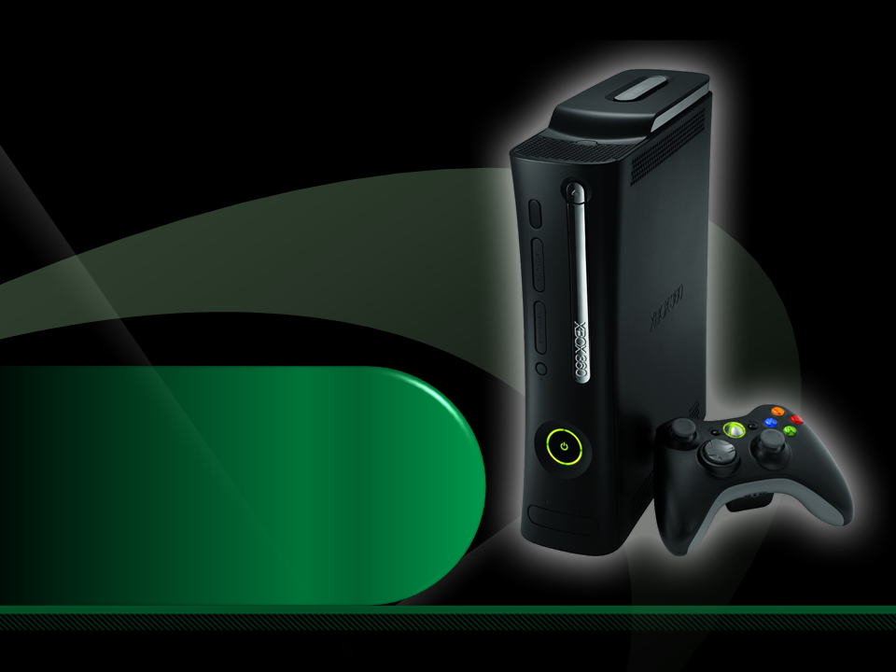
Complete an evaluation on CommNet and enter to win an Xbox 360 Elite!

Slide 50

Required Slide
© 2009 Microsoft Corporation. All rights reserved. Microsoft, Windows, Windows Vista and other product names are or may be registered trademarks and/or trademarks in the U.S. and/or other countries.
The information herein is for informational purposes only and represents the current view of Microsoft Corporation as of the date of this presentation. Because Microsoft must respond to changing market conditions, it should not be interpreted to be a commitment on the part of Microsoft, and Microsoft cannot guarantee the accuracy of any information provided after the date of this presentation. MICROSOFT MAKES NO WARRANTIES, EXPRESS, IMPLIED OR STATUTORY, AS TO THE INFORMATION IN THIS PRESENTATION.

