Slide 2
Customizing and Extending the BizTalk WCF Adapters
Paolo Salvatori
Principal Program Manager
BizTalk Customer Advisory Team
Microsoft
Stephen Kaufman
Delivery Architect
Microsoft Consulting Services
Session Code: INT401

Slide 3
Session Objectives And Takeaways
Session Objective(s):
  Introduction to WCF Adapters
  Extending WCF Adapters
    Custom Service/Endpoint Behaviors
    Custom Message Inspectors
    Custom Binding Elements/Channels
Takeaways
  Architecture of BizTalk WCF adapters
  How to increase application functionality with the extensibility points provided by WCF Adapters

Slide 4
Agenda
Brief Introduction to WCF\WCF Adapters
WCF Extensibility Points
Lots of Demos!
  Debatching Custom Channel
  Protocol Transition
  Throw Typed Fault From an Orchestration
  Large Message Transmission
  Duplex Message Exchange Pattern
  WCF LOB Adapter SDK: Echo Adapter

Slide 5

The ABC of WCF
WCF is a runtime and a set of APIs for exchanging messages between components and applications.
WCF was designed according to the tenets of service orientation.
WCF services can expose one or multiple endpoints.
Every endpoint is defined by 3 elements:
  A: Address
  B: Binding
  C: Contract
C
B
A
A
B
C
WCF
Service
Client
Address
(Where)
Binding
(How)
Contract
(what)

Slide 6
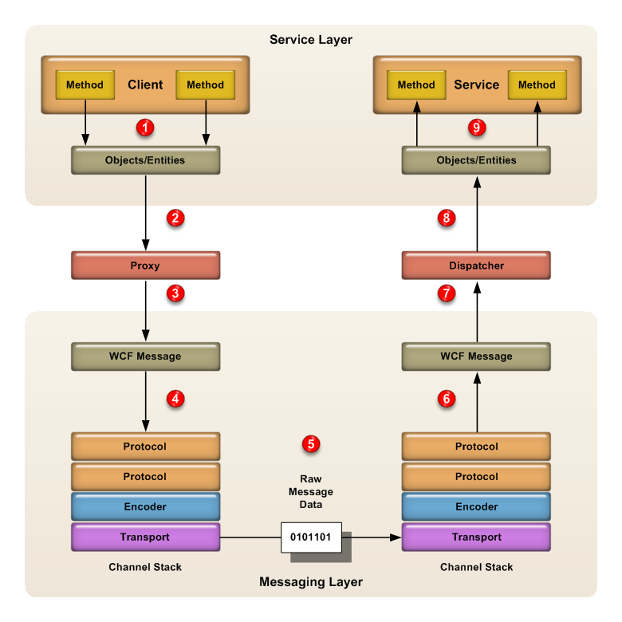
WCF Architecture: Messaging Runtime
The WCF runtime is divided into 2 primary layers:
  The Service Layer aka Service Model defines the mechanisms and attributes used by developers to define and decorate service, message and data contracts.
  The Messaging Layer is responsible for preparing a WCF message for transmission on the send side and produce a WCF message for the dispatcher on the receive side.
It’s the responsibility of the proxy/dispatcher components to translate between the two layers transforming .NET method calls into Message objects.

Slide 7
WCF Binding Comparison
Binding Class Name | Transport | Message Encoding | Message Version | Security Mode | Reliable Messaging | Tx Flow*
BasicHttpBinding | HTTP | Text | SOAP 1.1 | None | X | X
WSHttpBinding | HTTP | Text | SOAP 1.2 WS-A 1.0 | Message | Disabled | WS-AT
NetTcpBinding | TCP | Binary | SOAP 1.2 | Transport | Disabled | OleTx
NetNamedPipesBinding | Named Pipes | Binary | SOAP 1.2 | Transport | X | OleTx
NetMsmqBinding | MSMQ | Binary | SOAP 1.2 | Message | X | X
CustomBinding | You decide | You decide | You decide | You decide | You decide | You decide
Binding | Response Time (milliseconds) | Throughput
WsHttpBinding | 1300 | 1200
BasicHttpBinding | 1150 | 1800
NetTcpBinding | 400 | 5100
NetNamedPipeBinding | 280 | 7000
Performance data was taken from:
Essential Windows Communication Foundation, Addison Wesley, 2008. Chapter 4

Slide 8
Agenda
Brief Introduction to WCF\WCF Adapters
WCF Extensibility Points
Lots of Demos!
  Debatching Custom Channel
  Protocol Transition
  Throw Typed Fault From an Orchestration
  Large Message Transmission
  Duplex Message Exchange Pattern
  WCF LOB Adapter SDK: Echo Adapter

Slide 9
BizTalkServiceInstance
Each WCF Receive Location is hosted by a separate instance of a ServiceHost-derived class.
  BtsServiceHost for RLs running in an in-process host
  WebServiceHost for RLs running in an isolated host
For each WCF Receive Location, the WCF Receive Adapter creates a separate a singleton instance of the BizTalkServiceInstance class.
The class is decorated with the ServiceBehavior attribute:
  InstanceContextMode = InstanceContextMode.Single
  ConcurrencyMode = ConcurrencyMode.Multiple
Hence, all incoming messages to a WCF RL are received and processed by a single well-known instance of the BizTalkServiceInstance class.
  This allows to avoid service activation/deactivation costs and improve performance/scalability.
[ServiceBehavior(InstanceContextMode = InstanceContextMode.Single, ConcurrencyMode = ConcurrencyMode.Multiple)]
internal sealed class BizTalkServiceInstance : ITwoWayAsync,
ITwoWayAsyncVoid,
IOneWayAsync,
IOneWayAsyncTxn,
ITwoWayAsyncVoidTxn
{
...
}

Slide 10
Generic Service Contracts
The BizTalkServiceInstance class implements multiple untyped, generic service contracts.
  IOneWayAsync
  IOneWayAsyncTxn
  ITwoWayAsync
  ITwoWayAsyncVoid
  ITwoWayAsyncVoidTxn
Each contract was designed for a different scope (as suggested by their name):
  OneWay vs TwoWay Message Exchange Pattern
  Transactional vs Non-Transactional Communication
All the methods exposed by these service contracts are generic, asynchronous and untyped
  AsyncPattern = True indicates that an operation is implemented asynchronously using a Begin<methodName> and End<methodName> method pair in a service contract
  Action = “*” means that the method accepts a message with any Action
  ReplyAction = “*” means that the method can return a message with any Action
  Every method accepts as parameter or returns a generic WCF Message
As a consequence, each WCF Receive Location can accept multiple message types and versions that can be normalized into a canonical format using a different map before being published to the MessageBox.
Also Send Ports are message-type agnostic.

Slide 11
One-Way WCF Receive Locations
When you define a one-way WCF receive location:
  If the RL uses the NetMsmqBinding, the underlying WCF service will expose an endpoint using IOneWayAsync.
  If the RL uses any other binding, the underlying WCF service will expose an endpoint using ITwoWayAsyncVoid.
  As consequence , a WCF client application cannot use a service contract with one-way operations to send messages to a WCF RL that uses a binding <> NetMsmqBinding .
[ServiceContract(Namespace = "http://www.microsoft.com/biztalk/2006/r2/wcf-adapter")]
public interface IOneWayAsync
{
[OperationContract(AsyncPattern = true, IsOneWay = true, Action = "*")]
IAsyncResult BeginOneWayMethod(Message message, AsyncCallback callback, object state);
[OperationContract(IsOneWay = true, Action = "BizTalkSubmit")]
void BizTalkSubmit(Message message);
void EndOneWayMethod(IAsyncResult result);
}
[ServiceContract(Namespace = "http://www.microsoft.com/biztalk/2006/r2/wcf-adapter")]
public interface ITwoWayAsyncVoid
{
[OperationContract(AsyncPattern = true, IsOneWay = false, Action = "*", ReplyAction = "*")]
IAsyncResult BeginTwoWayMethod(Message message, AsyncCallback callback, object state);
[OperationContract(IsOneWay = false, Action = "BizTalkSubmit")]
void BizTalkSubmit(Message message);
void EndTwoWayMethod(IAsyncResult result);
}

Slide 12
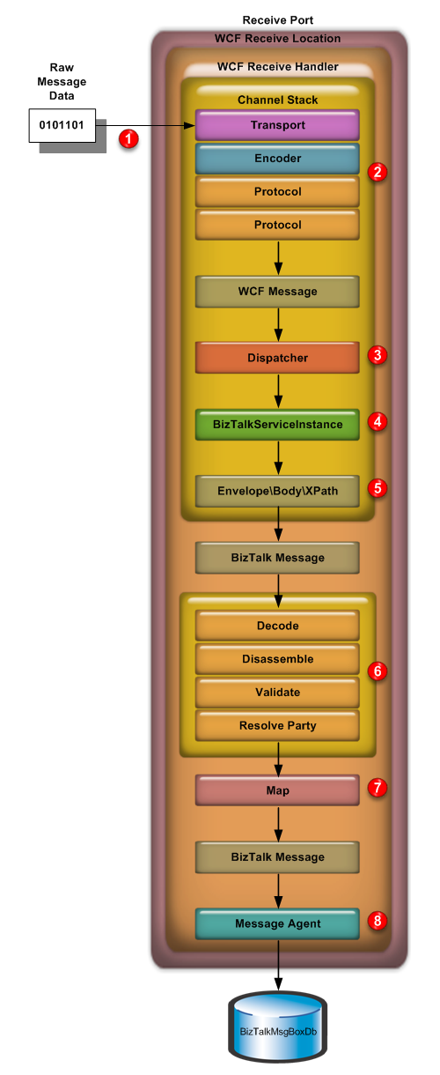
One-Way WCF Receive Locations
The Raw Message Data are sent over the wire.
The Transport Channel receives and decodes the incoming stream of bytes and creates a WCF Message that is processed through the Channel Stack.
The WCF message is passed on to the Dispatcher
The WCF message is passed on to the BizTalkServiceInstance.
Based on the RL configuration, the entire SOAP Envelope, the Body of the SOAP message or a specific Xml Element is used as content of the BizTalk message.
The BizTalk message is processed through the pipeline.
A Map is eventually applied.
The BizTalk message is published to the MessageBox.

Slide 13
Available WCF Adapters
Adapter Name | WCF Binding Name | When to use?
WCF-BasicHttp | BasicHttpBinding | When you need interoperability with WS-I Basic Profile 1.1 services, such as those created with ASP.NET Web services (ASMX) or other first-generation service frameworks
WCF-WSHttp | WSHttpBinding | When you need interoperability with more advanced services that leverage WS-* protocols, such as those created with WCF or other modern service frameworks
WCF-NetTcp | NetTcpBinding | When you need efficient inter-machine communication with other WCF applications
WCF-NetNamedPipe | NetNamedPipeBinding | When you need efficient intra-machine communication with other WCF applications
WCF-NetMsmq | NetMsmqBinding | When you need durable, asynchronous communication with other WCF applications (using MSMQ as the underlying transport)
WCF-Custom | Any | When you need to define a custom binding configuration for an “in-process” host
WCF-CustomIsolated | Any | When you need to define a custom binding configuration for an “isolated” host – this is only a receive adapter, not used on send ports

Slide 14
WCF-Custom\WCF-CustomIsolated Adapters
The WCF-Custom and WCF-CustomIsolated adapters offer you complete control over the channel stack and behaviors configuration, and as a consequence, they are the only WCF adapters you really need.
The WCF-Custom/WCF-CustomIsolated Adapters allow to:
  Implement and exploit extensibility points.
  Have full access to properties exposed by bindings/behaviors.
  Enable the use of the bamInterceptor endpoint behavior.
  Export/Import the binding configuration.
  Disable a receive location on failure.
  Run an http-based RL within an in-process host.
  Use bindings (e.g. wsDualHttpBinding) for which a WCF Adapter does not exist.

Slide 15
WCF Adapter Extensibility Points
Custom Behaviors
  Service Behaviors
    They enable the customization of the entire service runtime including the ServiceHost.
  Endpoint Behaviors
    They enable the customization of service endpoints and their associated EndpointDispatcher
Custom Binding Elements\ Channels
  Binding Elements, Channels, ChannelFactories, Binding Element Extension...
Custom Bindings
  The WCF LOB Adapter SDK allows developers to create new bindings to use with WCF-Custom and
  WCF-CustomIsolated Adapters.

Slide 16
How to Enable the WCF Extensibility Points
To enable the WCF extensibility points you have to perform 3 operations:
  Install the assemblies implementing the WCF extensibility points in the global assembly cache (GAC)
  Modify the machine.config file on your computers.
    behavior extensions
    binding element extensions
    binding extensions
  Configure the WCF-Custom or the WCF-CustomIsolated Receive Location or Send Port by using the BizTalk Server Administration console.

Slide 17
Agenda
Brief Introduction to WCF\WCF Adapters
WCF Extensibility Points
Lots of Demos!
  Debatching Custom Channel
  Protocol Transition
  Throw Typed Fault From an Orchestration
  Large Message Transmission
  Duplex Message Exchange Pattern
  WCF LOB Adapter SDK: Echo Adapter

Slide 18
Debatching Channel
Problem
How can I debatch an inbound message within a WCF-Custom Send Port and make a separate call for each item?
You will see:
How to enable extensibility points.
How to configure and use a custom binding.
How to create a transactional WCF-Custom Send Port.
How to enable WCF performance counters in the BTSNTSvc.exe.config.
How to use the serviceThrottling behavior on a WCF Receive Location.
How to use the Import/Export tab in a WCF-Custom RL/SP.
How to activate the net.tcp binding protocol for a IIS 7.0 hosted application.

Slide 19
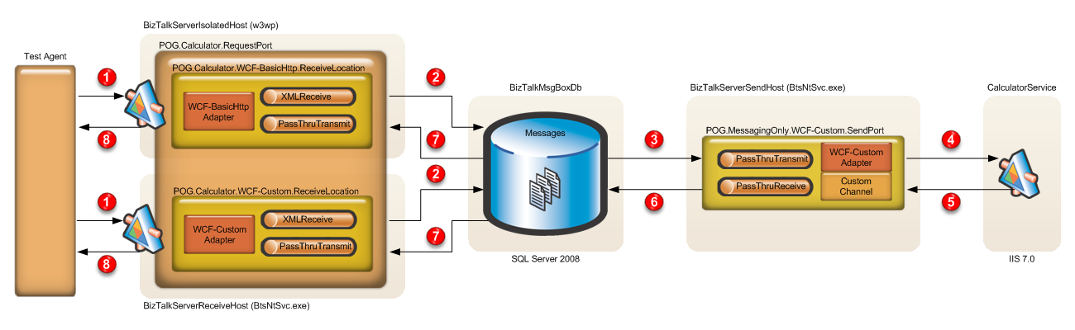
Debatching Channel
A WCF-BasicHttp or WCF-Custom Receive Location receives a new request message from the Test Agent.
The Message Agent submits the incoming message to the MessageBox.
The inbound request is consumed by a WCF-Custom Send Port.
The WCF-Custom Send Port uses a custom channel to debatch the inbound message and make a separate call for each operation item.
The WCF web service returns a response message. The custom channel repeats this pattern for each operation, collects results and creates a unique response message (Scatter and Gather).
The WCF-Custom Send Port publishes the response message to the MessageBox.
The response message is retrieved by the WCF-BasicHttp or WCF-Custom Receive Location.
The response message is returned to the Test Agent.

Slide 20
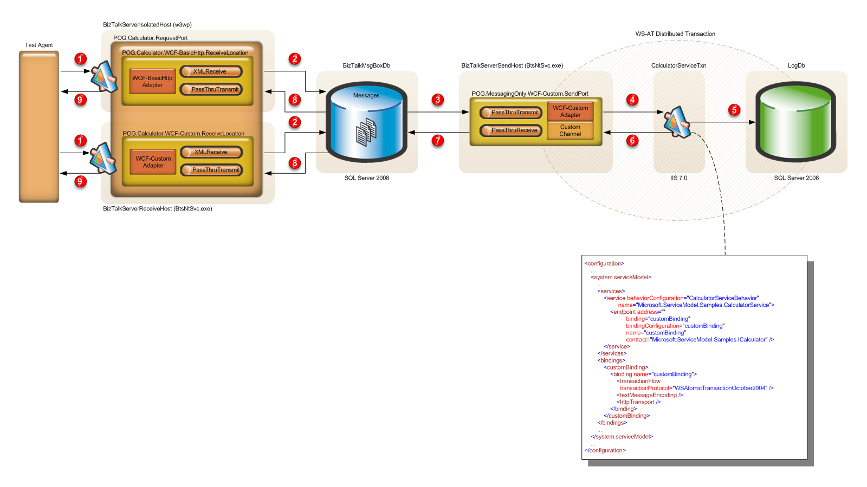
Transactional Debatching Channel

Slide 21
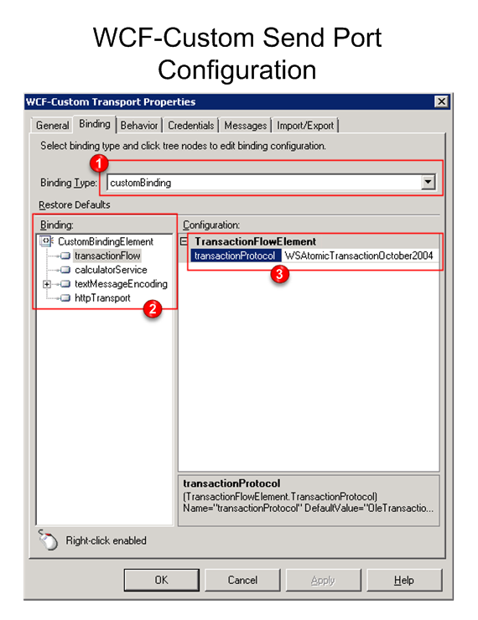
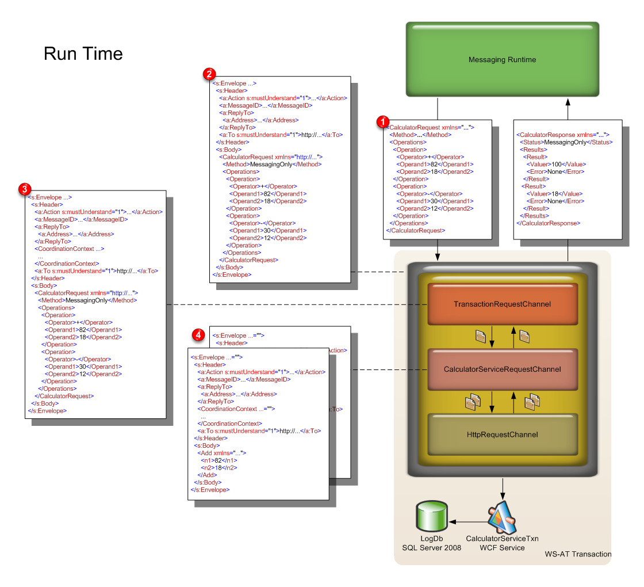
Debatching Channel Detail

Slide 22
Debatching Channel
demo

Slide 23
Typed Faults
Problem
How can I throw Typed Faults from Orchestrations Published as WCF Services ?
You will see:
How to configure and use a custom endpoint behavior.
How to configure and use a message inspector.
How to return a typed fault from an orchestration.
How analyzing incoming/outgoing message with the Service Trace Viewer.
How to extend the WSDL exposed by a WCF Receive Location.
How to use the bam Interceptor within a WCF-CustomIsolated RL.
How to use the performance counters exposed by the bam Interceptor.

Slide 24
WCF and Typed Faults
[Serializable]
[DataContract(Name = "CustomError", Namespace = "http://microsoft.biztalk.cat/10/customerror")]
public class CustomError
{
...
}
[ServiceContract(Name = "HelloWorld", Namespace = "http://microsoft.biztalk.cat/10/helloworld")]
public interface IHelloWorld
{
[OperationContract(Action = "SayHello", ReplyAction = "SayHello")]
[FaultContract(typeof(CustomError), Action = "CustomErrorFault")]
HelloWorldResponse SayHello(HelloWorldRequest request);
}
[ServiceBehavior(Name = "HelloWorld", Namespace = "http://microsoft.biztalk.cat/10/helloworld")]
public class HelloWorld : IHelloWorld
{
[OperationBehavior]
public HelloWorldResponse SayHello(HelloWorldRequest request)
{
if (request == null || string.IsNullOrEmpty(request.Name))
{
throw CreateFault("The name cannot be null or empty.");
}
return new HelloWorldResponse(string.Format("Hi {0}!", request.Name));
}
private FaultException<CustomError> CreateFault(string message)
{
...
return fault;
}
}

Slide 25
BizTalk Server and Typed Faults
BizTalk Server 2006 R2 and BizTalk Server 2009 allow handling typed fault contracts when consuming WCF services from within orchestrations.
WCF adapters actually do not support returning typed fault contract exceptions within orchestrations published as WCF services.
However, untyped SOAP faults can always be returned by orchestrations or pipelines.

Slide 26
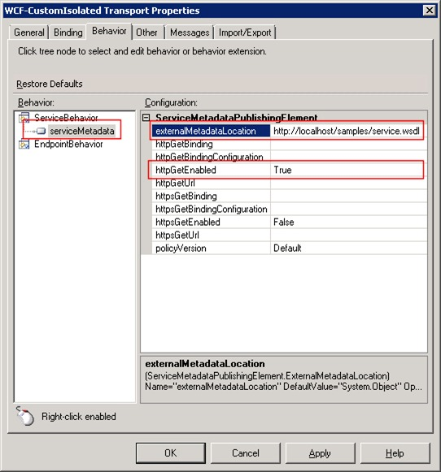
Extending the WSDL
How can you extend the WSDL generated by the WCF Service Publishing Wizard to expose soap fault messages?
There are 2 solutions:
  Manual Approach
    You define a custom WSDL using a text or xml editor.
    You publish the resulting WSDLfile to IIS
    You configure your WCF-Custom RL to expose the newly created WSDL file using the serviceMetadata behavior.
  Create a custom endpoint behavior to dynamically modify the WSDL generated by BizTalk.

Slide 27
WsdlExtensions Endpoint Behavior
The WsdlExtensions property exposed by the endpoint behavior accepts an XML snippet that allows to specify how to customize the WSDL at runtime.
  The prefix for the namespace of new messages created inside the WSDL.
  One or multiple Xml Schemas each defining a different typed fault. These schemas must be deployed to BizTalk. At runtime, the component is able to retrieve the content of each schema from the BizTalkMgmtDb that subsequently is inserted in the outbound WSDL.
  One or multiple fault messages, each containing one or multiple parts.
  One or multiple operation-fault associations. At runtime the component search through the original WSDL structure and creates faults accordingly.
<WsdlExtensions xmlns="http://microsoft.biztalk.cat/10/wsdlextensions">
<Prefix>bts</Prefix>
<XmlSchemas>
<XmlSchema>
<Name>CustomError</Name>
<Namespace>http://microsoft.biztalk.cat/10/customerror</Namespace>
</XmlSchema>
</XmlSchemas>
<Messages>
<Message>
<Name>HelloWorld_SayHello_CustomErrorFault_FaultMessage</Name>
<Namespace>http://microsoft.biztalk.cat/10/customerror</Namespace>
<Parts>
<Part>
<Name>detail</Name>
<Element>CustomError</Element>
</Part>
</Parts>
</Message>
</Messages>
<PortTypes>
<PortType>
<Name>HelloWorld</Name>
<Operations>
<Operation>
<Name>SayHello</Name>
<Faults>
<Fault>
<Name>CustomErrorFault</Name>
<Message>HelloWorld_SayHello_CustomErrorFault_FaultMessage</Message>
</Fault>
</Faults>
</Operation>
</Operations>
</PortType>
</PortTypes>
</WsdlExtensions>

Slide 28
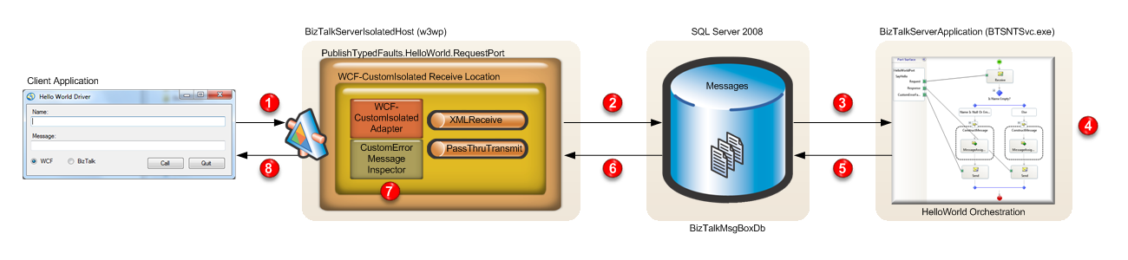
Typed Faults
A WCF-CustomIsolated Receive Location receives a request message from the Client App.
The Message Agent submits the incoming message to the MessageBox.
The inbound request starts a new instance of the HelloWorld orchestration.
If the name contained in the request message is null or empty, the orchestration returns a CustomError message containing context information.
The HelloWorld orchestration publishes the response or error message to the MessageBox.
The response message is retrieved by the WCF-CustomIsolated Receive Location.
The CustomErrorMessageInspector intercepts the response message and eventually creates a fault message.
The response message is returned to the Client Application.

Slide 29
Typed Faults
demo

Slide 30
Duplex Message Exchange Pattern
Problem
Can I use duplex message exchange pattern to invoke a WCF Receive Location?
You will see:
How to configure a Request/Response:
  WCF-NetTcp Receive Location
  WCF-NetNamedPiped Receive Location
  WCF-CustomIsolated + WsDualHttpBinding
To support Duplex Message Exchange
How to configure the client app to send a request and expose a callback contract to asynchronously receive the response message.

Slide 31
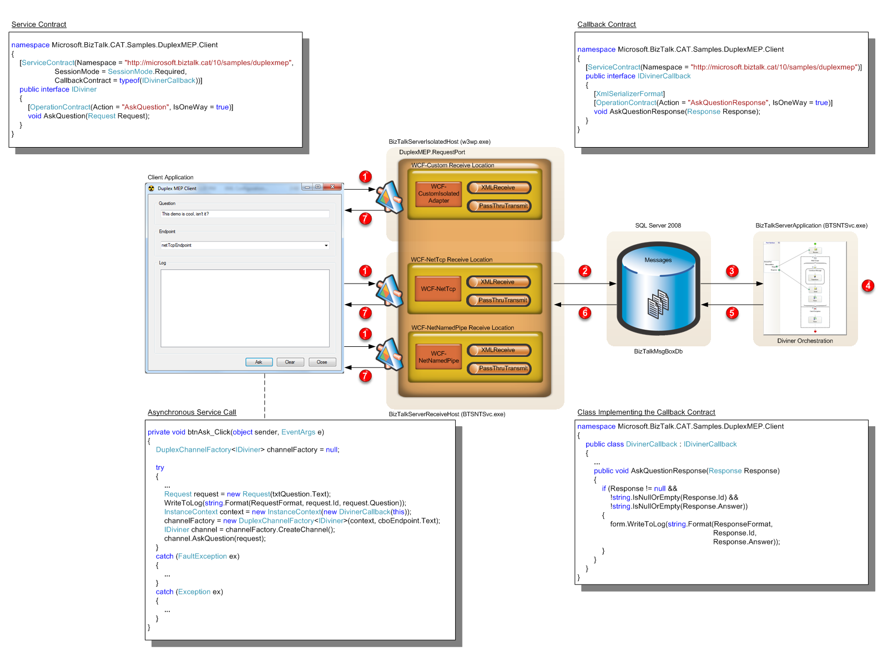
Duplex Message Exchange Pattern

Slide 32
Duplex Message Exchange Pattern
demo

Slide 33
Resources
Stephen Kaufman’s Blog
  http://blogs.msdn.com/skaufman
Paolo Salvatori’s Blog
  http://blogs.msdn.com/paolos
Using the Windows Communication Foundation (WCF) Adapters in BizTalk Server
  http://www.microsoft.com/downloads/details.aspx?familyid=a976dc7d-2296-4f88-be4d-0d314fca9e59&displaylang=en&tm
Microsoft BizTalk Server Performance Optimization Guide
  http://msdn.microsoft.com/en-us/library/cc558617.aspx
Microsoft BizTalk Server Operations Guide
  http://msdn.microsoft.com/en-us/library/cc296643.aspx

Slide 34
question & answer

Slide 35




Resources
Required Slide
Speakers,
TechEd 2009 is not producing
a DVD. Please announce that
attendees can access session
recordings at TechEd Online.
www.microsoft.com/teched
  Sessions On-Demand & Community
www.microsoft.com/learning
Microsoft Certification & Training Resources
http://microsoft.com/technet
  Resources for IT Professionals
http://microsoft.com/msdn
  Resources for Developers

Slide 36
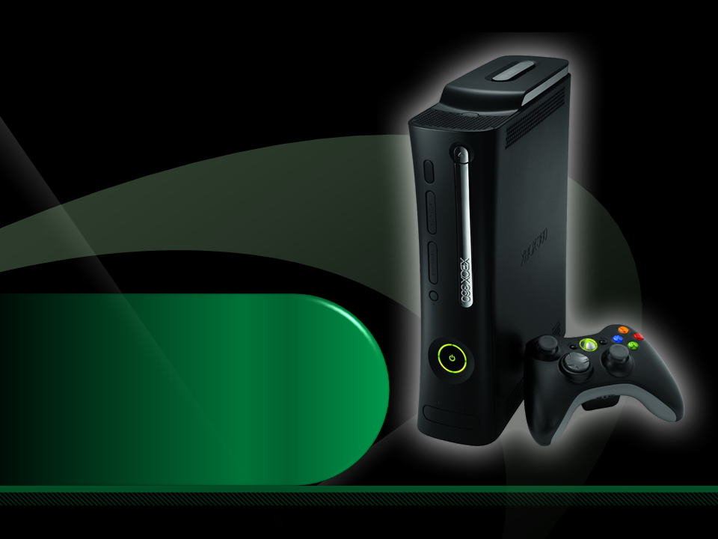
Complete an evaluation on CommNet and enter to win an Xbox 360 Elite!

Slide 37

Required Slide
© 2009 Microsoft Corporation. All rights reserved. Microsoft, Windows, Windows Vista and other product names are or may be registered trademarks and/or trademarks in the U.S. and/or other countries.
The information herein is for informational purposes only and represents the current view of Microsoft Corporation as of the date of this presentation. Because Microsoft must respond to changing market conditions, it should not be interpreted to be a commitment on the part of Microsoft, and Microsoft cannot guarantee the accuracy of any information provided after the date of this presentation. MICROSOFT MAKES NO WARRANTIES, EXPRESS, IMPLIED OR STATUTORY, AS TO THE INFORMATION IN THIS PRESENTATION.

