Slide 2
Maximising Your Data: Self-Service Capacity Planning with Microsoft SQL Server and Microsoft Office SharePoint Server 2007
Sean Roberts & Gordon McKenna
Inframon Ltd
Session Code: ITS203

Slide 3

Agenda
Role Play
What is capacity planning?
Collecting the Data
  DEMO: Microsoft Operations Manager 2007 R2
Measuring the Data
  DEMO: SQL Server Analysis Services 2008 SP1
Publishing
    DEMO: PerformancePoint Server 2007
Forecasting
    DEMO: SQL Server Analysis Services 2008 SP1

Slide 4
Introduction to Inframon
“One of the best System Center Partners in the world” – Ryan O’Hara, Director of System Center Marketing, Microsoft, November 2009
System Center Specialists
EMEA based System Center constancy, solutions and training
The only two System Center Operations Manager MVPs in the UK… with more to come!

Slide 5
Business v IT
Role Play
“I need to plan!”

Slide 6
An Analysis of Issues
Budget Overruns
No Capacity Planning Function
Cannot measure, scorecard or predict future performance
Non fact based investment decisions
Budget Under Runs

Slide 7
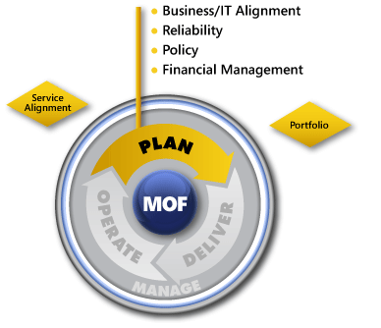
What is Capacity Planning
The capacity plan outlines the strategy for assessing overall service and component performance and uses this information to develop the acquisition, configuration, and upgrade plans. It provides management with a clear statement of resource and service capacity; an assessment of current capacities; a list of resources to be upgraded or acquired; and a projection of future capacity requirements*
Types of Capacity Planning:
Business capacity planning
Service capacity planning
Component capacity planning
*Taken from MOF V4. See www.microsoft.com/mof/ for more details

Slide 8
Key Questions
What are the future business and IT plans for growth, mergers, and acquisitions that may affect the capacity requirements for this service?
Are there business peaks or other time-based variations in demand that can affect the capacity requirements? How can we maximize use of quiet times?
What historical trend data can we analyze to evaluate current capacity and how can we use this data to model capacity against various scenarios?
How can we meet the capacity predictions of the organization in the simplest, most cost-effective way?*
*Taken from MOF V4. See www.microsoft.com/mof/ for more details

Slide 9
Capacity Planning Strategies
Lead Strategy
  Guestimates and what ifs – Affects budget, can affect service delivery, typically over provision
Lag Strategy
  Reactive – Affects service delivery
Match Strategy
  Forecasting and Trending

Slide 10
The Management Challenge
Intranets
Email
Extranets
Active Directory
VOIP
Virtual Desktops
Bespoke Applications

Slide 11
Service Components? It’s Complicated….
Service
Multiple Physical Locations
Multiple Tiers
Mixed Applications Services
Mixed Operating Systems
Across Physical and Virtual
Front End
Middle Tier
Back End
New York
London
Tokyo
Service
Service
Service
Apache Tomcat
JBOSS
Oracle i7
IIS7
SQL Server Service Broker
SQL Server 2005
IIS7
SQL Server Service Broker
SQL Server 2005
Windows Server 2008 R2 ®
Windows Server 2003 R2 ®
SuSE Linux
Windows Server 2003 R2 ®
Windows Server 2003 R2 ®
Windows Server 2008 SP1
Windows Server 2003 R2 ®
Windows Server 2003 R2 ®
Windows Server 2008 SP1
Virtual
Physical
Physical
Virtual
Manage and Protect

Slide 12
Microsoft Operations Manager – The Perfect Tool!
Why Use Microsoft Operations Manager?
Operations Manager Architecture
  Agents
  Management Packs
  Distributed Applications
  Synthetic Transactions
  Service Level Tracking
  Inbuilt Reports
  Service Level Dashboard V2
  Operations Manager Data Warehouse

Slide 13
Operations Manager Architecture
Monitored
Clients
Operational DB
Monitored Servers
Data Warehouse

Slide 14
Microsoft Operations Manager 2007 R2
DEMO
Key Features

Slide 15
Capacity Planning Steps
Collect
Measure
D
Forecast
B
A
C
Publish
Microsoft System Center Operations Manager
Microsoft SQL Server Analysis Services 2008 SP1/Microsoft Office PerformancePoint Server 2007 SP3
Microsoft Office SharePoint Server 2007
Microsoft Office PerformancePoint Server 2007 SP3

Slide 16
End to End Enterprise Reporting Framework Self Service Portal
OpsMgr
Default Reports
IT Operators
SharePoint/MOSS 2007
SSRS 2008
Custom Reports
Data Warehouse
IT Analysts
OLAP
Cube
Performance Point
Analysis
IT Managers
Service Level Dashboard V2
Executives

Slide 17
Steps to Create the Portal
Extract Data from OperationsManagerDW
Build and deploy the cube
Build and deploy the PerformancePoint scorecards
Forecast using PerformancePoint

Slide 18
Microsoft Operations Manager DW
Live Data Warehouse
Multiple Aggregates
  Raw
  Hourly
  Daily
Choosing the right aggregate; Gotchya!

Slide 19
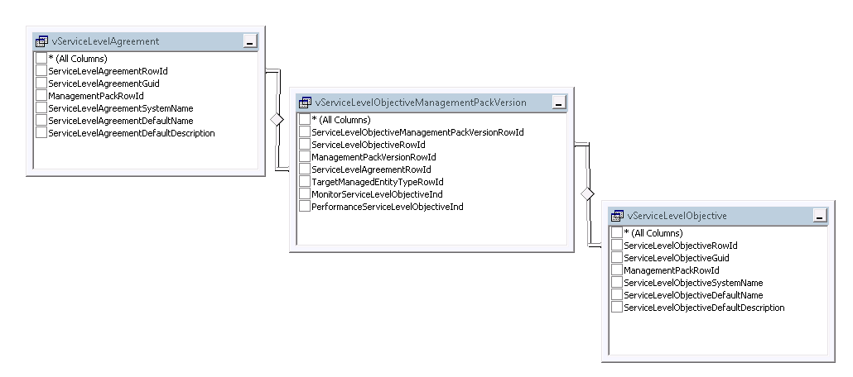
Service Level Objectives

Slide 20
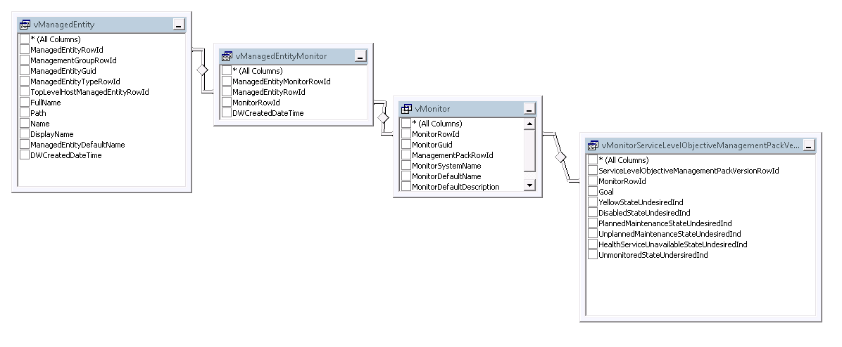
Managed Entities (State)

Slide 21
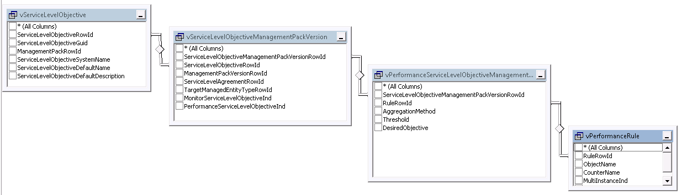
Managed Entities (Collection)

Slide 22
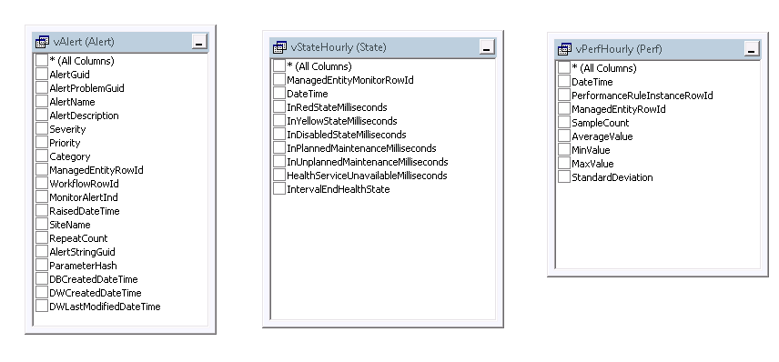
Fact Tables

Slide 23
Linking Distributed Apps to contained entities
Look in vManagedEntity, Distributed apps have a managed entity type of %_service
Stored procedure to extract hierarchy Microsoft_SystemCenter_DataWarehouse_Report_Library_ReportObjectListParse
Gotchya! Can’t use stored proc in data SSAS source view.

Slide 24
Operations Manager Data Warehouse
DEMO
Key Features

Slide 25
Dimensions and Measures
Dimensions
  Time
  Service Level Agreement
    Objective Type
      Service Level Objective
        Service Level Goal
  Service Components
  LOB Application
Measure Groups
  State
  Performance
  Alerts

Slide 26
Where to create KPIs???
Options;
  In the data (OpsMgr)
  In the cube (SSAS/MDX)
  In PerformancePoint
Best Practice from the Field
  In the data (OpsMgr)
  In PerformancePoint
Why?

Slide 27
Building the SSAS Cube
DEMO
Key Features

Slide 28
PerformancePoint Server 2007 SP3 Gotchya!
Connecting to SSAS 2008 can be “Challenging”
Steps to following
  Install SQL 2005 client components
  Install ADOMD.Net for SQL 2005
  Install SQL 2005 SP3
  Install AJAX Extensions 1.0
  Install PerformancePoint, don’t configure! Install SP3
  If necessary update the Web.Config file to point to new version of System.Web.Extension 3.5.0.0

Slide 29
Publish; PerformancePoint
Change in Licensing
The Designer
Publishing to SharePoint

Slide 30
Performance Point Steps
Create KPI
Create Scorecard
Create Reports
Create Dashboards
Publish in SharePoint

Slide 31
Forecast; PerformancePoint
Known Limitations (32bit v 64bit)
Forecasting in PerformancePoint
Forecasting Algorithms reside in SSAS
Cannot publish to x64 environment

Slide 32
PerformancePoint
DEMO
Key Features

Slide 33
Conclusion
Capacity Planning as a core function
Key Steps
  Collect
  Measure
  Publish
  Forecast

Slide 34

Complete an evaluation on CommNet and enter to win an Xbox 360 Elite!

Slide 35

Required Slide
© 2009 Microsoft Corporation. All rights reserved. Microsoft, Windows, Windows Vista and other product names are or may be registered trademarks and/or trademarks in the U.S. and/or other countries.
The information herein is for informational purposes only and represents the current view of Microsoft Corporation as of the date of this presentation. Because Microsoft must respond to changing market conditions, it should not be interpreted to be a commitment on the part of Microsoft, and Microsoft cannot guarantee the accuracy of any information provided after the date of this presentation. MICROSOFT MAKES NO WARRANTIES, EXPRESS, IMPLIED OR STATUTORY, AS TO THE INFORMATION IN THIS PRESENTATION.

