Slide 2
Configuration Manager.Next
Application Management – Part 1
Bill Anderson & Mark Florida
Lead Program Managers
Microsoft Corporation

Slide 3
Agenda
Application Management Overview
  Comparison to ConfigMgr 2007 SWD
  Key concepts
Scenarios
  Creating and deploying an application
  Content distribution
  User targeting
  Policy evaluation
  Software Catalog and client experience

Slide 4




User Centric
Application management model to capture admin intent
  Manage apps, not setup scripts
  Conditional delivery rules get the right app to the user in the right way
Allow the administrator to think user first
  Software delivery targeted at the user
  User/Device “affinity” tracks user relationships to systems
Allow the user to define their relationship to applications and to ConfigMgr
  Self Service Application Web Portal

Slide 5
System vs. User-Centric
Session focus will be on new improvements for user-centric
Following are still in the product
  Machine targeting
  Query/Collection targeting
  Non State-based installs
  a.k.a - ConfigMgr 2007 Software Distribution

Slide 6






Embracing User Centric
End User Participates…
  New Features:
  Software Catalog
  User Device Affinity
Administrator is explicit…
Administrator defines rules…
  New Features:
  Application Model
  Conditional Delivery Rules
ConfigMgr 2007
ConfigMgr v.Next

Slide 7


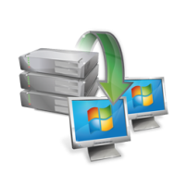
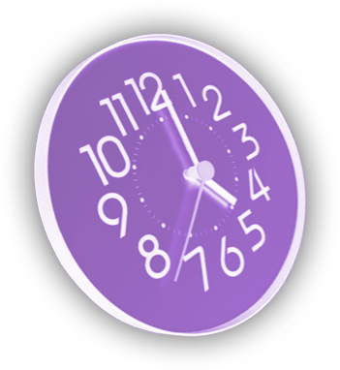


Embracing User Centric
User-to-Application Relationship…
  New Features:
  Application Model
  User Device Affinity
Run once and done…
Continual Re-evaluation…
  New Features:
  Conditional Delivery Rules
ConfigMgr 2007
ConfigMgr v.Next

Slide 8
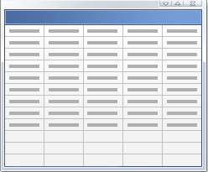
How We Accomplish This
Application
Admin and end user metadata about the application
End user data used in web portal
  You deploy the application
  Contains 1 or more Deployment Types
Web Portal
Available applications and metadata
    Required apps go direct to user/machine
User targeted apps only
Install on demand, or integrated
approval
Deployment Type
Hybrid of SCCM 07 Package and Program
Content is on DT like package, contains rest of program settings
What’s new/different?
Detection method – app is “state based”
  If present, don’t install. If not, make sure it’s there.
DT’s for specific technologies
  MSI, Script, App-V, MEDV, Term Services, Citrix
Conditional Delivery Rules
  A set of rules eval’d on client to determine to install or not
    Requirement Rules – platform req’s, etc. Can be any CI
    User Rules – Primary User, my Primary PC
    Dependencies – relationships to other apps including auto-install

Slide 9

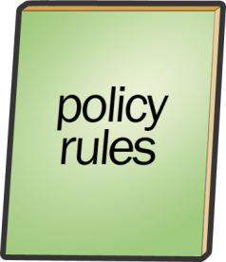



How We Accomplish This
“Users X need app Y….”
Deploy the Application
Similar to ConfigMgr “advertisement”
Assigns an Application to a Collection with an intent
  Deploy options: required, available, prohibited
Melissa (End user)
Application
Minimum system req’s?
Dependent apps?
Primary User?
Minimum system req’s?
Dependent apps?
Primary User?
Kiosk

Slide 10
ConfigMgr 2007 to CM-Next Comparison…
ConfigMgr 2007 | CM-Next
Package | Application and Deployment Types
Program
Advertisement | Deployment
Collection rules | Requirement rules
Run Advertised Programs | Software Center
None | Software Portal
None | User Device Affinity
None | Single Instance Content Management

Slide 11
Scenarios
Create and deploy a simple application to a user
Publish an application for the software catalog

Slide 12
High-level Process Steps
Create & Deploy an application
App Model Creation
Content Distribution
Deploy
Application Installation
Client Evaluation
Monitoring

Slide 13
Scenario 1
Deploy Adobe Reader to Users
App Model Creation
Content Distribution
Deploy
Application Installation
Client Evaluation
Monitoring
Import Application
Creates the deployment type
Configure application
Configure installation program
Add requirements
Review detection methods
Creates the application

Slide 14
Basic Application End-to-end – App Modeling
demo

Slide 15
Scenario 1
Deploy Adobe Reader to Users
App Model Creation
Content Distribution
Deploy
Application Installation
Client Evaluation
Monitoring
Distribute content to a distribution point group

Slide 16
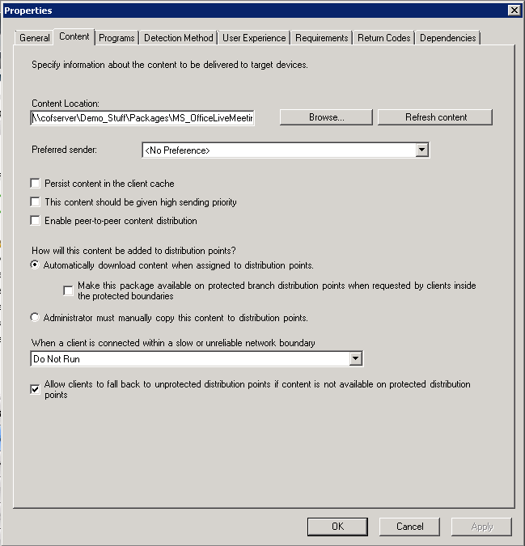
Local Deployment Type Content Settings
Changes from ConfigMgr 2007 SWD:
  No Scheduled DP update
  No Custom Share Name
  No “Run from Net” for applications
  Peer-to-Peer setting (Branch Cache)
  Binary Delta Replication is done implicitly (no longer an admin option)

Slide 17
New Content Management System
New feature: Single Instance Content Management
Only for Application Management; not for ConfigMgr 2007 SWD feature
Why the change:
  Application Management is model based – more objects to clearly capture admin intent
  More objects shouldn’t mean duplicate content storage.
  Share the same actual content between Applications

Slide 18
Single Instance Content Management
Step 2: Admin creates a new deployment type for Finance
Step 1: Admin creates an application with content
Application (Adobe)
Deployment Type (Standard)
Content Description (Pointer to acroread.msi)
Acroread.msi
Fin.mst
Deployment Type (Finance)
Content Description (Pointer to acroread.msi & fin.mst))
Application Model - Objects
Distribution Point File Storage

Slide 19
Content – Additional New Features
DP Groups
  State based
DP Throttling
  Sender like controls on DPs
Branch Cache Improvements
  Admin can turn on/off Brach Cache on a DT
Pre-stage
  Admin can manually move content from server to server while saving network bandwidth
App-V - No need to enable streaming on Distribution Points, removed additional streaming store on DPs

Slide 20
Scenario 1
Deploy Adobe Reader to Users
App Model Creation
Content Distribution
Deploy
Application Installation
Client Evaluation
Monitoring
Add collections
Review Deployment status
Available, required, prohibited

Slide 21
Basic Application End-to-end – Content Distribution & Deployment
demo

Slide 22
Scenario 1
Deploy Adobe Reader to Users
App Model Creation
Content Distribution
Deploy
Application Installation
Client Evaluation
Monitoring
Review Deployment status

Slide 23
Monitoring Objectives
Core operational monitoring and troubleshooting of deployments will be possible within the Admin Console
  Ability to troubleshoot from a deployment perspective
  Ability to troubleshoot from user/device perspective
Three main deployment monitoring metrics
  Completion Statistics (compliance of admin intention)
  Enforcement Statistics (deployment type metrics)
  DP Statistics (distribution of content metrics)
For each metric, Admin is able to:
  “At a glance”, see a summary view for all targets
  Drill into a specific success state down to individual users or devices

Slide 24
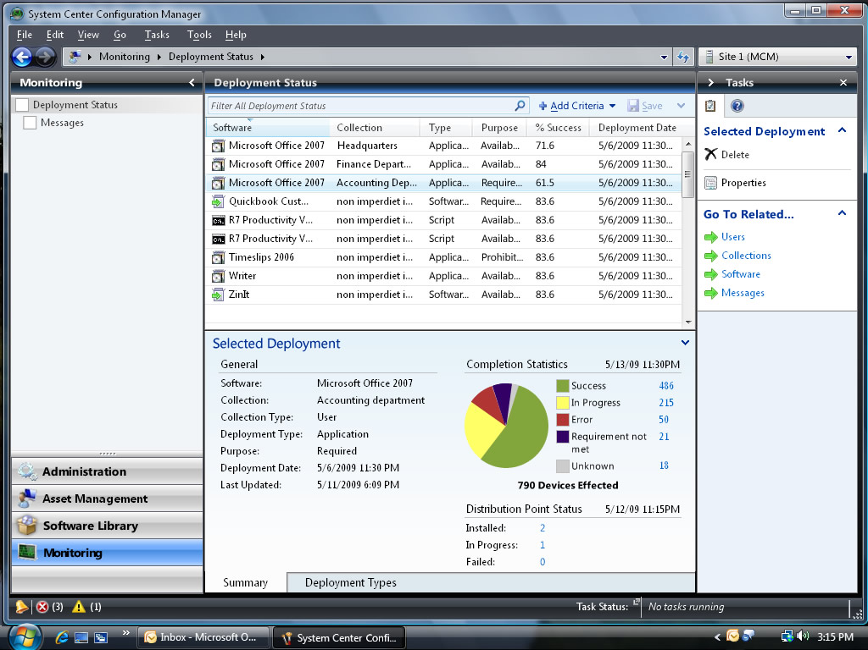

Slide 25
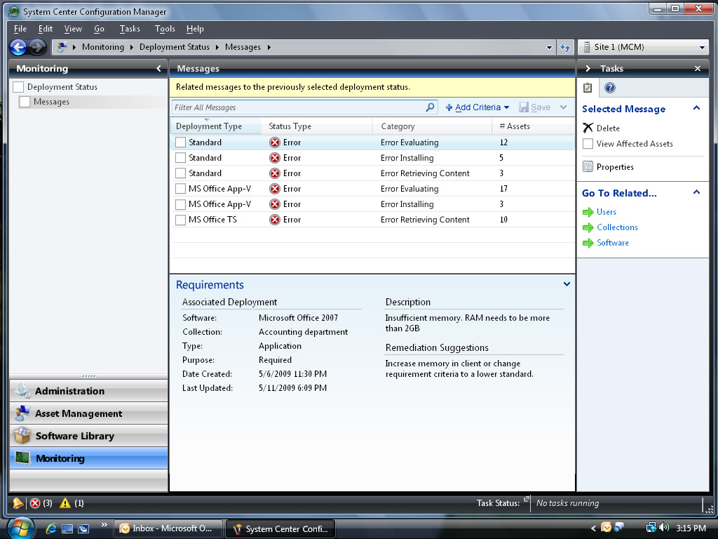

Slide 26
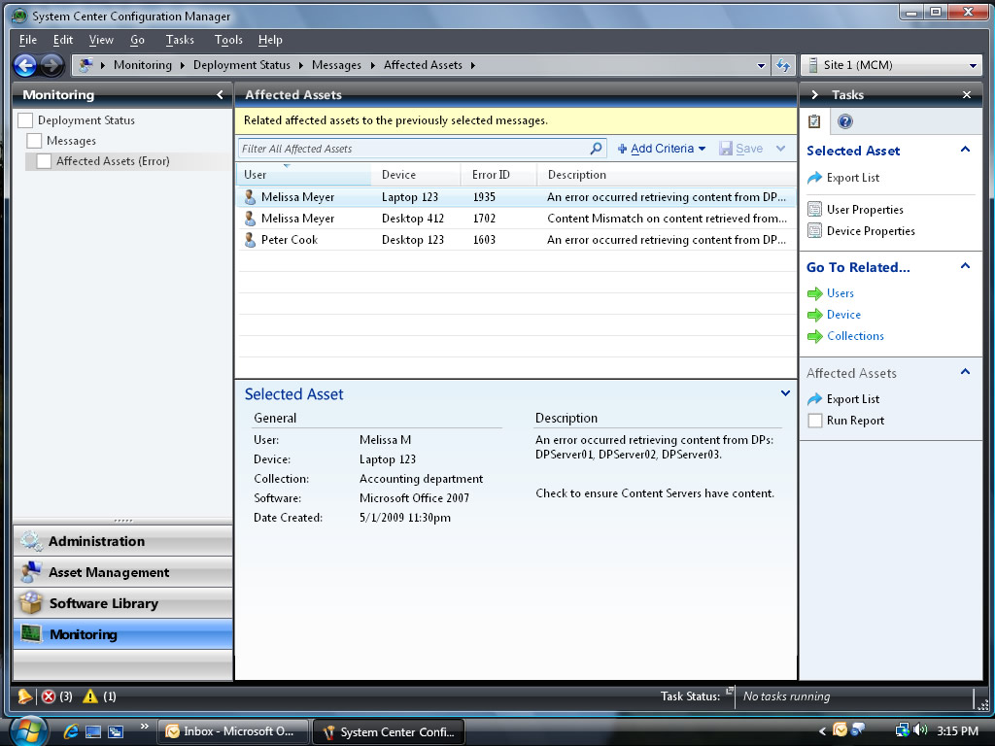

Slide 27
Scenario 1
Deploy Adobe Reader to Users
App Model Creation
Content Distribution
Application Installation
Client Evaluation
Monitoring
Deploy
User Notification
User chooses time before deadline
Application Installation
User launches application
Sees required apps must be installed
User can view progress
User notified when complete

Slide 28
Client Evaluation
Evaluate Deployment Type Requirements
Deployment Type not applicable
Deadline Reached
Locate and Download Content if defined
Enforce Intent (Required)

Slide 29
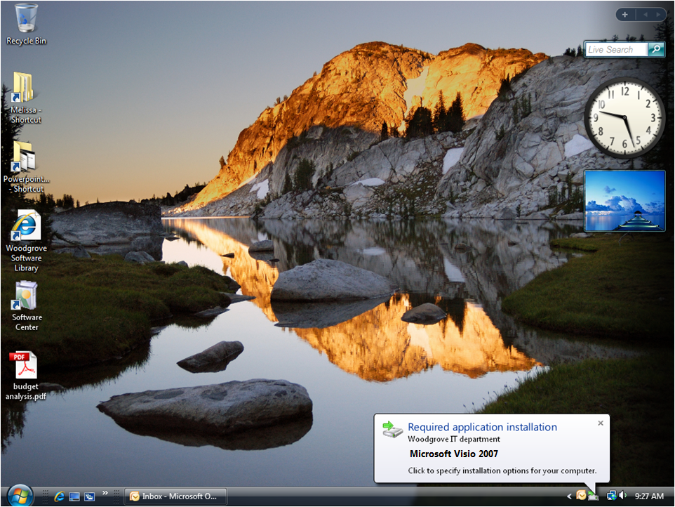

Slide 30
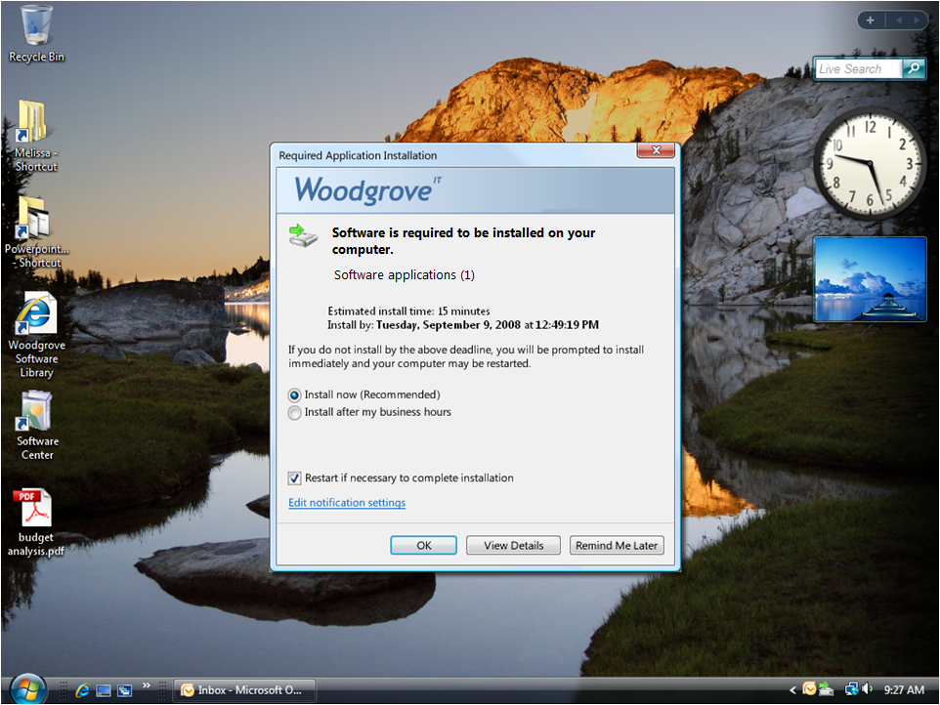

Slide 31
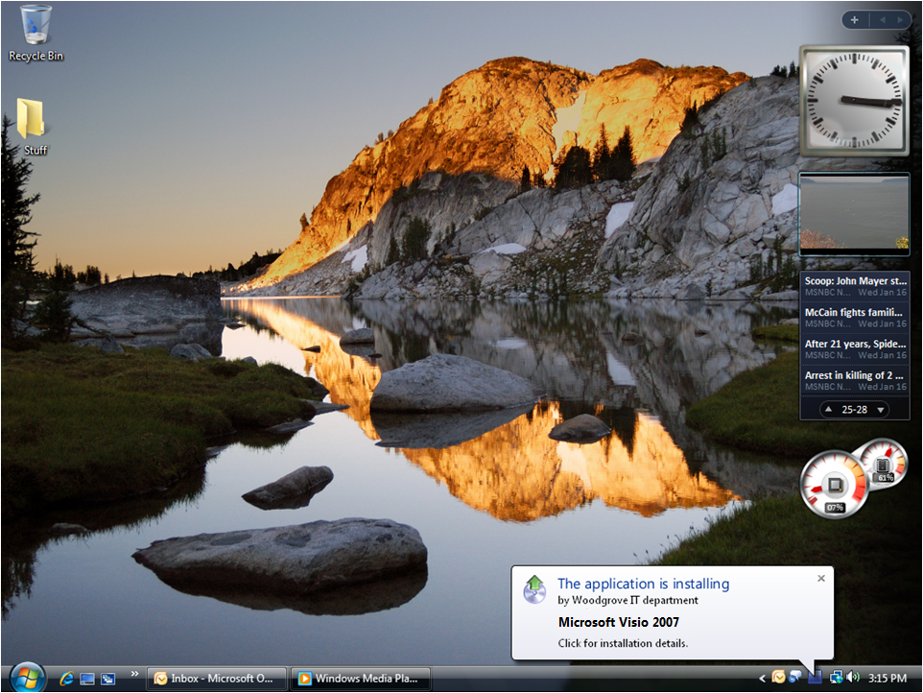

Slide 32


Slide 34
Scenario 2 - Publish an application to software catalog
Target application to Melissa as available
Target application to Melissa as available, where Project “requires approval”
Melissa requests application and is approved
Melissa installs application
App Model Creation
Content Distribution
Deploy
Application Installation
Client Evaluation
Monitoring

Slide 35
Software Catalog- Details
Tech Details:
  Web based catalog for users
  Deployed as a site system role
  Based on IIS and Silverlight
  Targeted specific to users
Application Installation
  Quick and easy self-installation
  Leverages full infrastructure for content and status
Install Software
  Direct installation from software catalog
  Automatic installation upon approval
Browse and search for software
  Fully localized for site and applications
Request Applications
  Request approval for software
  View request history
Users can share links to software
Extensible-SDK
  Approval workflow
  Design and Interface

Slide 36
Software Catalog:
Publish and Install an Application
demo

Slide 37
Takeaway and feedback
Many new features, but all existing software distribution still in tact
  Play with the new features early, and can move apps at your own pace
  You will want to move though! ☺
Key new areas to learn/understand
  Detection methods are required
  Requirement rules partially replace collection query logic

Slide 38
Related Content
Breakout Sessions
MGT304 Software Distribution in Microsoft System Center Configuration Manager V.next: Part 2
MGT305 Accelerating Windows 7 Deployments with MDOP, Microsoft System Center, and Virt
MGT306 Microsoft System Center and the Green Client

Slide 39
Related Content
Hands-on Labs
MGT03-HOL Deploying Microsoft System Center Configuration Manager 2007
MGT05-HOL Device Management with Microsoft System Center Configuration Manager 2007
MGT10-HOL Introduction to Microsoft System Center Configuration Manager 2007
MGT12-HOL Managing Microsoft Updates with Microsoft System Center Configuration Manager 2007
MGT21-HOL Upgrading from Microsoft Systems Management Server 2003 to Microsoft System Center Configuration Manager 2007
MGT23-HOL Deploying Windows 7 with Microsoft System Center Configuration Manager 2007
MGT24-HOL Integrating Microsoft Application Virtualization into Microsoft System Center Configuration Manager 2007 R2
MGT25-HOL Utilizing SQL Server Reporting Services with Microsoft System Center Configuration Manager 2007 R2
MGT26-HOL Generating Asset Intelligence Data with Microsoft System Center Configuration Manager 2007
MGT27-HOL Determining Client Health in Microsoft System Center Configuration Manager 2007 R2

Slide 40
Related Content
Interactive Session
MGT01-IS Microsoft System Center Configuration Manager V.next Overview
MGT02-IS Microsoft System Center Configuration Manager R2 Upgrade and Architecture
Product Demos
MGT01-DEMO Microsoft System Center Configuration Manager V.next: End-to-End

Slide 41
Links and Resources
System Center Nexus Team Blog - link
What’s new SP2 TechNet Documentation Library- link
Configuration Manager download
ConfigMgr Product Homepage – link
Configuration Manager Product Team Blog – link
Windows MDOP – link
Windows Server 2008 R2 Branch Cache overview – link
Branch Cache ConfigMgr Deployment Guidance – link

Slide 42
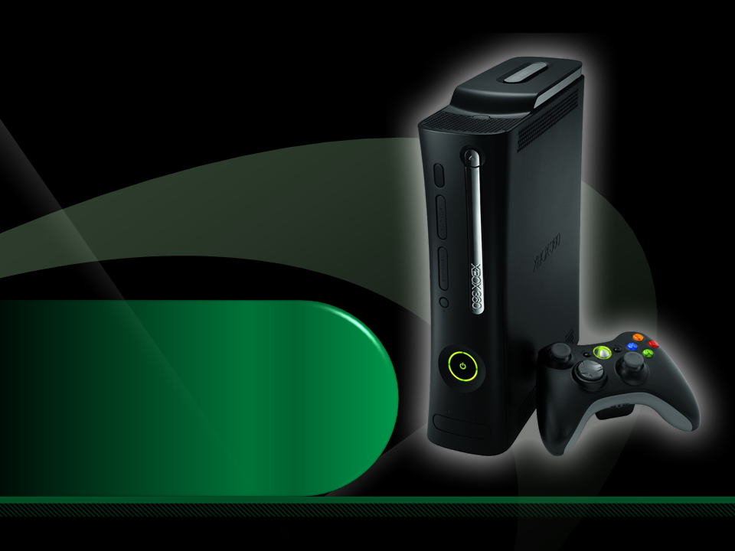
Complete an evaluation on CommNet and enter to win an Xbox 360 Elite!

Slide 43

Please Complete An Evaluation Form
Your input is important!
Multiple ways to access Online Evaluation Forms:
CommNet stations located throughout conference venues
Via a Windows Mobile device
Via the CommNet “Julian” offline Windows Mobile evaluation and session scheduling tool
From any wired or wireless connection to:
https://www.MyTechReady.com
1.
2.
3.
4.
For more information please refer to your Pocket Guide
Speaker – Click Here
to Launch Video

Slide 44

© 2009 Microsoft Corporation. All rights reserved. Microsoft, Windows, Windows Vista and other product names are or may be registered trademarks and/or trademarks in the U.S. and/or other countries.
The information herein is for informational purposes only and represents the current view of Microsoft Corporation as of the date of this presentation. Because Microsoft must respond to changing market conditions, it should not be interpreted to be a commitment on the part of Microsoft, and Microsoft cannot guarantee the accuracy of any information provided after the date of this presentation.
MICROSOFT MAKES NO WARRANTIES, EXPRESS, IMPLIED OR STATUTORY, AS TO THE INFORMATION IN THIS PRESENTATION.

