Slide 1
Web and Widgets A quick overview
Loke Uei
http://twitter.com/lokeuei
http://brightkite.com/people/lokeuei
MOB301

Slide 2
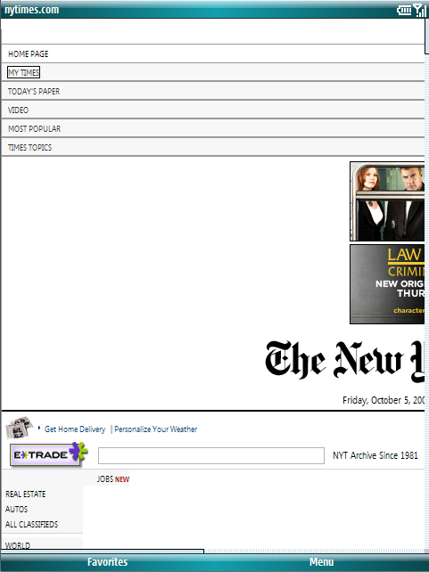
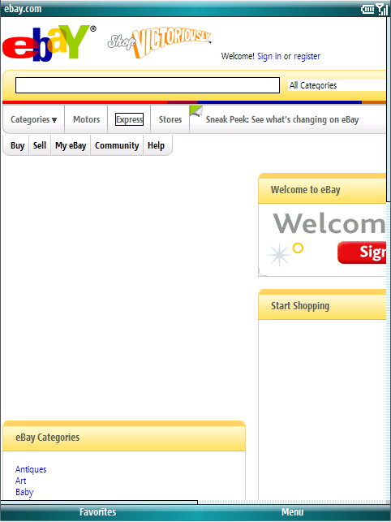
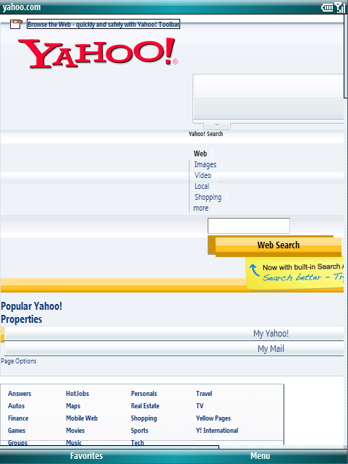
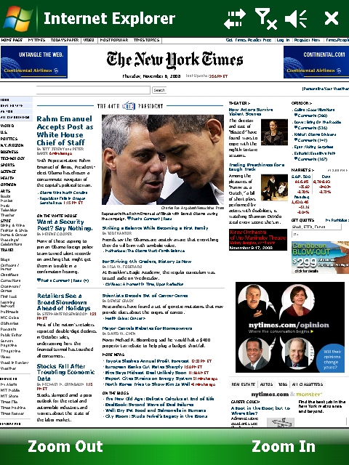
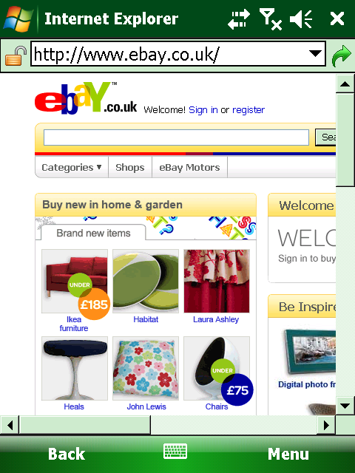
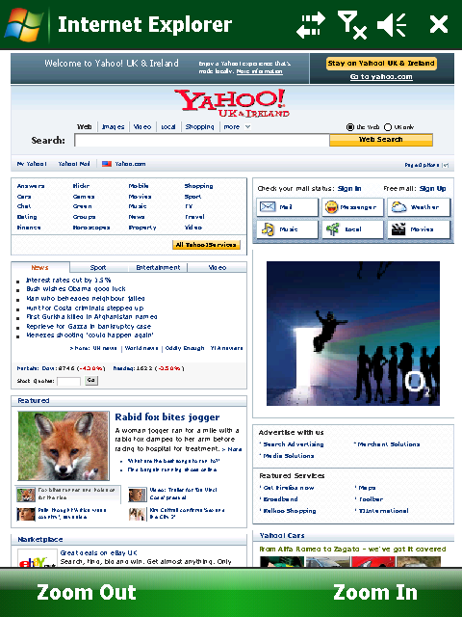
A New View of the Web
New York Times
eBay
Yahoo
Sites will look very similar to experience on Internet Explorer 6 on PC running Windows®

Slide 3
What is new in Internet Explorer Mobile?
Same technologies as its PC counterpart
Search integration
Improved user experience
Adobe FlashLite 3.1

Slide 4
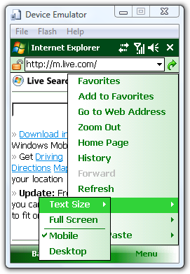
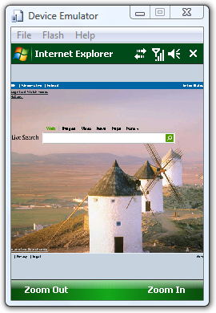
Best of Both World
Menu->View allows the user to choose between the mobile and PC web.

Slide 5
Detecting Internet Explorer Mobile 6
Mobile mode HTTP Headers
Previous versions of IEMo
GET ######### HTTP/1.1
Accept: */*
Accept-Language: en-us
Connection: Keep-Alive
Host: #########
User-Agent: Mozilla/4.0 (compatible; MSIE 6.0; Windows CE; IEMobile 8.12; MSIEMobile 6.0)
UA-pixels: 240x320
UA-color: color16
UA-OS: Windows CE (Pocket PC) - Version 5.2
UA-CPU: x86
Accept-Encoding: gzip, deflate
UA-Voice: TRUE
GET ######### HTTP/1.1
Accept: */*
Accept-Language: en-us
Connection: Keep-Alive
Host: #########
User-Agent: Mozilla/4.0 (compatible; MSIE 6.0; Windows CE; IEMobile 7.11)
UA-pixels: 240x320
UA-color: color16
UA-OS: Windows CE (Pocket PC) - Version 5.2
UA-CPU: x86
Accept-Encoding: gzip, deflate
UA-Voice: TRUE

Slide 6
Detecting Internet Explorer Mobile 6
Mobile mode HTTP Headers
Desktop mode HTTP Headers
GET ######### HTTP/1.1
Accept: */*
Accept-Language: en-us
Connection: Keep-Alive
Host: #########
User-Agent: Mozilla/4.0 (compatible; MSIE 6.0; Windows CE; IEMobile 8.12; MSIEMobile 6.0)
UA-pixels: 240x320
UA-color: color16
UA-OS: Windows CE (Pocket PC) - Version 5.2
UA-CPU: x86
Accept-Encoding: gzip, deflate
UA-Voice: TRUE
GET /######## HTTP/1.1
Accept: */*
Accept-Language: en-us
Connection: Keep-Alive
Host: #########
User-Agent: Mozilla/4.0 (compatible; MSIE 6.0; Windows NT 5.1)
UA-pixels: 240x320
UA-color: color16
UA-OS: Windows CE (Pocket PC) - Version 5.2
UA-CPU: x86
Accept-Encoding: gzip, deflate
UA-Voice: TRUE
Same as XP IE6!

Slide 7
Viewport
The Viewport is the dimensions of the screen the web page will be laid out on.
Parameter | Default | Minimum | Maximum
Width | 1024 | 100 | 10000
Height | 768 | 100 | 10000

Slide 8
Three ways to set Viewport
<meta name=“viewport” content=“width=1024, height=768”> Assure necessary width and height is available.
<meta name=“mobileoptimized” content=“240”> Only specifies width. Supported on IEMo before. Special value of “0” for Auto width.
<!DOCTYPE html PUBLIC "-//WAPFORUM//DTD XHTML Mobile 1.2//EN" "http://www.openmobilealliance.org/tech/DTD/xhtml-mobile12.dtd">

Slide 9
Code Considerations
Follow best web programming practices
Use Separate HTML, CSS, and Jscript files.
Load non-layout essential JScript at the end
Remove non-essential CSS and script

Slide 10
Media Considerations
Screen size
Varies in screen size between 240x230 and 480x800.
Make assets the correct size.
Do not ask the browser to resize images using the width and height attributes of the <img> tag.
Videos dimensions should not be streamed larger than the screen resolution.
** not supplied by Microsoft. Most OEM add at least a launch to play option, some add support for embedded windows media player

Slide 11
Media Considerations
Bit Rate
Choose the correct bit rate for EDGE and 3G networks.
Help reduce stalls and improve the users experience
Formats
.gif, .jpg, .png*, .bmp
.asf, .wma, .mp3, .wav
.avi, .wmv, .swf, .flv, .3gp**
** not supplied by Microsoft. Most OEM add at least a launch to play option, some add support for embedded windows media player

Slide 12
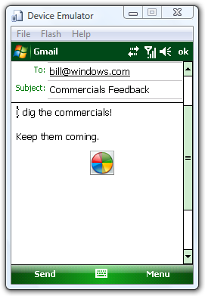
Mail and Phone integration
Send a Mail <a href=“mailto:bill@windows.com?subject=Commercials Feedback&body=I dig the commercials!%0A%0aKeep them coming.”>Feedback</a>
Dial a number <a href=“tel:867-5309”>Jenny</a>

Slide 13
Plug-ins (ActiveX controls)
Types
Windows Media Player
Adobe FlashLite
Future: SilverLight
Blocking download
codebase property of object tag not supported
Update through codebase is also blocked
Must install as windows mobile application

Slide 14
FlashLite Youtube
Adobe FlashLite 3.1
Delivering on PC experience for your mobile device
Support most Flash 9 content
No support for Action Script 3

Slide 15
FlashLite Full Screen
Press and hold for context menu
Select “Full Screen”
Works on most flash content
Content may still have other mechanism for full screen
Press and hold with cursor will also provide menu

Slide 16
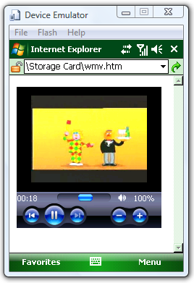
Media Player OCX
Windows Media Player
Embed on web page or launch to external player
Supported in IEMo before as well

Slide 17
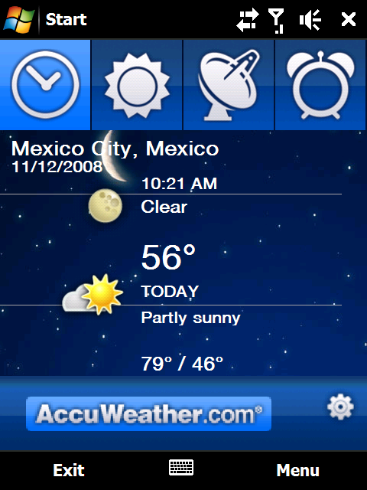
What is a widget?
“A portable chunk of the web”
Download as single package, runs locally
Look and feel of traditional device applications

Slide 18
Why Widgets?
Want to mash up local device data with content from the cloud
Faster time to market
Because you JavaScript

Slide 19
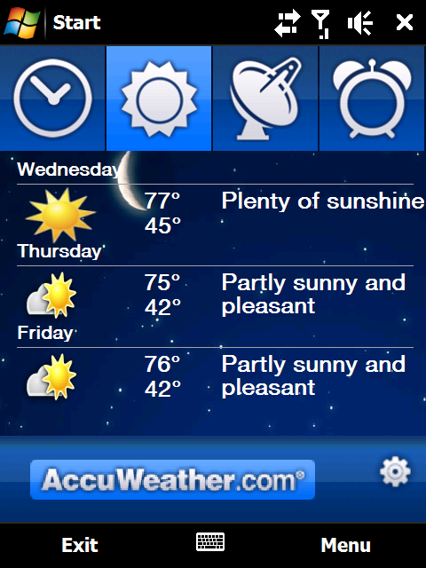
Widget Capabilities
Full Browser support for AJAX, plug-ins like Flash/Silverlight
Access beyond sandbox to device data
Installed as a shortcut in programs list

Slide 20
Under the Hood
Widget Package
Widgets Runtime
Powered by
Internet Explorer Mobile
Plug-ins
Flash
HTML
Security Broker
Silverlight
JavaScript
Windows Media
CSS
Web Rendering Engine
Script Engine
…
Menu
Images
JavaScript
Device Extensions
Settings
Location
XML Manifest
Camera
…

Slide 21
3 Steps to Building a Widget
Develop
Create UX
Develop Code
Package
Create Manifest
Package as Zip, renamed to .widget
Deploy
Transfer to device as link on web page, attachment, sideload

Slide 22
Building a Widget: Creating UX

Slide 23
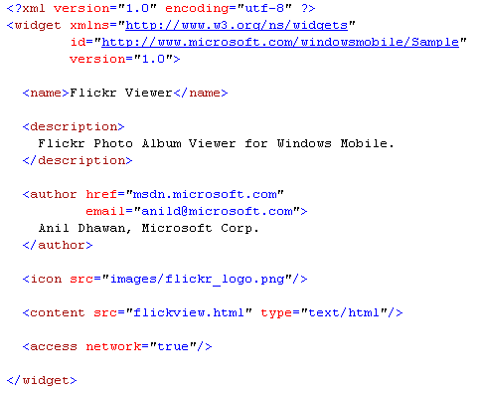
Building a Widget: Packaging

Slide 24
Building a Widget: Deploy

Slide 25
Widget API Overview
JavaScript Object Model extended to include widget-specific methods and events
Menu/Softkey access
Lightweight local persistence
SystemState
UI change events
Manifest metadata
Special widget object hosts widget-specific APIs

Slide 26
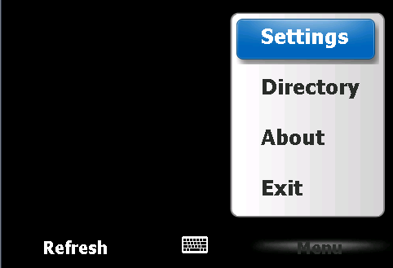
Widget APIs - Menu
// Programmable softkeys
var leftSoftKeyMenu = widget.createMenuItem( 10 );
leftSoftKeyMenu.text = “Refresh”;
leftSoftKeyMenu.onSelect = lskHandler;
widget.menu.setSoftKey( leftSoftKeyMenu, widget.menu.leftSoftKeyIndex );
function lskHandler() {
// left soft key
// handler code here
// to refresh
}

Slide 27
Widget APIs - Persistence
Persistent storage for strings
Available across widget runs
Preserved during upgrade process
widget.setPreferenceForKey( “lastLocation”,
“Istanbul );
// read previously stored setting
var lastLocation = widget.preferenceForKey( “lastLocation” );

Slide 28
Widget APIs - SystemState
Access to key System State properties
var systemState = widget.createObject("SystemState");
systemState.PowerBatteryStrength.addEventListener( ‘changed’, optimizeNetworkUsage );

Slide 29
Widget APIs - UI
Widgets can detect view state changes using onshow()/onhide() handlers
widget.onshow = function() {
// refresh UI
};
widget.onhide = function() {
// reduce network usage
};

Slide 30
Widget APIs – Manifest Metadata
Manifest metadata accessible via script
locale | Returns the current language-locale string, for example, "en-us”.
identifier | The App ID of the installed widget, as a string.
currentIcon | Pointer to a WidgetIcon object for the first icon in the manifest
authorName | The node text of the <author> element in the manifest.
authorEmail | The value of the email attribute of the <author> element.
authorURL | The value of the href attribute of the <author> element. If not a valid URI, will return null.
name | The widget’s name
description | The node text of the <description> element, or null.
version | The widget version string. The value of the version attribute in the <widget> element, or null.
width | The width of the client area of the widget (not including any chrome.)
height | The height of the client area of the widget (not including any chrome.)

Slide 31
http://developers.windowsmobile.com

Slide 32
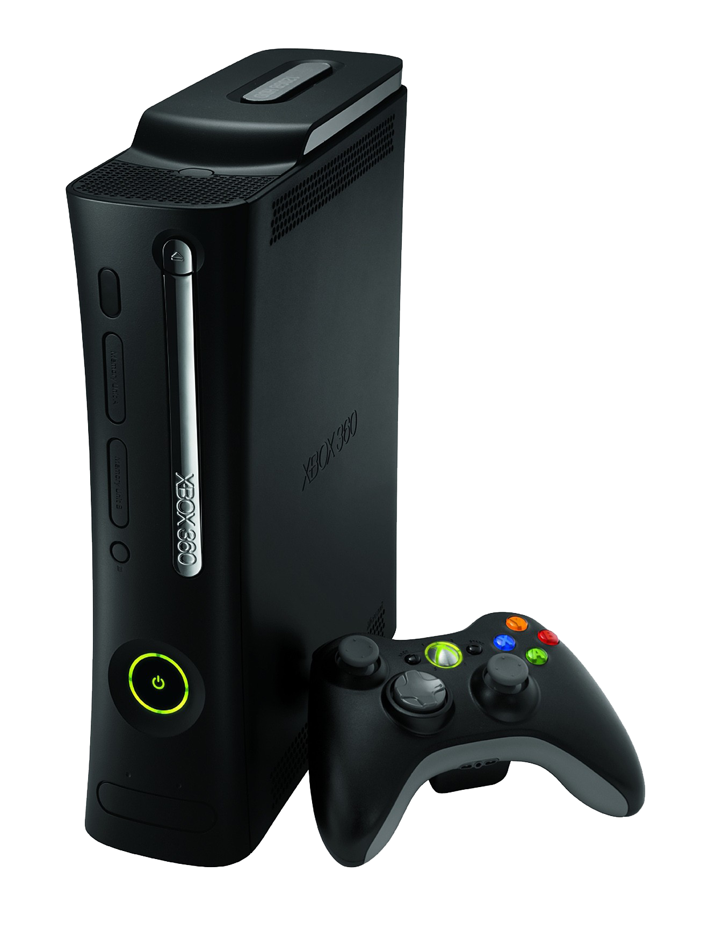
Required Slide
Complete an evaluation on CommNet and enter to win an Xbox 360 Elite!

Slide 33
© 2009 Microsoft Corporation. All rights reserved. Microsoft, Windows, Windows Vista and other product names are or may be registered trademarks and/or trademarks in the U.S. and/or other countries.
The information herein is for informational purposes only and represents the current view of Microsoft Corporation as of the date of this presentation. Because Microsoft must respond to changing market conditions, it should not be interpreted to be a commitment on the part of Microsoft, and Microsoft cannot guarantee the accuracy of any information provided after the date of this presentation. MICROSOFT MAKES NO WARRANTIES, EXPRESS, IMPLIED OR STATUTORY, AS TO THE INFORMATION IN THIS PRESENTATION.

