Slide 2
Microsoft Project Server 2010 for IT Professionals and Developers
Christophe Fiessinger & Jan Kalis
Senior Technical Product Manager
Microsoft Corporation
Session Code: OFS206

Slide 3
Agenda
What’s new for IT Professionals
  Architecture and Deployment
  Administration
  Upgrade and Migration
What’s new for Developers
  Project Desktop
  Project Server
    Architecture and overview
    New features and enhancements in 2010

Slide 4
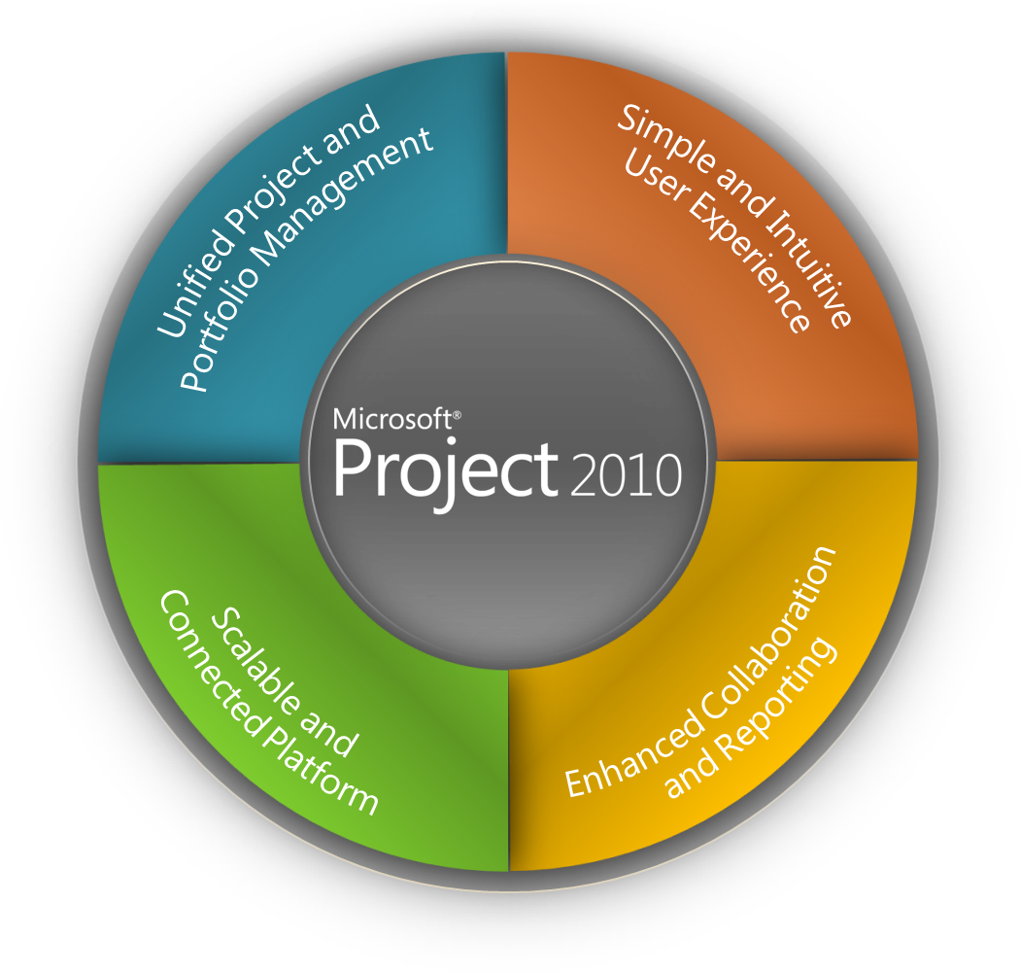

Project 2010 Investment Areas
Work Management Solutions for Individuals, Teams and the Enterprise
Single server with end to end
PPM capabilities
Flexible project capture and initiation
Enhance governance through workflow
Powerful portfolio selection analytics
Ribbon UI and Backstage view
Intuitive Excel-like behavior
Timeline and Team Planner views
Web-based project editing
Extend Interoperability
Simplified Administration
Rich Platform Services
Developer Productivity
Built on SharePoint Server 2010
Connect teams with SharePoint Sync
Better time and status reporting
Easily create reports and dashboards
Refer to OFS214: Microsoft Project 2010 Overview

Slide 5







Project and Portfolio Management For SharePoint
Demand Management
BI & Reporting
Portfolio Selection
Project Team Collaboration
Resource Management
Schedule Management
Synch to SharePoint
Sites
Composites
Communities
Insights
Content
Search
The Business Collaboration Platform for the Enterprise and the Web

Slide 6
What’s new for IT Professionals

Slide 7
Architecture

Slide 8
















Logical Architecture
Project Server is a SharePoint Application
Client
Application/PSI Server
Database Server
Microsoft SharePoint Server 2010
Farm Configuration Database
3rd Party Client
http://Svr:32843/ProjectServerApplication/*.asmx
Custom Logic
Impersonation
http://Svr/InstanceName/_vti_bin/psi/*.asmx
Microsoft SharePoint Foundation 2010
Central Admin
Content Database
Windows Workflow Foundation
Project Server
Archive Database(n)
Web Server
Web Service Tier
Business Logic Tier
Server Side
Scheduling
Project Server
Reporting Database(n)
Project Web Access
Microsoft SharePoint Server 2010
ASMX Interface
Queuing
Service
Project Server
Published Database(n)
IE Browser Level
Security Zone
AJAX
Microsoft SharePoint Foundation 2010
Internal Web Services
Project Server
Draft Database(n)
External Web Services
Eventing
Service
Data Access Layer
Filter Data Access Layer
WCF Services
ASMX over http/soap
Business Objects
Web Parts
WCF Interface
Shared Services
Content Database
Project Professional
Serializer
Scheduling Engine
Desktop Reporting
Client Active_Cache
Soap Client
Serializer
Master Pages
Shared Services
Service Database
Project User Context
Workflow Platform
Authentication
ASPX
Web Application
Content Database(n)
Project User Context
PSI Proxies
State Service
Database
WCF Services
PSI Forwarder
Server Active_Cache
PWA and WSS content pages
Web Analytics
Database

Slide 9
What’s Changed in Deployment?
Project Service App. replaces Shared Service Provider
Configuration of Non-Project Services for core functionality
New required configuration steps
No more ActiveX!
Improvements
  Overall Setup experience
    Pre-Requisite Installer
    Farm Configuration Wizard
  Improvements to Central Administration
    Manage Project Service with all other Services
Please Read “Deploy Project Server to a server farm environment” on TechNet

Slide 10


Project Server 2010 Software Requirements
SharePoint Server 2010 Enterprise
SQL Server 2005/2008/R2: Standard or Enterprise
Windows Server 2008/R2: Standard, Enterprise, or Data Center Editions
Project Server 2010
Project Professional 2010/2007
Excel 2007/2010
Internet Explorer IE7/IE8
64-bit
Optional
    Exchange 2007 SP1 or later
    Team Foundation Server 2010 for Application Lifecycle Management

Slide 11
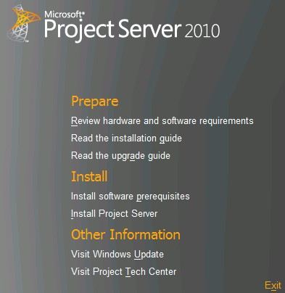

Installation Process
Base Installation
Install Operating System
Run Windows Update
SQL Server
Install SQL Server and Components (Analysis Services, etc…)
Install Software Updates
Sharepoint Server 2010
Run Pre-Requisite Installer
Install Sharepoint Server 2010
Project Server 2010
Post Configuration
Install Project Server
Run SharePoint Configuration Wizard
Central Admin Configuration
Project Web Access Admin Configuration
PowerShell Support

Slide 12
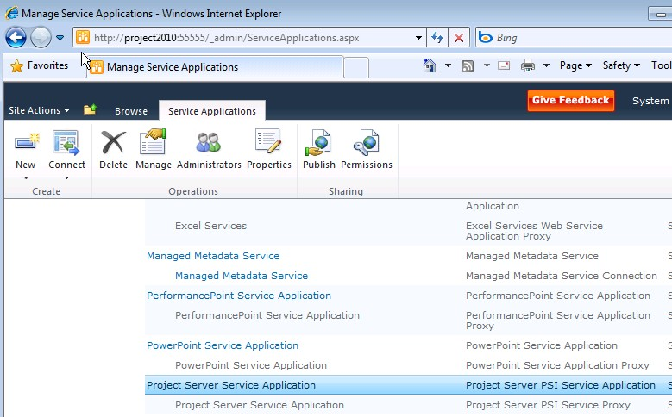
Enable Required Services
Minimal Services Required to operate a Project Server 2010 server farm:
  Project Service Application
  Reporting
    Excel Services
    PerformancePoint Service
    Secure Store Service
  Charting
    State Service
By default, all available services are enabled by the configuration wizard
Performance Consideration: only enable necessary services to fulfill requirements

Slide 13
Post Setup Project Web Access Core Items
Time Reporting Periods
  Required now for My Tasks/My Timesheets/SEM
Base Security
Cube Building Service (Analysis Services OLAP cubes)
Exchange Integration
  Project Server users can view Project Server tasks as Outlook tasks without ActiveX
  Requires configuration in both Project Server and Exchange Server
  Detailed setup procedures will be available

Slide 14
Deployment Scenarios
Together/Coexistence
  Single farm with both Project Server and SharePoint Server
Apart/Standalone
  Dedicated Project Server Farm running WSS or SharePoint Server
 | Dedicated Project Server Farm | Dedicated SharePoint Server Farm
Coexistence | Add SharePoint Server | Add Project Server
 | Merge into a single Farm
Standalone | Split Existing Farm into two Farms
  EPM and Office SharePoint Server 2007 Coexistence — Intranet Scenario
  (TechNet whitepaper applicable to 2010)

Slide 15
Together Pros and Cons
Single Project and SharePoint Server Farm
Advantages
  Server Consolidation
  Administration and Maintenance
    Single software update plan
  Leverage high availability
Disadvantages
  Software Updates
  Additional training required for
  SharePoint Administrator(s)
  Additional Licenses Required

Slide 16
Apart Pros and Cons
Separate Project and SharePoint Server Farm
Advantages
  Farm Hardware and Software Updates
  No dependency on the Intranet farm’s availability
  Change Management
  Security Isolation
  Leverage the same SQL Server infrastructure as the other Farm
Disadvantages
  Additional Administrative Tasks
    Applying and testing patches on two farms versus one
  Content Management and Governance
    Project Server’s SharePoint content cannot be stored on another farm
  Greater cost
    Additional hardware
    Additional software licenses

Slide 17
Deployment Considerations in a Single Farm
Server and Client licenses
  Must install Project Server and SharePoint Server on each of
  your servers
Isolate PS for performance/manageability/ governance purposes
  Isolate Project Server content databases and Application Pool
    Separate Root Site Collection
    Separate Site Collection for Project Workspaces
Isolate Reporting and Online Analytical Processing
(OLAP) databases
Patched together (Cumulative Updates/Service Packs) and
plan accordingly
Customization
Line Of Business Integration
Outsourcing and farm consolidation

Slide 18
Capacity Planning
Project Server 2007 Performance and capacity planning best practices whitepaper on TechNet
Upcoming Project Server 2010 Scalability Tests and Tools similar to
  Microsoft Office Project Server 2007 Performance Testing (white paper)
  Project Server 2007 Performance Lab Kit
  (Visual Studio solutions)

Slide 19
Administration

Slide 20
Administration
Centralized Administration
Multi-tenancy
User Delegation
Departmental Fields
Cube Administration
And more…

Slide 21

Project Server 2010 Administration
demo

Slide 22
Upgrade and Migration

Slide 23
Upgrade & Migration to Project Server 2010
Project Server 2003 needs to be migrated via 2007
  2007 does not need to be in production
  We will offer “Virtual Migration Environment”
Project Portfolio Server migration
  Project Portfolio Server 2006 needs to be upgraded to 2007
  Project Portfolio Server (PPS) 2007
    Migrated to Project Server 2010 feature set
      Use the gateway to transfer data
      Map and develop existing functionality on Project Server 2010
    Finish existing projects in PPS 2007 and start new in Project Server 2010
    Use side-by-side with Project Server 2010
Project Server 2007 to Project Server 2010
  Out-of-the-Box Experience

Slide 24
Upgrade from Project Server 2007
Streamlined upgrade Out-of-the-Box experience
Two ways to get environment ‘upgraded’
  In-place upgrade
    Could be constrained by the 64 bit requirements or by the dependency on SharePoint Server
  4 or 5 Database Attach
    4 DB = Project Server data only
    5 DB = SharePoint data (Project Workspaces) and Project Server data
    Upgrade of the databases happen automatically during PWA Provisioning. Possible warnings or errors in the ULS folder.
Backwards Compatibility Mode is automatically enabled after upgrade
  Enables of 2007 and 2010 clients to connect to 2010 server

Slide 25





Backwards Compatibility Mode
Accelerate deployment of Project 2010
Seamless co-existence and data exchange among various Project desktop versions
Both Project 2010 desktop and Project Server 2010 scenario
Project Server 2010
in “Compatibility Mode”
Project MPP file
Project 2010
Project 2007
Project 2003
Project
Professional 2010
Project
Professional 2007

Slide 26


Backwards Compatibility Mode
Project Server 2010 in BCM
Project
Professional 2007
Project
Professional 2007
Project
Professional 2007

Slide 27

Backwards Compatibility Mode
Project Server 2010 in BCM
Project
Professional 2010
Project
Professional 2007
Project
Professional 2007

Slide 28



Backwards Compatibility Mode
Project Server 2010 in BCM
Project
Professional 2010
Project
Professional 2010
Project
Professional 2007

Slide 29

Backwards Compatibility Mode
Project Server 2010 in BCM
Project
Professional 2010
Project
Professional 2010
Project
Professional 2010

Slide 30
Backwards Compatibility Mode
Project Server 2010 in Native Mode
(BCM to Native = One way setting only)
Project Professional 2007
can no longer connect to server
Project
Professional 2010
Project
Professional 2010
Project
Professional 2010

Slide 31
Project Server and Professional Version Compatibility matrix
 | Project Server 2003 | Project Server 2007 | Project Server 2010
Project Professional 2003 | Full connectivity | - | -
Project Professional 2007 | - | Full connectivity | Connectivity to Server in BCM* (Project Professional 2007 SP2 required)
Project Professional 2010 | - | - | Full connectivity

Slide 32
Backwards Compatibility Mode
demo

Slide 33
What’s new for Developers

Slide 34
Extensibility Overview
Project Professional/Standard 2010
  Object Model, VBA, VSTO
  Fluent UI, Backstage
Project Server 2010
  Web Services – Project Server Interface (PSI) & Evening
  Project Demand Management Workflow
  Rich Reporting/Business Intelligence
  Project Web Access site modifications
    Theming, Fluent UI, Extensible Grid
Project and SharePoint “better together”
  Project Workspaces (SharePoint Sites)
  Any other customizations/add-ons leveraging any of the SharePoint Enterprise Suite
More on http://msdn.microsoft.com/project/

Slide 35
Project Professional 2010
Project Standard 2010
“aka” Project desktop extensibility

Slide 36
Project 2010 “desktop” extensibility
WITHOUT code
“Custom Fields”
  Custom metadata associated with tasks, resources, assignments and (projects)
  Could have an icon representation and formulas
Views Modification
  Adding columns, custom grouping and filtering, e.g. based on the Custom Fields
Custom Visual Reports
  Manage your custom templates for Excel and Visio – based reporting

Slide 37
Project 2010 “desktop” extensibility
WITH code
Desktop Object Model (OM)
  Rich customizations and add-ons leveraging Project functionality including scheduling
  Visual Basic for Applications (VBA) or Visual Studio Tools for Office (VSTO) could be used
User Interface (UI) modifications
  Ribbon
  Backstage

Slide 38
Project Server 2010 extensibility

Slide 39
Project Server Architecture
3rd Party Application
Project Professional
IE
WCF Forwarder
Web Service
Forwarder
Project Web Access
WSS and
MOSS
3rd Party Application
WFE
Web Services
WCF Service
WSS and
MOSS
Events
Business Objects
Queue
App Server
Data Access Layer (DAL)
MS SQL
Draft
Publish
Reporting
Archive
Content
Config

Slide 40

Project Server 2010 Interface
Admin
Object Link Provider
WSS Interop
Archive
Project
Driver
Calendar
Queue
Portfolio Analysis
Cube Admin
Resource
Workflow
Custom Fields
Resource Plan
Events
Security
Lookup Table
Statusing
Notifications
Timesheet

Slide 41
Project Server Events
New feature in Project 2007
Raised on the server
3rd party applications “subscribe” to events
“Hooks” for
  Adding new functionality
  Customizing exiting functionality
  Integrating with other applications

Slide 42
Project Server extensibility – what’s new in 2010

Slide 43
Impersonation (ENHANCED) and Status Broker (NEW)

Slide 44



Impersonation with
Project Server 2010
Application
Server
WCF Services
Web Frontend
Web Services
Business Objects
PWA
Custom LOB Application
WCF Forwarder
Context
Web Service Forwarder

Slide 45
Status Broker in Project 2010
Project Server
External System

Slide 46
Status Broker in Project 2010
New Global Permission in the Time and Task Management group
The following 3 methods were extended
  ReadStatusForResource(…)
  UpdateStatus(…)
  SubmitStatusForResource(…)
Additional parameter for specifying the ResID
  <Changes>
  <Proj ID='c98af47e-c800-4826-b9f5-2e1d84a41855'>
  <Assn ID='8b4e7966-f42e-4f08-9758-532e6e087e22'
  ResID='8b36b53d-780c-4c53-9f4c-8996108ff40d'>
  <Change PID='251658274'>10</Change>
  </Assn>
  </Proj>
  </Changes>

Slide 47
Project Server 2010
Workflow (NEW)

Slide 48











Project Workflow Overview
Enables custom project selection process
Custom Workflows created in Visual Studio 2010
  No Support for SharePoint Designer (SPD)
Enterprise Project Management
Create
Select
Plan
Manage
Demand Management
Portfolio Selection
Work Planning
Collaboration & Reporting

Slide 49
Project Workflow Architecture
Project Workflows
Project Server 2010
Windows SharePoint Service
Windows Workflow Foundation
.NET Framework 3.5

Slide 50
Project Server Workflow Breakdown
Project Server Interface
Project Server Workflow Channel
Custom Activity
Custom Activity
Custom Activity

Slide 51
Grid Component (NEW)
Reporting (ENHANCED)

Slide 52
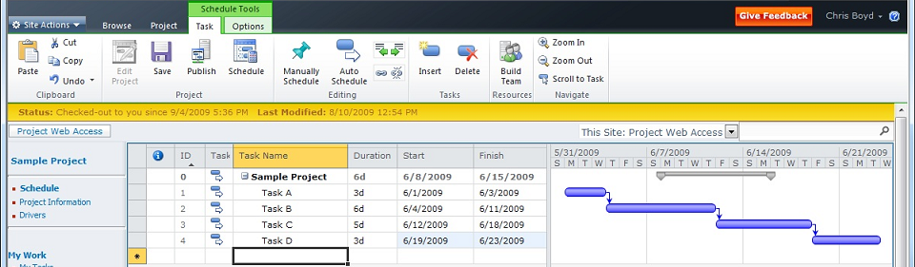
New Grid Control

Slide 53
Grid Control Features
JavaScript (Not ActiveX)
Multi-Browser Support
  IE7, IE8, Firefox, Safari (tier 2)
  PWA will only support IE7 and IE8
Ships with SharePoint
Feature Rich
  Copy and Paste (from Excel and others)
  Multi-Level Undo
  Change Highlighting
  Cell Level Errors
  Time-phased or Pivoted View
  Dynamic Paging

Slide 54
Project 2010 Reporting Database
Existing Project 2007 Reports should continue to work in Project 2010
Timesheet Custom Fields
  Change based on PWA View
Project Properties
  Workflow
  Minus the Notes Field
Work Contours
Departments
Multi Cube based on Department

Slide 55
Project 2010 for Developers
- Client Development (VSTO)
- Backwards Compatibility Mode
- Project Web Access UI customizations
demo

Slide 56


Related Project 2010 Content
Sessions @ TechED Europe
OFS214 - Microsoft Project 2010 Overview
OFS206 - Microsoft Project Server 2010 for IT Professionals and Developers
OFS202 - SharePoint 2010 Overview for IT Professionals
OFS215 - SharePoint Server 2010 Introduction for Developers
Project 2010 booth in the Office Pavilion
Project 2010 Product Information
http://www.microsoft.com/project/2010/
Microsoft Project 2010 TechCenter
http://technet.microsoft.com/projectserver/
Newsgroups
http://social.technet.microsoft.com/Forums/en-US/category/projectprofessional2010, projectserver2010
Project 2010 Developer Center
http://msdn.microsoft.com/project/
Newsgroups
http://social.msdn.microsoft.com/Forums/en/category/projectprofessional2010,projectserver2010

Slide 57


Resources
Required Slide
Speakers,
TechEd 2009 is not producing
a DVD. Please announce that
attendees can access session
recordings at TechEd Online.
www.microsoft.com/teched
  Sessions On-Demand & Community
www.microsoft.com/learning
Microsoft Certification & Training Resources
http://microsoft.com/technet
  Resources for IT Professionals
http://microsoft.com/msdn
  Resources for Developers

Slide 58

Complete an evaluation on CommNet and enter to win an Xbox 360 Elite!

Slide 59
question & answer

Slide 60

Required Slide
© 2009 Microsoft Corporation. All rights reserved. Microsoft, Windows, Windows Vista and other product names are or may be registered trademarks and/or trademarks in the U.S. and/or other countries.
The information herein is for informational purposes only and represents the current view of Microsoft Corporation as of the date of this presentation. Because Microsoft must respond to changing market conditions, it should not be interpreted to be a commitment on the part of Microsoft, and Microsoft cannot guarantee the accuracy of any information provided after the date of this presentation. MICROSOFT MAKES NO WARRANTIES, EXPRESS, IMPLIED OR STATUTORY, AS TO THE INFORMATION IN THIS PRESENTATION.

